Slide 1
Architecture 1001:
x86-64 Assembly
BitmaskExample.c
Xeno Kovah – 2021
xeno@darkmentor.com

Slide 2

All materials is licensed under a Creative Commons “Share Alike” license.
http://creativecommons.org/licenses/by-sa/4.0/
Attribution condition: You must indicate that derivative work
"Is derived from Xeno Kovah's 'Architecture 1001: x86-64 Assembly’ class, available at https://ost.fyi"
Notes:
Attribution condition: You must indicate that derivative work
"Is derived from Xeno Kovah's 'Architecture 1001: x86-64 Assembly’ class, available at https://ost.fyi"

Slide 3
BitmaskExample.c
int main(){
int a = 0x1301;
int b = 0x0100;
if(a & b){
return 0x70dd1e;
}
else{
return 0x707;
}
}
main:
0000000140001000 sub rsp,18h
0000000140001004 mov dword ptr [rsp+4],1301h
000000014000100C mov dword ptr [rsp],100h
0000000140001013 mov eax,dword ptr [rsp]
0000000140001016 mov ecx,dword ptr [rsp+4]
000000014000101A and ecx,eax
000000014000101C mov eax,ecx
000000014000101E test eax,eax
0000000140001020 je 000000014000102B
0000000140001022 mov eax,70DD1Eh
0000000140001027 jmp 0000000140001030
0000000140001029 jmp 0000000140001030
000000014000102B mov eax,707h
0000000140001030 add rsp,18h
0000000140001034 ret

Slide 4
22
TEST - Logical Compare
“Computes the bit-wise AND of first operand (source 1 operand) and the second operand (source 2 operand) and sets the SF, ZF, and PF status flags according to the result.”
Like CMP - sets flags, and throws away the result

Slide 5

👁
STOP
&&
STEP THROUGH
THE ASSEMBLY
&&
CHECK YOUR UNDERSTANDING

Slide 6
BitmaskExample.c Takeaways
Conditions depending on bit tests (which is often expressed with boolean logic instructions) will often see the RFLAGS set with the TEST instruction. TEST is like AND, but throws the results away
The unreachable jmp here is because it’s unoptimized code so the compiler is following a simpler set of asm construction rules
int main(){
int a = 0x1301;
int b = 0x0100;
if(a & b){
return 0x70dd1e;
}
else{
return 0x707;
}
}
main:
0000000140001000 sub rsp,18h
0000000140001004 mov dword ptr [rsp+4],1301h
000000014000100C mov dword ptr [rsp],100h
0000000140001013 mov eax,dword ptr [rsp]
0000000140001016 mov ecx,dword ptr [rsp+4]
000000014000101A and ecx,eax
000000014000101C mov eax,ecx
000000014000101E test eax,eax
0000000140001020 je 000000014000102B
0000000140001022 mov eax,70DD1Eh
0000000140001027 jmp 0000000140001030
0000000140001029 jmp 0000000140001030
000000014000102B mov eax,707h
0000000140001030 add rsp,18h
0000000140001034 ret

Slide 7
Instructions we now know (22)
NOP
PUSH/POP
CALL/RET
MOV
ADD/SUB
IMUL
MOVZX/MOVSX
LEA
JMP/Jcc (family)
CMP/TEST
AND/OR/XOR/NOT
INC/DEC

Slide 8

20
10
14
5
21
7
16
17
8
13
6
18
imul
9
14
movsx
11
not
19
ACHIEVEMENT UNLOCKED!
14
2
15
3
4
12
1
22

Slide 9

GREAT KID, DON’T GET COCKY
YOU BASICALLY JUST LEARNED HOW
TO PRONOUNCE THE ALPHABET!

Slide 10
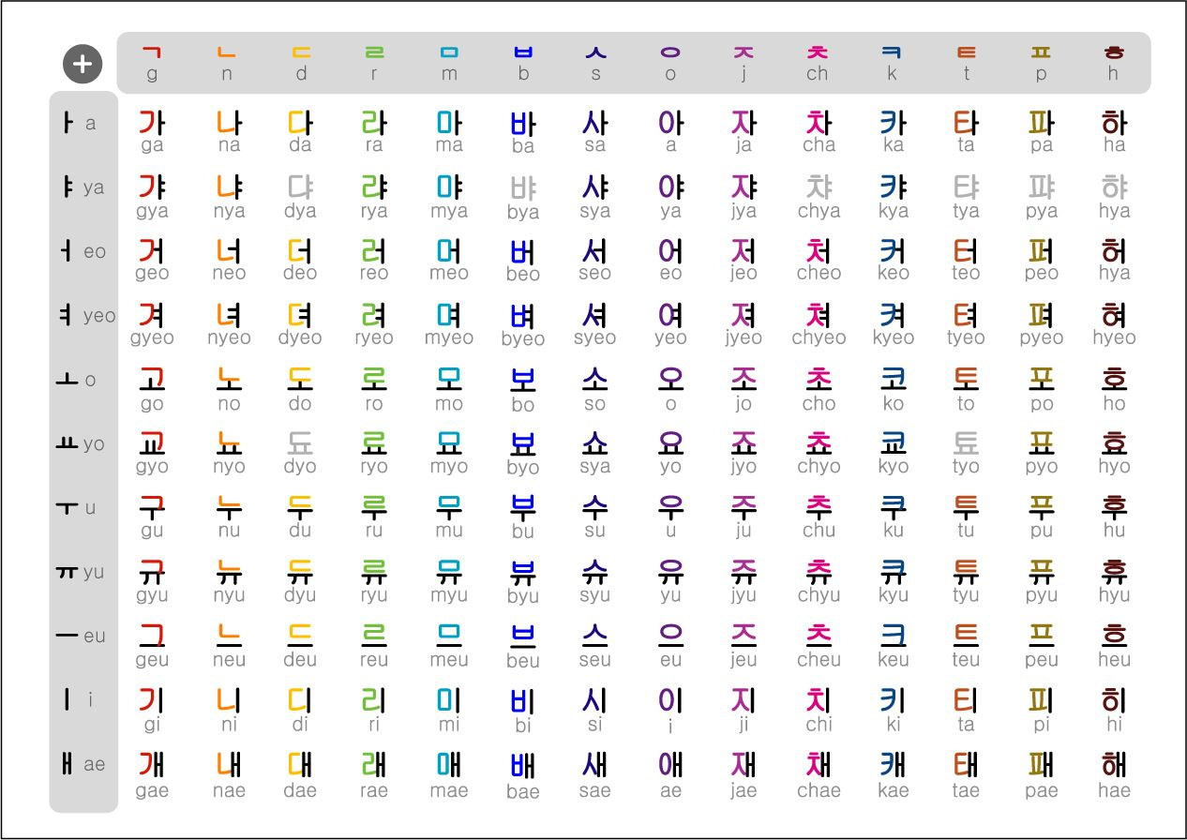

Slide 11
Letter: mov
Word: “move mem to reg
mov eax,dword ptr [rsp]
Letter: test
Word: “test-bits”
test max, 100h
Letter: je
Word: “if-equal”
je foo
Sentence: “If variable has bit 8 set, go somewhere, else continue.”

