Slide 1
Architecture 1001:
x86-64 Assembly
SingleLocalVariable.c
with GCC
Xeno Kovah – 2021
xeno@darkmentor.com

Slide 2

All materials is licensed under a Creative Commons “Share Alike” license.
http://creativecommons.org/licenses/by-sa/4.0/
Attribution condition: You must indicate that derivative work
"Is derived from Xeno Kovah's 'Architecture 1001: x86-64 Assembly’ class, available at https://ost.fyi"
Notes:
Attribution condition: You must indicate that derivative work
"Is derived from Xeno Kovah's 'Architecture 1001: x86-64 Assembly’ class, available at https://ost.fyi"

Slide 3
SingleLocalVariable.c
Adding a single local variable
int func(){
int i = 0x5ca1ab1e;
return i;
}
int main(){
return func();
}
func:
0x0000555555555129 <+0>: endbr64
0x000055555555512d <+4>: push %rbp
0x000055555555512e <+5>: mov %rsp,%rbp
0x0000555555555131 <+8>: movl $0x5ca1ab1e,-0x4(%rbp)
0x0000555555555138 <+15>: mov -0x4(%rbp),%eax
0x000055555555513b <+18>: pop %rbp
0x000055555555513c <+19>: retq
main:
0x000055555555513d <+0>: endbr64
0x0000555555555141 <+4>: push %rbp
0x0000555555555142 <+5>: mov %rsp,%rbp
0x0000555555555145 <+8>: mov $0x0,%eax
0x000055555555514a <+13>: callq 0x555555555129 <func>
0x000055555555514f <+18>: pop %rbp
0x0000555555555150 <+19>: retq

Slide 4
SingleLocalVariable.c Stack
If we step through line 0x5555`55555131 in func(), the stack looks like this:
0x7fff`ffffdf68 | 0x00007fff`f7ded0b3 Saved rip
0x7fff`ffffdf60 | 0x00000000`00000000 Saved rbp
0x7fff`ffffdf58 | 0x00005555`5555514f Saved rip
0x7fff`ffffdf50 | 0x00007fff`ffffdf60 Saved rbp
0x7fff`ffffdf4C | i = 0x5ca1ab1e
0x7fff`ffffdf48 | undef
0x7fff`ffffdf44 | undef
0x7fff`ffffdf40 | undef
main()
frame
func()
frame
rsp
rbp

Slide 5
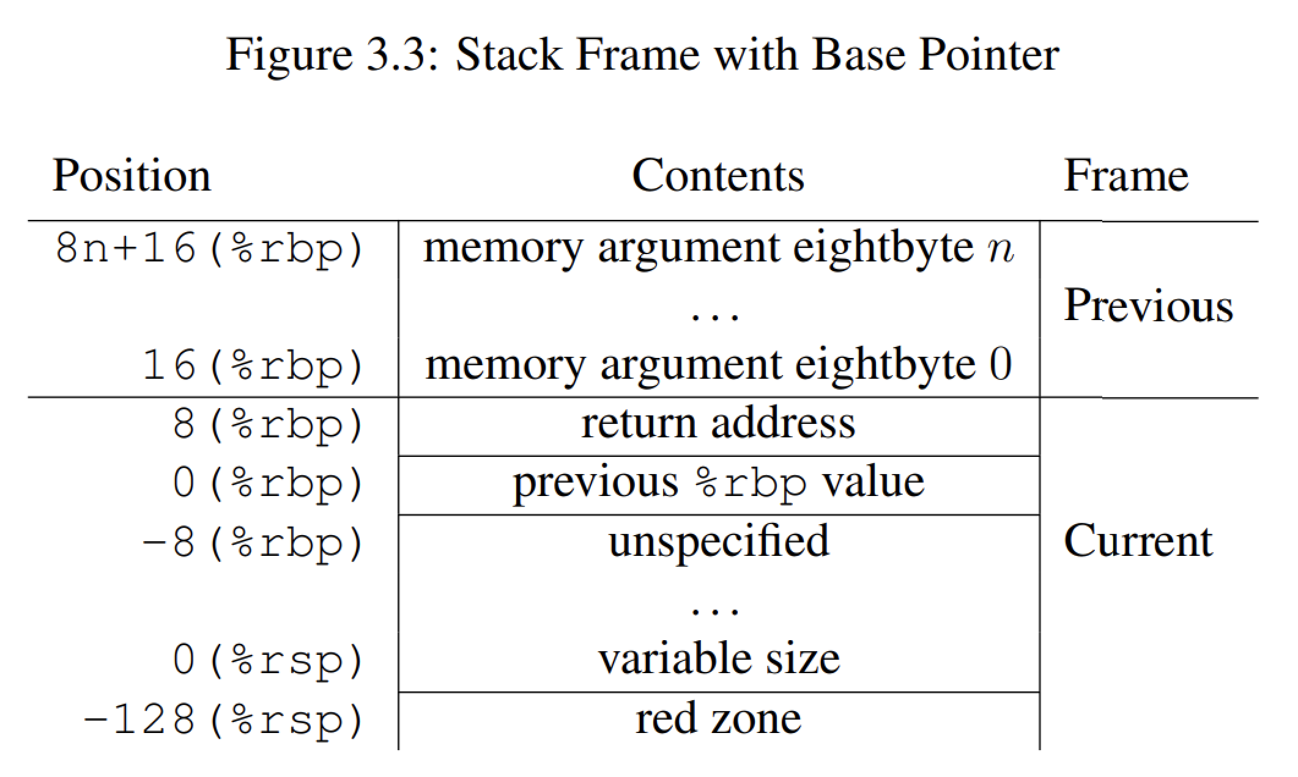
"The 128-byte area beyond the location pointed to by %rsp is considered to
be reserved and shall not be modified by signal or interrupt handlers. Therefore,
functions may use this area for temporary data that is not needed across function
calls. In particular, leaf functions may use this area for their entire stack frame,
rather than adjusting the stack pointer in the prologue and epilogue. This area is
known as the red zone."
  From System V ABI: https://raw.githubusercontent.com/wiki/hjl-tools/x86-psABI/x86-64-psABI-1.0.pdf

