Slide 1
Architecture 1001:
x86-64 Assembly
Intel vs. AT&T Syntax
Xeno Kovah – 2021
xeno@darkmentor.com

Slide 2

All materials is licensed under a Creative Commons “Share Alike” license.
http://creativecommons.org/licenses/by-sa/4.0/
Attribution condition: You must indicate that derivative work
"Is derived from Xeno Kovah's 'Architecture 1001: x86-64 Assembly’ class, available at https://ost.fyi"
Notes:
Attribution condition: You must indicate that derivative work
"Is derived from Xeno Kovah's 'Architecture 1001: x86-64 Assembly’ class, available at https://ost.fyi"

Slide 3
Intel vs. AT&T Syntax
My classes prefer Intel syntax
But I learned AT&T syntax first
I believe it’s important to know both, so you can read documents in either format
Origin story: Bell Labs -> Multics on mainframes -> UNIX on PDP-11 asm -> UNIX on PDP-11 C -> UNIX on 8086 C (with assembly syntax adapted from PDP-11) -> GNU's Not Unix (╯°□°）╯︵ ┻━┻
https://stackoverflow.com/questions/42244028/what-was-the-original-reason-for-the-design-of-att-assembly-syntax
http://www.columbia.edu/~hauben/book-pdf/CHAPTER%209.pdf
https://en.wikipedia.org/wiki/History_of_Unix
https://www.bell-labs.com/usr/dmr/www/otherports/newp.pdf

Slide 4
Intel vs. AT&T Syntax 2
Intel Syntax:
  Preferred on Windows. Think algebra or C: y = 2x + 1;
  Destination <- Source(s) (right to left)
  mov rbp, rsp
  add rsp, 0x14 ; (rsp = rsp + 0x14)
AT&T Syntax:
  Preferred on *nix/GNU. Think elementary school: 1 + 2 = 3
  Source(s) -> Destination (left to right)
  mov %rsp, %rbp
  add $0x14,%rsp
  Registers get a % prefix and immediates get a $
  https://sourceware.org/binutils/docs/as/i386_002dVariations.html#i386_002dVariations

Slide 5
Intel vs. AT&T Syntax 3
Intel indicates size with things like “mov qword ptr [rax], rbx", but it’s not in the actual mnemonic of the instruction
"In AT&T syntax the size of memory operands is determined from the last character of the instruction mnemonic. ...only when there’s no other way to disambiguate an instruction"
  movb - operates on bytes
  movw - operates on word (2 bytes)
  movl - operates on “long” (dword) (4 bytes)
  movq - operates on “quad word” (qword) (8 bytes)
  https://sourceware.org/binutils/docs/as/i386_002dVariations.html#i386_002dVariations

Slide 6
Intel vs. AT&T Syntax 4
Some mnemonics have been more or less renamed, to better conform to the b/w/l/q mnemonic naming conventions for lengths
  "cwde" -> "cwtl" ("convert (sign extend) word to long")
  "movsx" -> "movsbw"
I'm not a big fan of this! It makes it way harder to look up instructions in the Intel manual when you're first learning assembly! (Basically you're forced to google for your solutions)
  https://sourceware.org/binutils/docs/as/i386_002dMnemonics.html#Instruction-Naming
Notes:
And some versions of the gnu tools, instead of using like “mov -0x4(%rbp)” will show it as “mov 0xFFFFFFFC(%rbp)”
Some more links talking about the differences
http://www.w00w00.org/files/articles/att-vs-intel.txt <- haxors ;)
http://en.wikipedia.org/wiki/X86_assembly_language
http://sig9.com/articles/att-syntax

Slide 7
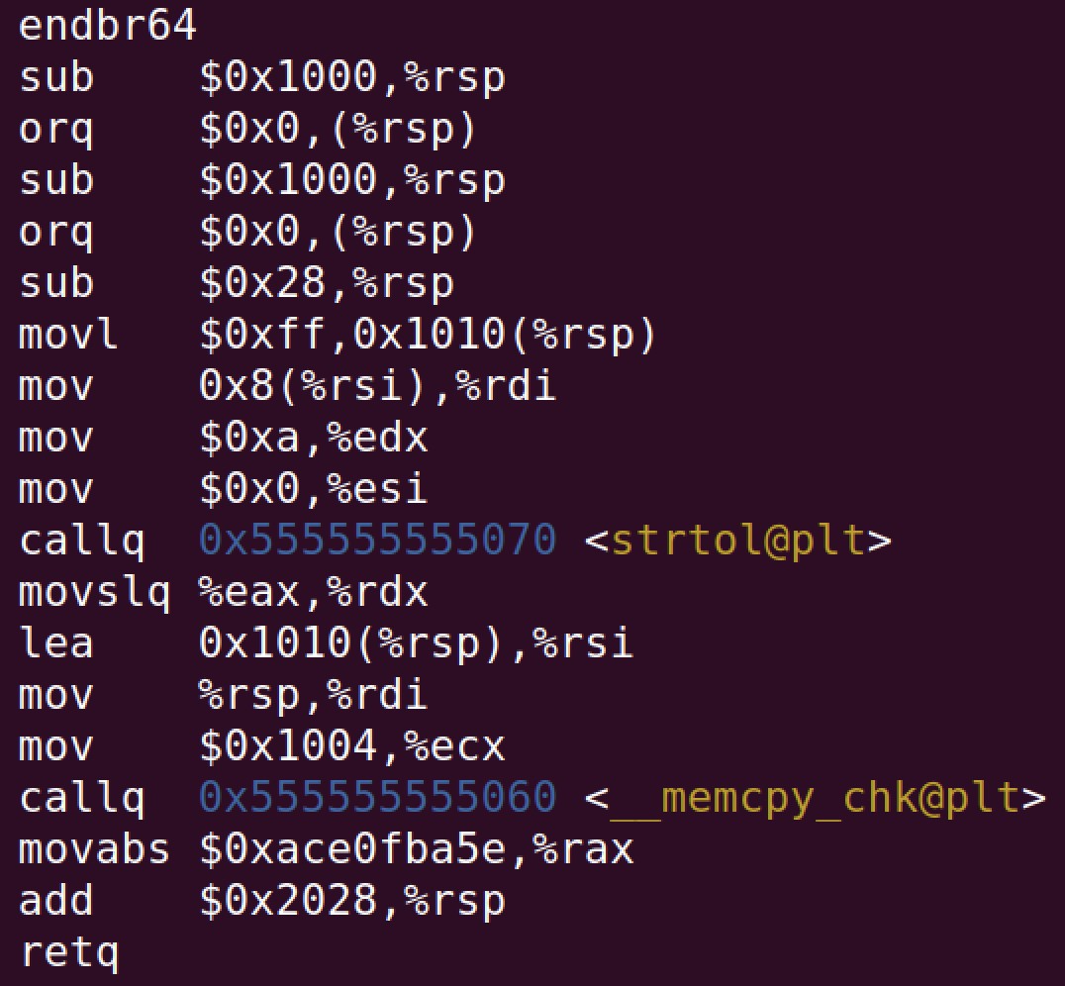
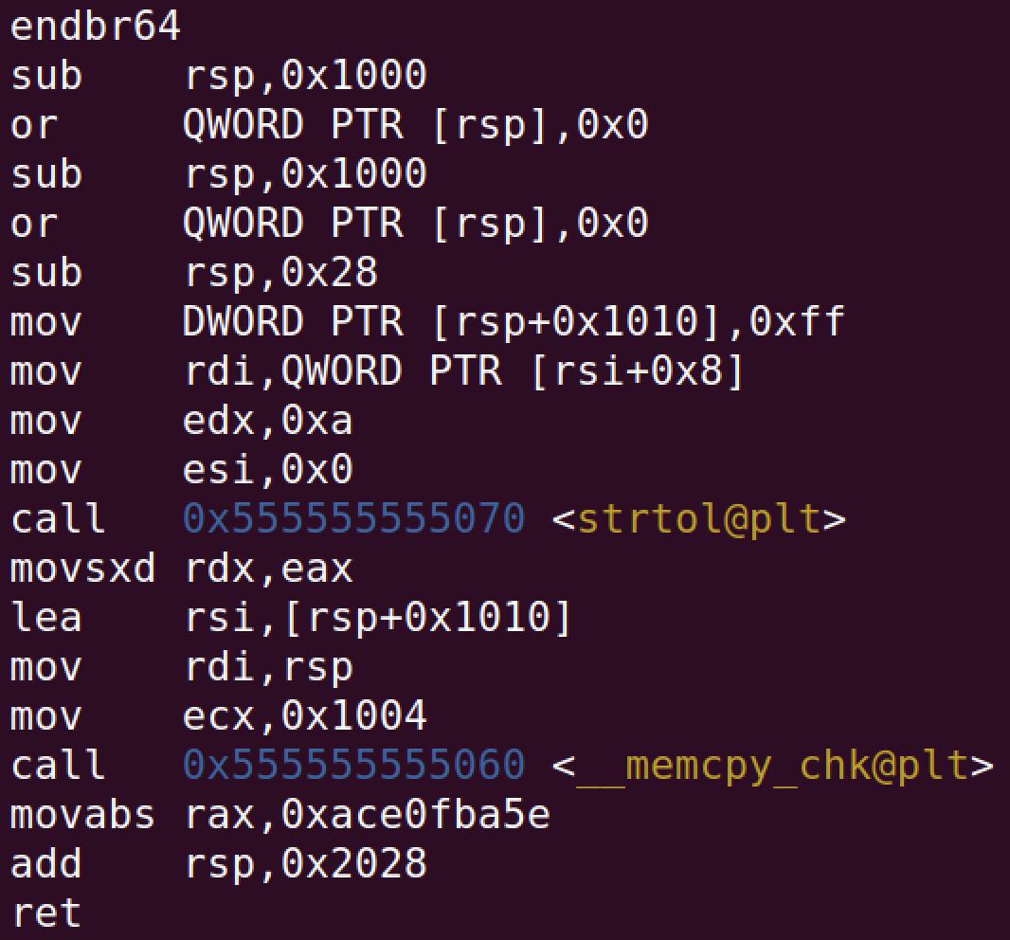
Intel vs. AT&T Syntax 5
Notes:
And some versions of the gnu tools, instead of using like “mov -0x4(%rbp)” will show it as “mov 0xFFFFFFFC(%rbp)”
Some more links talking about the differences
http://www.w00w00.org/files/articles/att-vs-intel.txt <- haxors ;)
http://en.wikipedia.org/wiki/X86_assembly_language
http://sig9.com/articles/att-syntax

Slide 8
Intel vs. AT&T Syntax 6
In my opinion the hardest-to-read difference is for r/mX values
For intel it’s expressed as
  [base + index*scale + disp]
For AT&T it’s expressed as
  disp(base, index, scale)
So basically it makes it much less clear what the operations are between those parameters
  https://sourceware.org/binutils/docs/as/i386_002dMemory.html#i386_002dMemory
Notes:
And some versions of the gnu tools, instead of using like “mov -0x4(%rbp)” will show it as “mov 0xFFFFFFFC(%rbp)”
Some more links talking about the differences
http://www.w00w00.org/files/articles/att-vs-intel.txt <- haxors ;)
http://en.wikipedia.org/wiki/X86_assembly_language
http://sig9.com/articles/att-syntax

Slide 9
Intel vs. AT&T Syntax 7
Examples:
  call qword ptr [rbx+rsi*4-0xe8]
  callq *-0xe8(%rbx,%rsi,4)
  mov rax, qword ptr [rbp+0x8]
  movq 0x8(%rbp), %rax
  lea rax, [rbx-0xe8]
  leaq -0xe8(%rbx), %rax
Notes:
And some versions of the gnu tools, instead of using like “mov -0x4(%rbp)” will show it as “mov 0xFFFFFFFC(%rbp)”
Some more links talking about the differences
http://www.w00w00.org/files/articles/att-vs-intel.txt <- haxors ;)
http://en.wikipedia.org/wiki/X86_assembly_language
http://sig9.com/articles/att-syntax

Slide 10
Intel vs. AT&T Syntax 8
Notes:
And some versions of the gnu tools, instead of using like “mov -0x4(%rbp)” will show it as “mov 0xFFFFFFFC(%rbp)”
Some more links talking about the differences
http://www.w00w00.org/files/articles/att-vs-intel.txt <- haxors ;)
http://en.wikipedia.org/wiki/X86_assembly_language
http://sig9.com/articles/att-syntax

Slide 11
Intel vs. AT&T Syntax 9
AT&T
Intel
Shouldn't this be movq?
How do I know it's moving a qword and not a byte?
Short answer is that you don't yet. ¯\_(ツ)_/¯ (Another reason I prefer Intel over AT&T syntax)
But once you learn to RTFM later, you'll at least be able to figure it out
Notes:
And some versions of the gnu tools, instead of using like “mov -0x4(%rbp)” will show it as “mov 0xFFFFFFFC(%rbp)”
Some more links talking about the differences
http://www.w00w00.org/files/articles/att-vs-intel.txt <- haxors ;)
http://en.wikipedia.org/wiki/X86_assembly_language
http://sig9.com/articles/att-syntax

