Slide 1
Sandbox: structure and application

Slide 2
What is a sandbox?
Isolated virtual environment.
Malware detection.
Behavioral analysis.
Examples: Kaspersky KATA, Pyrebox, Cuckoo sandbox, Group-IB THF, ANY.RUN, FortiSandbox

Slide 3
Pros and cons
Understanding how malware works.
Higher detection rate.
Useful for research and intelligence gathering.
Extremely slow analysis.
Tremendous resource consumption compared to AV
Enterprise solutions are expensive

Slide 4
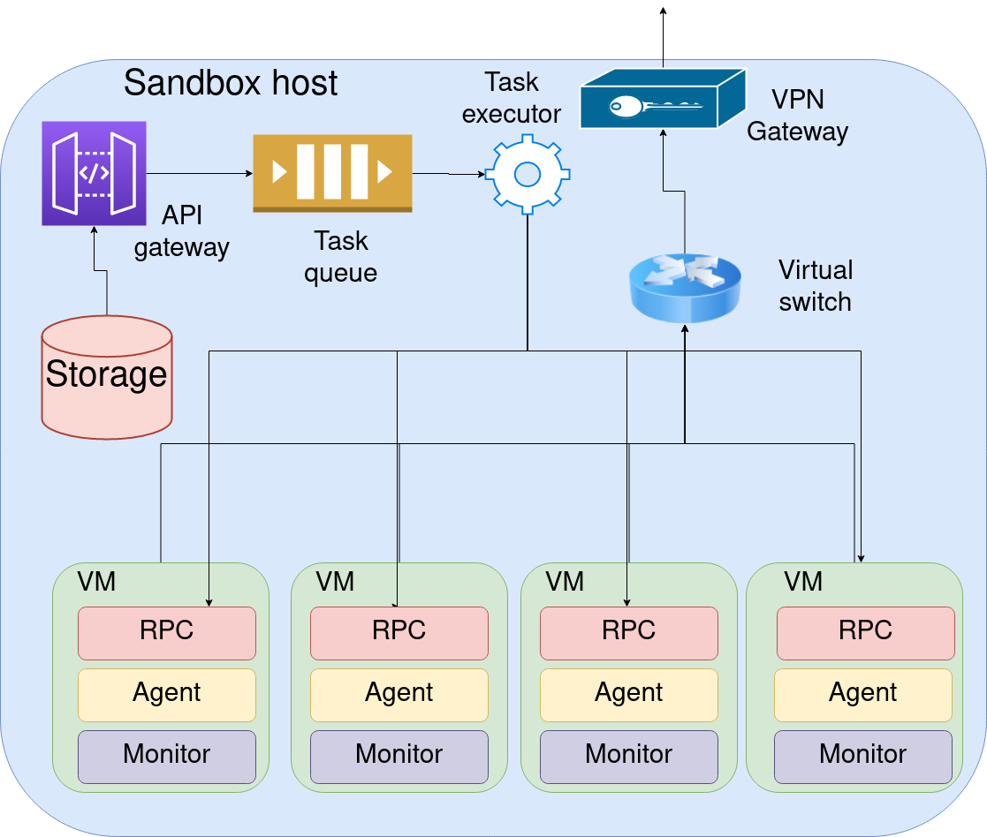
Typical sandbox architecture
Hypervisor
Monitor (as a kernel module or as a part of the hypervisor)
Agent (optional)
Classification system
Behavioral rules system
Reports database.
Job queue(Optional)

Slide 5
Cuckoo sandbox
Opensource sandbox
Community written signatures
Written in python
Is no longer supported
Different hypervisors

Slide 6
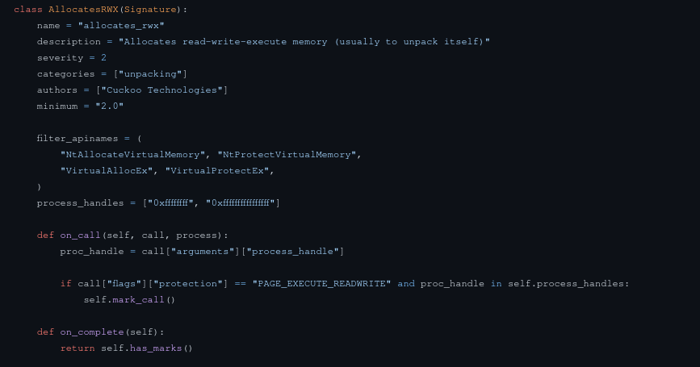
Cuckoo sandbox

Slide 7
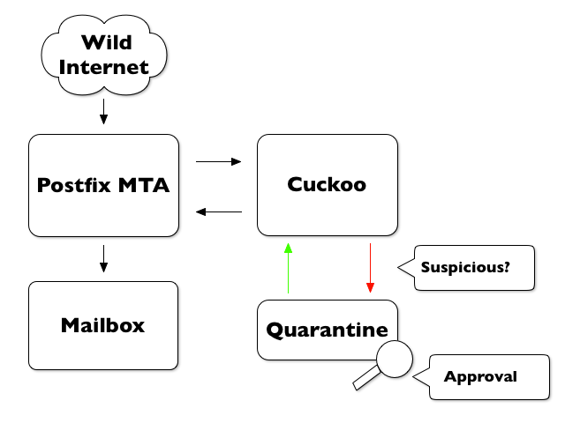
Sandbox integration schemes
SMTP Proxy
Traffic capture and MiTM Proxy (Bro IDS)
Endpoint solutions
Stand alone (for malware analysts and paranoid people)

Slide 8
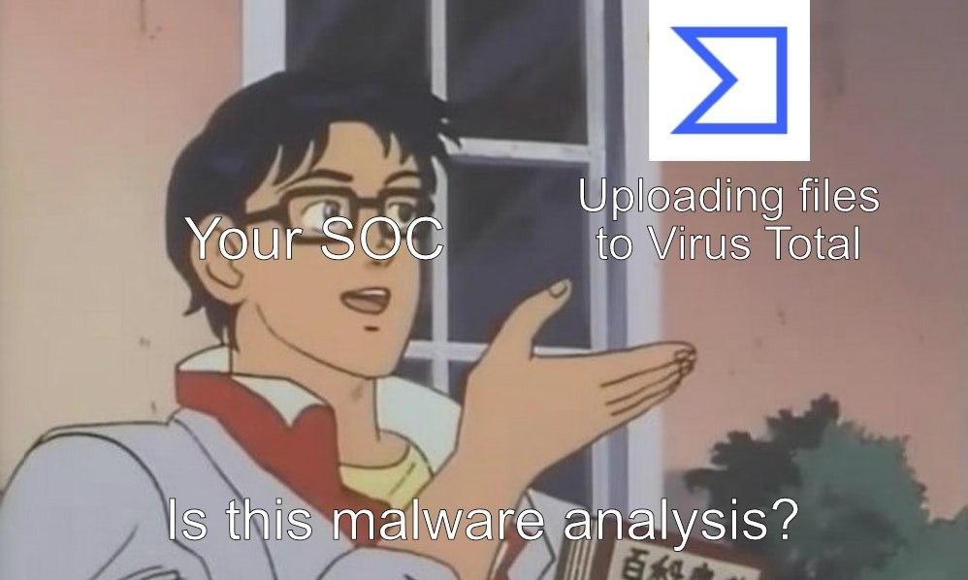
Other antimalware/infosec solutions
Antiviruses and multiscanners (Virus Total)
Endpoint detection and response (EDR)
Intrusion detection/prevention system (IDS/IPS)
Firewall
WAF
security information and event management (SIEM)

Slide 9
What are we up against?
Ransomware (most commonly cryptolockers) - Ryuk, Revil, Gandcrab, Lockbit, Hive.
Remote Acess Trojans (RAT) – Nanocore, Quasar, Remcos.
Spyware (stealers, keyloggers) – Agent Tesla, Loki, Pony, HawkEye.
Botnets – emotet
Banking Trojans – (RTM, Zeus, Dridex).

Slide 10
Malware replication
Worms (MyDoom)
Viruses
Trojans
Zero day/Zero click and other vulnerabilities.

Slide 11
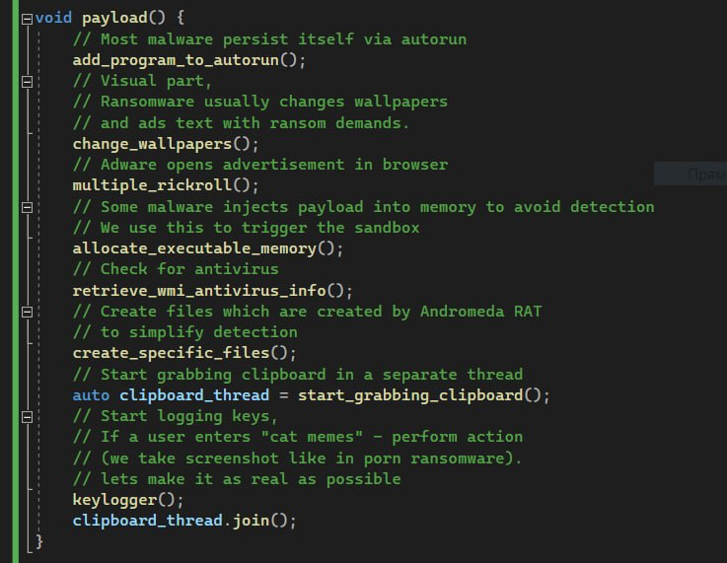
Toy example
Example which mimics real malware
Contains different instrumentations
No actual malicious actions performed
Easily detectable
Some components are designed to be detected
Creates a file specific for Andromeda malware

Slide 12
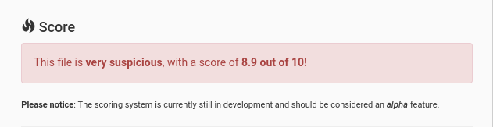
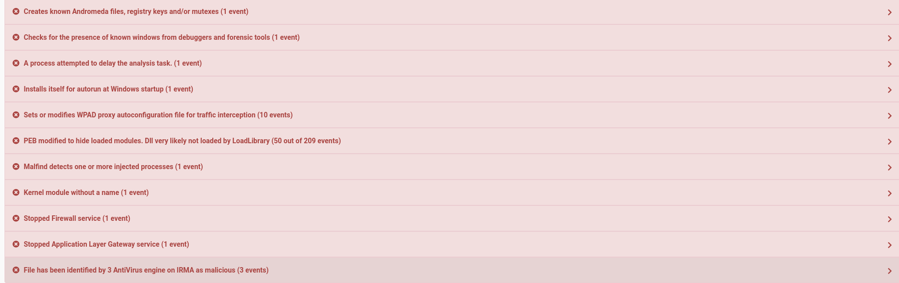
Pure sample analysis
https://cuckoo.cert.ee/analysis/2885609/summary/

Slide 13

Sandbox detection and escape
Red pill virtualiztion detection (Joanna Rutkowska)
Virtual machine escape (buffer overflows in drivers usually) CVE-2020-3962, CVE-2020-3963
Don’t mistake with the blue pill rootkit.

Slide 14
Sandbox detection
How to detect | How to evade detection
Running processes and loaded libraries, existing files specific for a sandbox. | Generate names of monitor and agent at each sandbox run.
Vendor and product Ids of devices specific for Virtual Machines. | Self written or patched hypervisor with emulation of real devices, including serial numbers and descriptors.
Low amount of RAM and low CPU count | This is unstable and rarely used method. Adding signature for CPU count and RAM amount would be sufficient.
Screen resolution (Vms usually have low screen resolution due to performance reasons) | Use VM with higher screen resolution
Missing common software (Adobe products, Bankinkg software, etc.). Non unique usernames and timezones. | Use different VM base images with preinstalled software. Change username and timezone for each run.

Slide 15
Sandbox detection
How to detect | How to evade detection
Mouse movement, clickable buttons, using Machine Learning to detect whether mouse movement was performed by a user. | Custom mouse HID driver. Recorded users mouse movement. Computer vision (Tesseract), GANs usage for userlike behavior
Sleep, sleep with NTP, sleep with get ticks count, instruction hammering (CloudEye). | Sleep skipping (kernel hooks), signature for instruction hammering, static detection. Signature for NTP communications.
Syscalls time comparison. | Use more performant hardware and harware virtualization technology like intel VT-X. Hook time calls.
Using invalid process instructions which work on a virtual CPU (0x0F, 0x3F). | Hypervisor patches.
Creating high CPU load for a long period of time. | Measure CPU load, signature to detect CPU overusage without syscalls.

Slide 16
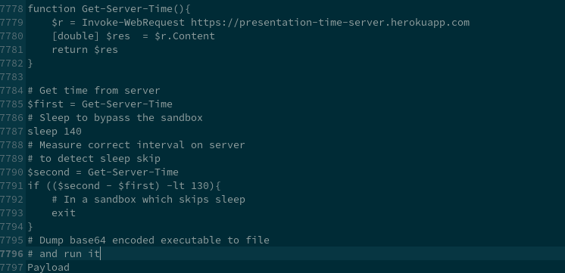
Sandbox bypass in action
Powershell script
Sleep with time check using HTTP time server
Base64 encoded binary in script body (Simplest and signature detectable method, need to use generic encryption)
Simple drop of file without injection, detectable by AV engines

Slide 17
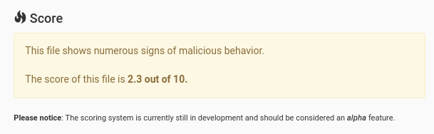
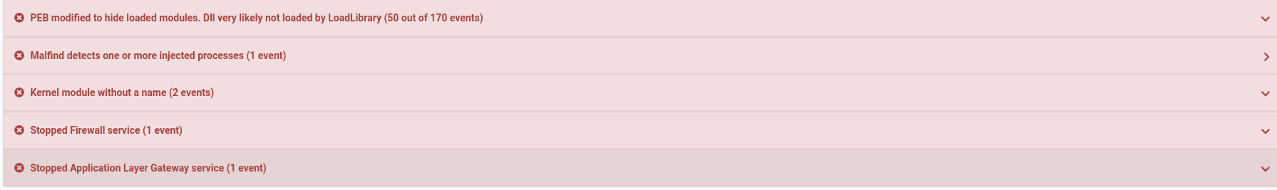
Sandbox bypass in action
https://cuckoo.cert.ee/analysis/2885781/summary/
Application didn’t run in the sandbox.
False positive markers
  No firewall interaction
  No dll loads, pure powershell
  No process injection, payload dropped on disk
  And we are not tampering with kernel modules for sure

Slide 18
Conclusion
Sandbox are easy to bypass nowadays.
Huge amount of methods to bypass.
There is no silver bullet, use integrated infosec systems.
Malware detonation approach.
Hardware sandboxes (switch level isolation, diskless machines).
Sandbox and EDRs are the most robust information security solutions.

Slide 19


