Slide 1

The Onion Routing Project
Vladimir Kalnitsky - klntsky@gmail.com
F0RTHSP4CE - f0rth.space

Slide 2
Tor Project Goals
Censorship bypassing
Anonymous internet access
Surveillance bypassing

Slide 3
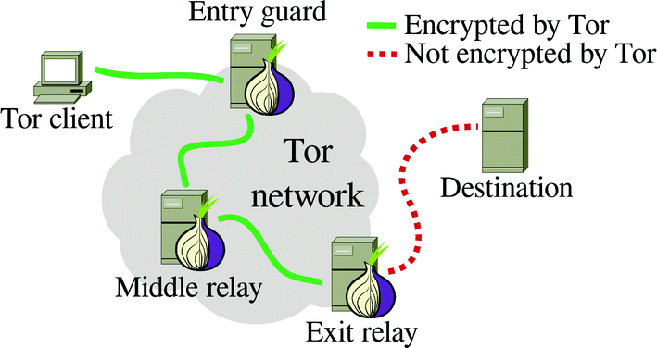
Censorship bypassing & anonymous access

Slide 4
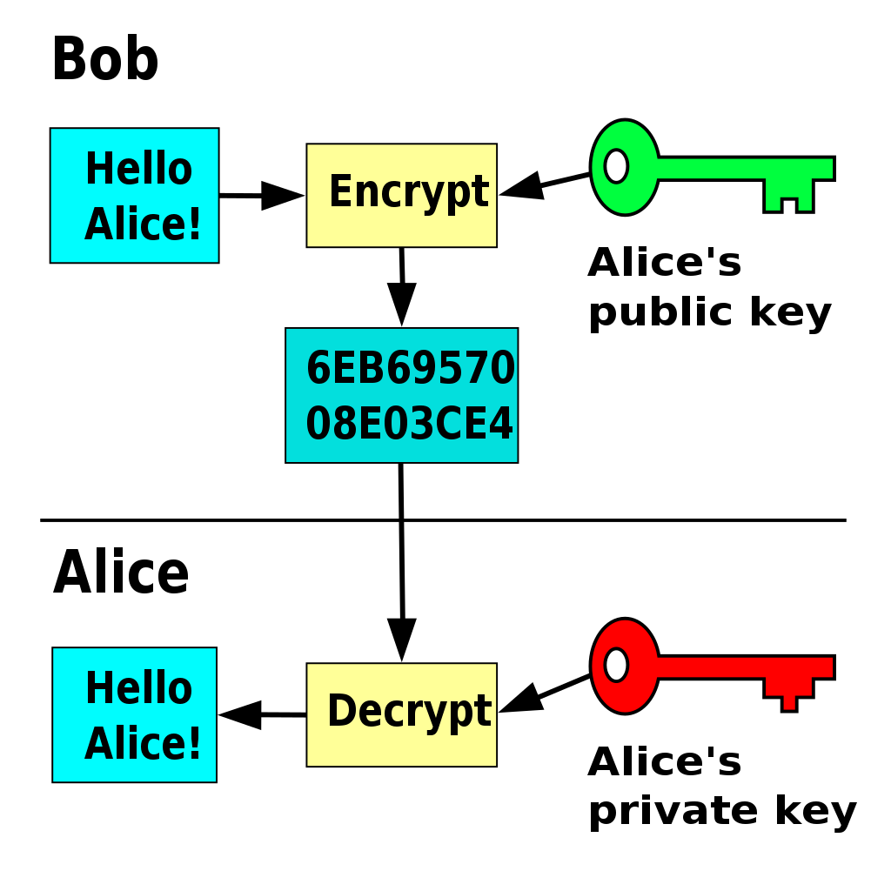
Asymmetric Cryptography

Slide 5
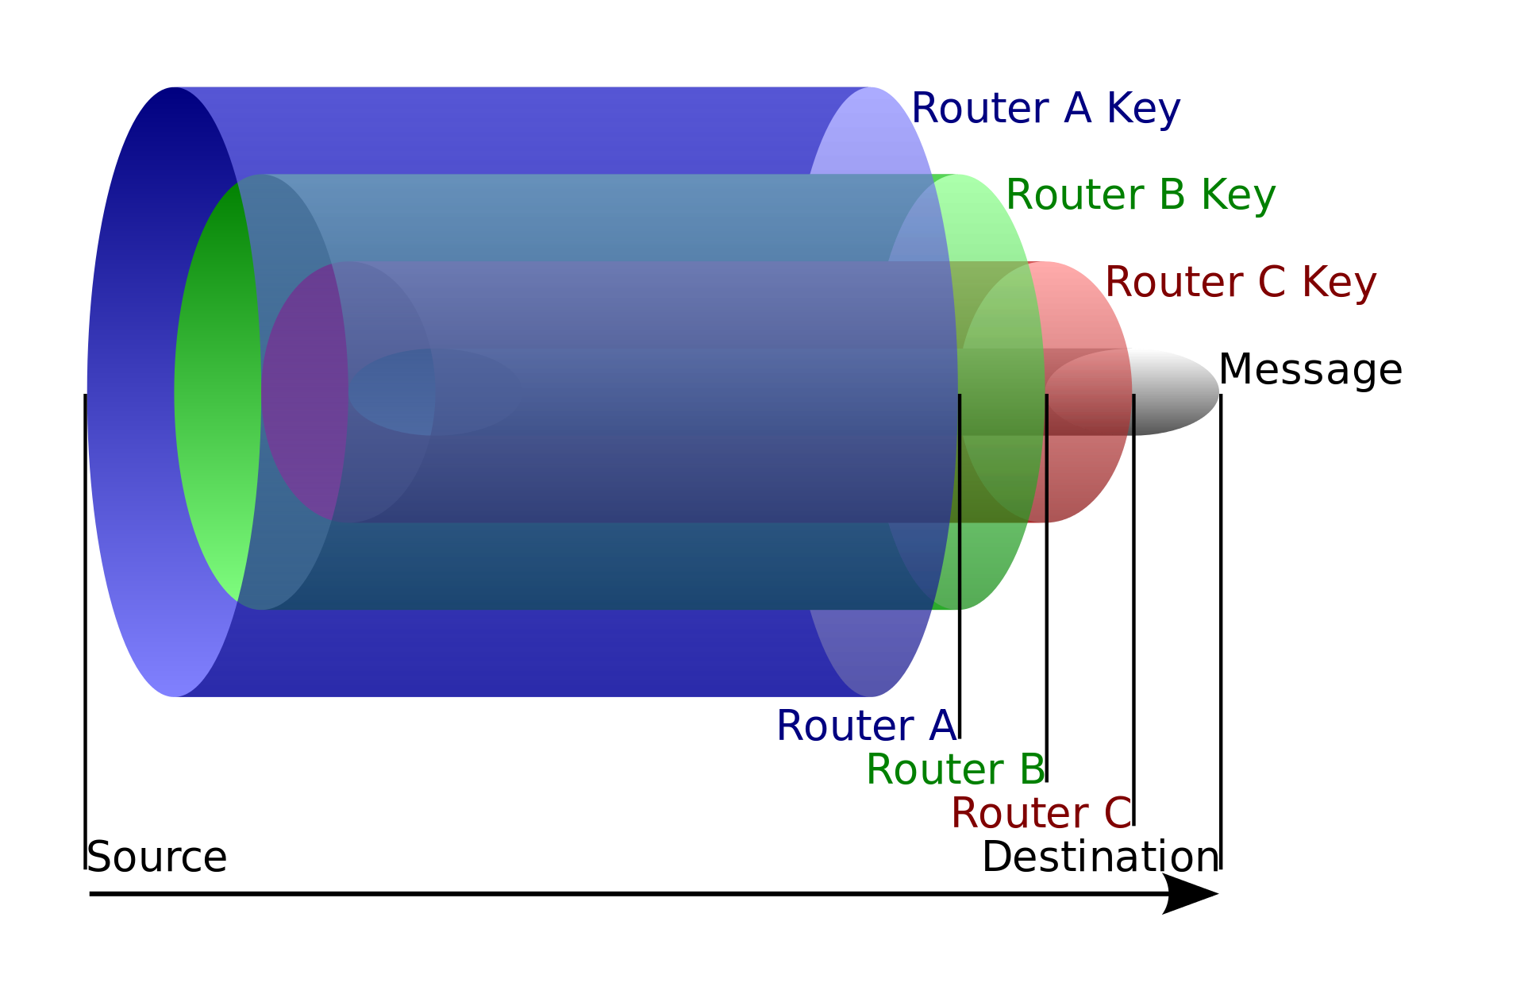
Onion Routing

Slide 6
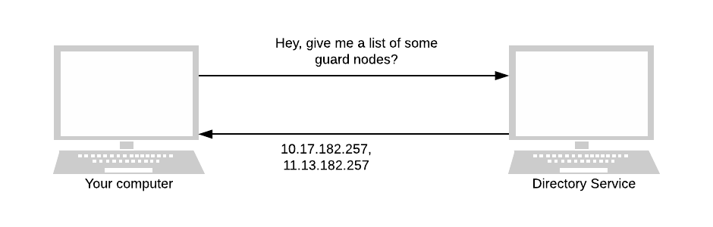
Directory Services
Tor is not peer-to-peer and decentralized
Routing is based on consensus
Each hour 10 hardcoded directories vote for relays to form consensus
Consensus contains all relay IPs with their flags, e.g.: exit, guard, stable, fast, HSDir or exit.

Slide 7
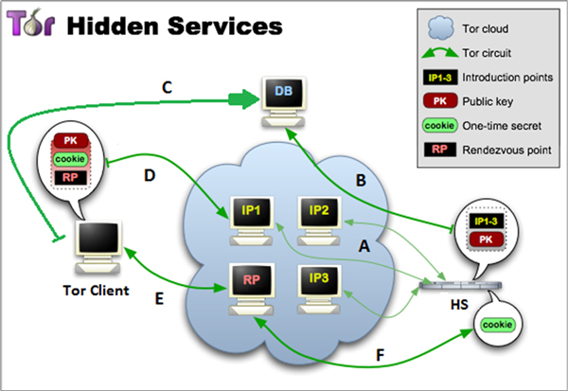
Anonymous hosting (“hidden services”)

Slide 8
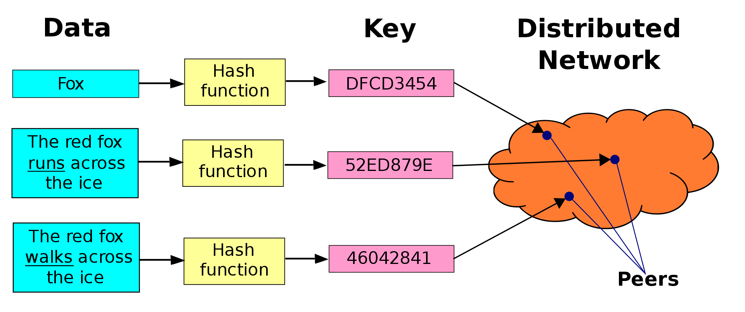
Hidden Service Discovery
Distributed Hash Table:

Slide 9
How to interact with Tor?
Tor Browser = Custom build of Firefox + Tor Daemon (Windows, Linux, Android)
Onion Browser (iOS)
Tor Daemon: local SOCKS proxy

Slide 10
Tor Bridges: bypassing blocking
Bridge relays: not listed in consensus
Bridges with obfuscation: look like ordinary web services for the observer
Project Snowflake: uses WebRTC allowing to run a proxy in the browser

Slide 11
Q&A Section

