Slide 1
START
PROGRAMMING
Excel_Functions.py
DATA INPUT
create_excel
Operator Name
copy_step_format
Client Name
basic_info_copy
Order ID
Column_Calculator.py
Amount
Auto_Volume.py
Step Number
step 1
Well Position
RESULT
Order Date
step 11
File_name.xlsx
Due Date
Well_Position.py
Database.xlsx
File Name
wells_entire_column
single_wells
EXCEL TEMPLATES
Data_Save.py
Full_Format.xlsx
ask_question
step 1
file_exist_check
create_excel
step 11
check_sheet
wells
Past_Orders_Template.xlsx
check_line
save_protocol
complete_message

Slide 2
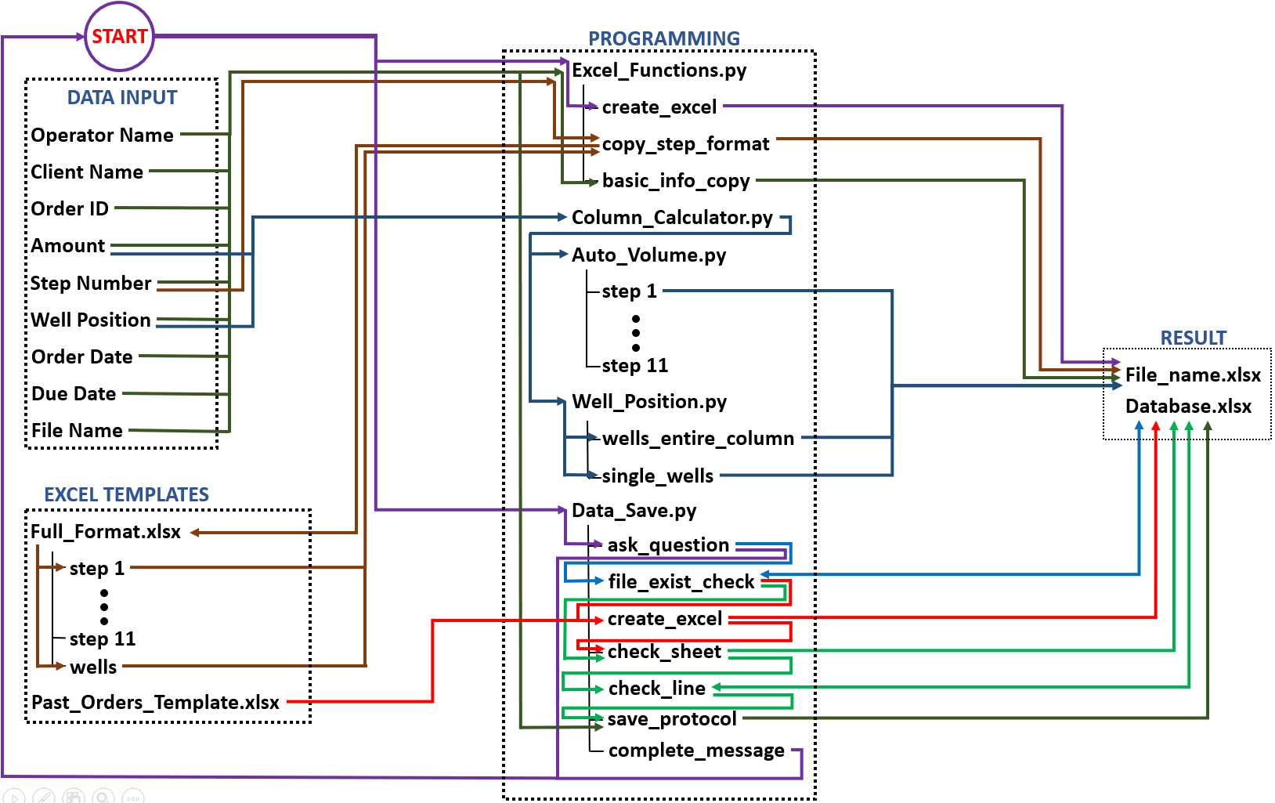


Slide 3
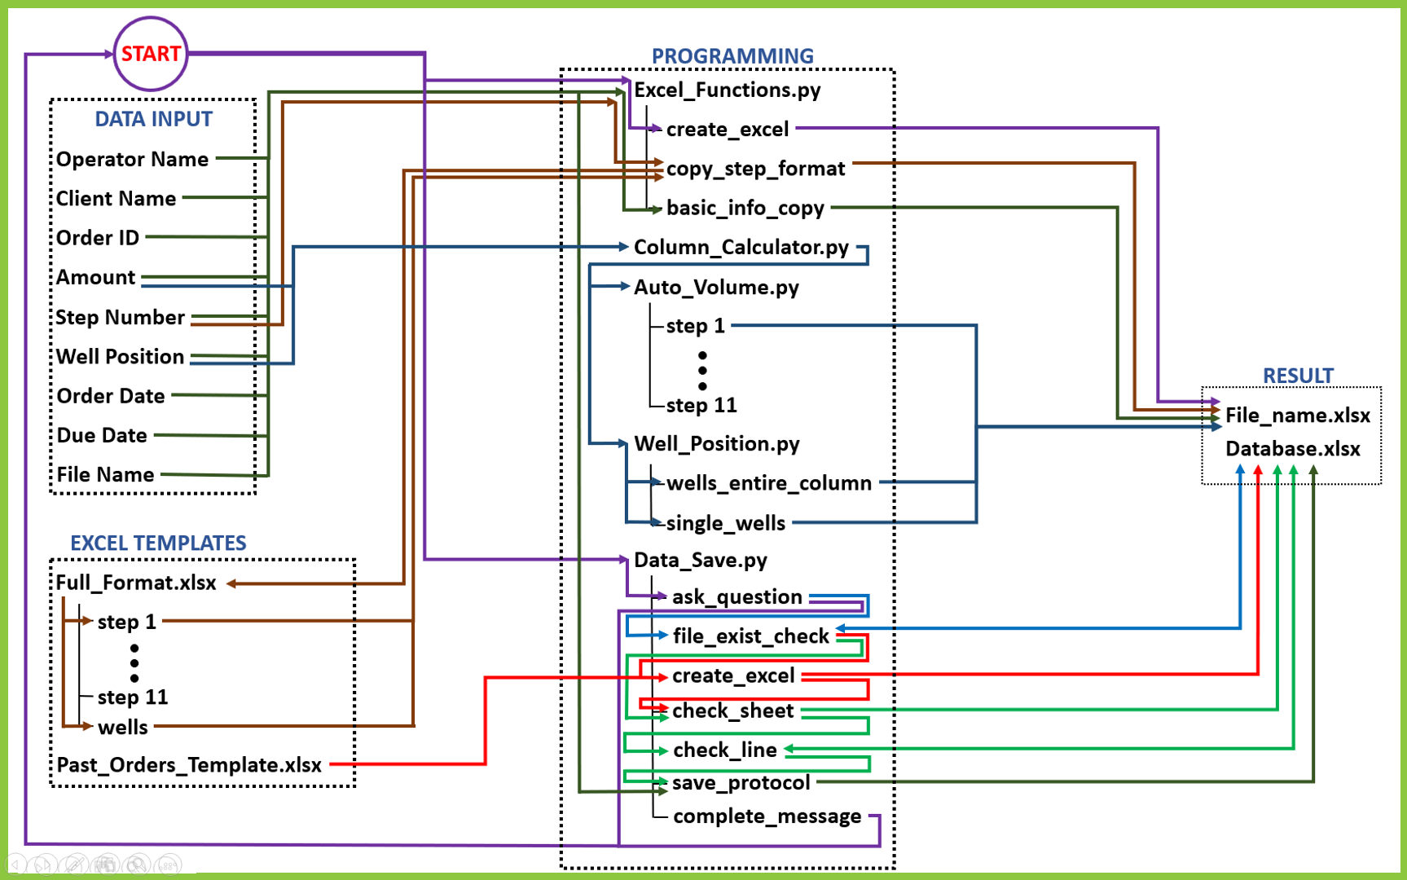

Slide 4
