Slide 1
Final Project Report
Yuxuan Zhou
4499958

Slide 2
Interesting visualizations from the EDA portion of the project.

Slide 3
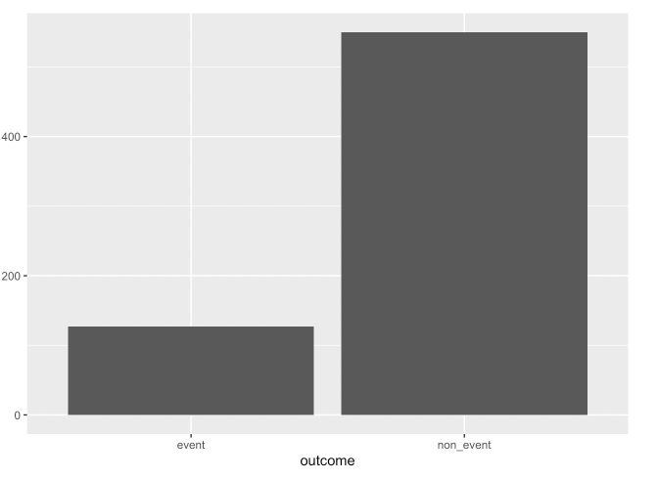
The event dataset is not balanced, which would affect our prediction

Slide 4
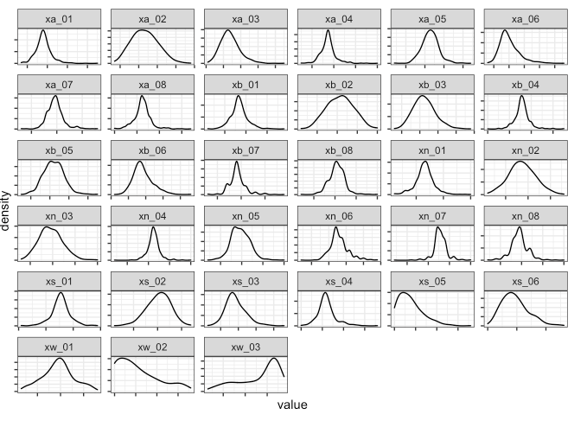
Most of continuous input are Gaussian likely distributed, which will make our prediction easier.

Slide 5
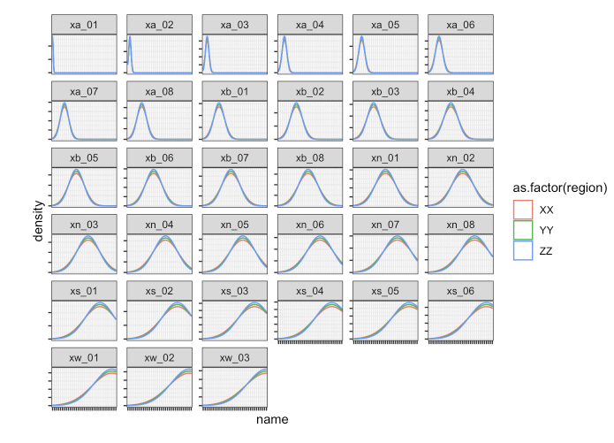
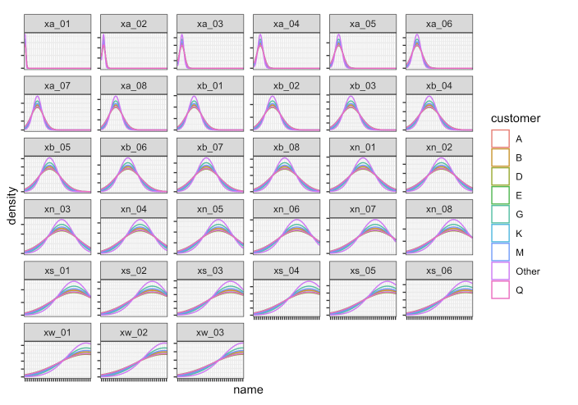
Categorical inputs have effect on continuous inputs.

Slide 6
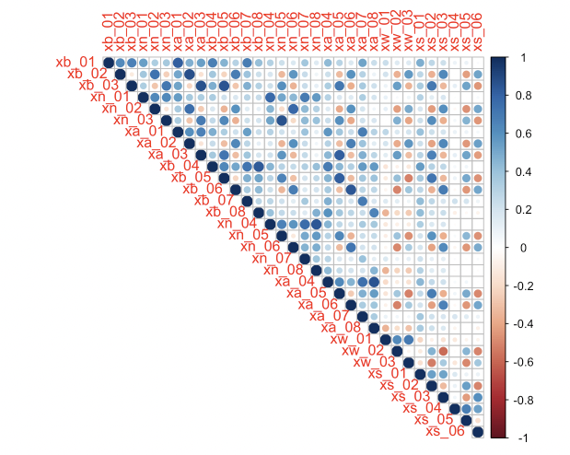
Continuous inputs are highly correlated, yes of course, cus these are come from NLP

Slide 7
Visualizations comparing model performance and selection of the best model.

Slide 8

Regression Models

Slide 9
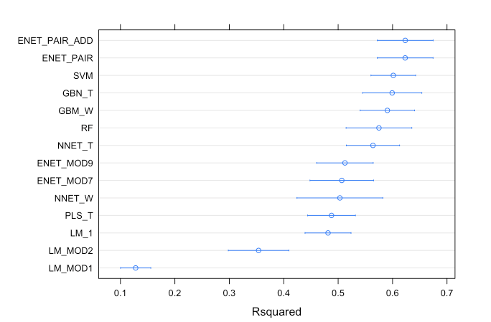
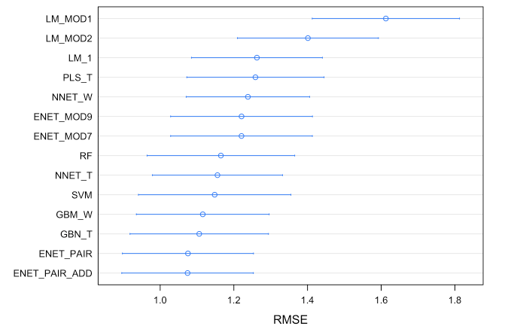
The lower RMSE the better this model is, the higher R-squared is the better the model is. Even though rsquared on training set is not trustiness, but both RMSE and R-squared are telling us Elastic net all pair-wise with additive categorical input – model is the best.

Slide 10
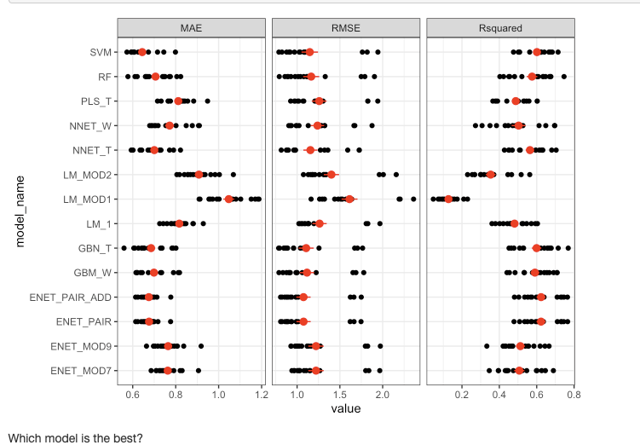
The result from ”repeatedcv” resampling, which tells us the same thing.

Slide 11
Classification Models

Slide 12
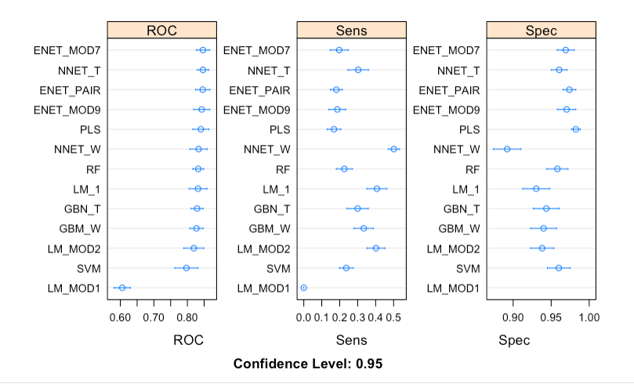
Neural network seems to be the best one.

Slide 13
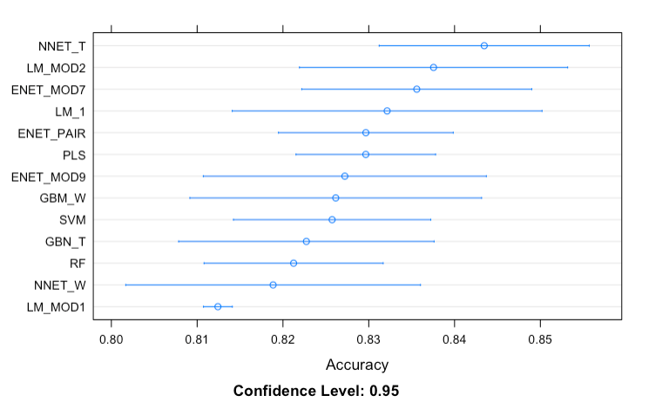
Again, neural network, but notice, ROC and accuracy performance matrix didn’t agree on same thing

Slide 14
Visualizations showing variable importances and/or coefficient summaries

Slide 15
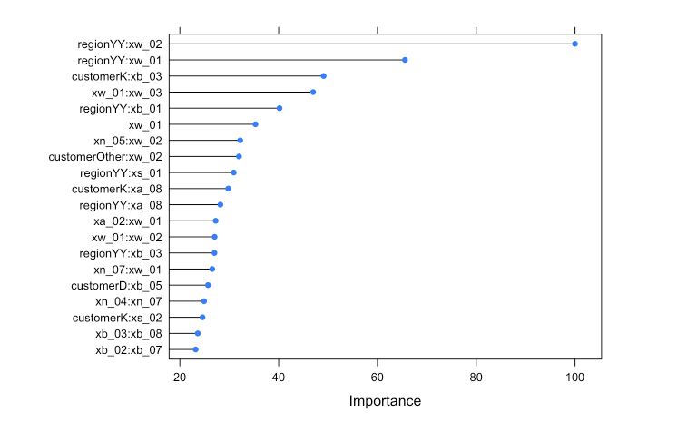
Regression model feature importance

Slide 16
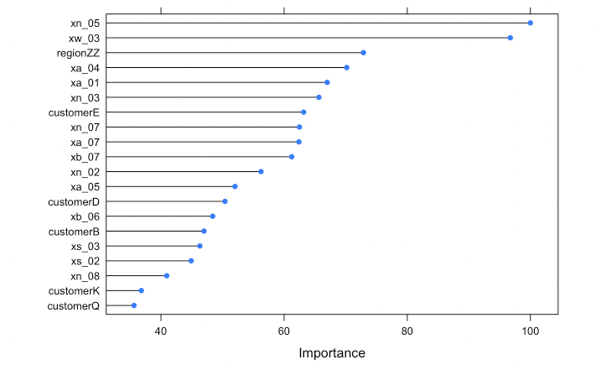
Classification model importance

Slide 17
Visualizations showing model predictions with text interpreting the trends.

Slide 18
Classification Models

Slide 19
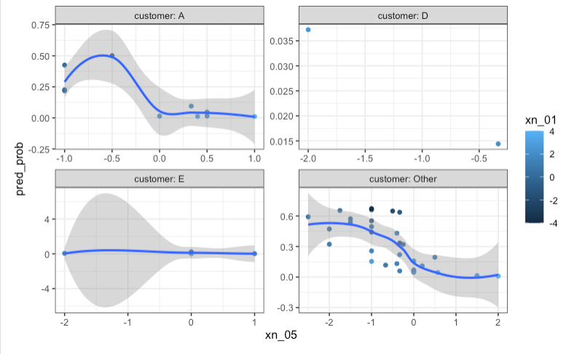
This is the result from holdout test set, it a little bit hard to see what the trend is, hence, we create our own viz_input_grid.

Slide 20
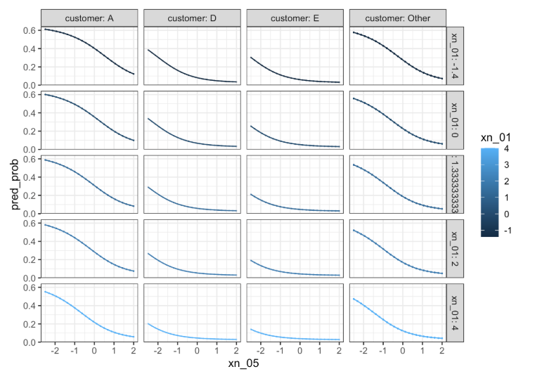
Through the figure, we can see the classification posterior probability decrease when xn_05 increase, it also decrease with increase of xn_01. Customer A and E have higher probability than D and E

Slide 21
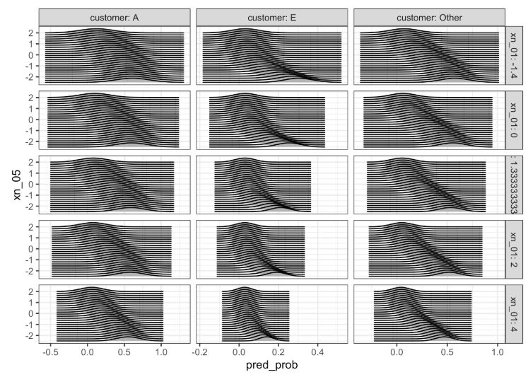
Through this figure, we can see that the confidence interval of posterior probability of classification is shrinking. And it narrows to a relative smaller interval with the increase of xn_01. I didn’t apply bound on this plot function, thus, probability below. Also, the posterior probability of classification decrease as xn_05 increase. The posterior mode is always above 0.

Slide 22
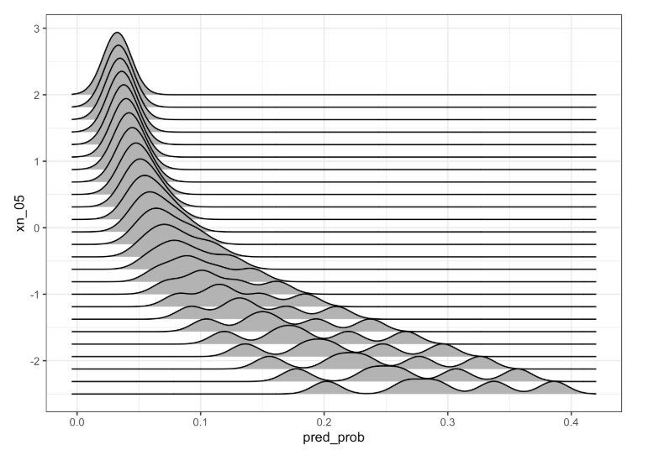
This figure we take a close look to customer D, as we can see, the model turns into multi peak model, that could be a reason why this customer is hard to predict.

Slide 23
Regression Models

Slide 24
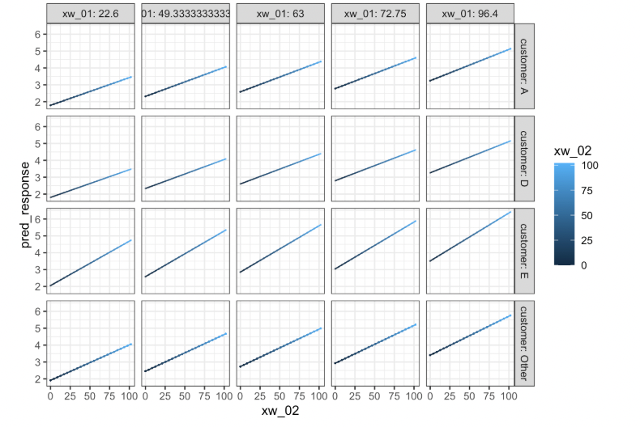
As we can see, no matter which customer, the posterior response increase as xw_01 and xw_02 increase. The difference is the start point.

Slide 25
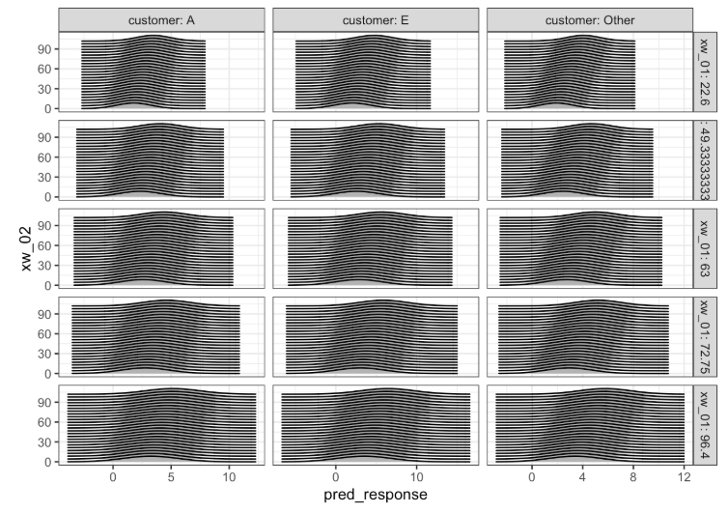
In regression model, the posterior confidence interval seems not change as xw_01 increase. The posterior mode has slight shifts as xw_02 increase.

Slide 26
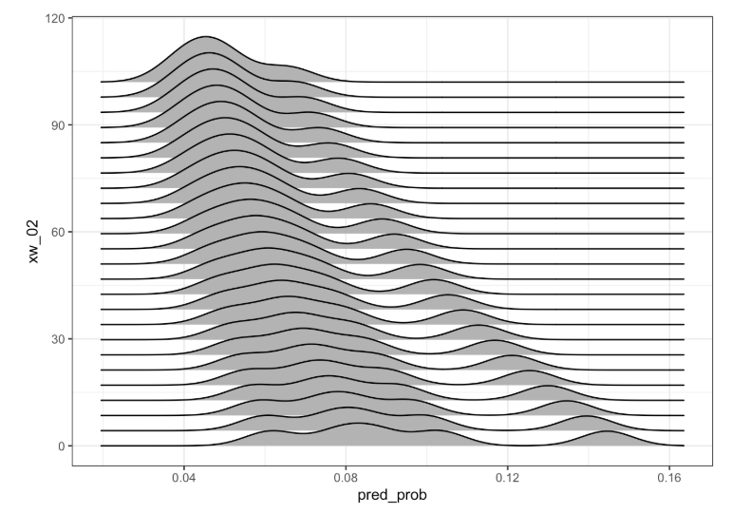
Again, lets dive into customer D, this model is also turns into multi-peak model, it explains why customer D is hard to predict.

