Slide 1
Predicting Game Prices on Steam
Data Science Project
Collaborators
Hasti Karimi
Ali Lotfollahi
Fatemeh Mohammadi

Slide 2
01
Introduction

Slide 3
Introduction
Objective:
Predict the prices of games available on Steam
Goals:
Collect comprehensive game data
Preprocess and clean the data
Analyze features and their impact on price
Build and evaluate predictive models

Slide 4
Data Collection
02

Slide 5
Data Collection
Target URL: SteamDB
Objective:
Extract URLs of about 3000 games and gather detailed information for each game.
Data Points Collected:
NAME
STORE_GENRE
RATING_SCORE
N_SUPPORTED_LANGUAGES
DEVELOPERS
SUPPORTED_PLATFORMS
POSITIVE_REVIEWS
NEGATIVE_REVIEWS
TECHNOLOGIES
RELEASE_DATE
TOTAL_TWITCH_PEAK
PRICE
N_DLC
24_HOUR_PEAK
Notes:
The goal of this part is to gather data on approximately 3000 games from the website SteamDB.
The data collected includes various attributes of the games, which will be used for subsequent analysis, preprocessing, feature engineering, and model training

Slide 6
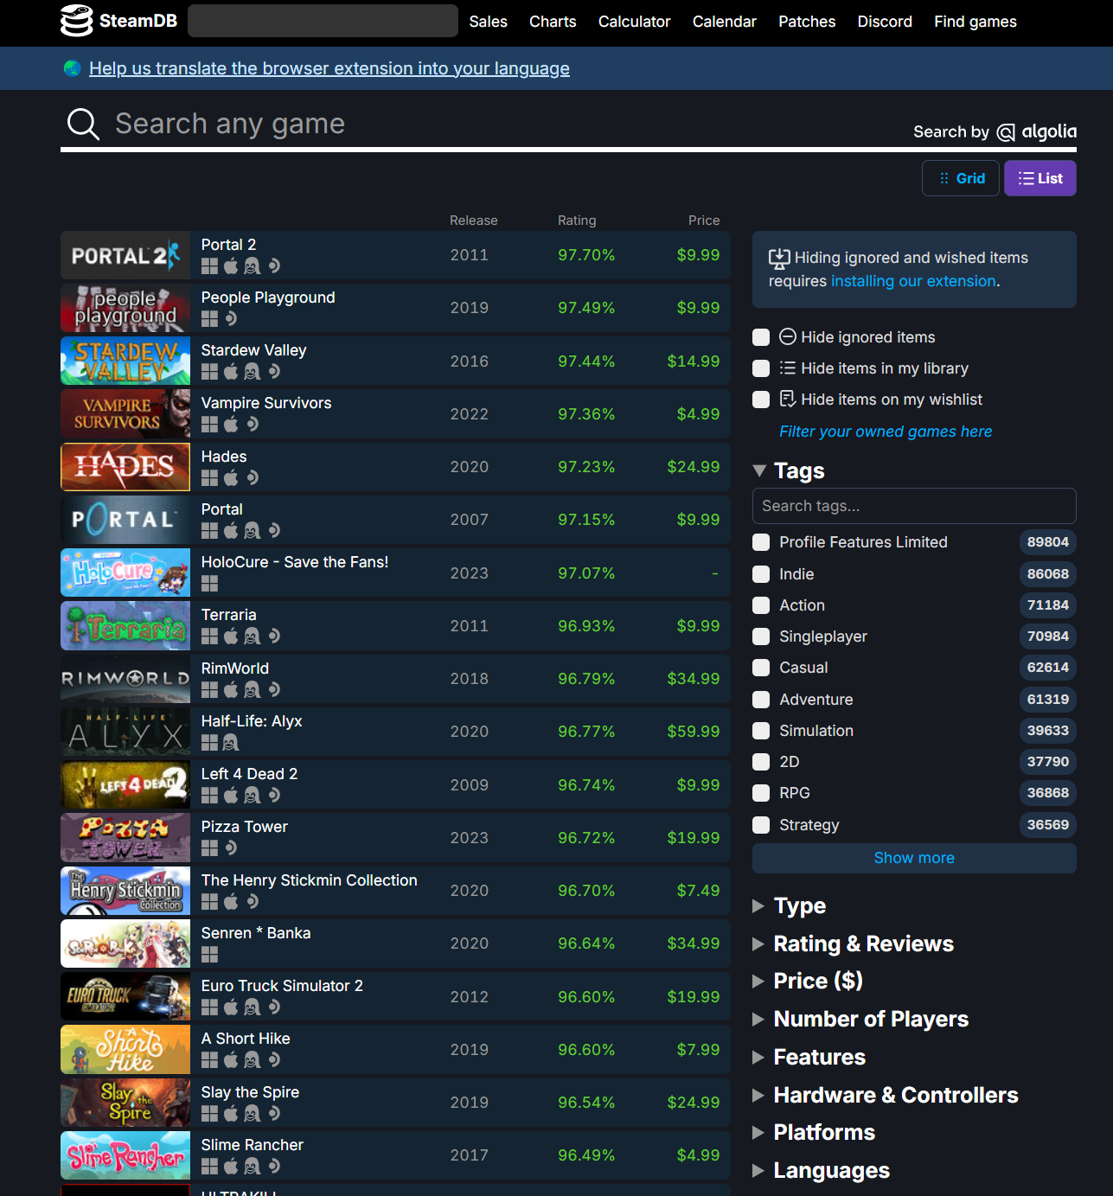
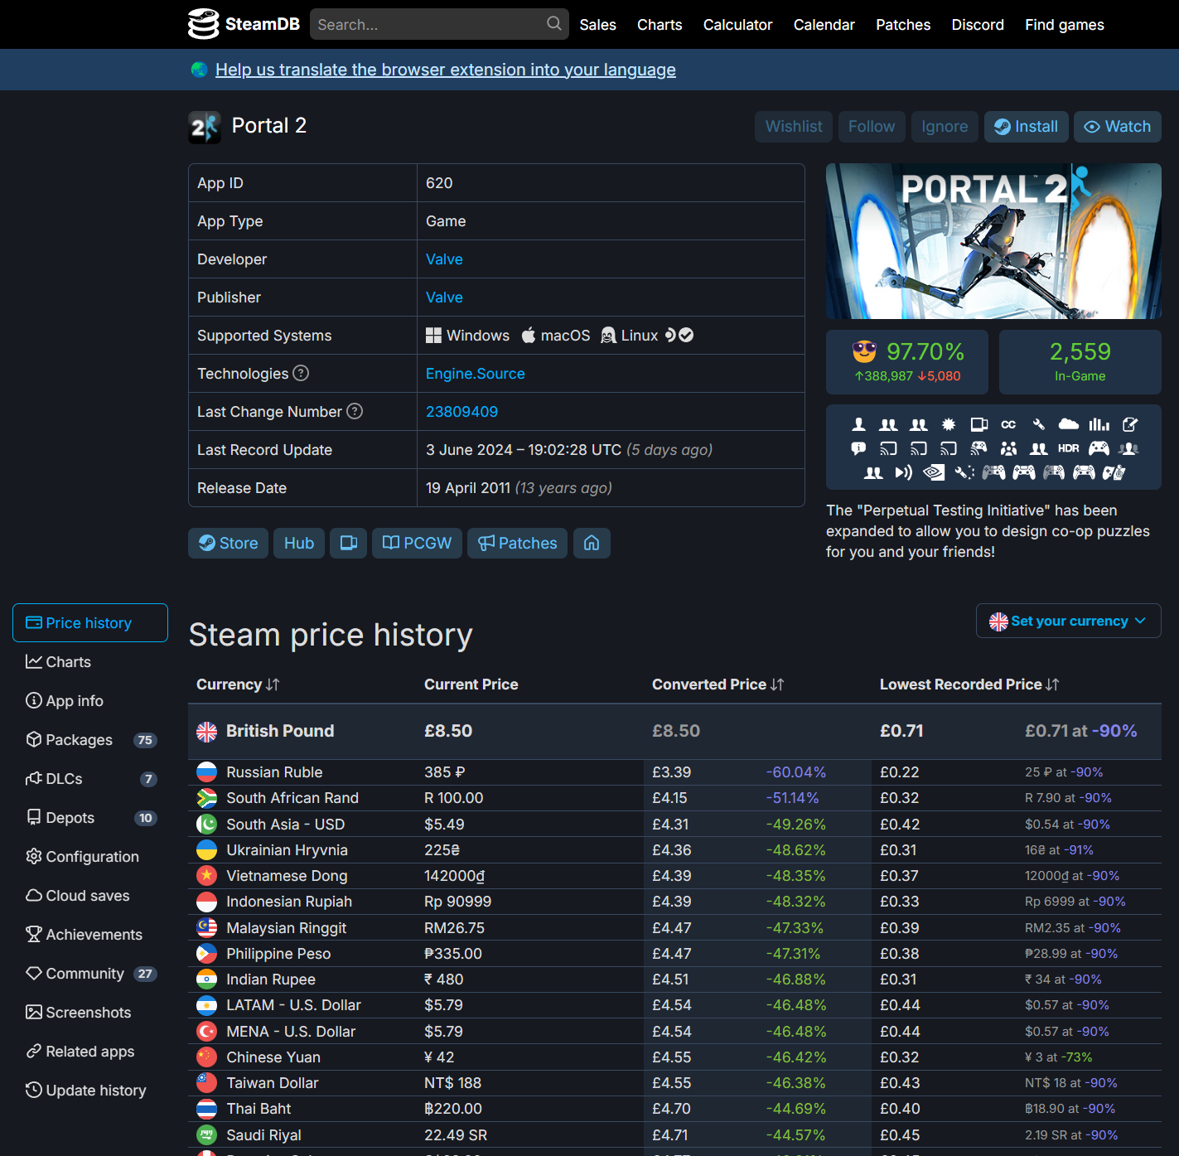

Slide 7
Scraping Process
Scripts and Notebooks:
webScrape_1.ipynb
webScrape_2_price.ipynb
Files Generated:
game_urls.txt.
games_info.csv
games_details.csv
Notes:
Scripts and Notebooks:
weScrape_1.ipynb: This script extracts game URLs and gathers detailed information for each game.
weScrape_2_price.ipynb: This script ensures that the prices of games are converted to USD, addressing the challenge of varied pricing in different currencies.
Files Generated:
game_urls.txt: List of URLs for the 3000 games.
games_info.csv: Contains detailed information about the games.
games_details.csv: Contains game names, release dates, and prices in USD.

Slide 8
Challenges in Data Collection
Volume of Data:
Scraping 3000 games required considerable time and resources.
Currency Variations:
Standardizing prices to USD.
Notes:
Challenges Faced
Time-Consuming Process: Scraping a large number of games required significant time and computational resources. Multiple systems were used to expedite the process.
Price Standardization: Different currencies on the SteamDB website posed a challenge, which was addressed by writing a separate script to ensure all prices are in USD.

Slide 9
Preprocessing
03

Slide 10
Preprocessing
Loading and exploring the data.
Removing duplicate entries.
Handling missing values across various columns.
Cleaning data and engineering new features.
Integrating datasets to form a comprehensive dataset.
Outlier Detection and Handling
Notes:
The preprocessing phase is crucial for ensuring that the data is clean, consistent, and ready for subsequent analysis. This phase involves handling missing values, correcting data types, creating new features, and addressing any inconsistencies. The preprocessing steps were executed in the Preprocessing.ipynb notebook, with game_info.csv and game_details.csv as inputs, resulting in the output file preprocessed_game_info.csv.

Slide 11
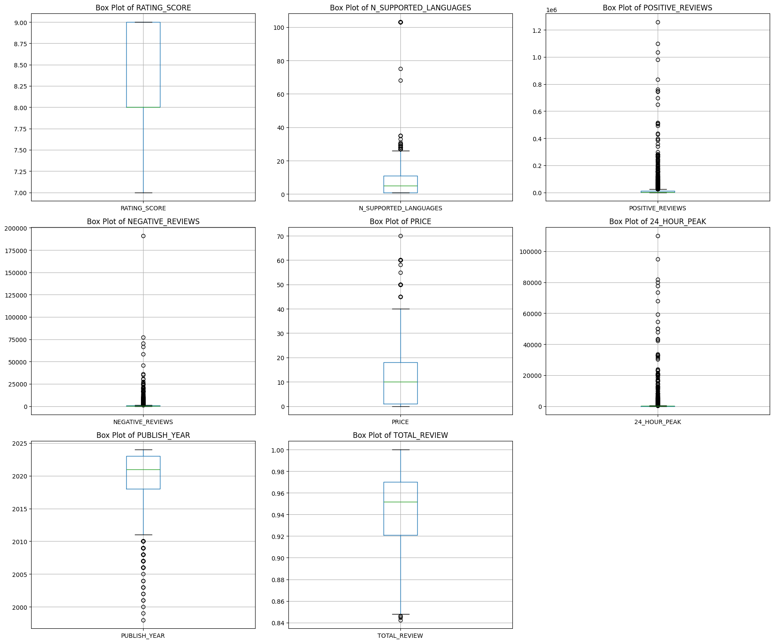
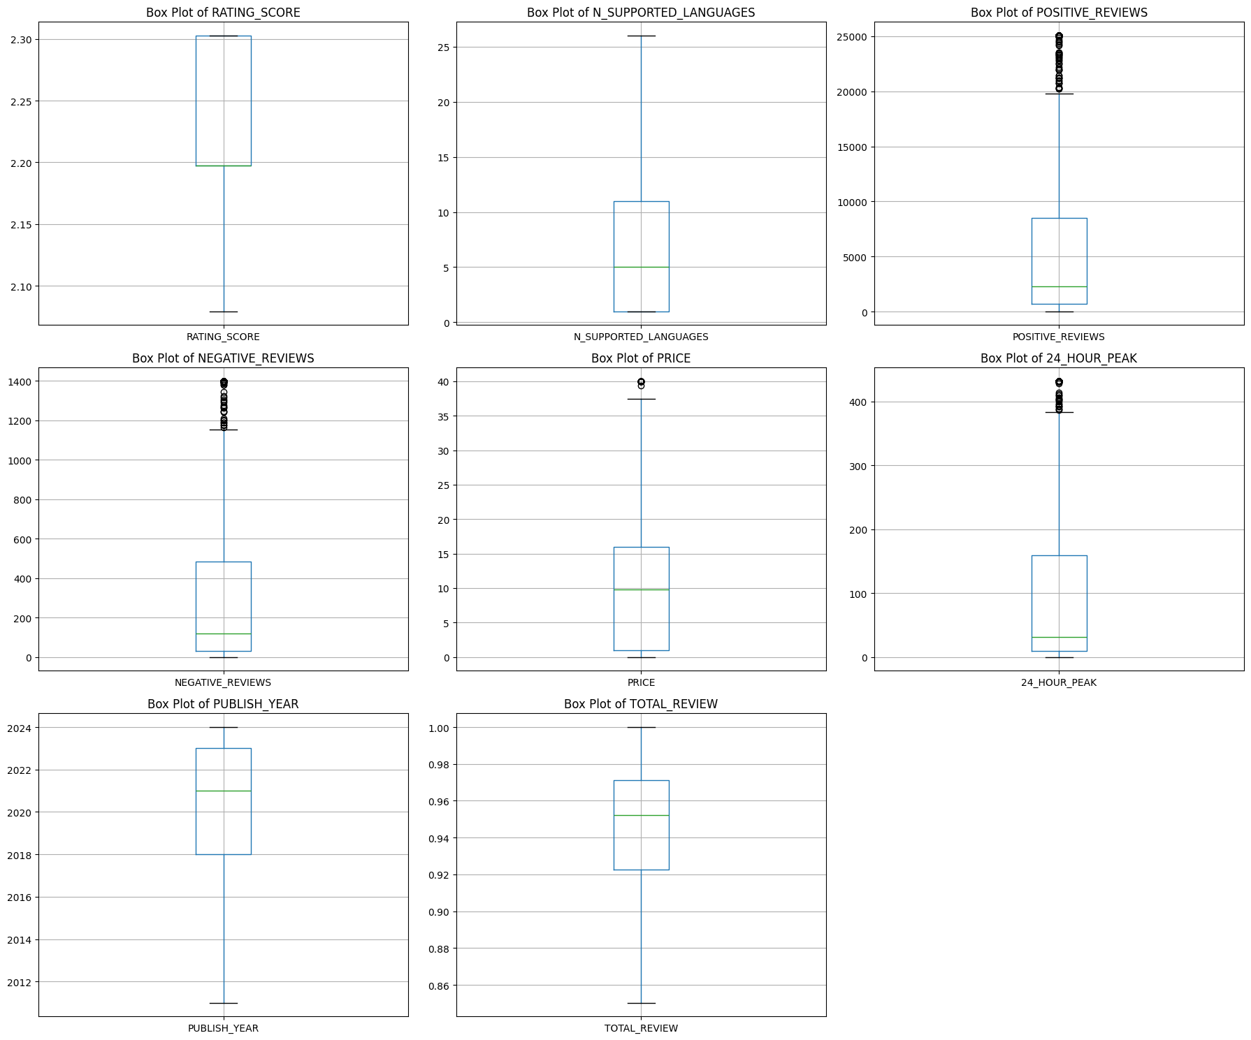
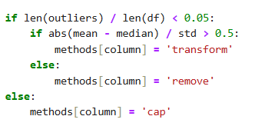
'RATING_SCORE': 'transform', 'N_SUPPORTED_LANGUAGES': 'remove', 'POSITIVE_REVIEWS': 'cap’,
'NEGATIVE_REVIEWS': 'cap’,
'PRICE': 'remove’,
'24_HOUR_PEAK': 'cap', ‘
PUBLISH_YEAR': 'remove’,
'TOTAL_REVIEW': 'remove'

Slide 12
Analysis
04

Slide 13
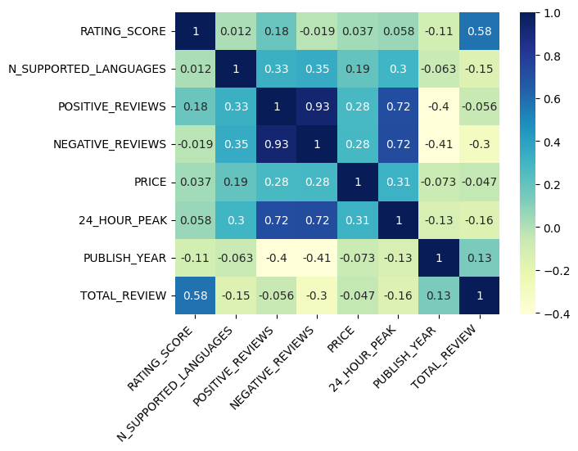
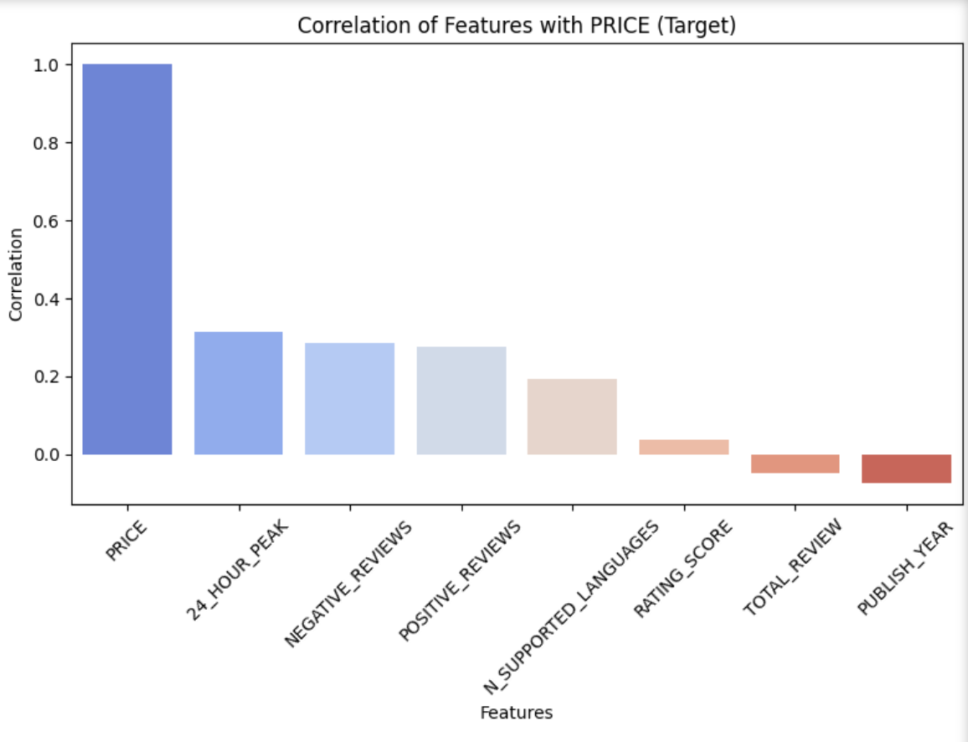
Correlation Heatmap
24_HOUR_PEAK | 0.314733 | +
NEGATIVE_REVIEWS | 0.284251 | +
POSITIVE_REVIEWS | 0.275162 | +
N_SUPPORTED_LANGUAGES | 0.193140 | +
PUBLISH_YEAR | -0.073061 | -
TOTAL_REVIEW | -0.046987 | -
RATING_SCORE | 0.037429 | +

Slide 14
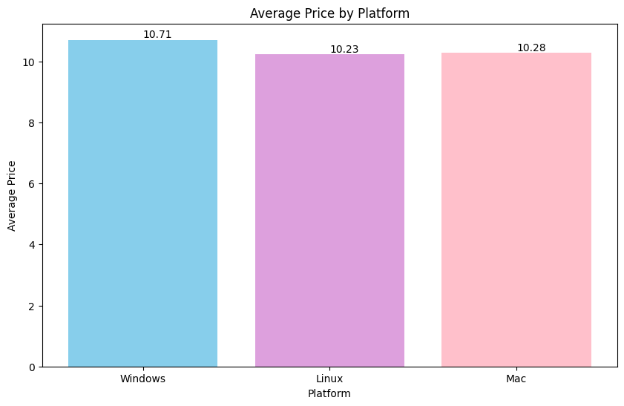
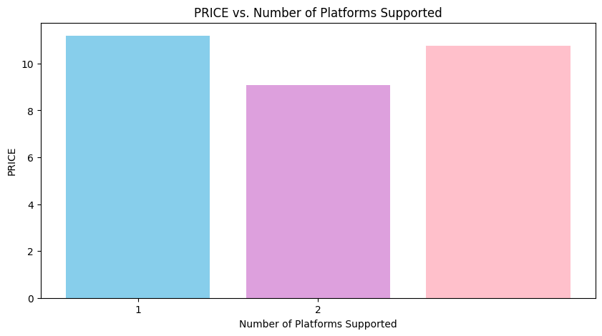

Slide 15
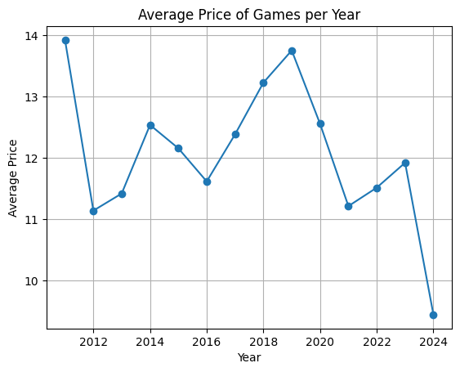
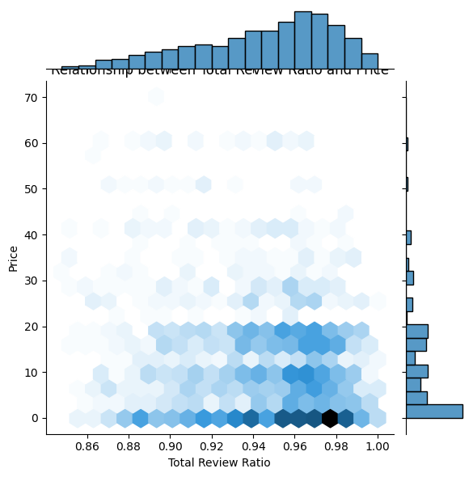
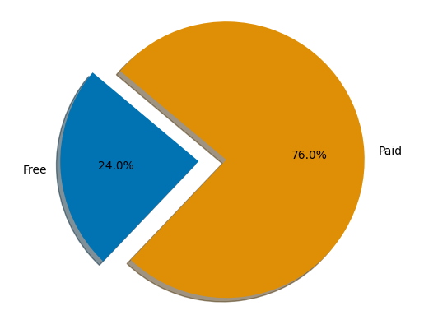
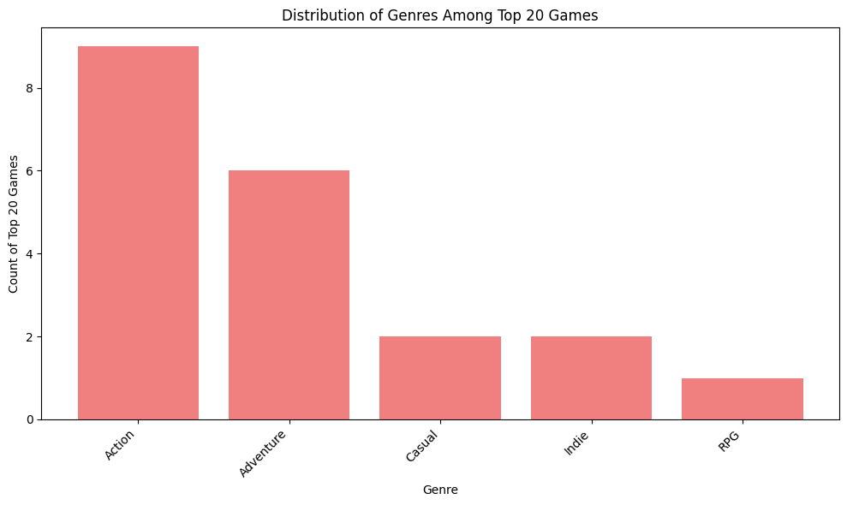
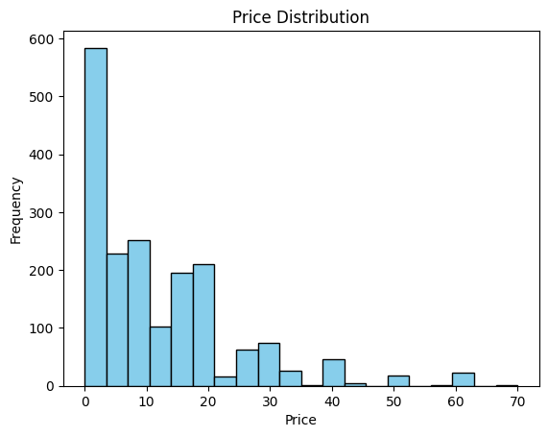
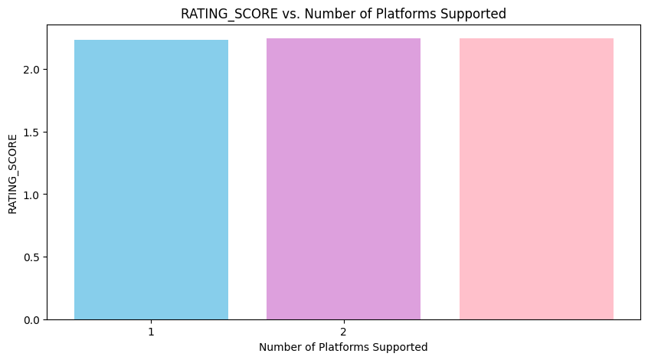
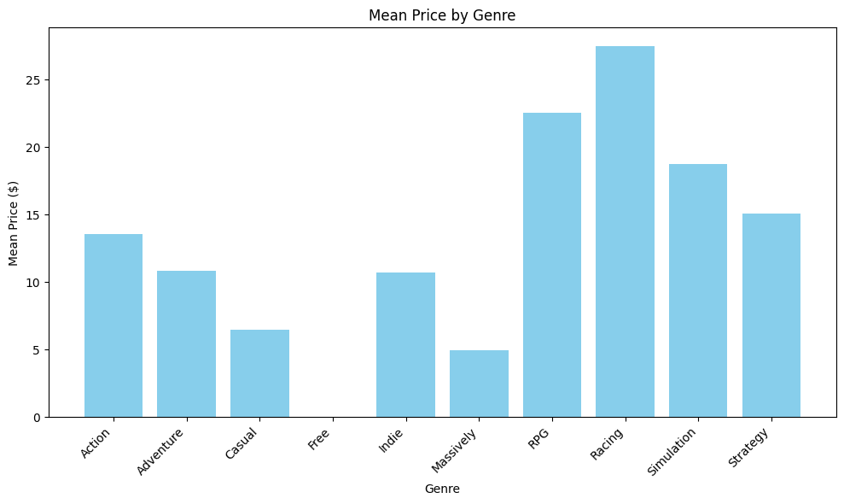

Slide 16
Summary:
- Successfully cleaned and transformed the data.
- Standardized all features for analysis.
- Prepared the data for further exploratory analysis and modeling.

Slide 17
Next Steps:
Further Exploration of the Data
"EDA is like peeling an onion; there's always another layer to uncover"
Feature Engineering and Selection
Model Training and Evaluation
Train various models and evaluate their performance.

Slide 18
Thank You!

