Slide 1
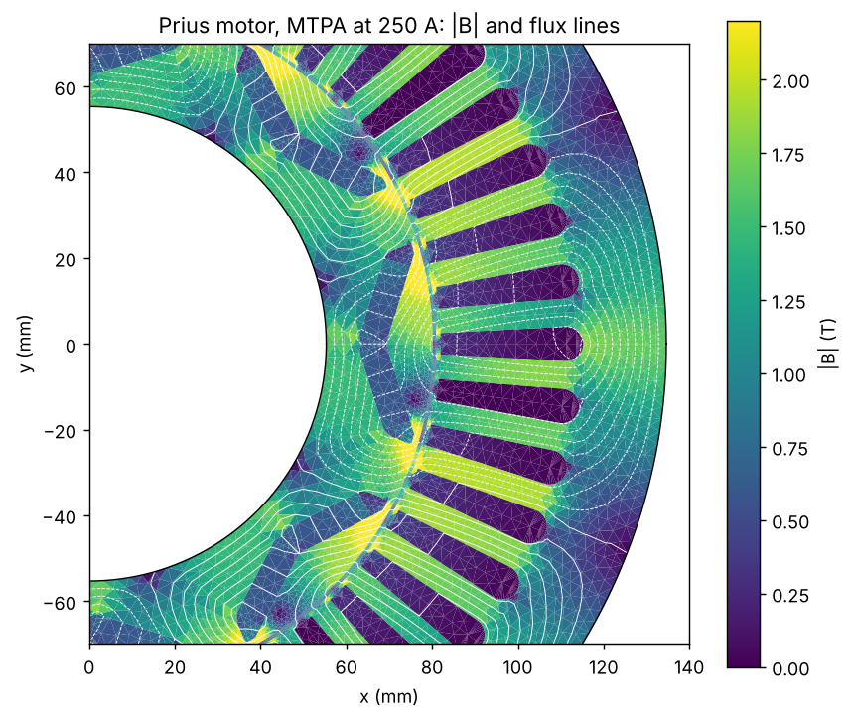
2004 Toyota Prius traction motor: verified FEA to drive, thermal and design
Open-source chain in PINNeAPPle (pinneapple_simulation.electromagnetics.machines):
2-D nonlinear FEA -> second-code cross-check -> drive (MTPA, flux weakening, WLTC) -> end effects -> thermal and demagnetisation -> skew and tolerances -> FEA + GP + NSGA-II design -> exchange formats
Every number in these slides is a measured output of examples 10 to 17 (results/*.json), regenerated by this script.
Geometry and materials: pyleecan's Toyota_Prius.json (48 slots, 8 poles, V magnets, M400-50A).
Limits: a model study from public data; no test-bench measurement of this motor was available.

Slide 2
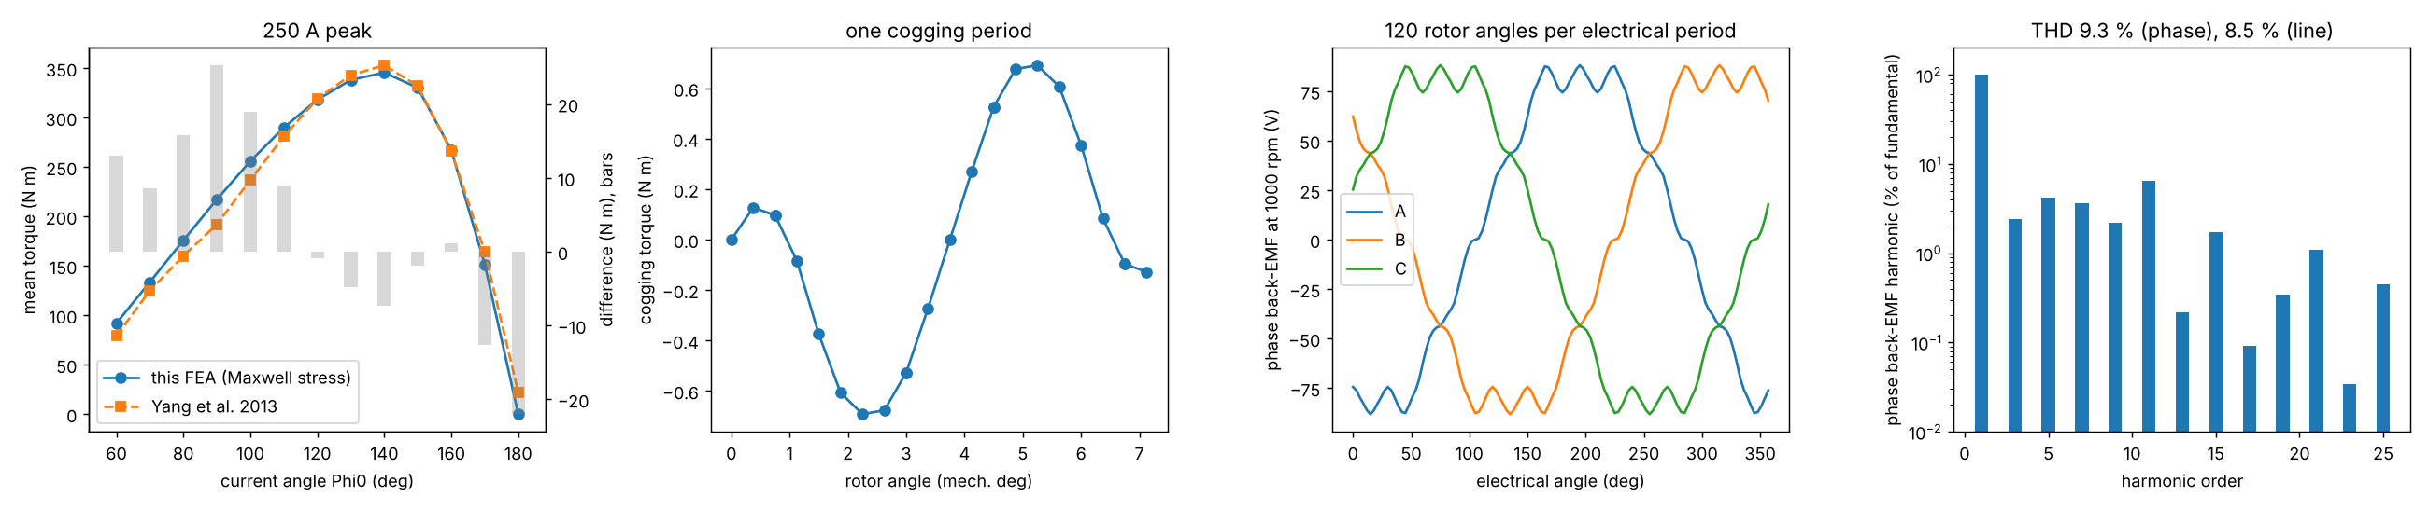
2-D FEA, verified
Nonlinear A_z FEM, conforming mirrored meshes, Arkkio torque: 29936 elements.
Verification cases against closed forms: 6 of 6 pass (magnetised ring: second order, as P1 should).
Torque vs current angle at 250 A against Yang et al. 2013: peak 345.6 vs 353 N m, rms difference 13.3 N m (their model and the pyleecan geometry differ: centre post, steel data).
Cogging 1.38 N m pk-pk; back-EMF fundamental 87.6 V peak at 1000 rpm.
Limits: 2-D only; P1 elements; iron loss from B waveforms without minor loops.

Slide 3
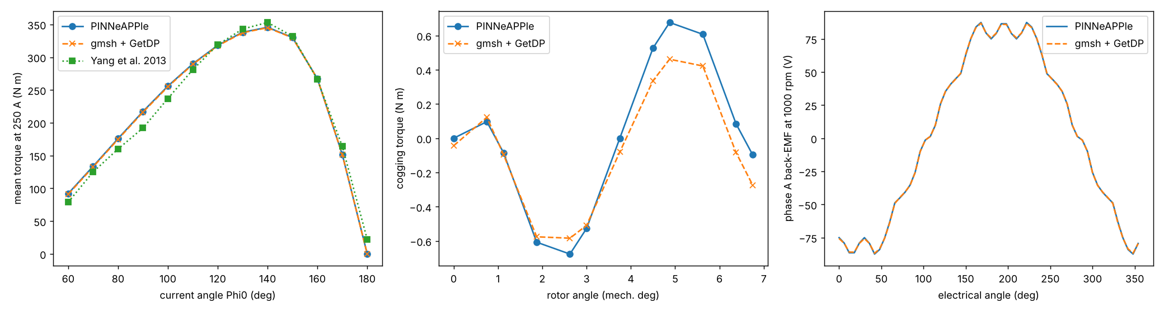
Second code: gmsh + GetDP
Same geometry and materials, GetDP's own mesh, Newton solver and torque: torque vs angle within 1.09 N m.
Back-EMF fundamental 87.60 vs 87.64 V; L_d 1.370 vs 1.385 mH; L_q 1.856 vs 1.864 mH.
Cogging does not agree: 1.34 vs 1.00 N m at 1920 gap nodes, both converged; with linear iron 1.223 vs 1.211 N m -> the difference is in the saturated bridges.
Limits: cogging uncertain by about 25 % between two codes; FEMM, pyleecan, Elmer not run (inputs written).

Slide 4
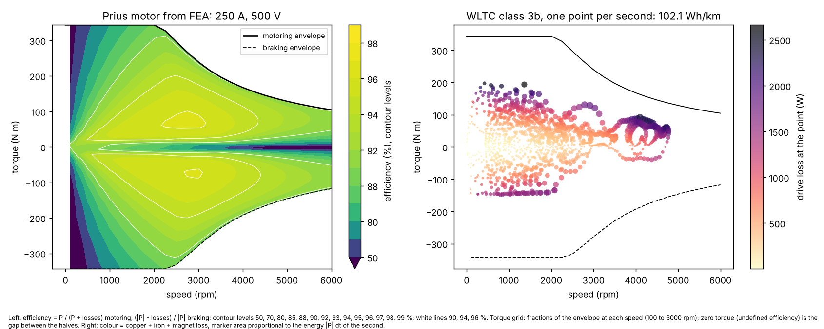
Drive: MTPA, flux weakening, WLTC
FEA flux map (saturation, cross-saturation), 250 A, 500 V DC with SVPWM: 343.6 N m at low speed, 104.4 N m at 6000 rpm, 77.7 kW peak.
Peak efficiency 96.2 % at 2750 rpm, 70.7 N m (copper + iron + magnet loss).
WLTC class 3b, illustrative compact car: 102.1 Wh/km at the battery (drive losses only).
Optimiser checked against the closed forms of a linear machine (1e-14) and energy bookkeeping.
Limits: steady state; no inverter, mechanical or battery losses; the car is not a measured Prius.

Slide 5
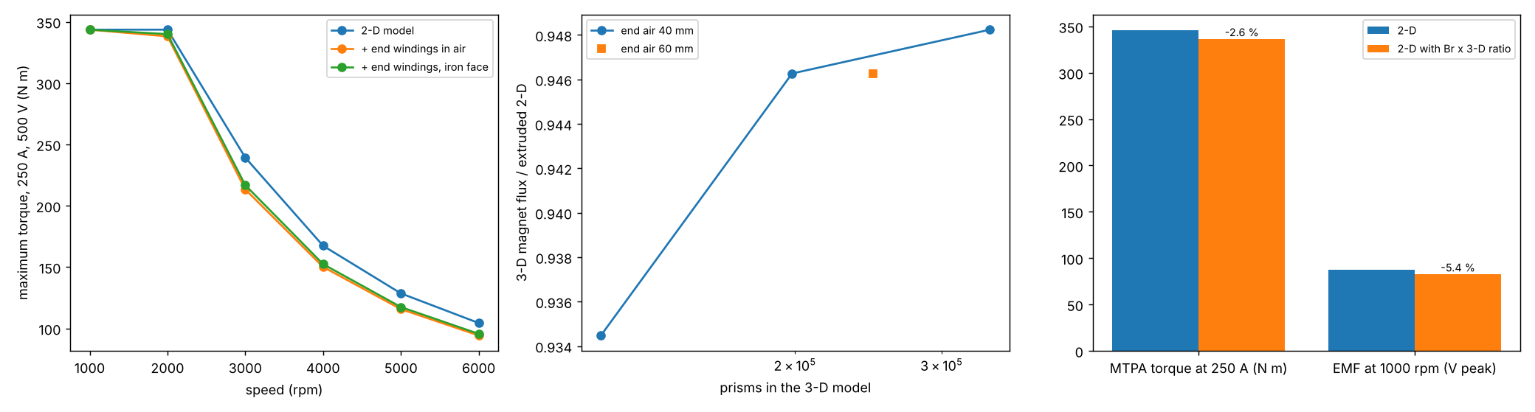
End effects
End windings (Neumann, thin filaments, verified against Rosa and Maxwell): L_end 135.2 uH in air, 115.3 uH with the iron face.
Effect on the envelope at 3000 rpm: 239.3 -> 213.3 N m.
Magnet end leakage, 3-D GetDP model of half the stack: flux ratio 0.9345 -> 0.9463 -> 0.9482 on three meshes.
Corrected 2-D model: MTPA torque -2.6 %, back-EMF -5.4 %.
Limits: corrections, not a coupled 3-D solution at load; no measured end-winding inductance to compare.

Slide 6
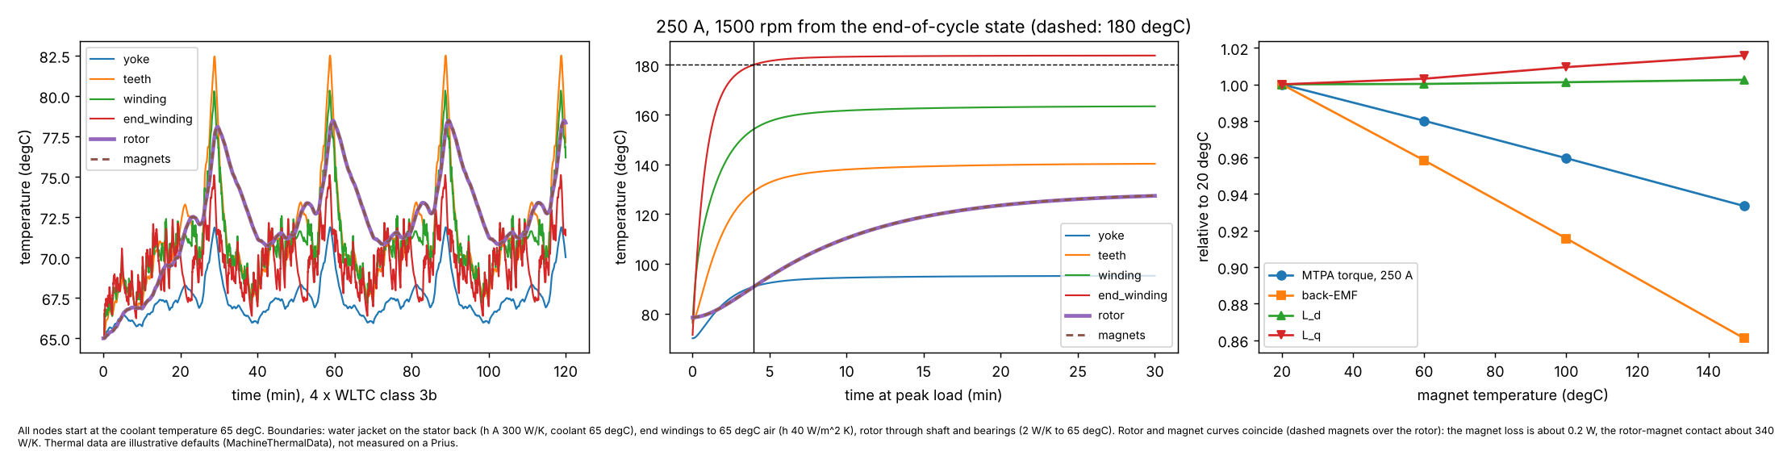
Magnet temperature and thermal network
Magnets 20 -> 150 degC (Br -0.1 %/K): torque at 250 A 345.6 -> 322.6 N m, back-EMF 87.6 -> 75.4 V.
4 x WLTC from the drive losses: teeth 82.5, winding 80.3, magnets 78.5 degC.
Peak load from that state: hotter winding node at 180 degC after 237 s; magnets settle at 127 degC.
Limits: seven-node network with illustrative thermal data (not fitted to a Prius); one temperature per node.

Slide 7
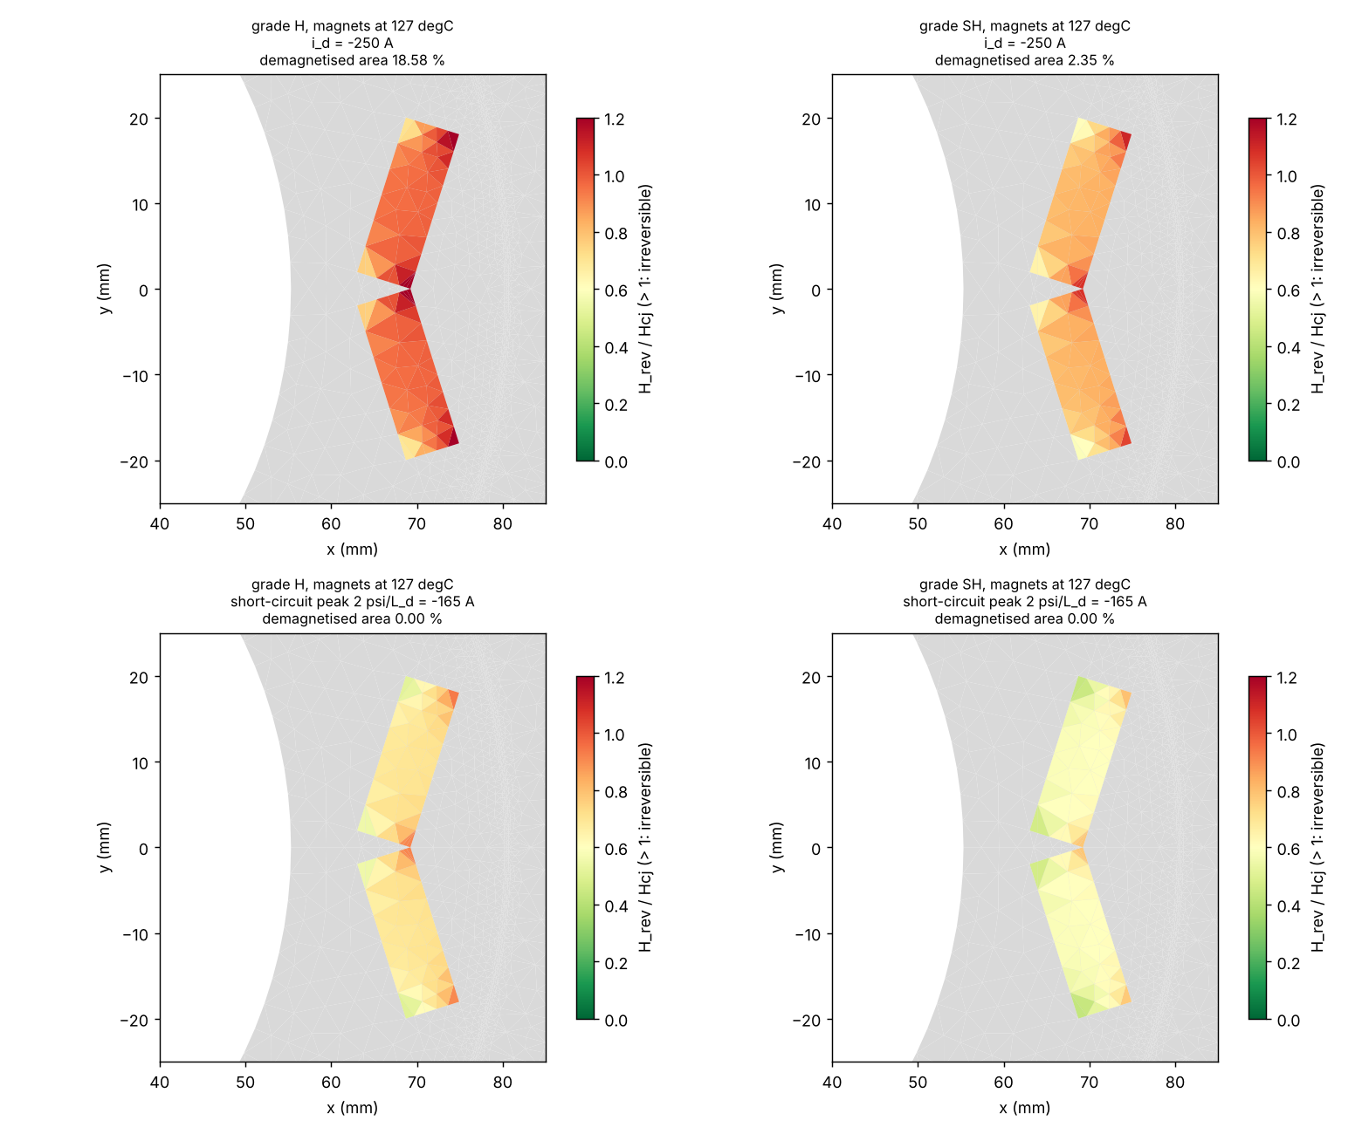
Demagnetisation
Reverse field per magnet element against Hcj(T) of the grade letters, magnets at 127 degC.
Full d-axis current (-250 A): demagnetised area N 99.4 %, M 93.3 %, H 18.6 %, SH 2.4 %, UH 0.0 %.
Short-circuit estimate: N 31.8 %, M 3.2 %, H 0.0 %, SH 0.0 %, UH 0.0 %.
Mesh study inside the magnets (4 levels): grade H at -250 A 18.6 to 19.4 % -> area fractions converge; the worst element does not (sharp corners).
Limits: Hcj coefficient assumed (-0.55 %/K); static knee test; the Prius magnet grade was not found in accessible public sources, so the rows compare candidate grades.

Slide 8
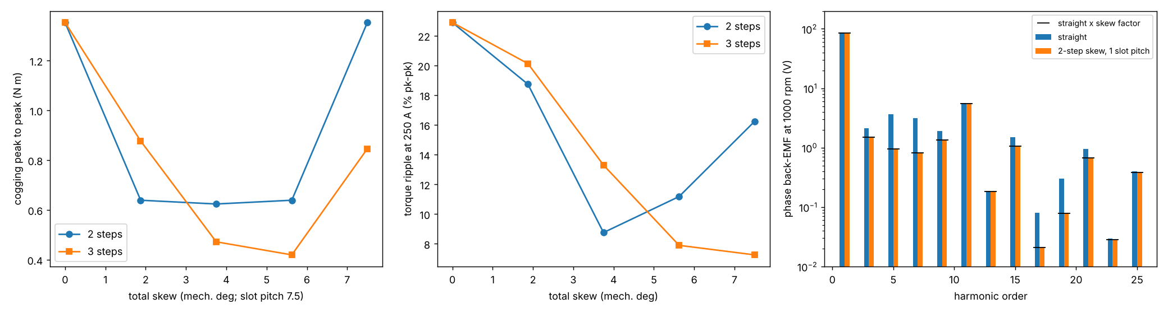
Step skew
Multi-slice FEA. Straight rotor: cogging 1.35 N m, ripple 22.9 %, torque 345.6 N m.
2 steps over 3.75 deg: cogging 0.62 N m, ripple 8.8 %, torque 338.8 N m.
3 steps over 5.625 deg: cogging 0.42 N m, ripple 7.9 %, torque 335.3 N m.
Back-EMF fundamental x0.96593 vs closed-form skew factor 0.96593; THD 9.3 -> 7.2 %.
Limits: multi-slice: no inter-segment axial flux, no end effects.

Slide 9
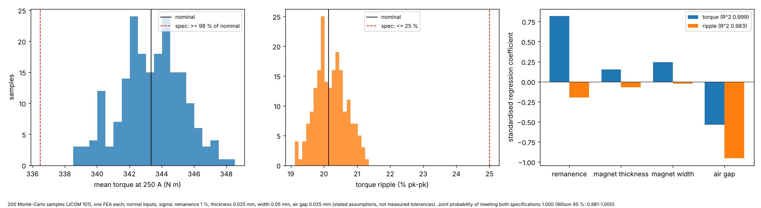
Manufacturing tolerances
200 Monte-Carlo samples (JCGM 101), one nonlinear FEA each: remanence, magnet thickness and width, air gap.
Torque 343.3 +- 1.96 N m; ripple 20.2 +- 0.47 %.
Largest effects: remanence on torque (SRC 0.82), air gap on ripple (SRC -0.95); linear fits R^2 0.999 / 0.983.
Yield against the stated specification 1.000 (Wilson 95 %: 0.981 to 1.000).
Limits: the tolerance sigmas are assumptions, not measured spreads.

Slide 10
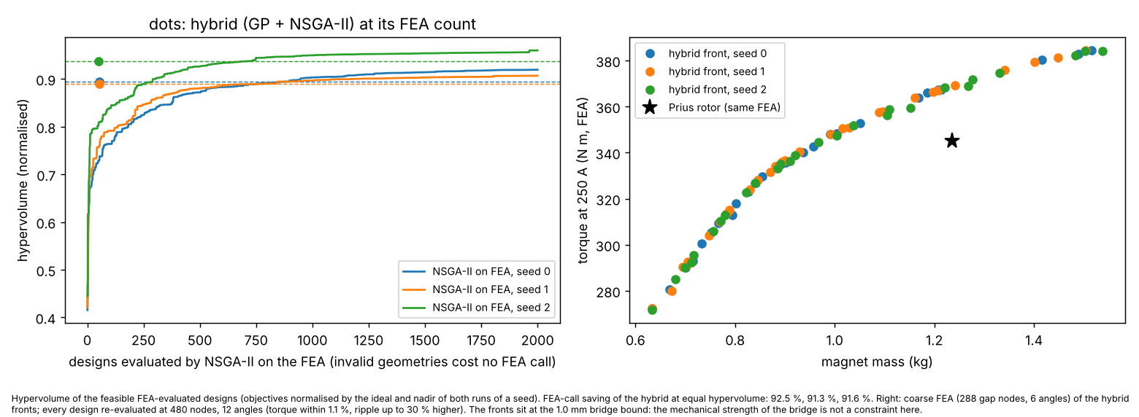
Rotor design: FEA + Gaussian process + NSGA-II
Five rotor variables, maximise torque, minimise magnet mass, ripple <= 30 %; every front design re-evaluated by a finer FEA.
FEA calls to equal hypervolume, hybrid vs NSGA-II on the FEA: seed 0: 53 vs 711 (92.5 % saved); seed 1: 52 vs 601 (91.3 % saved); seed 2: 51 vs 605 (91.6 % saved).
Finer FEA: all front designs feasible, torque within 1.1 %, ripple up to 30 % higher (6 angles under-sample it).
Designs beating the Prius rotor sit at the 1.0 mm bridge bound.
Limits: no bridge stress, demagnetisation or speed constraints: shows the method and the FEA-call saving, not a better rotor.

Slide 11
Exchange formats and limits
In: pyleecan machine files (the real Toyota_Prius.json reads to exactly the model). Out: pyleecan JSON, FEMM Lua, Elmer case, gmsh/GetDP, MATLAB .mat, DXF, VTK, CSV/Parquet/HDF5 data contracts.
What is verified: closed forms (FEM, filaments, thermal, skew factor, drive), a second FEA code, a published torque curve.
Not verified: any measurement of this motor; FEMM/pyleecan/Elmer runs; cogging to better than about 25 %; thermal data; magnet grade.
Next: test-bench data (torque, EMF, temperatures) to calibrate thermal and loss models; a 3-D coupled end-region solution at load; bridge stress as a design constraint.
Limits: see the Limits section of docs/guides/electromagnetics.md.

