Slide 1

Business Buccaneers MIS 4173 Capstone Project
Paige Lowery – Project Manager
William Kozel – Systems Analyst
Johann Quintero – Business Analyst
Jack Fentzke - Programming Coordinator

Slide 2
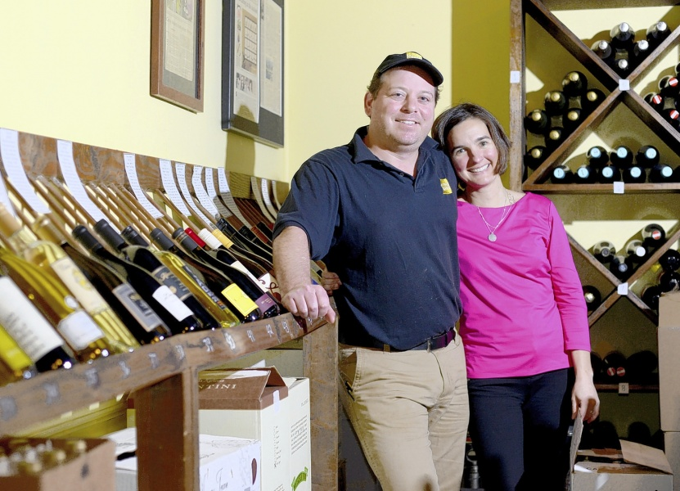
History and Background
Located in historical downtown Tarboro, NC
Owned by Inez and Stephen Ribustillo
Fine dining and wine shop
Seasonal and sustainable, local ingredients
Open for lunch and dinner
Catering services

Slide 3
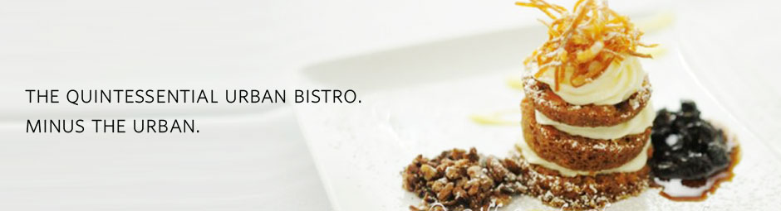
Current Environment
No customer loyalty program
Outdated system for updating customers on promotions
Email subscription program
Calling locals about promotions

Slide 4

Loyalty Program
Patrons of the restaurant sign up to enroll in Loyalty Program.
Each transaction allows customer to earn points.
Points can be redeemed for glasses/bottles of wine.
The owner will be able to generate reports.

Slide 5
Functional Requirements
The system must run on C# and Access (Software our team is comfortable working in)
The system must have the ability to store local data
The system must be able to take user credentials to avoid fraudulent entries
The system must be able to produce reports for benefit of the managers
The system must be able to recognize incomplete entries and prompt for completion
The system must run on Windows 7 or higher
The system must allow users to edit records and add new users

Slide 6
Non-functional Requirements
The system shall run on Chrome, Firefox, Safari and Internet Explorer
The system shall be able to run on iOS 8 or later
The system shall be able to run on Android KitKat or later
The system shall be available at 99.9% uptime
The system shall be able to download full database backups daily

Slide 7
Specifications
Reliability | High user testing to ensure uptime during heavy business hours
Serviceability | Needs to be easily worked on so that the user can correct errors
Scalable | Must be able to accept large number of menu items, guests, and reward items
Usable | System shall be easily understood by staff with little knowledge of CRMs
Secure | System shall be able to easily perform backups of data
Modern | System shall be able to run on current PC hardware

Slide 8
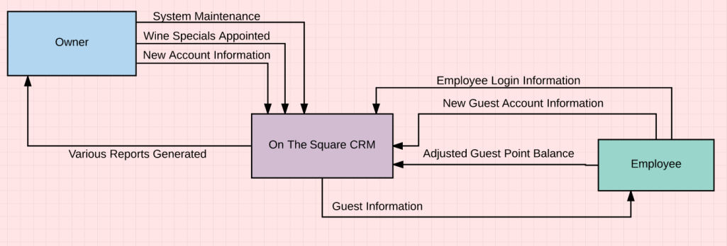
Context Diagram

Slide 9
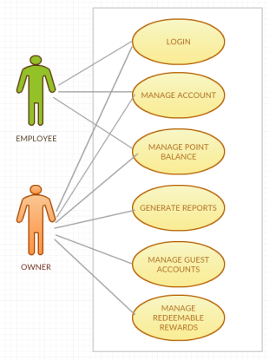
Use Case Diagram

Slide 10
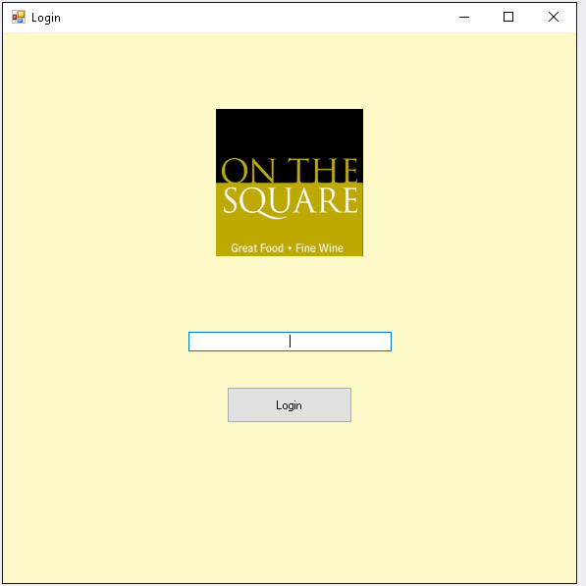
Staff Login

Slide 11
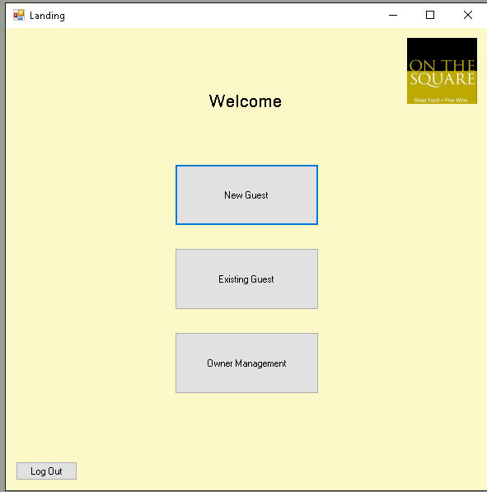
Staff Menu

Slide 12
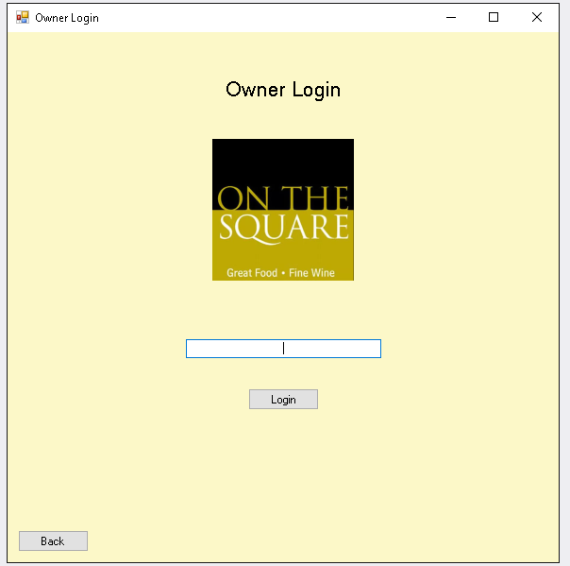
Owner Login
All employees will login with a universal PIN number.
Owners will have a special button that will take them to the owner menu.
Owners will have more access.

Slide 13
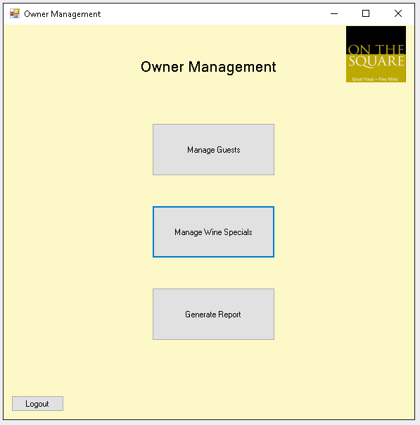
Owner Menu

Slide 14
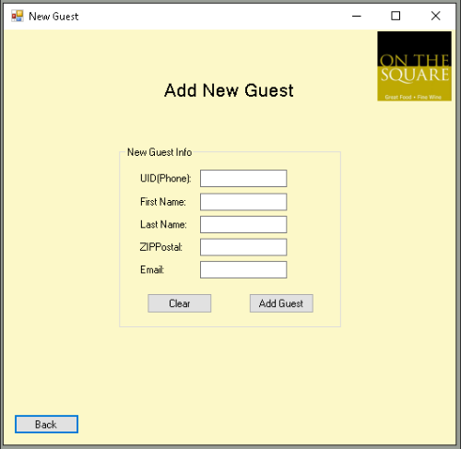
Manage Guests
The owner will be able to:
Add new guests
Modify existing guests’ information
Delete existing guests

Slide 15
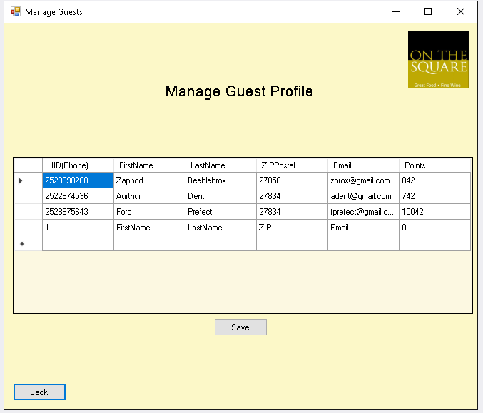
Manage Guests
The owner will be able to:
Add new guests
Modify existing guests’ information
Delete existing guests

Slide 16
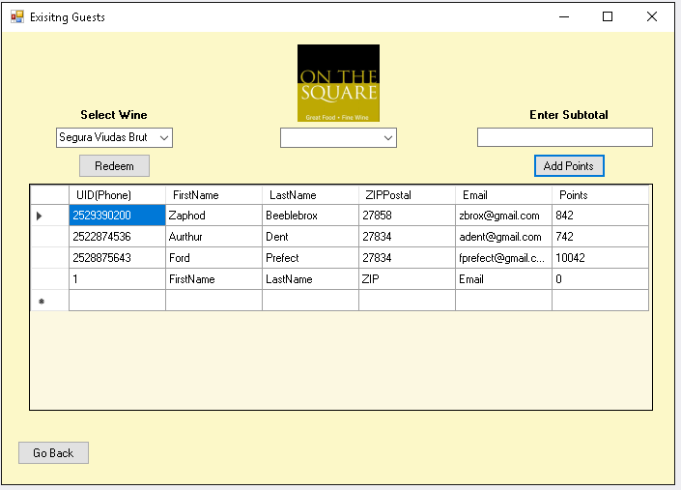
Adding Points
The owner will have the ability to add points 2 ways:
Adding by subtotal
Manually adding

Slide 17
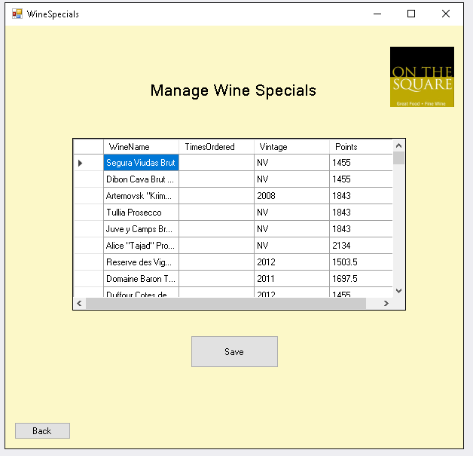
Manage Wine Specials
The owner will be able to:
Add glasses/bottles of wine to rewards
Modify existing rewards options
Delete rewards options
Change point values of glasses/bottles of wine

Slide 18
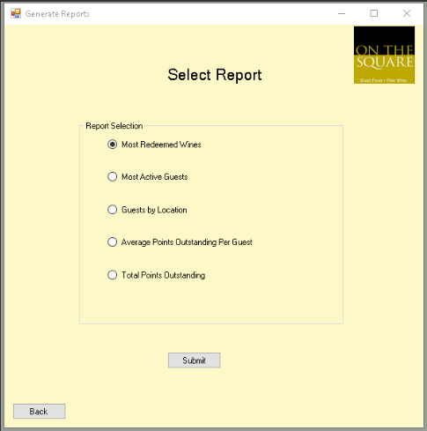
Generate Reports
The owner will have access to reports about the program.
Allows the restaurant to understand which wines are being redeemed and how many customers are enrolled in the program.

Slide 19
Project Assessment
Accomplishments:
Virtual collaboration
Submitting each milestone by the deadline
Challenges:
Online project and team
Outdated system at the company
Major Changes in the system
Timeline

Slide 20
Questions and Feedback?

