Slide 1

DB Coding Challenge 2023
Group 2 - Team 7
Ruslan Salkaev, Chao Fan, Alexandru Hrenciuc , Vlad Coada

Slide 2
List of Features
See all the bonds active in the system
View bonds due for maturity within +/- 5 days
See important details of the bonds (ISIN, CUSIP, Issuer, Maturity Date)
Expand on row to reveal more details
View books based on logged-in account
Authentication system
Alerts for maturing and post-mature active bonds
See list of clients and trade records, along with holding positions
Option to redeem bonds and change bond status

Slide 3
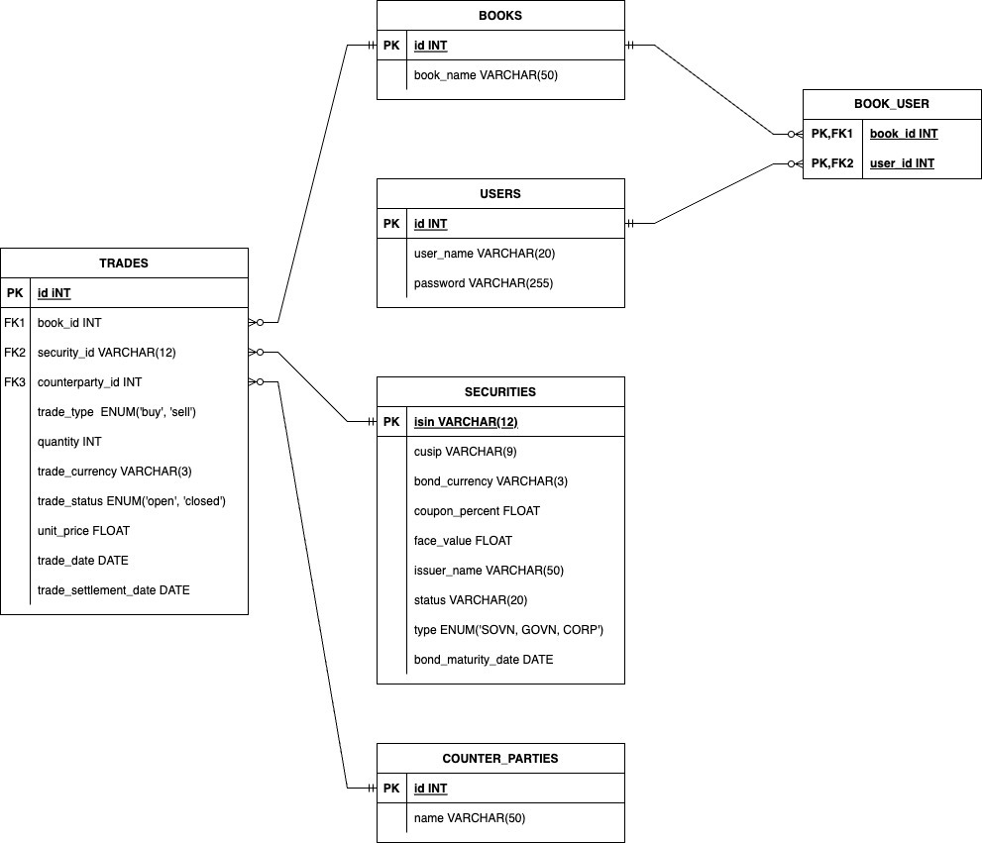

Slide 4
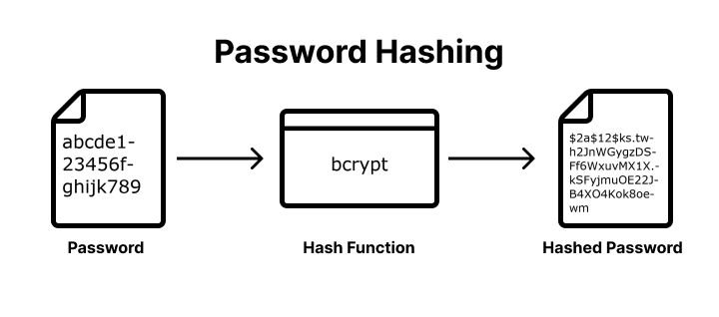

Authenticator
Hash code
JWT spring security

Slide 5
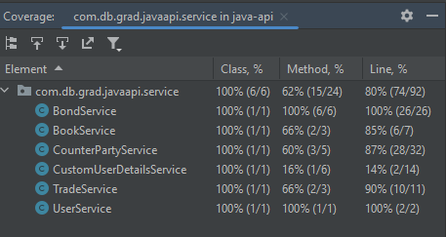
Test coverage

Slide 6
DEMO

Slide 7
Future implementationss
INSERT BONDS, TRADES RECORDS
IMPROVE LOGIN MECHANISM
IMPROVE USER INTERFACE
SEE ALL THE REDEEMED BONDS
ALERT MECANISM FOR EXPIRING BONDS(EMAIL, POP-UP)

Slide 8
challenges AS A TEAM
DIFFERENT PERSPECTIVE AND LOGIC
GIT WORKFLOW
NEW TECHNOLOGY
FIXING BUGS

Slide 9
Q&a

Slide 10
Thank You!

