Slide 1
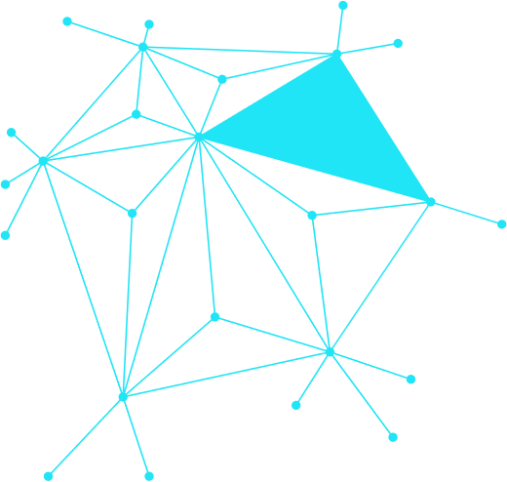
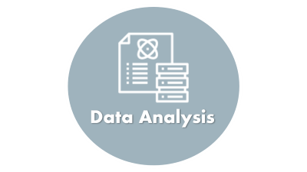
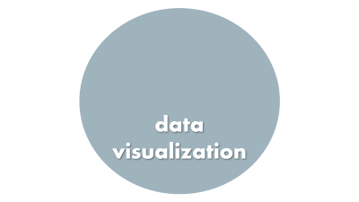
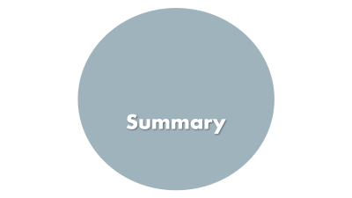
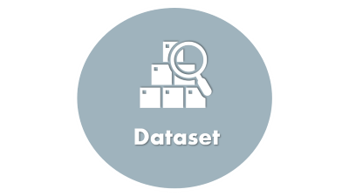
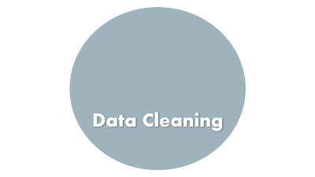
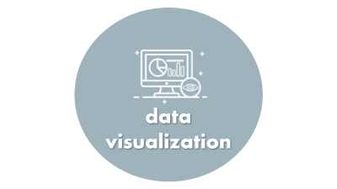

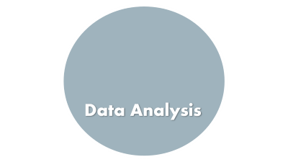
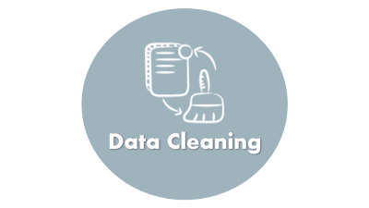
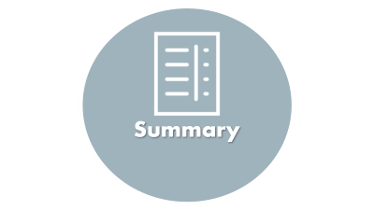
How Phone and Social Media
Use Affects Mental Health
Fatima Al-Amri & Ashgan Al Shamali

Slide 2

Introduction

Slide 3


Introduction
The rise of smartphones and social media has transformed how people live and connect.
However, growing screen time has raised concerns about its effect on mental health.
Studies suggest links between excessive digital use and issues like stress, poor sleep, and anxiety.
Understanding these patterns is essential for promoting healthier digital habits.
This project explores how screen and social media usage impact well-being using real data.

Slide 4

Dataset

Slide 5
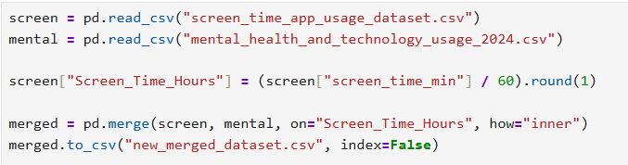

Dataset
Two datasets were obtained for this study: ▫ Mental Health & Technology Usage 2024 ▫ Screen Time & App Usage Data
The mental health dataset includes stress levels, sleep, and tech habits.
The screen time dataset tracks daily app usage across categories.
Both datasets were merged using screen time as a common key.
This integration provided a complete view of users' digital behavior and mental health.

Slide 6

Data Cleaning

Slide 7

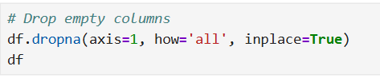
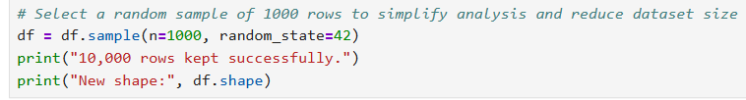

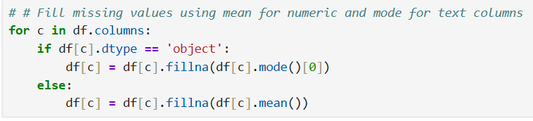
Data Cleaning
Removed irrelevant and duplicate columns from both datasets.
Converted screen time from minutes to hours for consistency.
Merged datasets using Screen_Time_Hours as a common field.
Handled missing values and ensured data types were consistent.
Engineered new features such as:
▫ Heavy User Indicator (≥ 120 mins/day)
▫ Digital Well-Being Index = (Sleep – Social Media) / (Stress + 1)

Slide 8

Data Analysis

Slide 9
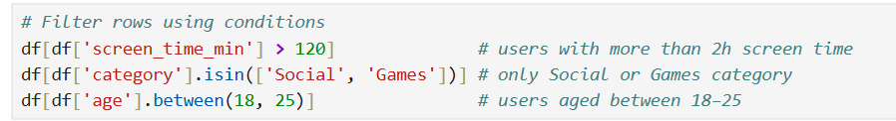
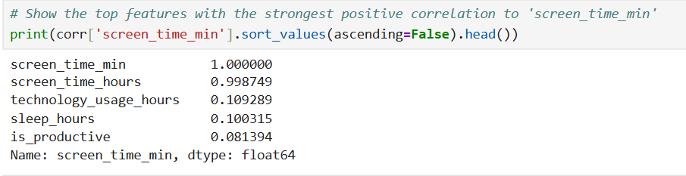
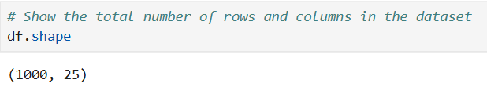
Data Analysis
Explored the structure and content of the dataset.
Reviewed data types, column names, and basic statistics.
Checked for missing values and inconsistencies.
Identified key variables related to screen time and mental health.
Prepared the data for deeper insights and visualization.

Slide 10

data visualization

Slide 11
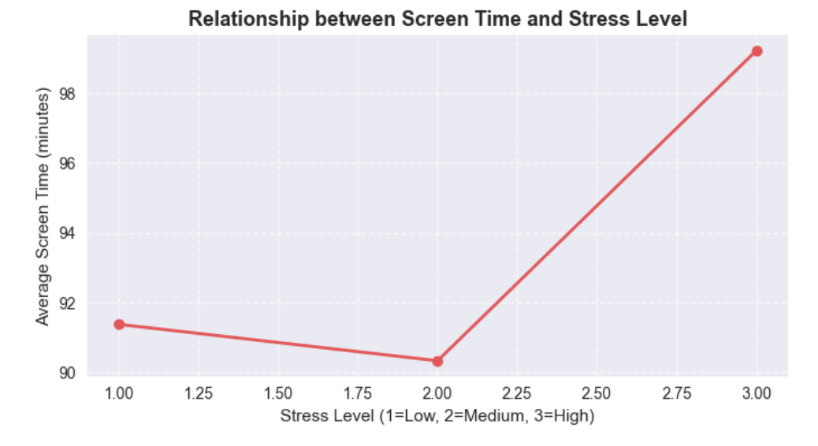
Data visualization
The higher the stress level, the higher the time to use the screen.
This may indicate that people with high stress tend to spend more time in front of screens, perhaps as a means of entertainment or escape from stress.

Slide 12
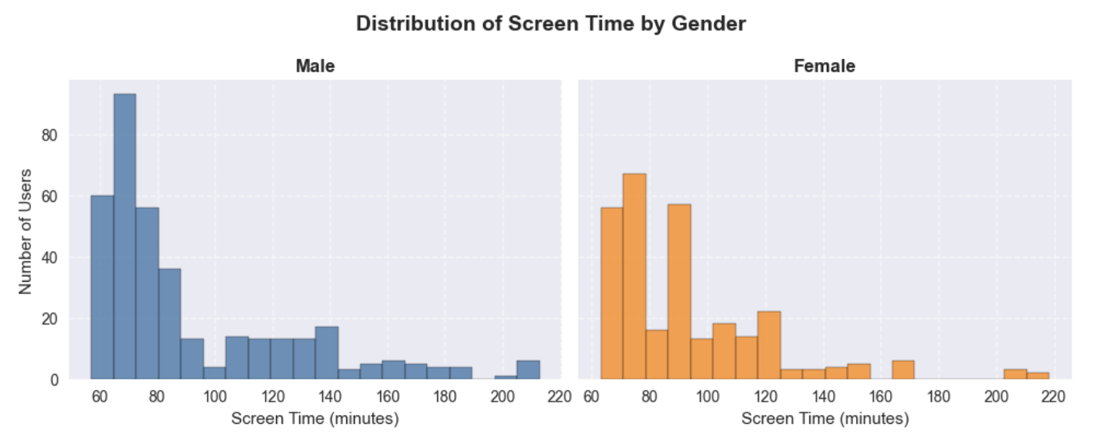
Data visualization
Distribution shows that most users spend moderate time in front of screens, but males tend to use the screen for slightly longer periods compared to females.This may be related to different use activities between the sexes, such as games or entertainment versus social or educational applications.

Slide 13
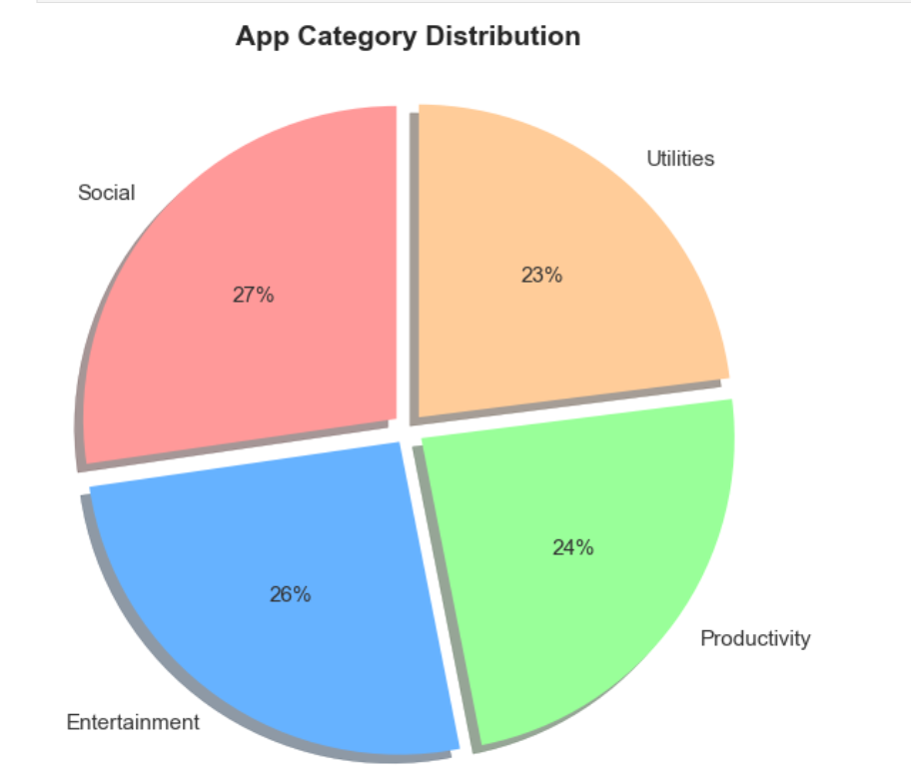
Data visualization
Balance: The distribution is largely balanced, with all percentages ranging from 23% to 27%. This suggests that the application market (in this data) is diverse and does not depend on a single type.
Equal attention: There seems to be a close demand from users for social media applications, entertainment, productivity and assistance.

Slide 14
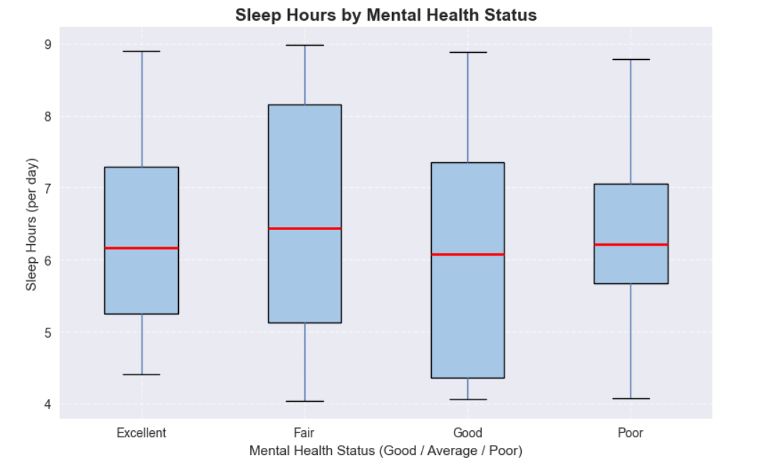
Data visualization
There is a clear positive relationship between sleep hours and mental health status.
People with better mental health tend to sleep more and more consistently.
Those reporting poor mental health sleep fewer hours on average.
Promoting healthy sleep habits may help improve mental resilience.

Slide 15
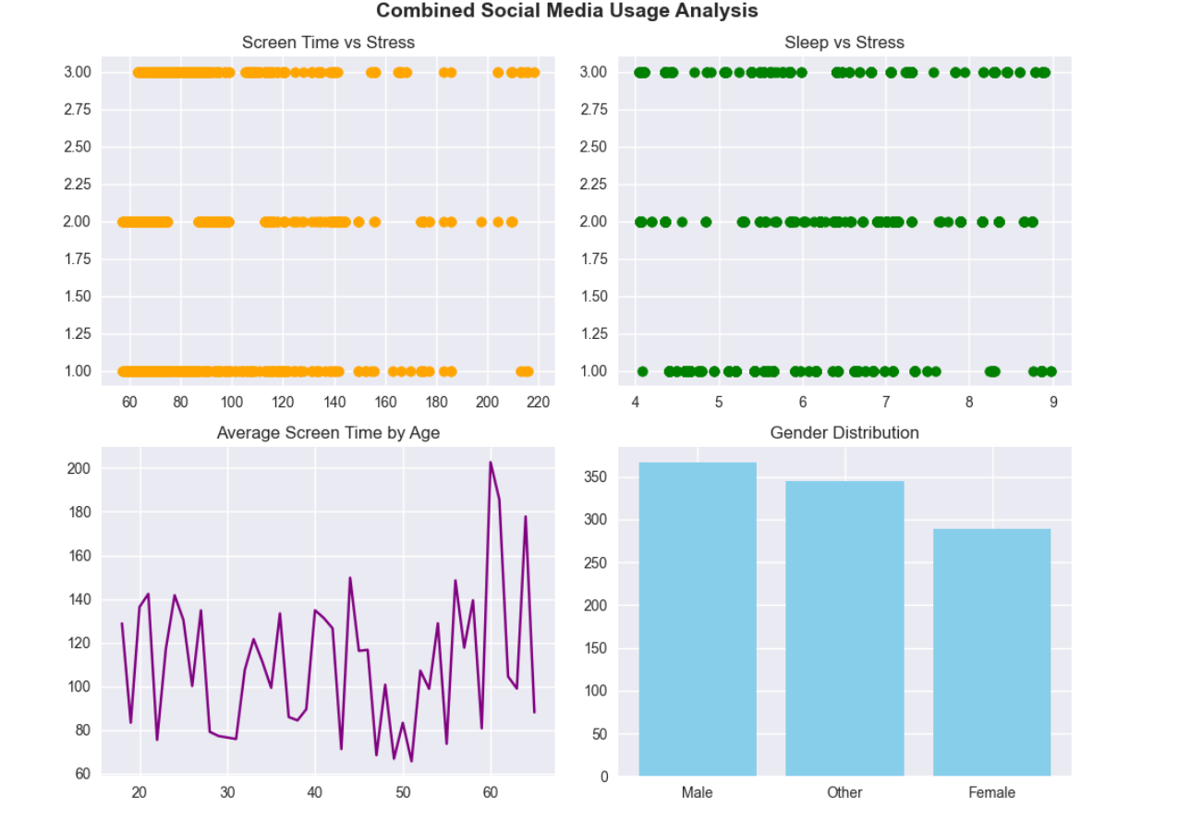
Data visualization
Screen Time & Stress: More screen time is linked to higher stress levels.
Sleep & Stress: Unexpectedly, more sleep sometimes appears with higher stress—may need deeper analysis.
Age & Screen Time: Usage varies by age, with spikes in older groups—no clear trend.
Gender Distribution: Most users are male, followed by "Other" and then female—gender may influence results.

Slide 16

Summary

Slide 17

Summary
Potential Benefits & Applications:
The analysis of screen time and mental health data using Python reveals how digital behavior impacts well-being.
By applying thoughtful data analysis, we uncovered meaningful patterns linking screen use to stress, sleep, and mental health.
These insights highlight the importance of balanced digital habits and can guide healthier lifestyle choices, informed awareness, and more supportive digital environments.

Slide 18

Summary
Benefits of These Insights:
Help people understand how screen and social media habits affect their stress and sleep.
Encourage healthier daily routines, like reducing screen time before bed.
Support better decisions in education, health, and digital policy planning.

