Slide 1
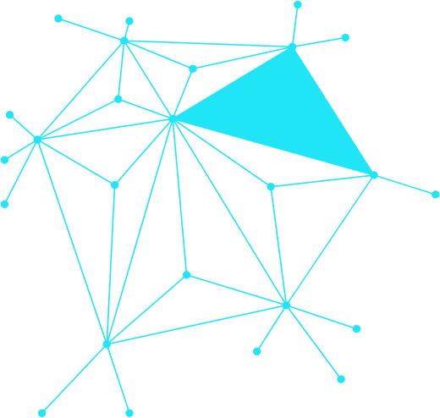
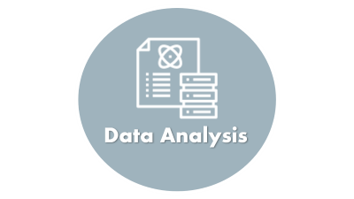
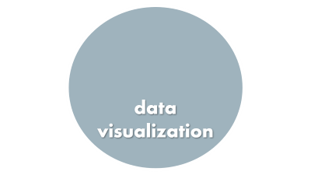
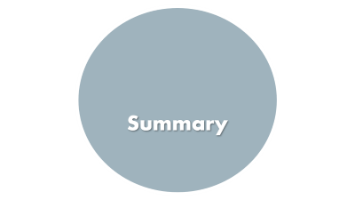
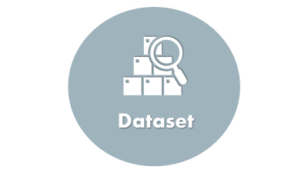
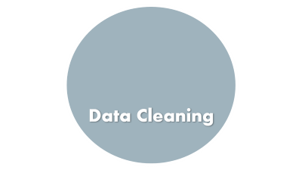
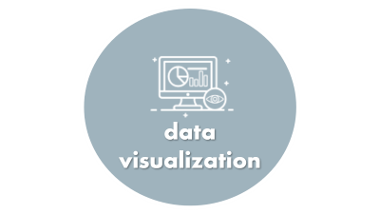

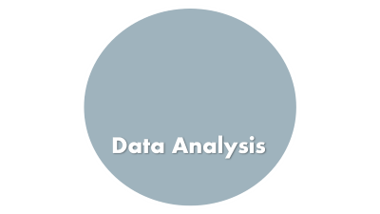
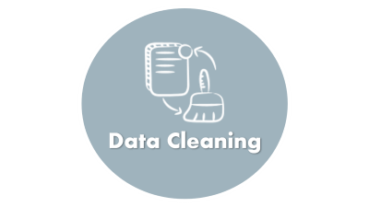
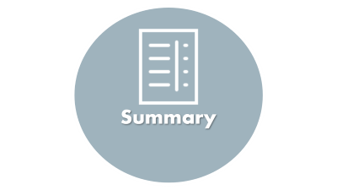
The Impact of Screen Time and
Technology Use on Mental Health
Fatima Al-Amri & Ashgan Al Shamali

Slide 2

Introduction

Slide 3


Introduction
The rise of smartphones and social media has transformed how people live and connect.
However, growing screen time has raised concerns about its effect on mental health.
Studies suggest links between excessive digital use and issues like stress, poor sleep, and anxiety.
Understanding these patterns is essential for promoting healthier digital habits.
This project explores how screen and social media usage impact well-being using real data.

Slide 4

Dataset

Slide 5
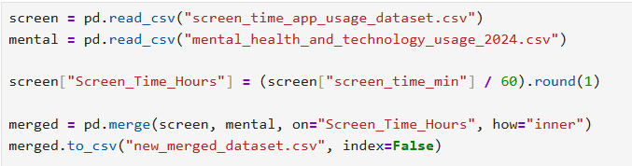

Dataset
Two datasets were obtained for this study:
▫ Mental Health & Technology Usage 2024
▫ Screen Time & App Usage Data
The mental health dataset includes stress levels, sleep, and tech habits.
The screen time dataset tracks daily app usage across categories.
Both datasets were merged using screen time as a common key.
This integration provided a complete view of users' digital behavior and mental health.

Slide 6
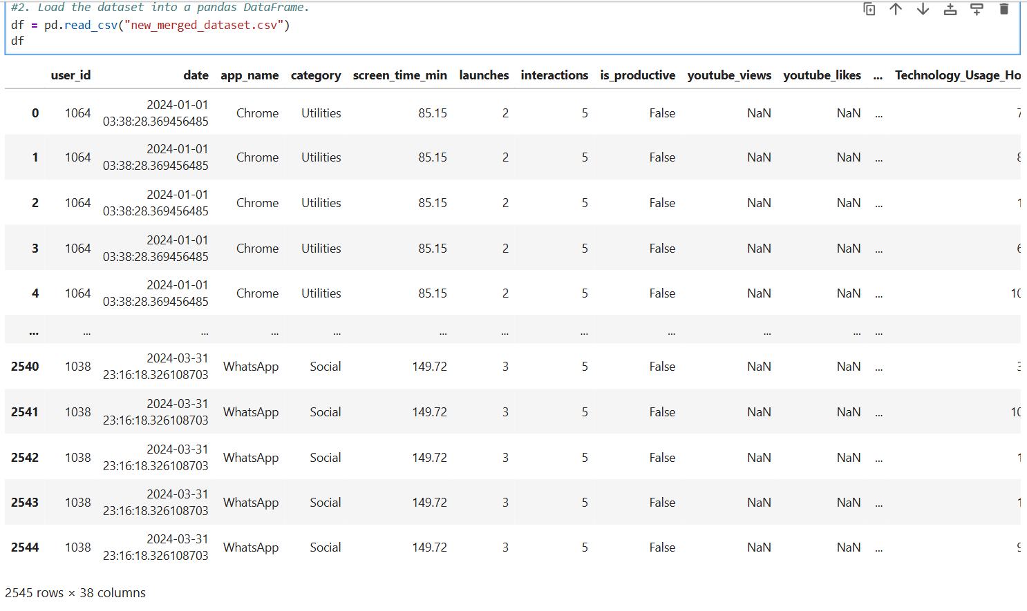

Dataset
The merged dataset contains 2,545 rows and 38 columns

Slide 7
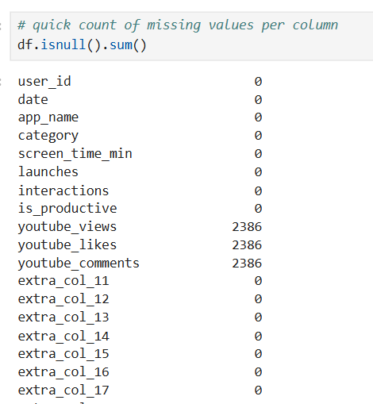
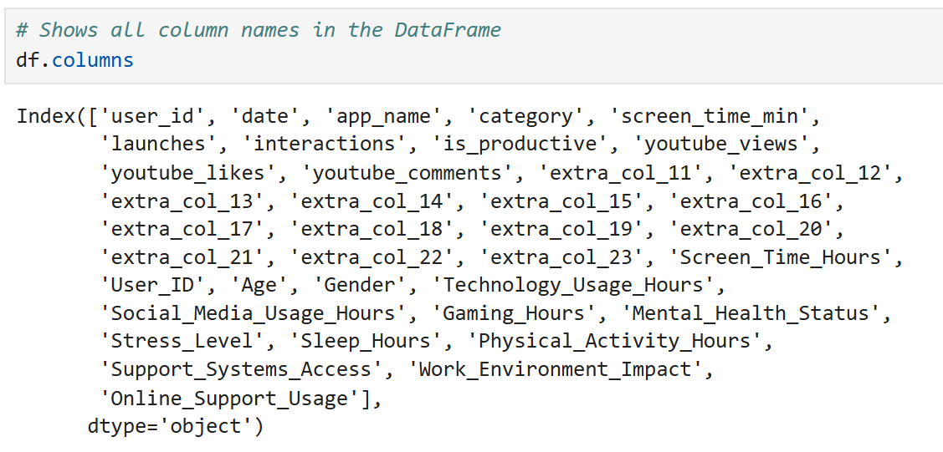
Dataset
We found that after merging, the dataset contains (38 columns), and their names are shown below.
The check for missing values shows that most columns are complete, but three columns youtube views, youtube likes, and youtube comments each have 2,386 missing values.

Slide 8

Data Cleaning

Slide 9

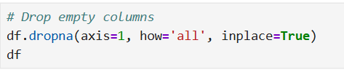
Data Cleaning
Removed irrelevant and duplicate columns from both datasets.
Converted screen time from minutes to hours for consistency.
Merged datasets using Screen_Time_Hours as a common field.
Handled missing values and ensured data types were consistent.
Engineered new features such as:
▫ Heavy User Indicator (≥ 120 mins/day)
▫ Digital Well-Being Index = (Sleep – Social Media) / (Stress + 1)

Slide 10
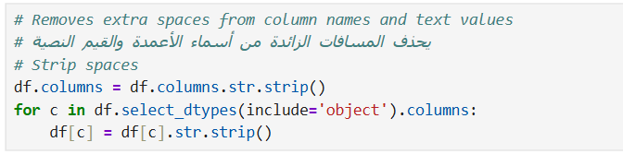
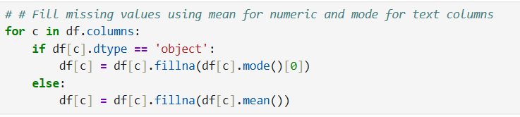
Data Cleaning
Removes extra spaces from column names and text values.
Fill missing values using mean for numeric and mode for text columns.

Slide 11
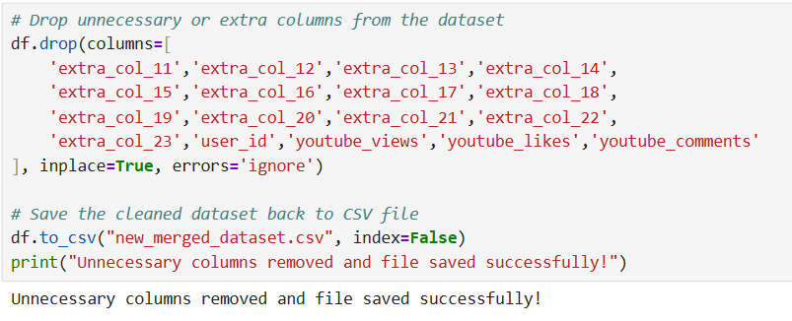

Data Cleaning
After data cleaning the dataset has 2,545 rows and 20 columns
Drop unnecessary or extra columns from the dataset

Slide 12
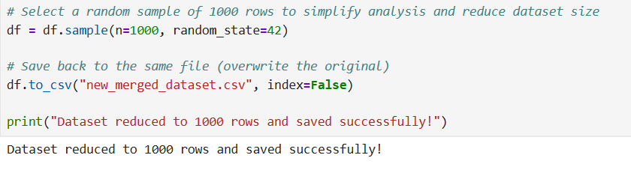
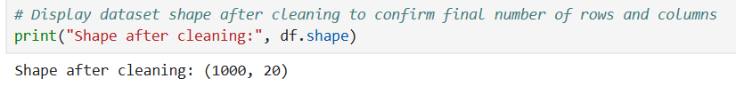
Data Cleaning
Shape after cleaning: (1000, 20)
Select a random sample of 1000 rows to simplify analysis and reduce dataset size.

Slide 13

Data Analysis

Slide 14
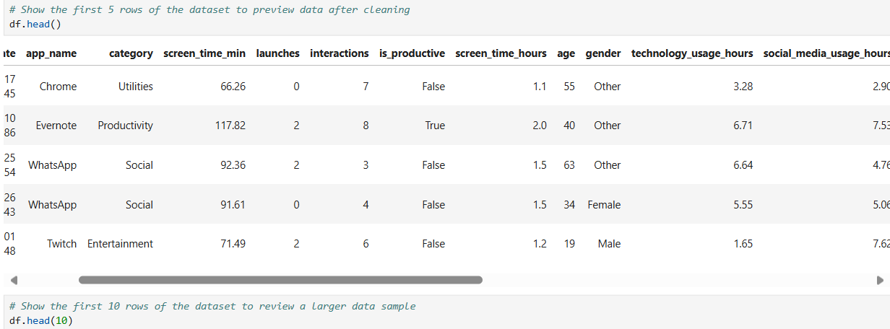
Data Analysis
Explored the structure and content of the dataset.
Reviewed data types, column names, and basic statistics.
Checked for missing values and inconsistencies.
Identified key variables related to screen time and mental health.
Prepared the data for deeper insights and visualization.
Show the first 5 rows of the dataset to preview data after cleaning.

Slide 15
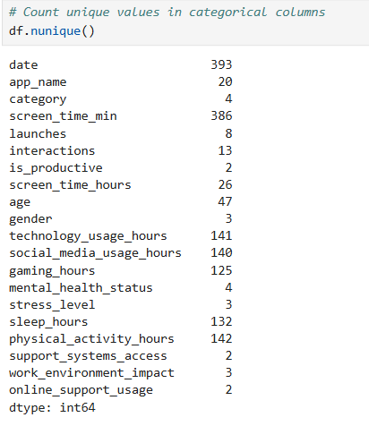
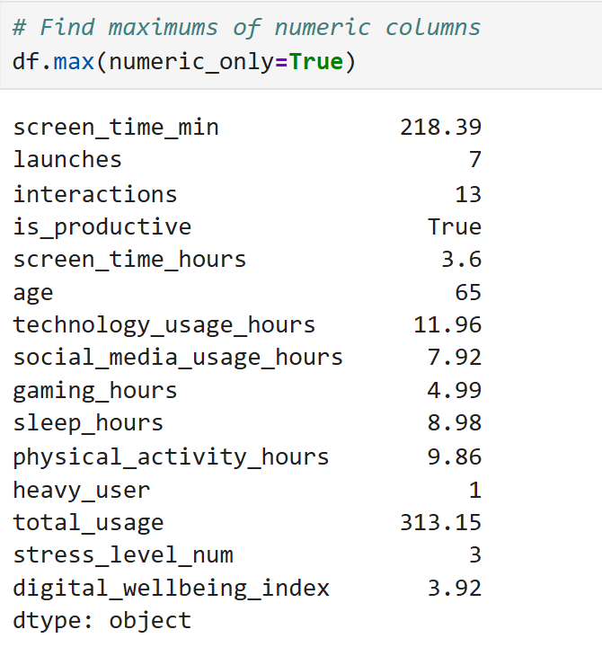
Data Analysis
maximums, numeric columns.
- One column shows True, which means it is a Boolean column that contains only True or False values instead of numbers.
Count nunique values in categorical columns.

Slide 16
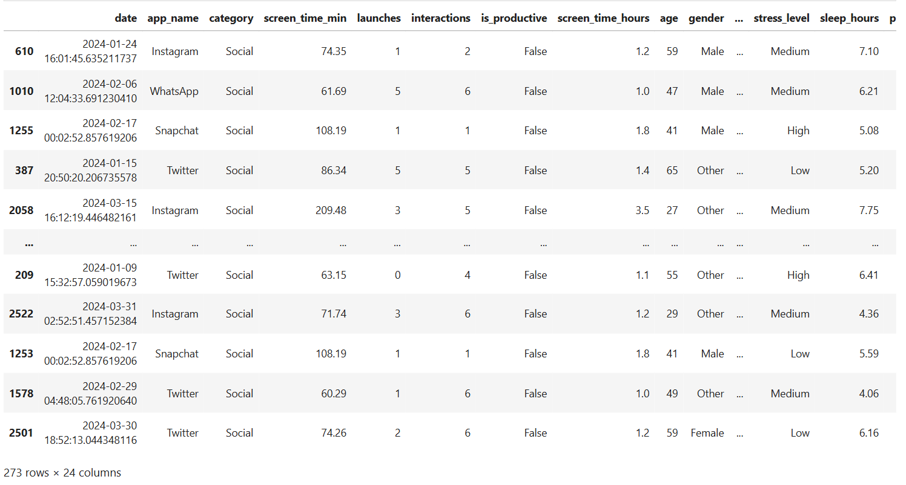
Data Analysis
Filter rows using conditions:
- only Social or Games category

Slide 17
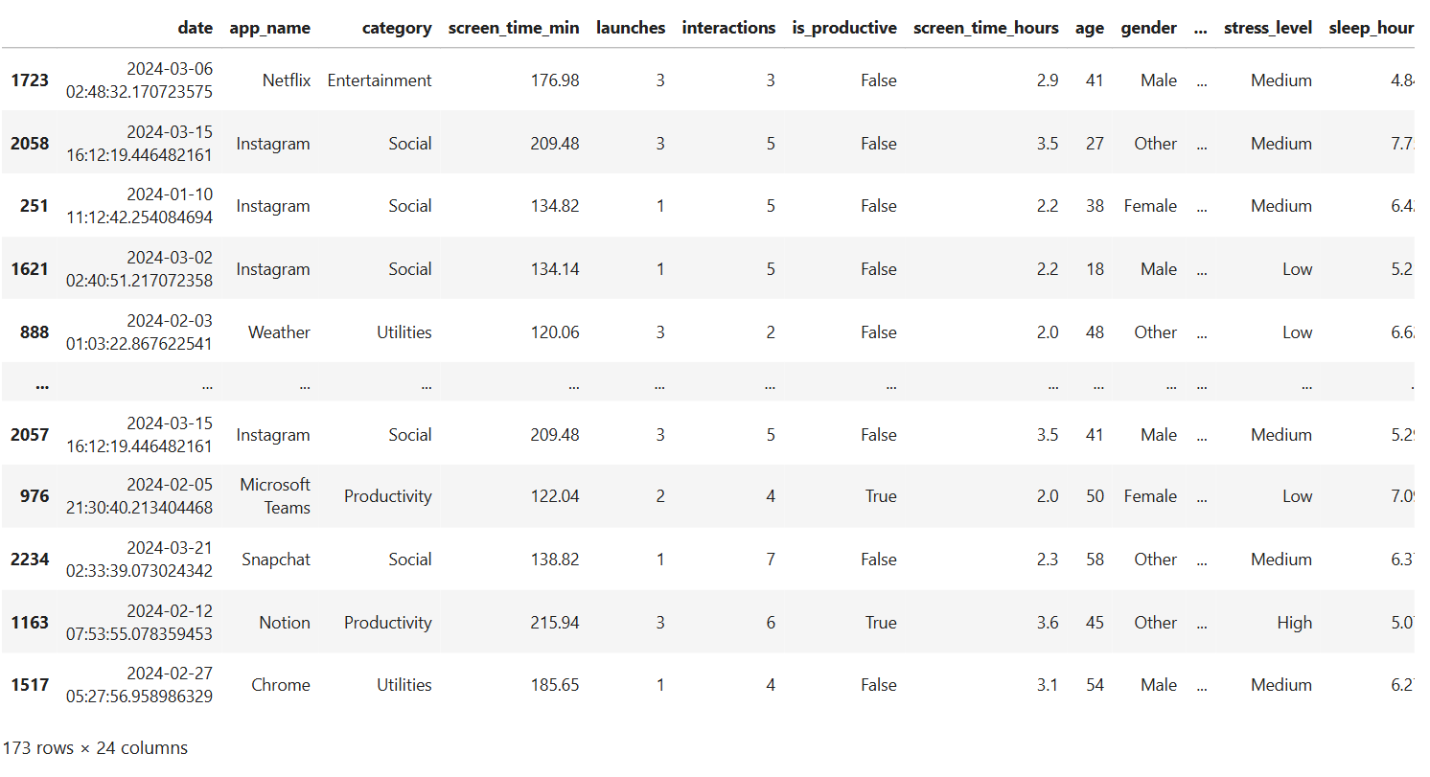
Data Analysis
Filter rows using conditions:
- users with more than 2h screen time

Slide 18
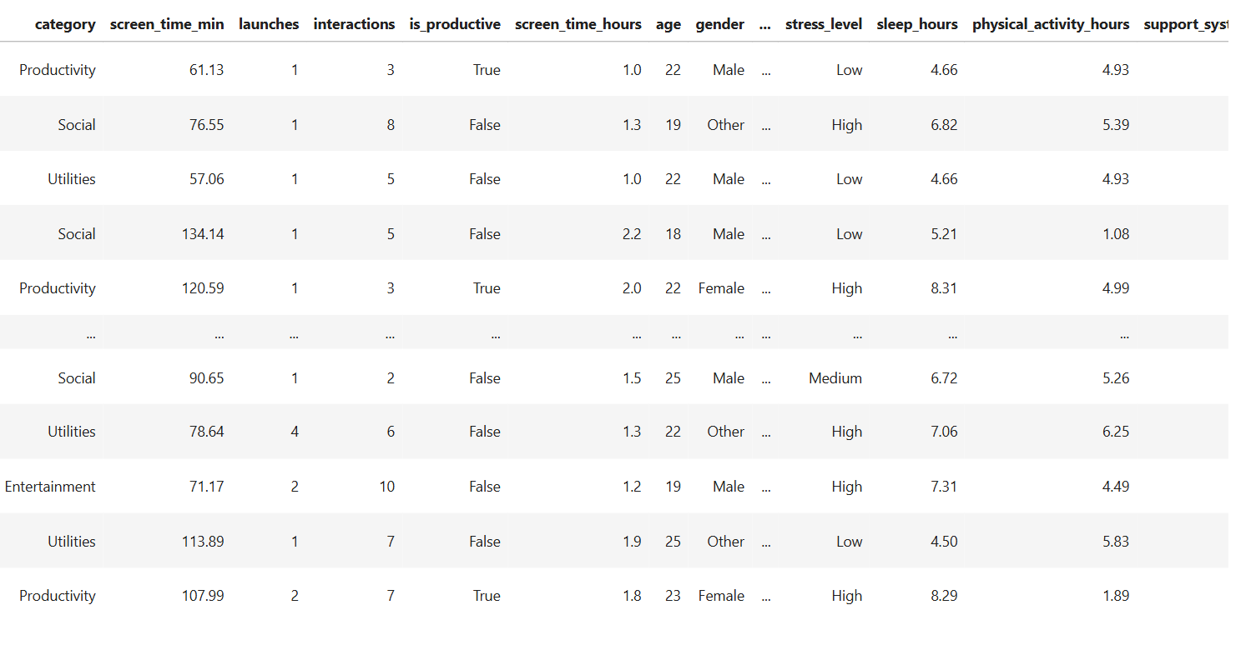
Data Analysis
Filter rows using conditions:
- users aged between 18–25

Slide 19
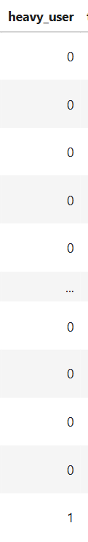
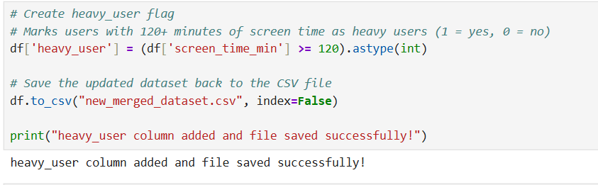
Data Analysis
Adds a (heavy_user( column to mark users with more than 120 minutes of screen time (1 = heavy user, 0 = regular user).

Slide 20
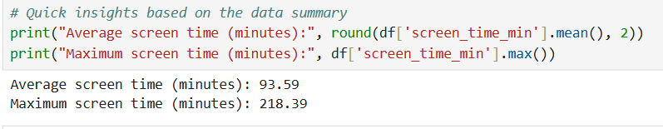
Data Analysis
Displays the average and maximum screen time in minutes to give a quick overview of user activity.

Slide 21

data visualization

Slide 22
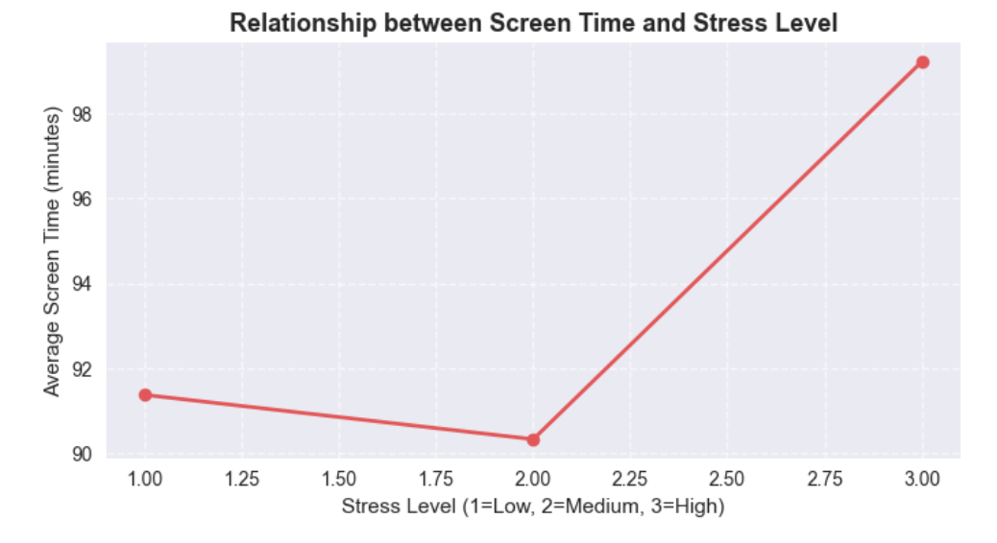
Data visualization
The higher the stress level, the higher the time to use the screen.
This may indicate that people with high stress tend to spend more time in front of screens, perhaps as a means of entertainment or escape from stress.

Slide 23
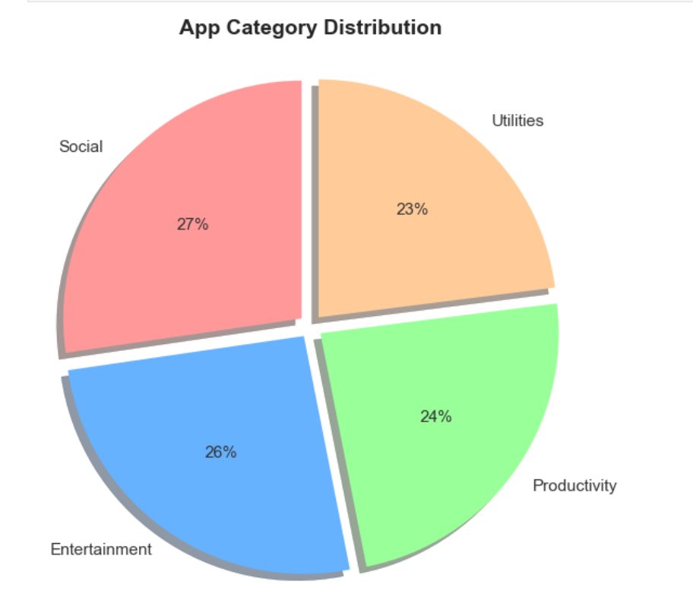
Data visualization
Balance: The distribution is largely balanced, with all percentages ranging from 23% to 27%. This suggests that the application market (in this data) is diverse and does not depend on a single type.
Equal attention: There seems to be a close demand from users for social media applications, entertainment, productivity and assistance.

Slide 24
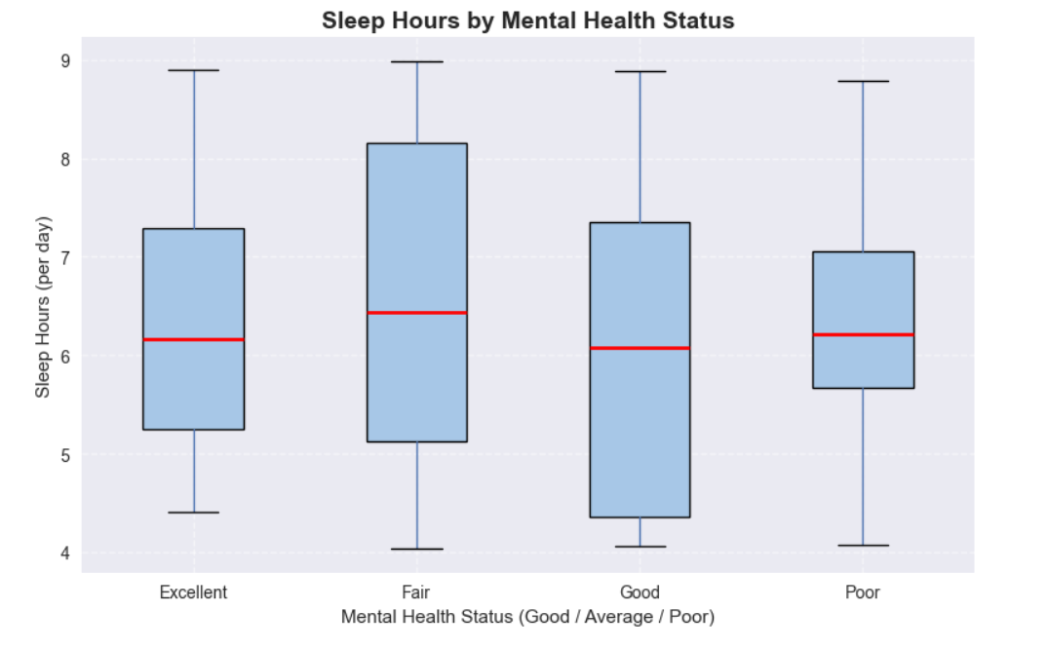
Data visualization
There is a clear positive relationship between sleep hours and mental health status.
People with better mental health tend to sleep more and more consistently.
Those reporting poor mental health sleep fewer hours on average.
Promoting healthy sleep habits may help improve mental resilience.

Slide 25
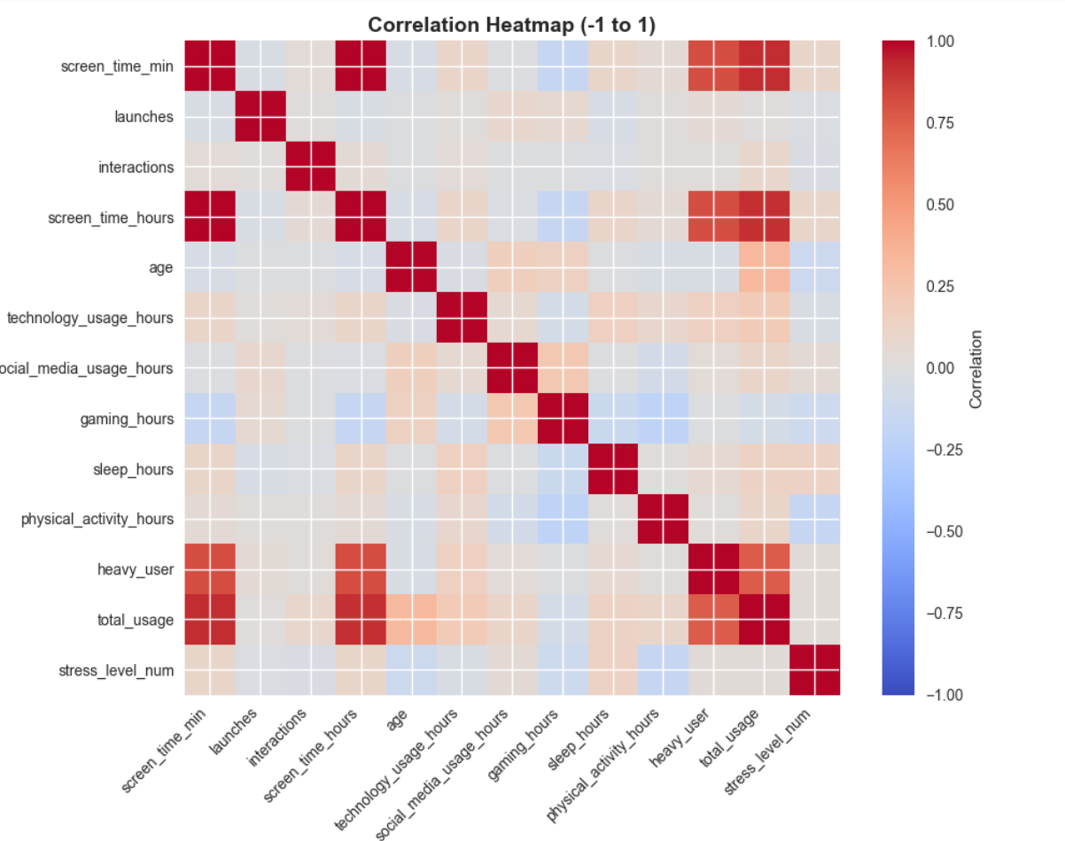
Data visualization
The heatmap shows strong positive correlations between screen time variables and total usage,
and negative correlations between sleep or physical activity and stress level
indicating that more screen time relates to higher stress, while more rest and activity reduce it.

Slide 26
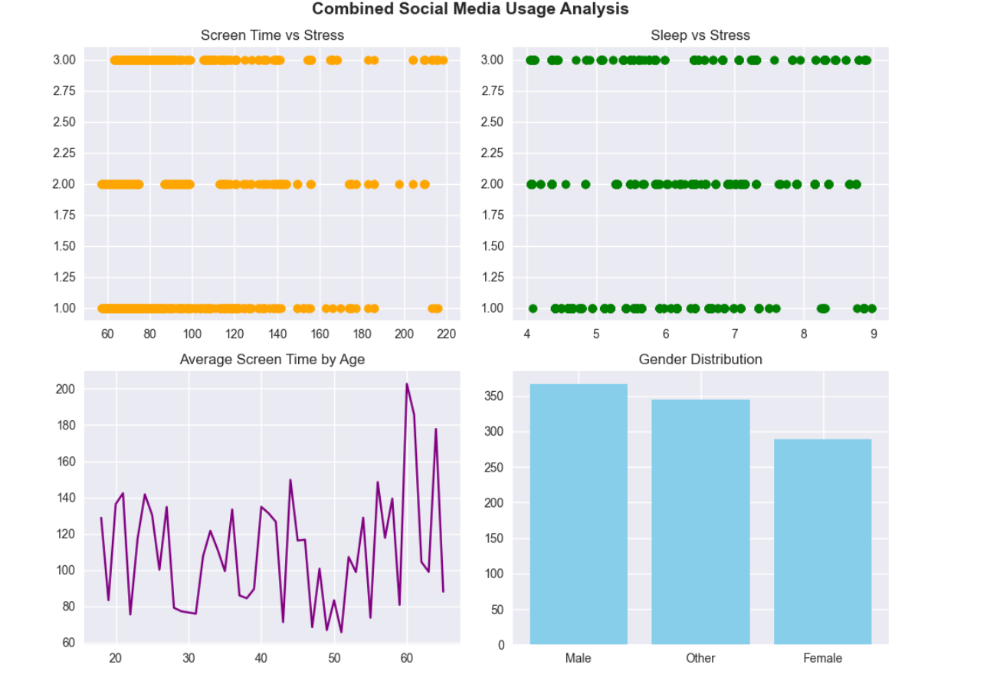
Data visualization
Screen Time & Stress: More screen time is linked to higher stress levels.
Sleep & Stress: Unexpectedly, more sleep sometimes appears with higher stress—may need deeper analysis.
Age & Screen Time: Usage varies by age, with spikes in older groups—no clear trend.
Gender Distribution: Most users are male, followed by "Other" and then female—gender may influence results.

Slide 27
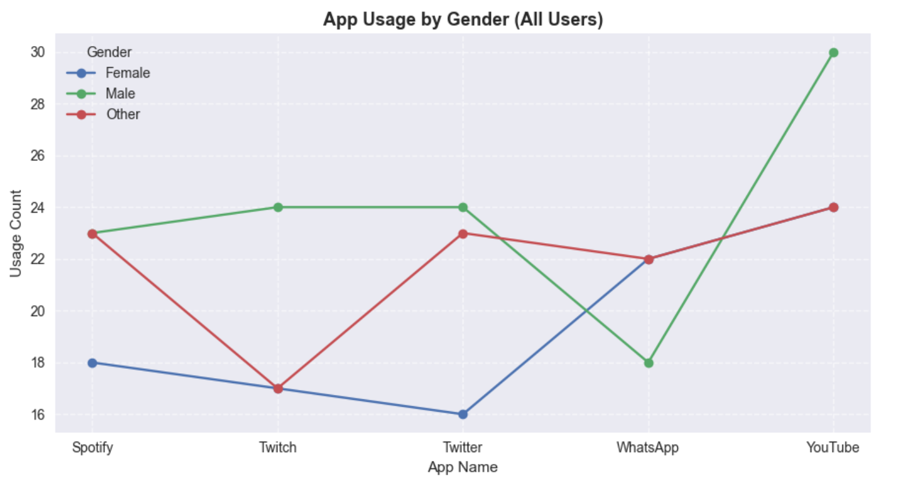
Data visualization
Males show the highest app usage, especially on YouTube.
Females have lower usage overall but are more active on WhatsApp.
Other users show moderate and balanced usage across all apps.

Slide 28
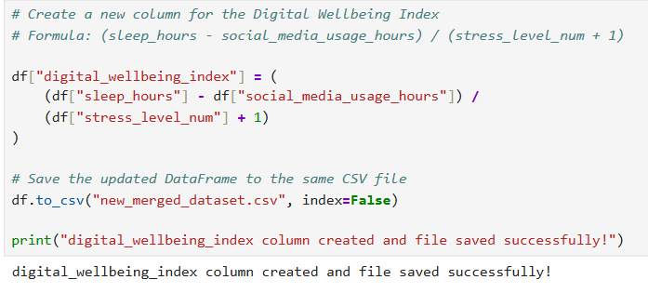
Data visualization
Creates a digital_wellbeing_index column that measures user balance between sleep, stress, and social media usage.

Slide 29
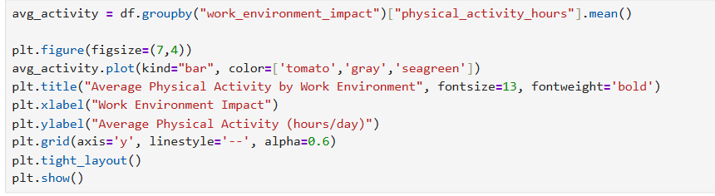
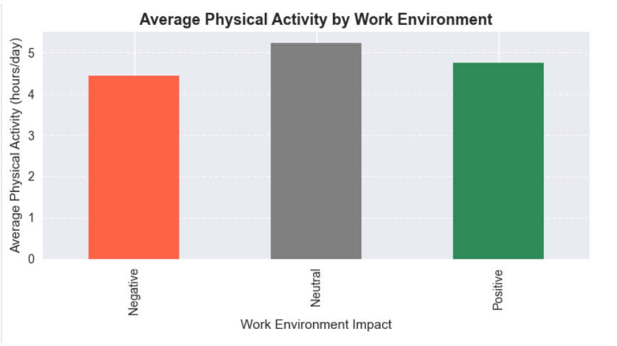
Data visualization
People with neutral or positive work environments tend to be more physically active than those in negative environments.

Slide 30

Summary

Slide 31

Summary
Potential Benefits & Applications:
The analysis of screen time and mental health data using Python reveals how digital behavior impacts well-being.
By applying thoughtful data analysis, we uncovered meaningful patterns linking screen use to stress, sleep, and mental health.
These insights highlight the importance of balanced digital habits and can guide healthier lifestyle choices, informed awareness, and more supportive digital environments.

Slide 32

Summary
Benefits of These Insights:
Help people understand how screen and social media habits affect their stress and sleep.
Encourage healthier daily routines, like reducing screen time before bed.
Support better decisions in education, health, and digital policy planning.

