Slide 1
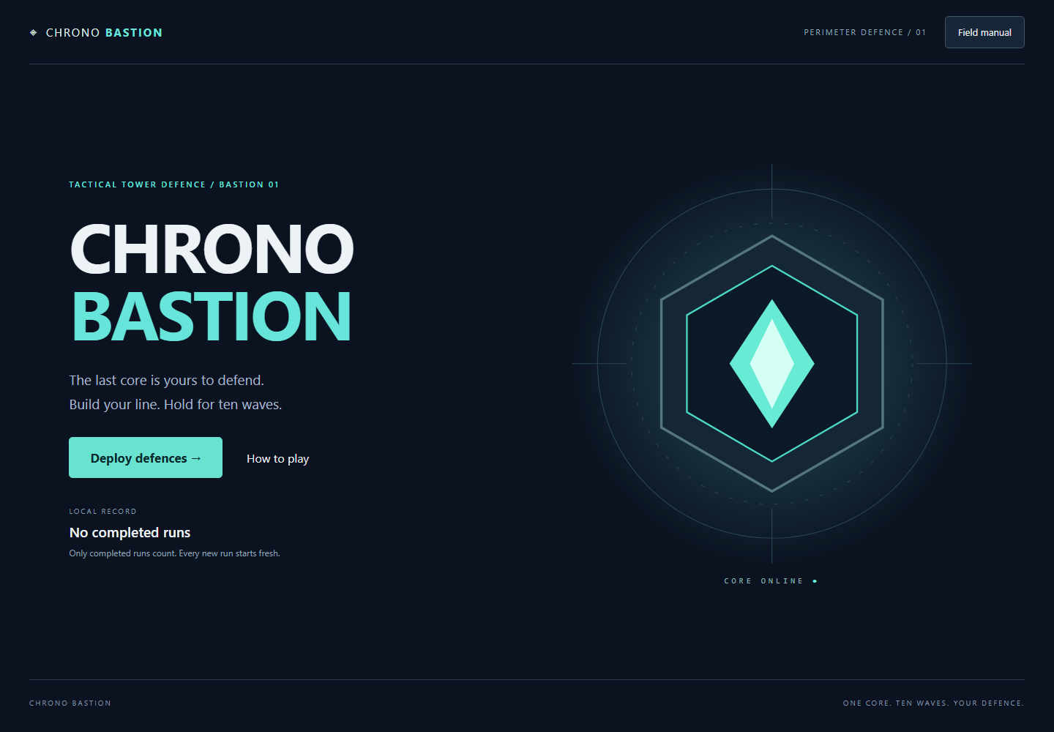
CHRONO BASTION
A functional tower defence game
Yerkingali Saruar
Ainabek Chingiskhan
IT-2502
.NET 10 · Blazor WebAssembly
01
Notes:
30 seconds. Introduce both teammates and group. A C# tower defence game for Introduction to Functional Programming. There are exactly two sequential ownership parts. Screenshot: docs/screenshots/main-menu.png.

Slide 2
Aim and project plan
Build a playable browser game with testable, functional C# rules.
01 Model immutable state and explicit failures
02 Implement and verify the complete engine
03 Connect a responsive Blazor interface
04 Test browser flows and publish static files
02
Notes:
1 minute. Aim: express and test interactive game rules through functional programming. Practical value: the same deterministic engine runs in tests, a console simulator and the browser. Explain sequential integration: Part 1 was complete before Part 2 connected it. Source: docs/DEFENSE.md, ARCHITECTURE.md.

Slide 3
Technology choice
Approach | Useful for | Decision
Console C# | Deterministic logic and testing | Keep as simulator
Desktop UI | Desktop interaction | Not selected
JavaScript game | Browser graphics | Browser adapters only
Blazor WebAssembly | C# components and static hosting | Selected
03
Notes:
1 minute. This compares project fit, not benchmark speed. Blazor keeps combat in C# and supports static hosting. JavaScript is restricted to browser capabilities. A desktop framework would add another delivery path for phones. Source: docs/DEFENSE.md.

Slide 4
Architecture and state flow
Blazor UI
GameSession
Pure engine
Render state
Dispatch commands
Own latest snapshot
Accumulate fixed ticks
Validate actions
Return new state + events
Browser boundary: localStorage stores only the best finished-run record.
04
Notes:
1 minute. Dependencies point from Web to Application to Core. Commands produce new immutable states. GameSession is the only mutable owner. One UI clock calls Advance; speed is applied once in Application. ShotFired reports damage already applied. Storage is outside the pure engine. Source: docs/ARCHITECTURE.md and actual Home.razor, GameSession.cs, GameEngine.cs.

Slide 5
Functional programming in the code
Immutable update
Explicit failure pipeline
enemy with
{
Health = Math.Max(0, enemy.Health
- DamageFor(stats)(enemy))
}
FindTower(state, padId)
.Bind(tower =>
ValidateUpgrade(state, tower))
.Map(tower => ...)
Source: CombatRules.ApplyHit and GameEngine.Upgrade (Map body omitted).
Also used: Option · recursive waves · target ranking functions
05
Notes:
2 minutes. ApplyHit returns a new enemy without changing the input. Map transforms a successful value; Bind chains another operation that may fail. ValidateUpgrade stops insufficient-gold actions without changing state. Also demonstrate recursive WavePlanner groups, Option for empty pads and higher-order target ranking. Source: Core/Rules/CombatRules.cs, Core/GameEngine.cs, Core/Content/WavePlanner.cs.

Slide 6
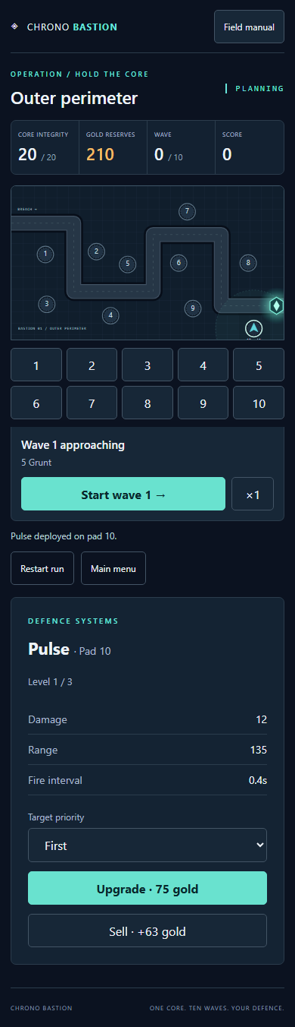
Interface methodology
One owner, reusable components
Home owns the session subscription and clock.
Board, HUD and tower panel receive state.
Actions return through EventCallbacks.
Dialogs, selection and visual effects stay in UI.
Emulated phone viewport
06
Notes:
1 minute. Start with actual gameplay, then complete controls, storage and failure handling. Parameters and EventCallbacks keep the board and panels reusable. Selection and dialogs belong to UI; combat belongs to the engine. On phones, the board keeps world coordinates and large pad buttons avoid precision tapping. Screenshot is an emulated 390x844 viewport, not a physical phone. Source: docs/UI_SPEC.md and Web/Components.

Slide 7
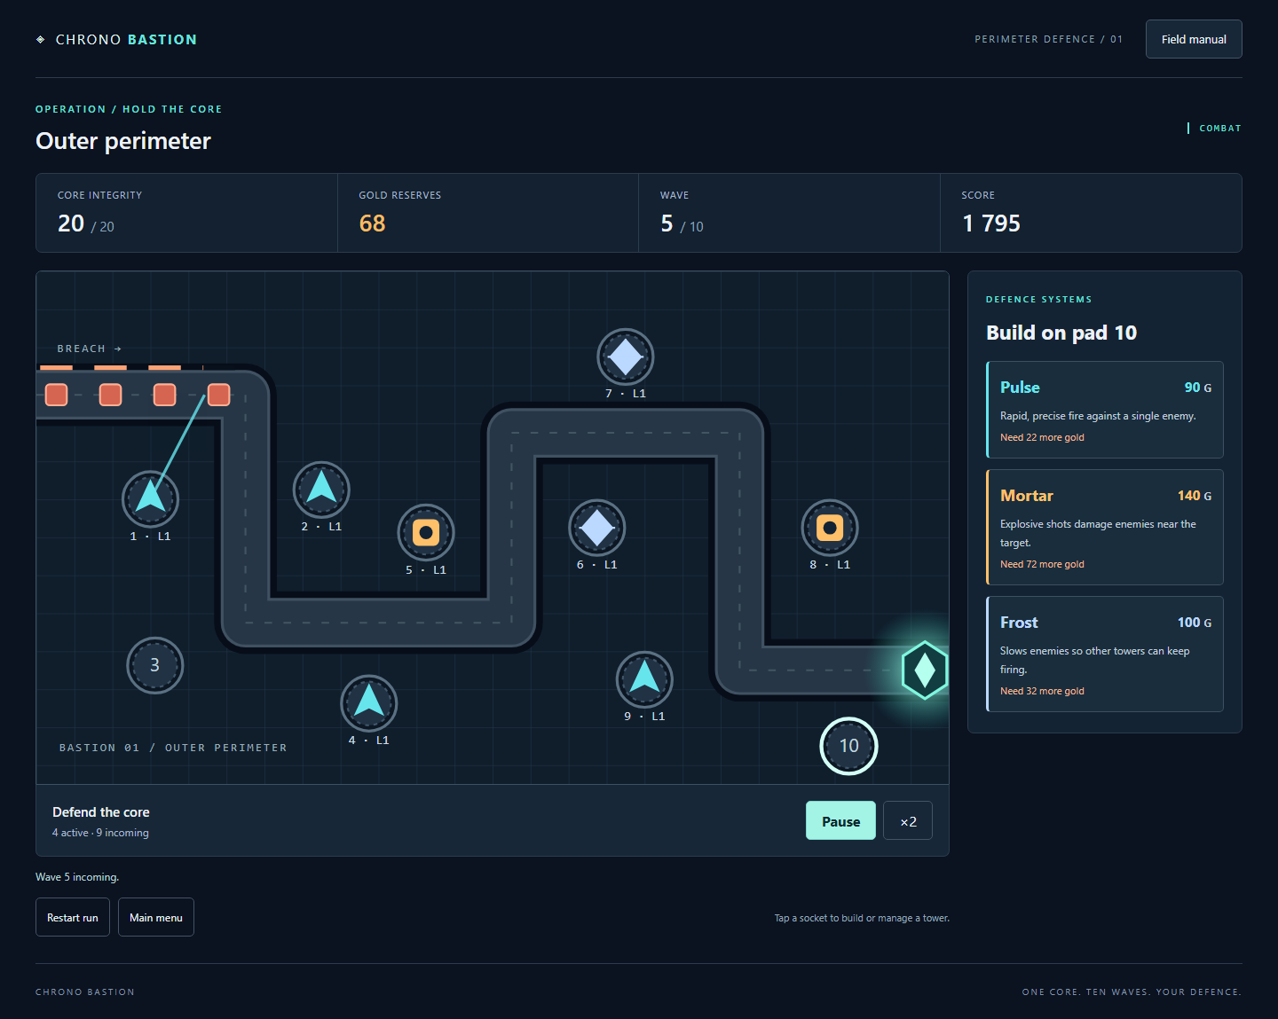
Live demonstration
Build → start a wave
Pause and change speed
Upgrade or sell
Inspect the final record
07
Notes:
3 minutes. Deploy Pulse on pad 2 and Mortar on pad 5. Show a selected tower range, start wave one, pause, switch speed, resume, and show targeting and selling. Explain that help/tab hiding pauses combat. Show the finished-run record and fresh restart. Use the real app; do not claim an unfinished run is saved. Screenshot: docs/screenshots/combat.png.

Slide 8
Verification evidence
Check | Evidence
.NET tests | 83 passed: 70 domain/session + 13 UI/storage
Complete browser victory | 10 waves, 151 kills, 12,090 points
Failure and restart | Undefended loss in wave 3; fresh wave-one run
Browser resilience | Corrupt/blocked storage, pause, speed, menu transitions
Responsive release | Chromium; phone layouts tested in emulation
08
Notes:
1 minute. Evidence must match docs/VERIFICATION.md. 70 existing Core/Application tests plus 13 new component/storage tests. Browser suite uses ordinary clicks and real resources. State that phone checks are emulated, not physical hardware. Test the packaged trimmed release at the repository base path. Source: scripts/Test.ps1, tests/browser/game.cjs and artifacts/browser-results.json.

Slide 9
Contributions and practical value
Part 1 · Yerkingali Saruar
Part 2 · Ainabek Chingiskhan
Architecture, engine, session,
functional utilities, domain tests
and complete-game simulator.
Blazor interface, browser adapters,
UI tests, final presentation
and release work.
Practical value: one reproducible engine across console, tests and browser.
Scope: one map, local records, no backend. Physical-phone testing remains unverified.
09
Notes:
1 minute. Explain the actual two-part ownership. Yerkingali supplied Core/Application, architecture, tests and simulator. Ainabek supplied Blazor, browser integration, interface tests, presentation and release work. Both should understand all code. Limits: one map, local records, no backend, no physical-phone test. Static hosting removes an application server, but do not claim measured large-scale performance.

Slide 10
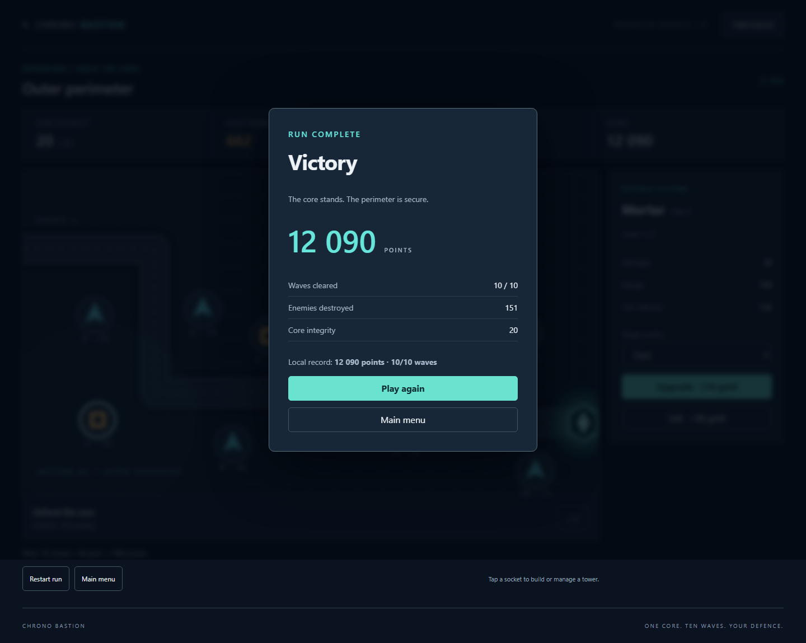
Play, inspect and discuss
Game
f1j1tun1.github.io/IFP_Final/
Repository
github.com/F1j1tun1/IFP_Final
Questions
10
Notes:
Leave time for questions so the full defense lasts 15–20 minutes. Open the game and repository. Be ready to explain Map vs Bind, pure functions, local mutation inside Tick, fixed-step timing, browser record limitations and each teammate’s part. Check docs/VERIFICATION.md for the current deployment status before the defense. Screenshot: docs/screenshots/victory.png.

