Slide 1



Home Page
Waiting for connection
Connected
Connected
Connected
Insert Pin
Insert Pin
Insert Pin
Select Pin
1234
1234
Invalid Pin
Confirm
Confirm
Menu page

Slide 2







Menu Page + Stop
Menu
Remote Control
Telemetry Display
Stopping the vehicle
Camera
Settings
Couldn’t connect to the vehicle
Waiting for connection
Try again
Emergency Actions
Stop Vehicle
Locate Vehicle
Camera page

Slide 3
Menu Page + Locate
Menu
Remote Control
Telemetry Display
Locating the vehicle
Camera
Settings
Couldn’t find the vehicle
Waiting for connection
Try again
Emergency Actions
Stop Vehicle
Locate Vehicle
???

Slide 4
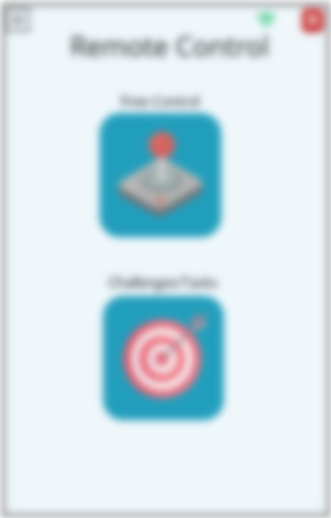


Remote Control Page
Remote Control
Free Control
Challenges/Tasks
Waiting for connection

Slide 5
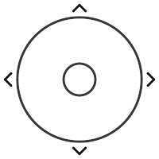
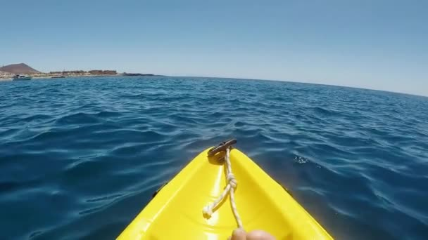

Free Control
Power
Waiting for connection

Slide 6

Challenges/Tasks Page
Challenges/Tasks
Sending message to the vehicle
Message sent successfully
Establishing the connections with the vehicle’s camera
Task X
Task X
Camera page
Task X
Task X
Something went wrong - …

Slide 7
Challenges/Tasks Page
Waiting for connection

Slide 8
Telemetry Display Page
Remote Control
Free Control
Challenges/Tasks
Waiting for connection

Slide 9

Camera Page
Waiting for connection

Slide 10


Settings Page
Settings
Settings
Settings
Settings
Language
Tasks
Change PIN
About the project
View
Tasks
Tasks 1: Título da task
- descrição
Current PIN
This application was developed as part of a project for the Systems Engineering course in the Master's Degree program in Electronics and Computers at the Faculty of Engineering, University of Porto
Security
Change PIN
About the project
Tasks 2: Título da task
- descrição
Incorrect PIN
New PIN
Team members
Format: only numbers
……
Tasks 3: Título da task
- descrição
Repeat new PIN
Tasks 4: Título da task
- descrição
PIN doesn’t match
Foto da equipa
Confirm

Slide 11
Settings Page
x
x
Settings
Settings
Settings
Team Members
Language
Tasks
Tasks
António Maia | up201907767@up.pt
António Maia | up201907767@up.pt
António Maia | up201907767@up.pt
António Maia | up201907767@up.pt
António Maia | up201907767@up.pt
António Maia | up201907767@up.pt
View
Tasks 1: Título da task
- descrição
Security
Change PIN
About the project
Tasks 2: Título da task
- descrição
Team members
……
Tasks 3: Título da task
- descrição
Tasks 4: Título da task
- descrição

