Slide 1
Understanding Graph Theorems
Jose Lopez
12/3/2023
CS 131

Slide 2
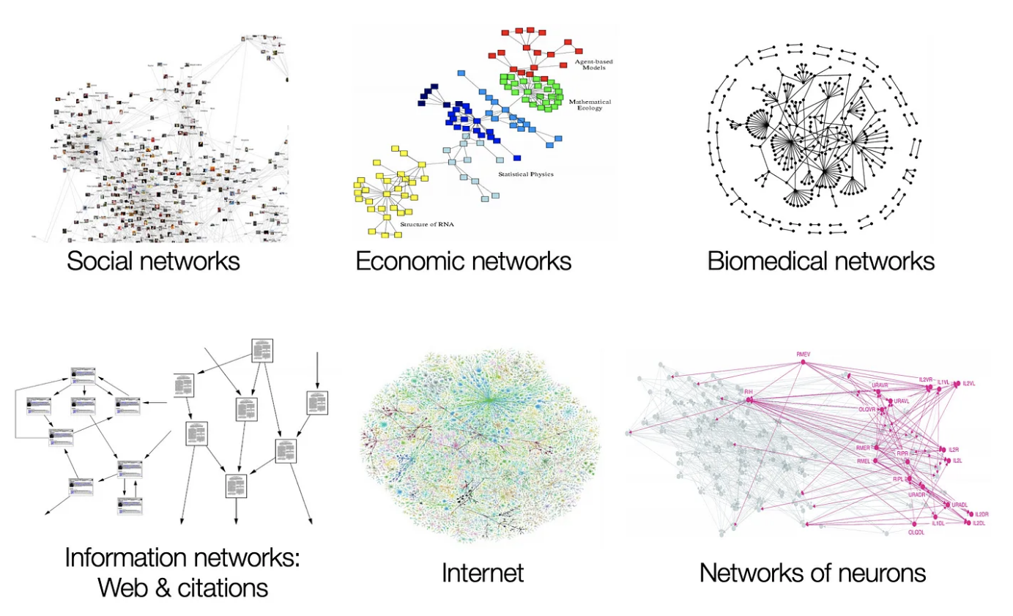
Introduction to Graph Theory
Brief overview of Graph Theory
Graph Theory is a branch of mathematics that studies the relationships between nodes (vertices) and connections (edges). At times, the edges of the graph are weighted, which indicates how to traverse from one edge to the other.
It has applications in computer science, social networks, transportation, and more.

Slide 3
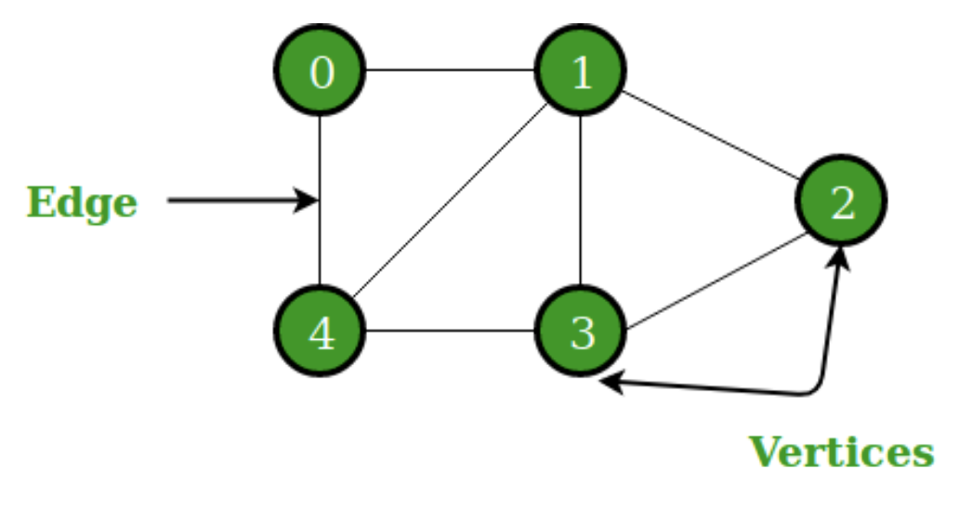
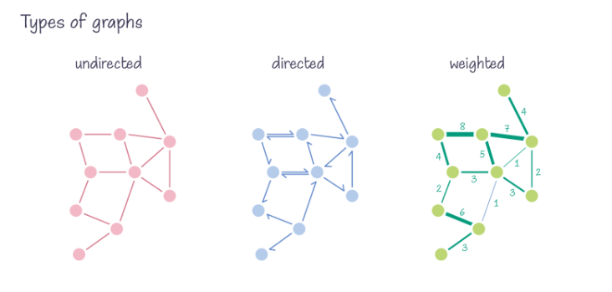
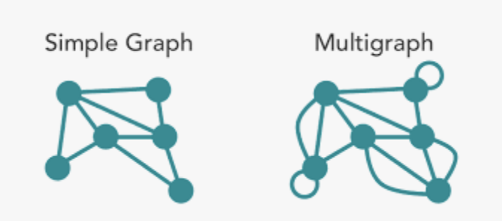
Basics of Graphs
Definition of a graph (vertices and edges)
A graph is a set of vertices connected by edges.
Simple vs. Multigraphs
Simple graphs have at most one edge between any two vertices, while multigraphs can have multiple edges between the same pair of vertices.
Undirected graphs
Connections between nodes are bidirectional
Edges are usually represented as unordered pairs
Handshake Theorem
Directed Graphs
Connections between nodes had a one way direction
Edges are usually represented as ordered pairs
In-Degree and Out-Degree Theorem
Weighted Graphs
Each edge has an associated weight or cost
Additional numerical values are added to the ordered pair
Traveling Salesman Problem

Slide 4
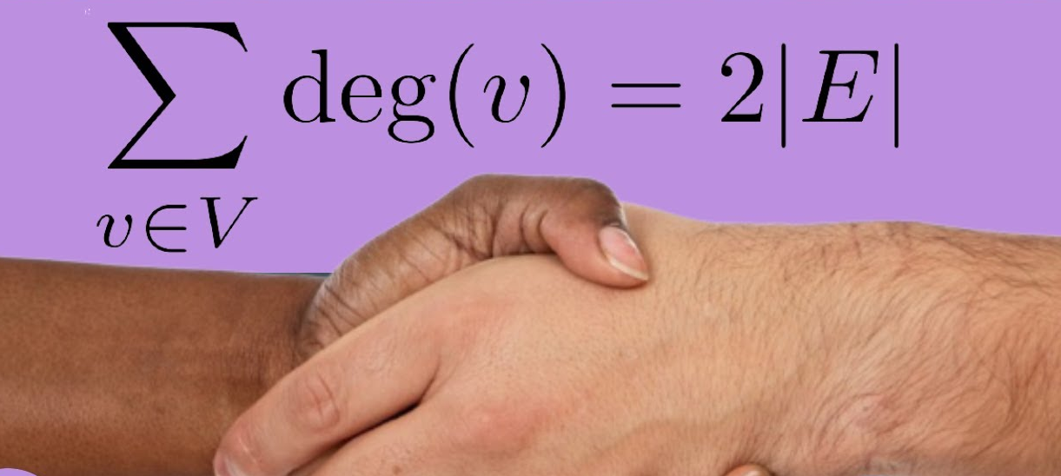
Handshaking Theorem
(undirected graphs)
Definition of Handshaking Theorem
The Handshaking Theorem is a fundamental principle in graph theory that relates the sum of degrees of all vertices to the total number of edges in a graph.
Explanation of the handshake metaphor in graph theory
Think of vertices as people and edges as handshakes; the theorem states that the total number of handshakes (degrees) is twice the number of people (edges).

Slide 5
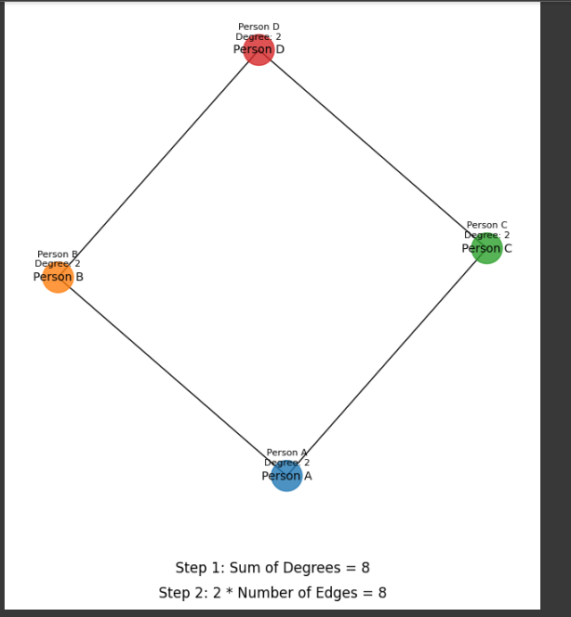
Handshaking Theorem Example
Nodes (Individuals):
Each node represents a person in the social network.
Nodes are labeled as "Person A," "Person B," "Person C," and "Person D."
Edges (Connections):
Edges between nodes represent relationships or interactions between individuals.
For example, an edge between "Person A" and "Person B" indicates a connection or relationship between them.
Node Degrees:
The degree of a node is the number of edges connected to it.
The graph uses color to represent node degrees. Darker nodes have higher degrees.
Handshaking Theorem Steps:
The annotations on the graph explain each step of the Handshaking Theorem:
"Step 1: Sum of Degrees = [Sum of all node degrees]."
"Step 2: 2 * Number of Edges = [Twice the number of edges in the graph]."
Node Annotations:
Each node is annotated with its degree. For example, "Person A" has a degree of 2, meaning there are two edges connected to this person.

Slide 6
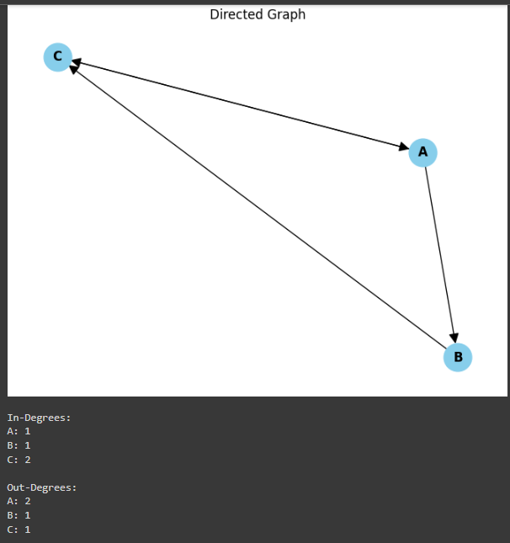

In-Degree and Out-Degree
(Directed Graphs)
Balance of Edge Traffic:
In directed graphs, the in-degree of a vertex represents the number of edges entering that vertex, while the out-degree represents the number of edges leaving.
The in-degree and out-degree theorem states that, in any directed graph, the sum of in-degrees across all vertices is equal to the sum of out-degrees.
Mathematical Formulation:
Practical Applications:
The in-degree and out-degree theorem finds applications in various real-world scenarios.
For example, in transportation networks, it ensures that the number of roads entering a location matches the number leaving, aiding in traffic flow analysis.
In information networks, it guarantees a balance in the dissemination and reception of data.
This equation shows a balance of flow that emphasizes what enters a vertex must also leave it

Slide 7
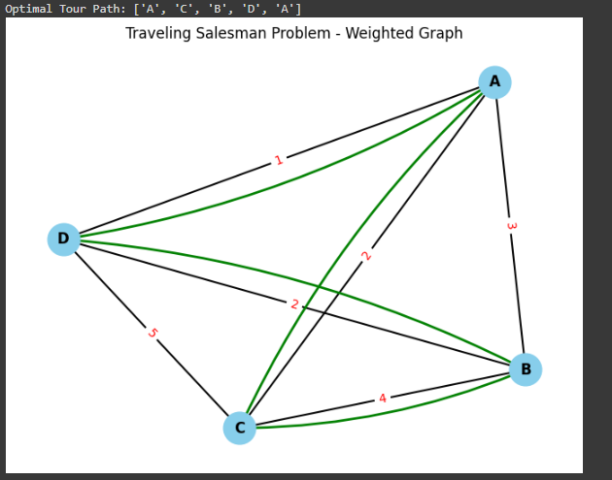
Traveling Salesman Problem
(weighted graphs)
Problem Definition:
TSP is a combinatorial optimization problem in graph theory.
The goal is to find the shortest possible tour that visits each city exactly once and returns to the starting city.
Graph Representation:
Cities are represented as nodes in a complete graph.
Edges between cities have weights representing travel distances or costs.
NP-Hard Problem:
TSP is classified as NP-hard, implying that finding an optimal solution becomes computationally challenging as the number of cities increases.
Due to the computational complexity, many algorithms focus on providing good but not necessarily optimal solutions efficiently

Slide 8
Applications
How understanding degrees in graphs can be useful
Emphasize the practical implications in solving real-world problems.
Algorithms that involve graph traversal, connectivity analysis, and degree-based computations often benefit from an understanding of these principles in their design and analysis.
Handshake Theorem:
Social Networking: In social networks, the Handshake Theorem can be applied to understand the relationships between individuals. The total number of handshakes represents the total number of connections or interactions within the network.
In-Degree and Out-Degree Theorems:
Information Flow in Social Networks: Analyzing in-degrees and out-degrees in social networks helps understand information dissemination. Individuals with high in-degrees may act as information hubs, while those with high out-degrees may be effective in spreading information.
Traveling Salesman Problem:
Delivery Services: Companies providing delivery services often face the challenge of optimizing routes for delivery trucks. The Traveling Salesman Problem helps minimize travel distances, reducing fuel costs and improving efficiency.

Slide 9
Conclusion: Graph Theory
In conclusion, we explored fundamental concepts in graph theory, including the Handshaking Theorem, which reveals insights into relationships between vertices and edges in undirected graphs. We talked about in-degree and out-degree in directed graphs, understanding the flow of connections into and out of vertices. These concepts form the basis for many real-world applications. And, we touched on the Traveling Salesman Problem (TSP). This brief presentation of graph theory opens the door for further exploration into its theoretical foundations and practical applications. Thank you!

