Slide 1
Dijkstra’s Algorithm
CS 131
Alexander Leontiev

Slide 2
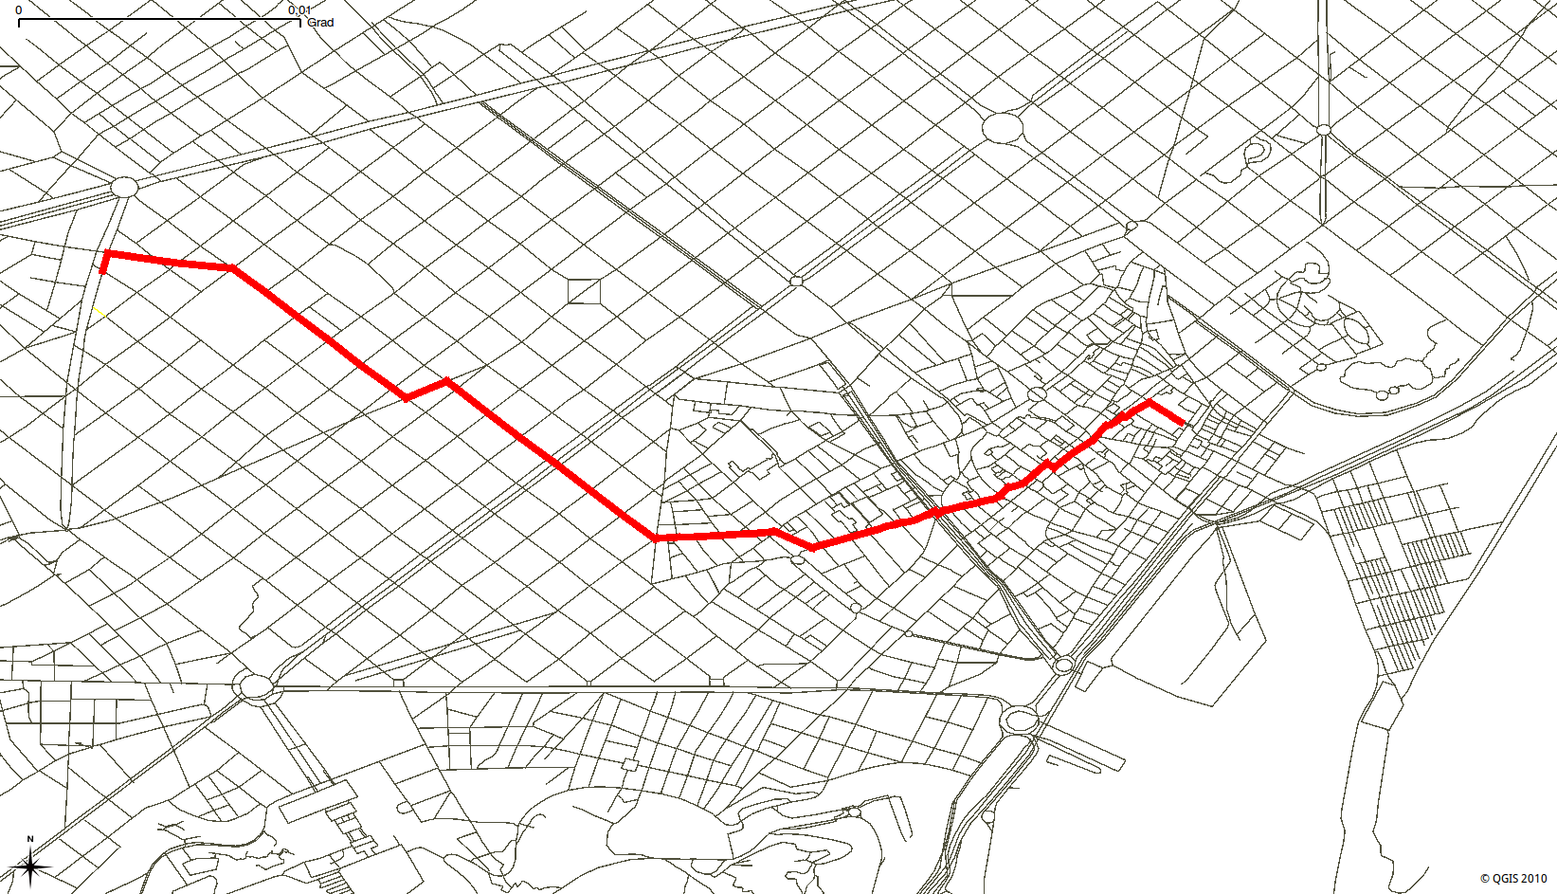
Introduction
What is the best path from point A to point B?
What information do we need to calculate this path?

Slide 3
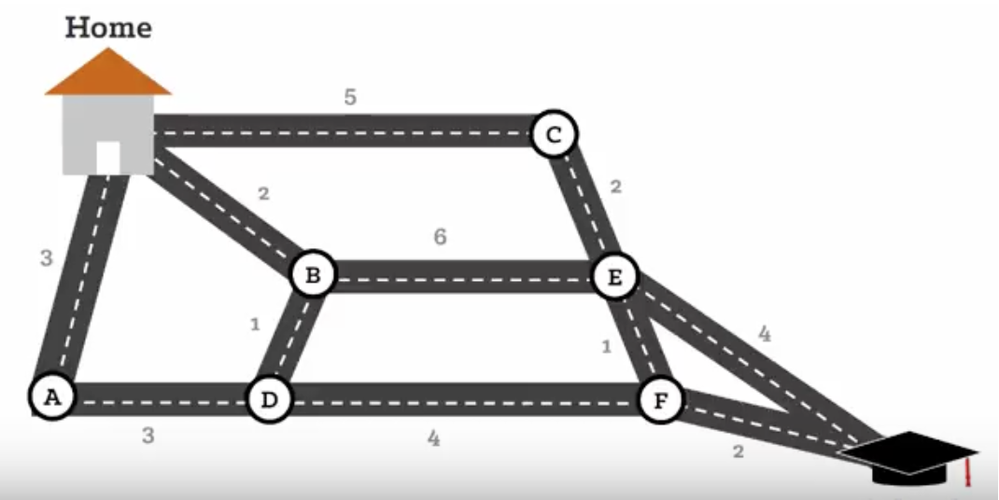
What is Dijkstra’s Algorithm
Dijkstra’s Algorithm calculates the shortest path in a weighted graph
Created by Edsger Dijkstra who studied theoretical physics then switched to his passion of computer science

Slide 4
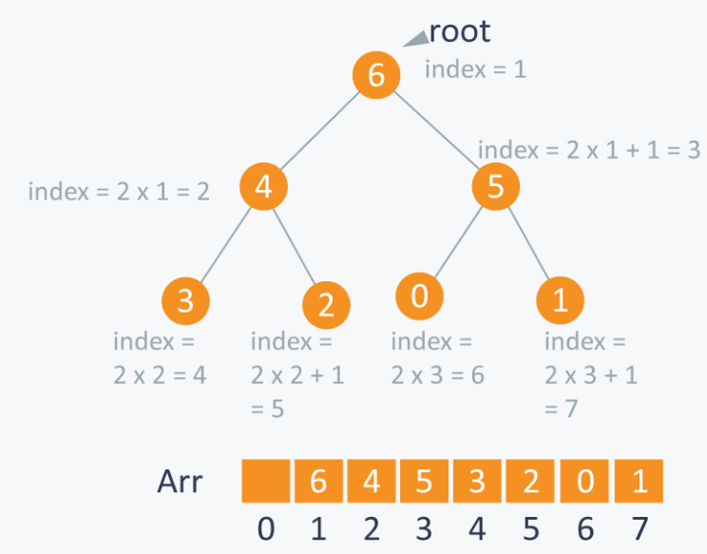
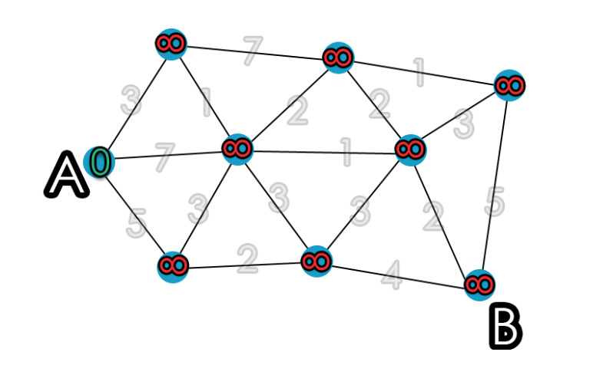
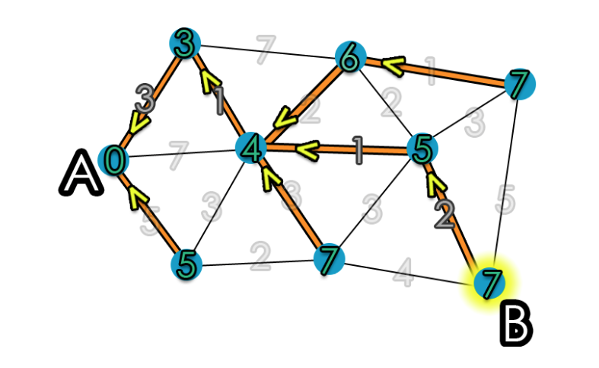
How Does it Work?
Prioritizing Shortest Paths (use a priority queue)
Greedy algorithm always looking for the smallest weight
Keep track of how we got the smallest weight and which vertex connects to that current vertex

Slide 5
Time Complexity
Time complexity of O(V)^2 where V is the amount of vertices
Can be reduced to O((V+E)logV) where V is the amount of vertices and E is the amount of edges by using a list representation for the graph

Slide 6
Applications
Navigation systems to find the best route
Connecting flights that will take the least amount of travel time and least expensive cost
Used in networking to send packets over

