Slide 1


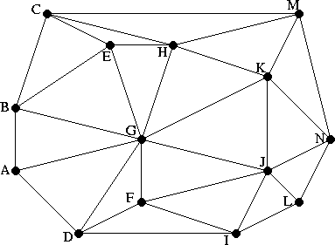
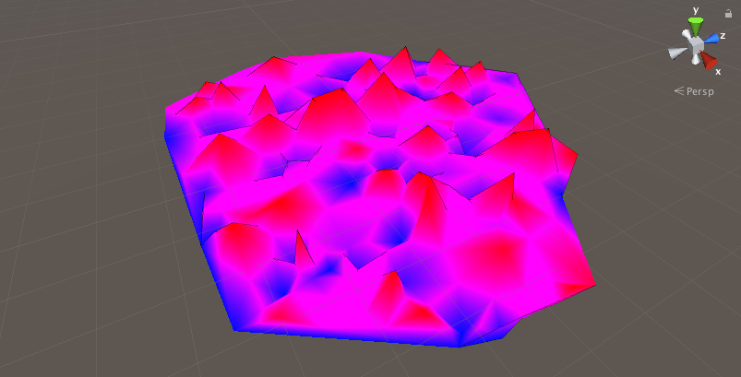
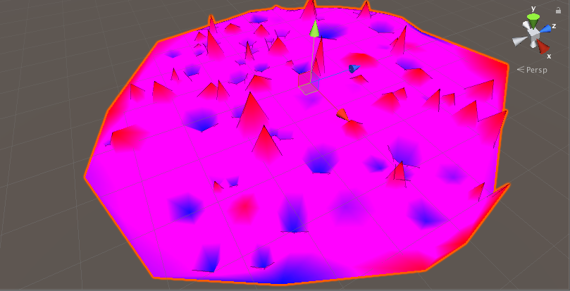
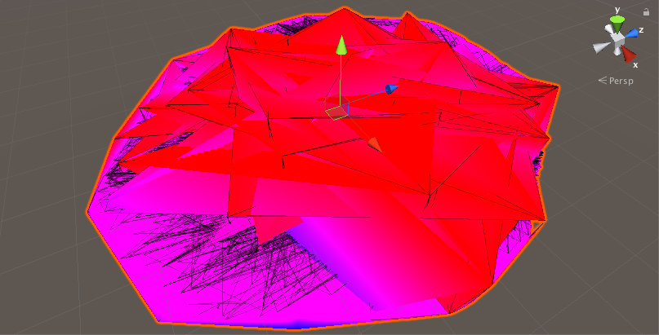
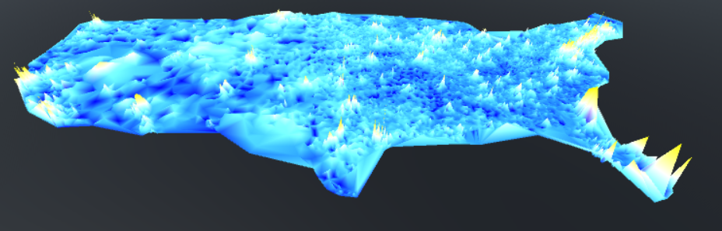
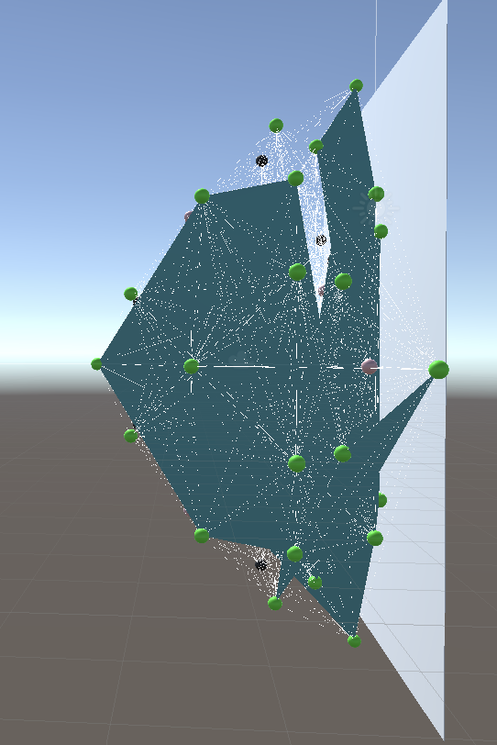
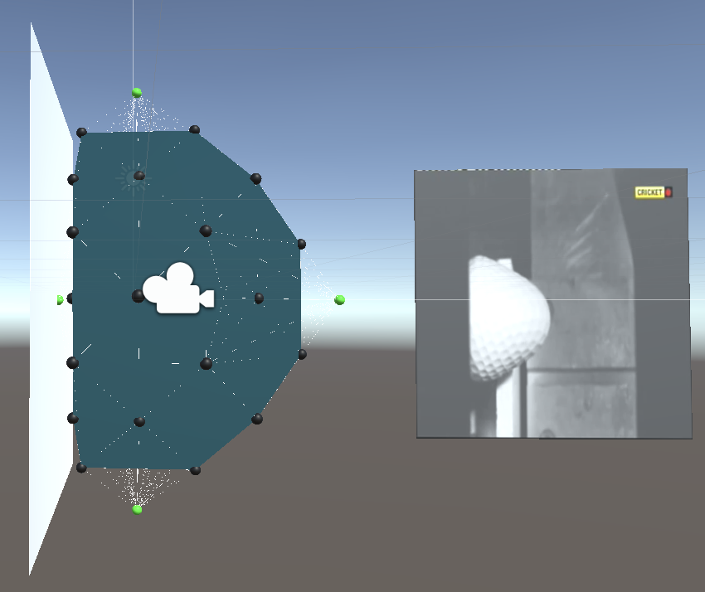
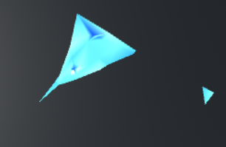
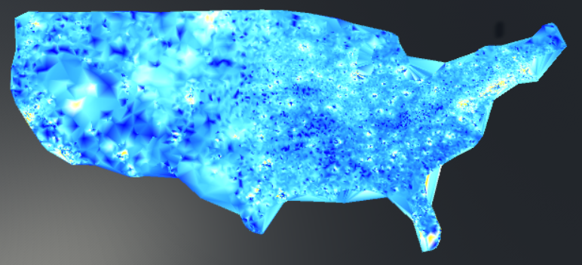
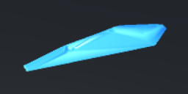
Delaunay Triangulation & Mesh Generation
Sandeep Ramesh, Brandon Gomez, Max Caverly
Group Summer Scholars Research Program
ABSTRACT
RESULTS
CONCLUSIONS
Understanding that irregular sets of data are used in analytics, we implemented the theory of Delaunay Triangulation, Centroids, and Visualizations, to accurately portray and smooth data sets. The algorithms utilize this specific triangulation design as it favors the most uniform generation of triangles, favoring angles closer to 60 degrees and triangles of similar size.
The first application of the mesh allowed for the repeatable and random generation of an irregular, three-dimensional mesh with altitude-based coloration. In addition, we “smoothed” the visualization by adding centroids between each known data point and then applied the relaxation method to set the y value of the added points. We realized that there is a limitation to the number of vertices allowed in a Unity mesh, limiting the number of additional points we cold add.
Our finished product shows a heat map of household wealth across the US, with higher population areas typically showing a greater wealth concentration. This map does not take into account cost of living in the US. The color scale is designed to emphasize and bring out detail in low-intermediate function values.
In regards to the project, we feel that the step-by-step process of applying the concept to different mini projects before the actual final project provided us with more experience and understanding of the concepts so that the final project was much easier to complete
INTRODUCTION
Many data sets, such as tax data, weather measurements, or even population density, are irregular, meaning that they are not measured on a evenly spaced square grid. In this event, we can apply Delaunay Triangulation to visualize the data. Delaunay Triangulation is an algorithm for connecting a series of irregularly spaced points into a connected triangular mesh. Our implementation includes the ability to smooth irregularly spaced data using additional smoothing points and a inverse relationship between distance and average value (i.e. the farther away from the centroid, the less effect on the y value).
For our second application, we ran into difficulties while implementing the mesh onto an animated golf ball simulation. This included issues with normalization, the perspective in which the mesh is viewed, and the inaccurate labeling of exterior points leading to inaccurate visualizations.
MATERIALS and METHODS
Finally, we applied our approach to geo-located US tax data. The mesh is based off of 2016 US Tax Data and compares tax returns of over $75k to under $75k (compared to an average household income of about $65k in 2016). The map is color-coded based on of the ratio of high to low income tax returns. The more yellow the spikes, the higher the ratio between high and low income families, and the bluer the region, the more the zip code is skewed towards lower incomes. Larger triangles in the triangulation were dropped to help ensure the best representation of boundaries in the data.
References
Triangle.NET.
https://archive.codeplex.com/?p=triangle
Unity Documentation.
https://docs.unity3d.com/Manual/index.html
Thank you to Dr. Joiner for assisting the group throughout the program. Your contributions to our code and concepts were integral in the completion of this project. Also to Nicholas Marino for aiding in the bug fixes.
Using C# and Unity 3D, we were able to create meshes with a open source library called Triangle.NET. This library allows us to feed the mesh a list of x-y points, and returns a list of triangles connecting those points in a mesh.
Three test cases were used, creation of a contour plot of a set of random points, applying the method to generate an outside shell on a simulation of a golf ball under collision, and visualization of us tax data known at different zip codes.
Include some type of graphic element (Flow Chart or Diagram).
Acknowledgments

Slide 2
