Slide 1

ALITA BATTLE ANGEL Movie Review
Presentation By Pramisha Khaling Rai

Slide 2
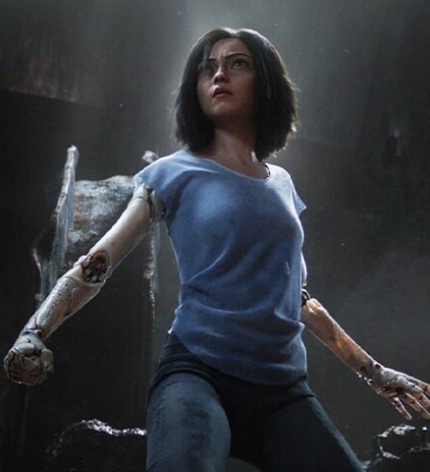
MOVIE INFO
Rating: PG-13 (Sequences of Sci-Fi Violence|Action|Some Language)
Genre: Sci-fi, Action, Adventure, Fantasy, Animation
Original Language: English
Director: Robert Rodriguez
Producer: James Cameron, Jon Landau
Writer: James Cameron, Laeta Kalogridis
Release Date (Theaters): Feb 14, 2019
Rerelease Date (Theaters): Oct 30, 2020
Release Date (Streaming): Jul 9, 2019
Box Office: $405 Million USD
Runtime: 2h 2m
Distributor: 20th Century Fox
Production Co: Lightstorm Entertainment, Troublemaker Studios
Sound Mix: Dolby Atmos
Aspect Ratio: Scope (2.35:1)

Slide 3
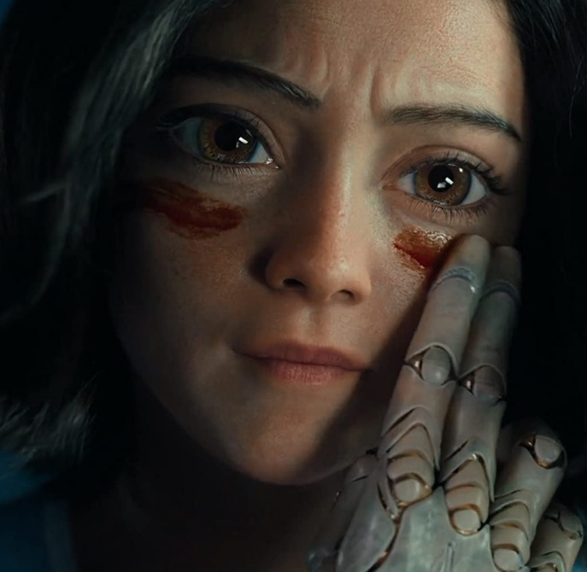
ABOUT MOVIE
"Alita: Battle Angel" is a cyberpunk action film based on the Japanese manga series "Gunnm" by Yukito Kishiro. The film was directed by Robert Rodriguez and produced by James Cameron. It was released in 2019 and follows the story of a cyborg named Alita (played by Rosa Salazar). Set several centuries in the future, the abandoned Alita is found in the scrapyard of Iron City by Ido, a compassionate cyber-doctor who takes the unconscious cyborg Alita to his clinic. When Alita awakens, she has no memory of who she is, nor does she have any recognition of the world she finds herself in. As Alita learns to navigate her new life and the treacherous streets of Iron City, Ido tries to shield her from her mysterious past.

Slide 4






CAST & CREW
ALITA
DR. IDO
HUGO
Rosa Salazar
Christoph Waltz
Keean Johnson
VECTOR
CHIREN
ZAPA
Mahershala Ali
Jennifer Connelly
Ed Skrein

Slide 5

Visual Spectacle:
One of the standout features of "Alita: Battle Angel" is its visually stunning and detailed world-building. The CGI work to bring the character of Alita to life is particularly impressive, capturing the manga's intricate art style and making the titular cyborg character a compelling and believable part of the film.

Slide 6
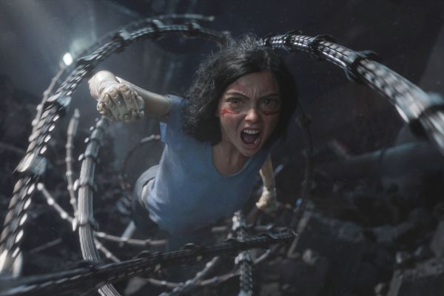
Action Sequences:
The film is filled with intense and well-choreographed action sequences, showcasing Alita's combat skills and agility. The use of CGI and practical effects in these scenes contributes to a visceral and engaging experience for the audience.

Slide 7
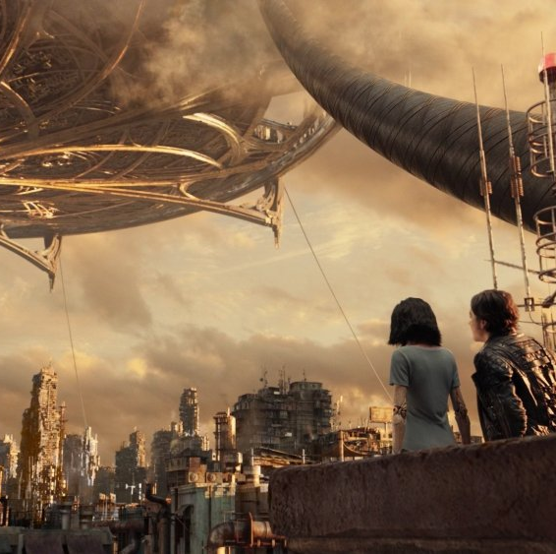
World Building:
"Alita: Battle Angel" successfully creates a rich and immersive cyberpunk world, exploring the societal divide between the wealthy elite in the floating city of Zalem and the impoverished residents on the ground. The film delves into themes of class disparity and the consequences of advanced technology.

Slide 8
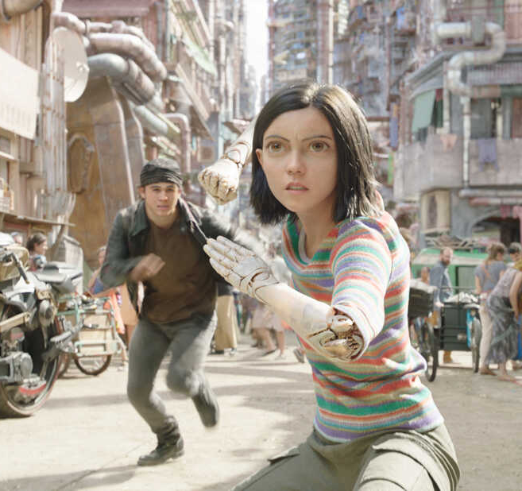
Plot and Pacing:
While the film is generally well-received for its action and visuals, some critics note that the plot may feel formulaic or predictable at times. However, the pacing keeps the story moving forward, and the narrative does offer enough twists and turns to keep viewers engaged.

Slide 9

Set Design and Cinematography:
The film's production design and cinematography contribute to the overall immersive experience. The gritty, dystopian aesthetic is well-captured, and the world feels lived-in and authentic.

Slide 10
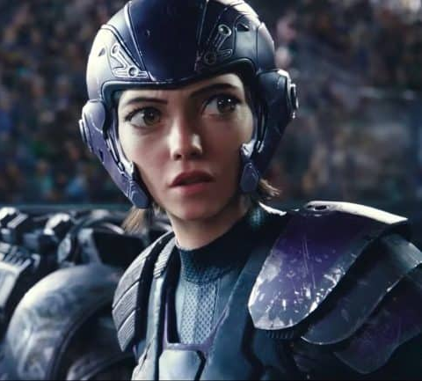
Potential for Sequels:
The ending of "Alita: Battle Angel" sets up the possibility for future installments, and fans have expressed interest in seeing the continuation of Alita's story. As of my last knowledge update in January 2022, any developments regarding a sequel or additional films may have occurred since then.
In summary, "Alita: Battle Angel" generally received positive reviews for its stunning visuals, engaging action sequences, and character development. While some critics mentioned predictable plot elements, the overall reception was favorable, and the film gained a dedicated fan base eagerly awaiting further exploration of Alita's adventures in potential sequels.

Slide 11
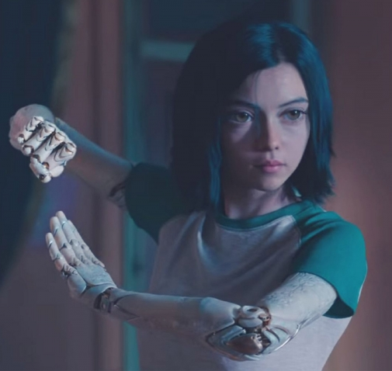
THE END

