Slide 1
Masaccio – Monitoring for urbAn SAfety with the IoT
Stefan Ilic
Fabio Giancristofaro

Slide 2
Summary
Introduction
Risk analysis
Architecture
Services
Services implemented

Slide 3
introduction
Our system is focused on increasing safety of students in schools. Recent headlines underscore the need for better ways to protect students and staff from threats including armed intruders, abductions, fights, natural disasters, bullying, vandalism, and thefts.
To help create a safe and secure environment our system works in sync with operators on the school premise to make both students and parents feel and be more secure.

Slide 4
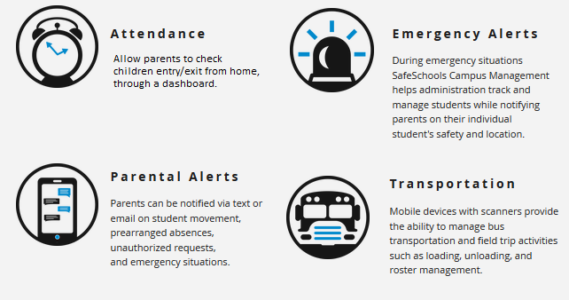
introduction

Slide 5
Risk analysis
Main risks:
Ensure fault tolerance
Each critical message has to be delivered
Ensure privacy of student data

Slide 6
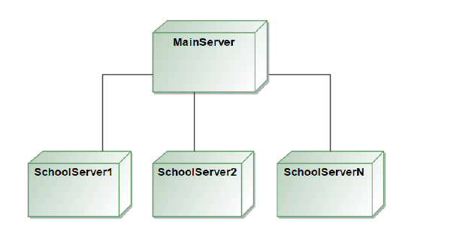
High level architecture overview
Our system is combination of:
Client server architecture
Distributed system architecture

Slide 7
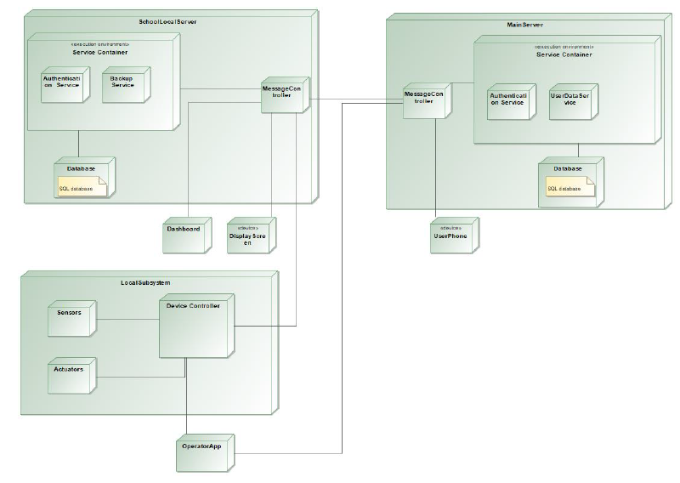
Main parts of the system:
Main server
SchoolLocalServer
LocalSubSystem

Slide 8
List of services
Access right management
Parents information service
People counters
CCTV video surveillance
Alarm system
First responders communication service

Slide 9
Implementation technology
Backend:
Python
RabbitMQ, Flask microframework
PHP
Frontend:
HTML
Javascript

Slide 10
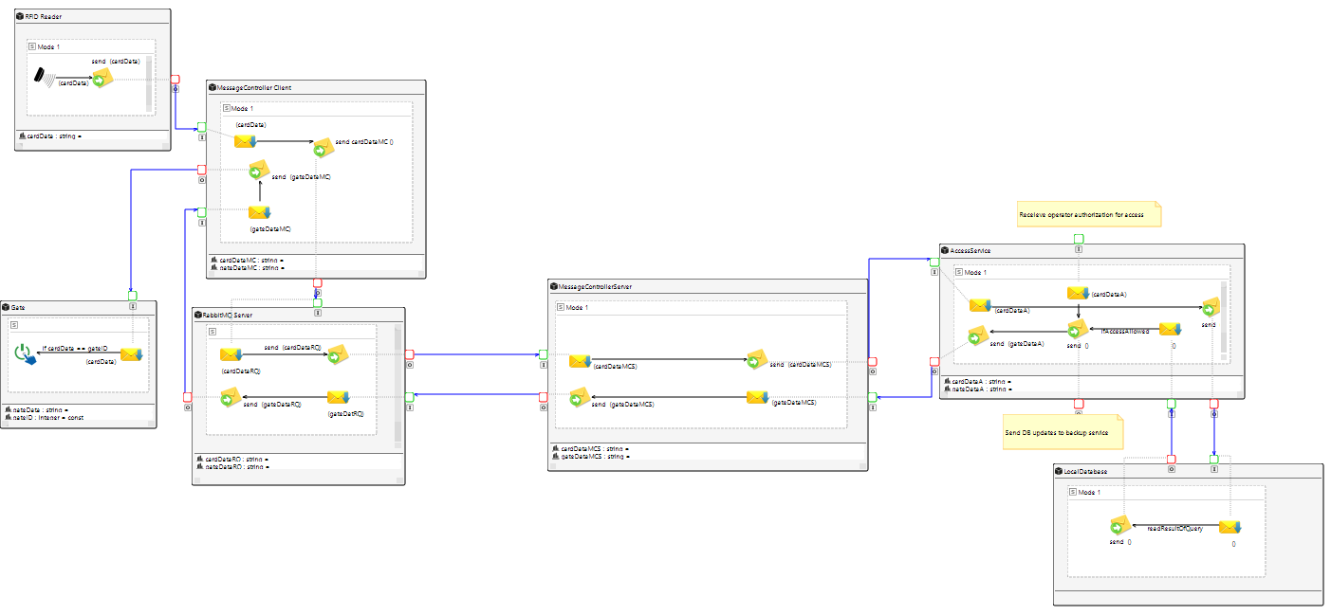
implemented Services – access right

Slide 11
access right
Only authorized people can enter in a selected areas
Permission check includes:
Selected room
Current time
Current occupancy
Unauthorized people can enter with a guest card after security check (manual)
Record entrance and departure time, current room occupancy

Slide 12
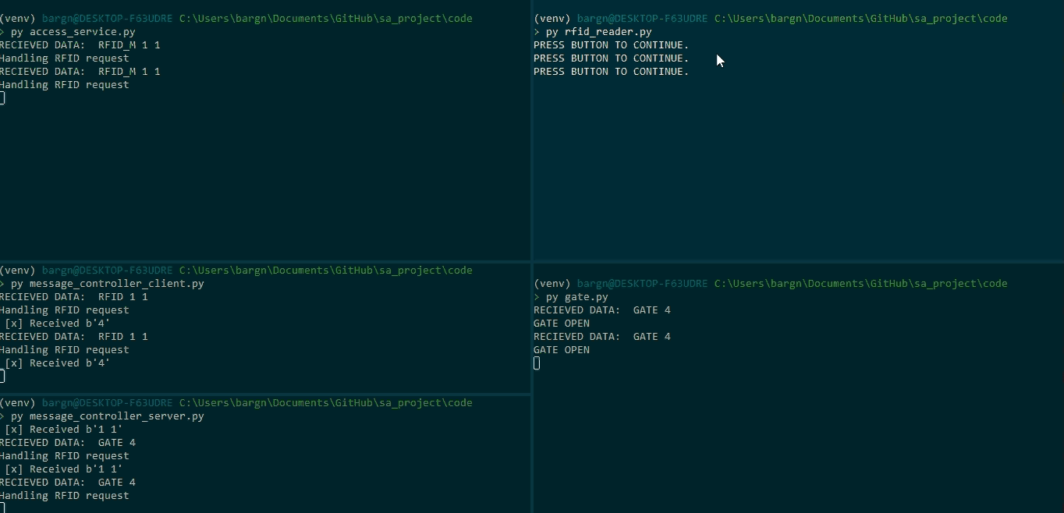

Slide 13
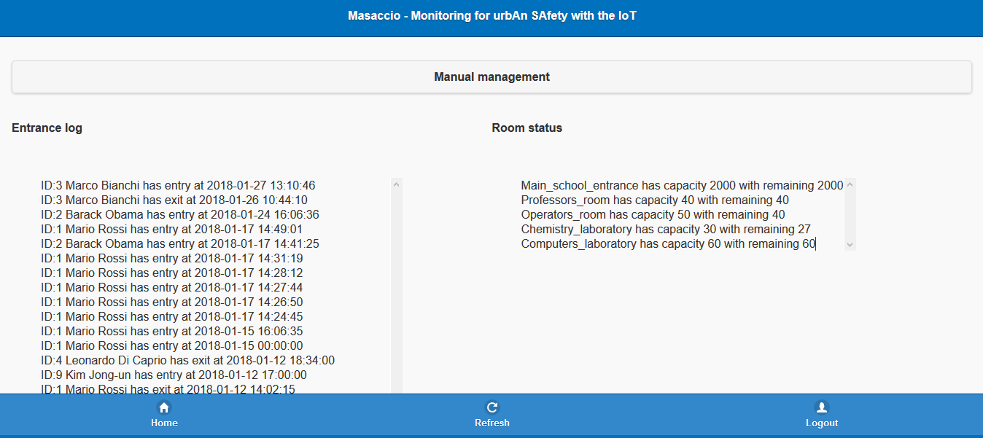
Operator dashboard

Slide 14
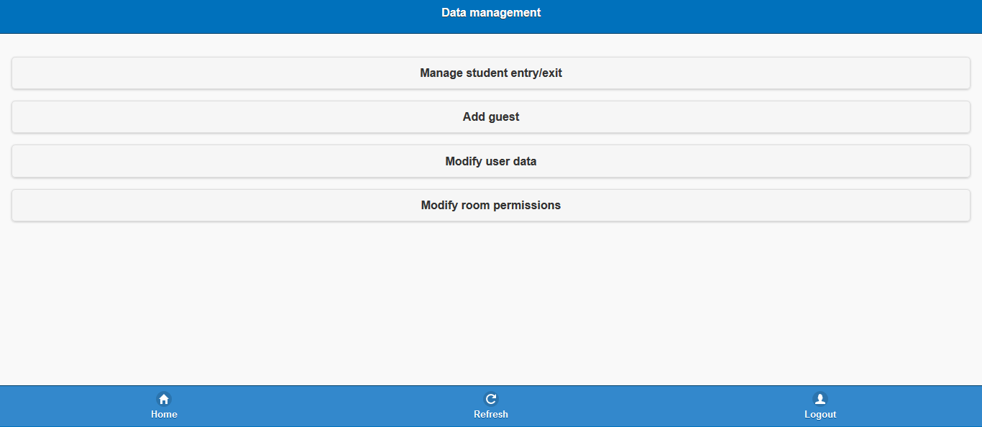
Operator dashboard

Slide 15
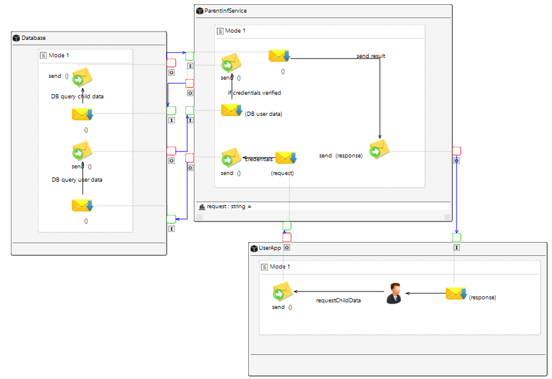
implemented Services – parent information
Parents can check time of student arrival and departure from school

Slide 16
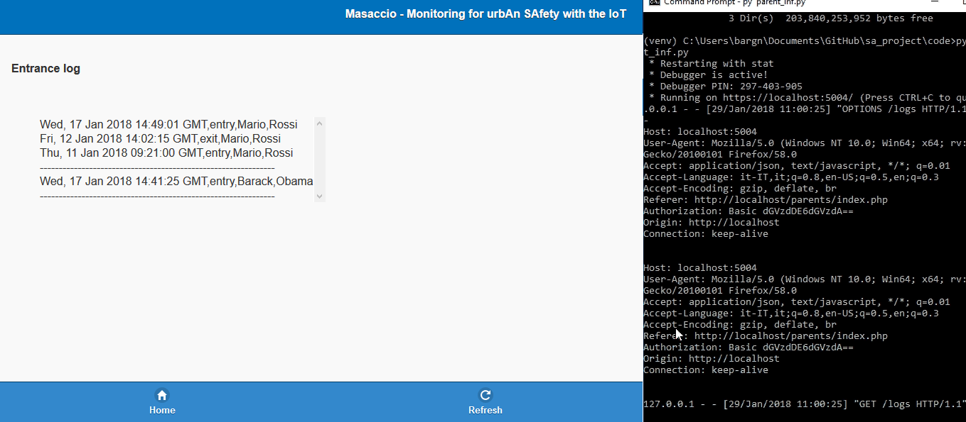
parent dashboard

