Slide 1
Attention & Transformers

Slide 2
What is a Transformer?
A Transformer is a neural network architecture designed for sequence modeling that relies entirely on attention, without using recurrence (RNNs) or convolution (CNNs).
Its key innovation is self-attention, which allows the model to look at all tokens simultaneously and decide which tokens matter most for each token.

Slide 3
What is Attention?
Attention is a mechanism that assigns importance weights to different tokens when computing a representation for a given token.
In simple terms:
Each token asks: “Which other tokens should I pay attention to, and how much?”

Slide 4
When was attention first introduced?
Attention was first introduced in 2014 in the context of neural machine translation.
Paper: “Neural Machine Translation by Jointly Learning to Align and Translate”
Context :
  Used with RNN-based encoder-decoder models
  Solved the fixed-length bottleneck problem of seq2seq models
  Allowed the decoder to focus on different parts of the input sequence dynamically

Slide 5
Attention existed before Transformers!
Year | Architecture | Role of Attention
2014 | RNN Encoder-Decoder | Soft alignment
2015 | RNN + Attention | Improved translation
2017 | Transformer | Attention-only model
The Transformer (2017) by Ashish Vaswani et al. was revolutionary because it removed recurrence entirely and relied only on attention.

Slide 6
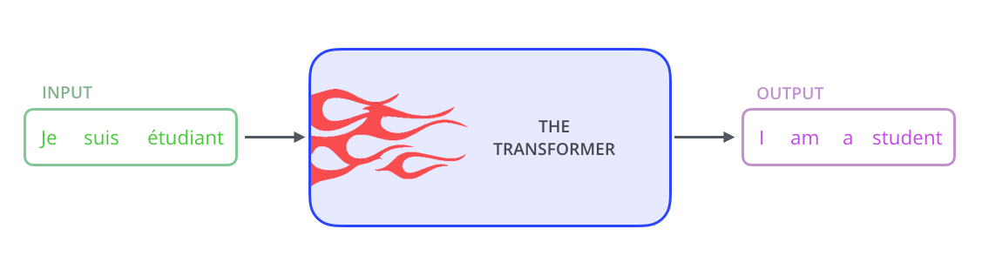
Understanding the Transformer
The original transformers was made for machine translation task and that is what we shall do as well. In a machine translation application, it would take a sentence in one language, and output its translation in another.

Slide 7

But before that, Let’s have a brief look into the black box that is our Transformer. We can see that it consists of Encoders and Decoders.

Slide 8

Before being passed to the Encoder, The sentence “je suis étudiant” is broken down into its respective words* and each word is embedded using an embeddings matrix. (which is trained along with the transformer)

Slide 9
Tokenization
Before embedding, text must be broken into tokens. A token is not always a full word. It can be:
A full word: "pizza" -> 1 token
A subword: "unbelievable" -> "un", "believ", "able" (3 tokens)
A punctuation mark: "." -> 1 token
In practice, modern transformers use subword tokenization.
Common methods include BPE (used in GPT) and WordPiece (used in BERT).
Why subword tokenization?
Handles rare or unseen words gracefully. Keeps vocabulary size manageable (typically 30,000 to 50,000 tokens). Common words stay whole, rare words get split.
However, tokenization is a preprocessing step independent of the transformer architecture itself.

Slide 10
Tokenization
Input: "Je suis étudiant"
Tokens: ["Je", "suis", "étudiant"] <- treated as whole words
Each token is then looked up in a vocabulary table and assigned an integer ID, which is then passed through the embedding matrix.
"Je" -> ID 2345 -> embedding vector x1
"suis" -> ID 8712 -> embedding vector x2
"étudiant" -> ID 1923 -> embedding vector x3
So the full pipeline before the encoder is:
Raw text -> Tokenizer -> Token IDs -> Embedding matrix -> Vectors + PE

Slide 11
Step 1: Raw Text
You start with a plain sentence.
"Je suis étudiant"
Step 2: Tokenizer
The tokenizer splits the raw text into tokens.
Each token is a unit the model can work with.
"Je suis étudiant" -> ["Je", "suis", "étudiant"]
Step 3: Token Ids
The model cannot work with words directly.
It only understands numbers.
So there is a fixed vocabulary table that was built before training.
It is simply a dictionary that maps every known token to a unique integer.
Vocabulary table (example):
...
"Je" -> 2345
"suis" -> 8712
"étudiant" -> 1923
"pizza" -> 4471
"bonjour" -> 0891
...
The tokenizer looks up each token in this table and returns its ID.
["Je", "suis", "étudiant"] -> [2345, 8712, 1923]
These integers are the only thing passed into the model.
The model never sees the actual text.
Step 4: Embedding Matrix
Now the model needs to convert each integer ID into a meaningful vector.
The embedding matrix is a big table of shape:
[vocabulary size x embedding dimension]
e.g. [30,000 x 512]
Each row corresponds to one token in the vocabulary.
To get the embedding for a token, you simply retrieve the row
at the index equal to the token ID.
ID 2345 -> retrieve row 2345 -> [0.21, -0.43, 0.87, ..., 0.11] (512 numbers)
ID 8712 -> retrieve row 8712 -> [0.54, 0.12, -0.33, ..., 0.67] (512 numbers)
ID 1923 -> retrieve row 1923 -> [-0.09, 0.77, 0.41, ..., -0.22] (512 numbers)
These vectors are called embeddings. They are the model's internal
representation of each token. They are learned during training and
encode semantic meaning.
"Je" -> x1 (512-dimensional vector)
"suis" -> x2 (512-dimensional vector)
"étudiant" -> x3 (512-dimensional vector)
Step 5: Vectors + Pe
The embedding vectors alone carry meaning but no position information.
The transformer processes all tokens in parallel so it has no natural
sense of order.
Positional encoding (PE) vectors are added to the embedding vectors
to inject position information.
Final input to encoder = embedding + positional encoding
x1 + t1 -> "Je" with position 0 information
x2 + t2 -> "suis" with position 1 information
x3 + t3 -> "étudiant" with position 2 information
These combined vectors are what actually enter the first encoder layer.

Slide 12
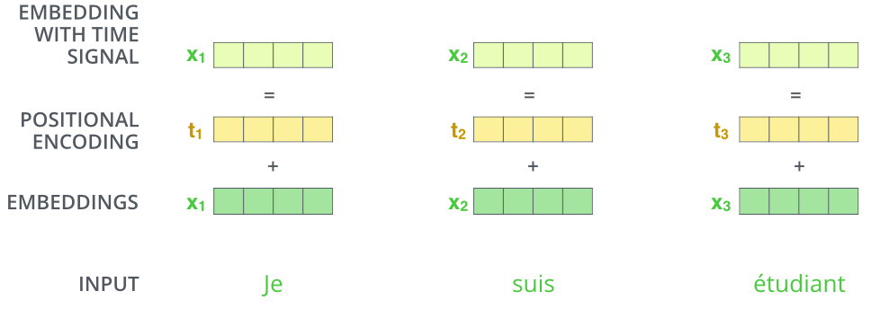
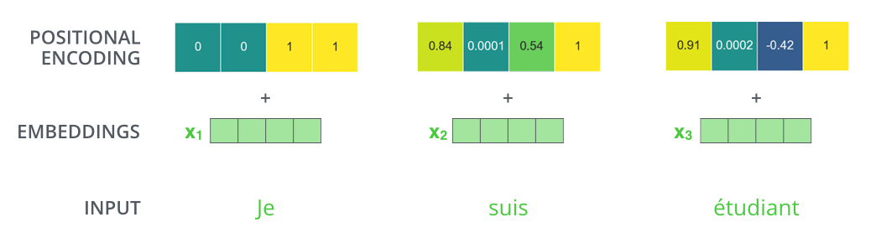
To these embeddings positional information is added as model contains no recurrence and no convolution.
In order for the model to make use of the order of the sequence, we must inject some information about the relative or absolute position of the tokens in the sequence.

Slide 13
Understanding Positional Encoding
To understand What is Positional Encoding and why we need it, let’s imagine the scenario in which we do not have it.
First an input sentence, for E.g “Pramod likes to eat pizza with his friends”. Will be broken down into the respective words: Pramod, likes, to, eat, pizza,with, his, friends.
Second, Each word will be converted into an embedding of a given dimension.
Now, without Positional Encoding. The model has no information about the relative positioning of the words. (As everything is taken at once in parallel)
So the sentence is no different from “Pramod likes to eat friends with his pizza” or any other permutation of the word.
Hence, the reason we need PE (Positional Encoding) is to tell the model about the positions of different words relative to each other.

Slide 14
Understanding Positional Encoding
Analogy :
Imagine you want to describe a time uniquely.
You use:
seconds hand (changes fast)
minutes hand (changes slower)
hours hand (changes very slowly)
Together they uniquely identify any moment.
Positional encoding does the same:
some dimensions change fast across positions
some dimensions change slowly across positions
Together they uniquely identify any position.
We cannot just use 0, 1, 2, 3... as a single number because that does not scale well and the model does not handle raw integers easily.
Instead we represent each position as a LIST OF SINE AND COSINE VALUES at different frequencies.
This list is the positional encoding vector.

Slide 15
Now, what will be the preferred characteristics of such a PE:
Unique encoding for each position:
  Each position must have a distinct representation.
  Encoding should not change with sentence length.
  Example:
    Position 2 in a 10-word sentence and Position 2 in a 100-word sentence should be encoded identically.
  Otherwise:
    No consistent positional pattern exists, making training unstable.
Linear relation between two encoded positions:
  If I know the position p of one word, it should be easy to calculate the position p+k of another word.
  Helps the model:
    Learn relative position patterns
    Capture sequence structure efficiently

Slide 16
Now, what will be the preferred characteristics of such a PE:
Generalizes to longer sequences than those encountered in training:
  Positional encoding should work for:
    Sequences longer than those seen during training
  Otherwise:
    Model becomes length-limited
    Fails in real-world applications
Generated by a deterministic process:
  Should be produced using:
    A fixed mathematical formula
    An easily computable algorithm
  Benefits:
    Stable training.
    Better generalization
    No dependency on training data

Slide 17
Now, what will be the preferred characteristics of such a PE:
Extensible to multiple dimensions:
  Should naturally scale to:
    Different embedding sizes
    Different model configurations
    Ensures flexibility across tasks and architectures
These requirements motivate the use of sinusoidal positional encoding in the original Transformer.

Slide 18
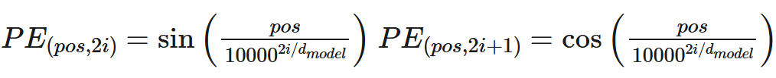
Sinusoidal Encoding
pos = position of the word in the sentence (“Pramod likes pizza” Pramod is at position 0, likes in 1 and so on)
i = value for ith and (i+)th index of the embedding, sine for even column number cosine for odd column number (“Pramod” is converted into a vector of embedding. Which has different indexes)
d_model = dimension of the model (in our case it is 512)
10,000 (n) = this is a constant determined experimentally

Slide 19
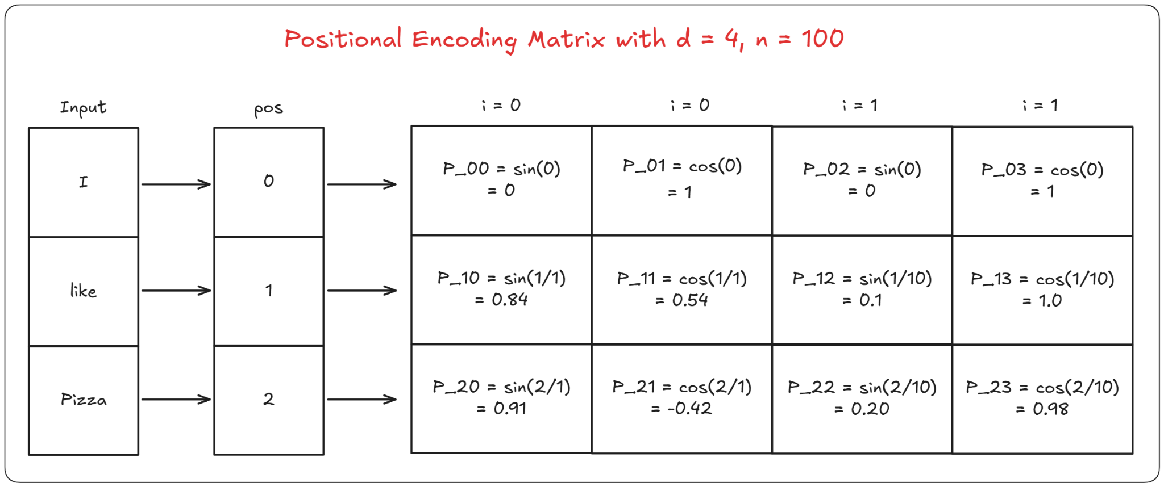
As you can see, using this we can calculate the PE value for each position and all the indexes for that position. Here is a simple illustration showing how its done.

Slide 20
Positional Encoding Matrix (d = 4, n = 100)
Each token gets a 4-dimensional PE vector. The formula is:
P(pos, 2i) = sin( pos / n^(2i/d) )
P(pos, 2i+1) = cos( pos / n^(2i/d) )
where pos is the token position and i is the pair index (0 or 1 here).
Column breakdown (d = 4, so two pairs):
Col 0 -> sin, i=0, denominator = 100^(0/4) = 1
Col 1 -> cos, i=0, denominator = 100^(0/4) = 1
Col 2 -> sin, i=1, denominator = 100^(2/4) = 10
Col 3 -> cos, i=1, denominator = 100^(2/4) = 10
Row-by-row:
"I" (pos=0):
[ sin(0/1), cos(0/1), sin(0/10), cos(0/10) ]
= [ 0, 1, 0, 1 ]
"like" (pos=1): [ sin(1/1), cos(1/1), sin(1/10), cos(1/10) ]
= [ 0.84, 0.54, 0.10, 1.0 ]
"Pizza" (pos=2): [ sin(2/1), cos(2/1), sin(2/10), cos(2/10) ]
= [ 0.91, -0.42, 0.20, 0.98]

Slide 21

The encoding component is a stack of encoders (the paper stacks six of them on top of each other – there’s nothing magical about the number six, one can definitely experiment with other arrangements).
The decoding component is a stack of decoders of the same number.

Slide 22
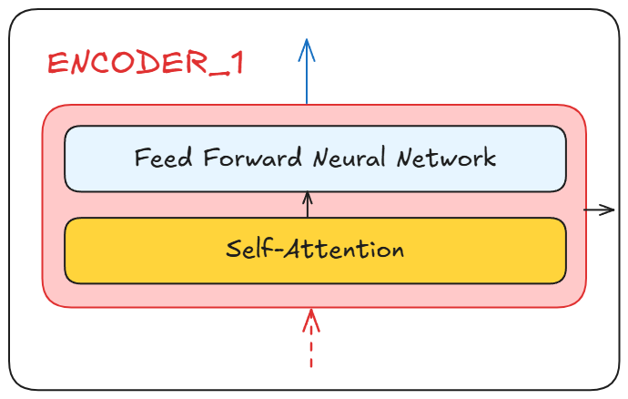
The Encoders are all identical in structure (yet they do not share weights).
Each one is broken down into two sublayers:
Self-Attention Layer
  First component applied to the encoder input
  Allows each word to attend to all other words in the input sentence
  Produces context-aware representations for each token
Feed-Forward Neural Network (FFN)
  Applied after self-attention
  The same FFN is used at every position
  Operates independently on each token
  Adds non-linearity and representation power

Slide 23
Why Encoders Do Not Share Weights
Key Fact
All encoder blocks have identical structure but independent weights.
Encoder 1: WQ1, WK1, WV1, FFN1 <- its own weights
Encoder 2: WQ2, WK2, WV2, FFN2 <- its own weights
Encoder 3: WQ3, WK3, WV3, FFN3 <- its own weights
Model Capacity
Each layer adds its own learnable parameters
More parameters = more capacity to learn complex patterns
With 6 layers, d_model = 512:
Independent weights -> ~18 million parameters
Shared weights -> ~3 million parameters
Sharing weights severely limits what the model can learn.
Each Layer Learns Different Abstractions
Encoder 1 sees raw embeddings
-> learns basic syntax and word level patterns
Encoder 2 sees output of encoder 1
-> learns phrase level relationships
Encoder 3 sees output of encoder 2
-> learns sentence level semantics
If weights were shared, every layer applies the same transformation.
Depth adds no value.
Residual Connections
Each encoder output = LayerNorm(input + sublayer(input))
If weights are shared, the same transformation is repeatedly added
Independent weights allow each layer to learn a complementary
transformation that adds new information rather than repeating it
Independent weights allow each encoder layer to learn a different level of abstraction, maximizing the benefit of depth.

Slide 24
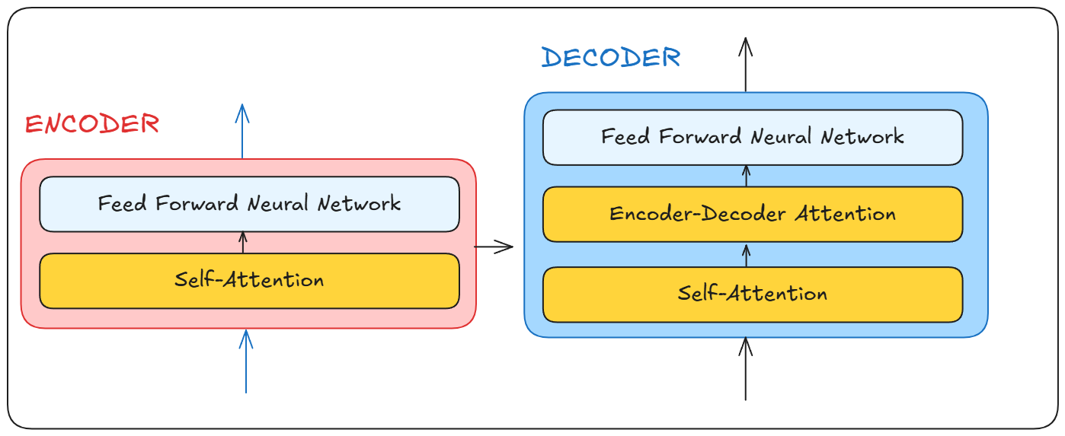
The decoder block takes the output from the encoder, runs it through it self, produces an output and sends it back to itself to create the next word.
Encoder-Decoder attention allows the decoder to query encoder outputs and align generated words with the most relevant parts of the input sentence while producing each output token.

Slide 25
Think of it like this. The encoder understands your language let’s call it X and another language called Y The decoder understands Y and the language you are trying to translate X to, lets call it Z.
So Y acts as the common language that both the encoder and decoder speak to produce the final output.

Slide 26
Understanding Self-attention
We have all heard of the famous trio, “Query, Key and Values”.
Let us first build an intuition behind the idea.
Sentence (S): “Pramod loves pizza”
Question:
Who loves pizza?
You can come up with as many Questions (the queries) for the sentence as you want. Now for each query, you will have one specific piece of information (the key) that will give you the desired answer (the value).

Slide 27
Understanding Self-attention (cont.)
Query:
Q ->Who loves pizza?
K -> pizza, Pramod, loves (it will actually have all the words with different degree of importance)
V -> pizza (The value is not directly the answer, but a representation as a matrix of something similar to the answer)
This is an oversimplification really, but it helps understand that the queries, keys and values all can be created only using the sentences.

Slide 28
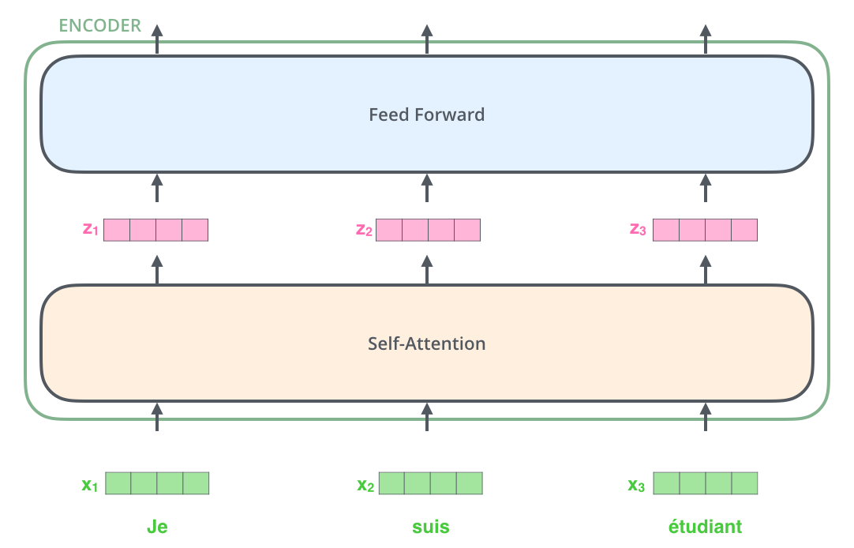
How and why Self-attention is applied
After embedding the words in our input sequence, each of them flows through each of the two layers of the encoder.
Each position flows through its own path in the encoder.
There are dependencies between these paths in the self-attention layer.
The feed-forward layer does not have those dependencies, however, and thus the various paths can be executed in parallel while flowing through the feed-forward layer.

Slide 29
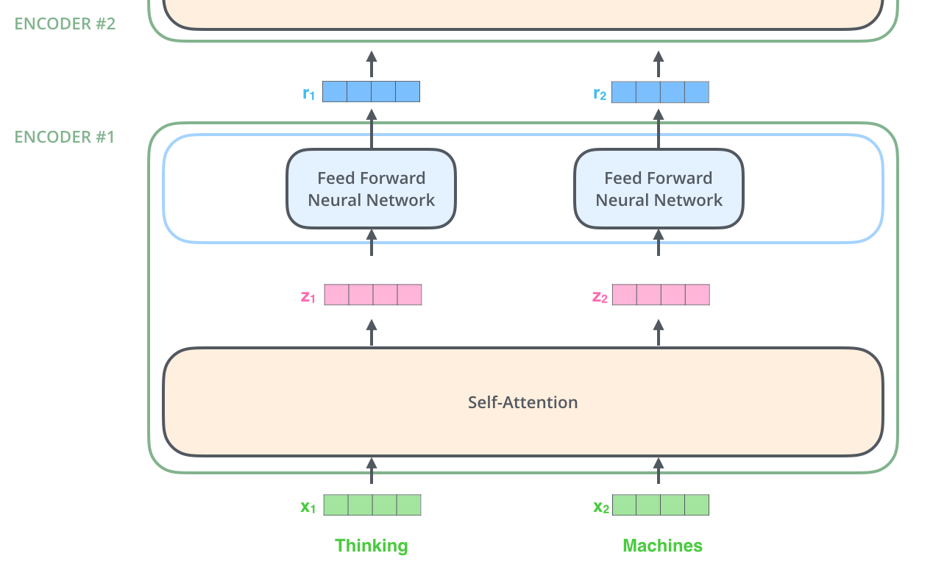
How and why Self-attention is applied
Encoder receives a list of vectors as input. It processes this list by passing these vectors into a ‘self-attention’ layer, then into a feed-forward neural network, then sends out the output upwards to the next encoder.
The word at each position passes through a self-attention process. Then, they each pass through a feed-forward neural network -- the exact same network with each vector flowing through it separately.

Slide 30
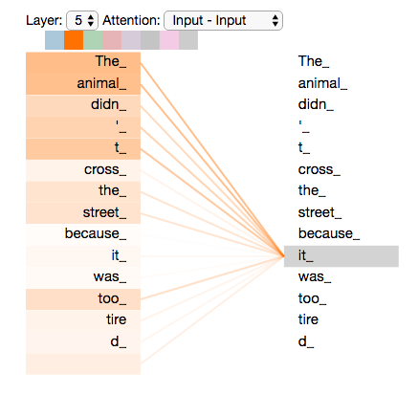
Self-Attention at a High Level
Say the following sentence is an input sentence we want to translate:
“The animal didn't cross the street because it was too tired”
What does “it” in this sentence refer to?
Is it referring to the street or to the animal?
It’s a simple question to a human, but not as simple to an algorithm.
When the model is processing the word “it”, self-attention allows it to associate “it” with “animal”.
As the model processes each word (each position in the input sequence), self attention allows it to look at other positions in the input sequence for clues that can help lead to a better encoding for this word.
Self-attention is the method the Transformer uses to bake the “understanding” of other relevant words into the one we’re currently processing.

Slide 31
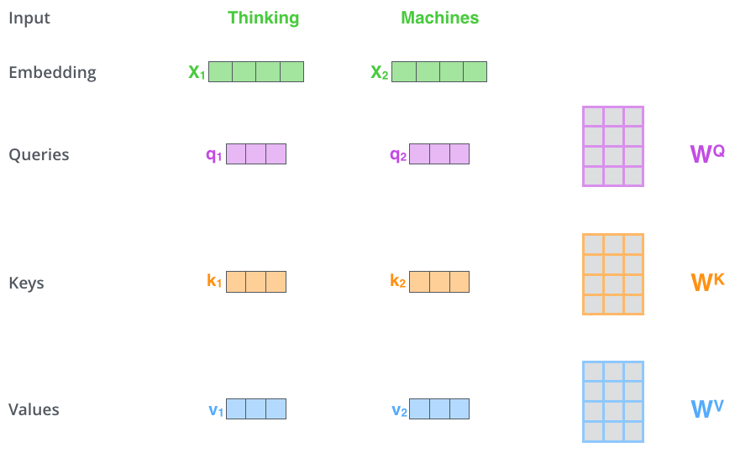
Self-Attention in Detail
First Step (calculating self-attention):
Start with the input embeddings
  Each word in the input sentence is represented by an embedding vector (for example, 512-dimensional).
Create Query, Key, and Value vectors
  For each word embedding, three new vectors are created: Query (Q), Key (K), Value (V)
  These are obtained by multiplying the embedding with three learned weight matrices.
Choose smaller dimensions for Q, K, and V
  The Q, K, and V vectors typically have a smaller dimension (e.g., 64) than the original embedding (e.g., 512).
  This is an architectural choice to reduce computation and make multi-head attention efficient.
Understand the roles of Q, K, and V
  Query represents what the current word is looking for
  Key represents what each word offers for matching
  Value represents the information each word contributes
Prepare for attention computation.

Slide 32
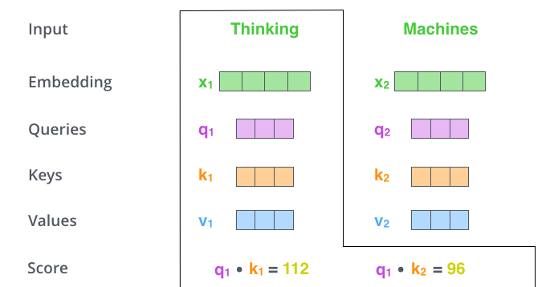
Self-Attention in Detail
Second Step : Calculate attention scores
Select the current word
  Choose the word for which self-attention is being computed (for example, the first word “Thinking”)
  Use its Query vector as the reference
Compare with all words in the sentence
  Score every word in the input sentence against the current word
  Each score represents how much attention the current word should give to another word
Compute scores using dot products
  The score with itself is the dot product of q₁ and k₁
  The score with the second word is the dot product of q₁ and k₂
  This continues for all words in the sentence
  Higher dot product means higher relevance

Slide 33
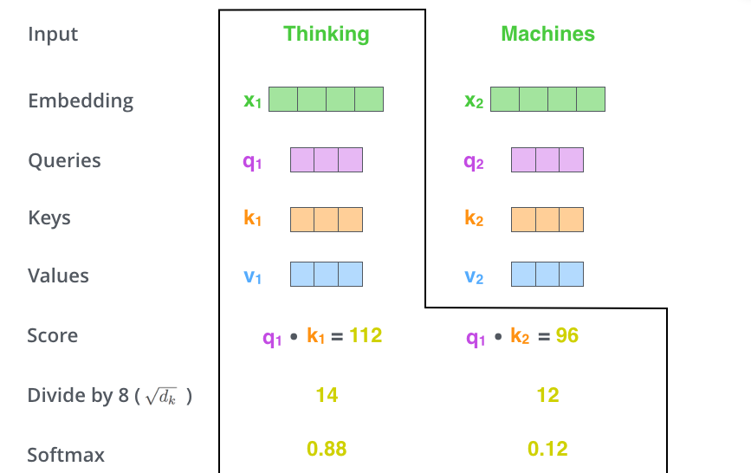
Self-Attention in Detail
Third and fourth steps : Scale scores and apply softmax
Scale the attention scores
  Divide each attention score by the square root of the key dimension
  In the original Transformer, this value is √d_{k} = √64 = 8
(d_{k} = embedding dimension / number of attention heads)
  Scaling prevents very large values and leads to more stable gradients during training
Apply softmax normalization
  Pass the scaled scores through a softmax function
  Softmax converts the scores into positive values that sum to 1
Interpret the softmax output
  Each softmax value represents how much attention the current word gives to another word
  The current word usually has the highest weight
  Other words can also receive high weights if they are contextually relevant

Slide 34
Self-Attention in Detail
Why is scaling attention scores by 1/√d_k so critical for transformers?
In self-attention, relevance scores are computed using dot products:
  q•k = q₁k₁ + q₂k₂ + ... + q_{dk} × k_{dk}
As the key/query dimension dk increases:
  The number of terms in the dot product increases
  Dot-product values naturally grow larger
Large dot-product values cause softmax saturation:
  One score dominates the softmax
  Attention weights become nearly one-hot
  Most tokens receive near-zero probability
When softmax saturates:
  Gradients vanish since p(1-p) -> 0
  Learning becomes unstable and inefficient
Scaling by 1/√d_k,
  Compensates for the increase in dot-product magnitude
  Keeps attention distributions smooth
  Ensures stable gradients and effective learning

Slide 35
Self-Attention in Detail
Why scale by √dₖ and not dₖ, dₖ², or any other function?
Dot-product attention score
  The raw attention score is computed as
    x = q · k = ∑ᵢ₌₁ᵈᵏ qᵢkᵢ
Variance of the dot product
  The dot product is a sum of dₖ independent terms.
  Therefore, the variance of x grows with dₖ.
  As dₖ increases, attention scores become larger and unstable.
General scaling idea
  Assume we scale the dot product by a function f(dₖ):
  y = x / f(dₖ)
The variance of the scaled score becomes:
  Var(y) = dₖ / f(dₖ)²
Requirement for stable attention
  For stable training, the variance of attention scores should remain approximately constant
  Var(y) ≈ 1
This gives:
  dₖ / f(dₖ)² ≈ 1
⇒ f(dₖ) = √dₖ
Why not scale by other functions?
Scaling by dₖ
  Var(y) = dₖ / dₖ² = 1 / dₖ
  Scores become too small
  Softmax becomes too flat
  Attention becomes weak
Scaling by dₖ²
  Variance collapses even faster
  Attention becomes ineffective
No scaling
  Variance grows with dₖ
  Softmax saturates
  Gradients vanish
Scaling by √dₖ exactly cancels the growth in dot-product variance, keeps attention scores well-behaved, and ensures stable and effective learning.

Slide 36
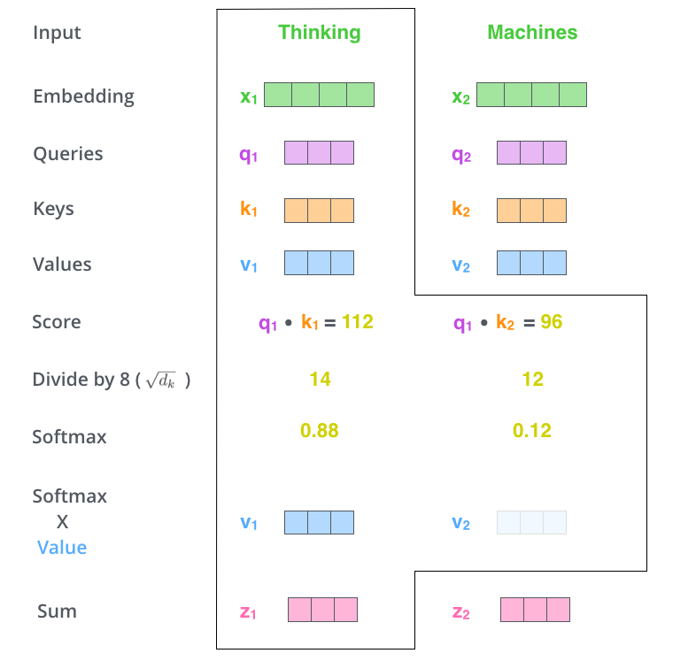
Self-Attention in Detail
5th Step: Weight the value vectors
  Multiply each Value (V) vector by its corresponding softmax attention score
  Purpose:
    Preserve information from highly relevant words
    Suppress irrelevant words by multiplying them with very small weights (e.g., 0.001)
6th Step: Sum the weighted value vectors
  Add all weighted value vectors together
  This sum produces:
    The output of the self-attention layer for the current position (token)
After self-attention
  The resulting vector is a context-aware representation of the token
  This vector is passed to the feed-forward neural network

Slide 37
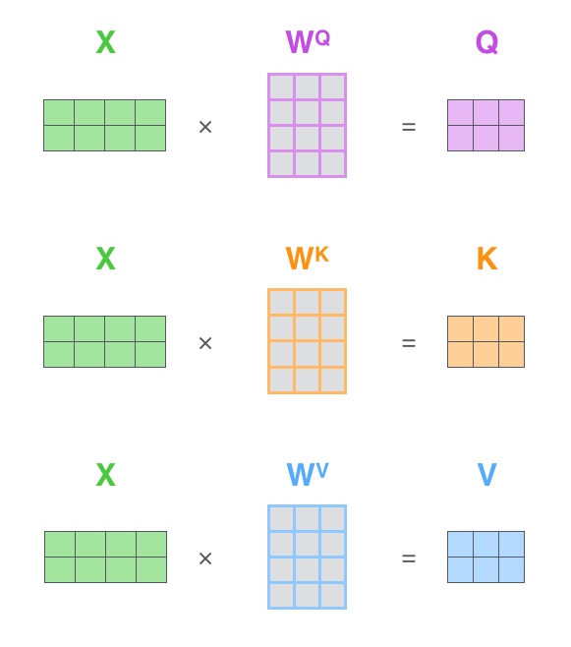
Matrix Calculation of Self-Attention
The first step is to calculate the Query, Key, and Value matrices. We do that by packing our embeddings into a matrix X, and multiplying it by the weight matrices we’ve trained (WQ, WK, WV).
Every row in the X matrix corresponds to a word in the input sentence. We again see the difference in size of the embedding vector (512, or 4 boxes in the figure), and the q/k/v vectors (64, or 3 boxes in the figure)

Slide 38
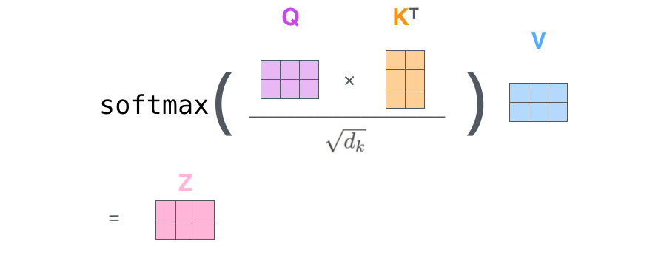
Matrix Calculation of Self-Attention
Finally, since we’re dealing with matrices, we can condense steps two through six in one formula to calculate the outputs of the self-attention layer.

Slide 39
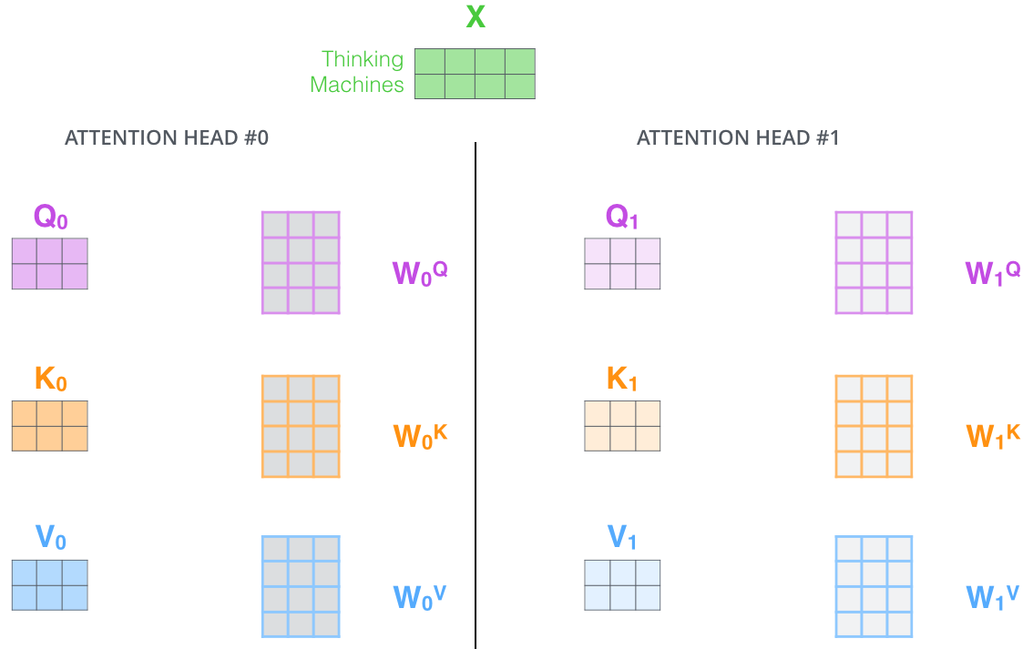
The Beast With Many Heads (Multi-headed Attention)
Benefit 1: Focus on different positions
A single attention output can be dominated by the current word.
Multiple heads allow the model to:
  Attend to different words simultaneously
  Capture long-range and subtle dependencies
Example:
In the sentence
“The animal didn’t cross the street because it was too tired”.
Multi-head attention helps determine what “it” refers to
Benefit 2: Multiple representation subspaces
Multi-head attention uses:
Multiple independent sets of Query, Key, and Value matrices
Each head:
  Has its own Q, K, V projections
  Is randomly initialized
  Learns a different way to represent relationships
With multi-headed attention, we maintain separate Q/K/V weight matrices for each head resulting in different Q/K/V matrices. As we did before, we multiply X by the WQ/WK/WV matrices to produce Q/K/V matrices.

Slide 40
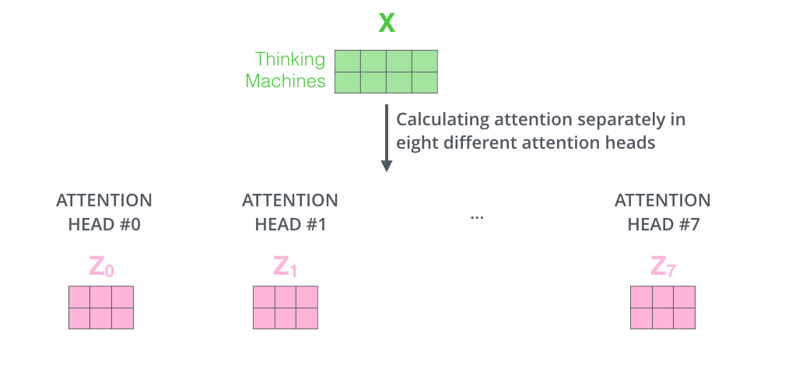
The Beast With Many Heads (Multi-headed Attention)
If we do the same self-attention calculation we outlined above, just eight different times with different weight matrices, we end up with eight different Z matrices

Slide 41
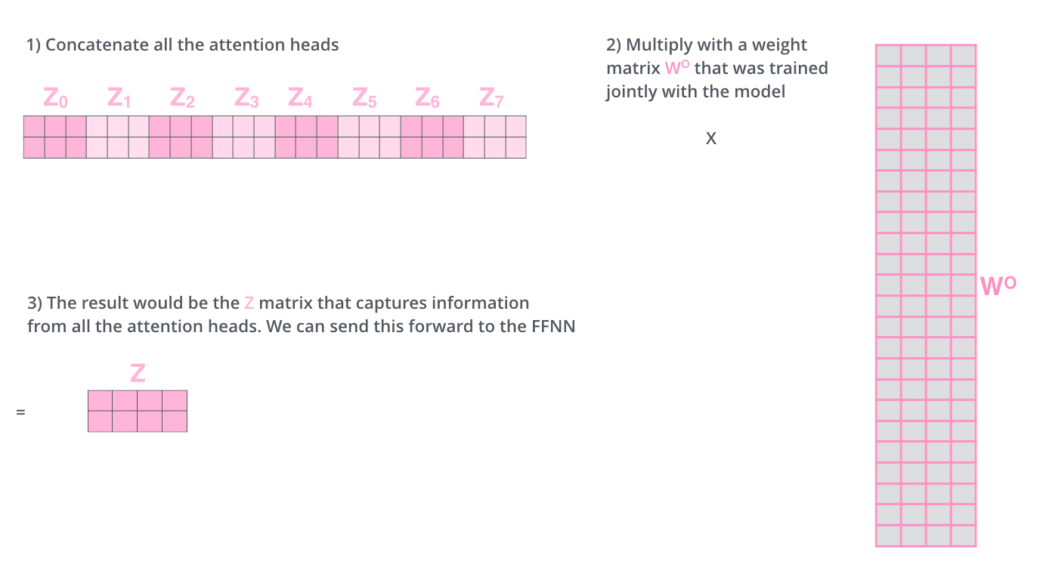
The Beast With Many Heads (Multi-headed Attention)
This leaves us with a bit of a challenge. The feed-forward layer is not expecting eight matrices - it’s expecting a single matrix (a vector for each word). So we need a way to condense these eight down into a single matrix.

Slide 42
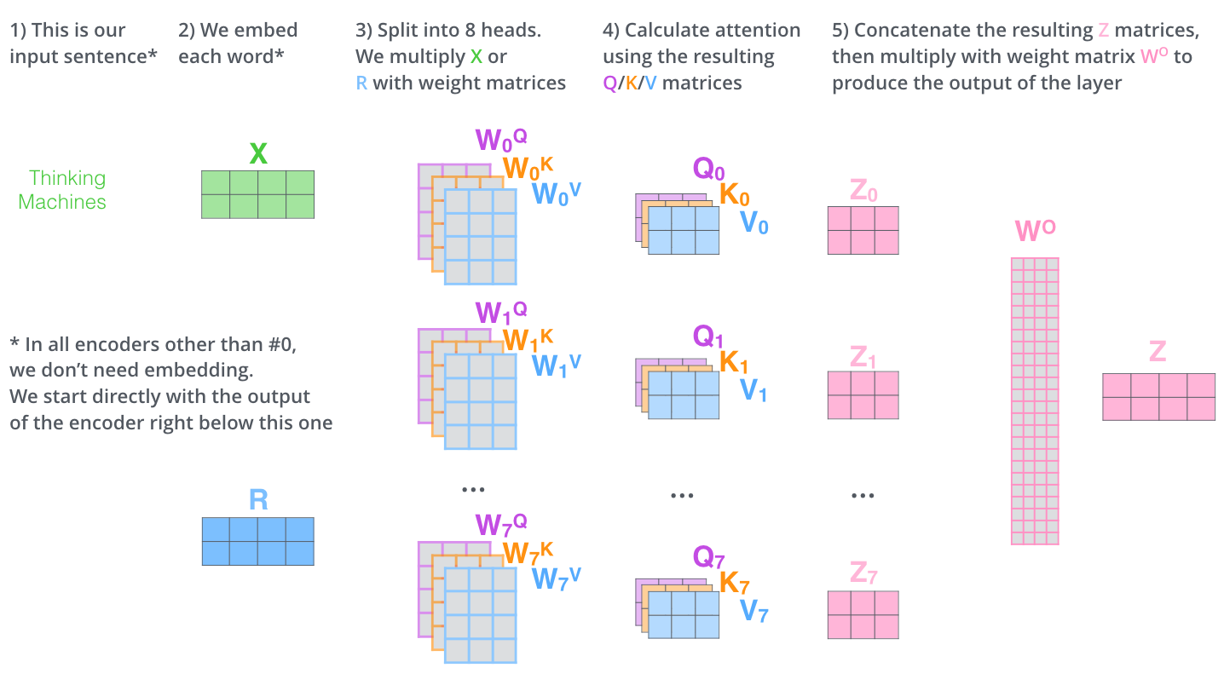
Workflow

Slide 43
Why this even works,
Imagine you are at point A and want to go to B in a huge city.
Do you think there is only one path to go there?
Of course not, there are thousands of way to reach that point.
But you will never know the best path, till you have tried a lot of them. More the better.
Hence a single matrix multiplication does not get you the best representation of query and key.
Multiple queries can be made, multiple keys can be done for each of these query. That is the reason we do so many matrix multiplications - to try and get the best key for a query that is relevant to the question asked by the user.

Slide 44
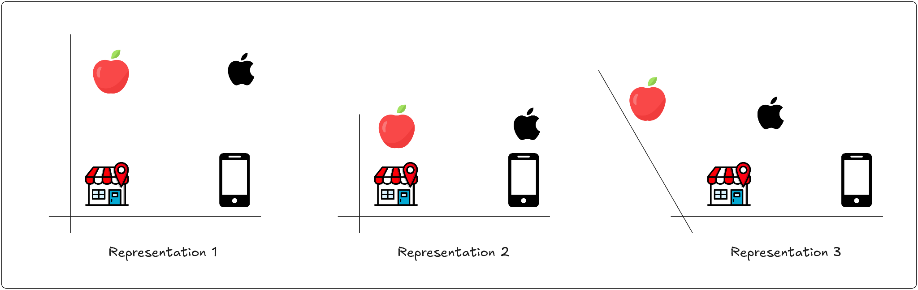
To visualize how Self-Attention creates different representation. Let’s have a look at the three different representation of different words “apple”,”market” & “cellphone”.
Q : What does the company apple make?
A : Representation 2 will be best to choose for this question, and it gives us the answer “cellphone” as that is the one closest to it.
Q : Where can I get a new iphone?
A : In this case Representation 3 will be the best option, and we will get the answer “market”.

Slide 45
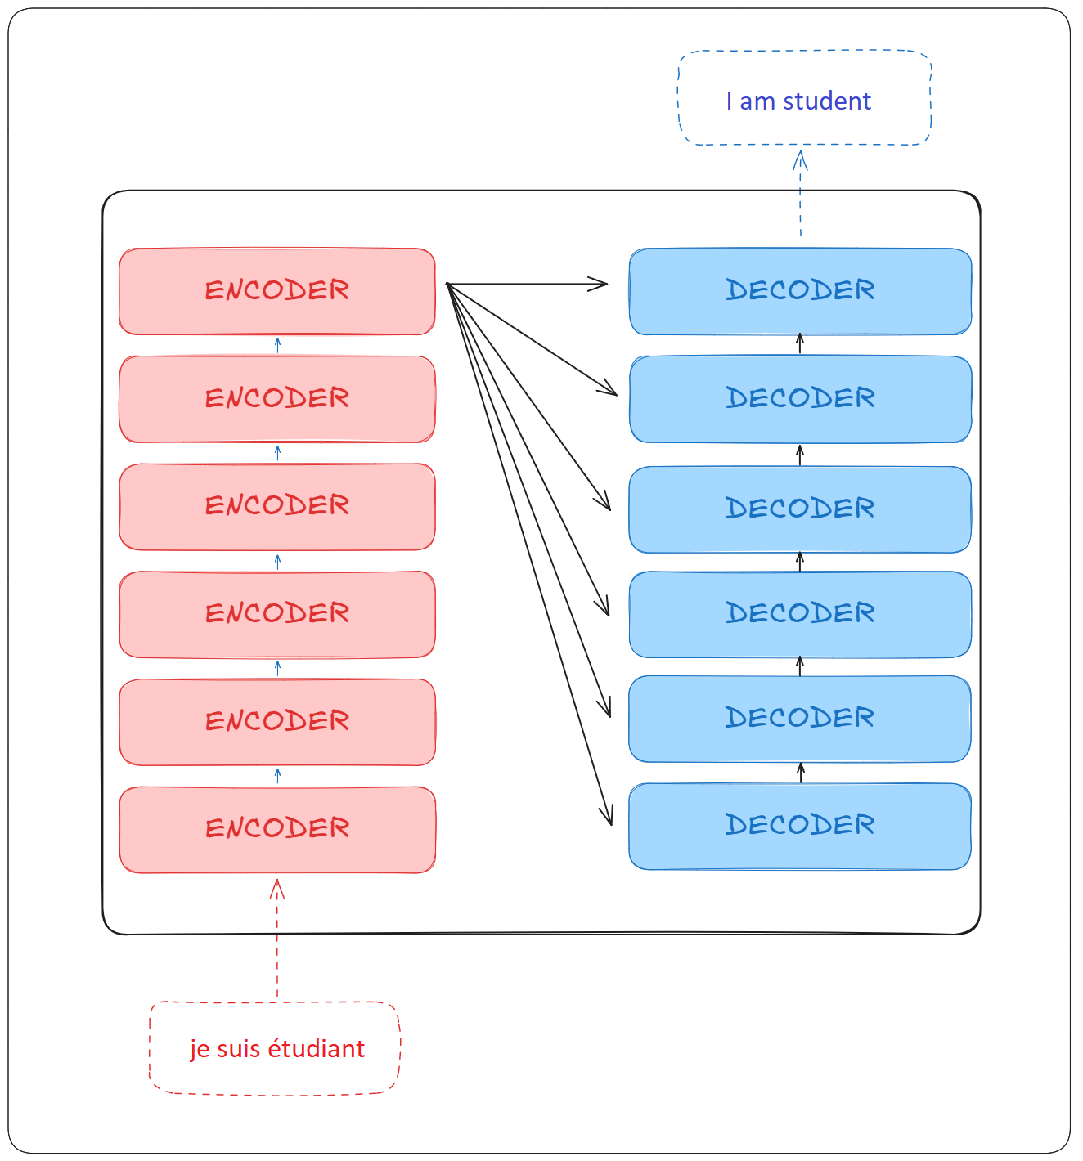
Understanding The
Encoder and Decoder Block
A single transformer can have multiple encoder, as well as decoder blocks.

Slide 46
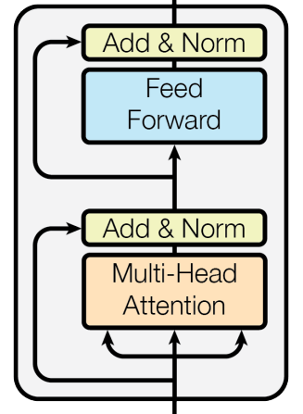
Encoder
It consists of multiple encoders, and each encoder block consists of the following parts:
Multi-head Attention
Residual connection
Layer Normalization
Feed Forward network

Slide 47
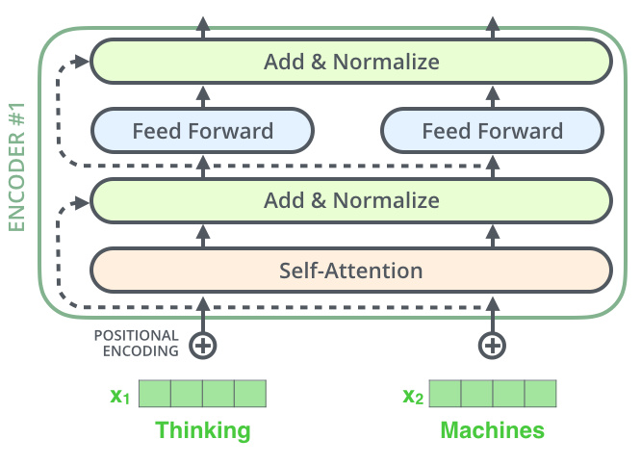
Residual connection
Residual connection or also known as skip connections, they work as the name applies.
They take the input and skip it over a block and take it to the next block.

Slide 48
Residual connection
Identity Preservation
Ensures every layer retains direct access to the original input representation
Each sublayer contributes an additive refinement rather than an overwriting transformation
Prevents loss of important features across depth
Training Stability
Smooths the loss landscape enabling more stable and efficient optimization
Empirically demonstrated to accelerate convergence and reduce sensitivity to initialization
Particularly beneficial as network depth increases
The Highway Analogy
Sublayer path = local road (complex transformation, slow gradient flow)
Skip connection = highway (direct path, fast gradient flow)
During backpropagation gradients can bypass complex sublayer transformations entirely via the skip connection, allowing them to reach the earliest layers without attenuation.
Residual connections preserve the original input by adding it directly to each sublayer output, providing stable gradient flow during backpropagation and ensuring that information from earlier representations remains accessible throughout the full depth of the network.
Why It Is Needed
Gradient Flow
In deep networks gradients diminish or explode as they propagate backward through many layers
The skip connection provides a direct gradient path back to earlier layers independent of sublayer weights
When sublayer weights are near zero gradients flow through the skip connection nearly unchanged effectively mitigating the vanishing gradient problem

Slide 49
Residual connection
How It Is Applied In The Transformer
Residual connections wrap every sublayer in both the encoder and decoder without exception:
Encoder:
After self-attention: output = LayerNorm(x + SelfAttention(x))
After FFN: output = LayerNorm(x + FFN(x))
Decoder:
After masked attention: output = LayerNorm(x + MaskedAttention(x))
After cross-attention: output = LayerNorm(x + CrossAttention(x))
After FFN: output = LayerNorm(x + FFN(x))

Slide 50
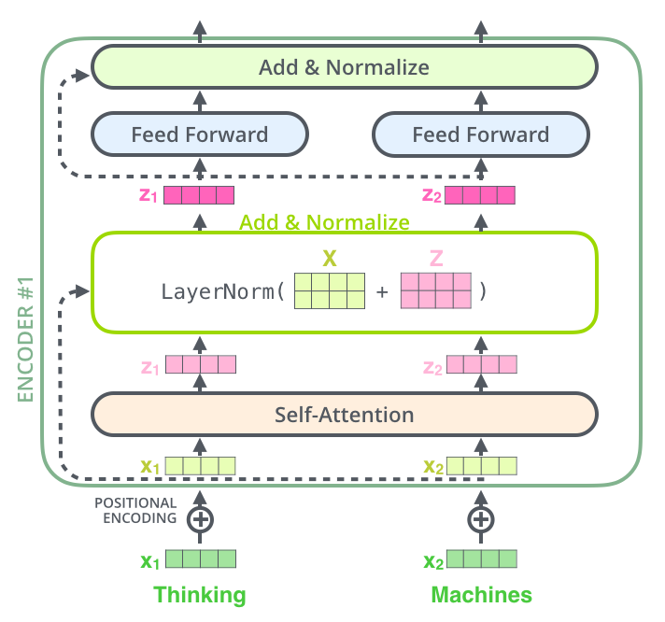
Residual connection
If we’re to visualize the vectors and the layer-norm operation associated with self attention, it would look like this:

Slide 51
Residual connection
Part 2: The Norm (Layer Normalization)
Layer normalization standardizes the vector so that its elements have mean 0 and variance 1, then applies learned scale and shift parameters.
The Formula:
LayerNorm(x) = gamma * (x - mean(x)) / sqrt(var(x) + epsilon) + beta
Where:
x = input vector
mean(x) = average of all elements in x
var(x) = variance of all elements in x
epsilon = small number (e.g. 0.000001) to prevent division by zero
gamma = learned scale parameter (initialized to 1)
beta = learned shift parameter (initialized to 0)
What Add And Norm Is
Every sublayer in the transformer is followed by:
output = LayerNorm(x + sublayer(x))
This has two parts:
ADD: x + sublayer(x) <- residual connection
NORM: LayerNorm(...) <- layer normalization
Part 1: The Add (Residual Connection)
x is the input to the sublayer.
sublayer(x) is what the sublayer produced.
We simply add them together.
x = [1.0, 2.0, 3.0, 4.0] <- original input
sublayer(x) = [0.5, -1.0, 0.2, 0.8] <- sublayer output
x + sublayer(x) = [1.5, 1.0, 3.2, 4.8] <- added together
This ensures the original input is never lost.
Even if the sublayer learns nothing useful, the original information still passes through unchanged.

Slide 52
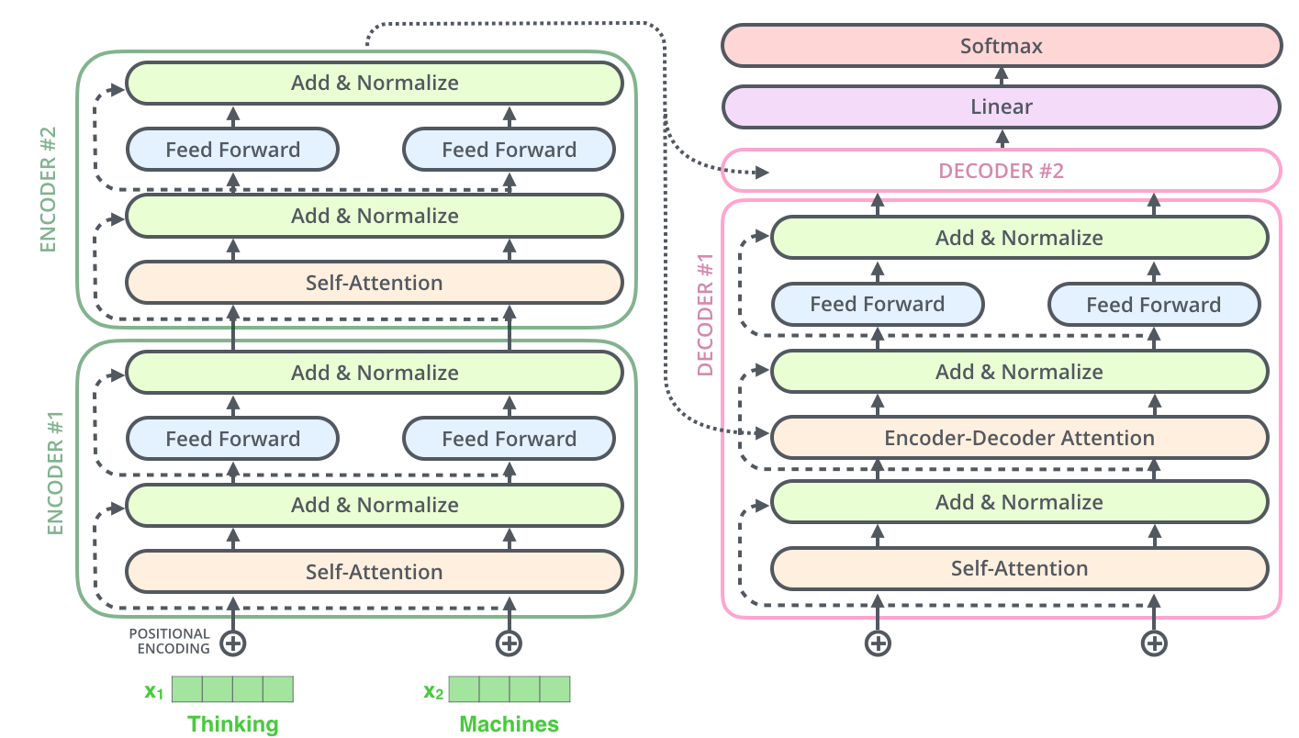
Residual connection
This goes for the sub-layers of the decoder as well.
If we’re to think of a Transformer of 2 stacked encoders and decoders, it would look something like this:

Slide 53
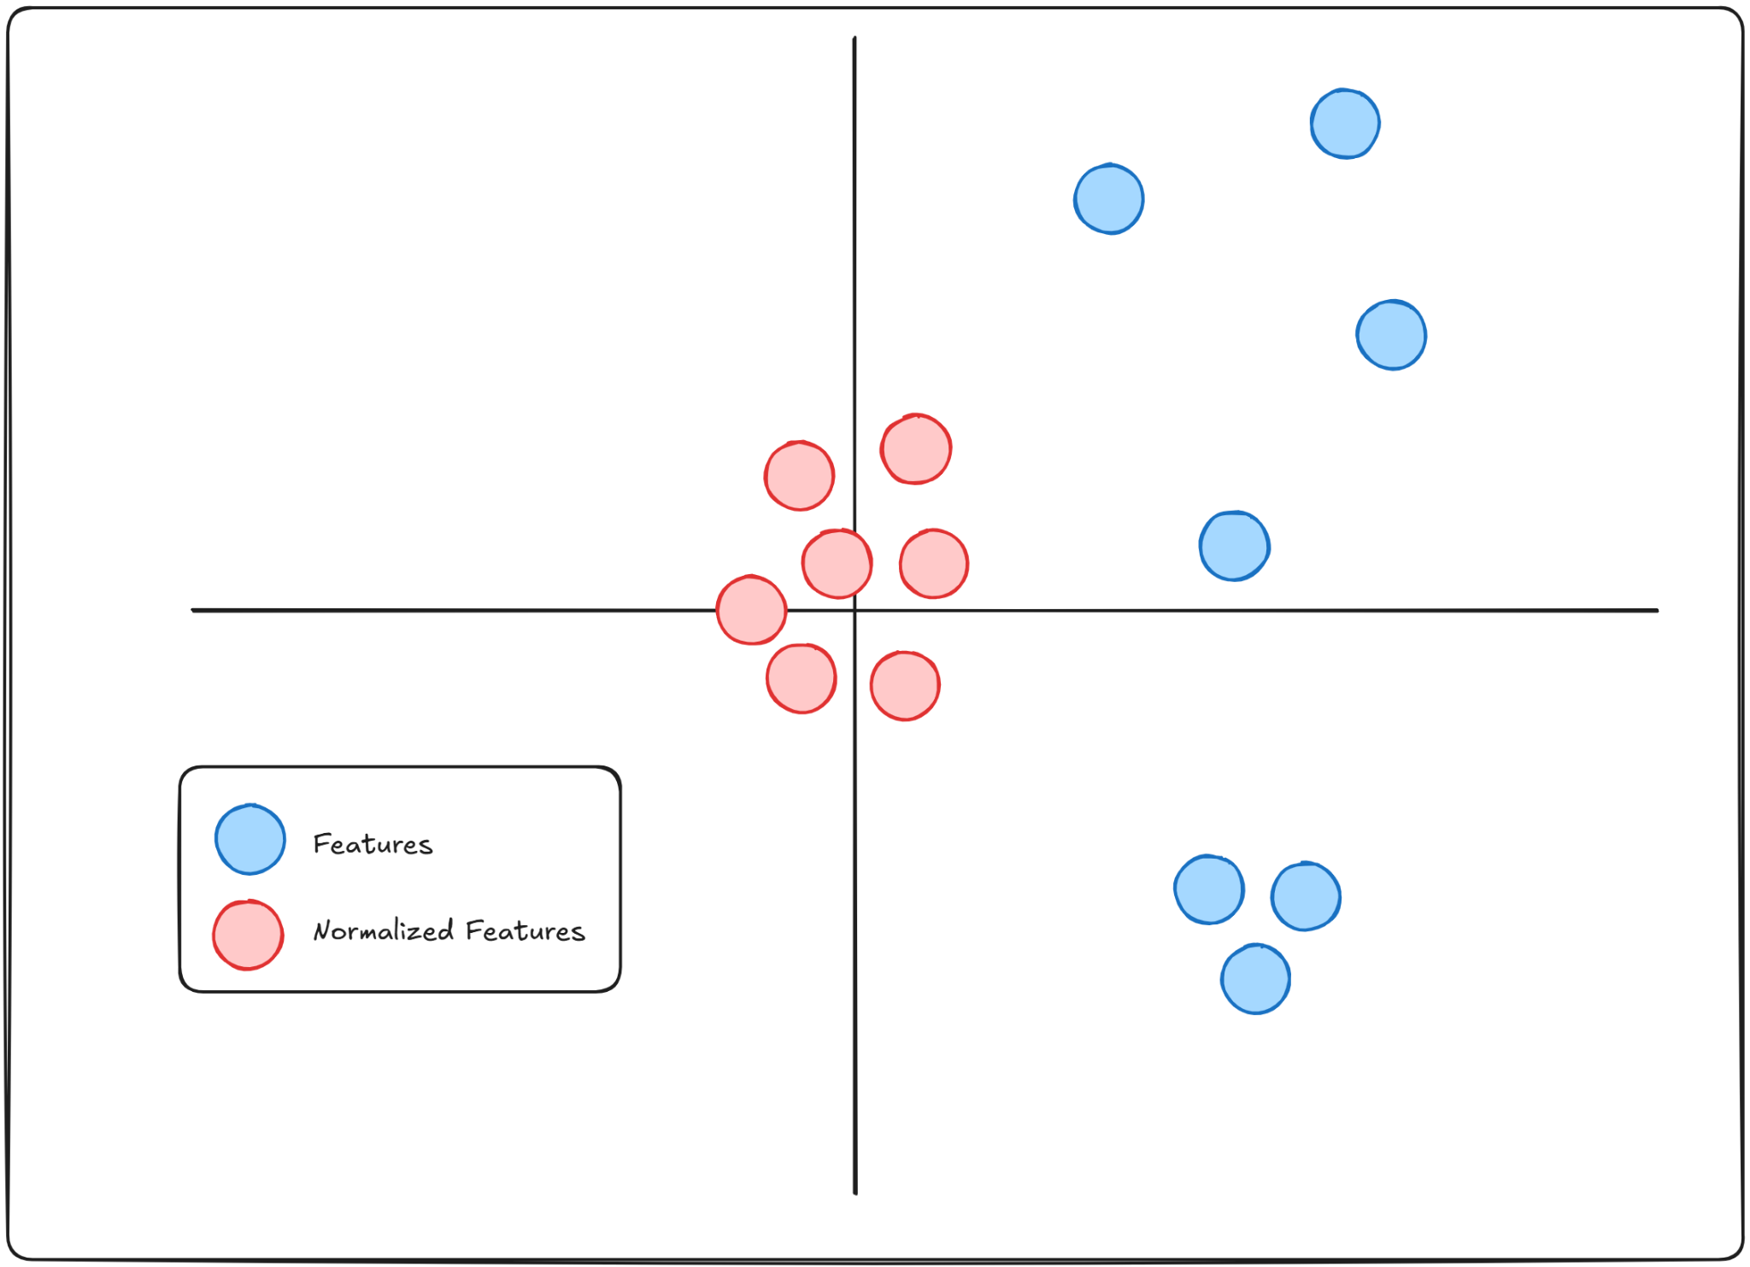
Layer Normalization
Normalization is a method to bring different features in the same scale
This is done to stabilize training.
Because when models try to learn from features with drastically different scales, it can slow down training as well as cause exploding gradients.

Slide 54
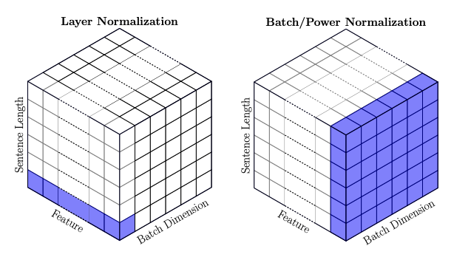
Layer Normalization
Batch normalization is the method where the mean and standard deviation of an entire batch is subtracted from the future layer.
In Layer normalization, instead of focusing on the entire batch, all the features of a single instance are focused on.
Think of it like this, we take each word from a sentence, and normalize that word.

Slide 55
Feed Forward Network
Intuition
Attention:
Each token asks every other token:
"What do you know that is relevant to me?"
Everyone talks to everyone. Global interaction.
FFN:
Each token then says:
"Now let me think about what I have just heard
and process it on my own."
No interaction. Local independent processing.
Why both are essential
Attention provides context and relationships
FFN provides depth and expressive power
Without FFN:
Transformers would be limited to linear combinations
Model capacity would be severely reduced
Feed Forward Network
Applied after the attention mechanism
Operates independently on each position
Why FFN is needed
Attention captures relationships between different tokens
However, attention is fundamentally a linear operation
Linear operations alone cannot model complex transformations
Role of non-linearity
FFN introduces non-linearity using activation functions (typically ReLU)
Enables the model to:
  Learn complex patterns
  Perform richer feature transformations
  Go beyond simple weighted averaging

Slide 56
Feed Forward Network
Why Both Are Essential
Without Attention:
Each token is processed in isolation.
The model cannot relate words to each other.
"it" in "the animal was tired because it..." cannot be
linked to "animal" without attention.
Without FFN:
The model can only do weighted averaging of value vectors.
It cannot learn complex non-linear language patterns.
Transformers would be limited to linear combinations.
Model capacity would be severely reduced.
Analogy
Think of a meeting followed by individual work:
Attention = the meeting
Everyone shares information with everyone else.
You learn what your colleagues know.
FFN = working alone after the meeting
You take what you heard and process it yourself.
You draw conclusions, make decisions, refine your understanding.
Neither alone is sufficient.
Only listening (attention only) means you never process what you heard.
Only working alone (FFN only) means you never gather context from others.

Slide 57
Feed Forward Network
Each token is processed independently AND simultaneously.
Independent is what makes parallel possible.
In the FFN there are no dependencies between tokens.
  z1 does not need z2 to compute its FFN output
  z2 does not need z1 to compute its FFN output
  z3 does not need z1 or z2 to compute its FFN output
Each token just takes its own vector, runs it through
the same FFN, and produces its own output. Nothing waits for anything else.
  FFN(z1) -> r1
  FFN(z2) -> r2 > all happening at the same time
  FFN(z3) -> r3 /
Contrast With Attention
In self-attention tokens are NOT independent.
To compute the output for "Thinking", you need the key vectors of ALL other tokens.
So all tokens must be available before any output can be computed.
This is still parallelized in transformers because the entire input sequence is available at once (unlike RNNs which process one token at a time).
But there are dependencies between tokens.
FFN has NO such dependencies at all. It is purely parallel with zero inter-token communication.

Slide 58
Does Softmax Add Non-Linearity? If so, why Need FFN?
Yes, softmax is non-linear. But it is not the right kind of non-linearity for transforming token representations.
What Softmax Non-Linearity Does
Softmax non-linearity decides HOW MUCH to mix value vectors.
z = 0.88v1 + 0.12v2
  The weights 0.88 and 0.12 came from softmax.
  But the final output z is still a linear combination of V.
Softmax non-linearity is consumed computing the weights.
It does not transform the representations themselves.
What FFN Non-Linearity Does
ReLU non-linearity transforms the representations themselves.
Softmax: decides the mixing proportions (non-linear)
ReLU: transforms what is being mixed (non-linear)
These are two fundamentally different roles.
The Paint Analogy
Softmax = deciding paint proportions
  88% blue + 12% red
  You are still mixing the same base colors.
  You cannot get a color outside the original set.
FFN + ReLU = chemically transforming the paint
  Entirely new colors can emerge that did not exist in the original mixture.

Slide 59
Decoder Block
The decoder uses components similar to the encoder.
The key difference lies in how these components are combined and used.
The decoder block is auto-regressive. Meaning it outputs one after the other and takes its own output as an input.

Slide 60
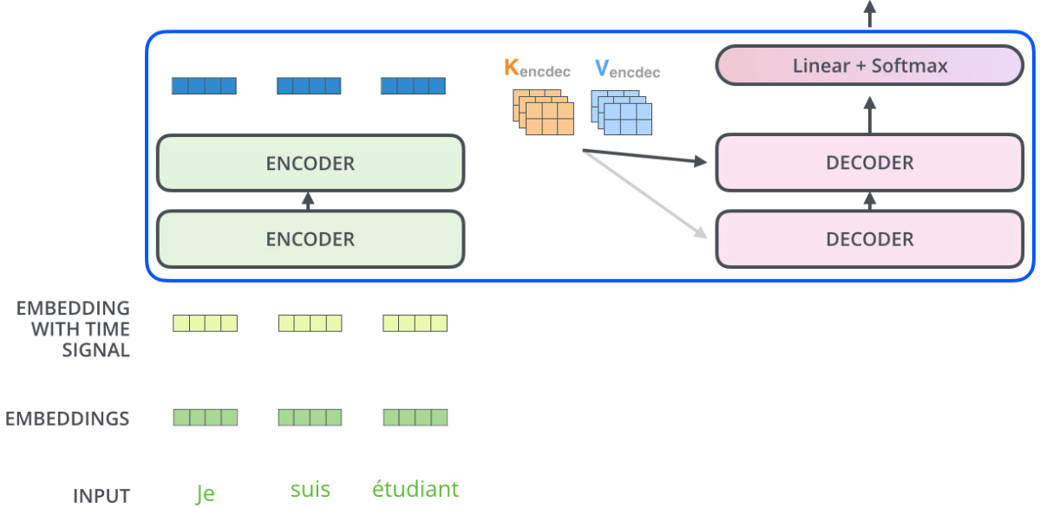
Decoder Block
Encoder processing
The encoder first processes the entire input sequence
The output of the top encoder layer contains contextual representations of the input
Preparing encoder outputs for the decoder
Encoder outputs are transformed into:
  Key (K) vectors
  Value (V) vectors
These vectors represent the encoded information of the input sequence
Encoder-Decoder attention in the decoder
In this sublayer:
  The decoder uses its own representations as Queries (Q)
  The encoder-provided K and V guide the attention
This allows the decoder to:
  Focus on the most relevant parts of the input sequence
  Align generated output tokens with input tokens
Purpose
Ensures the decoder generates output that is grounded in the input sequence
Enables effective sequence-to-sequence mapping (e.g., translation)

Slide 61
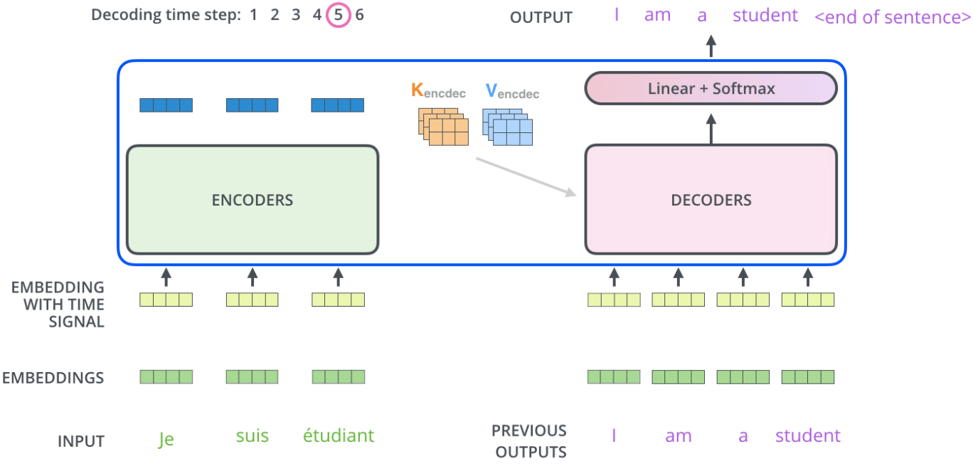
Decoder Block
Autoregressive decoding loop
Decoding proceeds step by step until an end-of-sequence token is generated
This token indicates that the decoder has finished producing the output sequence
Token feedback mechanism
At each decoding step:
  The newly generated token is fed back as input to the decoder
  It is provided to the lowest decoder layer for the next time step
Processing through the decoder stack
The decoder processes the input token through all its stacked layers
Intermediate decoding results propagate upward through the stack, similar to encoder processing
Embedding and positional information
Each input token to the decoder is:
Converted into an embedding vector
Augmented with positional encoding
Positional encoding ensures the decoder is aware of token order
Overall effect
Enables coherent, ordered, and context-aware sequence generation
Ensures each new token is generated based on all previously produced tokens

Slide 62
Decoder Block
Encoder-Decoder (cross) attention
Functions similarly to multi-head self-attention
Key difference lies in the source of Q, K, and V:
  Queries (Q) are created from the decoder layer below it
  Keys (K) and Values (V) are taken from the output of the encoder stack.
Allows the decoder to:
  Attend to relevant parts of the input sequence
  Align generated tokens with the encoded input
Self-attention: Q, K, V come from the same sequence
Cross attention: Q comes from one sequence, K and V from another
Overall purpose
Masked self-attention enforces correct generation order
Encoder–decoder attention grounds output tokens in the input sequence
Self-attention in the decoder
Operates differently from encoder self-attention
Designed to preserve the autoregressive nature of decoding
Masked self-attention
Each position in the decoder can attend only to earlier positions in the output sequence
Future positions are masked before applying softmax
  Masked values are set to −∞
  Ensures zero attention to future tokens
Prevents the model from "seeing" future words during generation

Slide 63
Masked Self-Attention in Detail
Recall in encoder self-attention, every token can attend to every other token.
In the decoder, each token can only attend to itself and tokens before it.
Future tokens are hidden. This is called masking.
Why Masking?
During generation, future words do not exist yet.
Allowing the model to see them during training would be cheating.
The model must learn to predict the next word without peeking ahead.
How Masking Works
Before softmax, a mask is added to the raw attention scores.
Future positions are set to -inf so that after softmax they become 0.

Slide 64
Masked Self-Attention in Detail
EXAMPLE: generating "I am a student" (4 tokens)
Before masking (raw attention scores):
I am a student
I [ s11 s12 s13 s14 ]
am [ s21 s22 s23 s24 ]
a [ s31 s32 s33 s34 ]
student [ s41 s42 s43 s44 ]
After masking (future positions set to -inf):
I am a student
I [ s11 -inf -inf -inf ] <- sees only itself
am [ s21 s22 -inf -inf ] <- sees I and itself
a [ s31 s32 s33 -inf ] <- sees I, am, itself
student [ s41 s42 s43 s44 ] <- sees all previous
After softmax, -inf becomes exactly 0.
Future tokens receive zero attention weight.
Result : The decoder learns to generate each token using only the tokens it has already produced, preserving the
autoregressive nature of generation.
s11 means the attention score between token 1 (I) and token 1 (I)
s12 means the attention score between token 1 (I) and token 2 (am)
s21 means the attention score between token 2 (am) and token 1 (I)
The naming convention is:
s(row)(column)
row = the token that is asking (the Query token)
column = the token being looked at (the Key token)
So s34 means token 3 (a) looking at token 4 (student).
HOW THEY ARE COMPUTED
Each score is a dot product of a Query vector and a Key vector:
s11 = q1 . k1 (I asking about I)
s12 = q1 . k2 (I asking about am)
s21 = q2 . k1 (am asking about I)
s22 = q2 . k2 (am asking about am)
Higher score means more relevant. Lower score means less relevant.

Slide 65
Decoder Block : Encoder-Decoder Attention / Cross-Attention in Detail
Why It Must Come From Below
The Q must carry information about what has been generated so far.
The masked self-attention sublayer is responsible for building that representation.
If Q came from somewhere else:
From raw embeddings: no context from previous tokens
From encoder: that is K and V, using it for Q too would collapse cross-attention into self-attention
From a higher sublayer: FFN comes after, not before
The masked self-attention output is the only place in the decoder that has the right information to form Q: context of what has been generated so far.
Visualizing One Decoder Layer
INPUT from previous decoder layer
|
v
Masked Self-Attention <- sublayer 1
|
v
Add & Norm
|
v
output of masked self-attention <- THIS IS "BELOW IT"
| THIS BECOMES Q
v
Cross-Attention <- sublayer 2
Q = output from above (from decoder, "below" cross-attention)
K = encoder output (from encoder stack)
V = encoder output (from encoder stack)
|
v
Add & Norm
|
v
Feed Forward Network <- sublayer 3
|
v
OUTPUT to next decoder layer

Slide 66
Decoder Block : Encoder-Decoder Attention / Cross-Attention in Detail
How K And V Are Created From Encoder Output
The encoder output is a matrix of shape:
[sequence_length x d_model]
e.g. [3 x 512] for "Je suis étudiant"
This matrix is multiplied by two weight matrices:
K = encoder_output * WK <- learned weight matrix
V = encoder_output * WV <- learned weight matrix
WK and WV here belong to the cross-attention sublayer of the decoder. They are different from the WK and WV used inside the encoder self-attention.
Same K And V For All Decoder Layers
An important detail: the same encoder output is sent to
ALL decoder layers, not just decoder layer 1.
Encoder layer 6 output
|
|-----> Decoder Layer 1 cross-attention (K, V)
|-----> Decoder Layer 2 cross-attention (K, V)
|-----> Decoder Layer 3 cross-attention (K, V)
|-----> Decoder Layer 4 cross-attention (K, V)
|-----> Decoder Layer 5 cross-attention (K, V)
|-----> Decoder Layer 6 cross-attention (K, V)
Each decoder layer gets its own copy of K and V derived from the same encoder output.
Each decoder layer has its own WK and WV matrices so each produces different K and V vectors from the same encoder output.
Each encoder layer has this structure:
Input
|
v
Multi-Head Self-Attention
|
v
Add & Norm
|
v
Feed Forward Network
|
v
Add & Norm
|
v
Output <- THIS is what becomes K and V
The output comes after BOTH sublayers of the last encoder.
Specifically after the second Add & Norm of encoder layer 6.
So K and V are derived from the output that has passed through:
Self-attention of encoder 6
FFN of encoder 6
Final Add & Norm of encoder 6

Slide 67
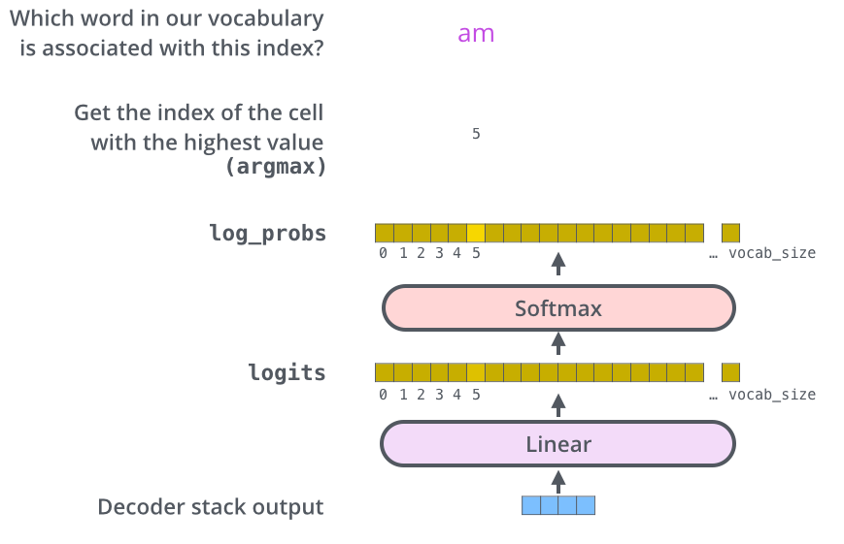
Final Linear and Softmax Layer
The decoder stack outputs a vector of floats. How do we turn that into a word?
That’s the job of the final Linear layer which is followed by a Softmax Layer.
Decoder output to word generation
  The decoder stack produces a vector of floating-point values
  This vector must be converted into an actual word
  What The Decoder Produces :
    After processing through all decoder layers, for each
generation step the decoder produces a single vector.
    Decoder output vector shape: [1 x d_model]
[1 x 512 ] This is just 512 floating point numbers.
For example: decoder_output = [0.21, -0.43, 0.87, 0.11, ..., 0.34], 512 numbers.
    This vector is a rich representation of what the next
word should be. But it is not a word yet. It is just
a point in 512 dimensional space. We need to convert
it into an actual word from the vocabulary.
Problem :
  Vocabulary has 10,000 words.
  Decoder output has 512 numbers.
  These do not match. We cannot directly compare a 512
dimensional vector against 10,000 words.
  We need a way to score every word in the vocabulary
against this decoder output vector.

Slide 68
Final Linear and Softmax Layer
The decoder stack outputs a vector of floats. How do we turn that into a word?
That’s the job of the final Linear layer which is followed by a Softmax Layer.
Linear layer
  A fully connected layer applied to the decoder output
  Projects the decoder vector into a logits vector
  The logits vector size equals the output vocabulary size
  A linear layer is a simple matrix multiplication.
  Linear layer weight matrix shape: [d_model x vocab_size] = [512 x 10,000]
  logits = decoder_output * W_linear
    = (1 x 512) * (512 x 10,000)
    = (1 x 10,000)
  Output is a vector of 10,000 numbers.
  One number for each word in the vocabulary.
  This output vector is called the logits vector.
    Logits are raw unnormalized scores.
    They are not probabilities yet.
    They can be any value: positive, negative, large, small.
    logits = [2.1, -0.5, 8.3, 0.2, -1.4, 3.7, ..., 0.9]
    10,000 values, one per vocabulary word
    Higher value = model thinks this word is more likely
    Lower value = model thinks this word is less likely

Slide 69
Final Linear and Softmax Layer
The decoder stack outputs a vector of floats. How do we turn that into a word?
That’s the job of the final Linear layer which is followed by a Softmax Layer.
Softmax layer
  Converts logits into probabilities
  Properties:
    All values are positive
    All probabilities sum to 1
Final word selection
  The word with the highest probability is selected
  This word becomes the output for the current time step
  This Is Called Greedy Decoding : Always picking the highest probability word is called
greedy decoding.

Slide 70
How the Transformer is Trained
GOAL
Given input-output sentence pairs, train the model to predict the correct output sequence one token at a time.
Input (French): "Je suis étudiant"
Target (English): "I am a student"

Slide 71
How the Transformer is Trained
Step 1: Forward Pass
The encoder processes the full input sentence and produces context vectors for each token.
"Je" "suis" "étudiant" -> Encoder -> [c1, c2, c3]
The decoder then generates the output one token at a time.
At each step it receives:
The encoder context vectors (via encoder-decoder attention)
The correct previous token (via teacher forcing)
<START> -> Decoder -> predicts "I"
<START> I -> Decoder -> predicts "am"
<START> I am -> Decoder -> predicts "a"
<START> I am a -> Decoder -> predicts "student"
<START> I am a student -> Decoder -> predicts <END>

Slide 72
How the Transformer is Trained
Step 2: Computing The Loss
At each step the decoder outputs a probability distribution over the entire vocabulary via softmax.
Example at step 2 (correct word is "am"):
Vocabulary: ... am is are was were ...
Probability: ... 0.72 0.15 0.08 0.03 0.02 ...
Cross-entropy loss measures how wrong the prediction is:
Loss = -log(probability of correct word)
= -log(0.72)
= 0.33 <- lower is better
Total loss = sum of loss at every position across all training sentences.
L = -log P("I") - log P("am") - log P("a") - log P("student")

Slide 73
How the Transformer is Trained
Without Teacher Forcing:
Step 1: input = <START> predicts = "I" correct = "I"
Step 2: input = "I" predicts = "like" correct = "am" <- WRONG
Step 3: input = "like" predicts = "pizza" correct = "a" <- derailed
Step 4: input = "pizza" predicts = "too" correct = "student" <- derailed
One wrong prediction at step 2 derails everything after it.
Errors compound. Training becomes unstable.
With Teacher Forcing:
Step 1: input = <START> predicts = "I" correct = "I"
Step 2: input = "I" predicts = "like" correct = "am" <- still wrong
Step 3: input = "am" predicts = "a" correct = "a" <- back on track
Step 4: input = "a" predicts = "student" correct = "student"
Even though the model predicted "like" at step 2, we feed "am" at step 3.
Errors never compound. Each step learns independently.

Slide 74
How the Transformer is Trained
Step 3: Backward Pass
The total loss is backpropagated through the entire transformer.
All learnable weights are updated via gradient descent:
Embedding matrix <- how words are represented
WQ, WK, WV matrices <- what the model pays attention to
WO matrix <- how attention heads are combined
FFN weights <- how each token is transformed
Layer norm parameters <- how activations are scaled
Step 4: Repeat
This process repeats over millions of sentence pairs.
Over time the model learns:
Which words to attend to (via attention weights)
How to transform representations (via FFN)
How to produce correct output sequences (via the full pipeline)

Slide 75
How the Transformer is Trained
Training Vs Inference
Training:
Teacher forcing is used
Correct previous token is always fed to the decoder
All positions are computed in parallel (fast)
Inference:
No teacher forcing
Model uses its own previous prediction as next input
Tokens are generated one at a time (sequential)
Generation stops when <END> token is produced

Slide 76
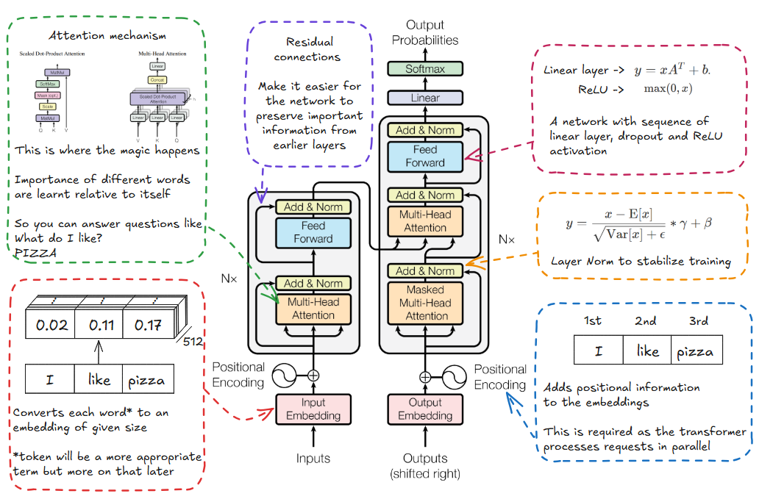

Slide 77
Transformer vs BERT vs GPT : Differences
Transformer:
  Encoder-Decoder architecture.
  Encoder: Self-attention + Feed-forward network.
  Decoder: Masked self-attention + Encoder-decoder attention.
BERT:
  Encoder-only architecture.
  Pretrained with Masked Language Modeling (MLM) and Next Sentence Prediction (NSP).
  Bidirectional attention (context from both sides).
GPT:
  Decoder-only architecture.
  Pretrained with Causal Language Modeling (CLM).
  Unidirectional attention (context from left only).

Slide 78
Transformer
Encoder (stacked layers)
Self-Attention
  Each token attends to all other tokens in the input.
Feed-Forward Network (FFN)
  Applies the same MLP independently to each token.
What it is,
A general sequence-to-sequence architecture introduced in “Attention Is All You Need” (2017).
Uses attention instead of recurrence or convolution.
Decoder (stacked layers)
Masked Self-Attention
  Prevents looking at future tokens during generation.
Encoder–Decoder Attention
  Decoder attends to encoder outputs (source sentence).
Structure
Encoder–Decoder architecture
Usage
Machine Translation, Summarization, Seq2Seq tasks.

Slide 79
BERT (Encoder Only)
What BERT keeps
Only the Encoder part of the Transformer.
No decoder, no generation mechanism.
Key Properties
Encoder-only architecture
Bidirectional attention
Each token attends to both left and right context.
Example: word meaning depends on entire sentence.
Pre Training Objectives
Masked Language Modeling (MLM)
  Random tokens are masked.
  Model predicts missing words.
Next Sentence Prediction (NSP)
  Learns sentence-level relationships.
Usage
Text classification, NER, QA, sentence similarity.
Not ideal for text generation.

Slide 80
GPT (Decoder Only)
What GPT keeps
Only the Decoder part of the Transformer.
Designed explicitly for generation.
Key Properties
Decoder-only architecture
Unidirectional (causal) attention
  Each token attends only to past tokens.
  Ensures valid autoregressive generation.
Pre Training Objectives
Causal Language Modeling (CLM)
  Predict next token given previous tokens.
Usage
Text generation, chatbots, code generation, story writing.

Slide 81
Resource Courtesy
https://jalammar.github.io/illustrated-transformer/
https://goyalpramod.github.io/blogs/Transformers_laid_out/
https://x.com/viplismism/status/2003807608571076782

