Slide 1
Python Chatroom
Based On TCP Protocol And AI Techniques

Slide 2

Introduction
Python Chatroom
AI Project BSCS VI.
The chatroom is excellent for communication over the network and the TCP connection ensures reliability. TCP Chatroom is built via the computer networking programming language Python3 which is the latest one. This TCP chatroom enables us to have one server that hosts the chat while multiple clients are connected to it and then communicate with each other via the main server.
This is a full-working chatroom, and you can easily send and receive messages also over the internet and locally by using the server’s IP. The port needs to be opened for the public connection.
Another advantage of this chatroom is that a rule of kicking and banning is activated as the admin site which is implemented using AI techniques so that the errors can be handled in such a way that becomes useful and trigger specific operation.
Team
BSCS-FA18-052 Muhammad Usama
Dated:
15-6-2021
project timeline

Slide 3
Project Phases
Project Phases
We need to deliver a project that benefits the business.
01
02
03
04
05
Planning Modeling
Testing
+
Extra Implementation
Project Needs
Implementation
Coding

Slide 4
PROJECT NEEDS

Slide 5

Project Needs
Project Needs
We need to deliver a project that benefits the business.
01. Light Weight Chatroom For Everyone
One of the biggest difficulty for us is to provide an ultimate light weight chatroom that fulfills everyone needs , and can run on any system having a lower RAM. To help people to save time picking phone while using computer to create project and have a conversation with other team members.
02. Seamless Communication
TCP protocoled must be implemented to ensure the looseness communication chain and the packet result whether is approaching or not so to help user detect any error and fix it. User must connected as long as he wants and chatroom must be open for 24 x 7
03. Automatic Error Handling ( AI Strategy)
Server must be able to perform advance analysis to handle the exception errors and must display it and change it for specific purpose according to the chatroom needs. Error handling must be implemented in such a way that the server automatically know who is on ban list , who is being kicked and who is being discounted etc.
04. High Quality In Low Budget
As no paid tools is used in the development of this chatroom , Various tools like python , pycharm and python libraries are used to give ultimate performance to the chatroom while maintaining a low budget cycle.

Slide 6

Project Needs
Project Features
We need to deliver a project that benefits the business.
Broadcast Message

Slide 7
Project Needs
Project Features
We need to deliver a project that benefits the business.
Broadcast Message
Multi-Threading

Slide 8
Project Needs
Project Features
We need to deliver a project that benefits the business.
Broadcast Message
Multi-Threading
TCP Based Chatroom

Slide 9
Project Needs
Project Features
We need to deliver a project that benefits the business.
Broadcast Message
Multi-Threading
TCP Based Chatroom
Admin Privileges ( Can Kick And Ban Users)

Slide 10
Project Needs
Project Features
We need to deliver a project that benefits the business.
Broadcast Message
Multi-Threading
TCP Based Chatroom
Admin Privileges ( Can Kick And Ban Users)
ASCII Encryption

Slide 11
Project Needs
Project Features
We need to deliver a project that benefits the business.
Broadcast Message
Multi-Threading
TCP Based Chatroom
Admin Privileges ( Can Kick And Ban Users)
ASCII Encryption
Latest Python 3 Based

Slide 12
Project Needs
Project Features
We need to deliver a project that benefits the business.
Broadcast Message
Multi-Threading
TCP Based Chatroom
Admin Privileges ( Can Kick And Ban Users)
ASCII Encryption
Latest Python 3 Based
GUI TKINTER BASED (FOR LIGHT WEIGHT)

Slide 13
Project Needs
Project Features
We need to deliver a project that benefits the business.
Broadcast Message
Multi-Threading
TCP Based Chatroom
Admin Privileges ( Can Kick And Ban Users)
ASCII Encryption
Latest Python 3 Based
GUI TKINTER BASED (FOR LIGHT WEIGHT)
PC HAVING LESS THAN 1 GB Ram Can Easily Run It.

Slide 14
Project Needs
Project Features
We need to deliver a project that benefits the business.
Broadcast Message
Multi-Threading
TCP Based Chatroom
Admin Privileges ( Can Kick And Ban Users)
ASCII Encryption
Latest Python 3 Based
GUI TKINTER BASED (FOR LIGHT WEIGHT)
PC HAVING LESS THAN 1 GB Ram Can Easily Run It.
WAN Compatible

Slide 15
Planning And Modeling

Slide 16
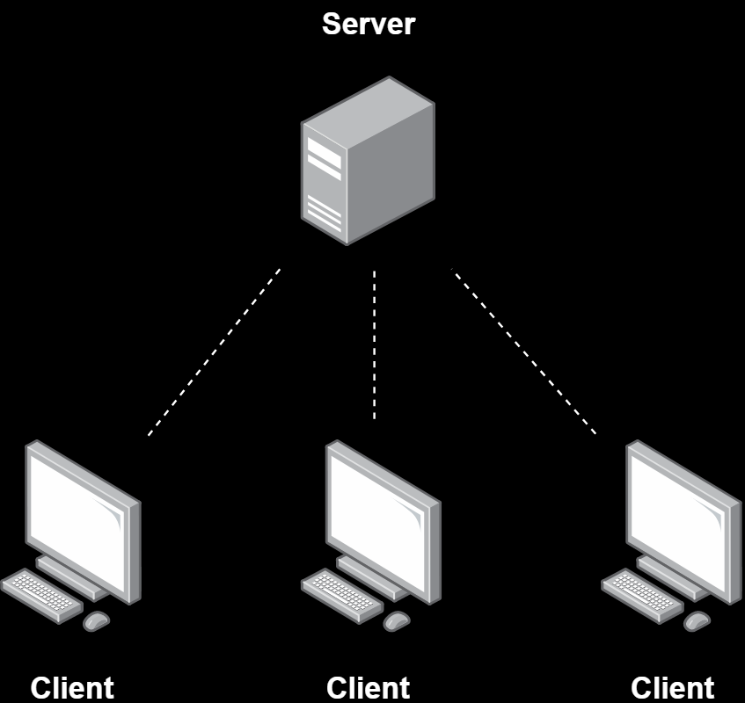
Project Needs
Planning And Modeling
1.2.1.1 Server-side:
On the server-side, the server is established using an INET socket and TCP connection. The IP is used as the server’s IP and the port is the non-reserved one. The server always receiving the client’s messages while multiple threads are running for multiple clients. It accepts the client connection.
The message is broadcasted to all clients via the server.
1.2.1.2 Client-Side:
On the client-side, the running server’s IP and port are needed to connect to it. After a successful connection, it then needs to write the message to broadcast via the server. There are two threads on the client-side, one for receiving and others for writing messages. Broadcasted messages are shown on each client.
The server must be running for the Client. On the server side, 3 different modules manage, broadcast the messages, and receives the messages from the client.

Slide 17
Planning And Modeling
Why TCP Protocols And Its Working
TCP is a connection-oriented protocol, whereas UDP is a connectionless protocol. A key difference between TCP and UDP is speed, as TCP is comparatively slower than UDP. Overall, UDP is a much faster, simpler, and efficient protocol, however, retransmission of lost data packets is only possible with TCP

Slide 18
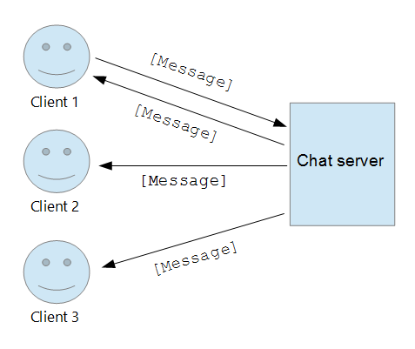
Planning And Modeling
Message Broadcasting
With the broadcast list feature, you can send a message to several of your contacts at once. Broadcast lists are saved lists of message recipients that you can repeatedly send broadcast messages to without having to select them each time.

Slide 19
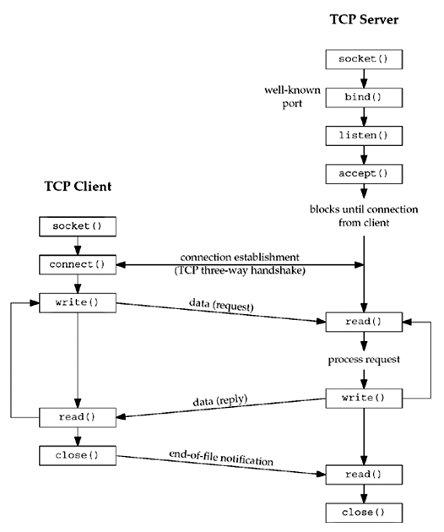
Planning And Modeling
Ultimate Graph

Slide 20
Critical Coding

Slide 21
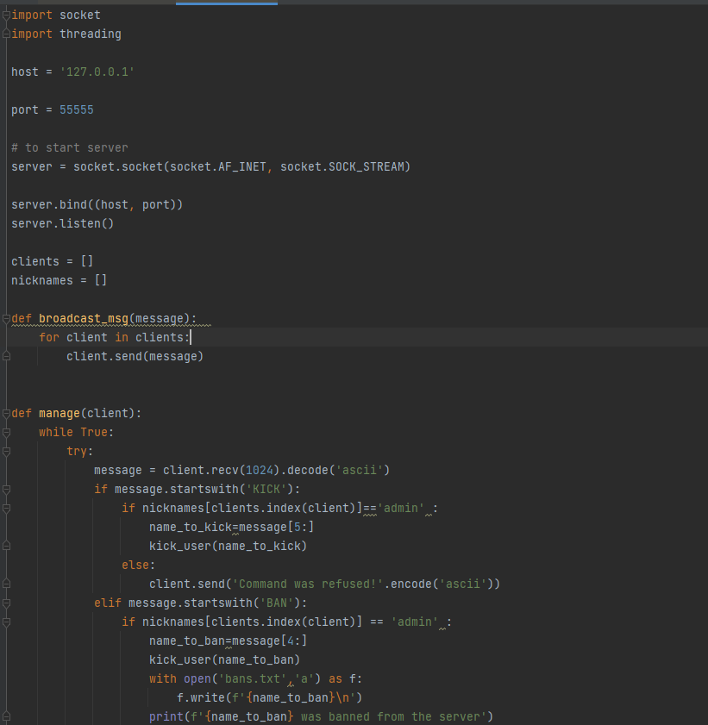
Methodology
Server.Py ?
Lets go first for CLI
The server socket is defined using AF_INET for internet socket and SOCK_STREAM for TCP protocols. Then the listen() module starts the server to listen.
Two lists are generated to store clients and their nicknames. Then the module Broadcast is used for broadcasting the messages to all clients are created.
Rest let me explain

Slide 22
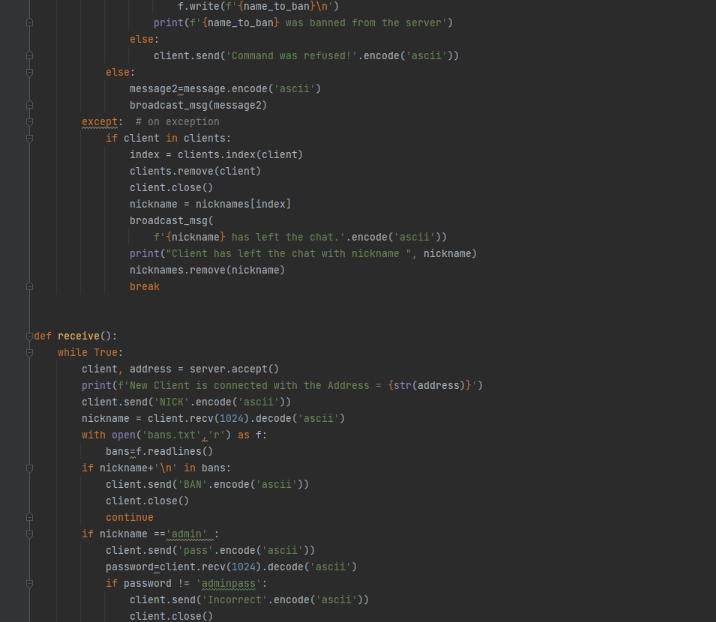
Methodology
Server.Py ?
The module manage gets client as an argument is used for managing the client’s request and broadcast the messages to all clients. if an exception occurs the client is removed and a disconnection interrupt is broadcasted to the rest clients the loop is then terminated to close the thread
The module Receive is executed when the server is started. It accepts the client’s connection and asks for the nickname. It is responsible for managing and executing all other modules and starting a new thread for the new client. It constantly executes while the server is up.

Slide 23
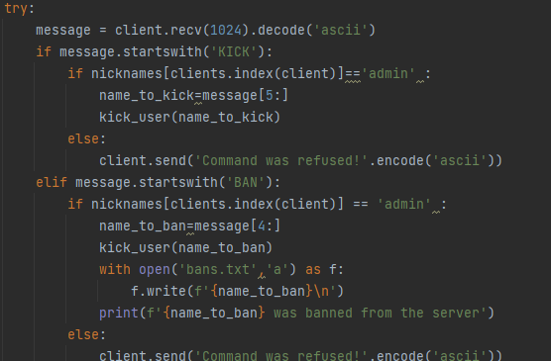
Methodology
Kick BAN Features
Kick Ban Feature On Server Side A portion of code

Slide 24
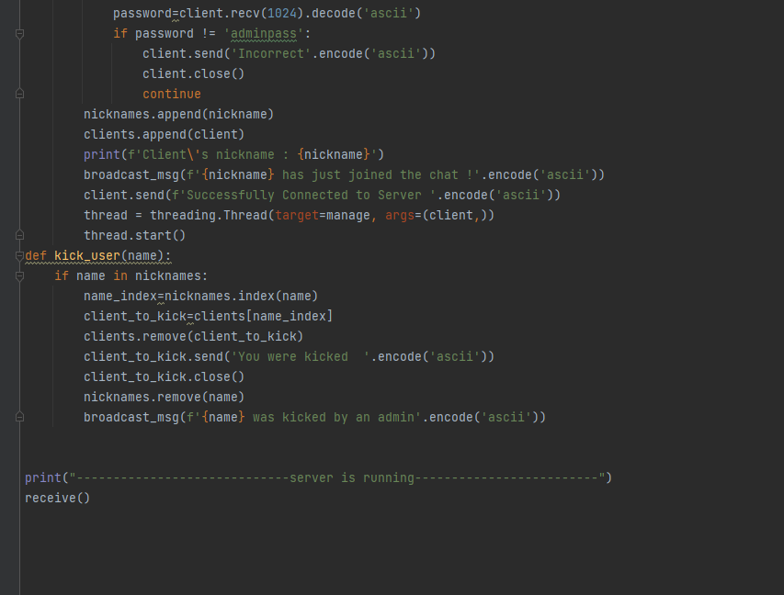
Methodology
Server.Py ?
The module manage gets client as an argument is used for managing the client’s request and broadcast the messages to all clients. if an exception occurs the client is removed and a disconnection interrupt is broadcasted to the rest clients the loop is then terminated to close the thread

Slide 25
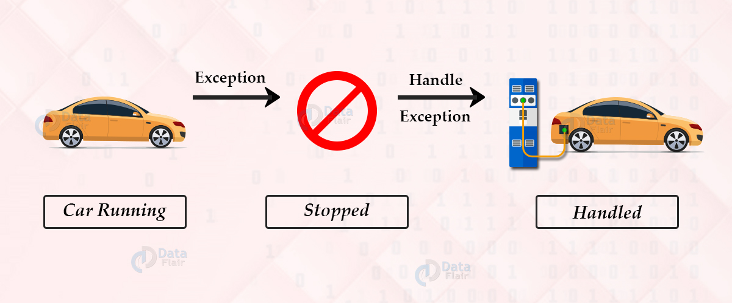
Methodology
Exception Handling Example

Slide 26
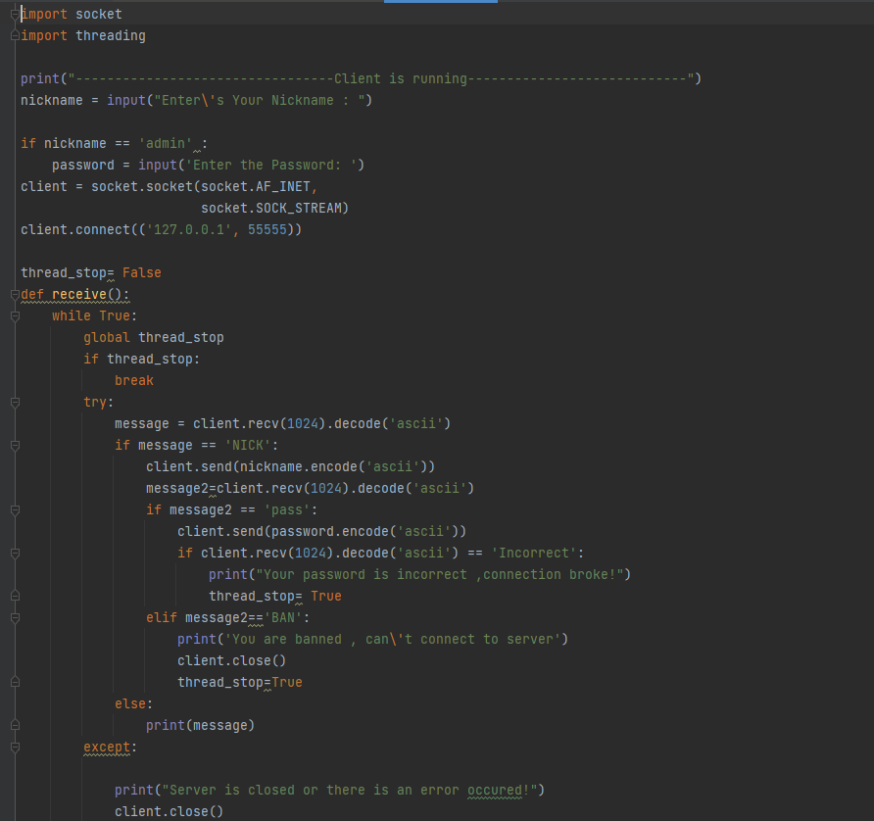
Methodology
Client.Py
Nickname is checked on the client site if he is the admin, the password is pre-saved on the client site so it can be sent to the server. A thread_stop variable is made to be used later.
The client’s socket is defined over the internet socket and TCP connection, Then the client is connected to the server via the server’s IP and port.
The receive module is generated to carry out the messages from the server. The messages encoded in ASCII are decoded into again its original type. If the message is NICK then the user has to give the nickname for identification purposes. Using the print the broadcasted messages are printed over the client’s screen which is from

Slide 27
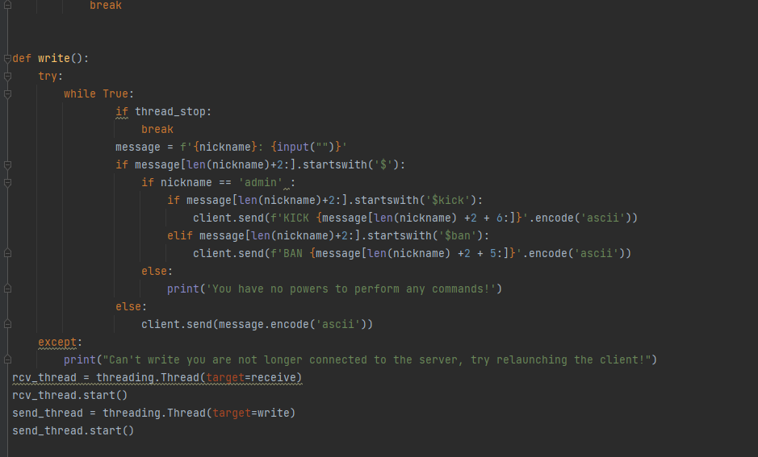
Methodology
Client.Py

Slide 28
CLI Chatroom DEMO

Slide 29
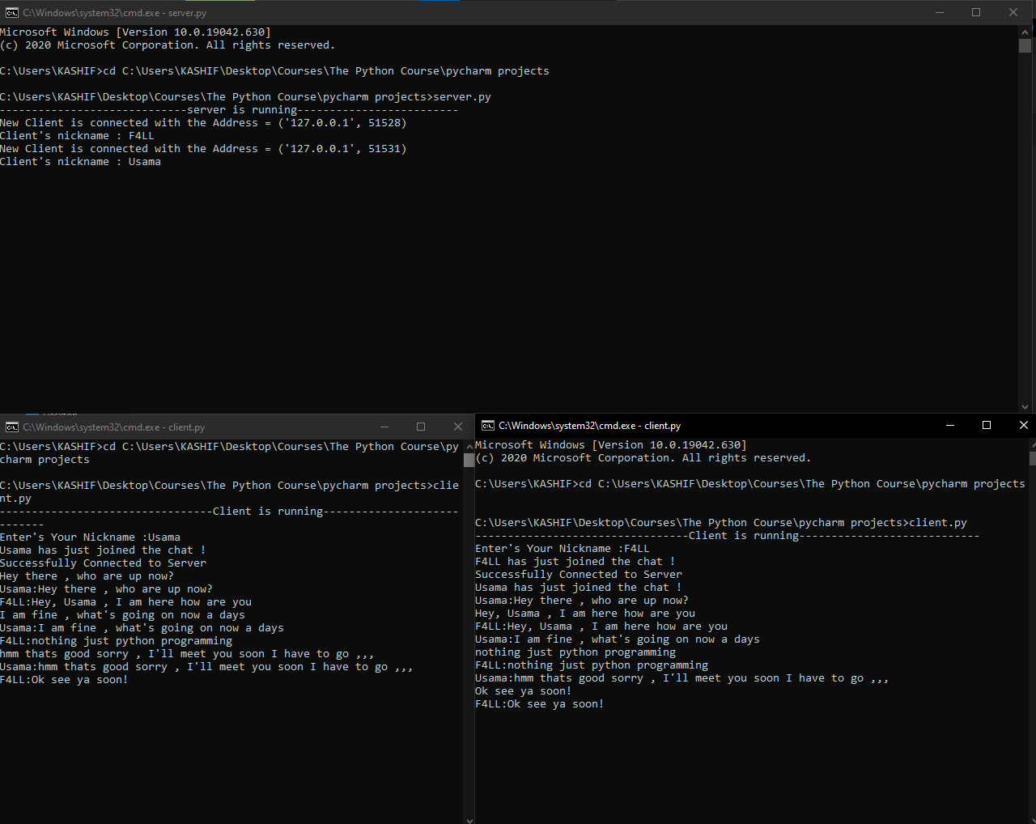
Methodology
Working CLI
The client is named nickname Usama, and the other client is named nickname as F4LL when Usama wants to communicate to the F4ll, he writes the message which broadcasted via the server and seen on the client’s side.
While on the server’s side the client’s IP and port and his connected nickname which he wrote are seen. If any client leaves the chatroom, it displays the specific client left.
So, it enables multiple clients to communicate with each other easily by connecting to the server.

Slide 30
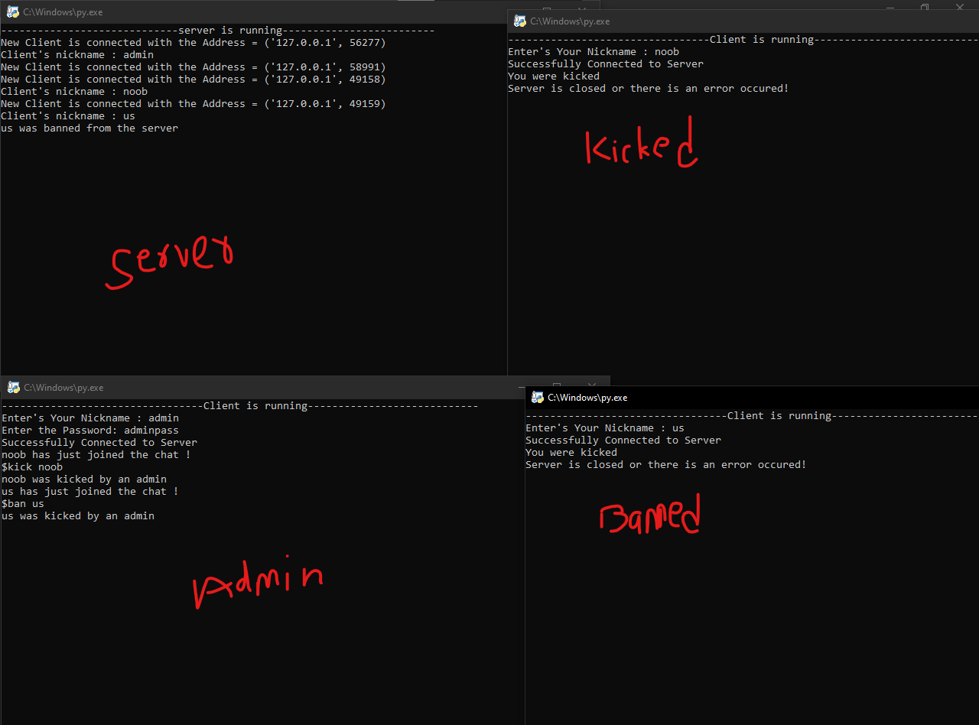
Methodology
BAN AND KICK FEATURE

Slide 31
GUI IMPLEMENTATION

Slide 32
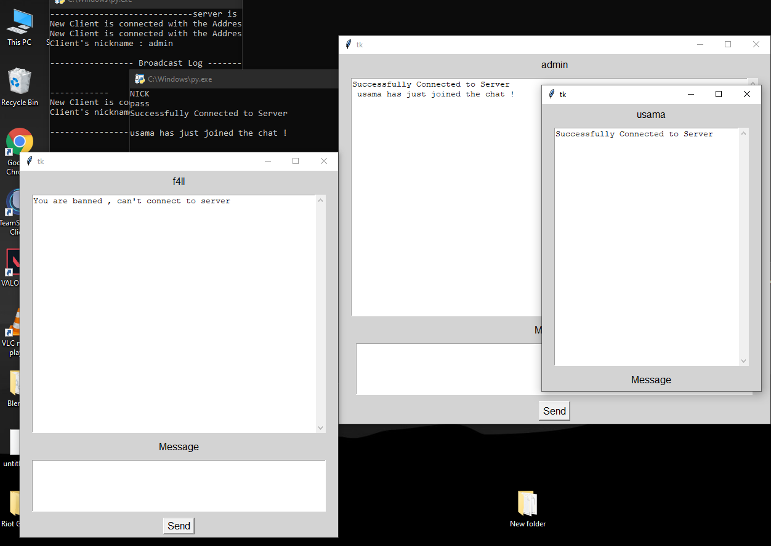
Methodology

Slide 33
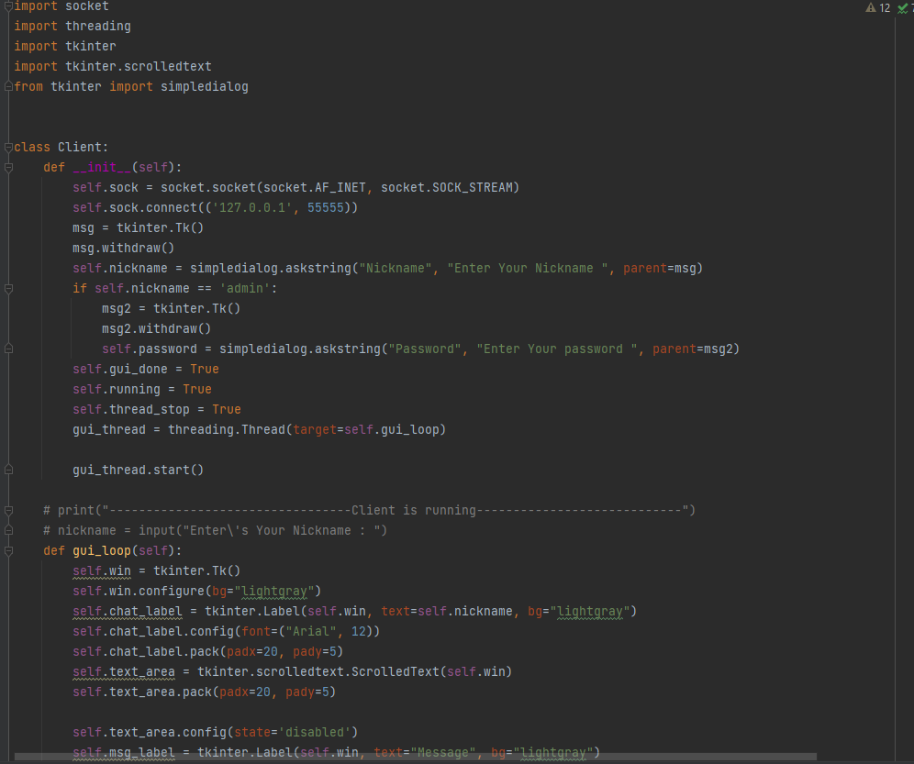
Methodology
GUI – USING TKINTER PYTHON

Slide 34
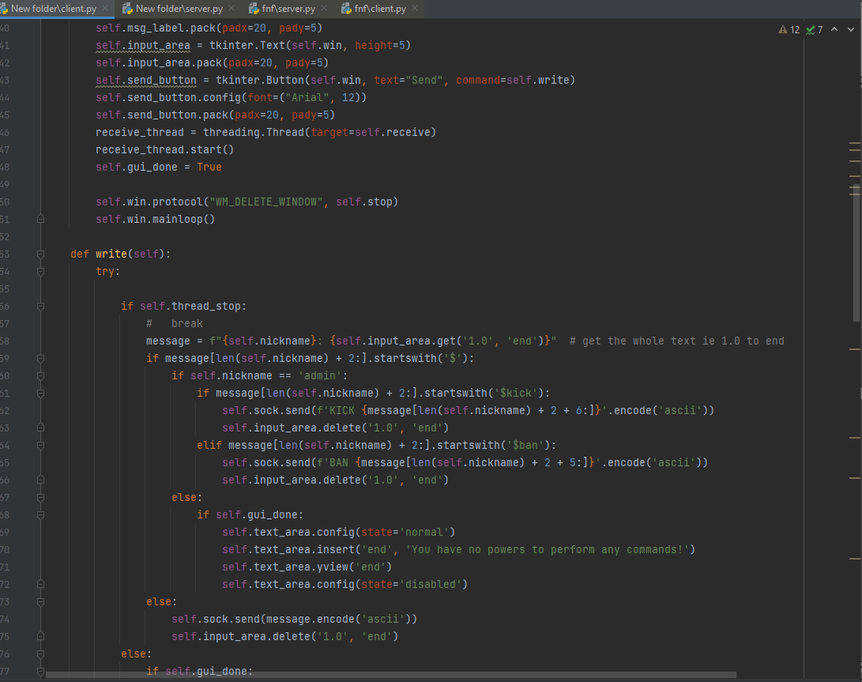
Methodology
GUI – USING TKINTER PYTHON

Slide 35
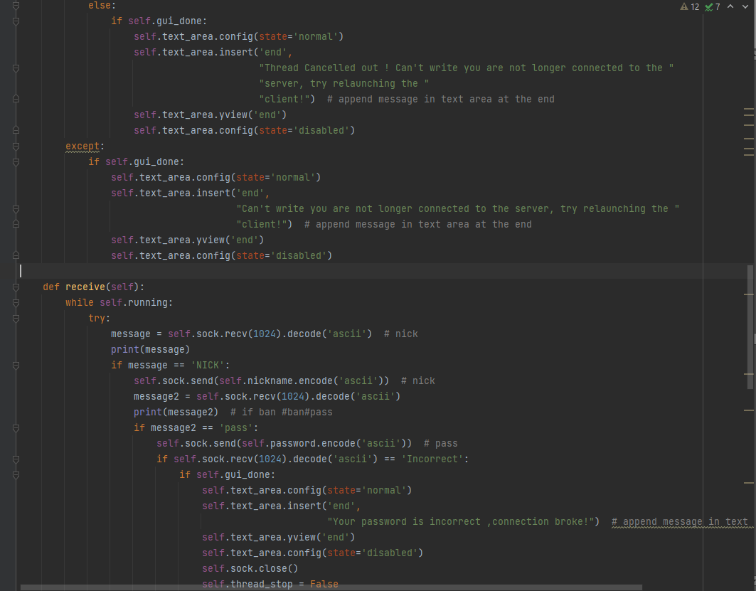
Methodology
GUI – USING TKINTER PYTHON

Slide 36
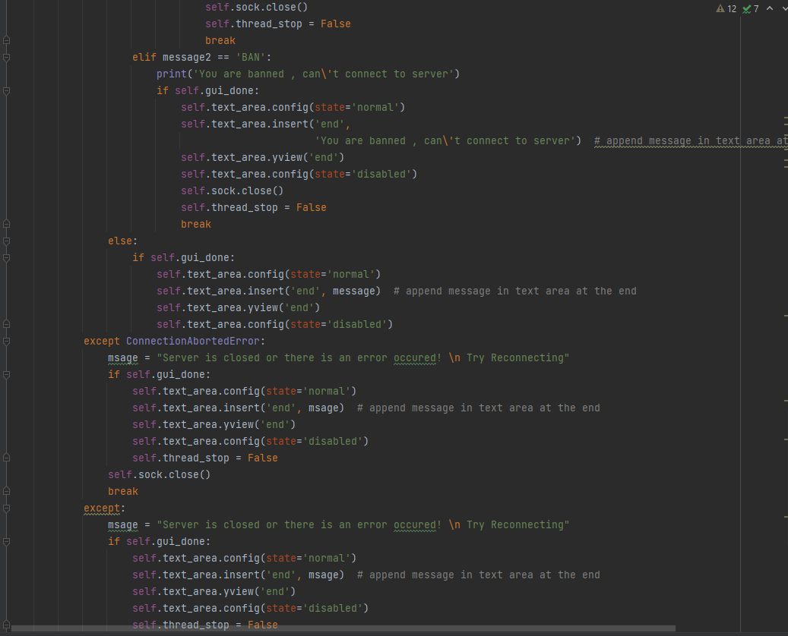
Methodology
GUI – USING TKINTER PYTHON

Slide 37
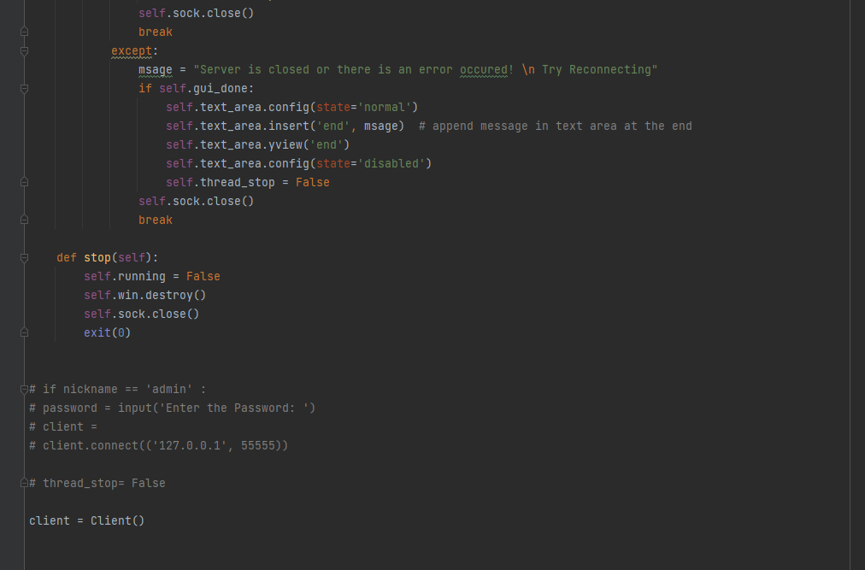
Methodology
GUI – USING TKINTER PYTHON

Slide 38
THANK YOU

