Slide 1
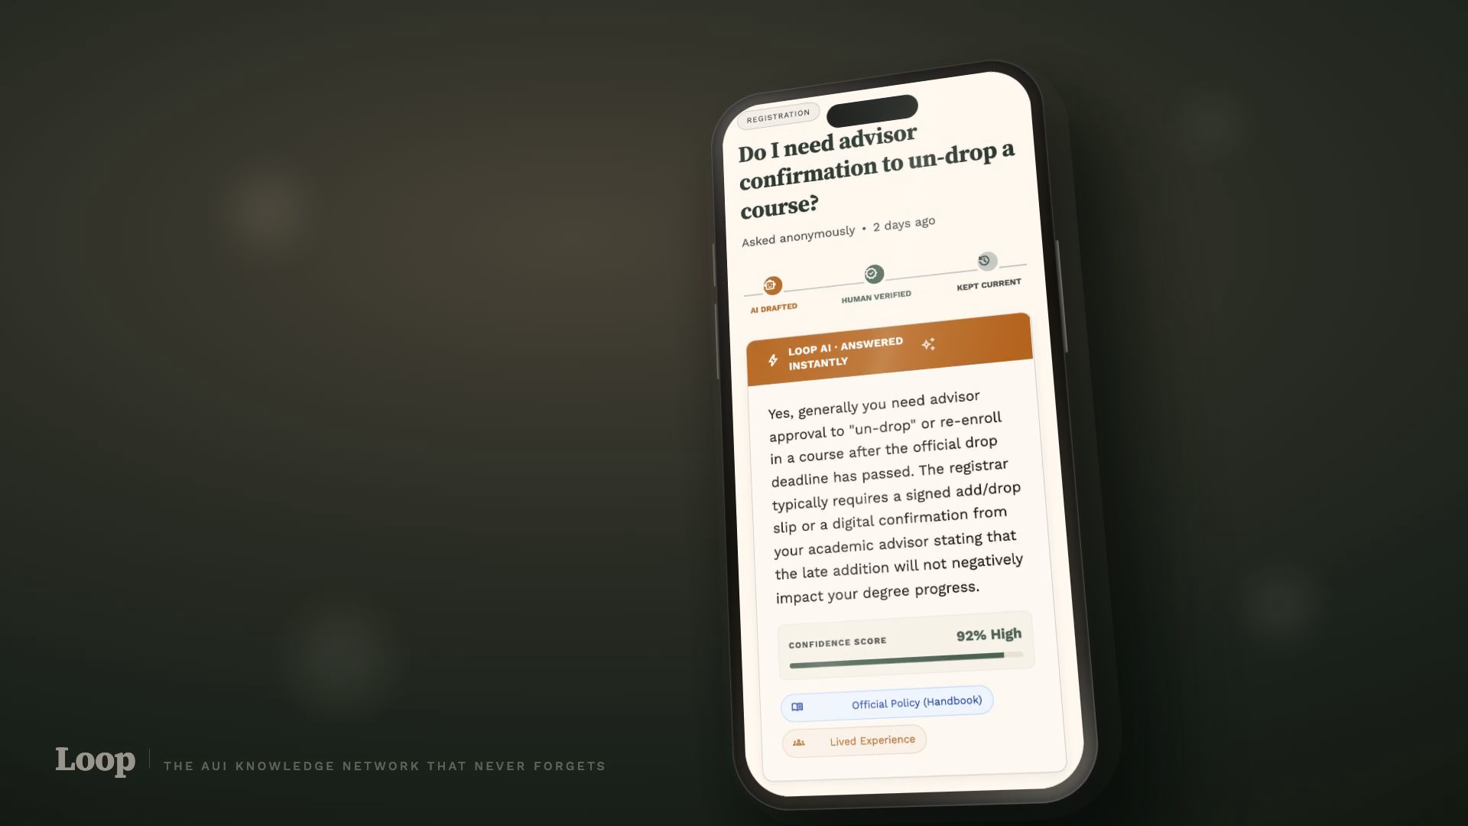
INSTITUTIONAL KNOWLEDGE DOESN'T SCALE · AUI UI/UX BOOTCAMP
Loop
The AUI knowledge network
that never forgets.
FAROUK · MANAL · HAYTAM · ANASS
Final presentation · July 2026

Slide 2
01 — THE PROBLEM
The answers that matter at AUI live in people's heads — and leave when they graduate.
A wasted visa trip. The website listed the documents. The office wanted something different in person.
A 200 MAD/week fine. A storage rule nobody explained — discovered only after it was broken.
Official channels hold policy. Peers hold practice. Neither is durable, searchable, and trustworthy at the same time. So every year, the whole campus relearns the same things from zero.
Questioned at the gate. Leaving campus late needs a signed process. New students learn it the hard way, every semester.
It's not just freshmen: a transfer at Add/Drop, an international student at residency renewal, a visiting professor relocating to Ifrane — anyone facing a process for the first time.
Three real costs, from our interviews — not hypotheticals.

Slide 3
02 — RESEARCH
Six interviews.
One repeating loop.
"There's a gap between the policy and the practice, and nobody owns fixing that gap."
MEHDI — 3RD YEAR, INTERNATIONAL · AFTER A WASTED VISA TRIP
Students from 2nd to 4th year: a club president, a student mentor, an international student, an exchange veteran. Plus an affinity board and a six-stage journey map built from their stories.
"It is a little strange that I'm doing the university's job for them — informally, for free."
What we learned:
HAMZA — SENIOR, CLUB PRESIDENT · ANSWERS THE SAME QUESTION EVERY YEAR
Official channels fall short even when you go there first
The real answer lives in one specific person who did it
Writing it down isn't enough — nobody finds the doc
"You can't really trust people. I go to AI first."
HAMZA — JUNIOR, STUDENT MENTOR · BURNED BY A FALSE SCHOLARSHIP RUMOR

Slide 4
03 — THE INSIGHT
The instant someone learns the real answer is exactly when it should be captured for the next person —
instead of relying on them to informally become "the source."
HOW MIGHT WE
…preserve and surface the institutional knowledge that leaves AUI when people graduate?
The reframing that unlocked everything: not "help freshmen find answers" — help anyone facing something for the first time, and make the answer outlive its author.

Slide 5
04 — DESIGN DIRECTION
Design for the confused community member — not just the freshman.
PRIMARY PERSONA
Yassine — "the confused / lost community member"
"I just didn't know I needed to register my car with campus security."
The core need: a fast, accurate answer to a timely question — without needing to know the right person.
Student or faculty. Needs one low-friction place to ask, and a current answer without an existing network. Frustration: info exists somewhere — scattered across portal, offices, and people's heads.
Why this direction over the alternatives:
Not a WhatsApp group or feed — history gets buried, membership resets yearly
Not a generic chatbot — confident answers, wrong about local practice
Not freshmen-only — the wall gets hit at every stage of an AUI career
Pressure-tested with Salma (the mentor who answers the same 3 questions) and Karim (visiting professor — no student network at all).

Slide 6
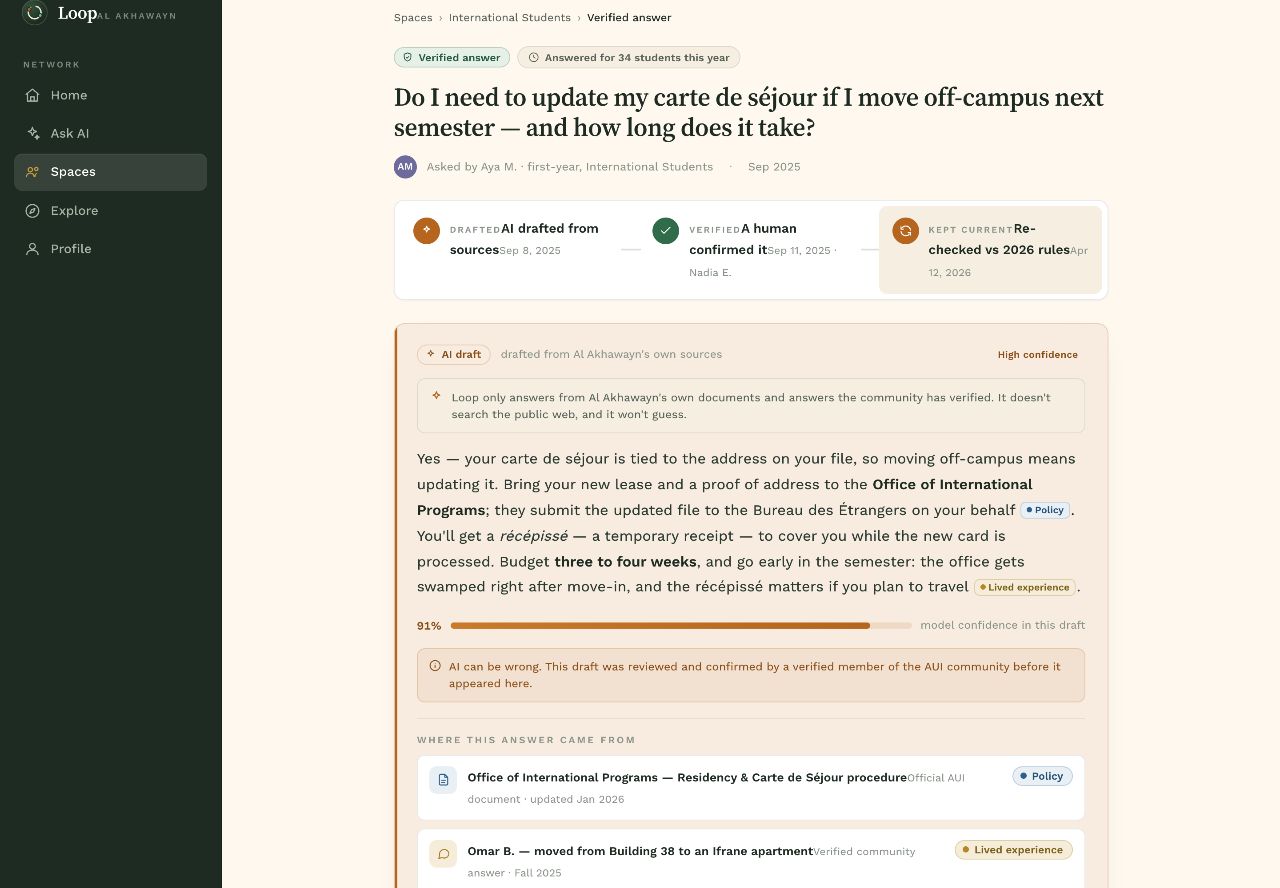
05 — THE PROTOTYPE
The Verified Answer — the one interaction worth building.
1 · AI drafts from AUI's own corpus — handbook + verified community answers
2 · Shows its work — confidence score, blue = policy, amber = lived experience
3 · A verified human confirms — one tap, with their name and standing
The demo screen: question → lifecycle stepper (drafted → verified → kept current) → AI draft with confidence and color-coded sources.
4 · The confirmation retrains Loop — the next person gets it instantly
One artifact fuses the AI, the trust system, and the learning loop.

Slide 7
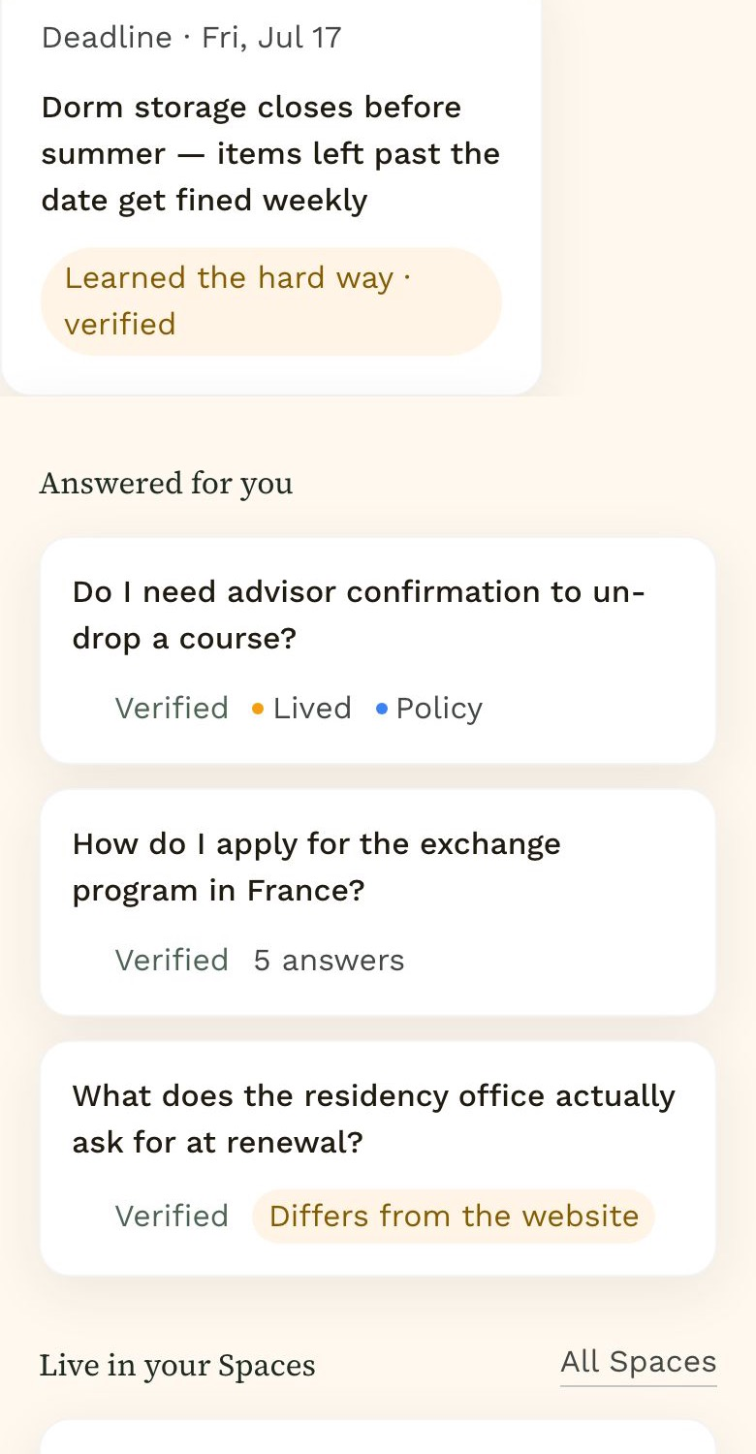
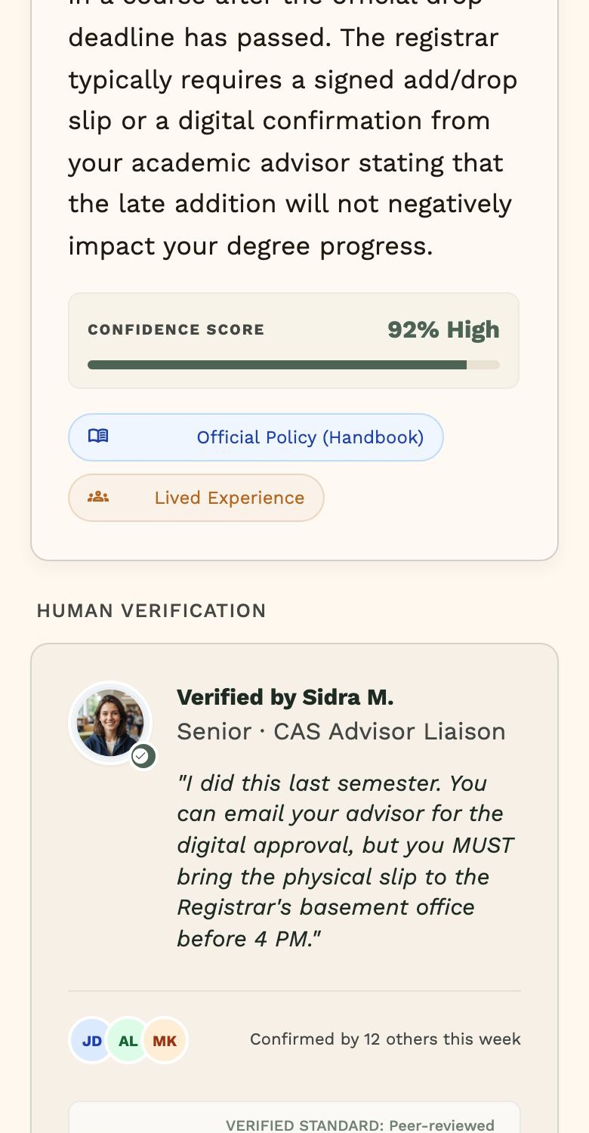
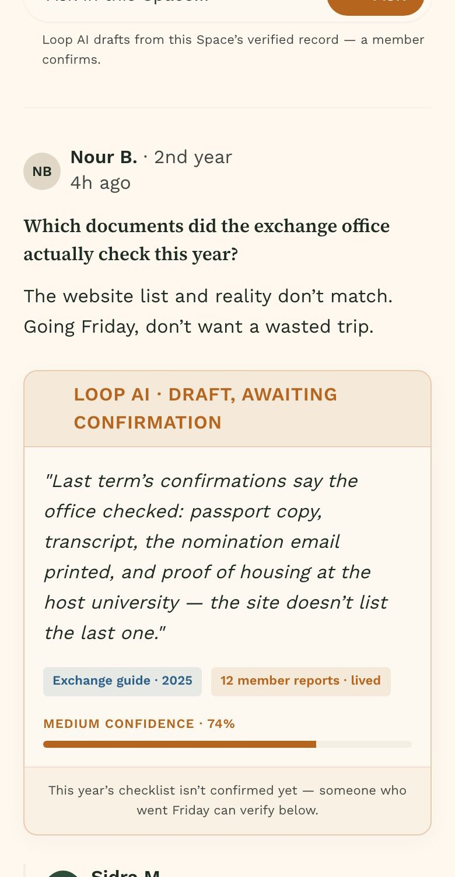
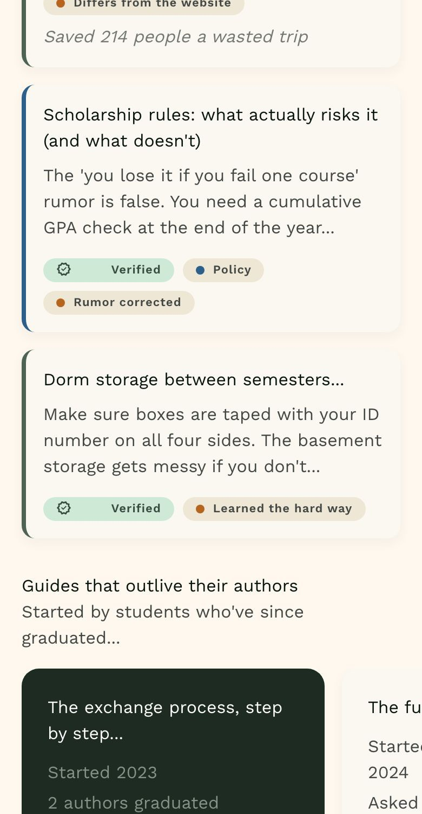
05 — THE USER JOURNEY
Yassine's journey — warned early, answered fast, never stranded.
Home. Rules surface before they cost.
Ask. AI drafts, a human confirms.
Spaces. Drafts wait for a verifier.
Explore. Knowledge by situation.

Slide 8
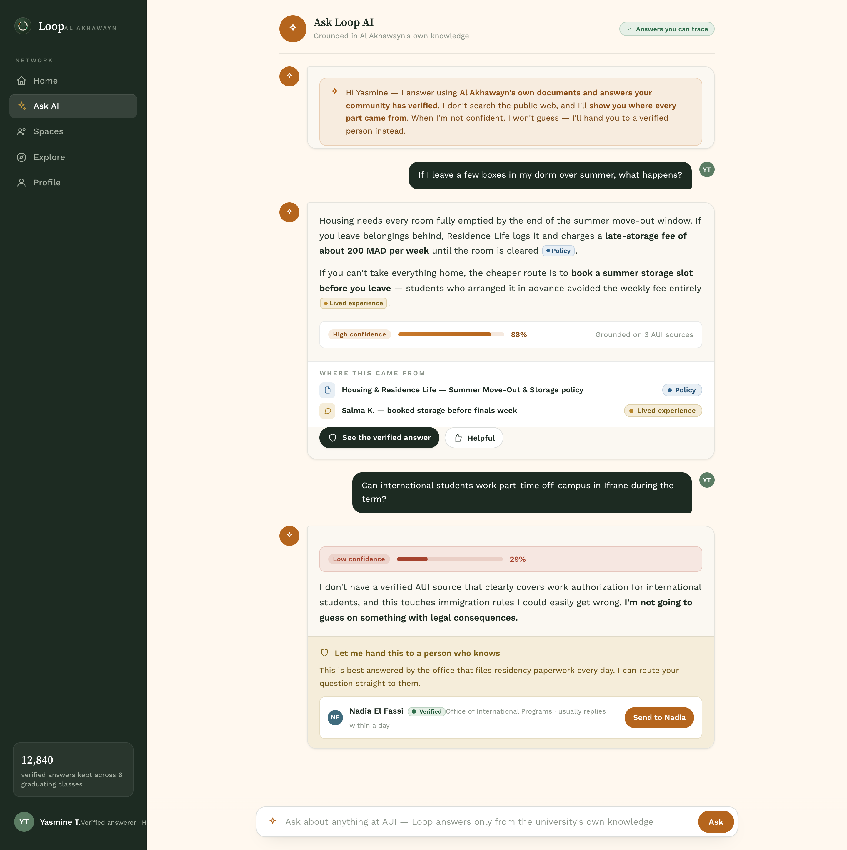
06 — THE AI DIMENSION
High automation, high human control — at the same time.
What the AI does. Drafts answers only from AUI's corpus. States its scope. Never searches the public web.
How you know it's AI. Terracotta + spark icon own every AI moment. AI content is never dressed as human.
When it's wrong. Anyone suggests a correction → a verifier reviews → the answer is rewritten and retrained — publicly, in the answer history.
The honest case, in the UI: 29% confidence on a legal-stakes question → "I'm not going to guess" → hand-off to Nadia at the International Programs office.
Who's in control. Below 60% confidence it refuses to guess and routes you to a verified person — by design.
Disclaimer on every answer: "AI can be wrong. This draft was reviewed by a verified member before it appeared here."

Slide 9
07 — HUMAN-CENTERED AI PRINCIPLE
Shneiderman (2020): the best systems combine high automation with high human control.
WHAT IT SAYS
Don't choose between a capable machine and a person in charge — automation and oversight should go up together.
WHERE IT SHOWS UP
The Verified Answer screen: the answer lifecycle stepper (drafted → verified → kept current) and the human verification card, given equal weight to the AI card.
HOW WE IMPLEMENTED IT
One-tap Confirm / Correct as direct-manipulation objects; a public answer history where a student's correction retrained the model; and a deliberate omission — the AI can never auto-publish. Every answer stays a draft until a person stands behind it.

Slide 10
08 — WHAT WE TESTED
Concept feedback changed the design — four times.
"Floating buttons are dated."
Killed the floating Ask button → an inline composer at the top of each thread, where the question belongs.
"Verification looks like a checkmark."
Rebuilt as a credible authenticator: who verified, their standing, what "confirmed" means, named co-confirmers, public history.
"Home feels empty."
An empty search box became a proactive hub: deadlines surfaced before they cost, live Space activity, the growing corpus.
"Explore is a generic feed."
Reorganized by situation — international, transfer, exchange, faculty — because people arrive as "I'm new here," not as categories.
The pattern: every change moved trust from implied to visible — and asking from a widget to where the conversation already is.

Slide 11
09 — WHAT WE'D DO NEXT
One more week: pressure-test the trust mechanics.
Test — the verification flow with real verified answerers: who qualifies, how confirmations are weighted, what makes someone willing to put their name on an answer. Concept-test with faculty (our extreme persona) — the least-served group.
Build — the correction pipeline end-to-end: correction → verifier review → answer rewrite → retrain, with the answer history as the audit trail. Today it's a designed story; next week it should be a working loop.
Rethink — the rewards system. Salma wants recognition without being treated as infallible; points-per-post is the wrong currency. We'd prototype "Keeper of Record": credit for answers still trusted after you graduate.
Success metric, from day one: time-to-trustworthy-answer, and the share of answers still accurate one year later.

Slide 12
What seniors know shouldn't graduate with them.
Loop — AI drafts. A verified human confirms. The campus never forgets.
FAROUK · MANAL · HAYTAM · ANASS — github.com/F4R0UK11/loop-project · Thank you. Questions welcome.

