Slide 1


Banking App Features
MyBSS
Bohumukhi Somobay Somiti
info@finaltouch.com.bd | www.finaltouch.com.bd

Slide 2

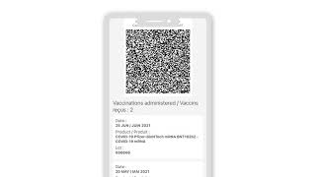
Mobile Banking Scenario
There will be a total of 50,000 clients. In this software system
Deposit amount
1,000/-
5,000/-
50,000/-
10,000/-
20,000/-
1,00,000/-
E-Generate Printed Satisfaction
Total account duration
1 year --> 24% ---> day 0.1%
3 year --> 30% ---> day 0.125%
info@finaltouch.com.bd | www.finaltouch.com.bd

Slide 3
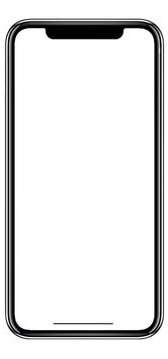
Mobile Banking Scenario
Every day the client will see the accumulated profits of his profile in the manner of chronograph
Chronograph
00000000.00000000
Per day profit
00000000.00000000
info@finaltouch.com.bd | www.finaltouch.com.bd

Slide 4
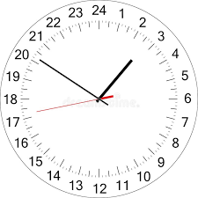
Mobile Banking Scenario
Every day the client will see the accumulated profits of his profile in the manner of chronograph
Chronograph
00000001.00000000
Per day profit
02-Set-2022 ---- 10am
Account deposit 1000tk
Start Chronograph Profited
03-Set-2022 ---- 12am ~
00000000.09999999
info@finaltouch.com.bd | www.finaltouch.com.bd

Slide 5
Features of Mobile Banking
Mobile Banking
Accounts
Manage
Other Accounts
Fund Transfer All Mobile Financial
৳
Service Requests
Withdrawal All Government Recognized Banks and Mobile Financials
৳
!
Alerts
Security
Central server
info@finaltouch.com.bd | www.finaltouch.com.bd

Slide 6
Accounts
Some of the options that must be included under this feature can be:
OTP login
Get NID detailed
Email statements
An ideal mobile banking app must help manage accounts at fingertips. This means, all the account details must be available on the mobile screen in as less as a few clicks.
Change phone number
Update KYC
info@finaltouch.com.bd | www.finaltouch.com.bd
MyBSS
6

Slide 7
Fund Transfer
Some of the mandatory options can be:
৳
Transfer funds to All Mobile Financial
Transfer funds with Banks
E-printed bonds
A good banking app allows sending money easily and securely. Fund transfers are made instantly through options such as NEFT, IMPS or RTGS.
Withdraw anytime
Send money using MyBSS
info@finaltouch.com.bd | www.finaltouch.com.bd
MyBSS
7

Slide 8
Withdrawal
Here are a few tasks performed through it:
৳
Schedule monthly bills of credit cards, EMIs etc.
Give standing instructions to auto debit the bill amount
The salient features that makes a mobile banking app complete allows paying bills in a single-window platform. This minimizes the need to transact through separate third-party websites and apps.
Pay utility bills like mobile recharges, DTH in a single-go
info@finaltouch.com.bd | www.finaltouch.com.bd
MyBSS
8

Slide 9
Manage Other Accounts
Few options listed could be:
View details of loan account
View summary of fixed deposits
A comprehensive banking app empowers the user to take charge of his/her linked accounts. This feature enables the users to know each detail such as the lock in period, maturity date, rate of interest etc.
View summary of recurring deposits
info@finaltouch.com.bd | www.finaltouch.com.bd
MyBSS
9

Slide 10
Service Requests
Here’s what can be incorporated in this feature:
Request for chequebook
Stop an already issued cheque
Register and update email address for receiving account statements
A Banking app serves the simplest yet crucial things that helps in banking
on-the-go rather than restricting the users to perform tasks while they are outsta- tion or abroad.
Generate OTPs for transactions
info@finaltouch.com.bd | www.finaltouch.com.bd
MyBSS
10

Slide 11
Alerts
These are some probable selections to address:
Know changes in account and communication details
Low balance alerts
Fee charged for debit/credit cards, locker, overdraft etc.
The app provides all news about the accounts, offers and deals or any other changes critical to customers. The feature helps customers stay informed and thus bank rationally.
info@finaltouch.com.bd | www.finaltouch.com.bd
MyBSS
11

Slide 12
Security
It must:
Ensure privacy of personal information
Use advanced encryption technology not to store data on device or SIM
Provides SMS alerts for every transaction made
Finally, a banking app is never perfect until it is safe enough to allow users access all the features.
Clears cache, browsing data and temporary memory on logout
info@finaltouch.com.bd | www.finaltouch.com.bd
MyBSS
12

Slide 13
MyBank is a mobile application, developed by Sesame India
Built in consideration to offer banking solutions for a variety of services anytime, anywhere
MyBSS
by Sesame
Serves multiple clients across India
Most-trusted solution provider in Kerala, India
Redefines convenience and ease to bank

Slide 14
Generates reports based on online data and trends
Wide range of facilities for business development,
customer satisfaction and customer retention.
24*7 access
MyBSS
Benefits
Increased efficiency and larger
profitability
Helps in effective decision making
Inter-connected banking and centralized control system
info@finaltouch.com.bd | www.finaltouch.com.bd
MyBSS
14

Slide 15
Available on single-time purchase
and/or monthly rental
Customized product (specific to the organization’s need)
Personalized (with banks logo, tagline etc.)
Why
MyBSS?
Safe and secure
Cost-effective
Easy installation
info@finaltouch.com.bd | www.finaltouch.com.bd
MyBSS
15

Slide 16
Demo and Trial
Banks and other financial institutions can schedule a demo to better under- stand the features of MyBank and judge its capabilities.
60 Days
Bank authorities can also request for a trial
where they can avail the real-time benefits of MyBSS.
info@finaltouch.com.bd | www.finaltouch.com.bd
MyBSS
16

Slide 17


Thank You
info@finaltouch.com.bd | www.finaltouch.com.bd

