Slide 1

Wojciech Kaczmarski, SP5WWP
M17 Foundation
m17foundation.org

Slide 2
LinHT – a GNU Radio configurable
handheld transceiver

Slide 3
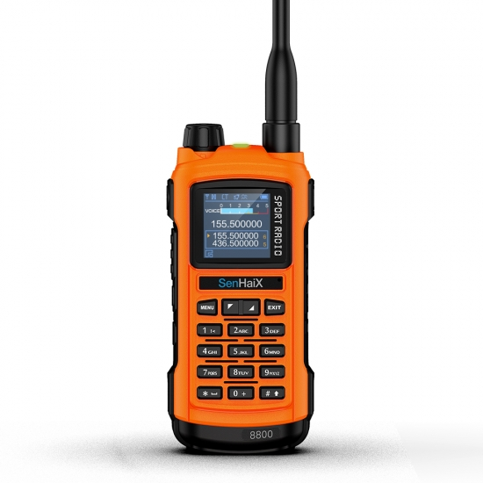
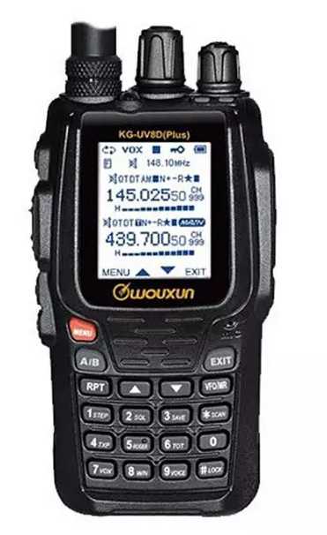
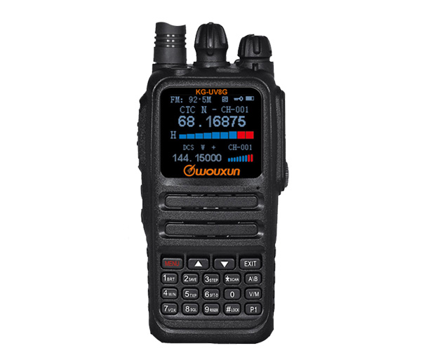
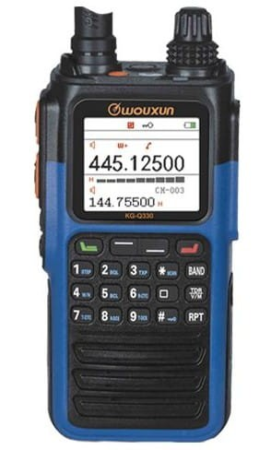
Technological stagnation
Technological stagnation
Manufacturers do not offer any real innovation
Visually appealing FM transceivers, using legacy RF ICs: AT1846, BK4819

Slide 4
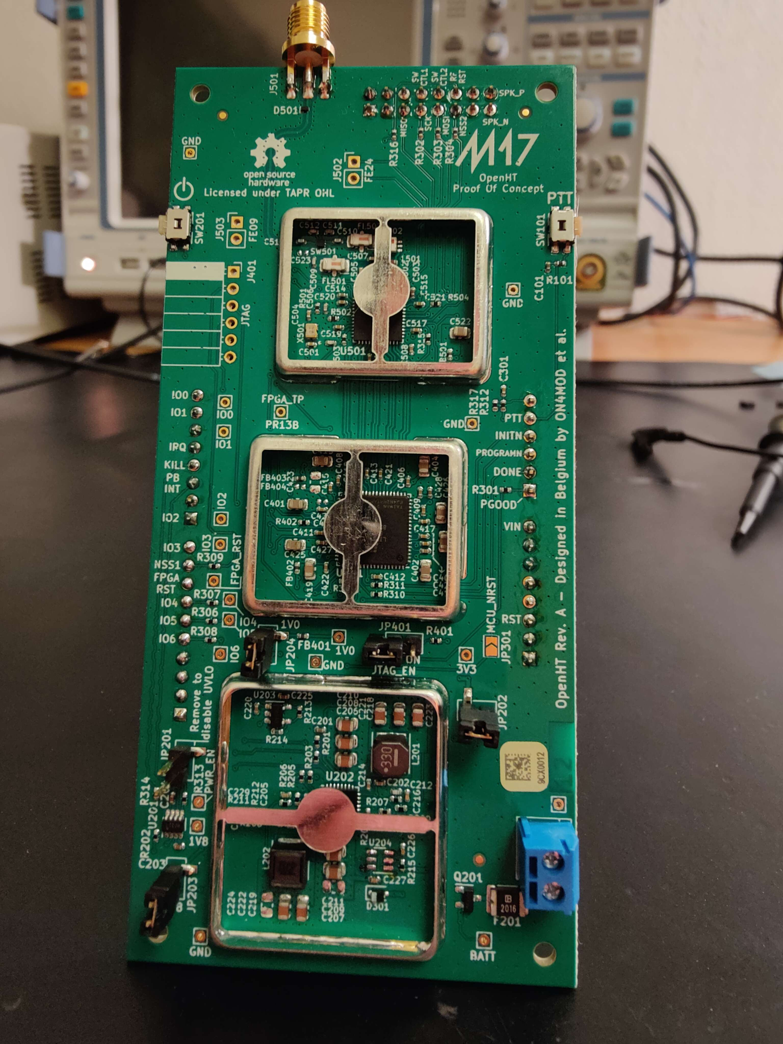
2023 - OpenHT
SDR-based transceiver: STM32 + FPGA
RF front end: Microchip AT86RF215
(430MHz and 2.4GHz band support)
Failure points:
Hard to develop for – FPGA
High cost
Limited STM32 dev board availability
Non-existent ergonomics
Never got through the PoC stage

Slide 5
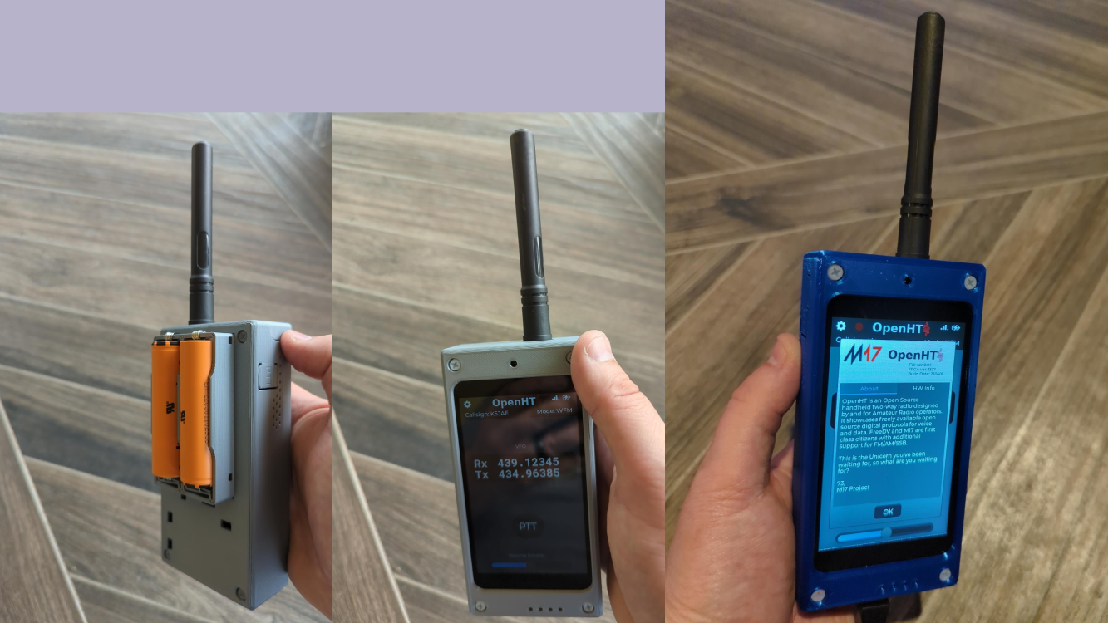
2023 - OpenHT

Slide 6
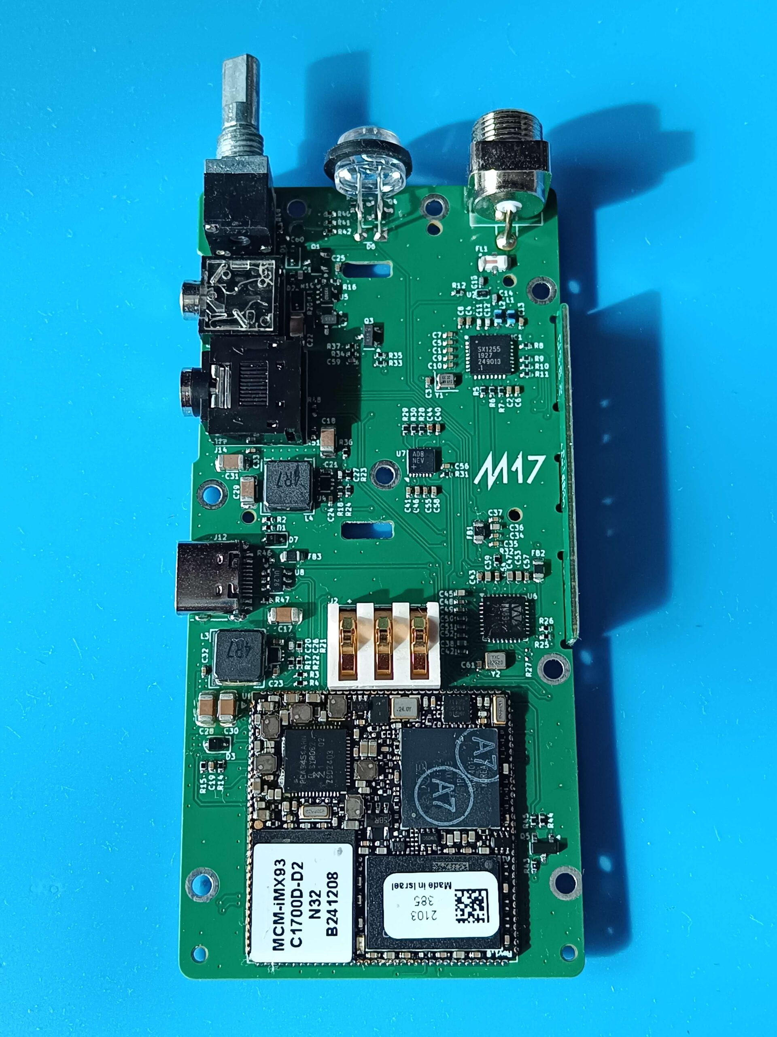
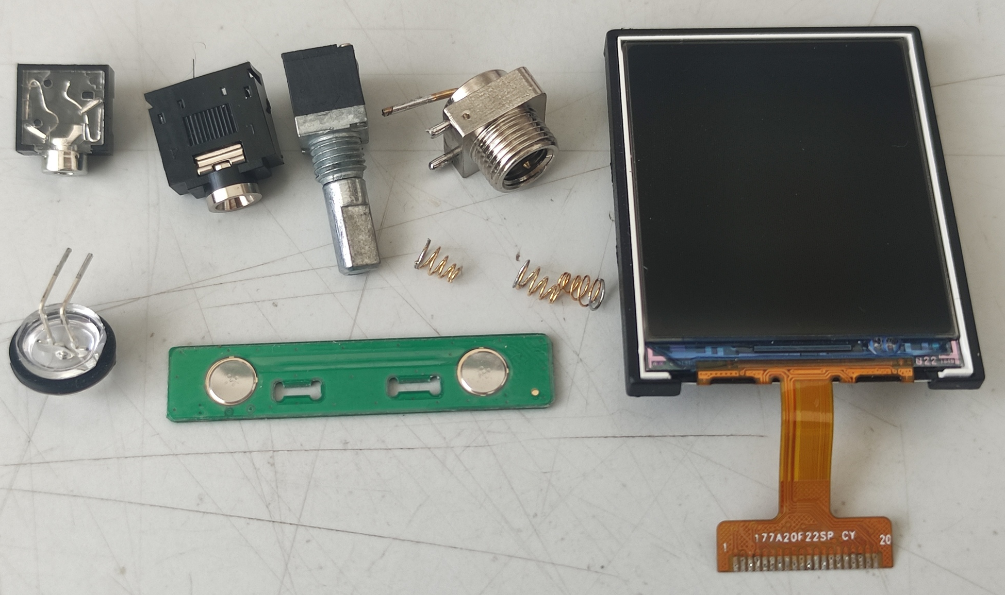
2025 - LinHT
Replacement board
Requires a donor, uses some of its parts
Donor radio: Retevis C62 (Chierda UV58D)

Slide 7
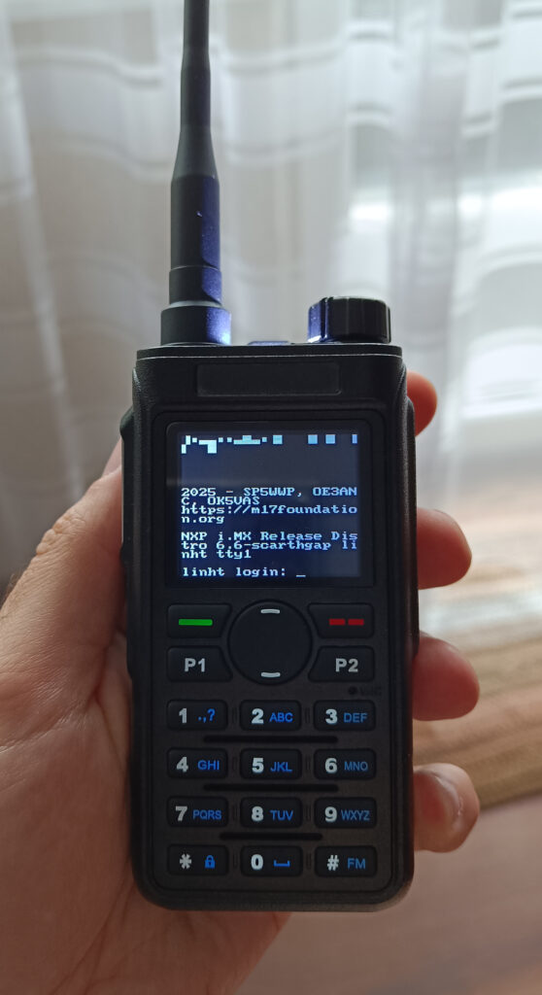
LinHT
SDR transceiver: SoM + RF front end
RF front end: Semtech SX1255 (430MHz band)
Advantages over OpenHT:
Runs Linux (<25s boot-up)
Easy to develop for (ssh, GR, gcc, python)
Lower cost
Standardized SoM footprint
Improved ergonomics

Slide 8
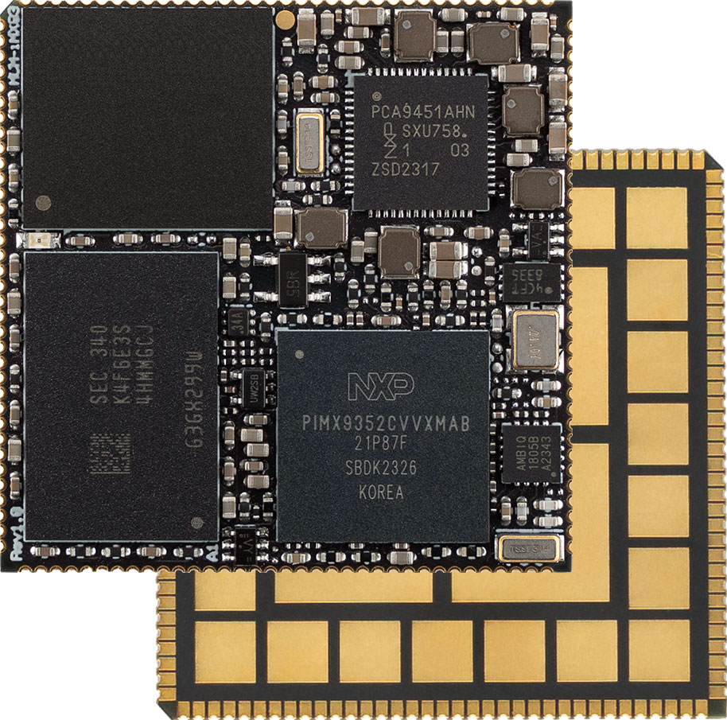
LinHT
Powerful SoM
Dual-core ARM Cortex-A55 @1.7GHz
ARM Cortex-M33 @250MHz
Floating Point Unit
ARM Ethos U-65 NPU
2GB LPDDR4
32GB eMMC
3x3cm footprint

Slide 9
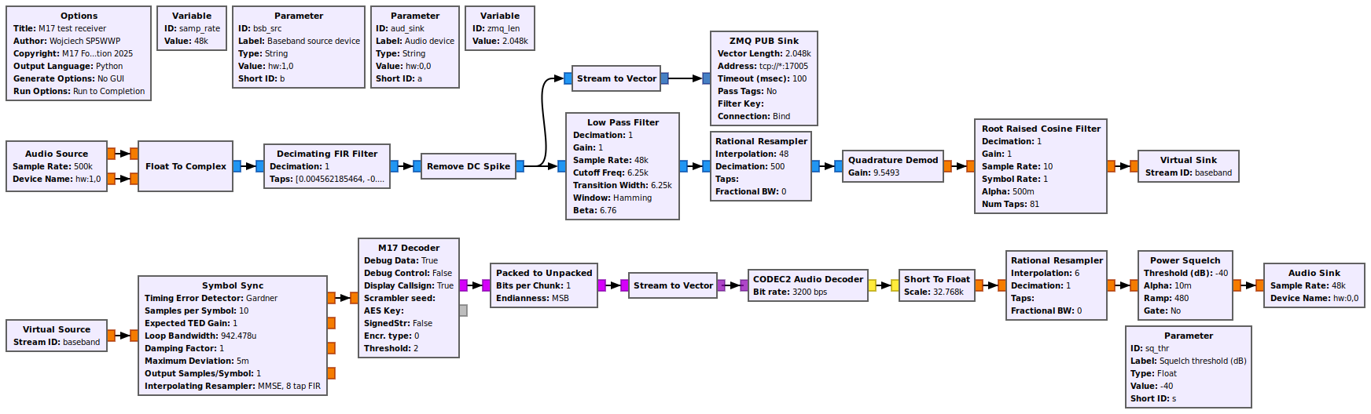
LinHT
GNU Radio integration
Define device’s capabilities with GNU Radio flowgraphs

Slide 10
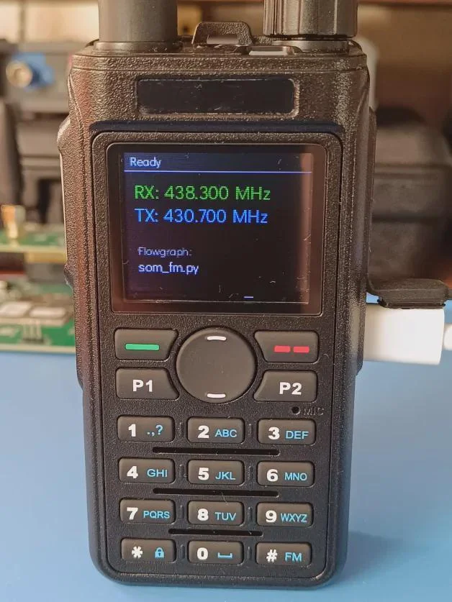
LinHT
Innovation offered:
Paradigm shift for amateur radio
Open-source hardware and software
Full, wideband IQ modem: truly all-mode
High educational value
GNU-Radio-definable (share flowgraphs!)
Portable, battery-powered SDR transceiver
NPU with TensorFlow Lite support
Easier RF protocol development

Slide 11
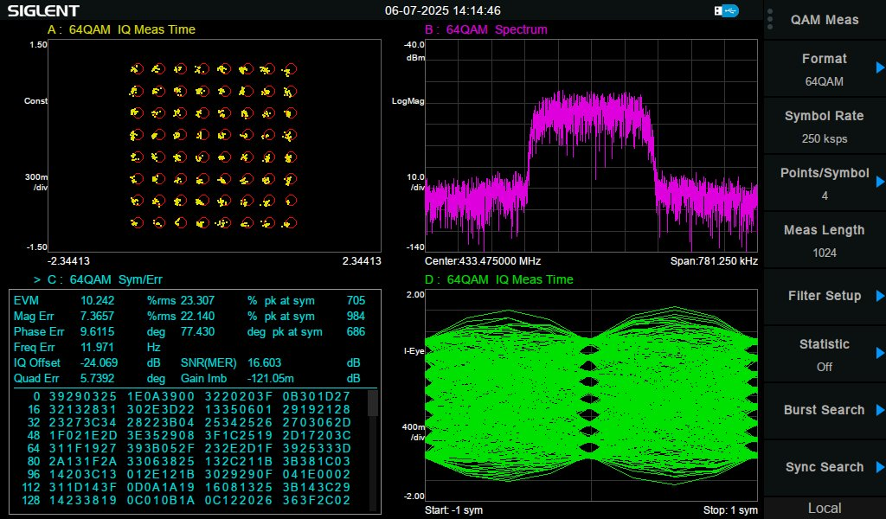
Wideband & high-order modulation ready

Slide 12
LinHT
Current draw
200mA in M17 mode (reception)
Keyboard backlight and display on

Slide 13
LinHT
Prototype cost:
$490 PCB+assembly at PCBWay, 5pcs.
$40 Retevis C62 (donor)
$469 SoM, 5pcs.
About $240/pc.

Slide 14
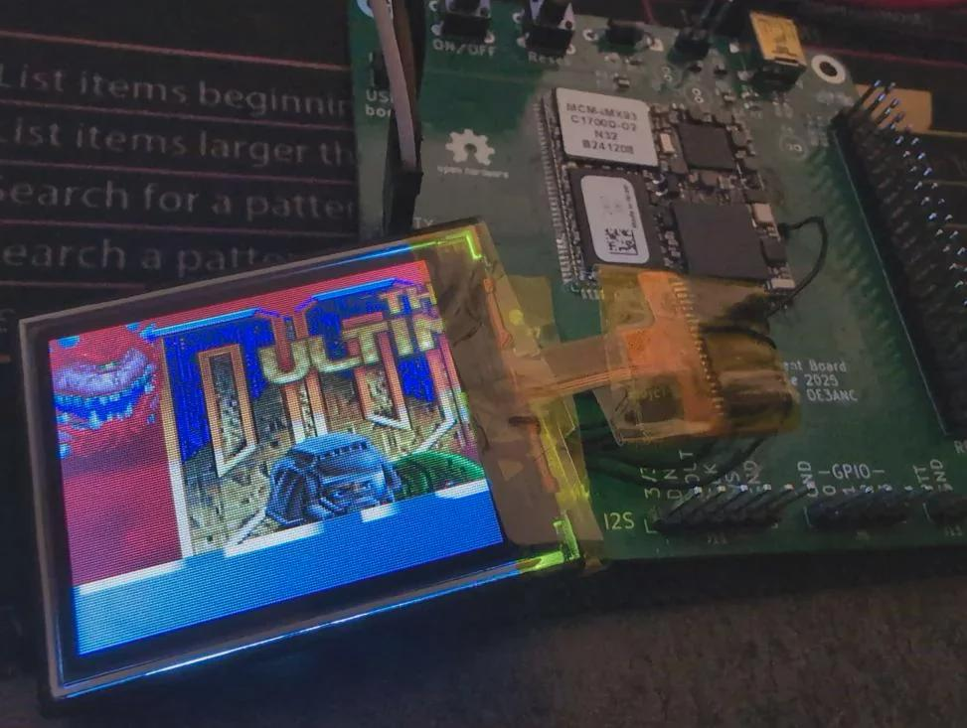
LinHT
Yes,
the device runs DOOM.

Slide 15

LinHT
Further reading
GitHub repository (PCB)

Slide 16
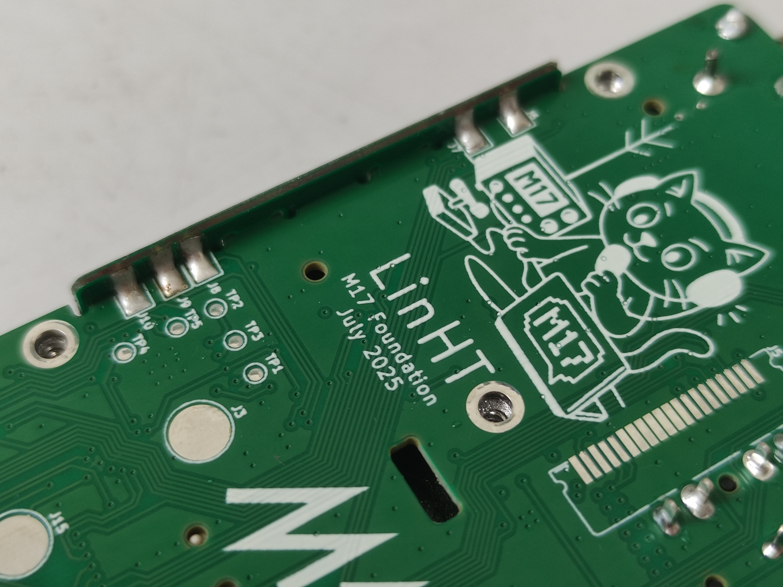
Thank you!

