Slide 1

Wojciech Kaczmarski, SP5WWP
M17 Foundation
m17foundation.org

Slide 2
Remote Radio Units -
- a new generation of repeaters

Slide 3
Current repeater setups
Usually 2 transceivers connected to a controller
Both connected to a single antenna through a diplexer

Slide 4
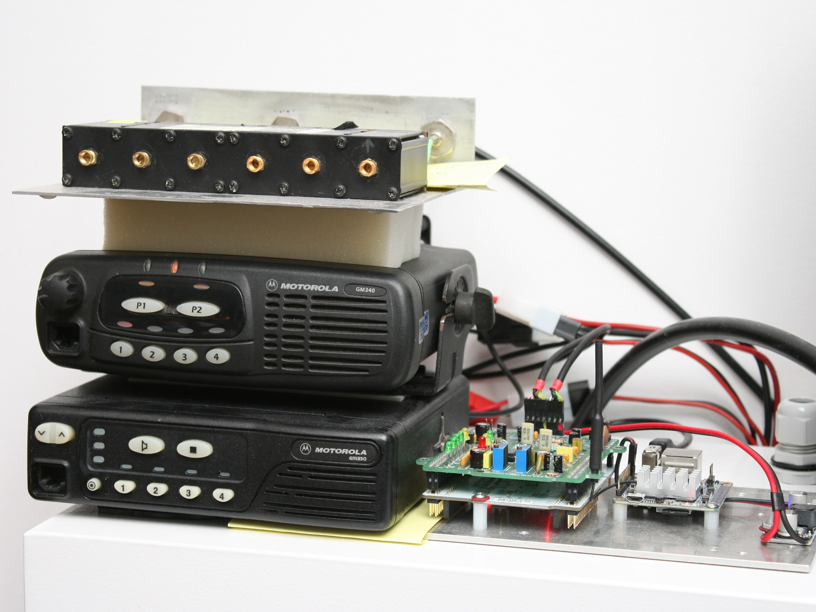

Slide 5
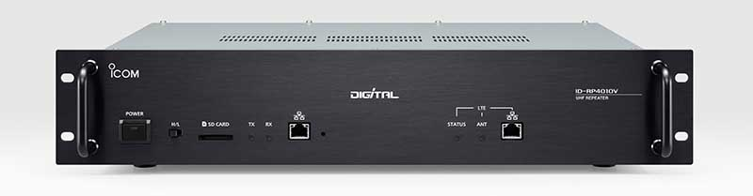
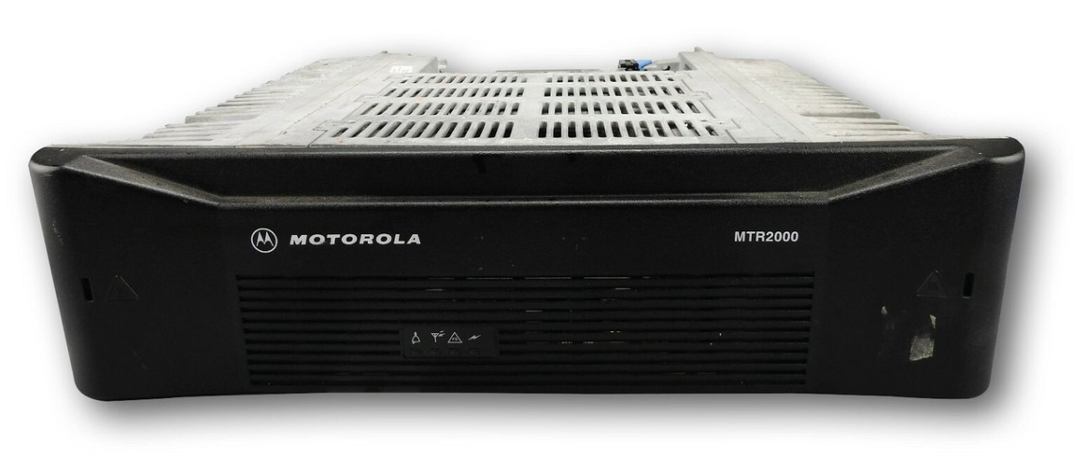

Slide 6
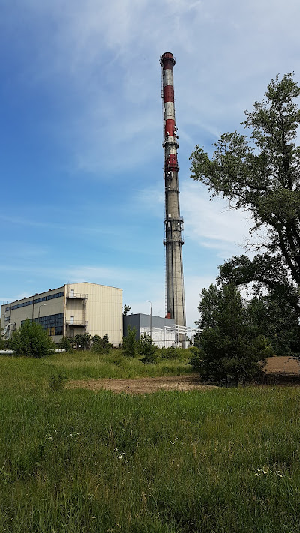
Current repeater setups
Long coax runs – significant losses
Hard to monitor RL or antenna faults
Low bandwidth (25kHz?)
Low data rates (9600bps)
Basically FM/AFSK/FSK only

Slide 7
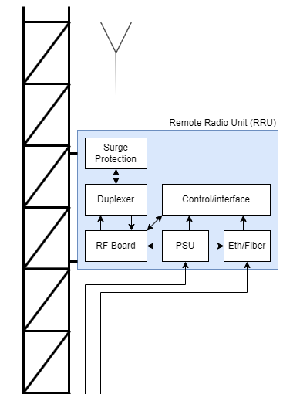

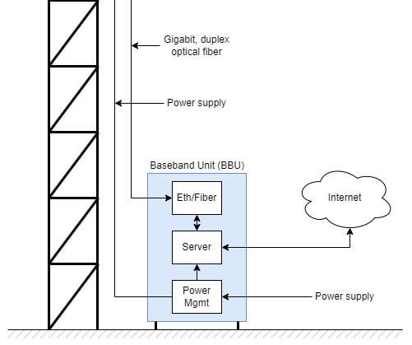
Solution: RRU
Put everything in an aluminum chassis
Control the whole device over optical fiber
Right? A remotely-controllable, all-in-one solution!
Bonus points: make it all open-source
(including the control protocol)

Slide 8
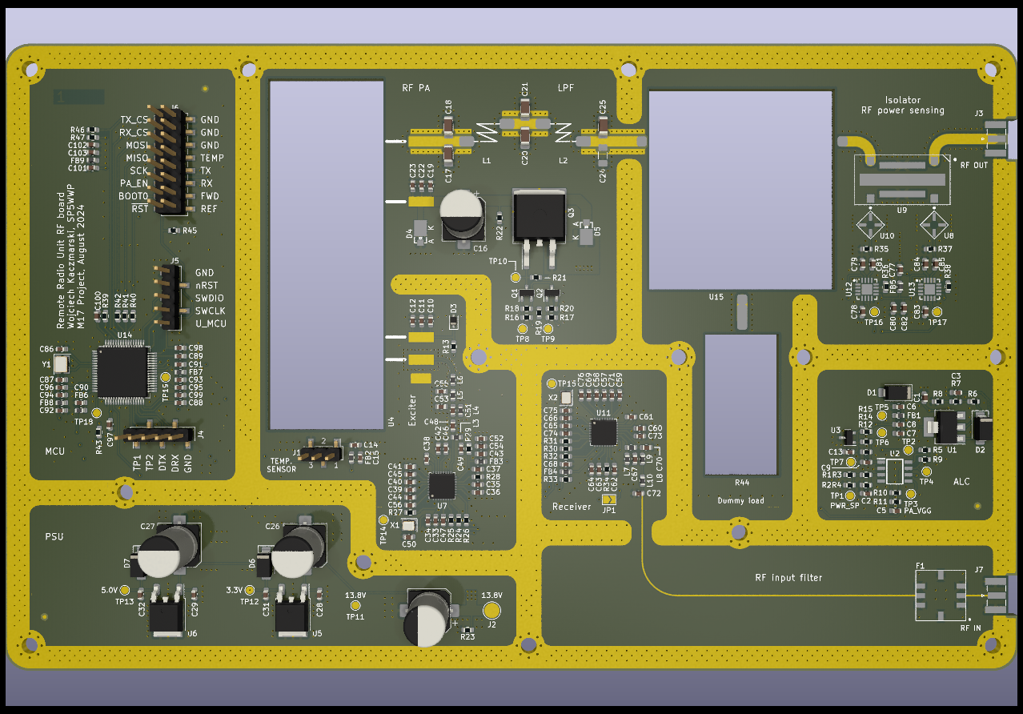


Slide 9
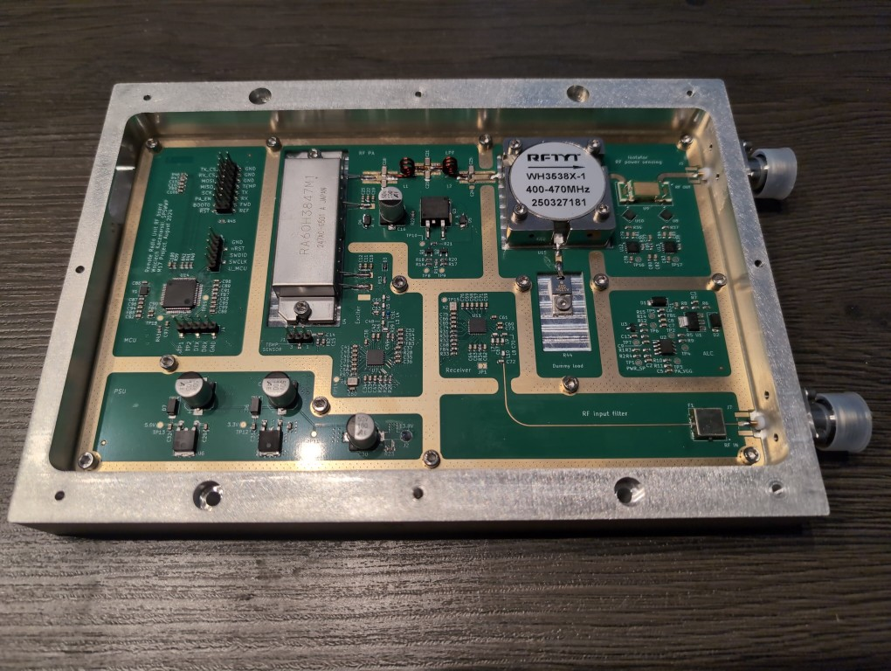

Slide 10
RRU
Advantages:
Minimal coax run losses
Minimal interference
Remote control and supervision
All-mode support through SDR
Wideband operation (with variable bandwidth)
High-order modulation support (64QAM)

Slide 11
RRU
Room for improvement
Use SDR front ends (SX1255, AK2401A) instead of FM-only (CC1200)

Slide 12

RRU
Further reading
M17 Wiki
GitHub repositories

Slide 13
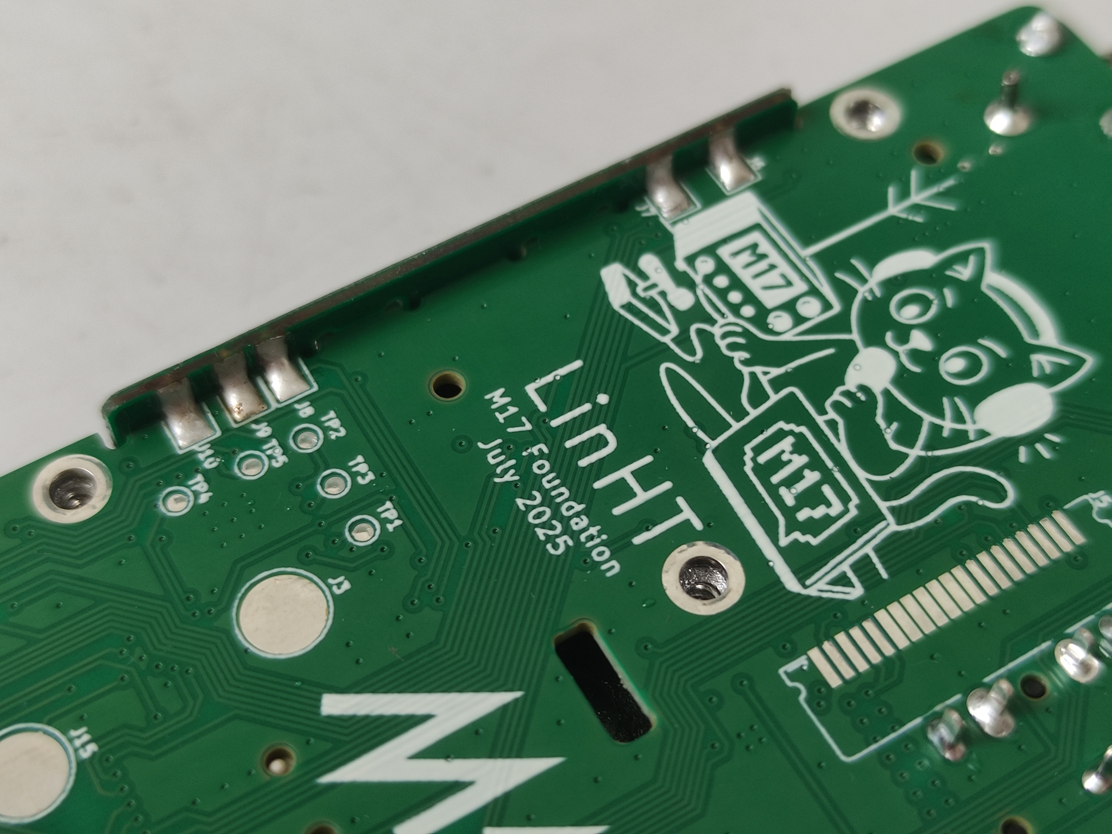
Thank you!

