Slide 1
Exam Generator
P78061502 蔡昀展
P76051292 方彥婷

Slide 2
MVC

Slide 3
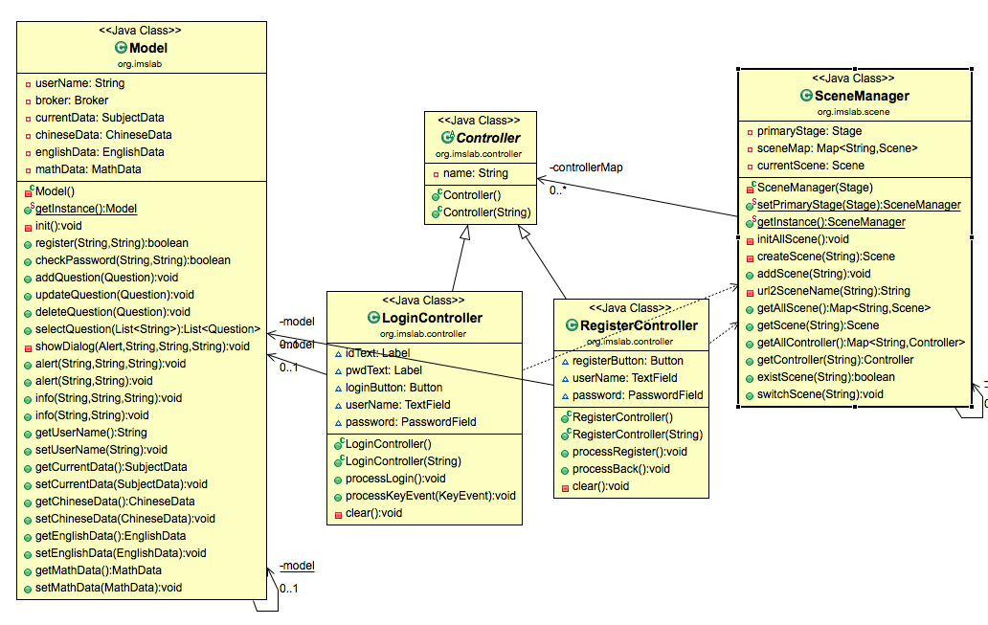
MVC 整體架構
Singleten

Slide 4
[SceneManager] Controller & View

Slide 5
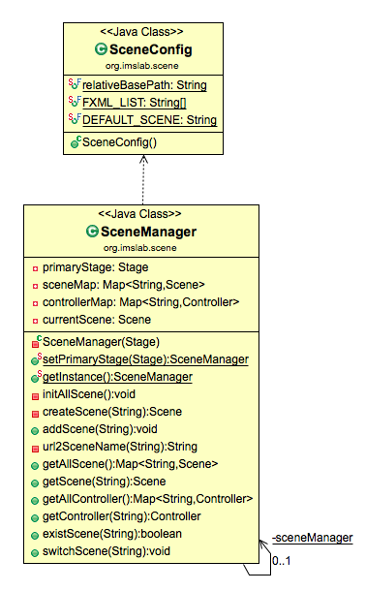
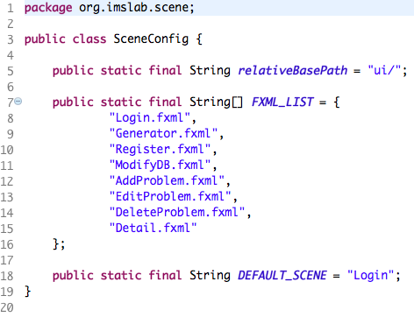
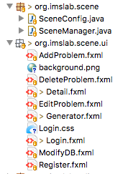


Slide 6
[Model] Controller & Model

Slide 7
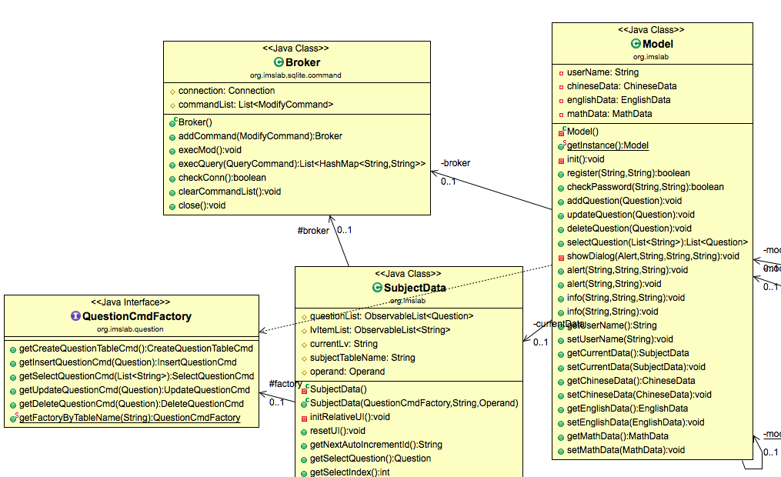
後端資料庫
Abstract Factory

Slide 8
Question

Slide 9
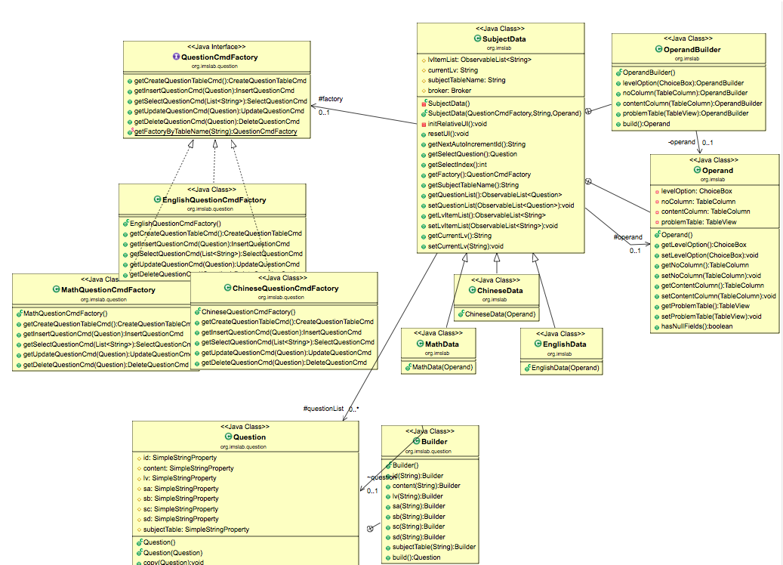
SubjectData
&
Command Factory

Slide 10
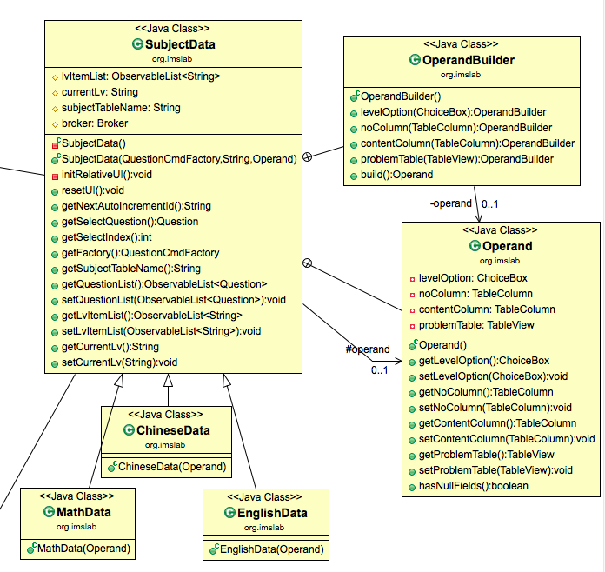
Builder Pattern

Slide 11
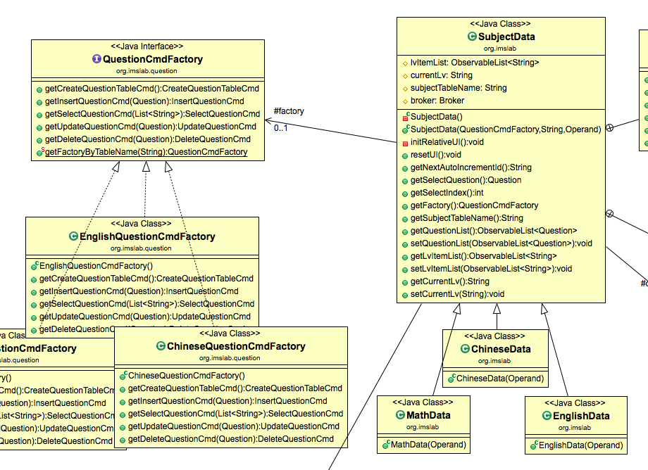
Abstract Factory

Slide 12
Command Pattern

Slide 13
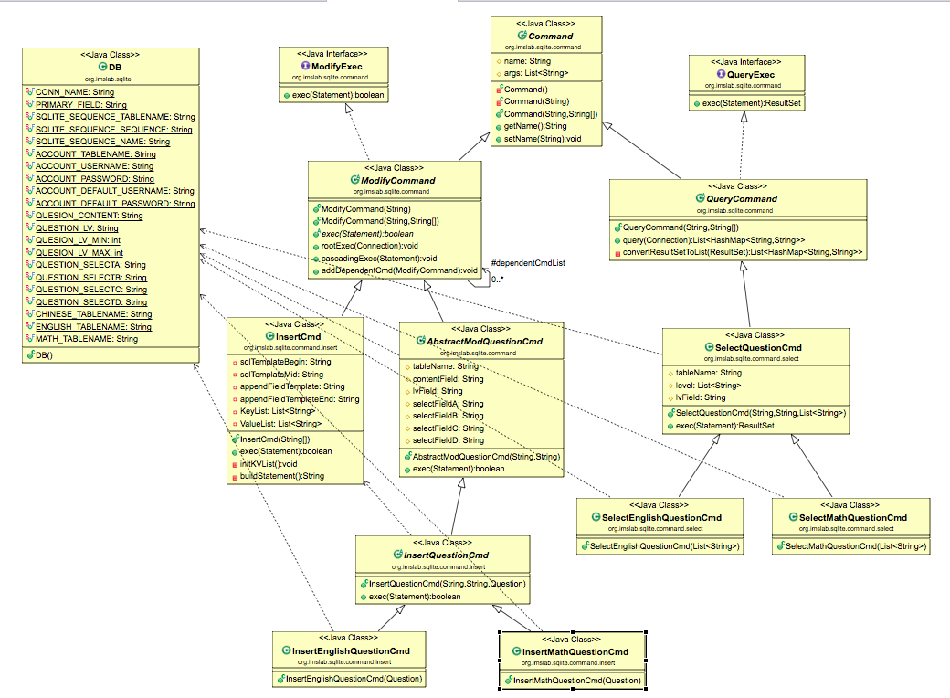
資料庫常數

Slide 14
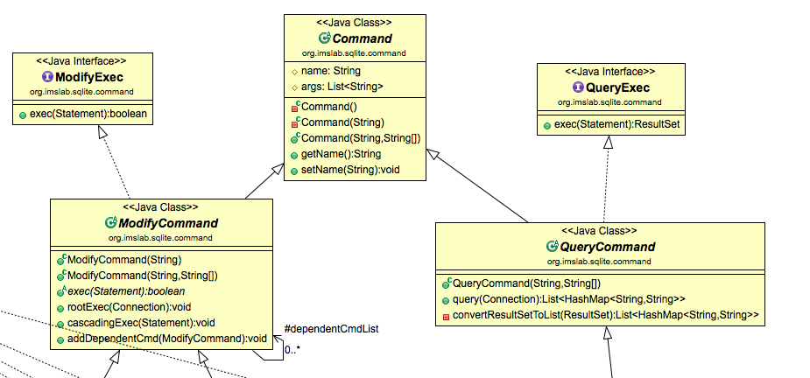

Slide 15
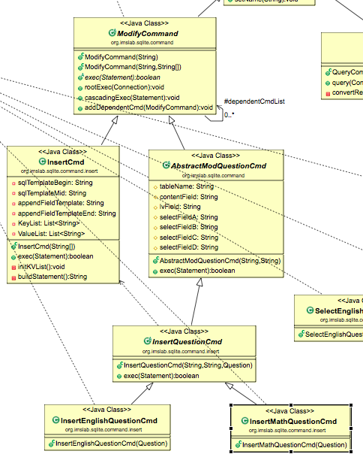
Abstract Factory
取得的指令實體

Slide 16
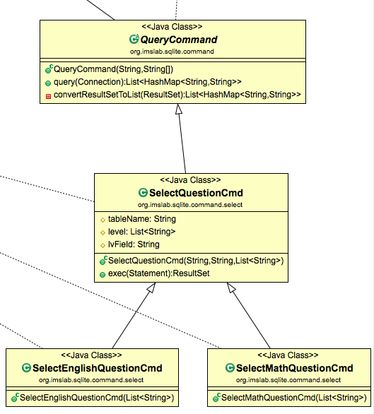
Abstract Factory
取得的指令實體

Slide 17
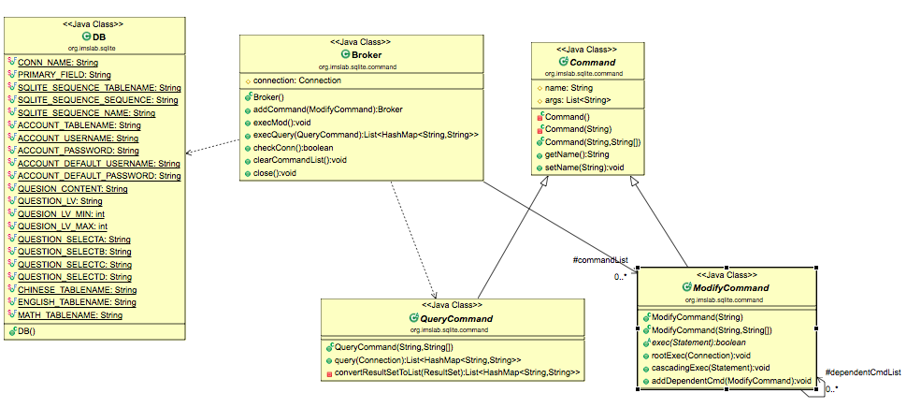
Composite Pattern

Slide 18
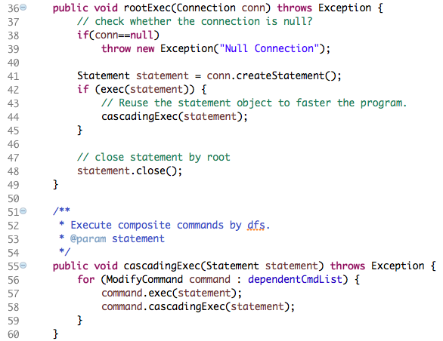

Slide 19
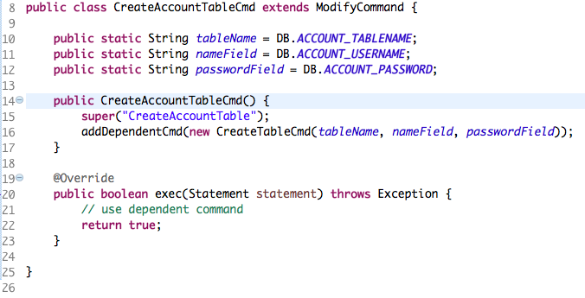
Composite Pattern

Slide 20
Thanks for listening ~

