Slide 1
Project2
F74041056 戴鎧如

Slide 2
Bullet
- bulletsound: QMediaPlayer * - type: int - mytype:int
<<constructor>> +Bullet(parent=0: QGraphicsItem *) +keyPressEvent(event: QKeyEvent *) +move()
UML Class
Player
<<constructor>> +Player(parent=0: QGraphicsItem *) +create()
Start
+start_scene: QGraphicsScene * -btn1: QPushButton * -btn2: QPushButton *
<<constructor>> +Start(parent=0: QWidget *) +startTheGame()
Game
+ scene: QGraphicsScene * + player: Player * + score: Score * + time: Time * + miss: Miss *
<<constructor>> +Game(parent=0: QWidget *)
Time
- ttime: int
<<constructor>> +Time(parent=0: QGraphicsItem *) +getTime(): int +decrease()
Final
+final_scene: QGraphicsScene * -btn3: QPushButton * -btn4: QPushButton *
<<constructor>> +Final(parent2=0: QWidget *) +reStart()
Score
- score: int
<<constructor>> +Score(parent=0: QGraphicsItem *) +increase1() +increase2() +increase3() +getScore(): int
Miss
- miss: int
<<constructor>> +Miss(parent=0: QGraphicsItem *) +increase() +getMiss(): int

Slide 3
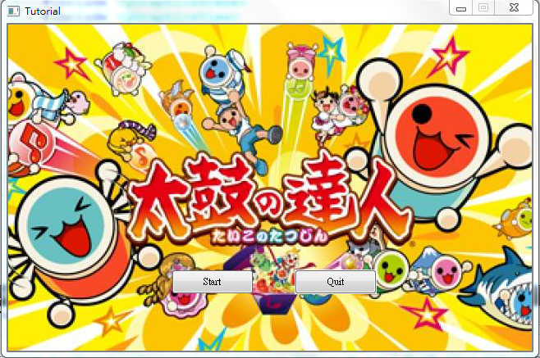
First
Start Window
Use your mouse to click the “Start” button, and the game will start
If you click the “Quit” button, the start window will close

Slide 4
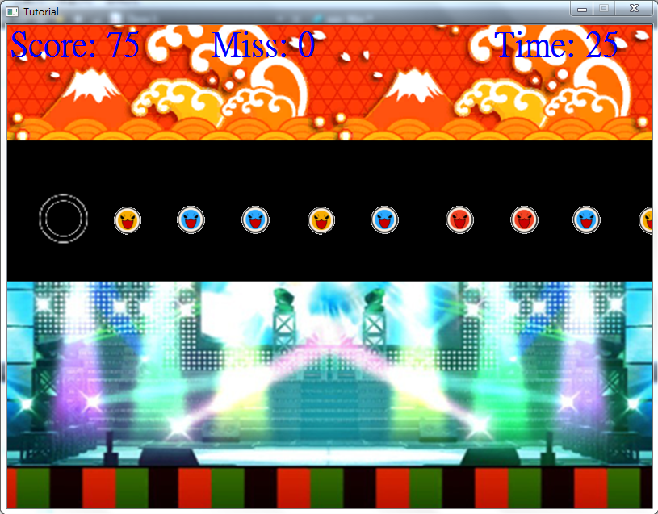
Second
Game window
1. Use the key to move the drums and get scores
→ “X” for “red” drums (+25 scores)
→ “Z” for “blue” drums(+50 scores)
→ “M” for “yellow” drums(+75 scores)
2. When the time is “0”, the game is over, and it will close the Game window, and open the Final window

Slide 5
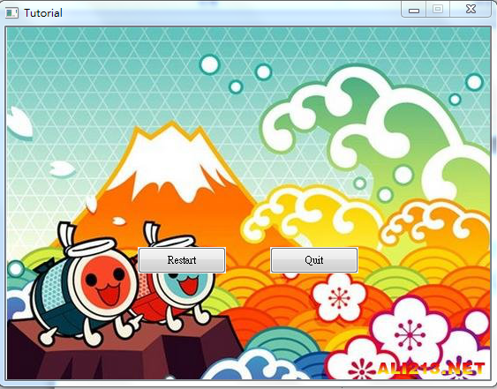
Final
Final Window
If you want to restart the game, click the “Restart” button, and it will show “Start Window”
If you click the “Quit” button, the final window will close

Slide 6
Bonus
I have background music
If you press the key, it will have bullet sound

