Slide 1
電腦視覺與深度學習 (Computer Vision and Deep Learning) Homework 2
TA:
Mark : 29A7882zz@gmail.com
Office Hour: 19:00~21:00, Mon.
09:00~11:00, Wed.
At CSIE 9F Robotics Lab.

Slide 2
Notice (1/2)
Copy homework is strictly prohibited!! Penalty: Grade will be zero for both persons!!
If the code can’t run, you can come to our Lab within one week and show that your programming can work. Otherwise you will get zero!!
Due date => 2020/01/01 (Wed.) 23:59:59
No delay. If you submit homework after deadline, you will get 0.
Upload to => 140.116.154.1 -> Upload/Homework/HW2
User ID: cvdl2019 Password: cvdl2019
Format
Filename: Hw2_StudentID_Name_Version.rar
Ex: Hw2_F71234567_林小明_v1.rar
If you want to update your file, you should update your version to be v2, ex: Hw2_F71234567_林小明_v2.rar
Content: project folder*( including the pictures ) *note: remove your “Debug” folder to reduce file size

Slide 3
Notice (2/2)
C++ (check MFC guide in ftp)
OpenCV 3.3.1 (https://opencv.org/release.html)
Visual Studio 2015 (download from http://www.cc.ncku.edu.tw/download/)
UI framework: MFC
Python
Python 3.7 (https://www.python.org/downloads/)
Tensorflow 2.0 / PyTorch 1.3.0
opencv-contrib-python (3.4.2.17)
Matplotlib 3.1.1
UI framework: pyqt5 (5.11.3)

Slide 4
Grading
0. Homework Format
1. (30%) Stereo – Disparity Map (出題：Kris)
2. (30%) Normalized Cross Correlation (出題：Jang)
3. (40%, reference) SIFT (出題Michael)
3.1 Show keypoints (20%)
3.2 Show matched keypoints (20%)

Slide 5
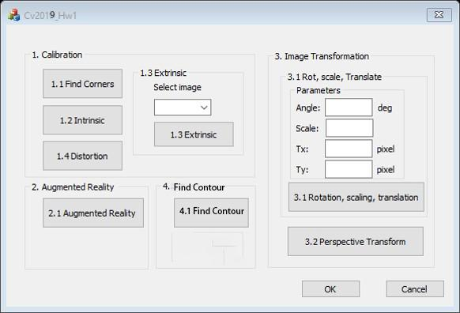
0. Homework Format
Use MFC to create GUI like following picture
Cv2019_Hw2
1. Stereo
3. SIFT
1.1 Disparity
3.1 Keypoints
1.2 L-R Check
3.2 Matched keypoints
3.3 Feature vector histogram
2. Normalized Cross Correlation
2.1 NCC

Slide 6
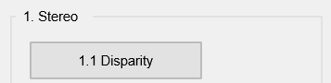
1. (30%) Stereo Disparity Map (出題：Kris)
User interface for the first question:

Slide 7
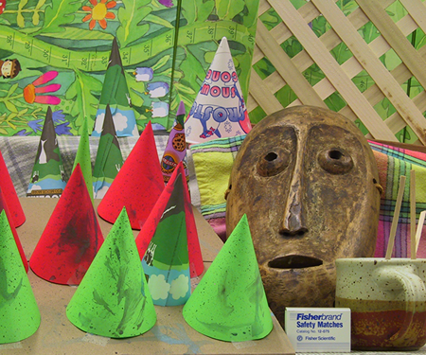
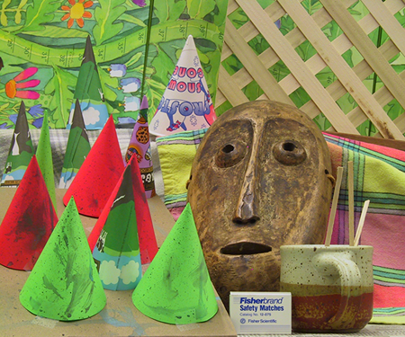
1. (30%) Stereo Disparity Map (出題：Kris)
Given: a pair of images, imL.png and imR.png (have been rectified)
Q: Find the disparity map/image based on Left and Right stereo images.
imL.png
imR.png
Left Image (Reference Image)
Right Image

Slide 8
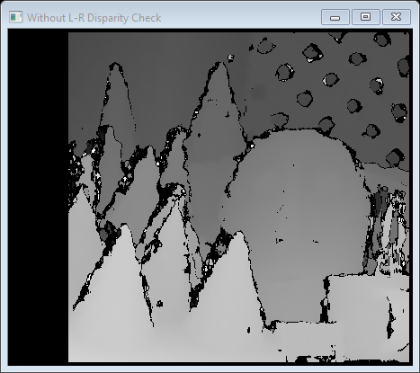
1.1 (30%) Disparity Map
Q: 1) Click button “1.1” to show the disparity map
Guides:
(1) Window Size: 9 = 3*3 pixel
(2) Search range and direction:
Disparity range: 0~64 pixels.
Map disparity range 0~64 pixels to gray value range 0~255 for the purpose of visualization.
If the left image is the reference image (the one used to cal. depth info for each pixel of that img), then the search direction at right image will go from the right to left direction.
Hint: OpenCV Textbook Chapter 12 (P.451)
StereoBM::create(64, 9);
Result

Slide 9
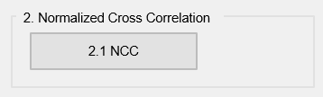
2. (30%) Normalized Cross Correlation (出題：Jang)
User interface for the second question:

Slide 10

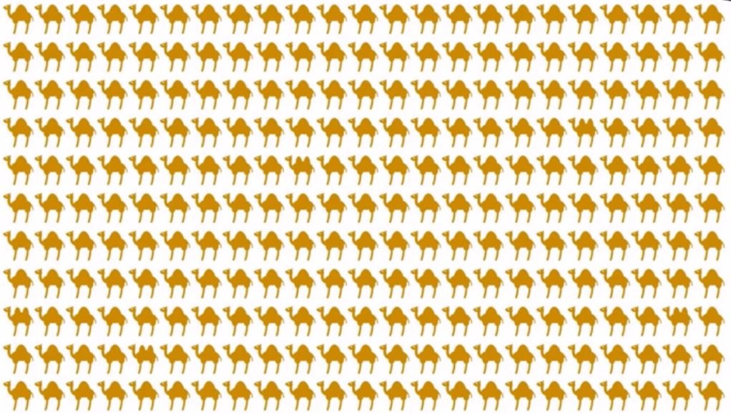
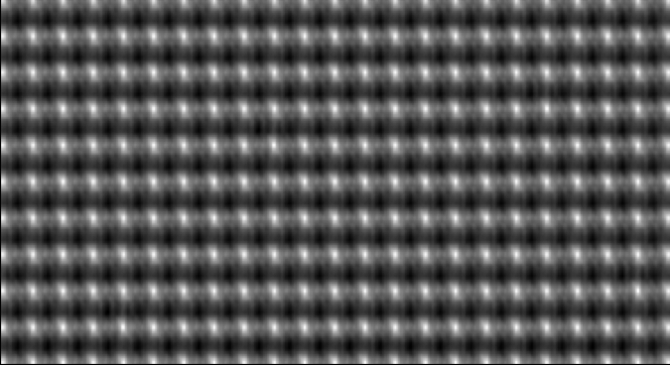
2. (30%) Normalized Cross Correlation (出題：Jang)
Given two images: ncc_img.jpg, ncc_template.jpg
Q: Click the button “NCC” to show:
One shows result of template matching feature.
The other shows 5 detected template images on the original image(ncc_img.jpg).
(You MUST use the Normalized Cross Correlation method.)
ncc_template.jpg
ncc_img.jpg
Template matching feature
(NCC value 0.0~1.0 🡺 gray value 0~255)
Hint : ref. p338 ~ p339 (opencv2refman_2.4.7.pdf)

Slide 11
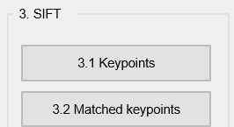
3. (40%) SIFT (出題：Michael)
User interface for the third question:

Slide 12
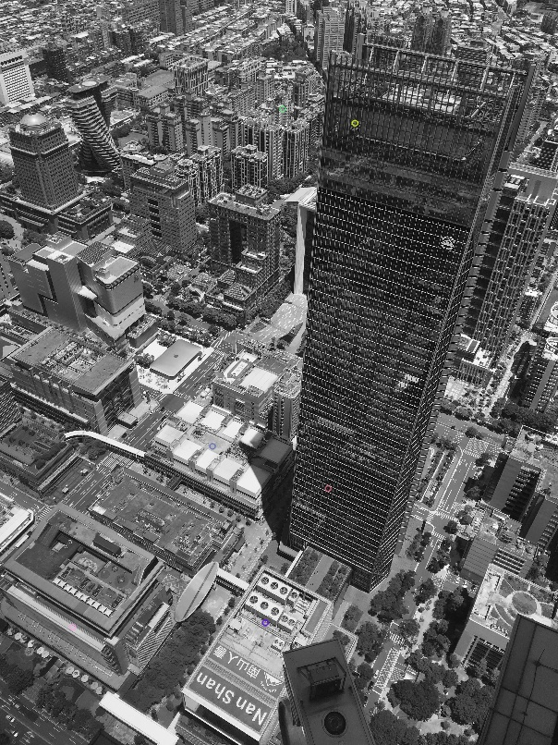
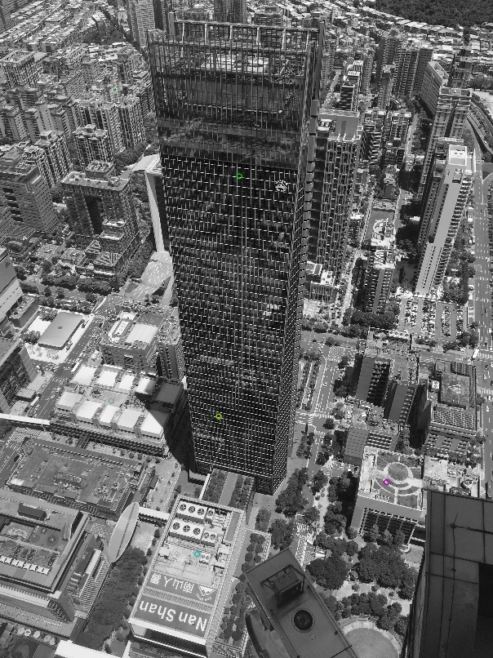
3. (40%) SIFT (出題：Michael)
Q: 3.1) (20%) Click button “3.1 Keypoints” to show:
6 feature points on each Aerial1.jpg and Aerial2.jpg
then save results as FeatureAerial1.jpg and FeatureAerial2.jpg as figure 1:
FeatureAerial1.jpg
FeatureAerial2.jpg
Figure 1. Feature points on two images.
Hint : (ref. : opencv2refman_2.4.7.pdf) ref. p663 ~ p670

Slide 13
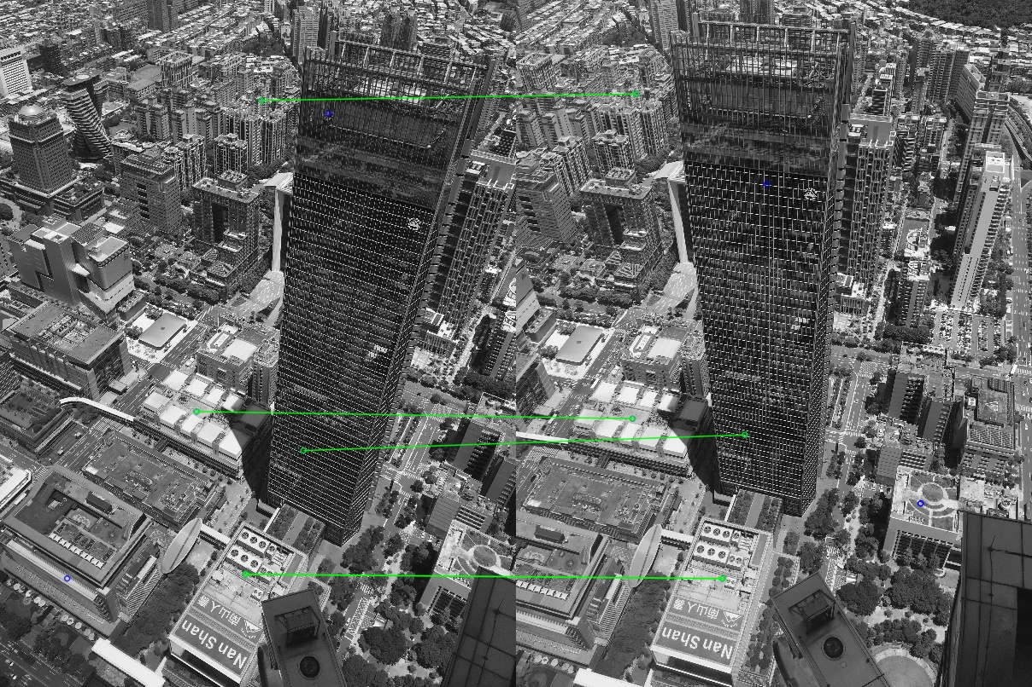
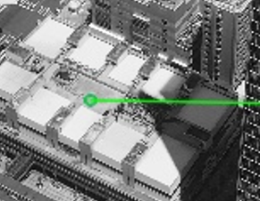
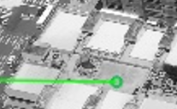
3. (40%) SIFT (出題：Michael)
Q: 3.2) (20%) Click button “3.2 Matched Keypoints”,
draw the matched feature points between two images from 6 keypoints pairs obtained in Q: 3.1) and show the results as Figure 2:
Aerial1.jpg
Aerial2.jpg
Figure 2. Feature points and their corresponding points.
Hint : (ref. : opencv2refman_2.4.7.pdf) ref. p663 ~ p670

