Slide 1
ATAC-seq
Thomas Juettemann, EMBL-EBI
Lars Grønvold, NMBU
Notes:
Hello Everyone and welcome to the ATAC-seq section of the course.
We start with a quick recap on epigenetic regulation, then move on to the importance of open chromatin, followed by an explanation of how ATAC-seq works.
Use cases, comparison of ATAC-seq to other open chromatin detection methods, and what defines a good ATAC-seq experiment comes after.
To finish it off, we look at two ways to do quality control of our data sets.

Slide 2



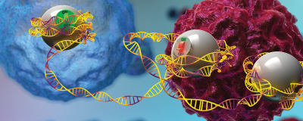
Genome & Epigenome = Hardware & Software
https://www.javelin-tech.com/blog/2020/10/solidworks-2021-hardware-recommendations/
https://www.wallpaperflare.com/blue-dna-strand-wallpaper-32045
https://informatics.tuwien.ac.at/bachelor/software-and-information-engineering/
https://www.the-scientist.com/lab-tools/researchers-engineer-epigenome-editors-to-study-how-gene-expression-affects-disease-65250
Notes:
As a bioinformatician it is my task to merge biology and computers, and you can also see epigenetics as a computer.
The genome is like the hardware.
Every cell comes with the same motherboard, the same CPU, RAM, hard drive etc.
This is of course the DNA.
The program running on top of this hardware is encoded in the protein and DNA interaction.
The way DNA is folded and compacted in the nucleus defines which parts of the program are run.

Slide 3
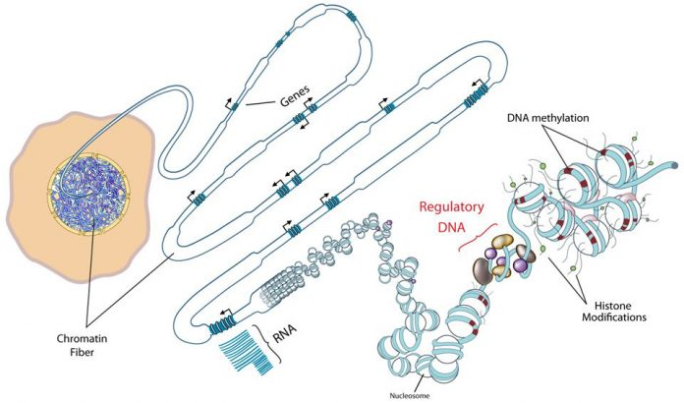
Hierarchical folding of chromatin defines the physical memory of the cell
http://www.roadmapepigenomics.org/
Notes:
It feels wrong to have an epigenetic talk without showing DNA packing.
I tried to shake things up a bit though by not using the standard ENCODE slide, this one is from the Roadmap Epigenomics project.
Eukaryotic genomes are hierarchically packaged into chromatin, and the nature of this packaging plays a central role in gene regulation.
2m DNA folded in a 5 micron nucleus, this is something that still fascinates me.
Folding is a memory.
Different aspects in the genome, like for example regulatory elements of the DNA, are more, less, or not at all accessible to the transcriptional machinery or to the binding of transcription factors.
This all depends on the type and/or the state of a cell.
Regulatory elements “talk” to the transcription starts sites and drive gene expression of specific genes.

Slide 4
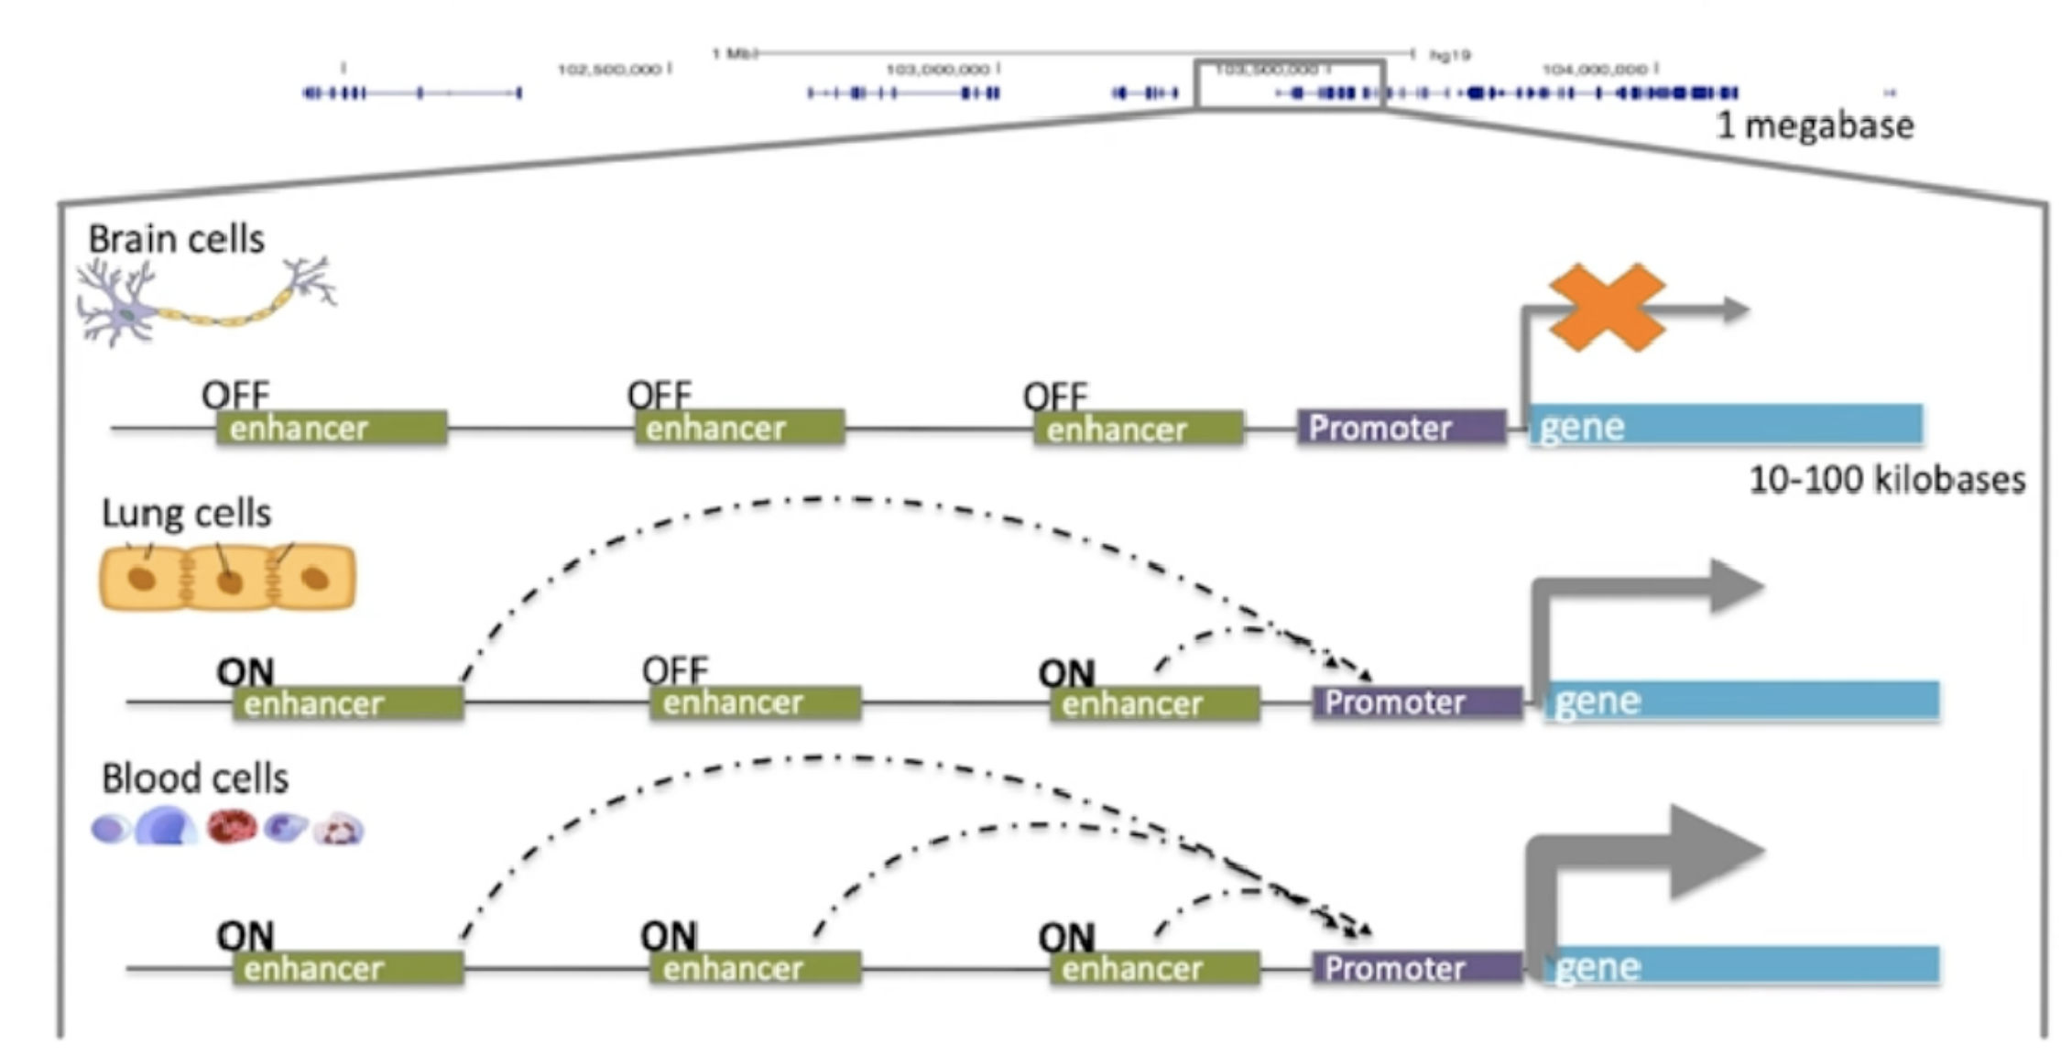
Gene expression control
TF
Notes:
The genomic sequence is mostly the same in all cells, but different regulatory elements like enhancers or promoters are active.
They can be combinatorial on and off in different cells and drive different gene expression programs.
These regulatory elements are in turn driven by things like transcription factors which bind to specific motifs in the enhancer and maintain accessibility and drive gene expression.

Slide 5
Gene expression control
On ≈ accessible
Off ≈ inaccessible
Notes:
One way to look at this is through the lens of accessibility.
Which elements in the genome are accessible to the binding of transcription factors?
These accessible elements have the potential to be regulatory (”on”), whereby inaccessible elements which are not bindable by transcription factors are likely off.
A very familiar concept to any computer scientist – is the light on or off, 0 or 1?
Sounds kinda important, doesn't it?
So, how can we locate accessible areas in the genome?

Slide 6
Assay of Transposase Accessible Chromatin sequencing
(ATAC-seq)
Notes:
The method of choice at the moment is the Assay of Transposase Accessible Chromatin sequencing.
How does it work?

Slide 7
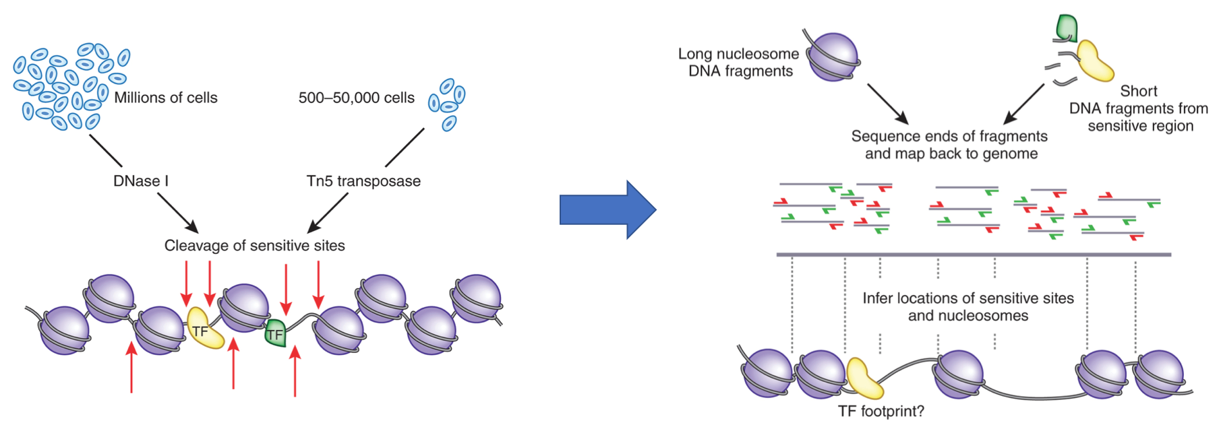
ATAC-seq
https://www.nature.com/articles/nmeth.2770?WT.feed_name=subjects_chromatin-analysis
Notes:
First you isolate nuclei and obtain intact chromatin.
You then expose this intact chromatin to Tn5 Transposase which is loaded in vitro with adaptors for high-throughput DNA sequencing.
The process of loading Tn5 with sequence adaptors is called tagmentation.
Tn5 can then simultaneously fragment and tag a genome with sequencing adaptors.
Wherever there was accessibility and wherever this transposase was able to bind, it generates amplifiable fragments which can be immediately PCRed, sequenced and aligned back to the genome.
The library prep and the assay are the same step.
It is really simple.
The joke goes that it is so simple, even a PI can do it.

Slide 8
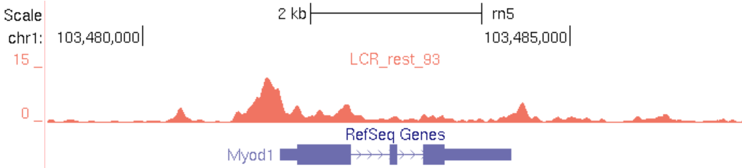
ATAC-seq
https://www.nature.com/articles/nmeth.2770?WT.feed_name=subjects_chromatin-analysis
Notes:
How does the alignment look like?
Shown here is an area of the genome around the Mylod1 gene which is important for muscle development.
Using ATAC-seq, we see a concentration, or pile-up, of reads right in front of the gene start.
This indicates that the promoter of this gene is accessible and the gene is expressed.

Slide 9
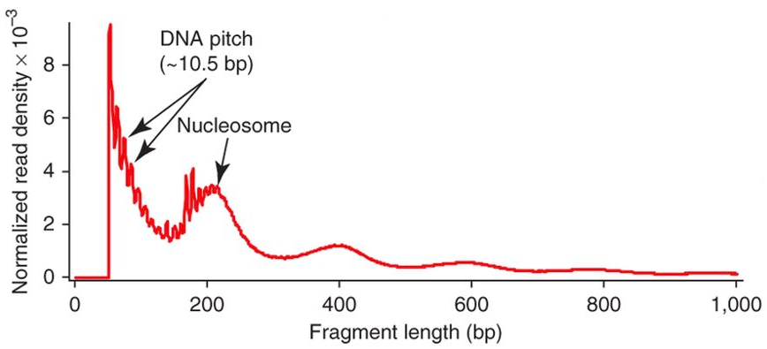
ATAC-seq
https://www.nature.com/articles/nmeth.2688
https://www.nature.com/articles/nmeth.2770?WT.feed_name=subjects_chromatin-analysis
Notes:
Something else that is worth mentioning: the fragment length coming out of ATAC-seq experiments.
The two arrows on the left indicate the majority of results, an abundance of short fragments that represents cases where you have two transposases cut between nucleosomes.
Quite often you see a mono-nucleosome peak, that represents cases where you get one cut on either side of a nucleosome.
This is indicated by the single arrow on the right.
The read length is the DNA that is wrapped around a nucleosome and a little bit of flanking sequence.
The same goes for the third and forth bump, 400 and 600bp fragment length.
This pattern is expected for most ATAC-seq experiments and often used as a step in quality control, as a large difference usually indicates a problem with the experiment.

Slide 10
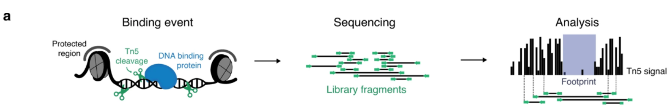
Common use cases
Mapping regions of open chromatin
Mapping nucleosome positions
Transcription factor footprinting
Notes:
Common use cases.
ATAC-seq is primarily used for mapping of regions of open chromatin across the genome.
Less common use cases are mapping nucleosome positions and transcription factor footprinting.
An example of the later is shown here.
We can see how a bound transcription factor influences the pile-up of the sequenced reads.
Tn5 transposase cleaves DNA and inserts sequencing adapters, but it is unable to cut chromatin occupied by proteins such as nucleosomes (gray) and other DNA binding proteins e.g., transcription factors (blue).
Sequencing libraries of DNA fragments are sequenced to yield reads (green, middle).
During analysis, each read is mapped to the genome and used to create a signal of single Tn5 insertion event (black bars), in which the binding of protein is visible as depletion of the signal, and that is defined as the footprint.

Slide 11
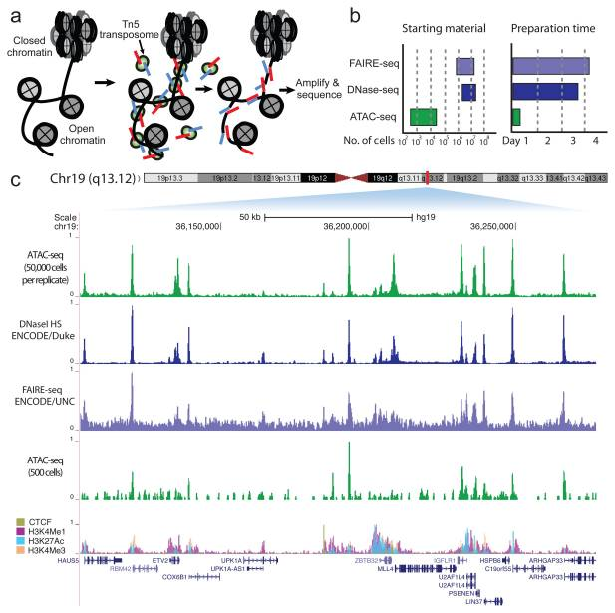
Comparison
https://www.ncbi.nlm.nih.gov/pmc/articles/PMC3959825/#R10
Notes:
A comparison of ATAC-seq to other open chromatin detection method.
The first thing which jumps to the eye is the lower starting material, and reduced preparation time compared to the other methods.
Especially the preparation step is costly as it requires a technician.
Looking the signal we see that ATAC-seq has a signal-to-noise ratio similar to DNase-seq, but again, it is important to remember that DNAase-seq needs generated from approximately 3 to 5 orders-of-magnitude more cells.
Lower ATAC-seq track was generated from 500 FACS-sorted cells.
Peak intensities were highly reproducible between technical replicates and highly correlated between ATAC-seq and DNase-seq.
assays at a locus in GM12878 lymphoblastoid cells displaying high concordance

Slide 12
Qualities of good ATAC-seq data
Enrichment of signal around transcription start sites (TSS enrichment)
High enrichment of reads in ATAC-seq peaks
’Sensible’ fragment length distribution (may depend on use case)
Low mitochondrial contamination (common problem in ATAC-seq)
All of the other stuff you would look for in many other NGS data types (good alignment rate, duplication rate/library complexity, etc)
Notes:
What defines good quality ATAC-seq data?
- Enrichment of ATAC-seq signal around transcription start sites.
We saw in the slide earlier that promoters will be accessible and therefore we expect much of the signal to around gene promoters.
That is usually quantified as “transcription start site enrichment”
- We do the same peak calling as in ChIP-seq, and we expect a high fraction of our reads to be in ATAC=seq peaks.
- Fragment length distributions. We expect it to look very different than just like randomly fragmented DNA, the pattern should be similar to the one shown previously.
Often though you only see the short fragment length distribution, and that is ok as well.
- Mitochondrial contamination is a common problem in ATAC-seq, some datasets out there have as much as 50 to 80 percent of sequencing reads being mitochondrial.
Those reads are generally filtered out bioinformatically, therefore we expect low mitochondrial contamination.
- Lastly, we want to check for all of the same stuff that is important for and any other NGS assay, alignment rarte, duplication rate, library complexity…

Slide 13
Quality control

Slide 14
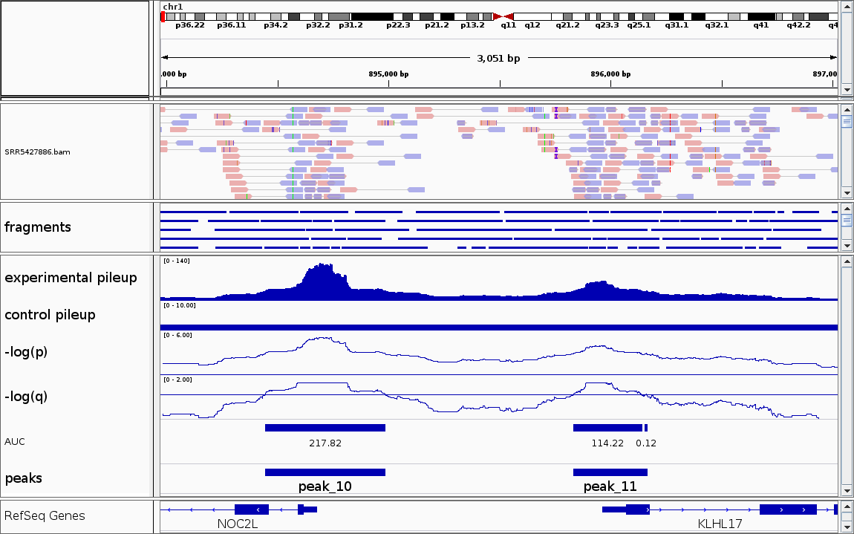
Genrich
https://github.com/jsh58/Genrich
Notes:
A first and common step is to visualize the results of peak calling in a Genome Browser, for example IGV.
IGV is small, easy to use locally installed genome browser.
When loading the results of our peak calling experiments, we expect to see a pile-up and peaks identified by ATAC-seq experiments upstream of genes.
In this example we have 2 genes, NOC2L and KLH17, and we see 2 peaks upstream.

Slide 15
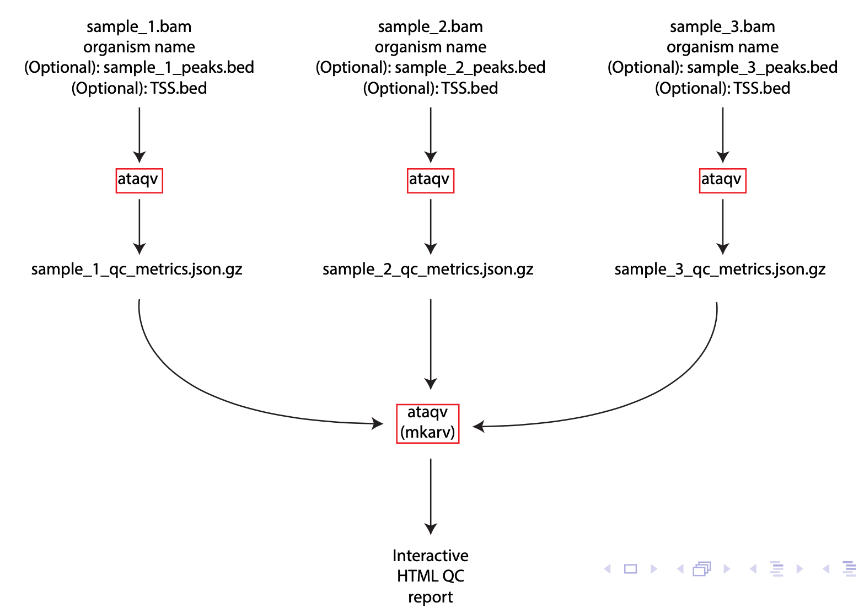
Notes:
Ataqv is another tool often used.
Ataqv is as modular as possible again so it can fit it into an existing pipeline.
The main input are BAM file which is a standard file in genomic analyses
Additionally the organism is needed because there is some organism specific metadata encoded in the software.
Further there are some optional inputs, for example the result of your peak calling in bed format, and file containing the TSS for the organism, also in bed format.
The later is used for calculation TSS enrichment.
You run ataqv for each of your replicate experiments, and the output is a human readable text file, and additionally a machine readable json file.
The result of all the ataqv runs is passed to another command line tool, mkarv.
Mkarv combines the results into a HTML report.

Slide 16
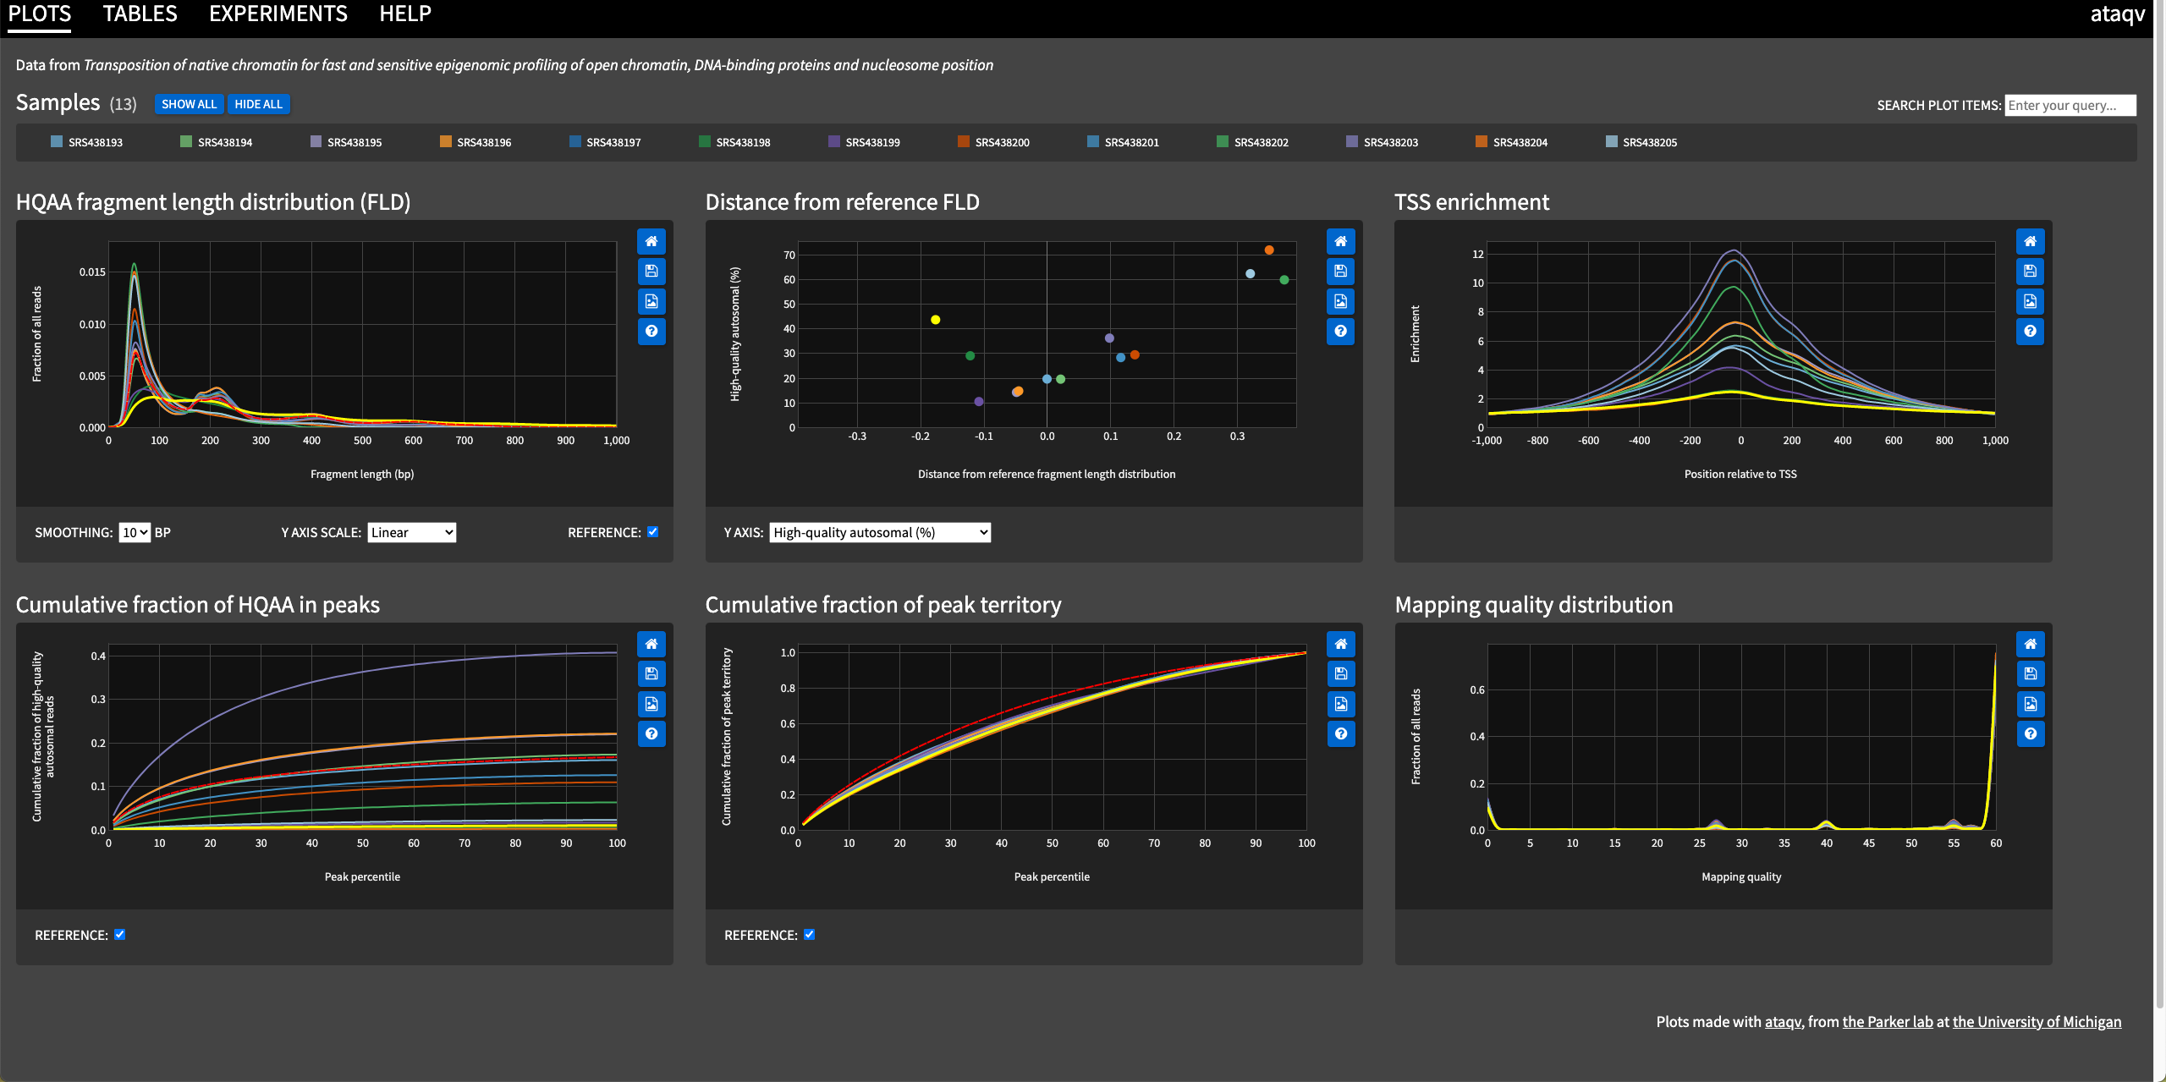
Ataqv HTML report
https://parkerlab.github.io/ataqv/demo/
Notes:
Here we see an example of the report created by ataqv.
The samples used to create the report are on the top, and hovering over them will highlight the specific sample in the report in bright yellow.
Clicking on sample will remove it, and clicking again will add it.
Each of the plots has 4 little icons on the right side, which allow you to reset, save the plot as SVG image, save it as PNG and lastly explain the plot (help)
The two plots that we are going use are HQAA fragment length distribution and TSS enrichment.
A successful ATAC-seq experiment should show HQAA-FLD in the same pattern as our example earlier in the slide.
Further it should also show a high enrichment of TSS in the centre of the peaks.

Slide 17
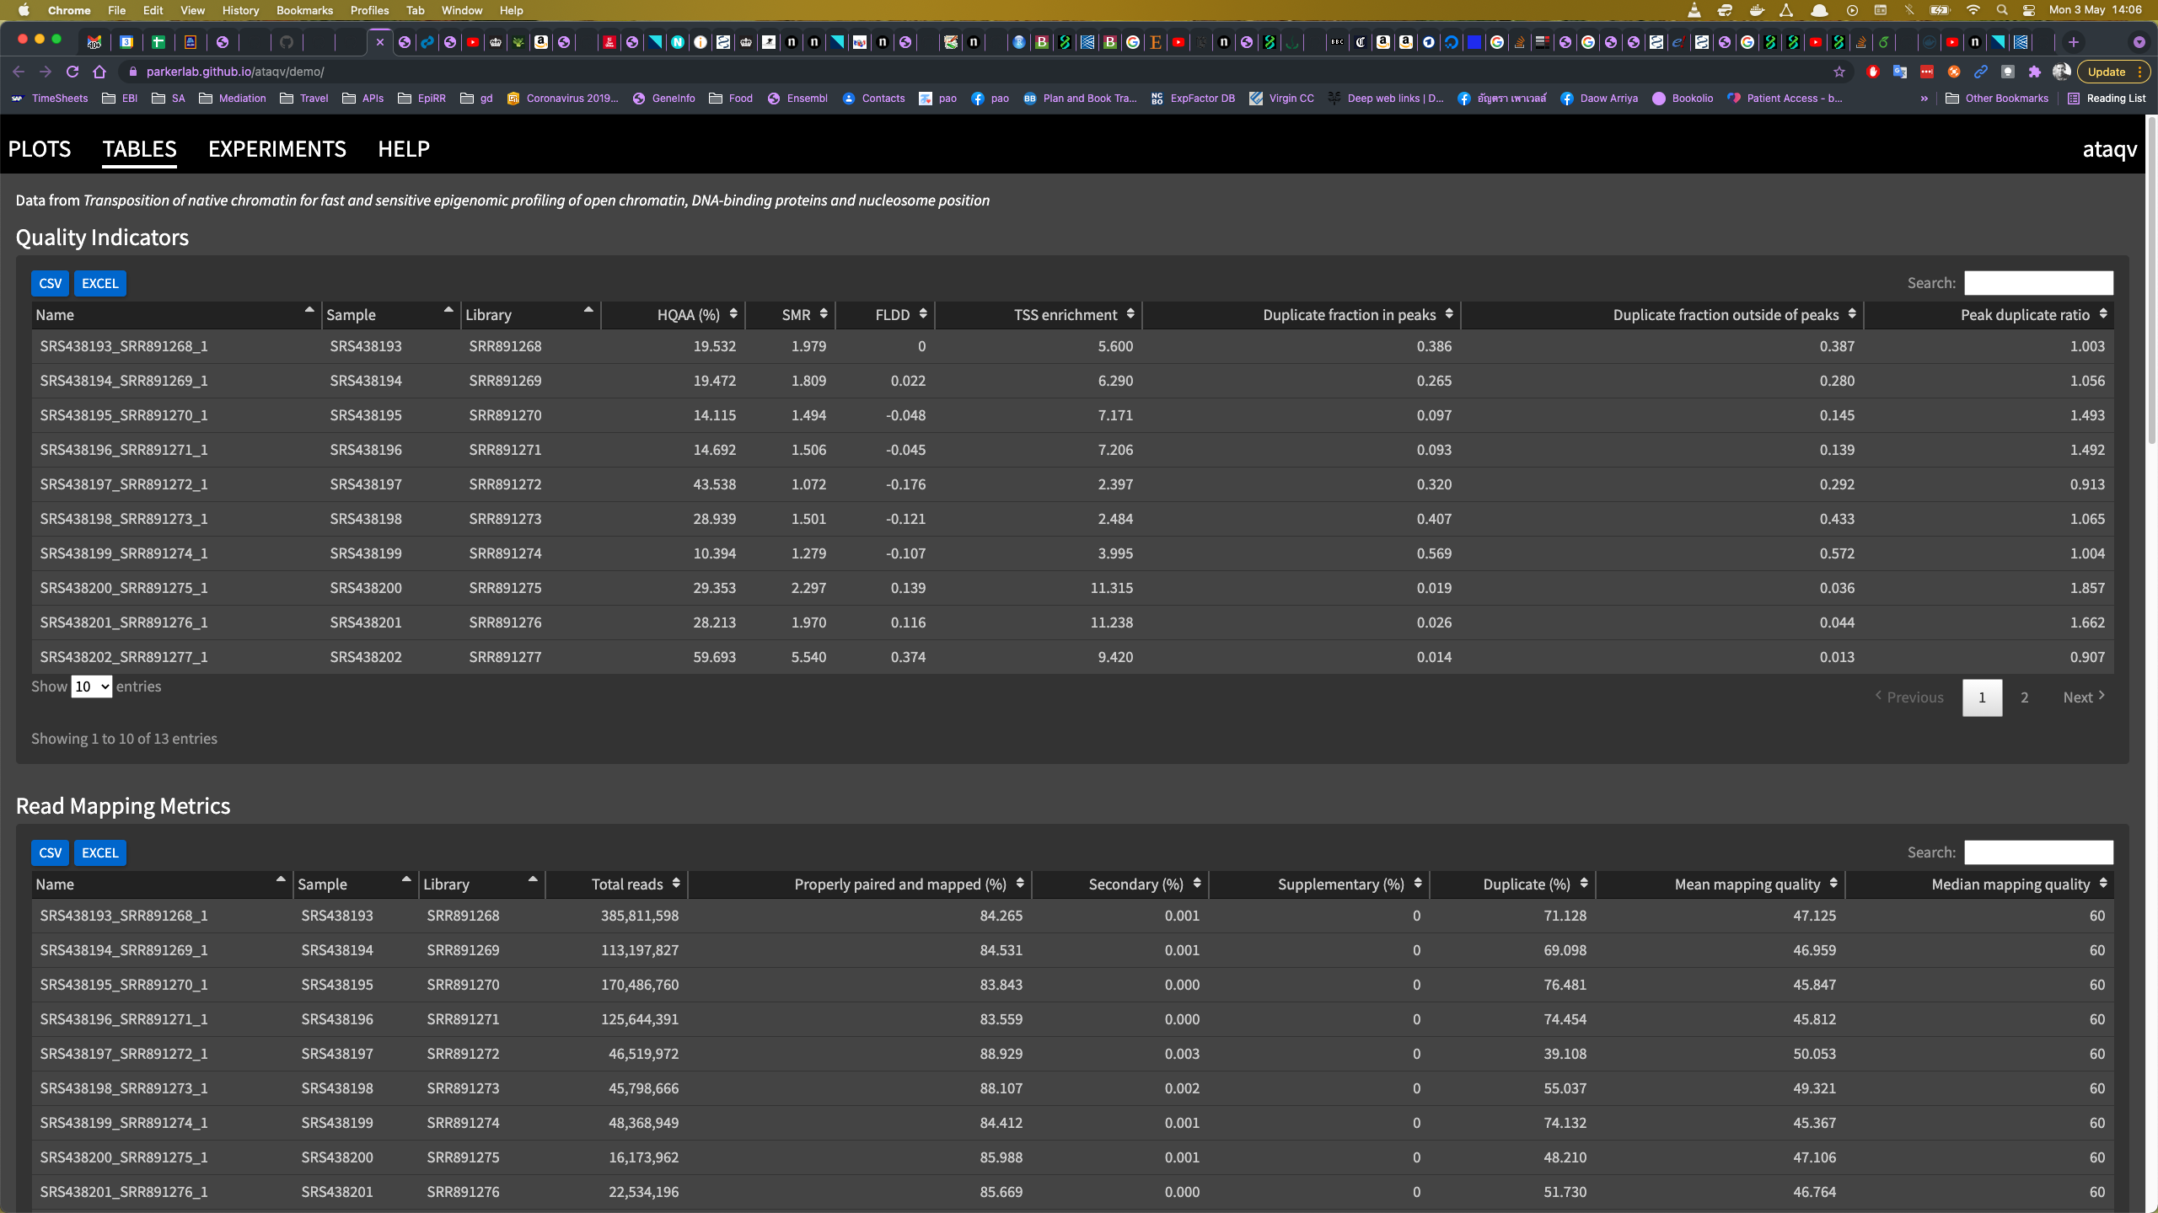
Ataqv HTML report
https://parkerlab.github.io/ataqv/demo/
Notes:
Ataqv also provides you with a table view of the experiments, showing various metrics and which are sortable in many ways.
The use oof these tables is beyond this course.

Slide 18
Questions?

