Slide 1
ATAC-seq
Thomas Juettemann, EMBL-EBI
Lars Grønvold, NMBU
Notes:
Hello Everyone and welcome to the ATAC-seq section of the course. We start with a quick recap on epigenetic regulation, then move on to the importance of open chromatin, followed by an explanation of ATAC-seq. Use cases and qualities come after, and we finish with two ways to do quality control of our data sets.
In the exercise section after we will put what we learned to use.

Slide 2



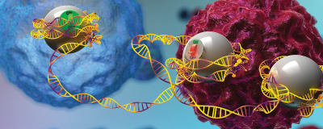
Genome & Epigenome = Hardware & Software
https://www.javelin-tech.com/blog/2020/10/solidworks-2021-hardware-recommendations/
https://www.wallpaperflare.com/blue-dna-strand-wallpaper-32045
https://informatics.tuwien.ac.at/bachelor/software-and-information-engineering/
https://www.the-scientist.com/lab-tools/researchers-engineer-epigenome-editors-to-study-how-gene-expression-affects-disease-65250
Notes:
The genome is like the hardware of a computer. Every cell comes with the same motherboard, the same CPU, RAM, hard drive etc. This is of course the DNA. The program running on top of this hardware is encoded in the protein and DNA interaction. The way DNA is folded and compacted in the nucleus defines which parts of the program are run.

Slide 3
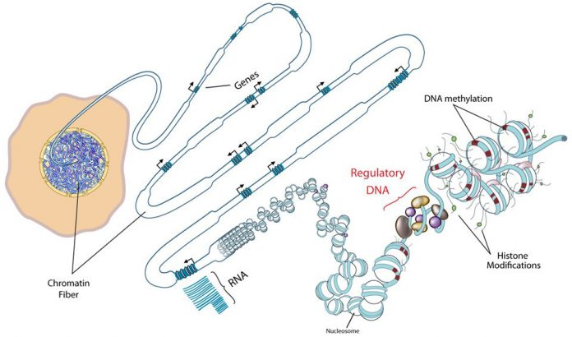
Hierarchical folding of chromatin defines the physical memory of the cell
http://www.roadmapepigenomics.org/
Notes:
Eukaryotic genomes are hierarchically packaged into chromatin, and the nature of this packaging plays a central role in gene regulation.
Folding is a memory. Different aspects in the genome, like for example regulatory elements of the DNA, are more, less, or not at all accessible to the transcriptional machinery or to the binding of transcription factors.
This all depends on the type and/or the state of cell.
Regulatory elements “talk” to the transcription starts sites and drive gene expression of specific genes.

Slide 4
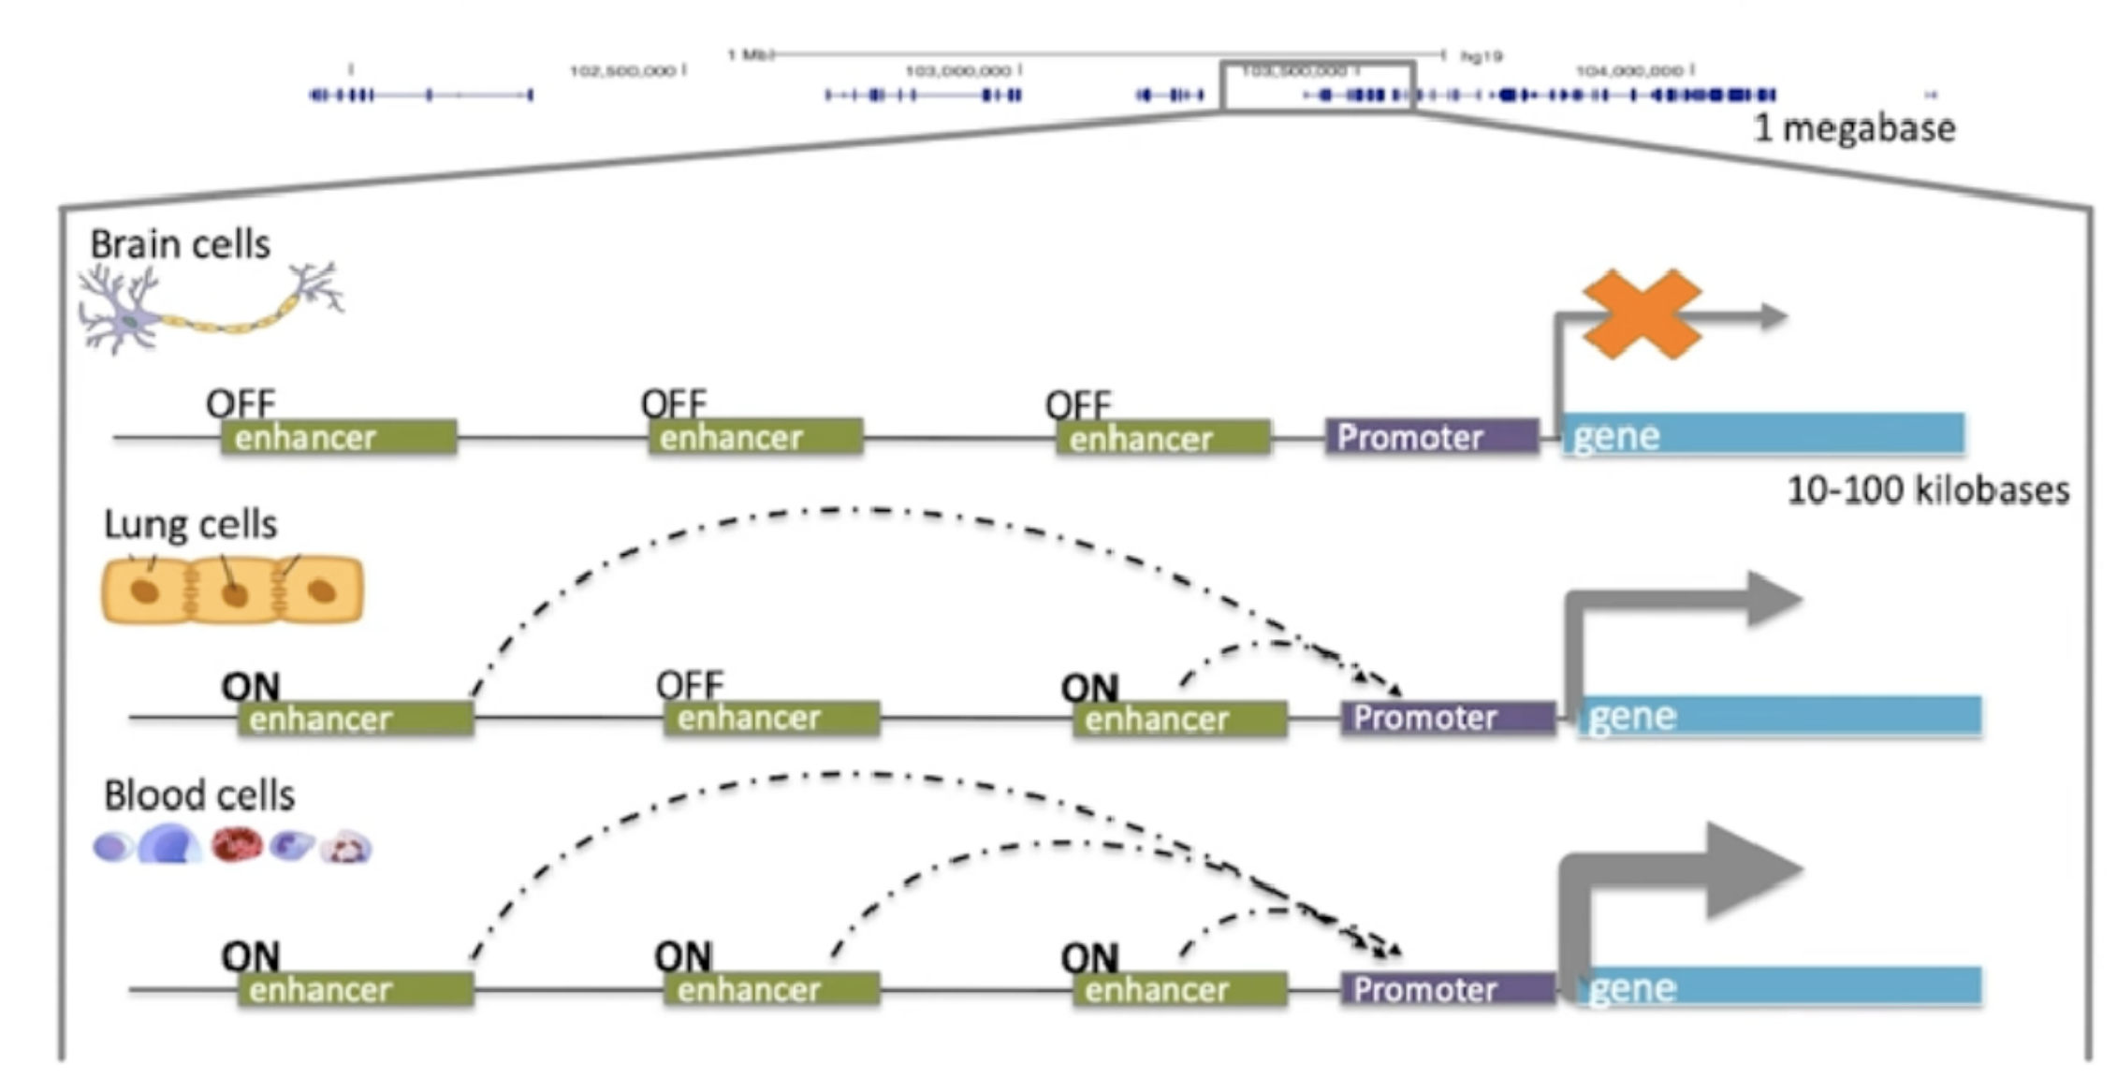
Gene expression control
TF
Notes:
As mentioned before, the genome is the same in all cells, but different regulatory elements like enhancers or promoters are active.
They can be combinatorial on and off in different cells, and drive different gene expression programs.
These regulatory elements are in turn driven by things like transcription factors which bind to specific motifs in the enhancer and maintain accessibility and drive expression.

Slide 5
Gene expression control
On ≈ accessible
Off ≈ inaccessible
Notes:
On way to look at this is through the lens of accessibility.
Which elements in the genome are accessible to the binding of transcription factors?
These accessible elements have the potential to be regulatory, where inaccessible elements which are not bindable by transcription factors are likely off.
A very familiar concept to any computer scientist – is the light off or on, 0 or 1?

Slide 6
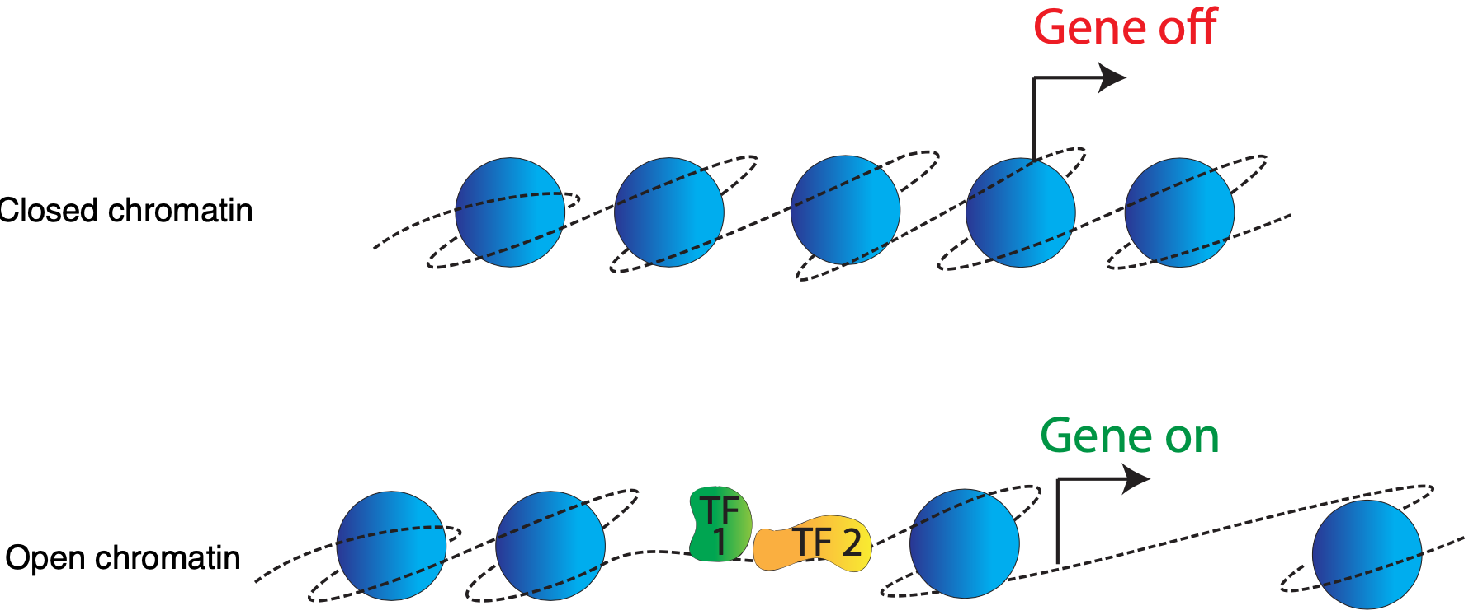
Notes:
This is the world's most naive model of gene regulation.
In each one of your cells, you have two meters of DNA, and it is not free floating in the nucleus, it is really tightly packed around these proteins which are called histones.
If your DNA is represented by this string (the dotted line), it is wrapped up around blue histone proteins and the complex of the two is called chromatin.
There is no space for any proteins to bind to the DNA.
In order to turn on and regulate gene expression, the DNA needs to be unpacked so it is accessible for other non-histone proteins.
These other proteins are mostly transcription factors, and the areas where they bind is mostly right in front of genes.
Therefore: Knowing where the DNA is accessible for transcription factor binding is important.
There are a few high-throughput assays which are able to identify areas of open chromatin.
The most modern and preferred one these days is…

Slide 7
Assay of Transposase Accessible Chromatin sequencing
(ATAC-seq)

Slide 8
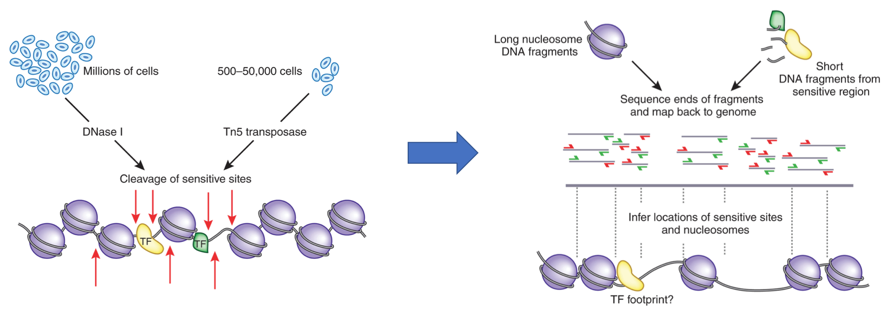
ATAC-seq
https://www.nature.com/articles/nmeth.2770?WT.feed_name=subjects_chromatin-analysis
Notes:
How does it work?
First you isolate nuclei and obtain intact chromatin.
You then expose this intact chromatin to Tn5 Transposase which is loaded in vitro with adaptors for high-throughput DNA sequencing.
The process of loading Tn5 with sequence adaptors is called tagmentation.
Tn5 can then simultaneously fragment and tag a genome with sequencing adaptors.
Wherever there was accessibility and wherever this transposase was able to bind, it generates amplifiable fragments which can be immediately PCRed, sequenced and aligned back to the genome.
The library prep and the assay are the same step.
It is really simple.
The joke goes that it is so simple, even a PI can do it.
DNase-seq, which utilizes DNase I, has an additional library preparation step, and also requires a much larger number of cells to begin with (500 to 50k vs millions)
Aside from a larger number of cells, the additional library preparation step of DNase-seq is costly as it requires a technician.

Slide 9
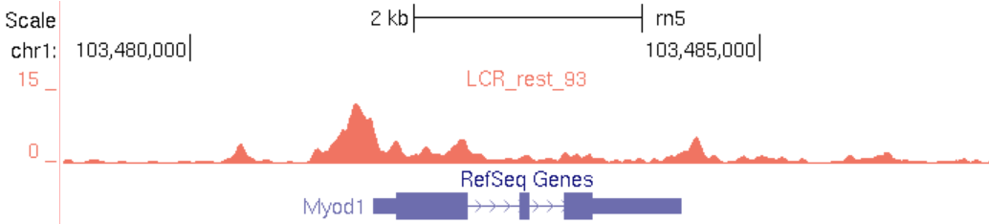
ATAC-seq
https://www.nature.com/articles/nmeth.2770?WT.feed_name=subjects_chromatin-analysis
Notes:
How does the alignment look like?
Shown here is an area of the genome around the Mylod1 gene which is important for muscle development.
Using ATAC-seq, we see a concentration, or pile-up, of reads right in front of the gene start.
This indicates that the promoter of this gene is accessible and the gene is expressed.

Slide 10
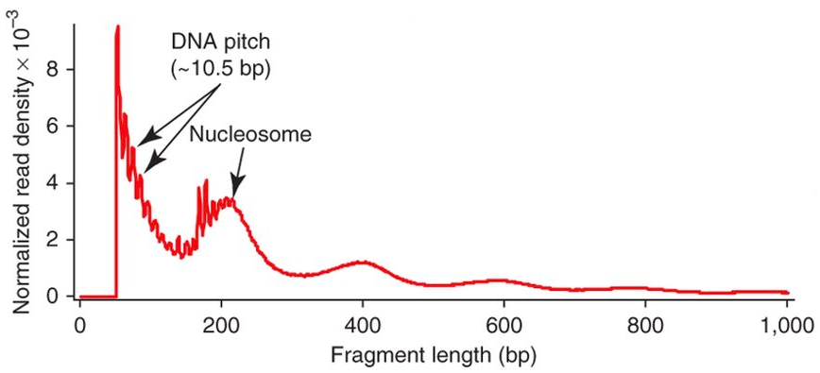
ATAC-seq
https://www.nature.com/articles/nmeth.2688
https://www.nature.com/articles/nmeth.2770?WT.feed_name=subjects_chromatin-analysis
Notes:
Something else that is worth mentioning: the fragment length coming out of ATAC-seq experiments.
An abundance of short fragments that represents cases where you have two transposases cut between nucleosomes, which is represented by the two arrows on the left.
Quite often you see a mono nucleosome peak, that represents cases where you get one cut on either side of a nucleosome.
This is indicated by the single arrow.
You get enough DNA to wrap around a nucleosome and a little bit of flanking sequence.
The same goes for the third and forth bump, 400 and 600bp fragment length.
This pattern is expected for most ATAC-seq experiments.
A large difference in this pattern usually indicates a problem with the experiment.

Slide 11
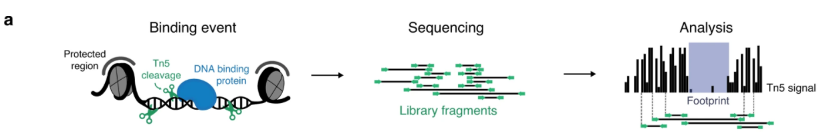
Common use cases
Mapping regions of open chromatin
Mapping nucleosome positions
Transcription factor footprinting
Notes:
ATAC-seq is primarily used for mapping of regions of open chromatin across the genome.
Less common use cases are mapping nucleosome positions and transcription factor footprinting.
An example of the later is shown here.
We can see how a bound transcription factor influences the pile-up of the sequenced reads.
Tn5 transposase cleaves DNA and inserts sequencing adapters, but is unable to cut chromatin occupied by proteins such as nucleosomes (gray) and other DNA binding proteins e.g., transcription factors (blue).
Sequencing libraries of DNA fragments are sequenced to yield reads (green).
During analysis, each read is mapped to the genome and used to create a signal of single Tn5 insertion events (black bars), in which binding of protein is visible as depletion of the signal, defined as the footprint

Slide 12
Qualities of good ATAC-seq data
Enrichment of signal around transcription start sites (TSS enrichment)
High enrichment of reads in ATAC-seq peaks
’Sensible’ fragment length distribution (may depend on use case)
Low mitochondrial contamination (common problem in ATAC-seq)
All of the other stuff you would look for in many other NGS data types (good alignment rate, duplication rate/library complexity, etc)
Notes:
What defines good quality ATAC-seq data?
- Enrichment of ATAC-seq signal around transcription start sites.
We saw in the slide earlier that promoters will be accessible and therefore we expect much of the signal to around gene promoters.
That is usually quantified as “transcription start site enrichment”
- We do the same peak calling as in ChIP-seq, and we expect a high fraction of our reads to be in ATAC=seq peaks.
- Fragment length distributions. We expect it to look very different than just like randomly fragmented DNA, the pattern should be similar to the one shown previously.
Often though you only see the short fragment length distribution, and that is ok as well.
- Mitochondrial contamination is a common problem in ATAC-seq, some datasets out there have as much as 50 to 80 percent of sequencing reads being mitochondrial.
Those reads are generally filtered out bioinformatically, therefore we expect low mitochondrial contamination.
- Lastly, we want to check for all of the same stuff that is important for and any other NGS assay, alignment rarte, duplication rate, library complexity…

Slide 13
Quality control

Slide 14
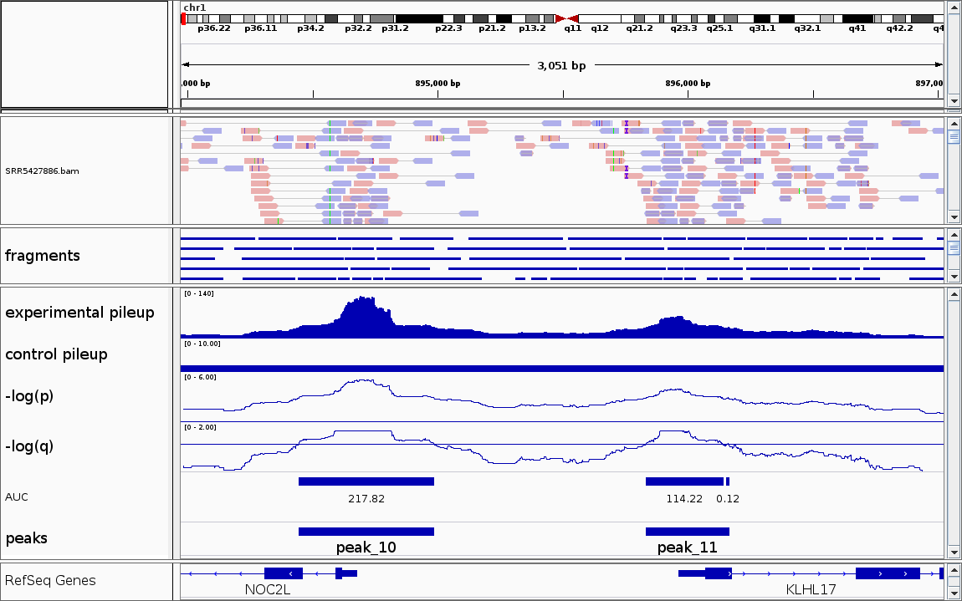
Genrich
https://github.com/jsh58/Genrich
Notes:
A first and common step is to visualize the results of peak calling in a Genome Browser, for example IGV.
IGV is small, easy to use locally installed genome browser.
When loading the results of our peak calling experiments, we expect to see a pile-up and peaks identified by ATAC-seq experiments upstream of genes.
In this example we have 2 genes, NOC2L and KLH17, and we see 2 peaks upstream.

Slide 15
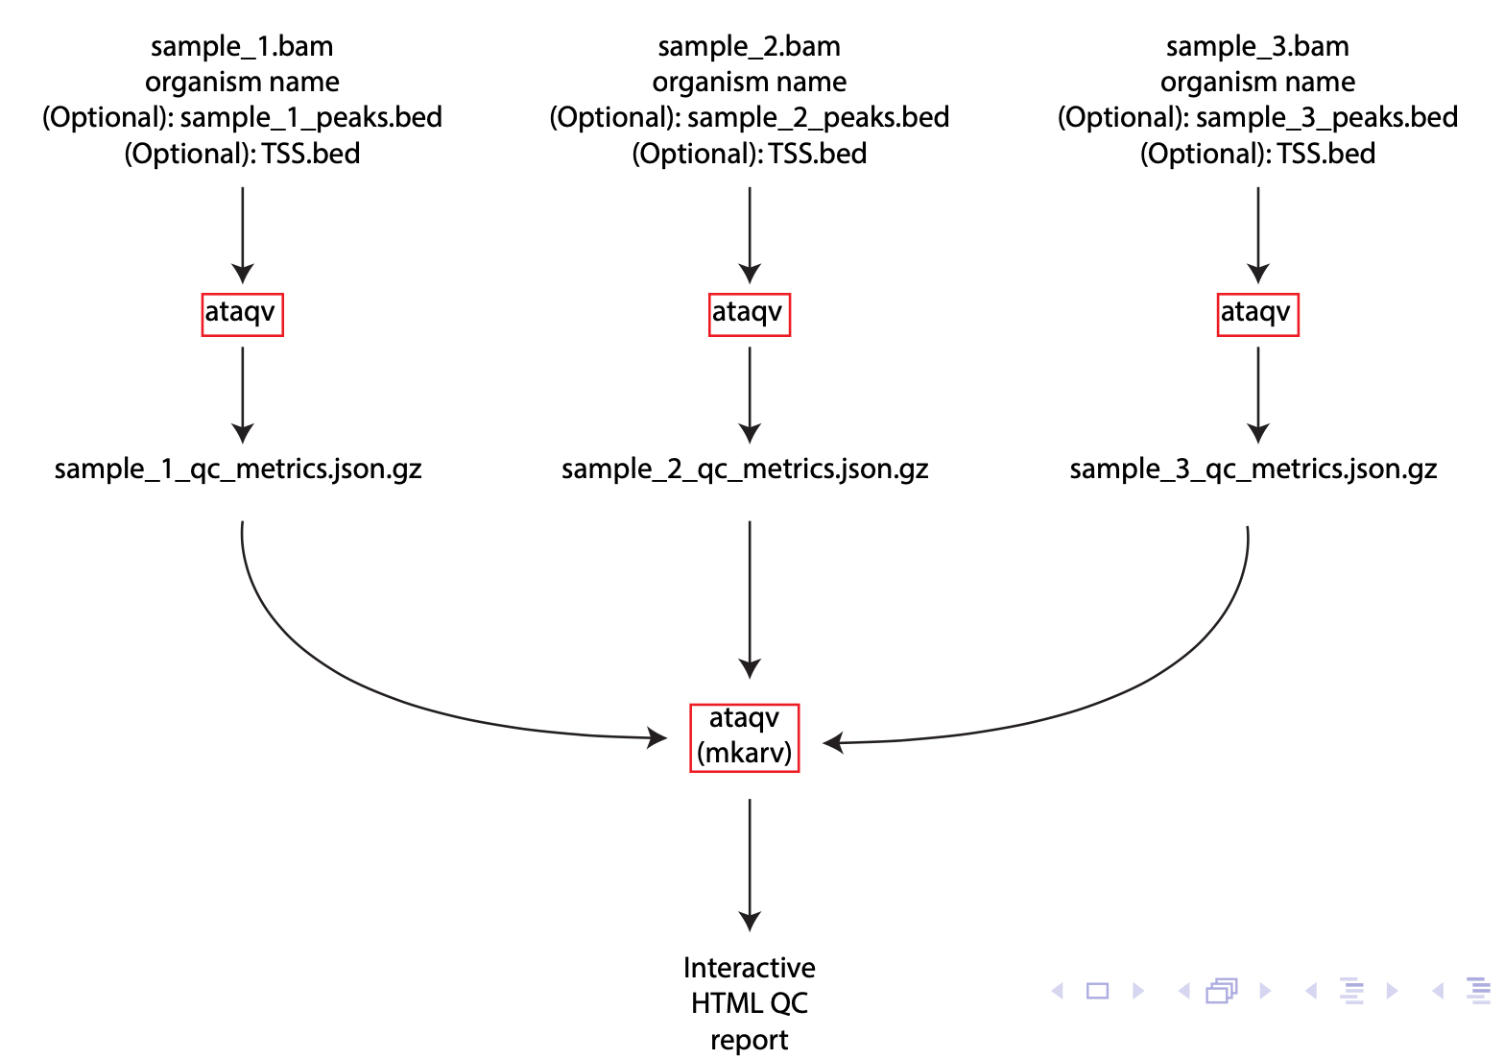
Notes:
The idea is that
Ataqv is it's it's kind of as modular as possible again so you can fit it into an existing pipeline, so you have you
We have created our samples as BAM file which is just kind of a file of a line reads as a standard file you see in genomic analyses
You additionally need to know the organism because there is some organism specific metadata encoded in the software.
Further there are some optional inputs, for example the result of your peak calling I bed format, and file containing the TSS for the organism, also in bed format.
The later is used for calculation TSS enrichment.
You run ataqv for each of your replicate experiments, and the output is a human readable text file and additionally a machine readable json file.
The result of all the ataqv runs is passed to another command line tool, mkarv.
Mkarv combines the results into a HTML report.

Slide 16
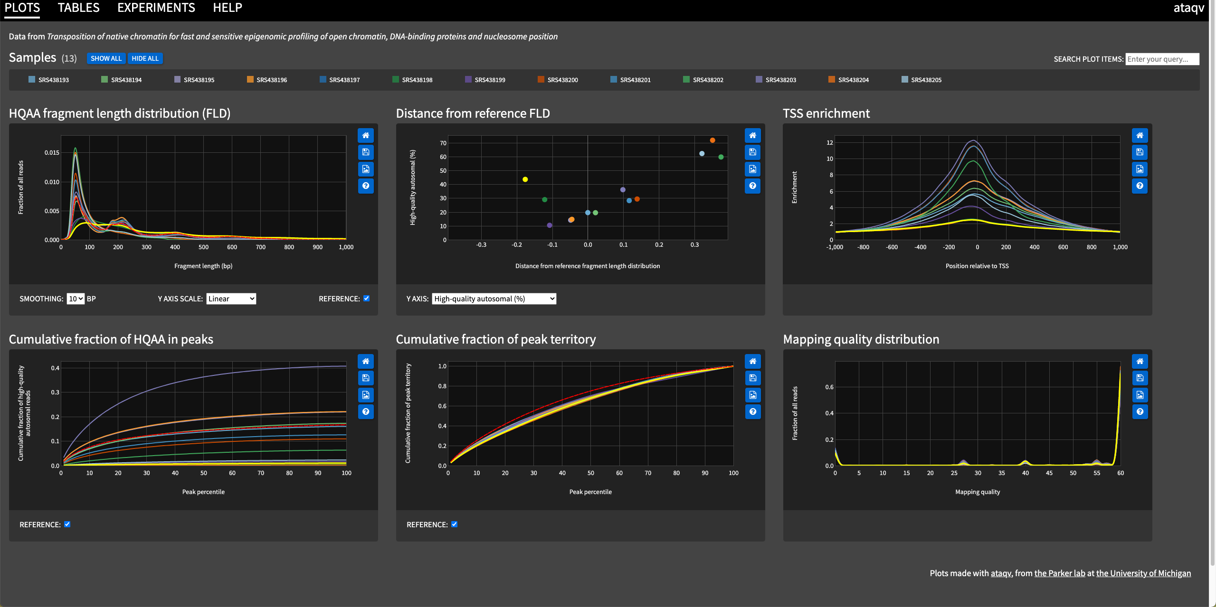
Ataqv HTML report
https://parkerlab.github.io/ataqv/demo/
Notes:
Here we see an example of the report created by ataqv.
The samples used to create the report are on the top, and hovering over them will highlight the specific sample in the report in bright yellow.
Clicking on sample will remove it, and clicking again will add it.
Each of the plots has 4 little icons on the right side, which allow you to reset, save the plot as SVG image, save it as PNG and lastly explain the plot (help)
The two plots that we are going use are HQAA fragment length distribution and TSS enrichment.
A successful ATAC-seq experiment should show HQAA-FLD in the same pattern as our example earlier in the slide.
Further it should also show a high enrichment of TSS in the centre of the peaks.

Slide 17
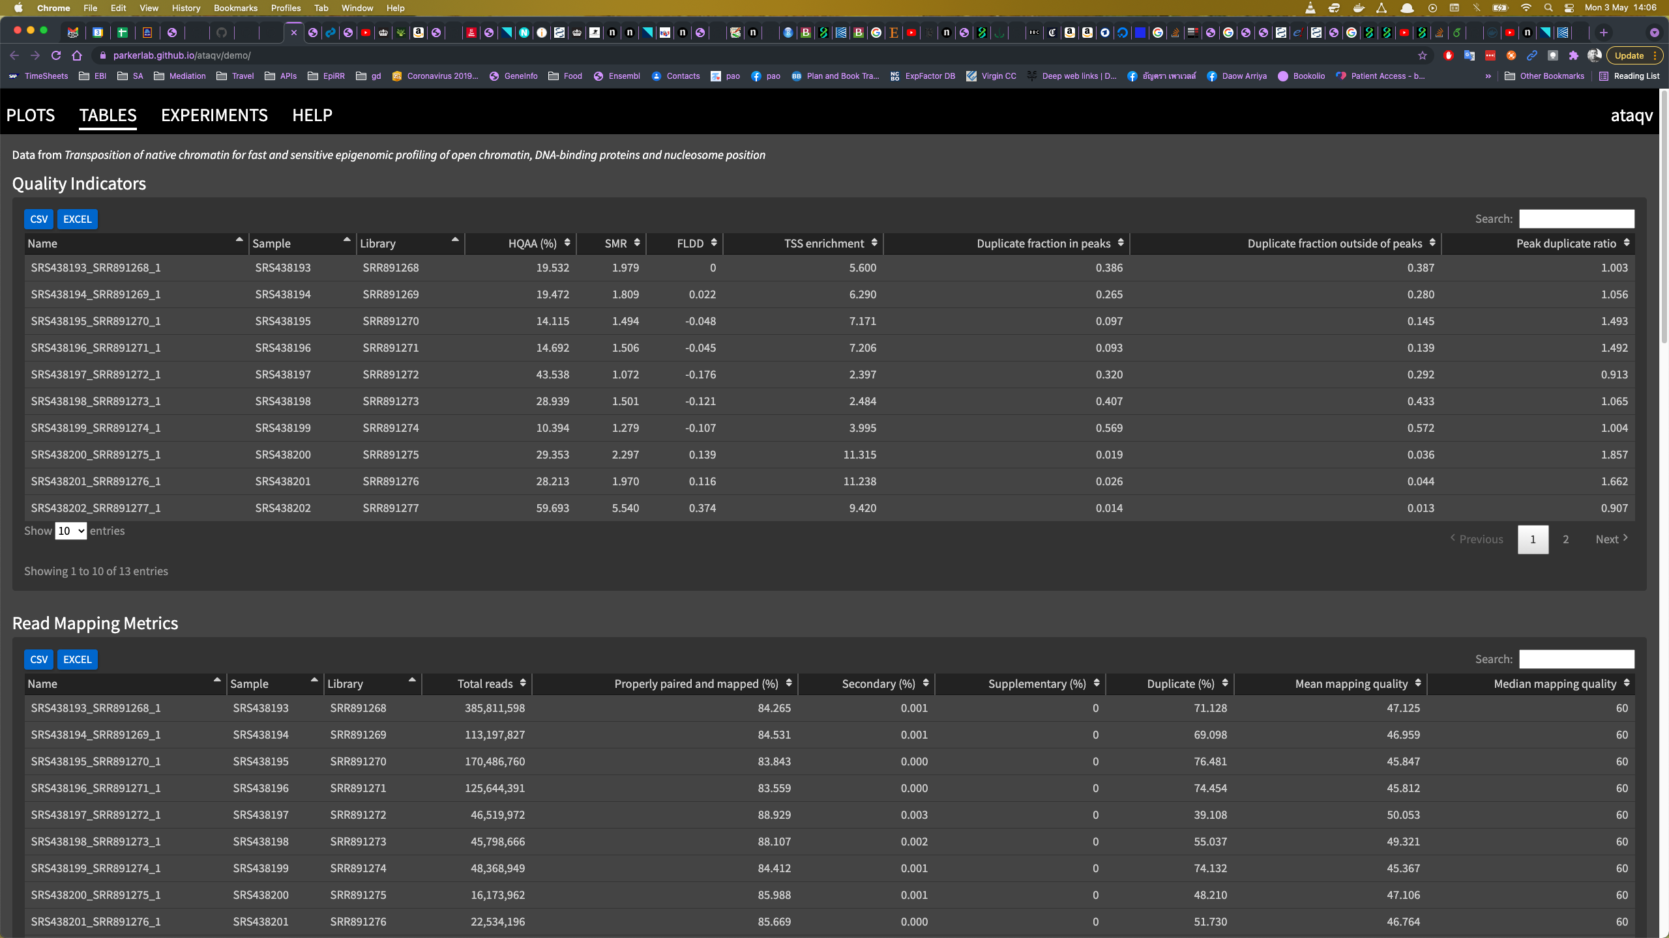
Ataqv HTML report
https://parkerlab.github.io/ataqv/demo/
Notes:
Ataqv also provides you with a table view of the experiments, showing various metrics and which are sortable in many ways.
The use oof these tables is beyond this course.

Slide 18
File formats
https://genome.ucsc.edu/goldenPath/help/bedgraph.html
https://genome.ucsc.edu/goldenPath/help/bigWig.html

