Slide 1
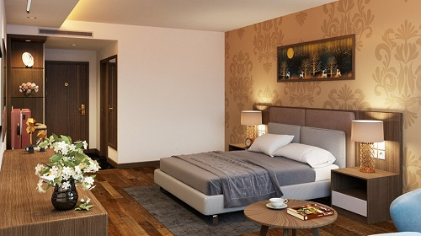
Bungalow.Web
Luxury Pool Bungalow
Fusce 11 tincidunt maximus leo, sed scelerisque massa auctor sit amet. Donec ex mauris, hendrerit quis nibh ac, efficitur fringilla enim.
Bungalow Amenities
Max Occupancy : 4 adults
Bungalow Size: 550 sqft
USD $200.00/night

