Slide 1
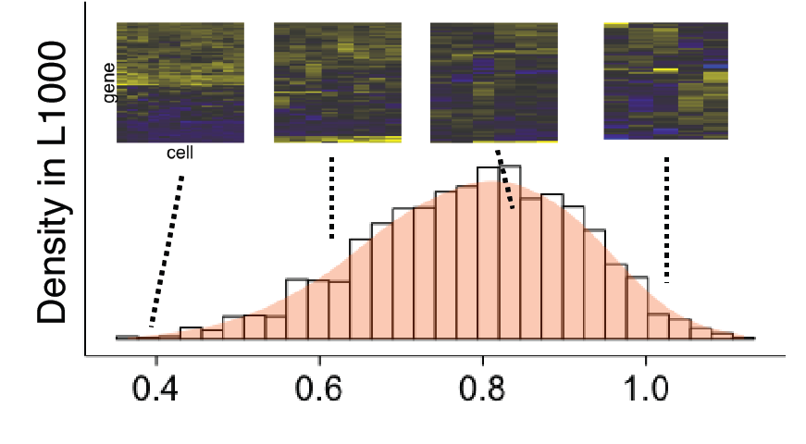
Figure 1

Slide 2
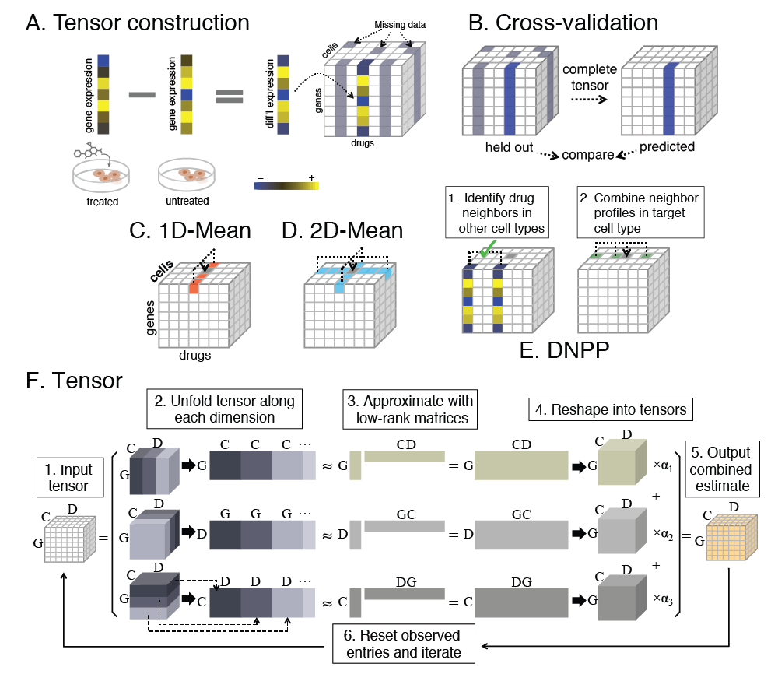
Figure 2

Slide 3

Figure 3

Slide 4
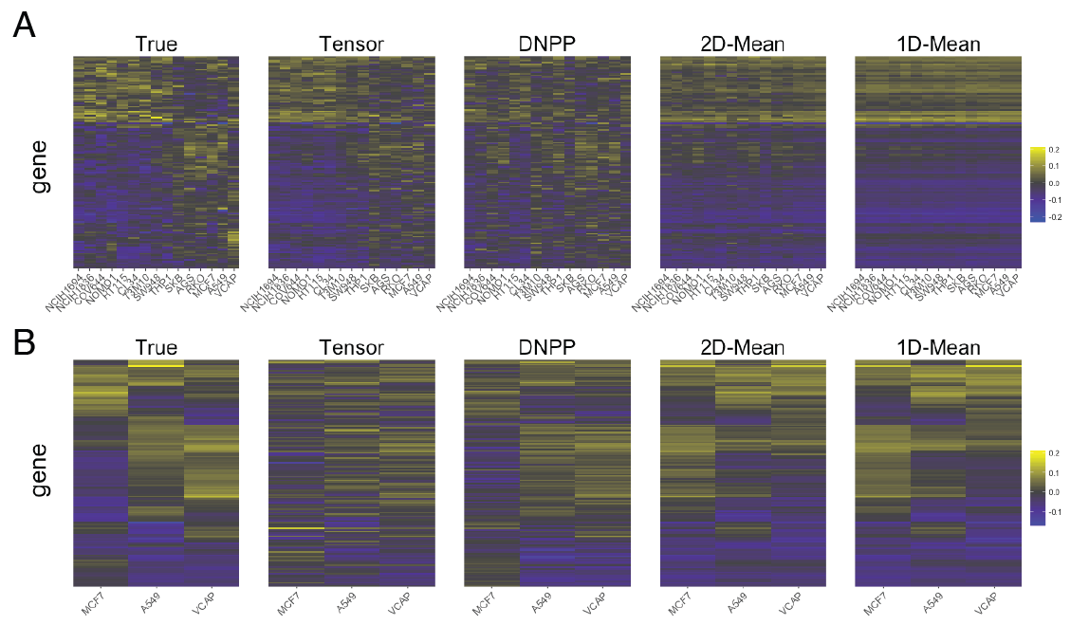
Figure 4

Slide 5
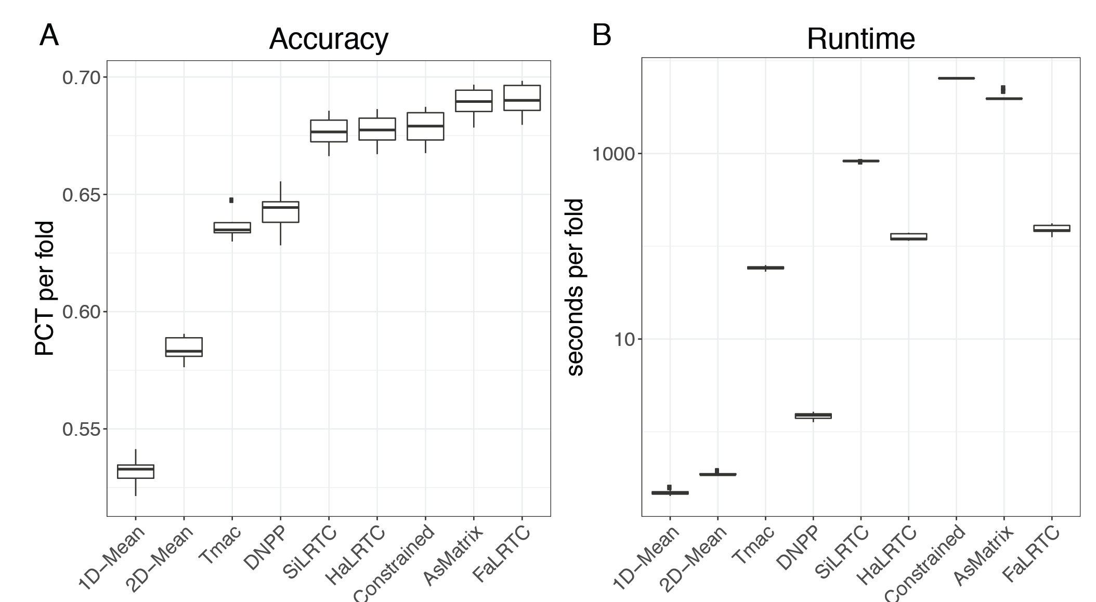
Supplementary Fig 1

Slide 6
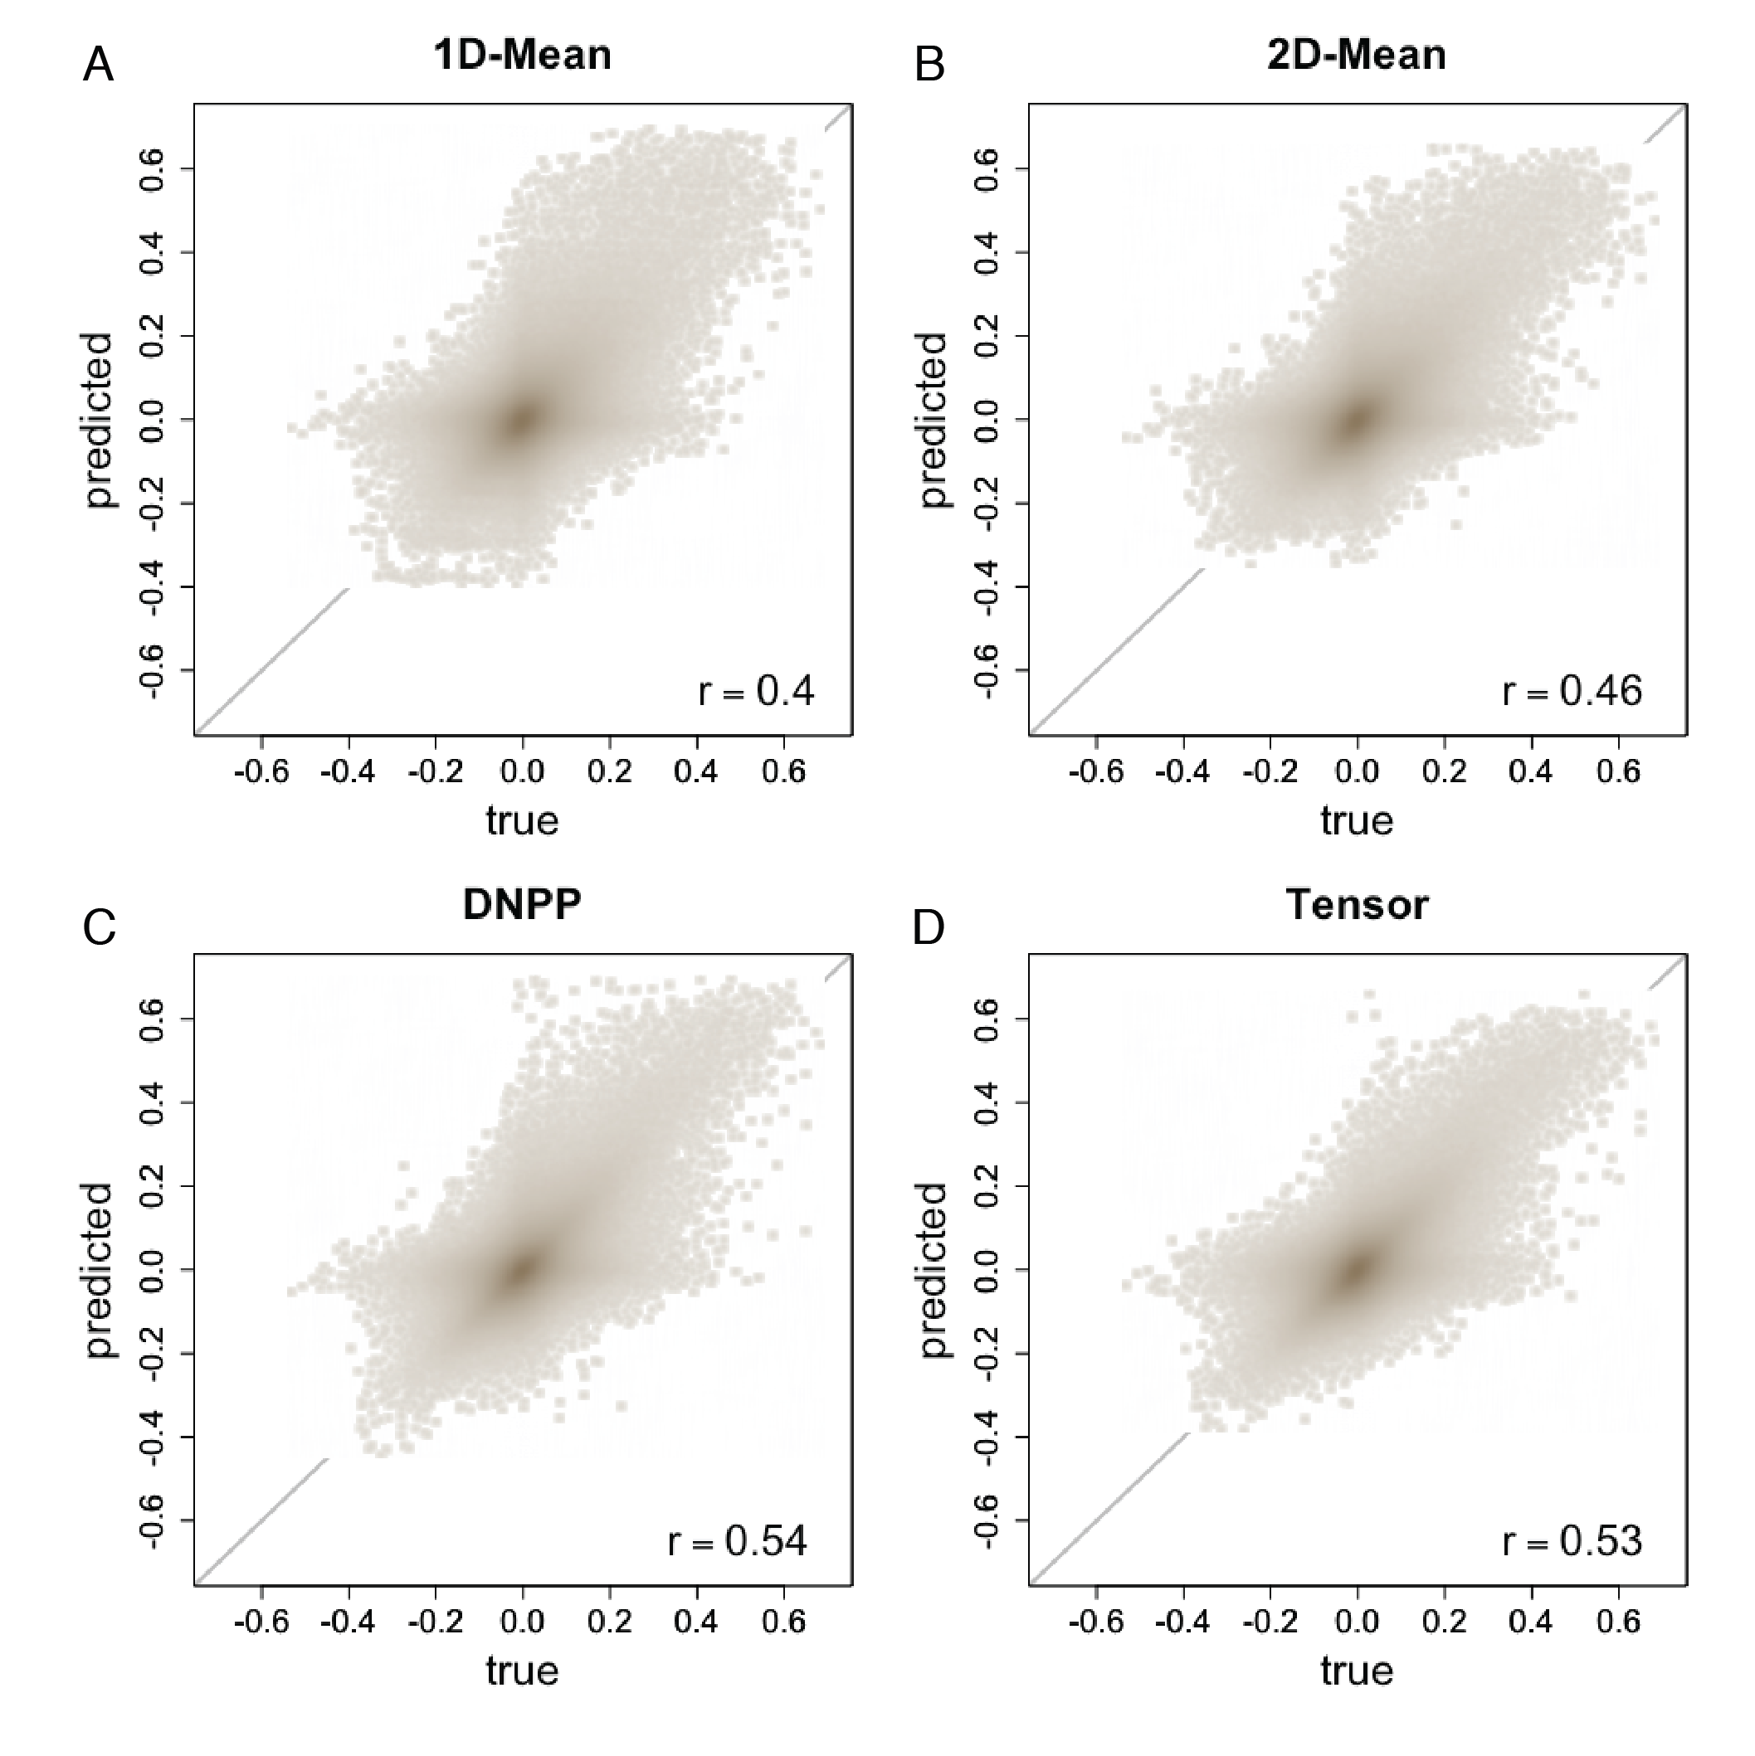
Supplementary Fig 2

Slide 7
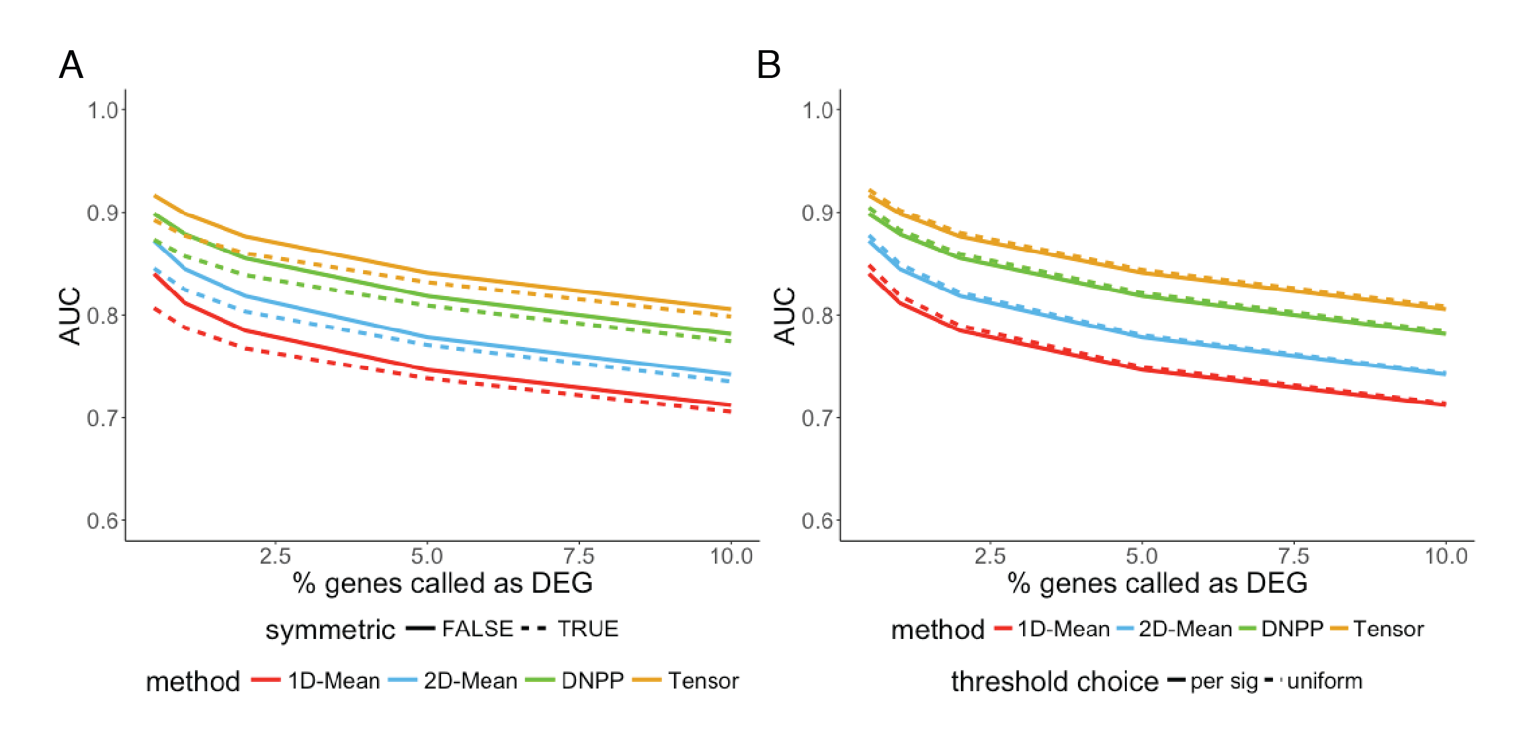
Supplementary Fig 3

Slide 8
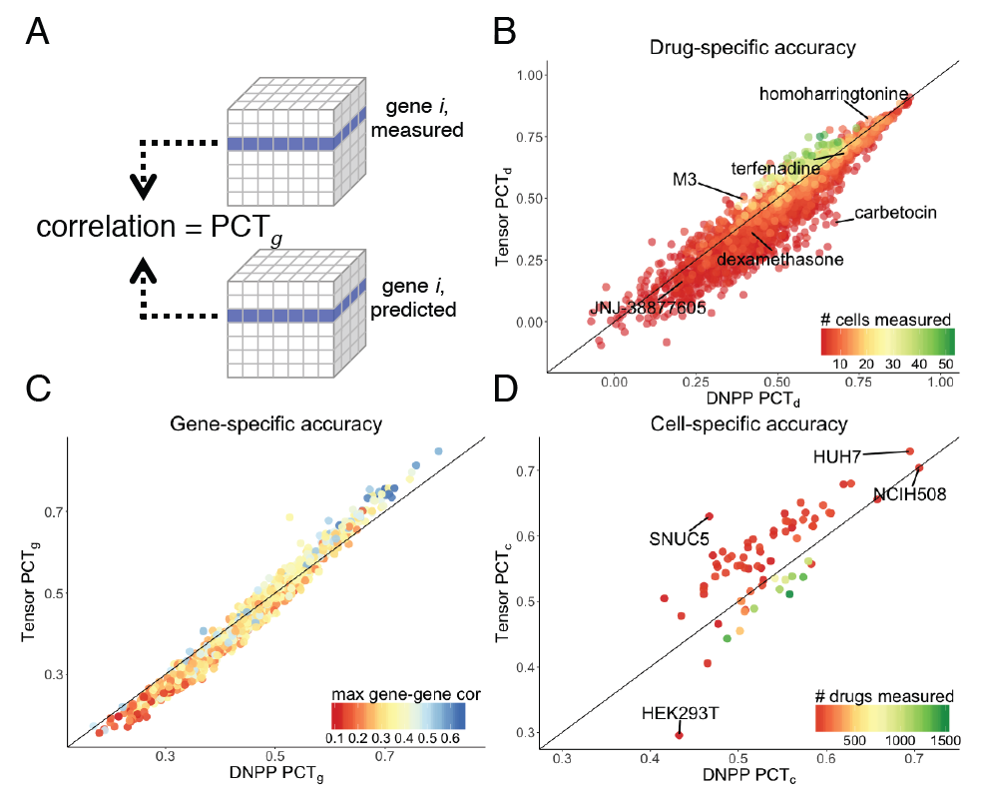
Supplementary Fig 4

Slide 9
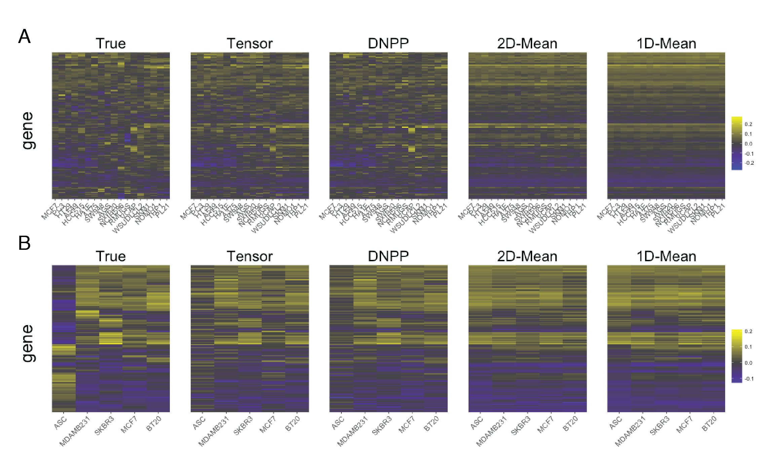
Supplementary Fig 5

