Slide 1
Rights Management and Confidential Data in AHAD/tDAR
Penny Crook
La Trobe University
Notes:
Focus on structures not vocabularies

Slide 2




AHAD Project Overview
Funded by Australian National Data Service (ANDS)
‘Seeding the Commons’ program
LTU Archaeology Program & eResearch Office
Victorian eResearch Strategic Initiative (VeRSI)
Partnership with tDAR in 2010
Initial release: May 2012 (www.ahad.edu.au)

Slide 3
Confidential Data
Works in progress
Commercial confidentiality
Rights to use but not distribute
Sensitive historical information

Slide 4
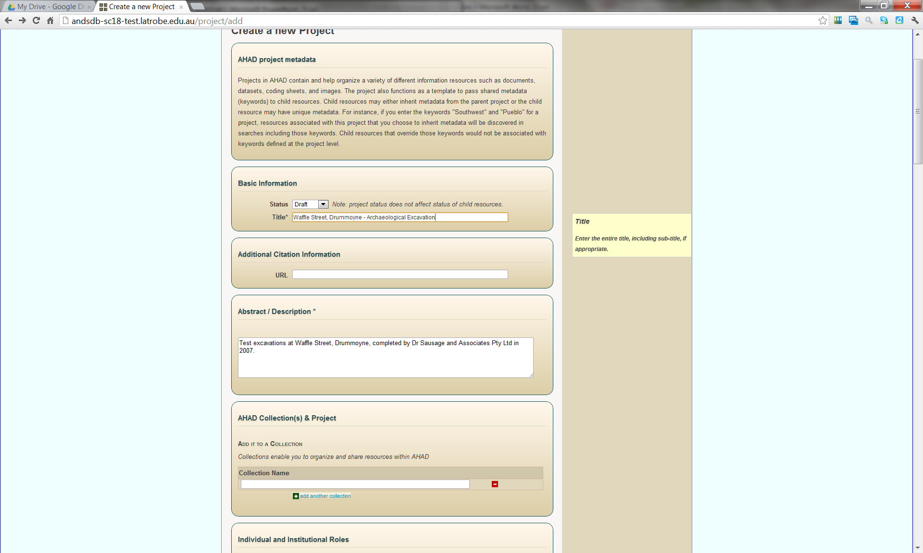

Slide 5
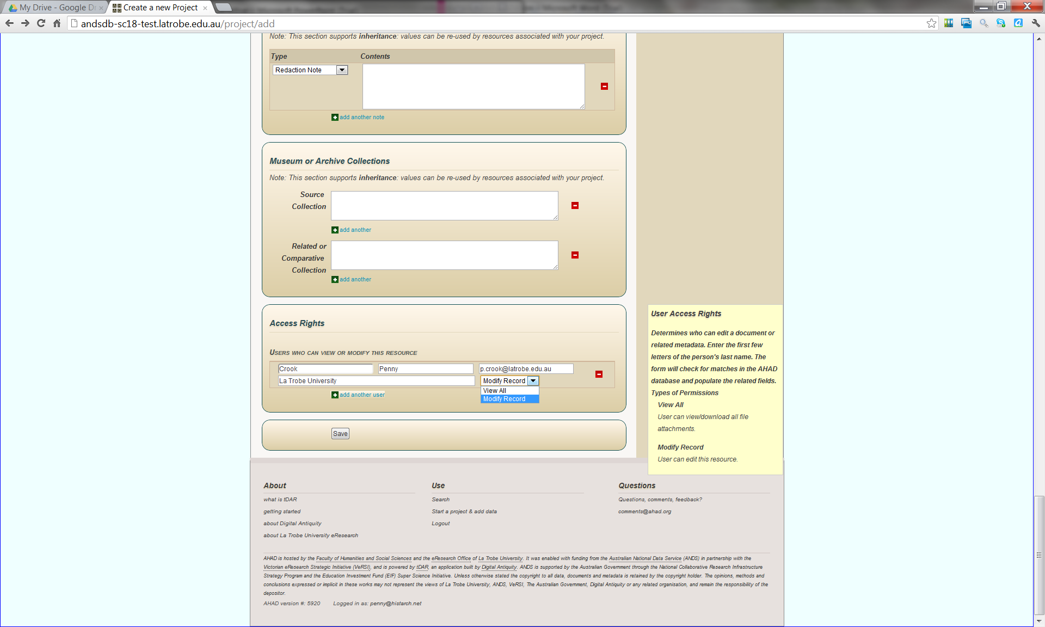

Slide 6
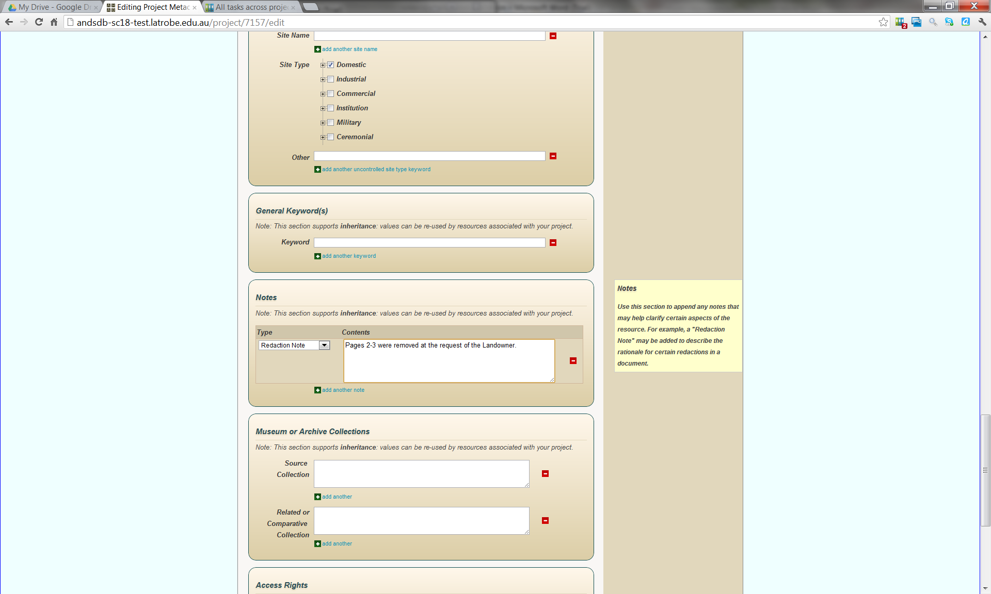

Slide 7
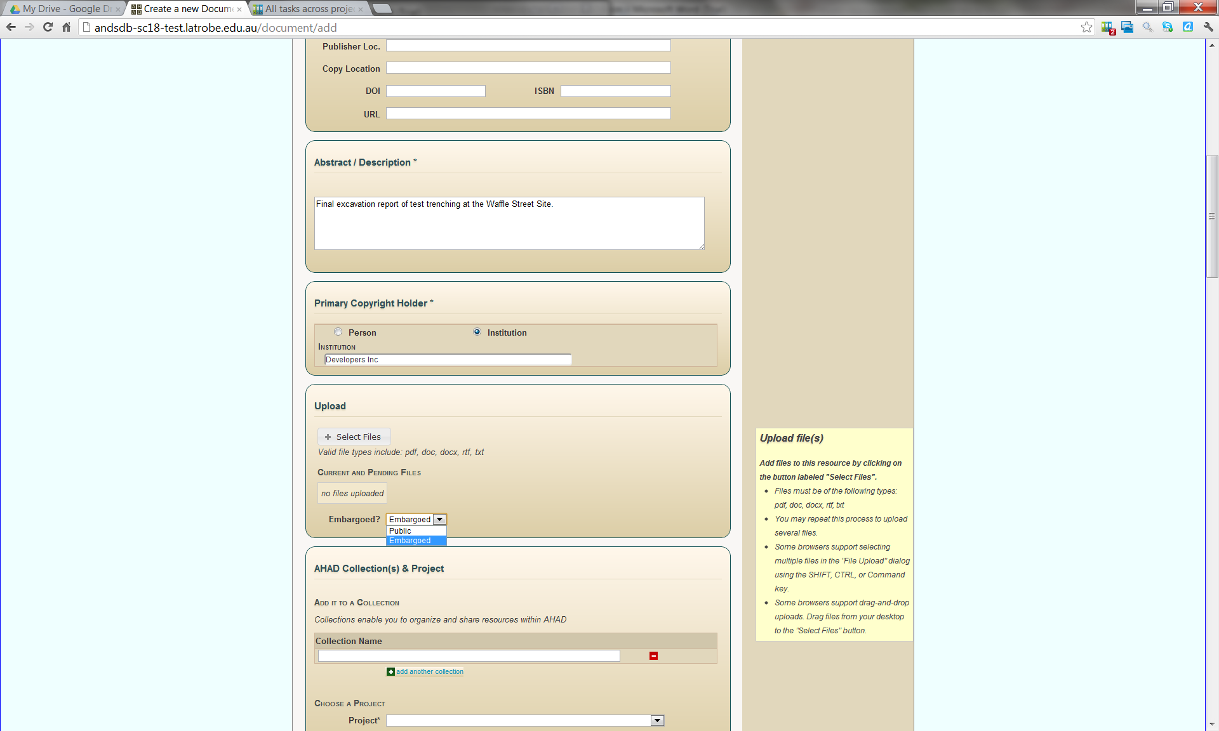

Slide 8
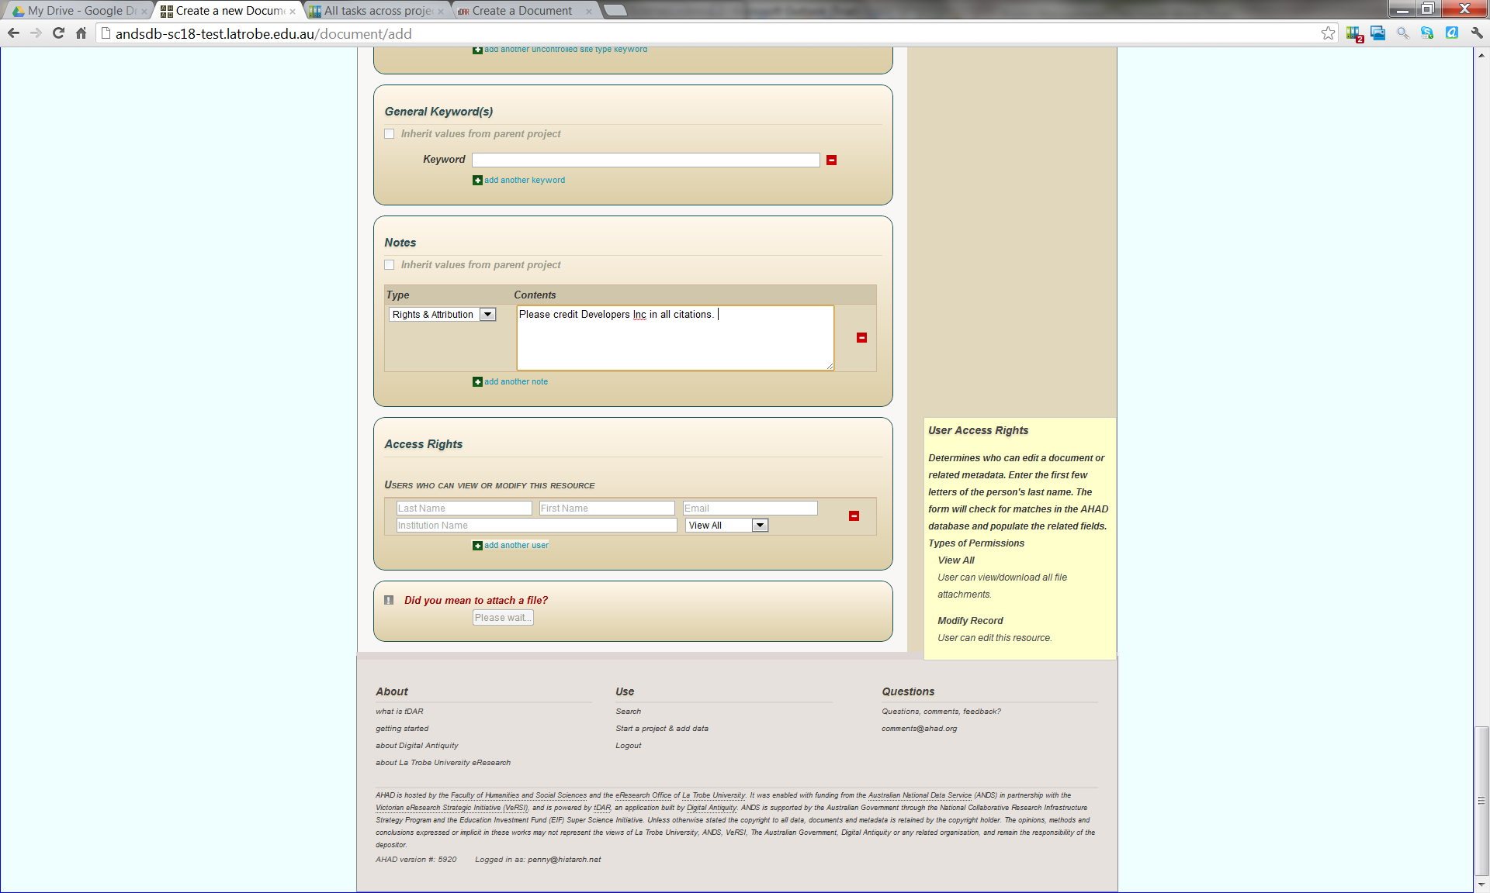

Slide 9
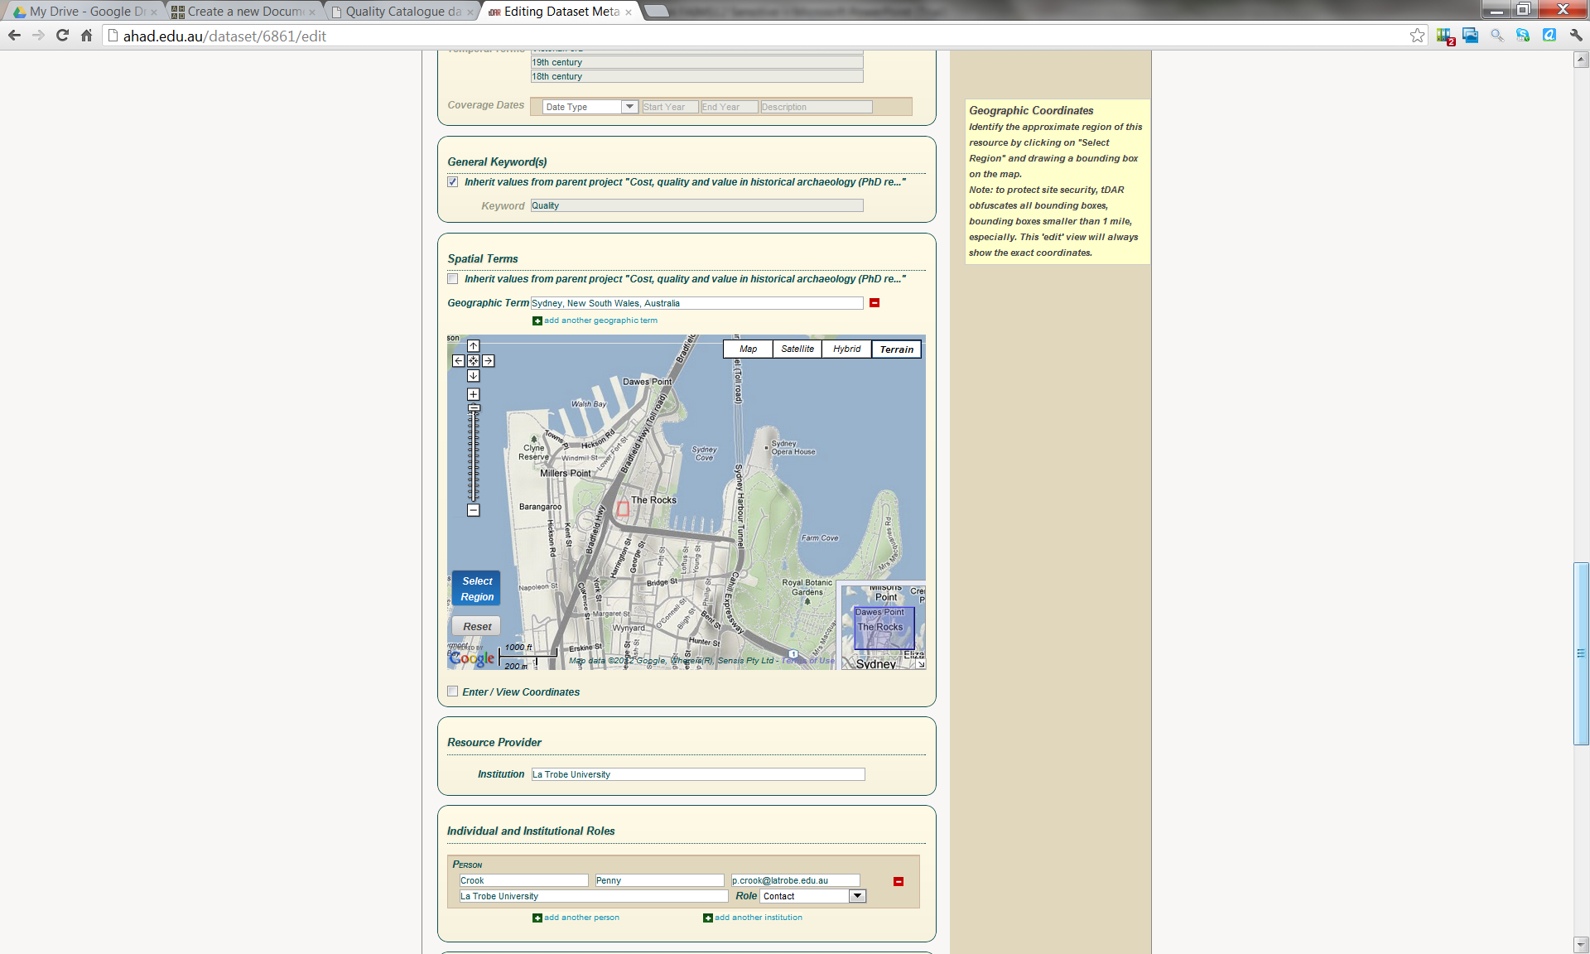

Slide 10
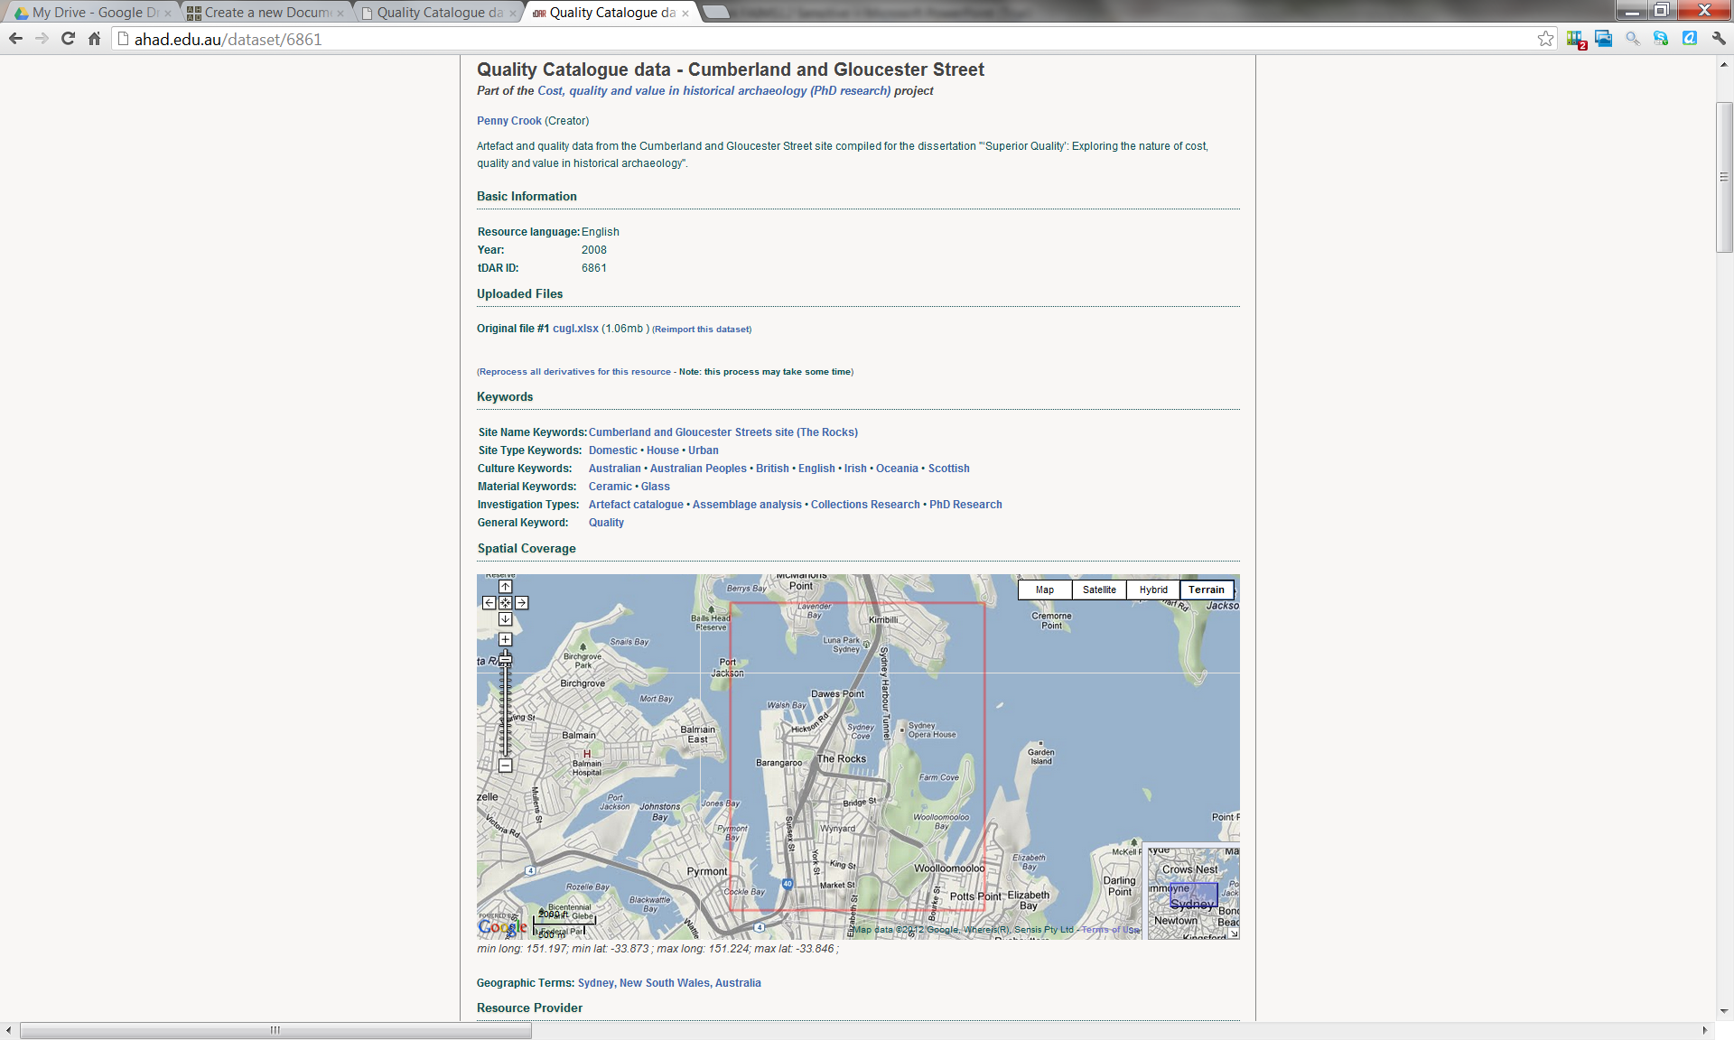
RDA

Slide 11
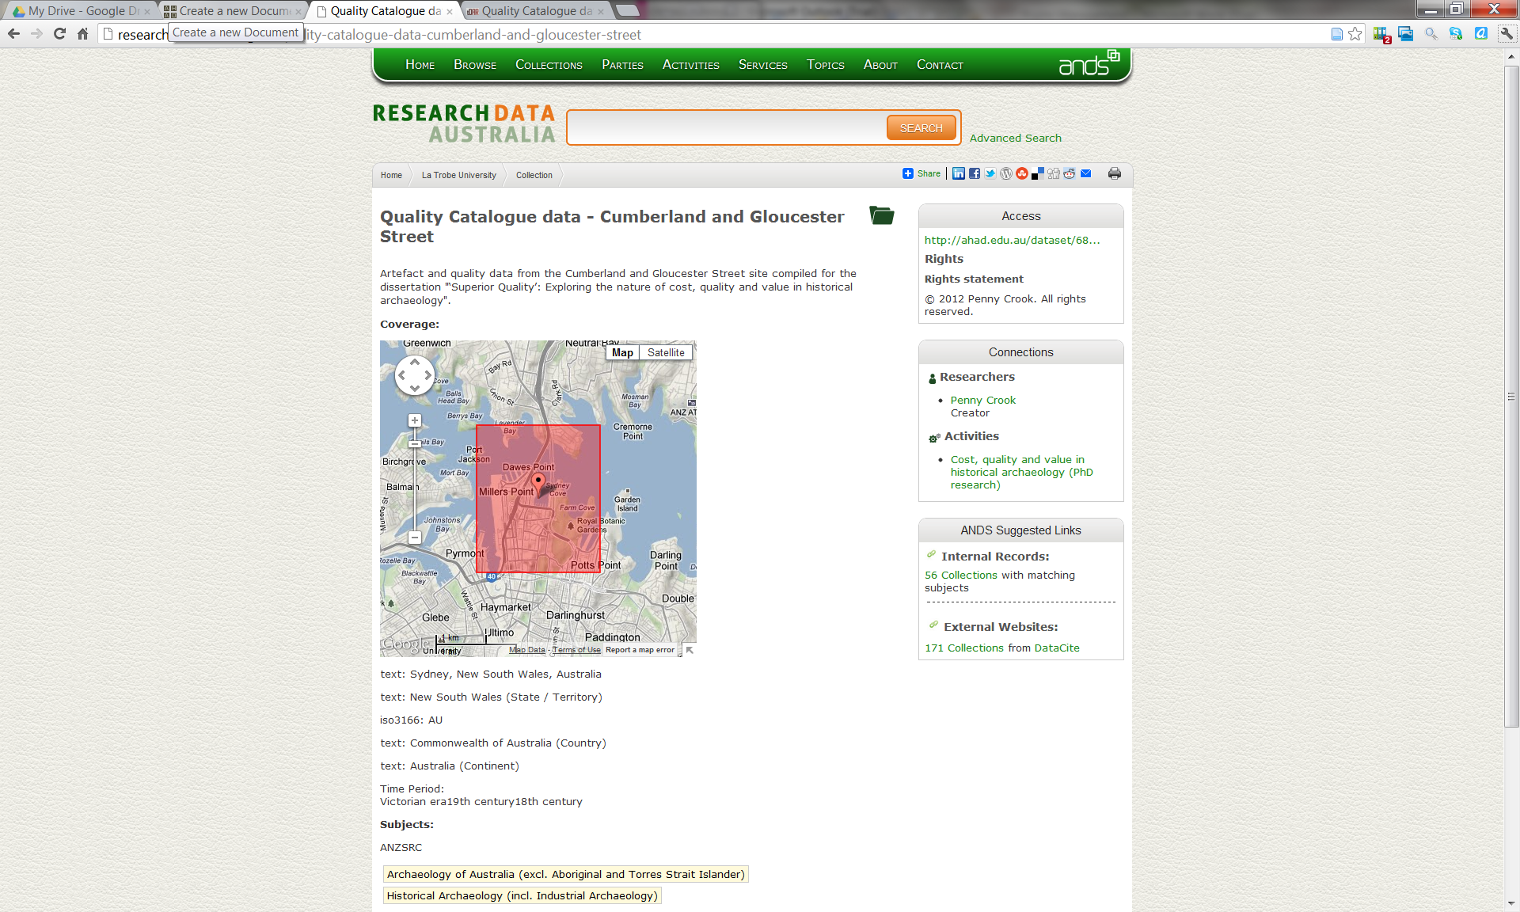

Slide 12
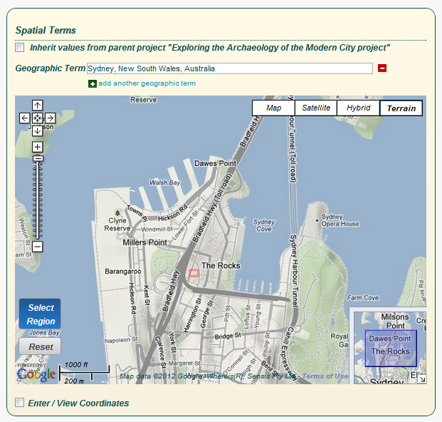

Slide 13
www.ahad.edu.au

