Slide 1
Sustainability: the ADS business model FAIMS workshop, Sydney , Australia, 18 August 2012

Slide 2
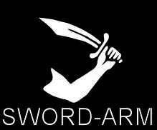

Sustainability & Automation Managing deposits: SWORDARM workflow
‘Clearing House’ for
data and metadata
Sword-Arm System
Dissemination
Collection
Management
System
Sword-Arm
PCMS
Account Management
Upload data
Management of the deposit
Creation of collection and file level metadata
Costing module
Licensing
Virus check
Checksum
Creation of file level metadata (DROID)
Allocation of DOI
Simple automated conversions
Once submitted the archive is passed
to the archivist for
validation
Archiving

Slide 3
You can’t fund a digital research infrastructure in Archaeology off the back of “pure” archaeological RESEARCH. It HAS to be underpinned by HERITAGE MANAGEMENT applications
Notes:
Not the paper I intended to give. Based on listening to conversations at the workshop – giving an external reaction
May also not be what NECTAR might want to here
I can say it as I don’t live here – I’m leaving tomorrow aftternoon

Slide 4
There aren’t enough research archaeologists
What we need isn’t sexy
(e.g. The Large Hadron Collider)
But it still costs a lot of money
We can never agree what we want
We always try to build something grand – and forget we need to fill it with STUFF
There isn’t a sustainable business model for research archiving
Notes:
There aren’t enough research archaeologists
What we need isn’t sexy i.e. The Large Hadron Collider
But it costs a lot of money
We can never agree what we want
We always try to build something grand – and forget we need to fill it with STUFF

Slide 5
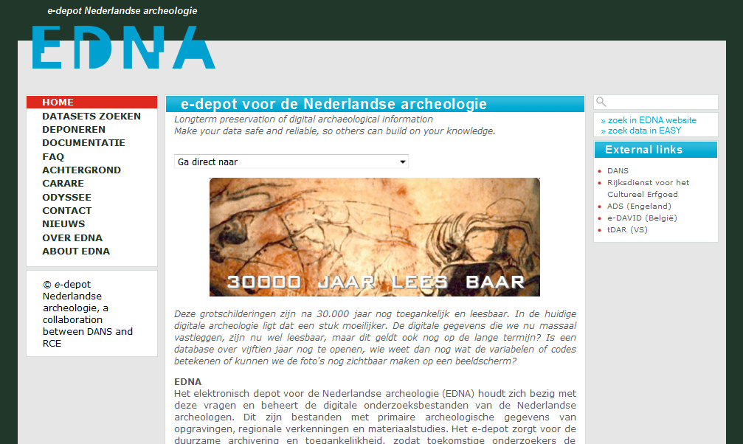
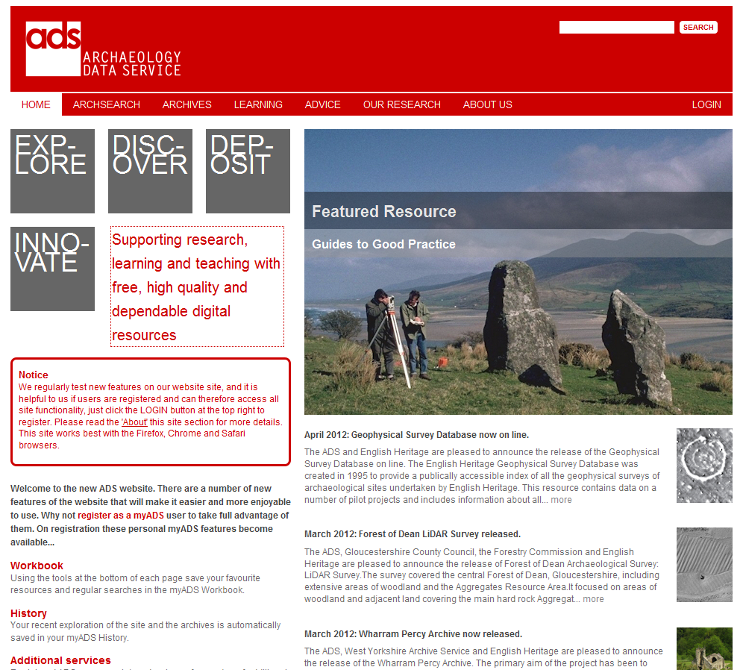
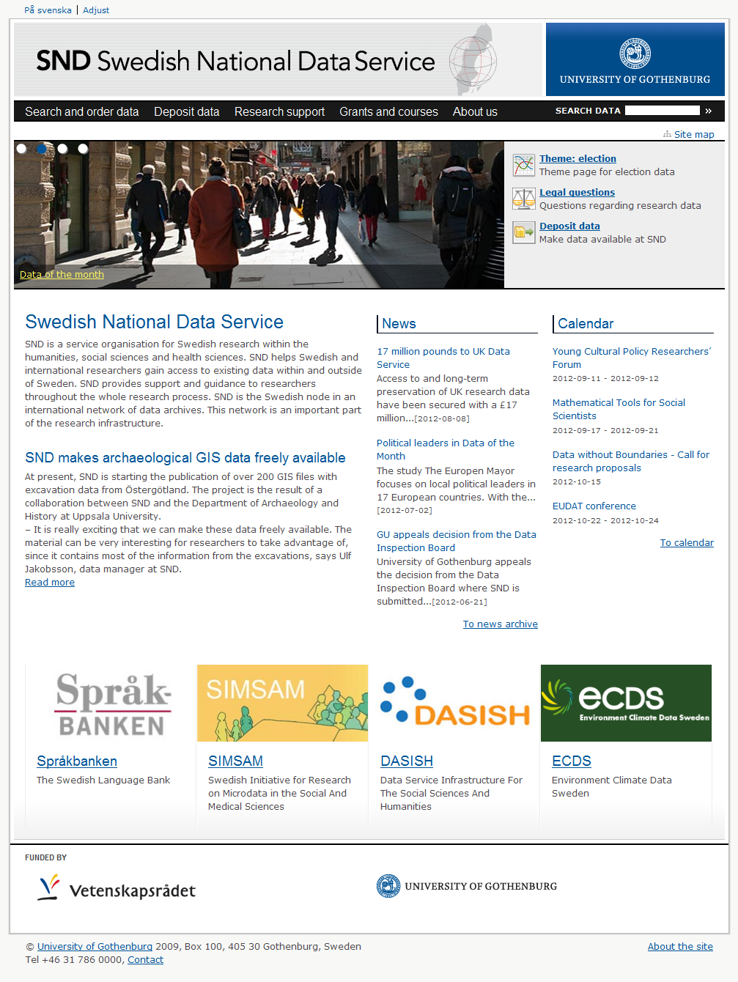
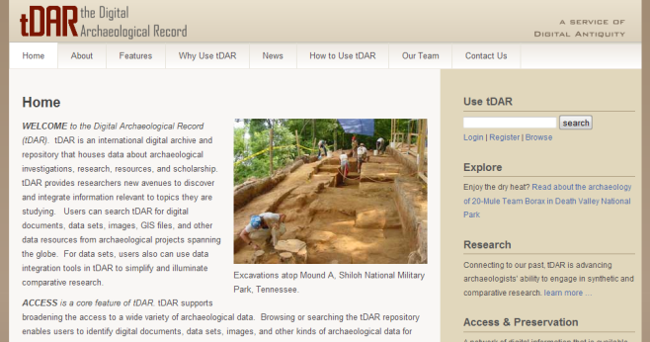
Experience shows....
Notes:
All based on contract archaeology

Slide 6
You CAN fund digital research infrastructure in Archaeology off the back of contract archaeology

Slide 7
They have something to gain
They are data creators... and consumers
There are more of them
They have (access to) money
There are legal imperatives
They have carrots
They have sticks
They can (more easily) agree what they want

Slide 8
The Archaeology Data Service: as it was
Set up in 1996 – 2 members of staff
Part of AHDS – UK led the world.
Annual core grant; free archiving for HE/FE
2006 – AHDS funding cut
AHRC got scared – how to cover all subject areas; Archaeology small – and relatively expensive
AHRC got bored – research infrastructure doesn’t (didn’t) ring the right bells in Treasury – and has to be for the long term – a year is along time in politics...
AHRC unable / unwilling to yield a big stick – lack of policing
Volatile funding for an archive if rely on project funding

Slide 9
The Archaeology Data Service: 15 years on...
Annual turnover c. £850,000 - £1,000,000
15 members of staff
Five-sixths from R&D and contract archaeology
Charging policy: deposit fees – one-off charge
Endowment fund
Mandated deposit – AHRC, NERC, English Heritage, Society of Antiquaries, British Academy, CBA
Embeded in commercial archaeology workflow

Slide 10
Business model
ADS one-off deposit charge levied at point of deposit
Included in project costing – to research council, or developer
Starts at c. £250
Generally < 1-10% of project costs
Costing based on:
Number of files
Complexity
Size

Slide 11
Costs of digital preservation
C = A + I + D + R
C (Cost of preservation) =
A (Management and Administration)
I (Ingest costs)
D (Dissemination costs)
R (Refreshment costs)

Slide 12
Refreshment costs
Retention period | Cost for refreshment | Cumulative total (pence)
5 years | 9 + 4 = 13 | 13
10 years | 9 - 3 + 4 – 1 = 9 | 22
15 years | 9 – 6 + 4 – 2 = 5 | 27
20 years | 9 – 9 + 4 – 3 = 1 | 28
ongoing |  | 28.1

Slide 13
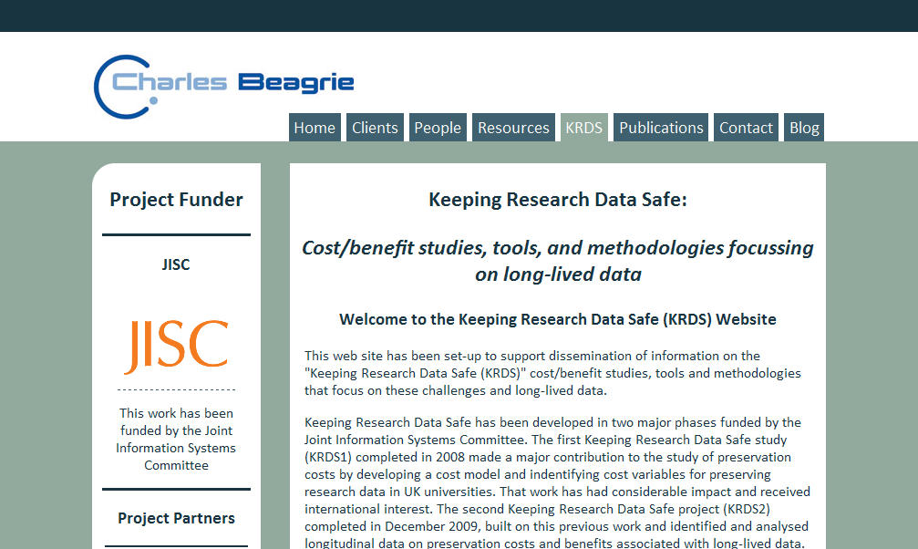
Keeping Research Data Safe

Slide 14
Project Funding model
English Heritage model – outline budget figure, followed by Digital Data Storage grant at point of deposit –
At that stage you know what your archive will be
Applied for by, and paid direct to, ADS
Greater level of policing e.g. Aggregates Levy Sustainability Fund

Slide 15
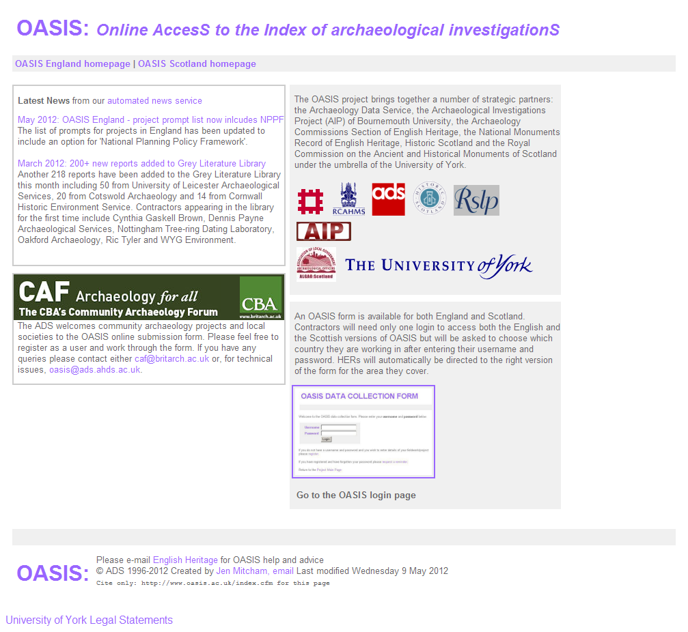
OASIS

Slide 16
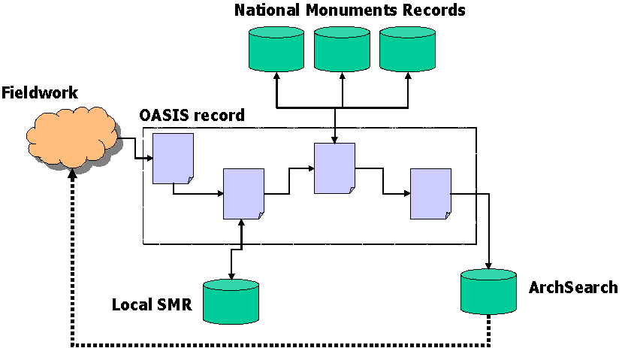
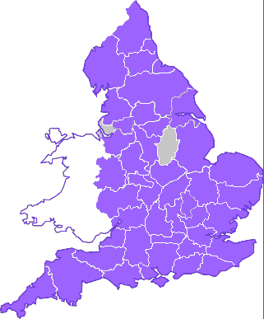
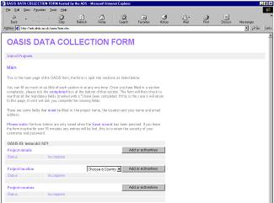
OASIS:
Online AccesS to the Index of archaeological investigationS
http://www.oasis.ac.uk/
Notes:
OASIS:
Although the acronym – OASIS – which is somehow formed from the full title ‘Online AccesS to the Index of Archaeological investigations’ is really bad, the overall aim of the OASIS project is actually really good and is something that yourselves may well encounter when working in the field.
The project brings together ourselves, the ADS,the, the Archaeological Investigations Project (AIP) of Bournemouth University, the Archaeology Commissions Section of English Heritage, and the National Monuments Record of English Heritage.
The aim of OASIS is to provide an online index to the mass of archaeological grey literature that has been produced as a result of the advent of large-scale developer funded fieldwork.
As part of this overall vision, the OASIS data capture form has been designed to help in the flow of information from data producers, such as contracting units, through to local and national data managers, such as SMRs and NMRs.
The map you can see highlights in which areas of the country the OASIS form is currently being used.

Slide 17
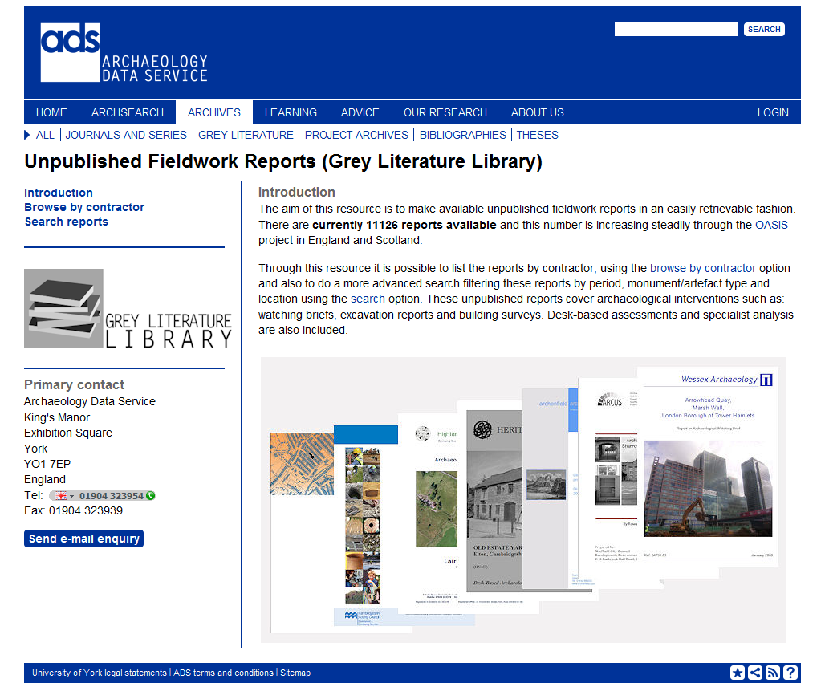

Slide 18
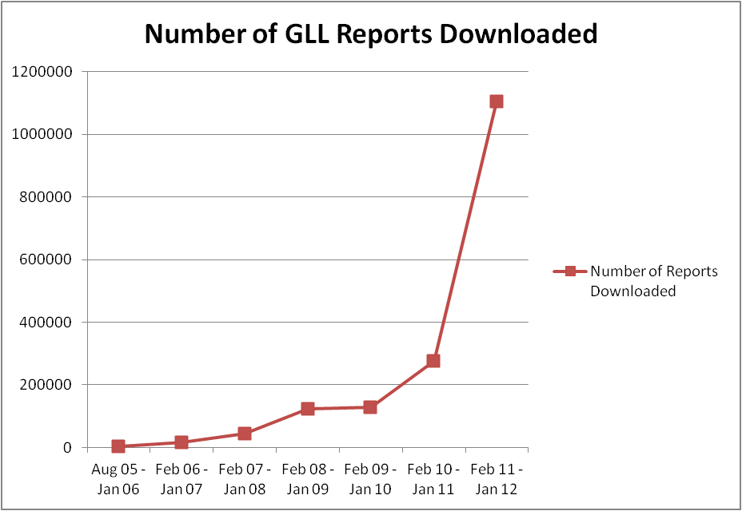
Grey Literature Library

Slide 19
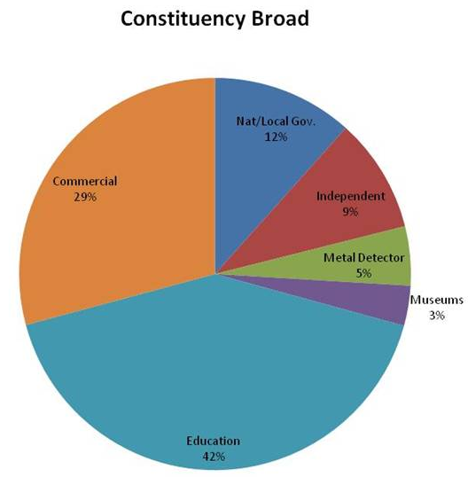
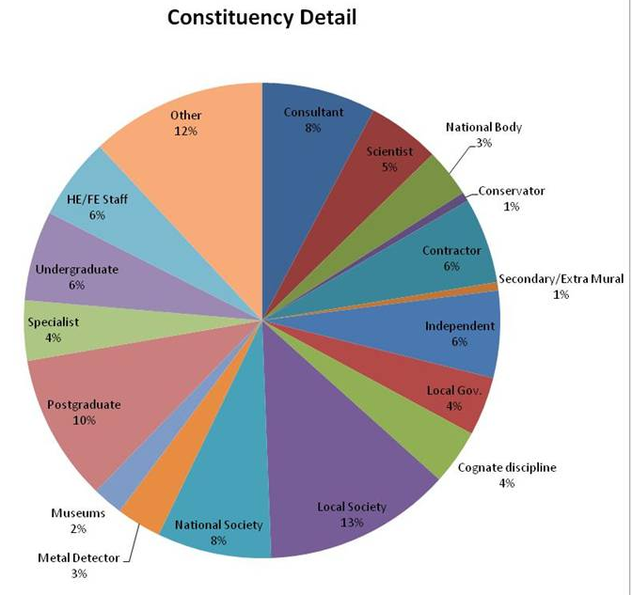
Who is using the ADS?

Slide 20
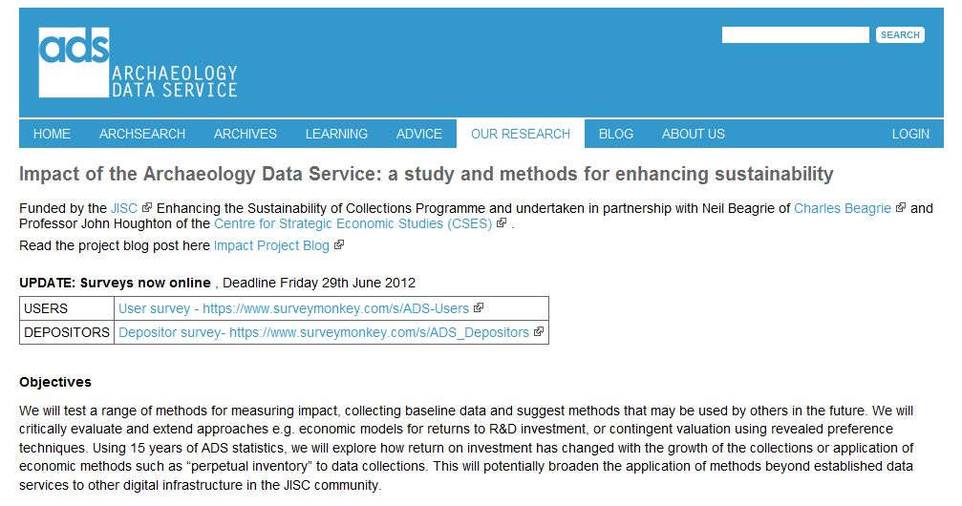
Economic Impact Study 2012-13

Slide 21
Conclusions
Sustainable model
Integrates twin cultures
You can do some fun stuff
You can even do some leading edge research
You can be useful to the taxpayer

Slide 22


julian.richards@york.ac.uk
http://archaeologydataservice.ac.uk/
Follow us on Twitter:
@ADS_Update
Befriend us on Facebook:
http://www.facebook.com/archaeology.data.service

