Slide 1
Four core tenets of sustainability: lessons from the Trusted Digital Repository Process
Adam Brin
Digital Antiquity

Slide 2
Sustainability
Technology
Organizational
Financial
Community

Slide 3
Organizational
Develop a simple mission statement and a shared interpretation
Ensure staff have a common understanding of goals and direction
Maintain realistic goals, and plan for the future (¼, ½, 1, & 2 times your history)

Slide 4
Organizational
Cross-train your organization…
No one person can do anything, or everything
Keep the staff up-to-date and in the loop
Maintain a history and context for decisions
Be consistent

Slide 5
Organization
Maintain an open (constant) dialog with community champions
Change
Document – policies, procedures, etc.

Slide 6

Community
Develop it.
Virtual communities
Local communities
Focus groups

Slide 7
Community
Find people who want ownership (i.e. have a vision) of your tool and empower it… stake holders
Listen
Understand that the “stated” need may not be the “actual” need

Slide 8

Listen
Listen to what the community is using your tool to do as well as the steps before and after (and make sure you fit well into the process)

Slide 9

Technology Sustainability
Once you write software, you think it’s done… it’s not.
Testing
Support
Bug Fixing
Very little software is ever ‘done’

Slide 10
Software
Support takes time
Software requires documentation
There’s a difference between software for the field and software for the web

Slide 11
Software
Software works best when it has a workflow and an opinion
Software works best when it does only a few things
Software works best when it’s modular
Software works best with a strong community and vision

Slide 12
Technology
New uses, bugs, or simply keeping it running requires time and work
Sustainable software requires:
An organization
A community
Care and feeding by people who understand it

Slide 13
Testing
Test your software
Automated, human, etc.
Ruggedize your software
tDAR currently has 600+ tests that are run automatically each time the code is changed. These tests test:
Common use cases
Uncommon user needs
Heavily used parts of the code

Slide 14
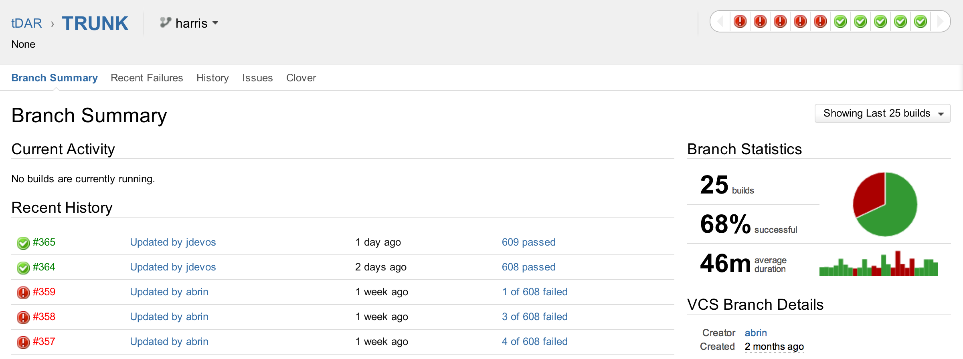
Best Practices… testing

Slide 15
Technology
Making software “open source” does not immediately solve the sustainability problem
Software programming is like gardening
Writing toolkits is often ‘harder’ than application software

Slide 16
Best practices for sustainable software
Open source wherever possible
Don’t be the biggest customer of tools you use
Don’t over-customize
Write as “little” code as possible

Slide 17
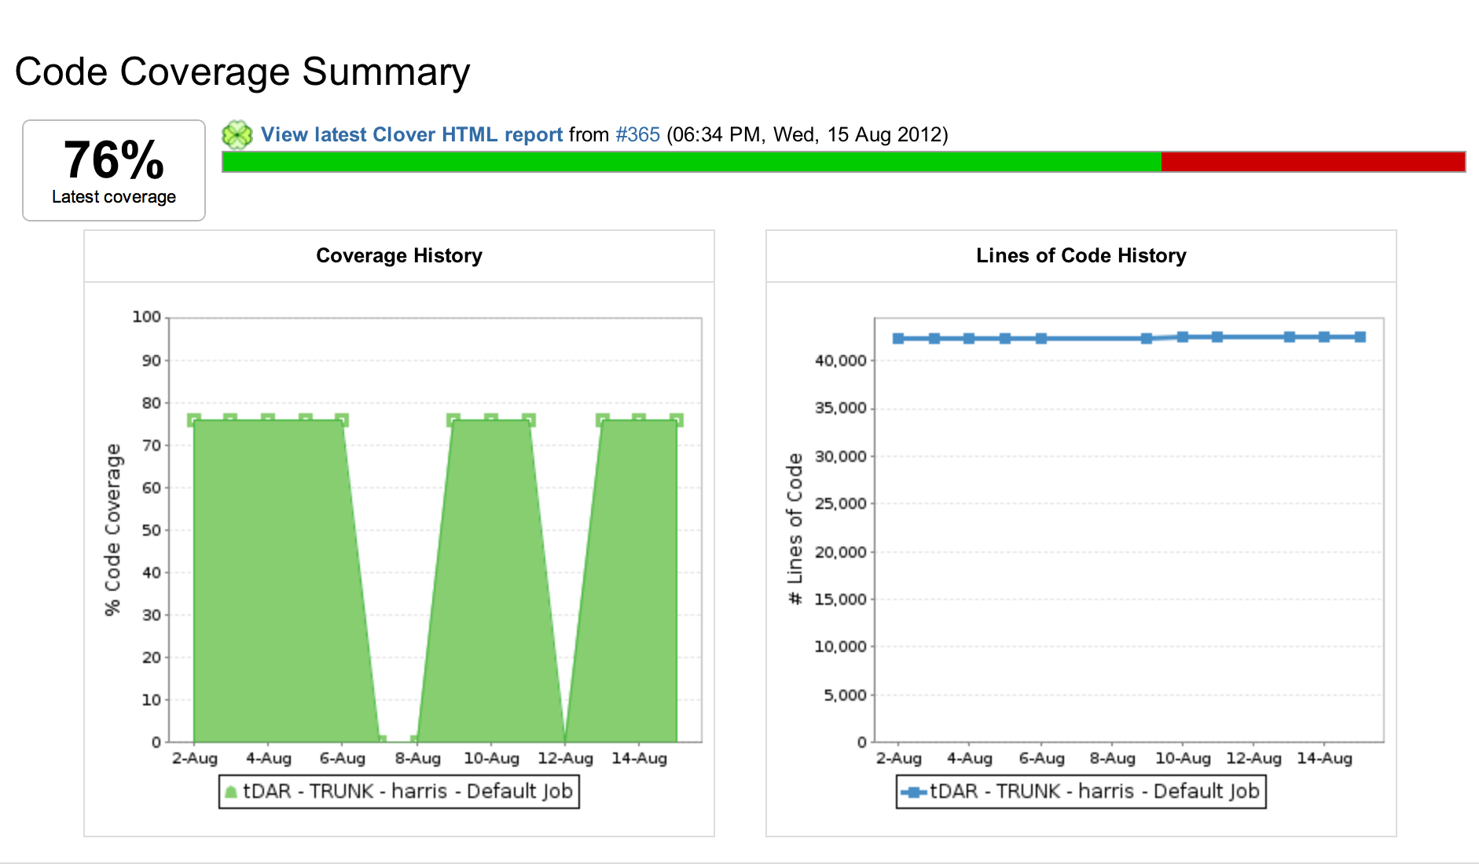
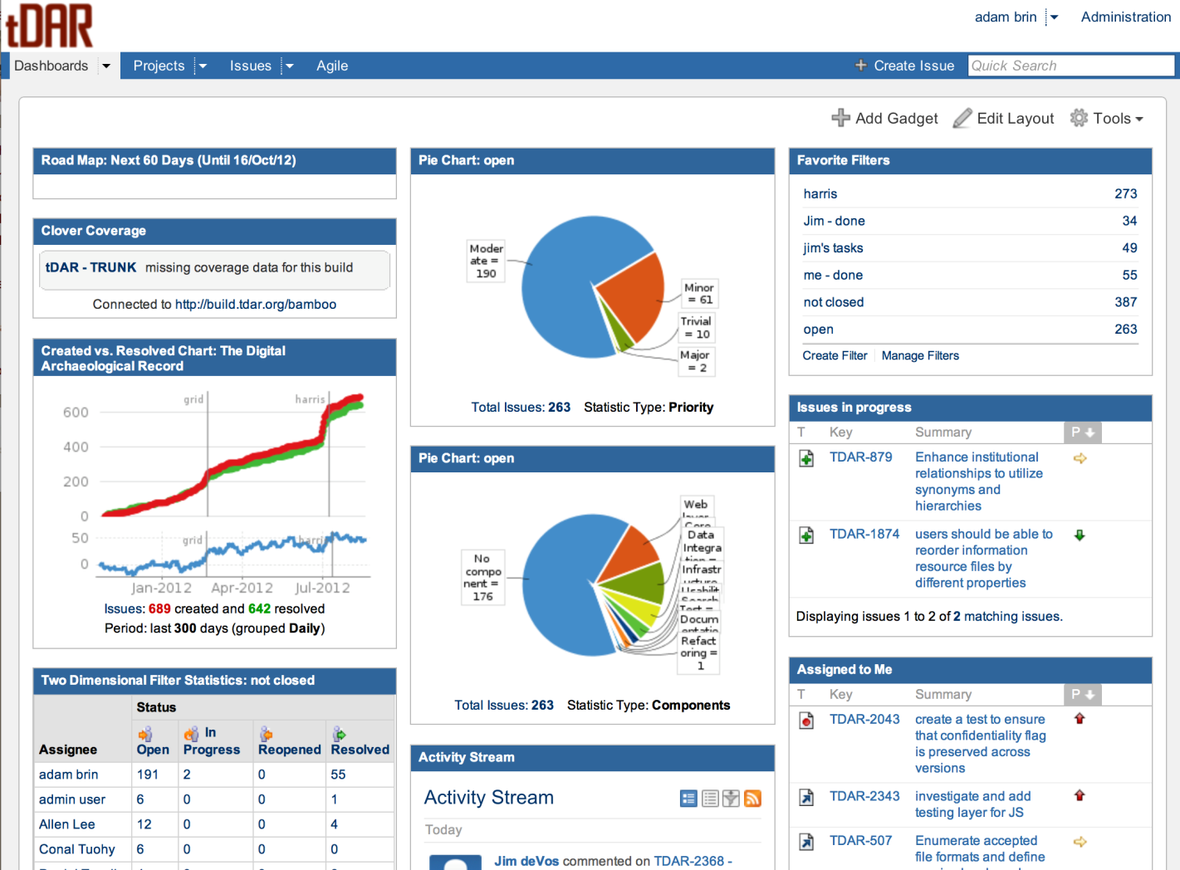
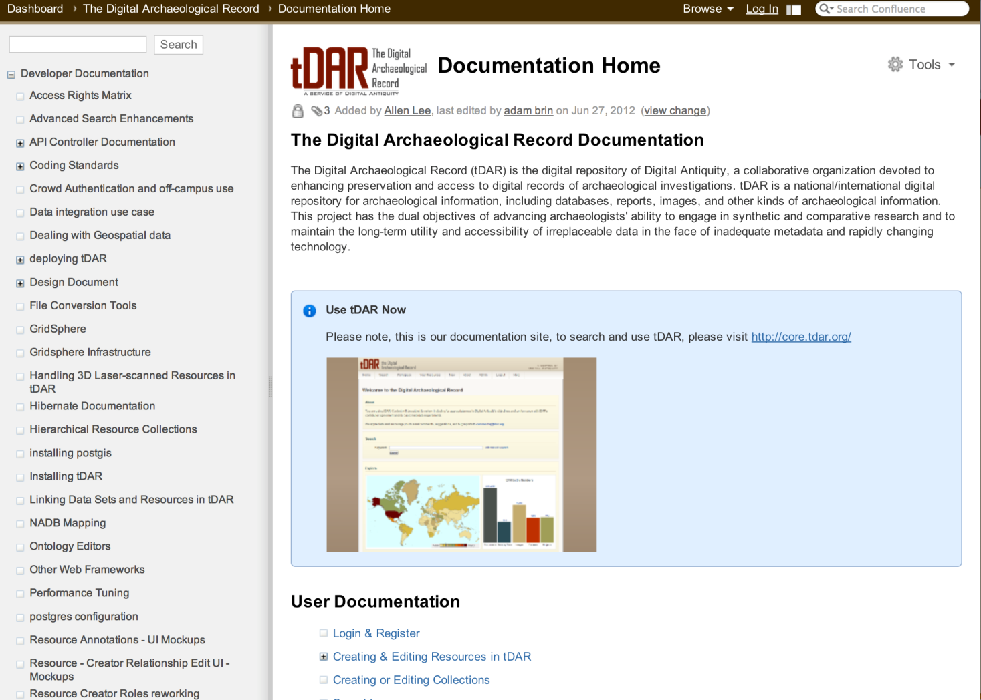
Best Practices

Slide 18




Financial
tDAR & Digital Antiquity has been funded by a series of grants from:
But, this won’t support us forever…

Slide 19
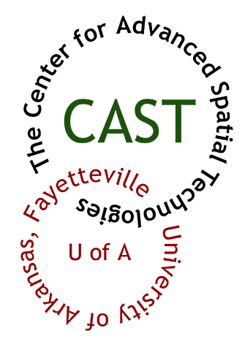



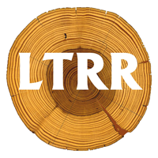





Supporters

Slide 20
Possible Charging models
Charge per access
Charge per deposit
Charge for add-on services
External funding (Grants)

Slide 21
tDAR cannot survive without
Funding via ingest
Support from the community
A strong organization
Consistent and quality software

