Slide 1
Using digital video to record, present and share information about archaeology and heritage
Sarah Colley
Dept. Archaeology, University of Sydney

Slide 2
Kentwell Cottage Video
Gojak team made video documentation of project on regular basis over several months
Produced basic log of digital video tapes
Colley logged & captured video from tape into Final Cut Pro
Basic editing (tidy, improve sound etc, cut 7 hours of video into 3-10 min clips, added metadata into clips themselves)
Exported clips in several formats with consistent filenames
Created systematic metadata records in Excel
Copies of archive on external hard drive & stored on backed-up USyd server space
Colley edited short interpretative video for You Tube

Slide 3
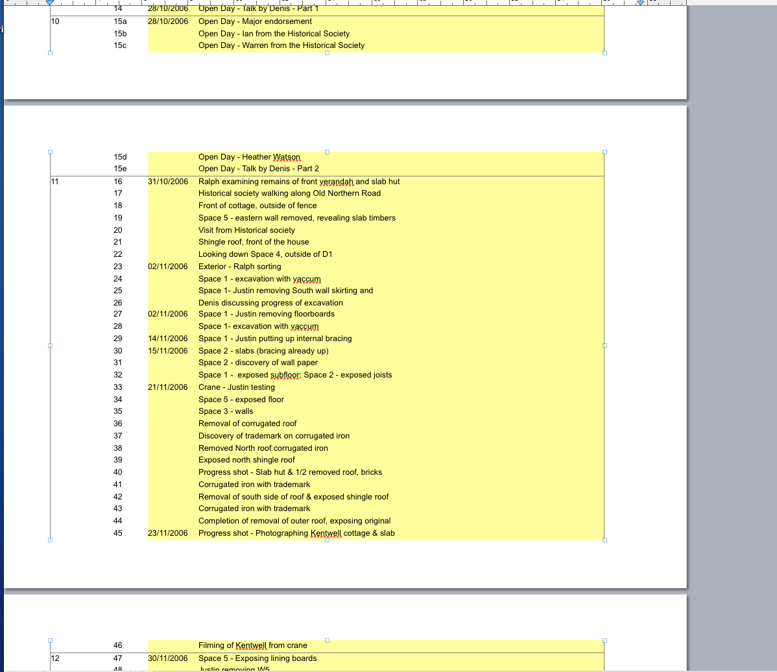
Tape Log – Denis Gojak 2009

Slide 4
Future aims
Upload to digital repository (e.g. USyD eScholarship Repository – DSpace)
Publish with e.g. Alexander Street Press – tagging to make more discoverable
Incorporate into extended version of NSW Archaeology Online

Slide 5
Lessons learned
Fantastic tool for recording ‘information’ and also interpretation & presentation to audiences
Involves skill to improve quality (capture content, editing, compression & export in appropriate formats)
Digital rights & permissions management essential from start of project
Metadata schema & media management
Making content discoverable and accessible online
Archiving in a repository?

