Slide 1





Findable
Data
Operations
Models
Accessible
Interoperable
Reusable
Data-Models-SOPs-Workflows-Samples-Publications-Specimens-People-Expertise

Slide 2
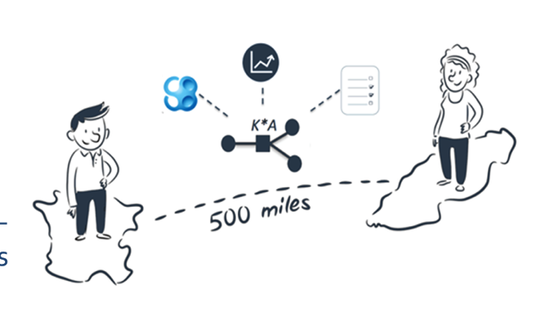
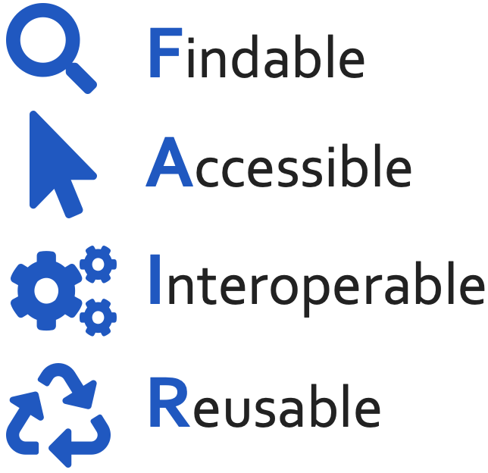
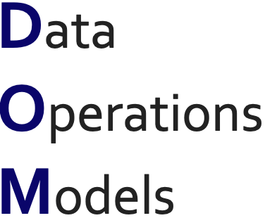
Making the Most of Life science
Project Assets
Collect, Manage, Store and Publish your data, models and operating procedures in a FAIR manner.

