Slide 1
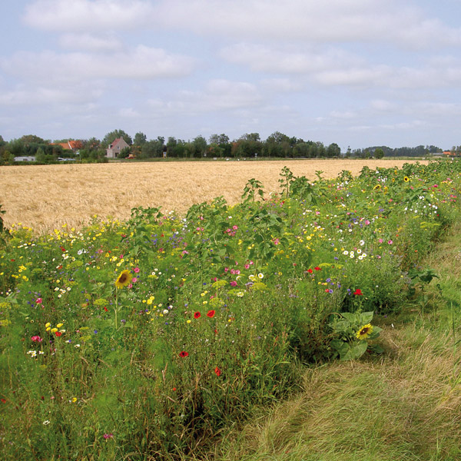
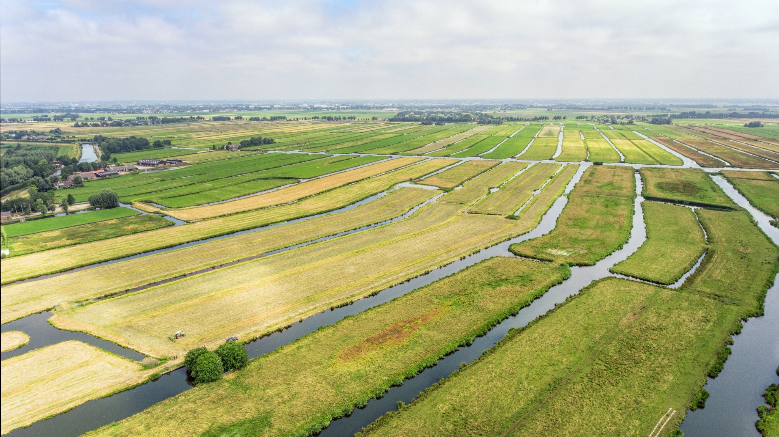
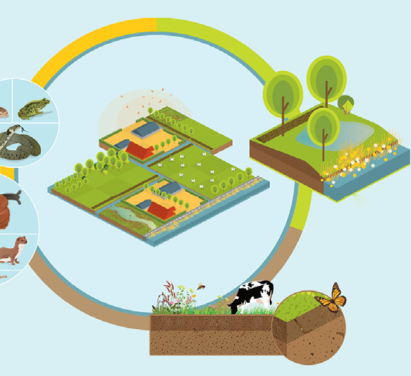
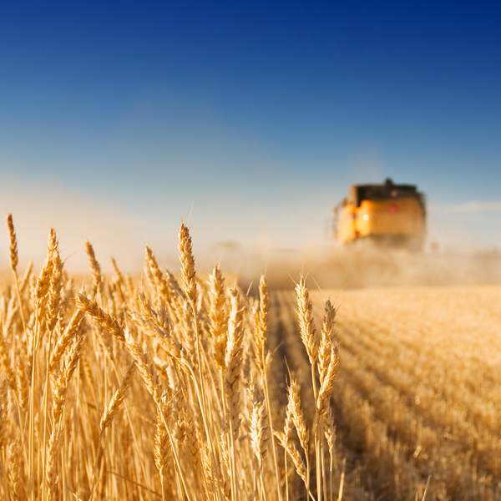
Biodiversity and agriculture nexus
WENR use case
Wageningen University and Research - Wageningen Environmental Research
Marian Vittek, Rob Knapen, Rob Lokers
FAIRiCUBE Project kick-off meeting 1/7/2022

Slide 2
Objective
General:
How data cube based infrastructure can improve the access to information related to biodiversity in agriculture
Specific:
Explore links between:
farm interventions
specific biodiversity indicators
derived measures of biodiversity

Slide 3
Research questions
Can the integration and ML-based analysis of currently available biodiversity, agriculture, environmental, and remote sensing data provide comprehensive, verifiable, and actionable insights for different regions?
Can datacube functionality and ML help in finding patterns between effects of farm level measures, indicators of physical conditions and direct measures of biodiversity?
Can the insights obtained in the study region be extended to other regions, learned patterns reused by applying transfer learning?

Slide 4
Input Data
Local data
Key Performance Indicators (KPI) data from farmers – on company level and parcel level: rotation index, crop diversity, annual greenness, winter greenness
National data – mainly available through AgroDataCube
National Land Use Database (LGN)
Open farm crop field data (from national farm registration), for multiple years
Open daily weather data (from KNMI, the Dutch Meteorological Institute)
Soil map and soil physical parameters
Administrative regions
Species occurrence data – available through NDFF
European / Global data: Sentinel 1,2 and OpenStreetMap

Slide 5
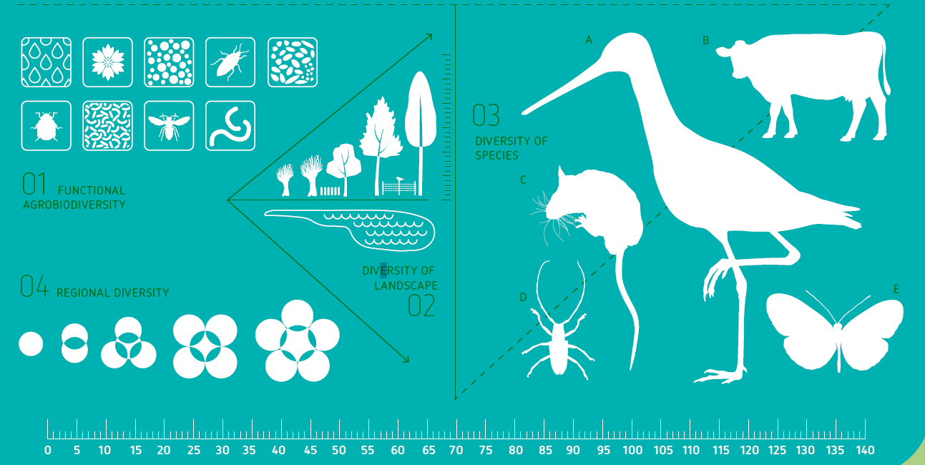
Methodology
Approach used at Dutch Biodiversity Monitor (DBM)
Create a tool which provide a standardized system to monitor the performance of farms for biodiversity
Use of Key Performance Indicators (KPIs) as variables used to measure the performance of farms
Investigate methods to extrapolate farm data on KPIs
Use of machine learning techniques to find relationship between species abundance and biodiversity
Select ML algorithms to extract patterns from spatial arrays of environmental features

Slide 6
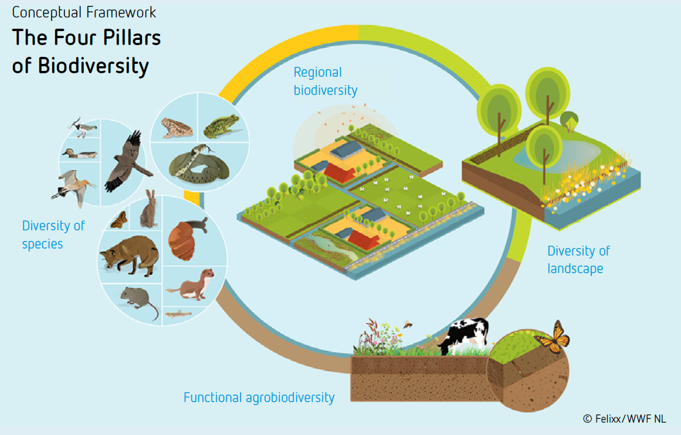

Slide 7
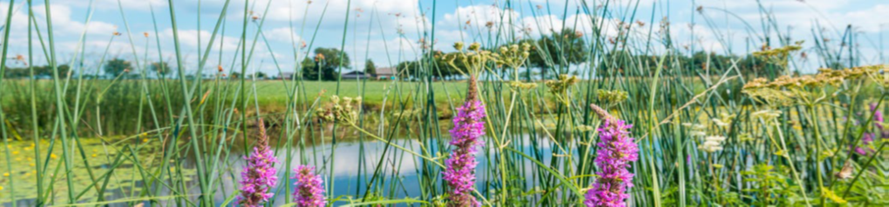
Methodology - Validation
Spatial occurrence of species data
National Databank Flora and Fauna (NDFF, ndff.nl)
Crowdsourcing portals such as Telmee (telmee.nl) and Waarneming (waarneming.nl)
Deep neural networks for multi-species distribution modelling which links together species occurrence and environmental covariates
Estimates performed in more time steps to evaluate the effect of farmers interventions on biodiversity

Slide 8
Challenges
Obtaining private data from farmers for calculation of KPI’s
Scaling up from farm to landscape level and higher
Computational capabilities
Transfer for vector to raster based datacube
Data semantics in agriculture
Data
Availability - right to use
Quantity - methods for extrapolation
Extraction of relevant information

Slide 9
Thank you for attention!
marian.vittek@wur.nl
rob.knapen@wur.nl
rob.lokers@wur.nl

