Slide 1
FAIRsharing Front-End Redesign
Topics
Why FairSharing Needs to be redesigned?
A quick scratch on UX / UI
How new designed benefits from UX and UI
New Design Mock Ups
Question & Answers

Slide 2
Why Redesign (1)
Home Page
Home Page Header gives accessibility but list presenter buttons can be compacted to one main category so the user unintentionally would not click on standard, database ,etc as the first visit before getting to know the website.
Size of the buttons and emphasizing level( such as colour, border) on each button is not meaningful
Sections are not margined properly so the user can not see and recognize what of what!
Search which is maybe one of the most important part of the app is not bolded.
Slow guns can be accompanied by a relevant full screen picture as background So they look more emphasized and clear.
Advanced search is out of sight on first visit
Website tags are not SEO friendly( No Semantic)
Fonts and sizes are inconsistent in different screens.

Slide 3
Why Redesign(2)
Records Page
Useless space waster dark blue header which delay user access to the content
Button colours are meaningless such as red for recommended or blue for maintainer which overlaps meaning with blue tag related to domain (More colour can mislead users )
Pagination is not placed right(our user see the content then wants to go to next page)
Table is unbelievably packed and is not legible.
Items numbers in the table cells are not the same number on the grid view or not exists sometimes!
Some cells comes sometimes with none value. What not even show them to users at all ?
Most of the button links leads us to an exact page which shows the content.
Facet buttons enable or disable status is not clear. Is the first time visiting data recommended or not recommended or both!? How should I know(UX problem)
Claimed and Maintainer has the same colour which causes confusion.
Contribute by adding standard button can be bolded on top menu instead of in an inappropriate position.
Any Problem please tell us also is not in the right place. (already is defined on top menu even in old ver)

Slide 4
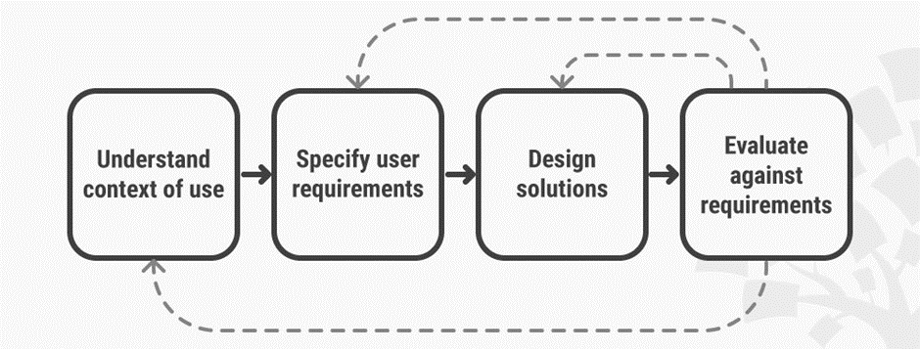
UI/UX Explanation(1)
Definitions
UI is the visual part of our application such as buttons, forms, graphics ,etc while UX focuses on the user experience such as accessibility , findability, and to put it in simple words, it is the simplification of steps for different type of users while using the website to lead to where they WANT OR MUST go!
A Continues cycle to get to the best UX

Slide 5
UI/UX Explanation(2)
Definitions
- The look of a product is all about creating a product that has visual appeal and which, in particular, harmonizes with a user’s values and captures the spirit of what they expect in that product.
- Feel is about that products should provide a pleasurable experience and not just a functional one.
- Lastly, usability. UX designers want to create products which can, ideally, be tailored to meet a user’s specific needs, but which provides functionality that is predictable.

Slide 6

UI/UX Explanation(3)
Dive into UI/UX Rules:
- Categorize and chunk big subjects into smaller ones.
Example: DR. Miller law is a well-known psychological theory that examined some random people and evaluate their brain memory ability.

Slide 7
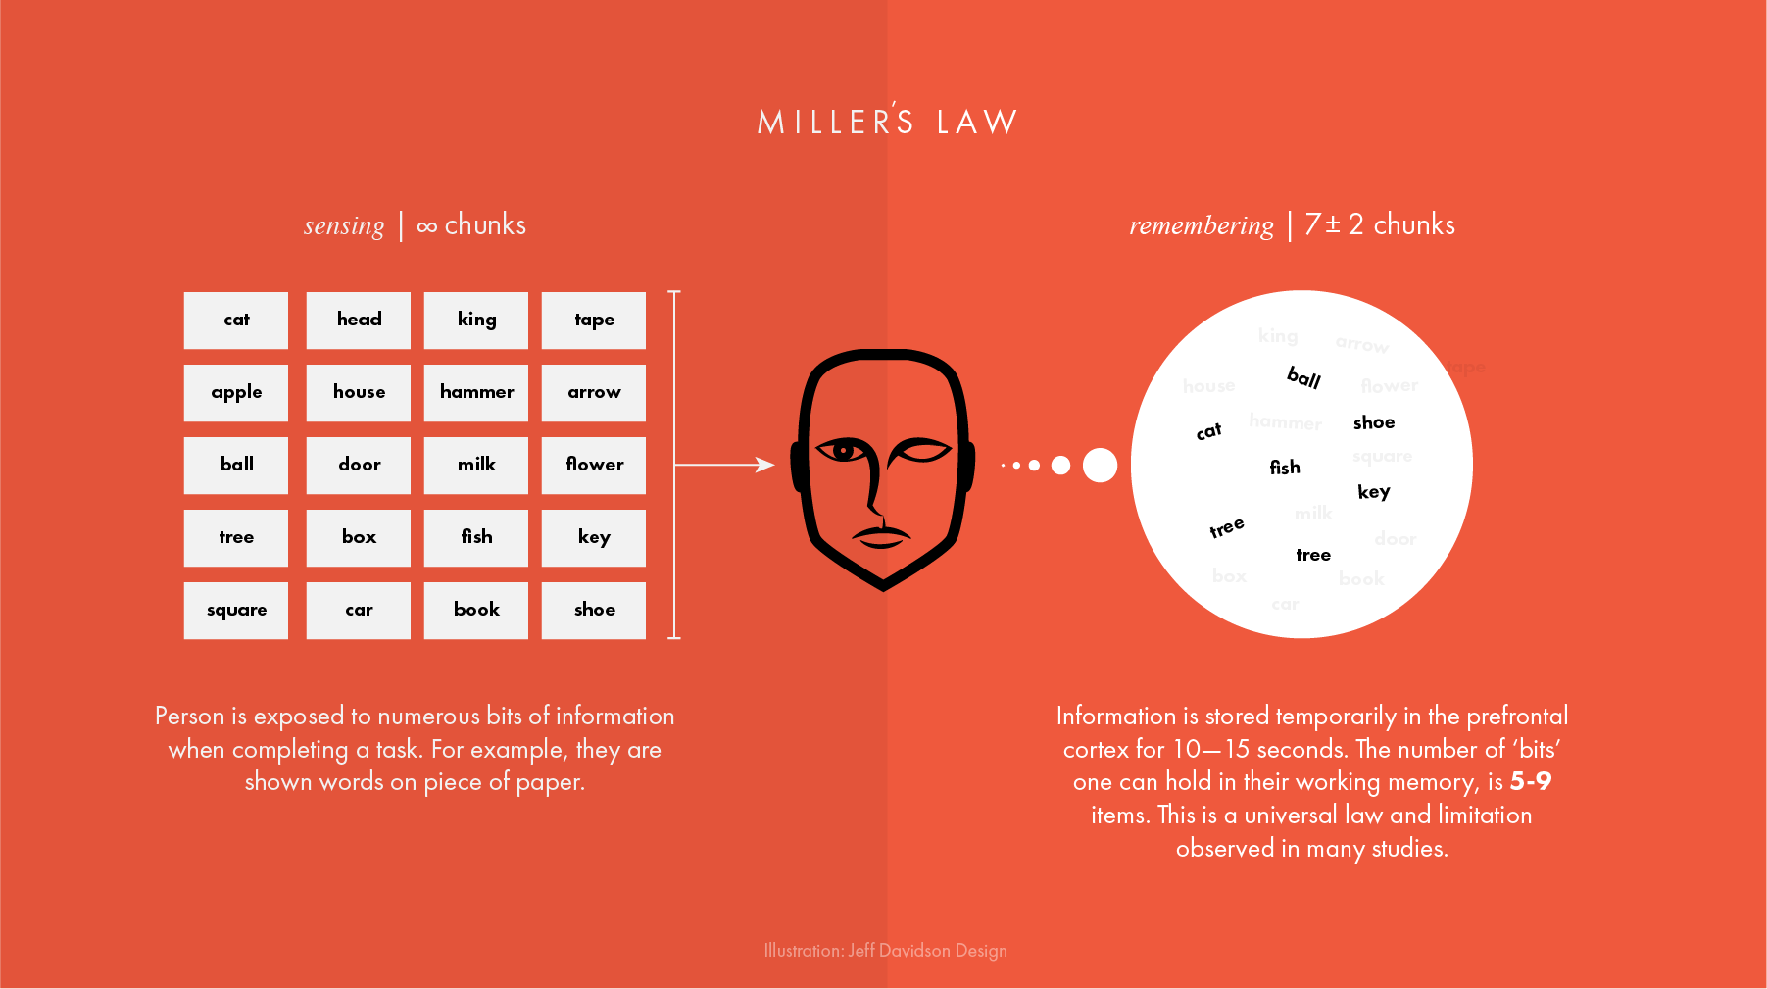
UI/UX Explanation(4)
Results showed most people could remember 7 plus-minus 2 of the words they were given.
10 to 15 second brain cortex can store those data temporarily in it concluding 5 to 9 items is ideal for a human brain.

Slide 8
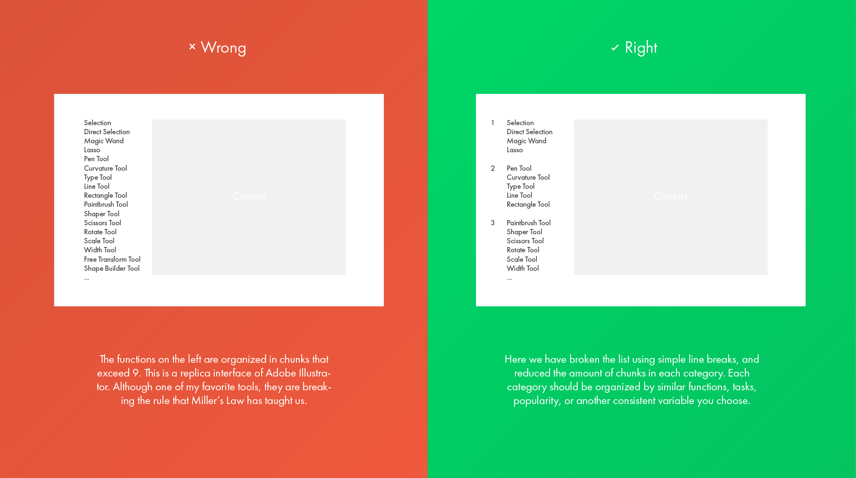
UI/UX Explanation(5)
Conclusion of Miller law:
Always try to categorize the data more than 5 to 9 items, into smaller chunks.
A good example is Photoshop Tool

Slide 9

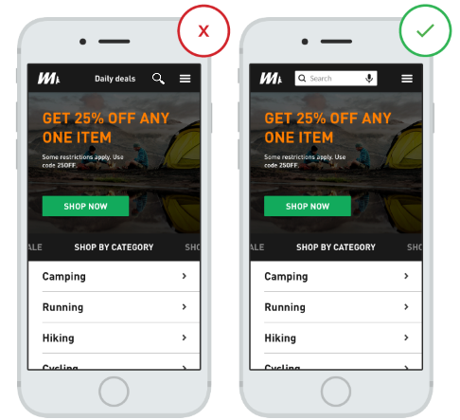
UI/UX Explanation(6)
Search field Best Practice
- using magnifying glass
- Display search field prominently

Slide 10
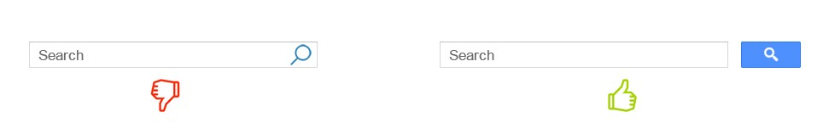
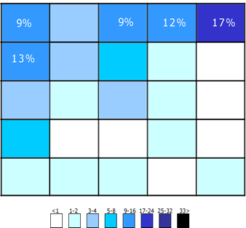
UI/UX Explanation(7)
Search field Best Practice
provide search button
Put your search box on every page
Put search box where user expect
to find it
use a good auto suggestion

Slide 11

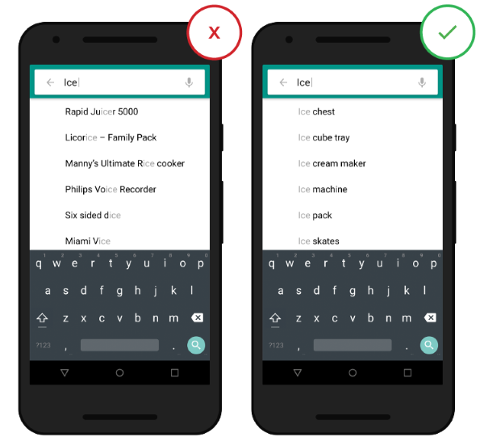
UI/UX Explanation(8)
Search field Best Practice
Make it clear what user can search for( IMDB Is
A good example )
Search field Result Best Practice
Don’t erase users’ query after they hit search button
- Use effective auto suggest

Slide 12
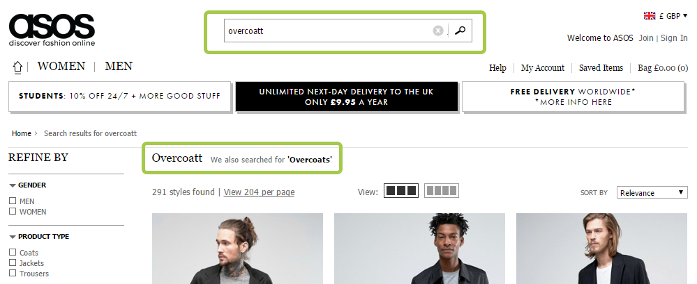
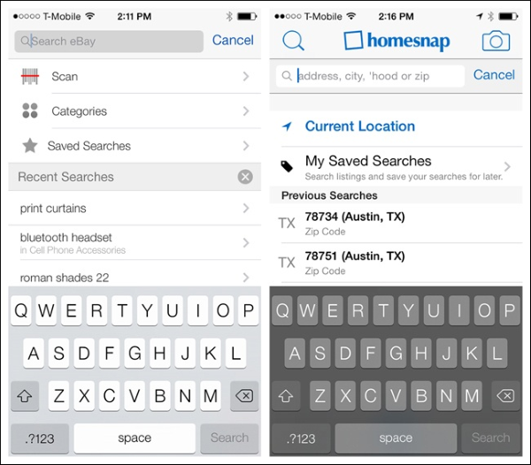
UI/UX Explanation(9)
Keep users recent search queries
Correct Typos
Choose proper page layout
Provide sort and filter options

Slide 13
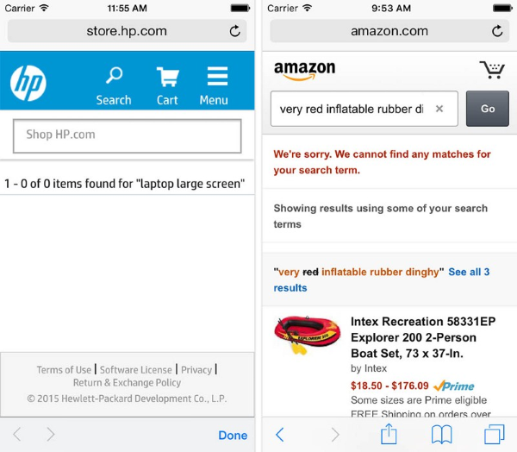
UI/UX Explanation(10)
- Don’t return ‘No Result!’

Slide 14
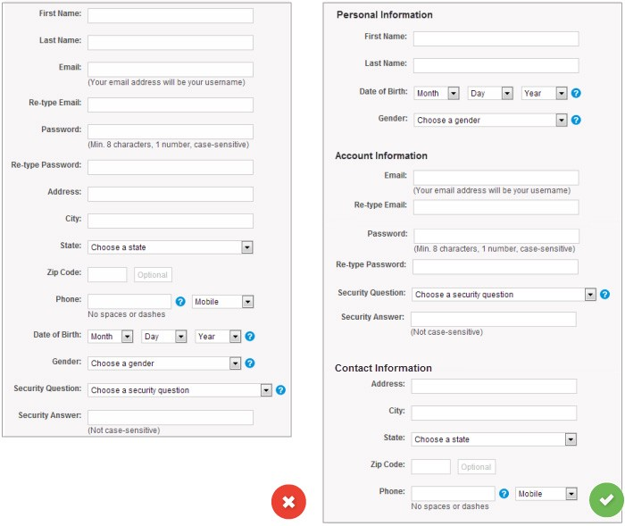
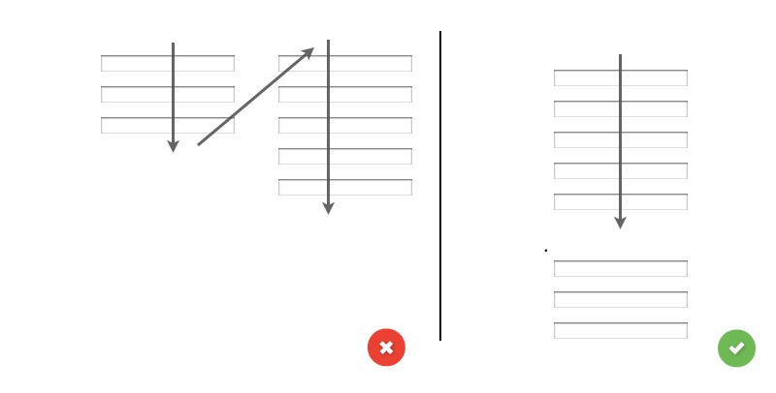
UI/UX Explanation(11)
Forms and Fields
- One Column vs Multiple Columns
- Group Related information

Slide 15
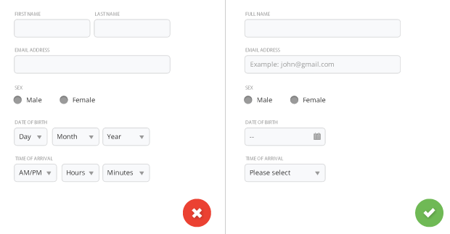
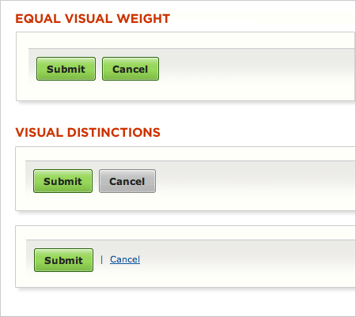
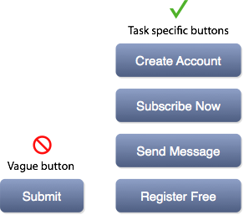
UI/UX Explanation(12)
- Number of Fields
Primary vs Secondary Actions
Avoid Generic words
like submit(be descriptive)

Slide 16
UI/UX Explanation(13)
Colour Pallet
Every professional website must have 3 colours: Primary(Dominant colour), Secondary and Accent colour
Primary Colour
Secondary Colour
Accent
Primary-Dark
Primary-Light
Secondary-Dark
Secondary-light
Accent-Dark
Accent-light
- your brand colour
It makes your website multi colours
- It is the optional colour
It highlights the second most important
Items in your website such as subtitles,
Background and secondary buttons.
It can be used to give more
Decoration. It can be used in
Charts, tables, etc.
- The colour user remembers you with it
- Make sure your logo contains at least one of your dominant colour

Slide 17
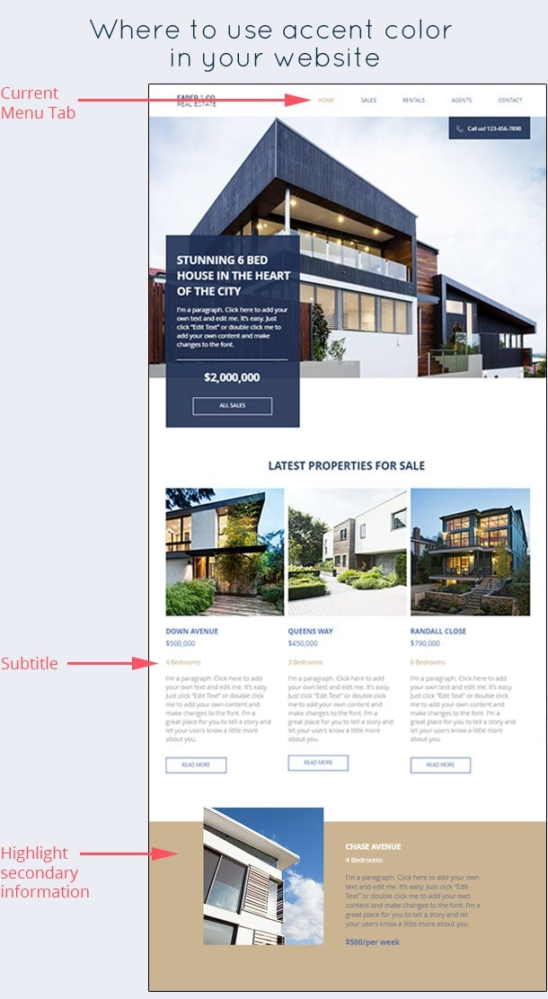
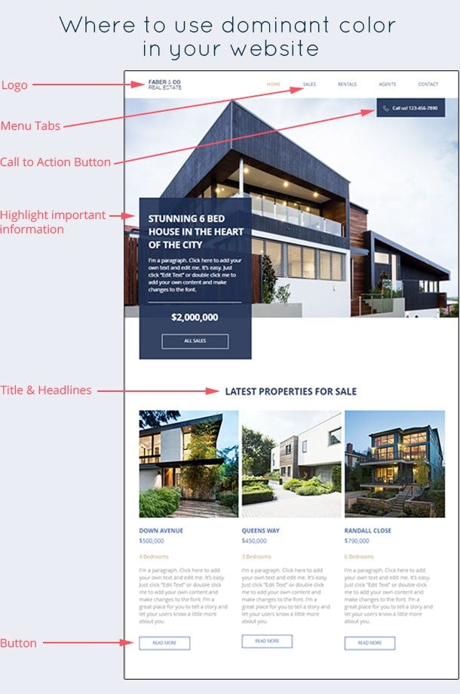
UI/UX Explanation(14)
Primary and Secondary example

Slide 18
Improvement of new Design(UI/UX)
Home Page Header seems the same but need more consideration to be compacted.
Size of buttons are the same and have a characteristic now (FairSharing style)
Home page sections are now separated, white-spaced and legible.
Search box now is the first object taking the user’s attentions. Advanced button has a better position
Slow guns are placed above the search box so the users notice what we are offering ”search and slowgun can have a full screen background-(My offer) ”
Whole content has an exact margin so it has given the layout more consistency and looks finer to users.
Communities is scrollable.
Record facet now is more meaningful and have a good UI/UX
Icons now talks more than texts!
Record table has turned into stack layout which gives more space to fit the content as well as grid

Slide 19
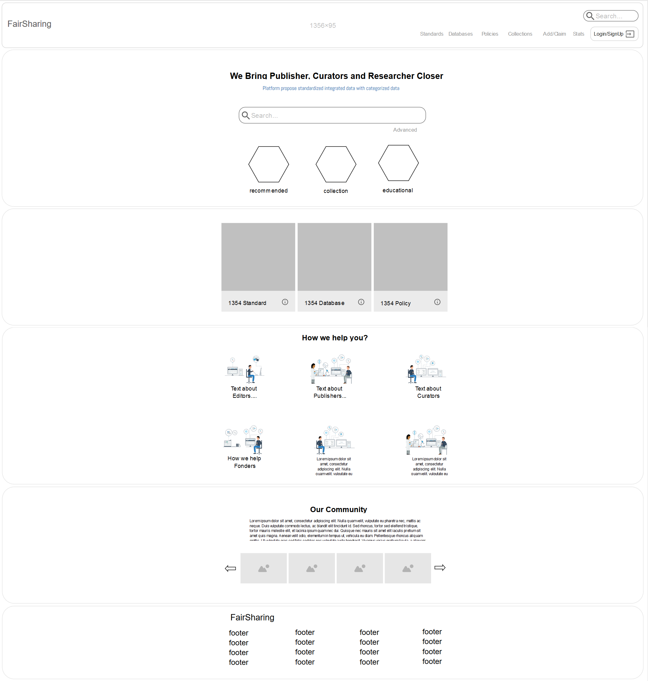
New Design Mock Ups

Slide 20
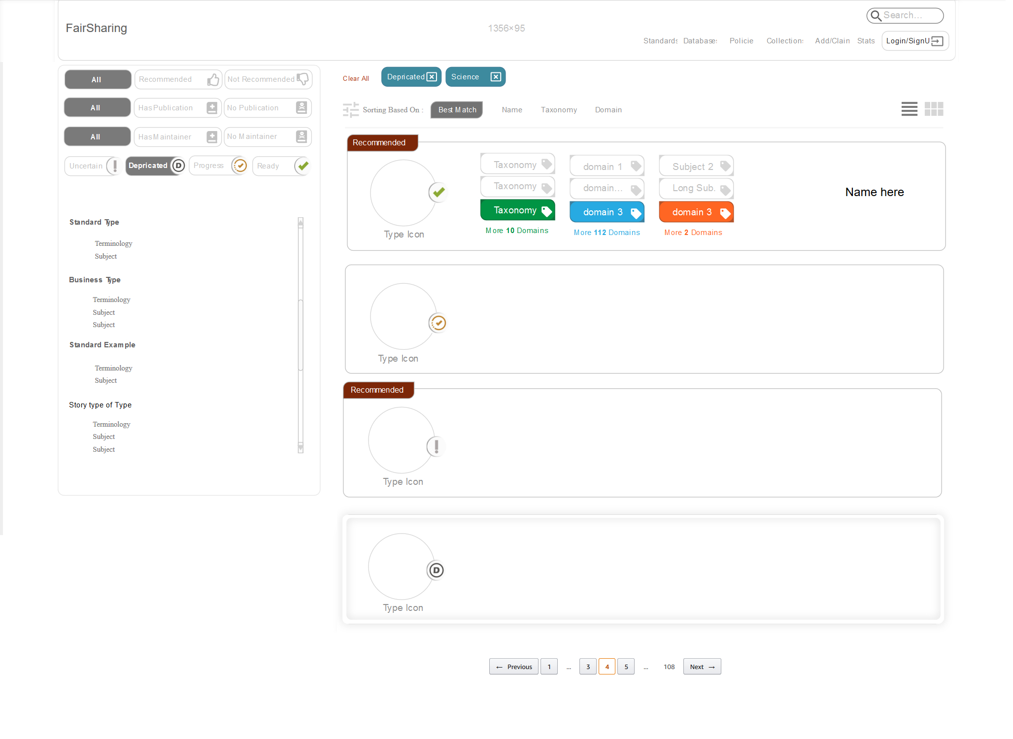

Slide 21
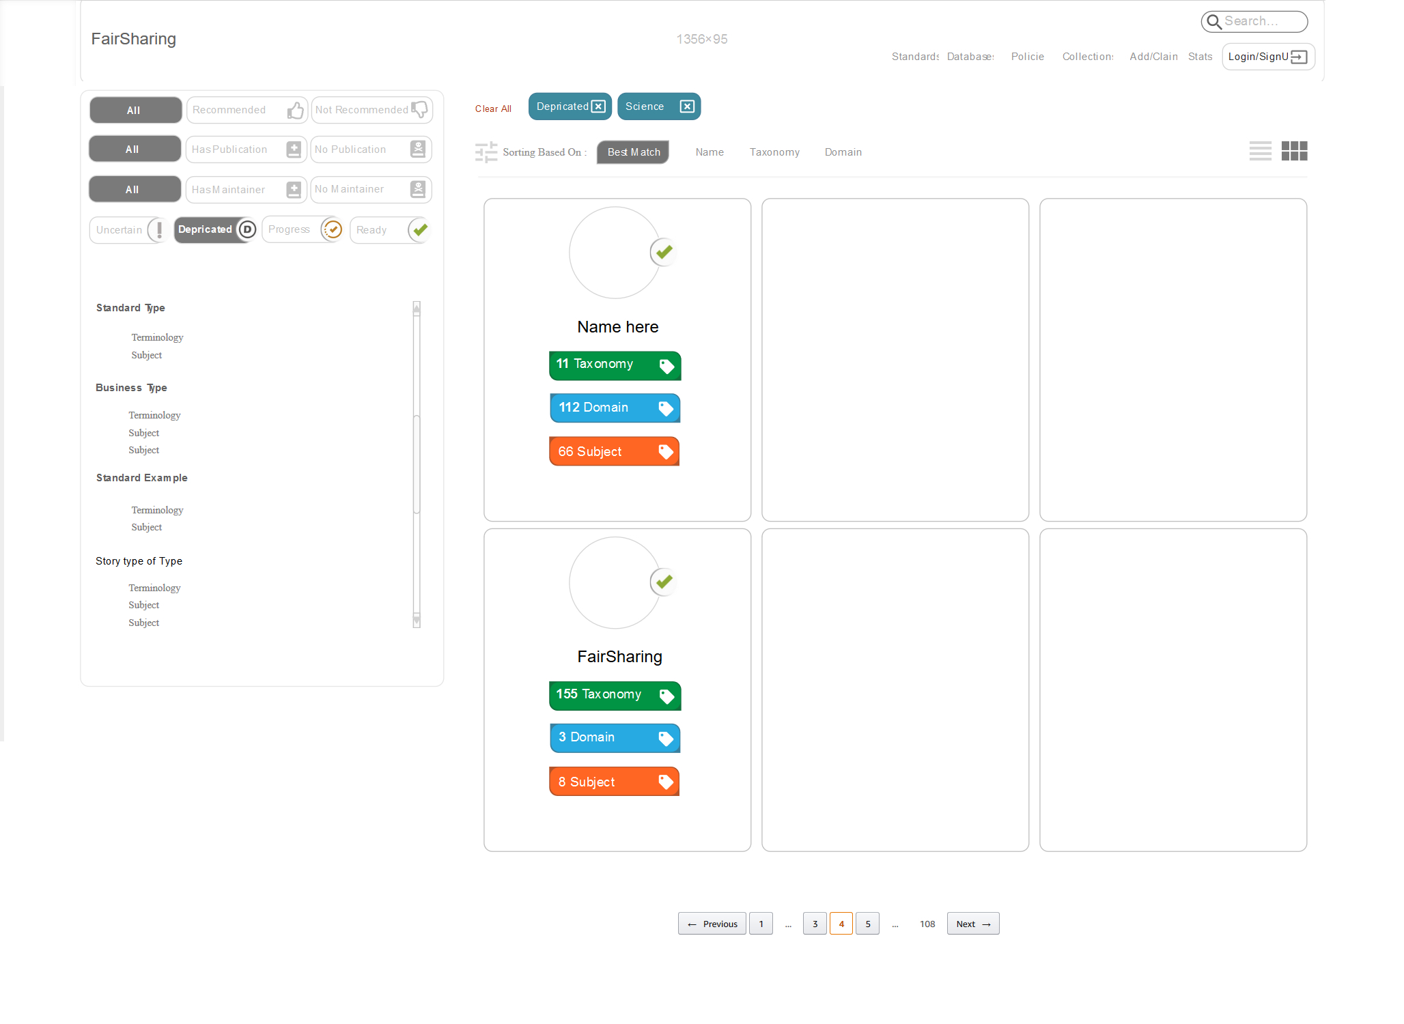

Slide 22
Questions And Answers
Please make a final decision on each part of the current design consulting deeper if its needed with me and others and let me know.
Let me know what is exactly required to be shown in the grid and stack list due to its unclear I believe and needs to be discussed inclusively with Pete to prioritize and put things together in the best way.
How much freedom I have in terms of matching the colour together or adding new colour to the colour pallet?
Any questions?

