Slide 1
Writing Control Structures

Slide 2
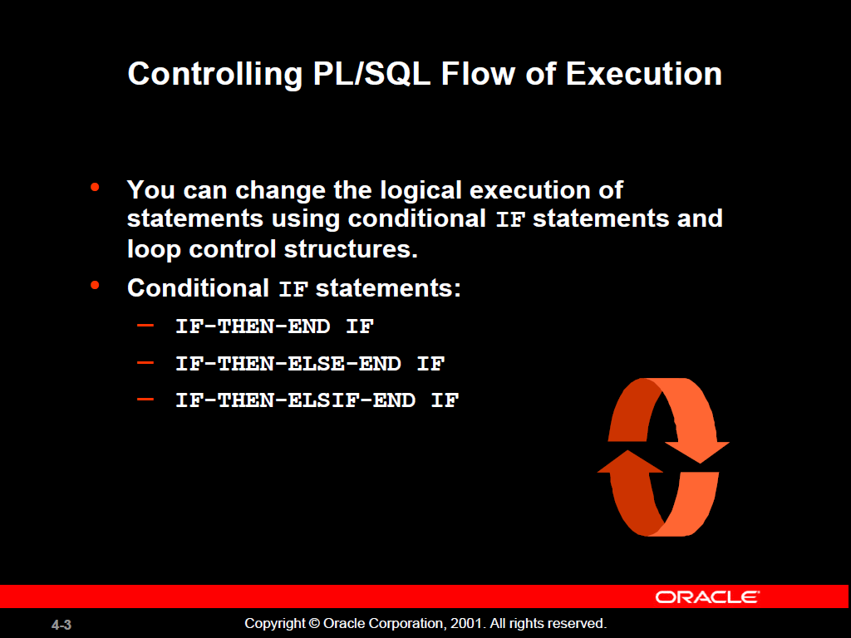

Slide 3
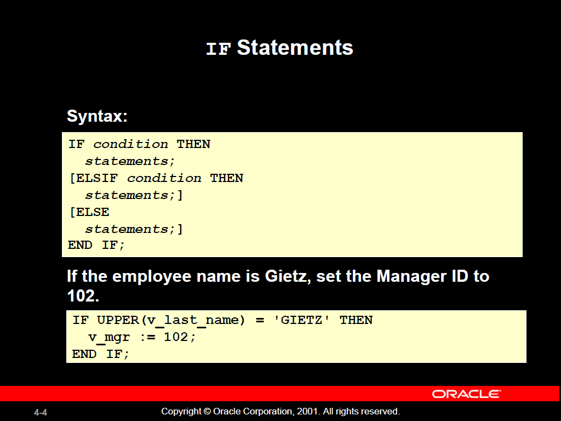

Slide 4
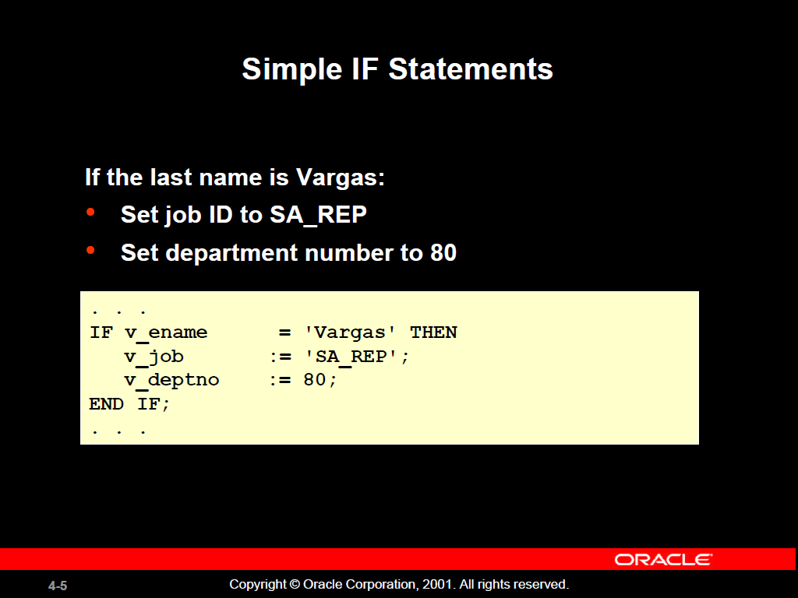

Slide 5
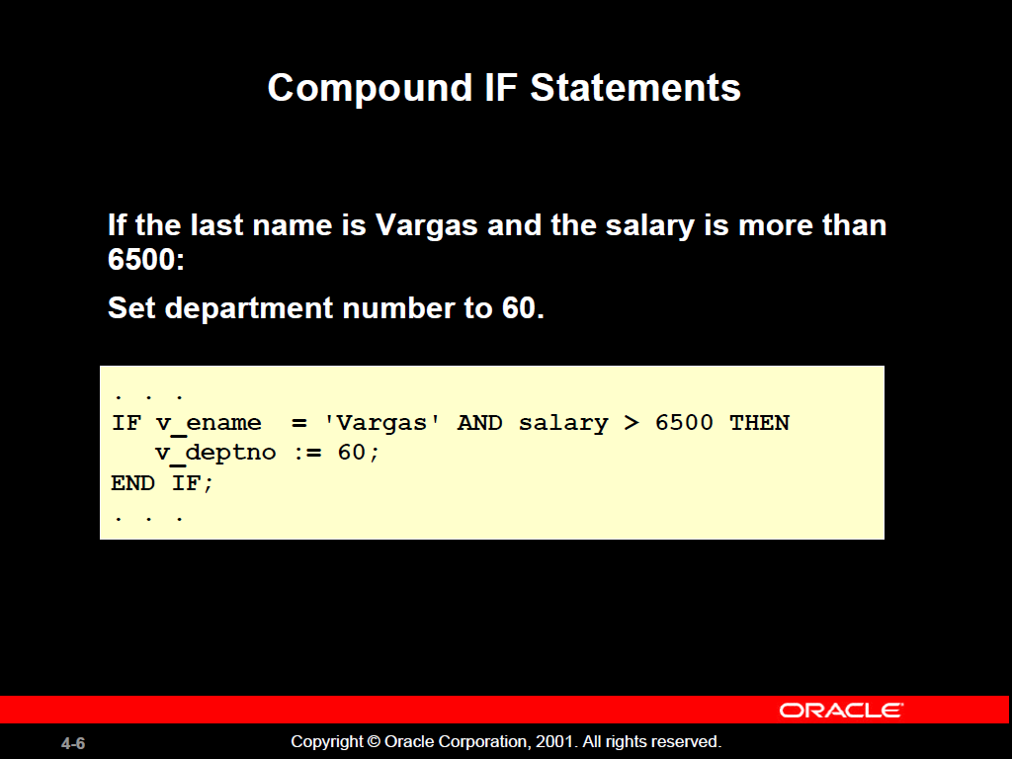

Slide 6
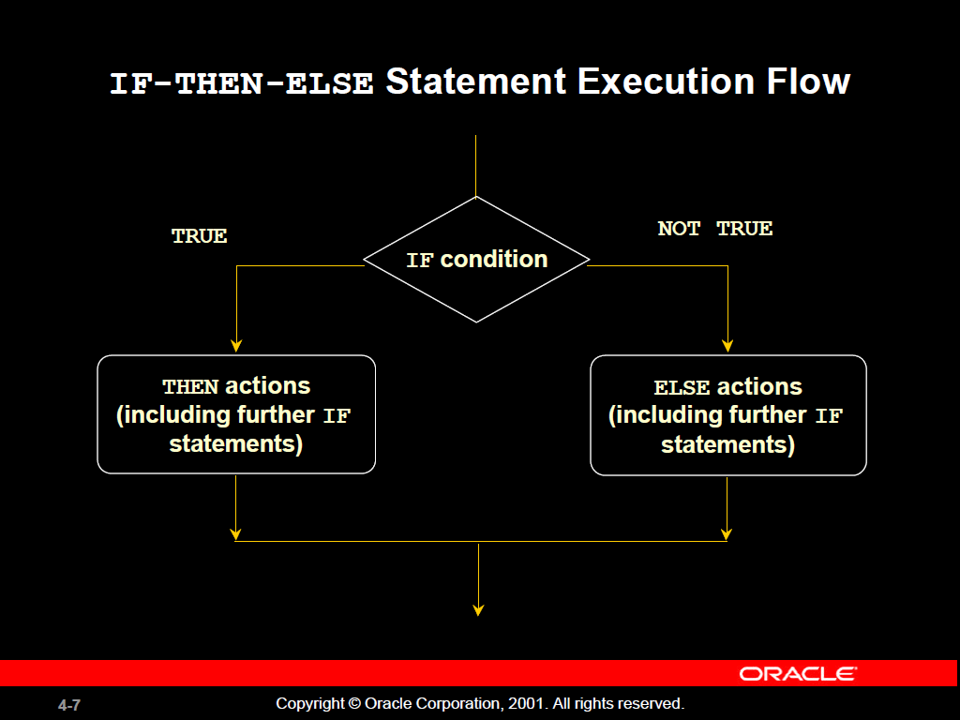

Slide 7
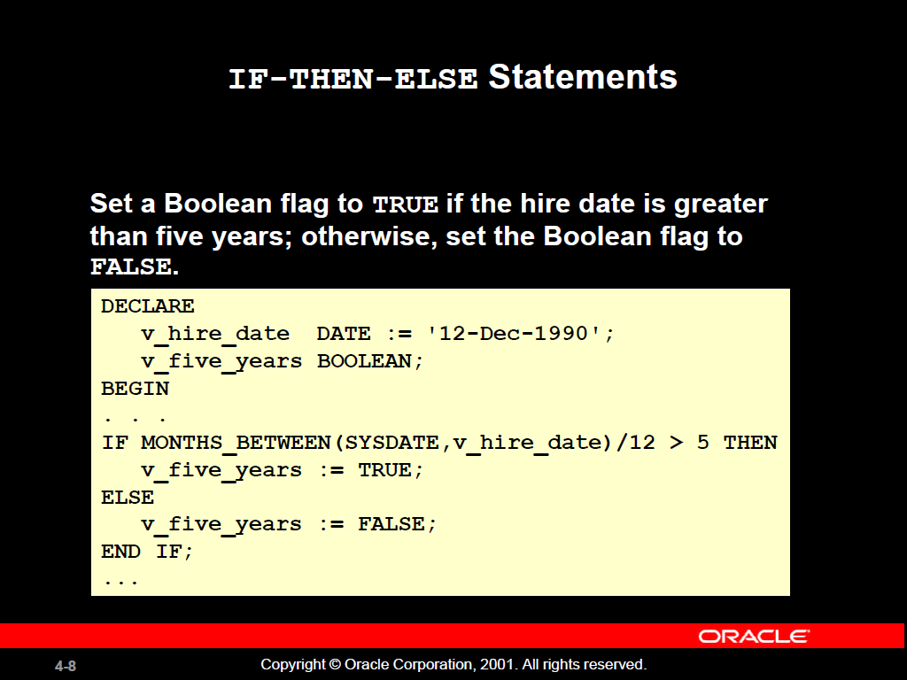

Slide 8
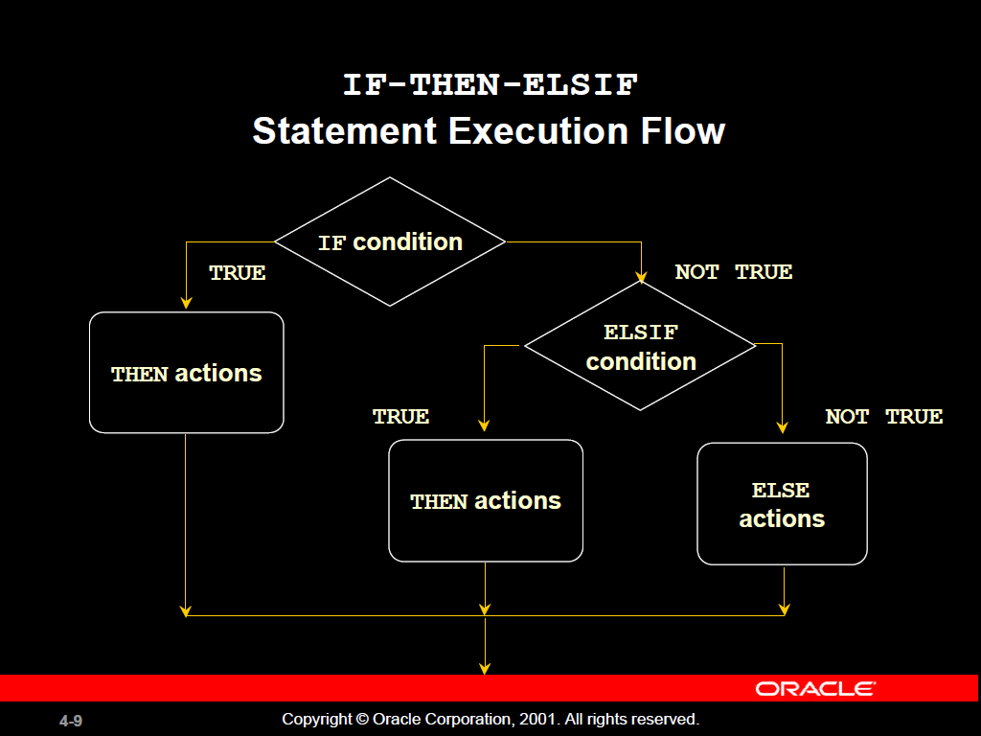

Slide 9
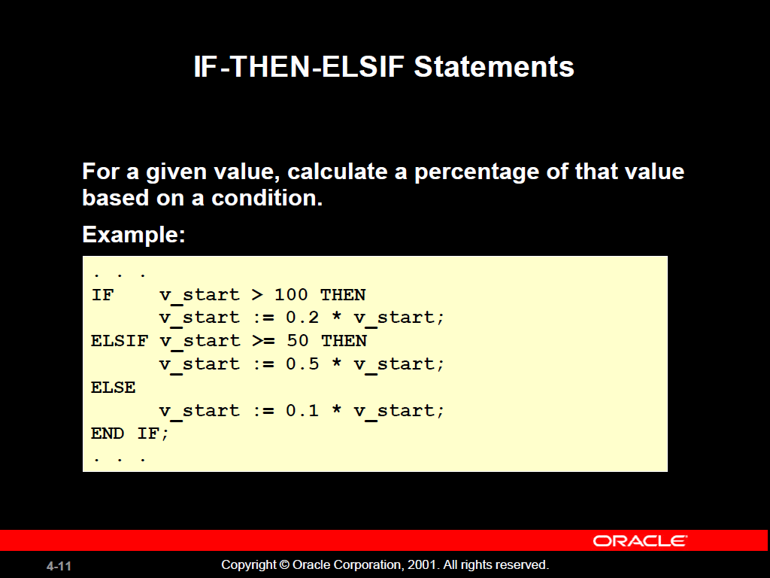

Slide 10
CASE Expressions
A CASE expression selects a result and returns it.
To select the result, the CASE expression uses an expression whose value is used to select one of several alternatives.
CASE selector
    WHEN expression1 THEN result1
    WHEN expression2 THEN result2
    ...
    WHEN expressionN THEN resultN
    [ELSE resultN+1;]
END;

Slide 11
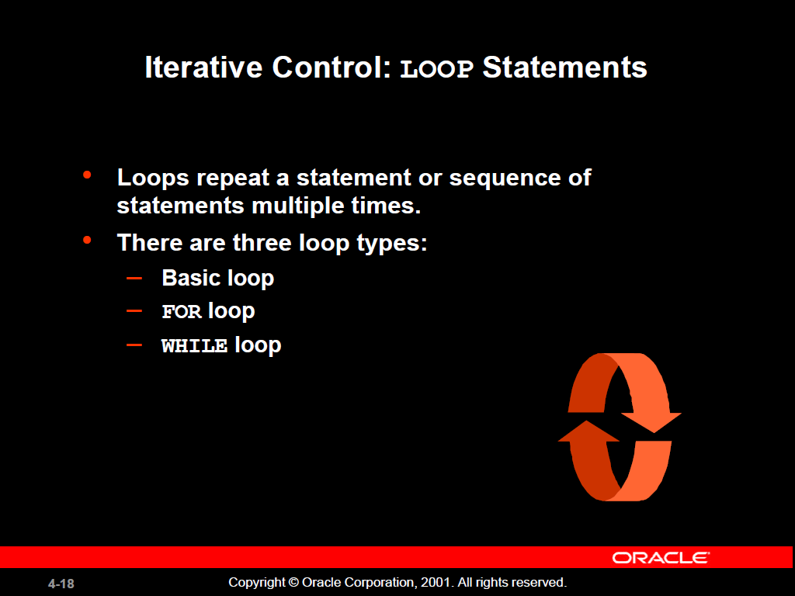

Slide 12
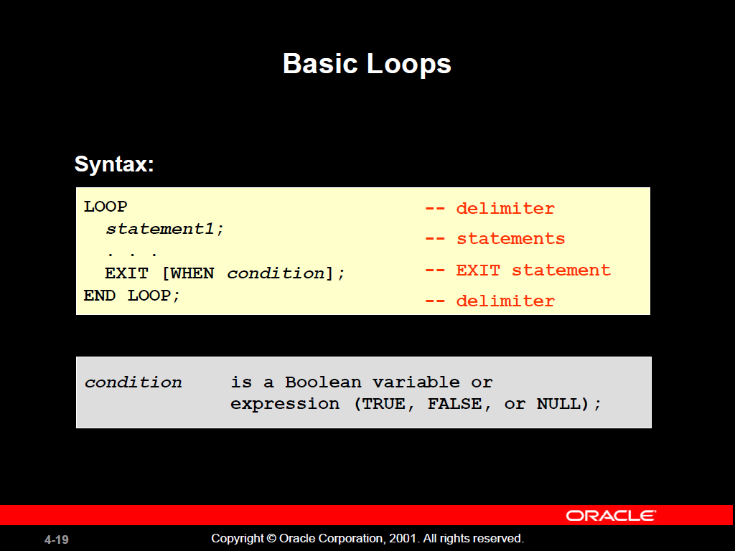

Slide 13
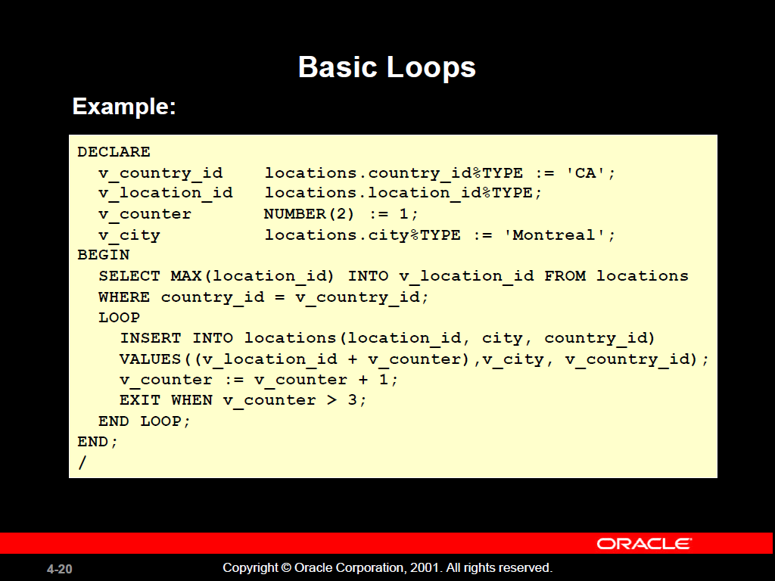

Slide 14
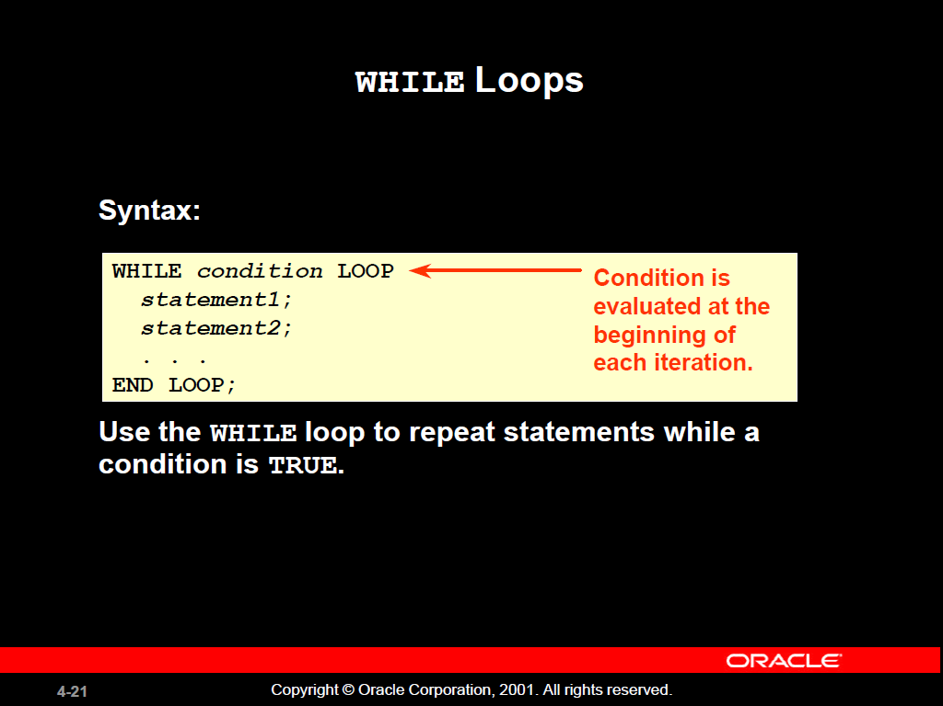

Slide 15
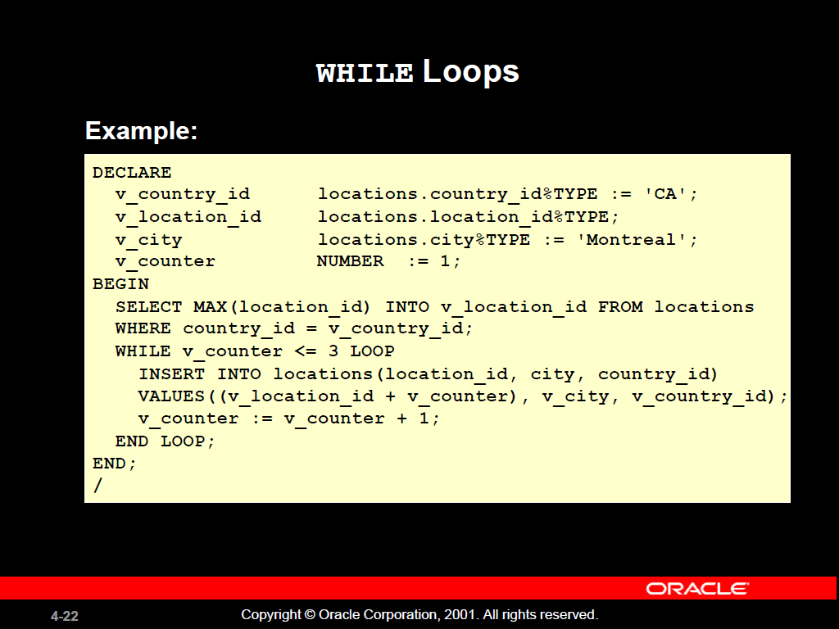

Slide 16
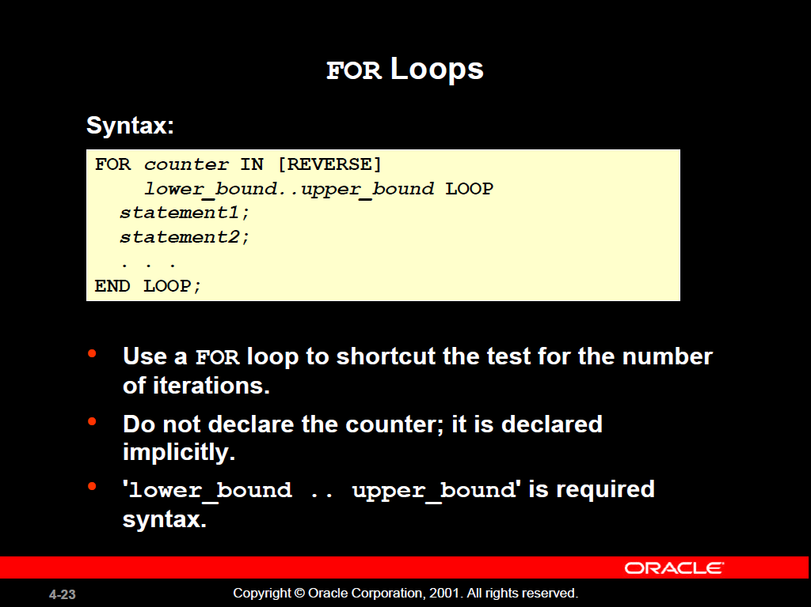

Slide 17
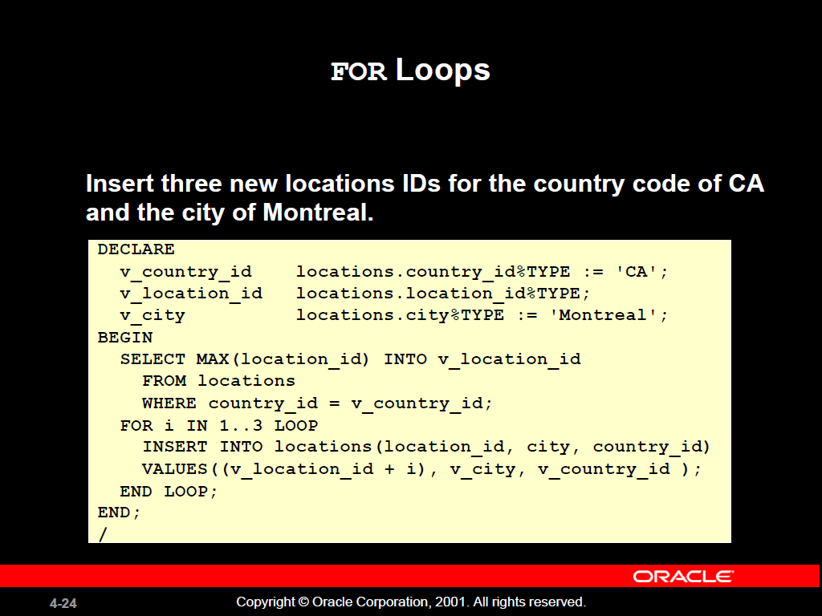

Slide 18
