Slide 1


Slide 2
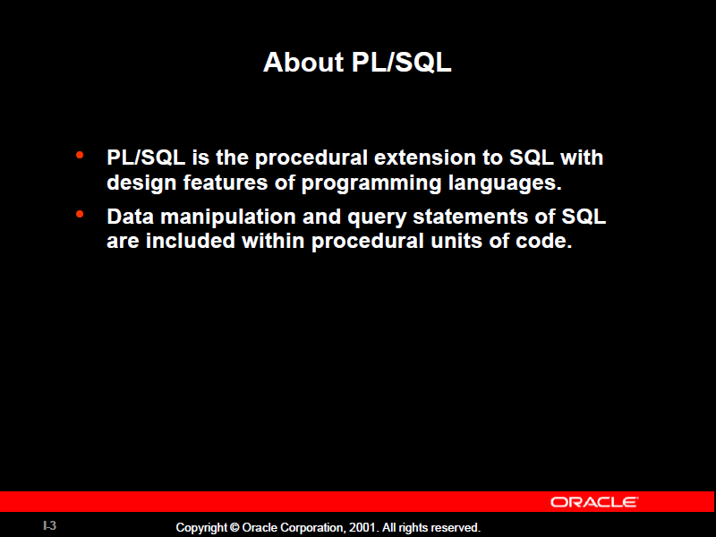

Slide 3
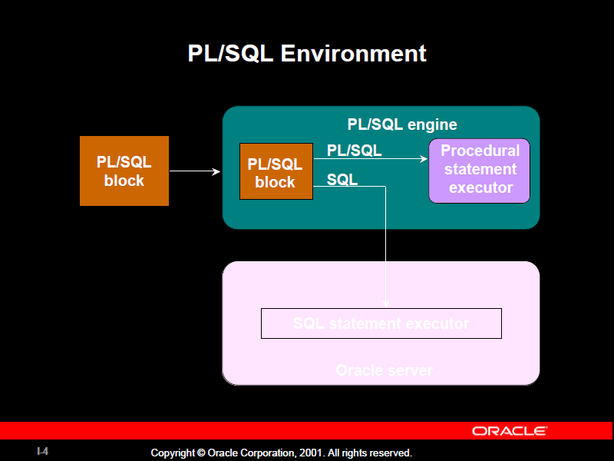

Slide 4
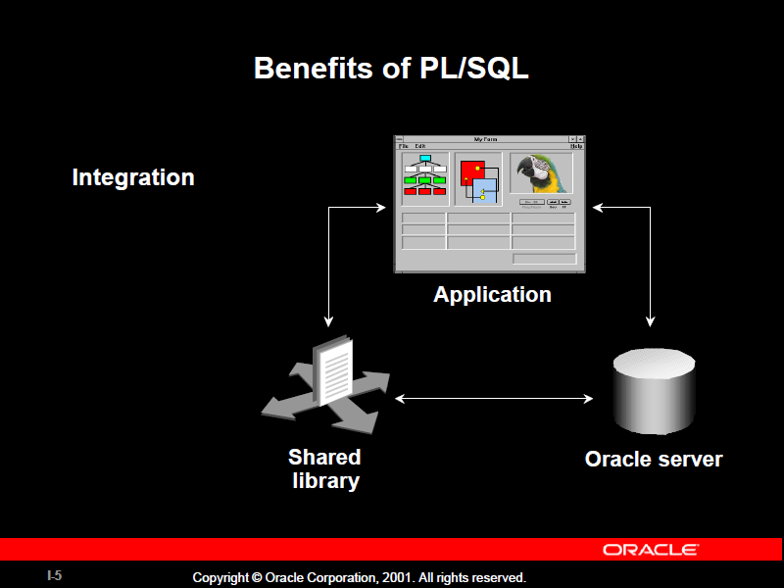

Slide 5
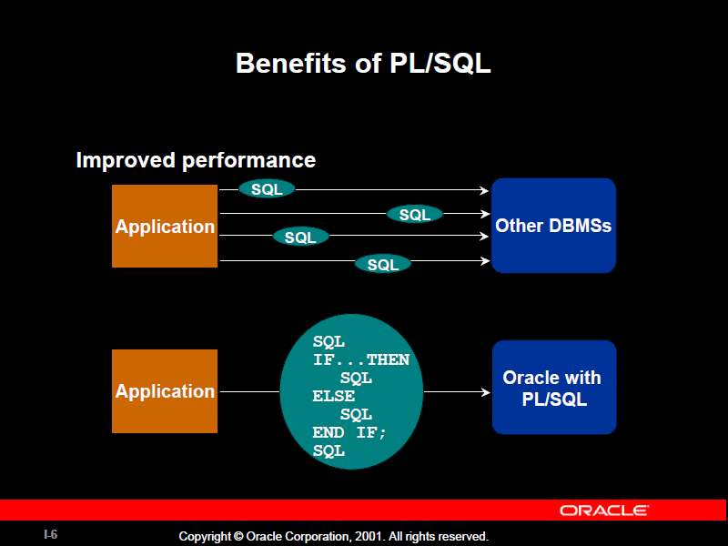

Slide 6
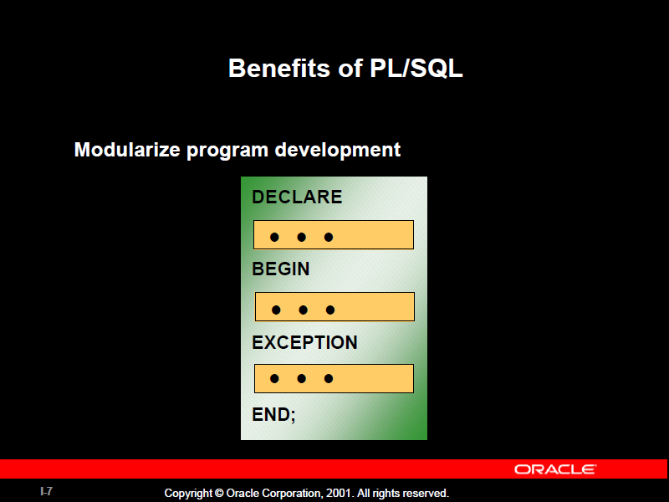

Slide 7
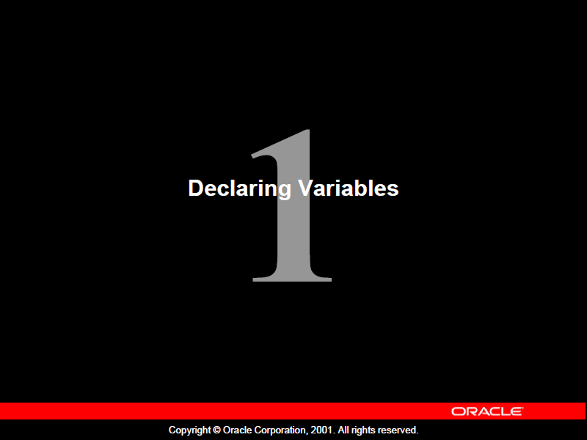

Slide 8
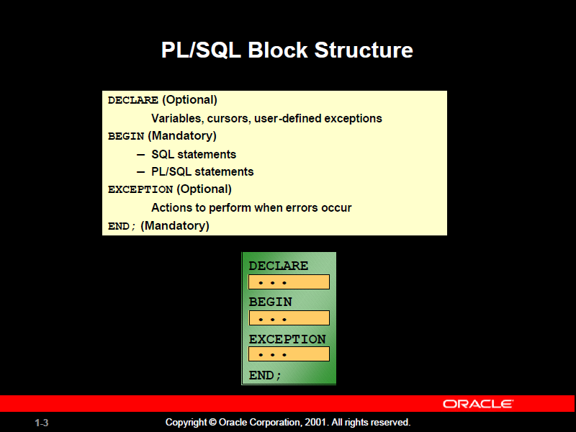

Slide 9
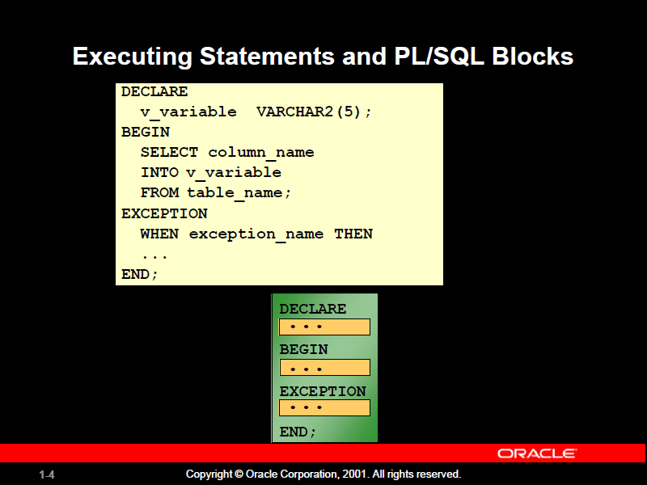

Slide 10
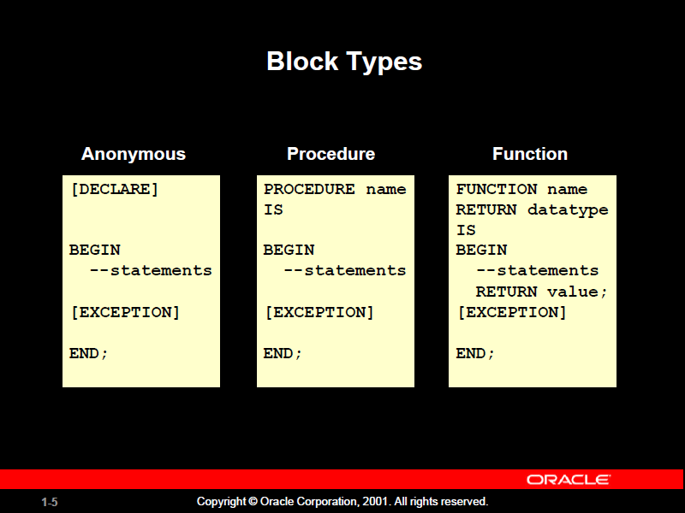

Slide 11
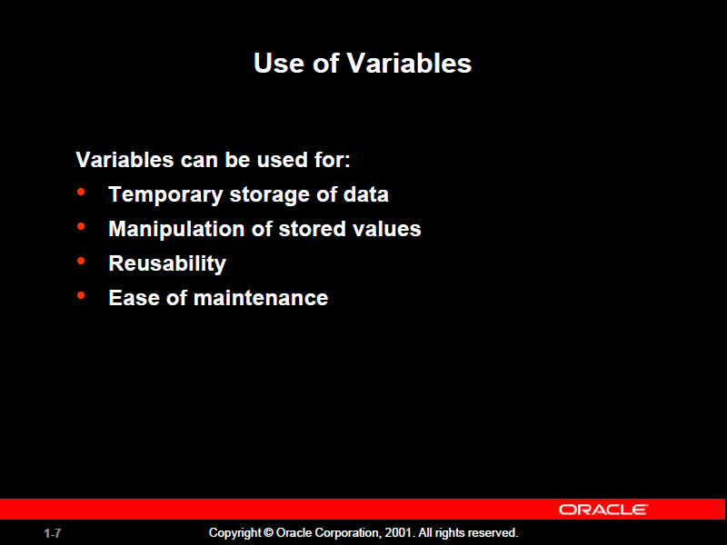

Slide 12
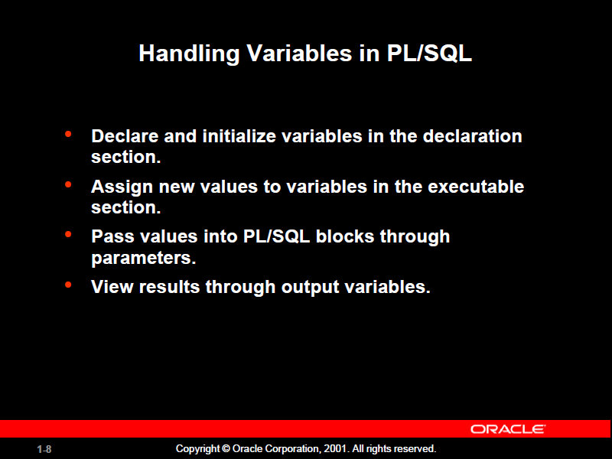

Slide 13
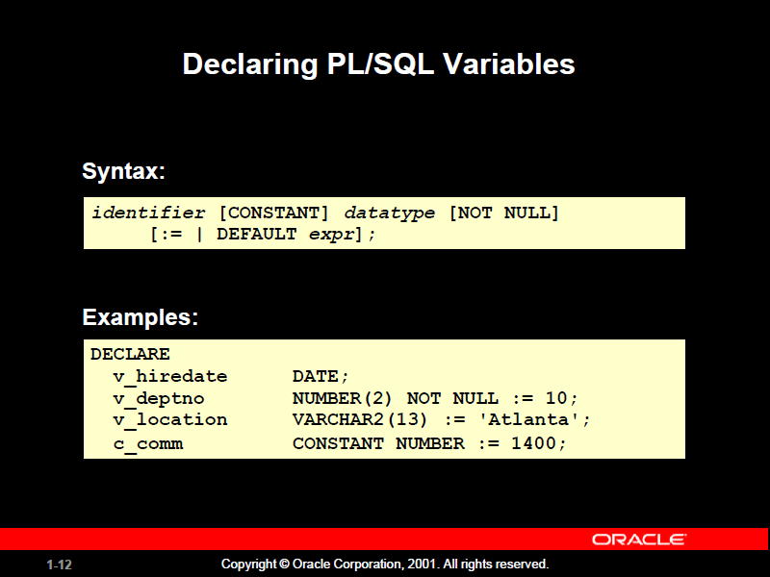
Notes:
Declaring PL/SQL Variables
You must declare all PL/SQL identifiers in the declaration section before referencing them in the PL/SQL block. You have the option to assign an initial value to a variable. You do not need to assign a value to a variable in order to declare it. If you refer to other variables in a declaration, you must be
sure to declare them separately in a previous statement.
In the syntax:
identifier is the name of the variable.
CONSTANT constrains the variable so that its value cannot change; constants must be initialized.
data type is a scalar, composite, reference, or LOB data type. (This course covers only scalar, composite, and LOB data types.)
NOT NULL constrains the variable so that it must contain a value. (NOT NULL variables must be initialized.)
expr is any PL/SQL expression that can be a literal expression, another variable, or an expression involving operators and functions.

Slide 14
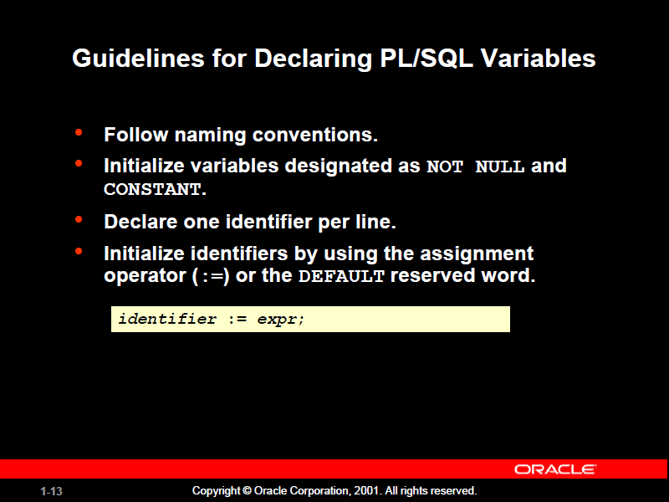

Slide 15
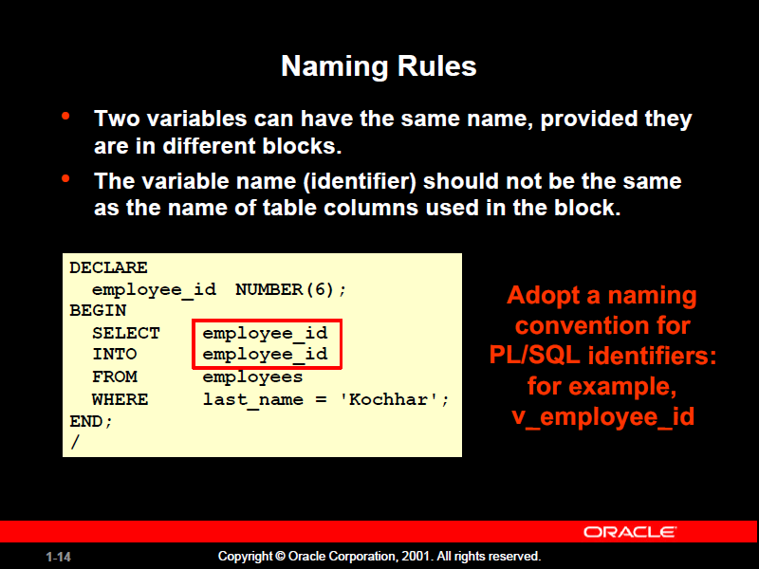

Slide 16
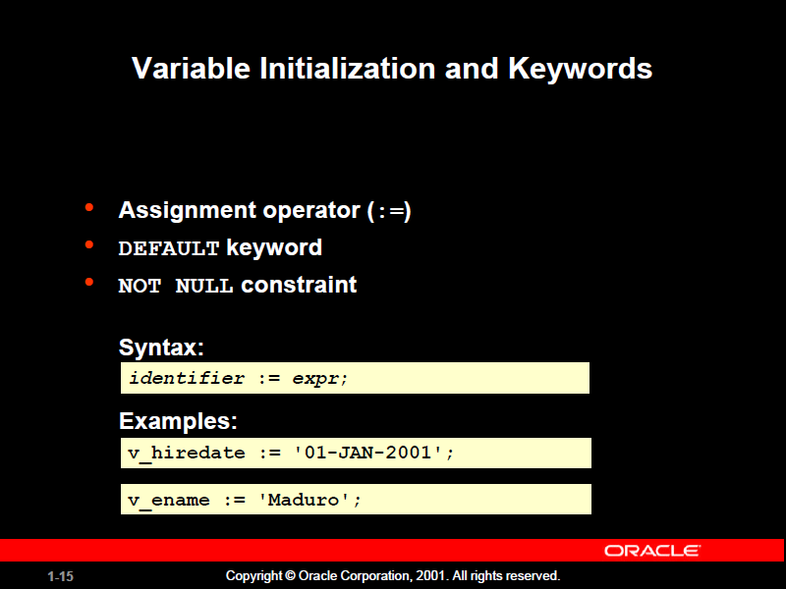

Slide 17
QUESTION
Write a query that computes a 10% bonus for the employee with the EMPLOYEE_ID 176 and assigns the computed value to the v_bonus variable.

Slide 18
Solution
DECLARE
v_bonus NUMBER(8,2);
BEGIN
SELECT salary * 0.10
INTO v_bonus
FROM employees
WHERE employee_id = 176;
END;

Slide 19
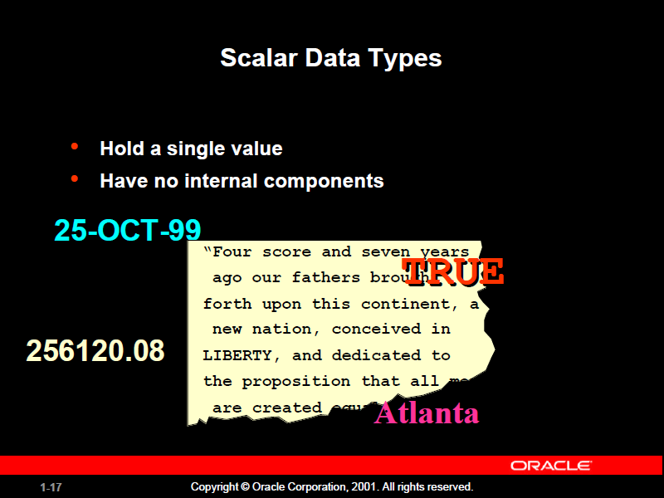

Slide 20
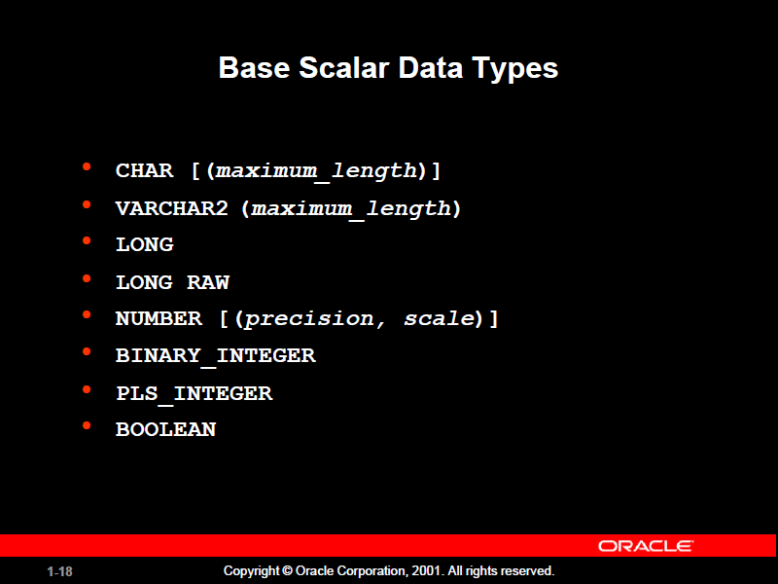

Slide 21
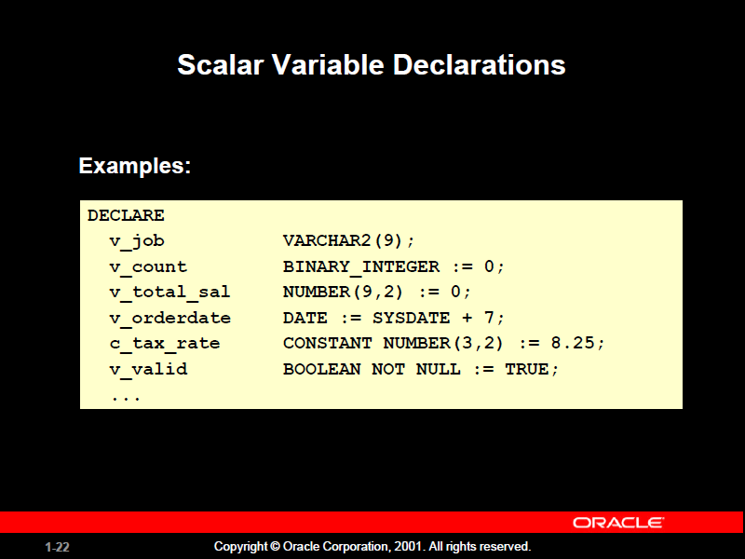

Slide 22
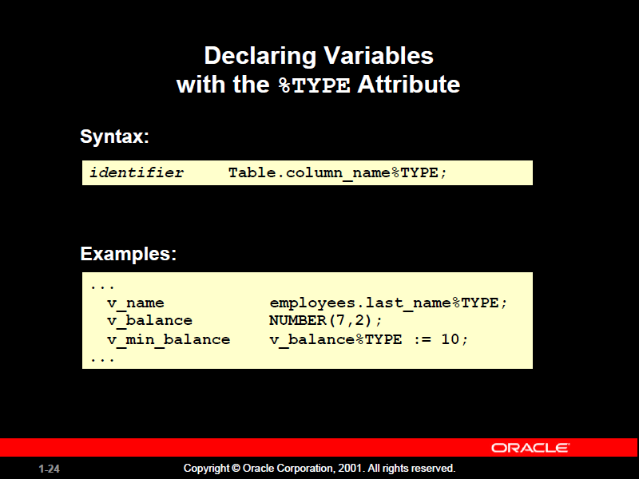

Slide 23
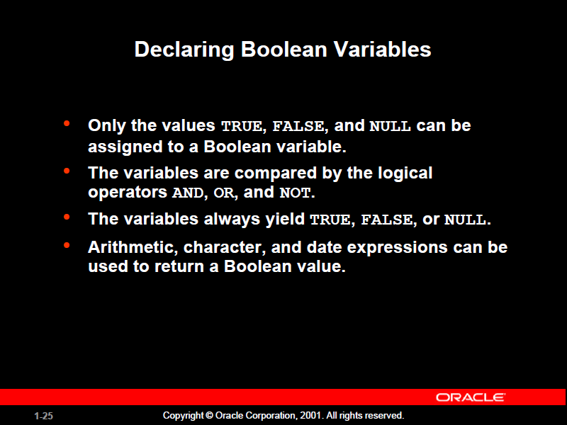

Slide 24
Examples
  v_sal1 := 50000;
  v_sal2 := 60000;
The following expression yields TRUE:
  v_sal1 < v_sal2
Declare and initialize a Boolean variable:
DECLARE
  v_flag BOOLEAN := FALSE;
BEGIN
  v_flag := TRUE;
END;

Slide 25
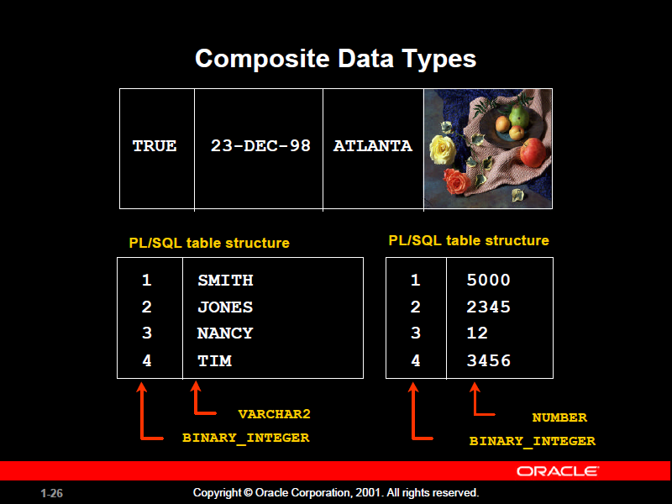

Slide 26
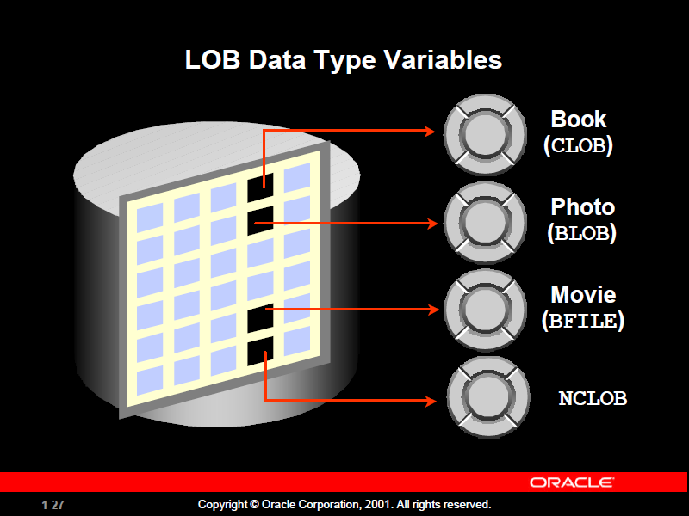

Slide 27
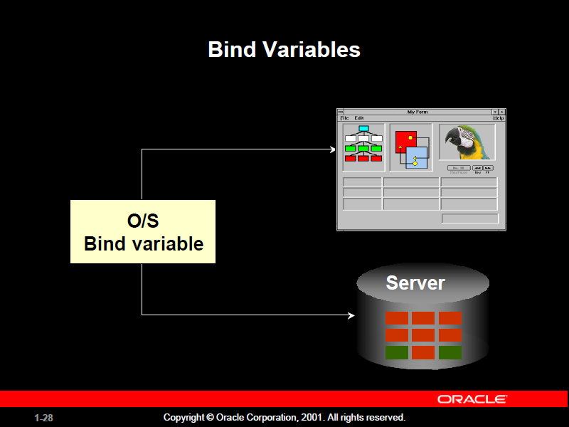
Notes:
Bind Variables
A bind variable is a variable that you declare in a host environment. Bind variables can be used to pass run-time values, either number or character, into or out of one or more PL/SQL programs. The PL/SQL programs use bind variables as they would use any other variable. You can reference
variables declared in the host or calling environment in PL/SQL statements, unless the statement is in a procedure, function, or package. This includes host language variables declared in precompiler programs, screen fields in Oracle Developer Forms applications, and iSQL*Plus bind variables.

Slide 28
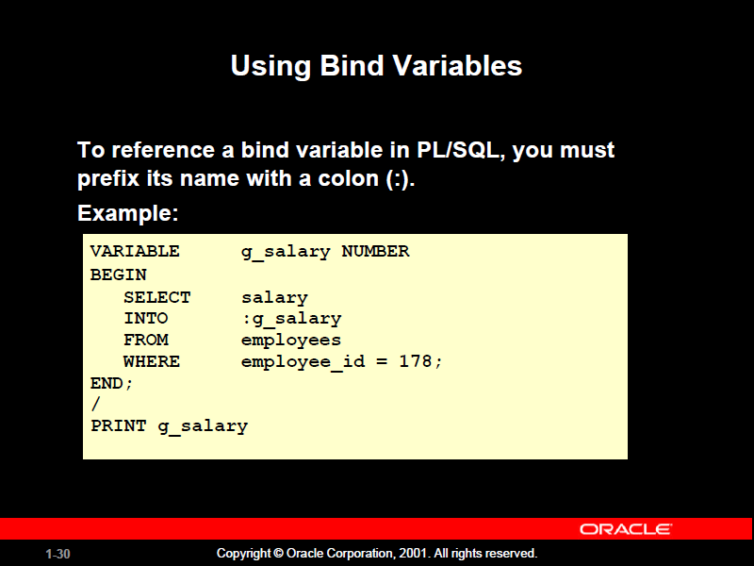

Slide 29
Example for Displaying Bind Variables
VARIABLE RESULT NUMBER
BEGIN
SELECT (SALARY*12) + NVL(COMMISSION_PCT,0) INTO :RESULT
FROM employees WHERE employee_id = 144;
END;
/
PRINT RESULT

Slide 30
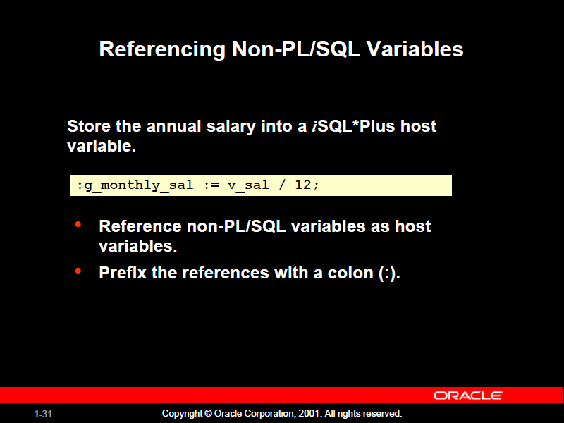

Slide 31
Question
Write a query that computes the monthly salary, based upon the annual salary supplied by the user. This script contains both iSQL*Plus commands as well as a complete PL/SQL block.

Slide 32
Solution
VARIABLE g_monthly_sal NUMBER
DEFINE p_annual_sal = 50000
SET VERIFY OFF
DECLARE
  v_sal NUMBER(9,2) := &p_annual_sal;
BEGIN
  :g_monthly_sal := v_sal/12;
END;
/
PRINT g_monthly_sal

Slide 33
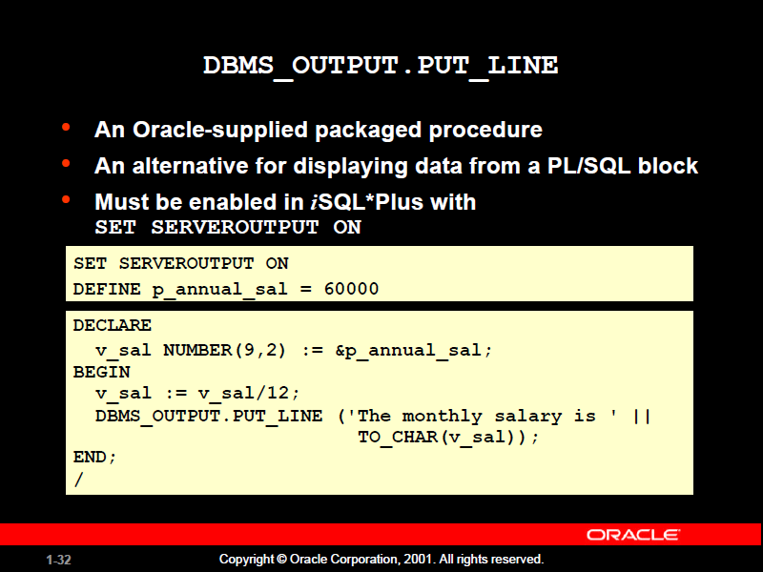

Slide 34
CHAPTER 2

Slide 35
WRITING EXECUTABLE STATEMENTS

Slide 36
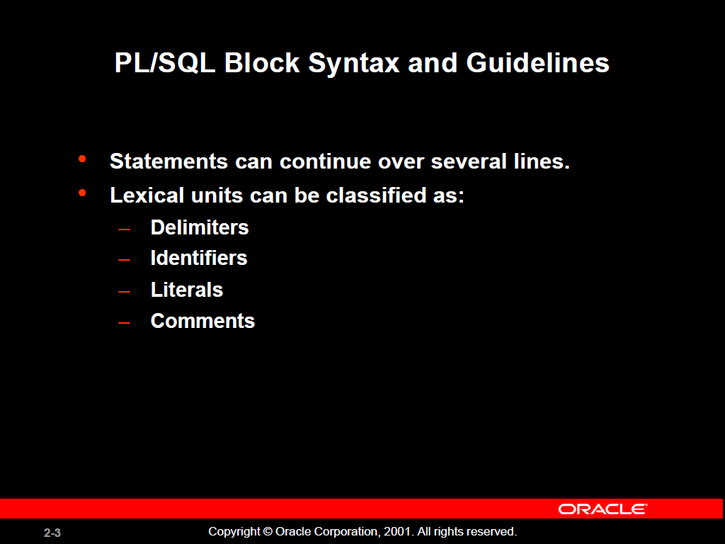

Slide 37
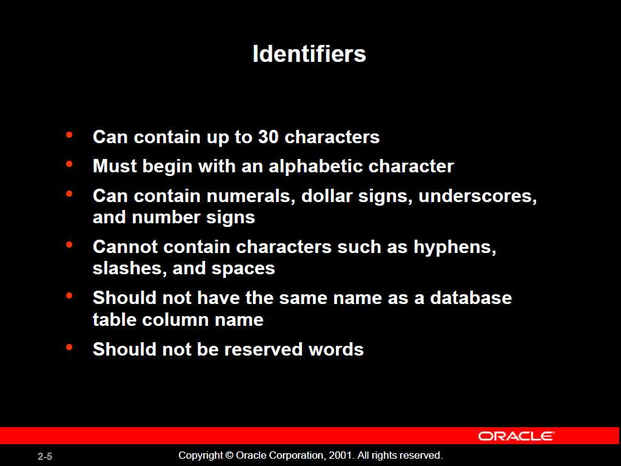

Slide 38
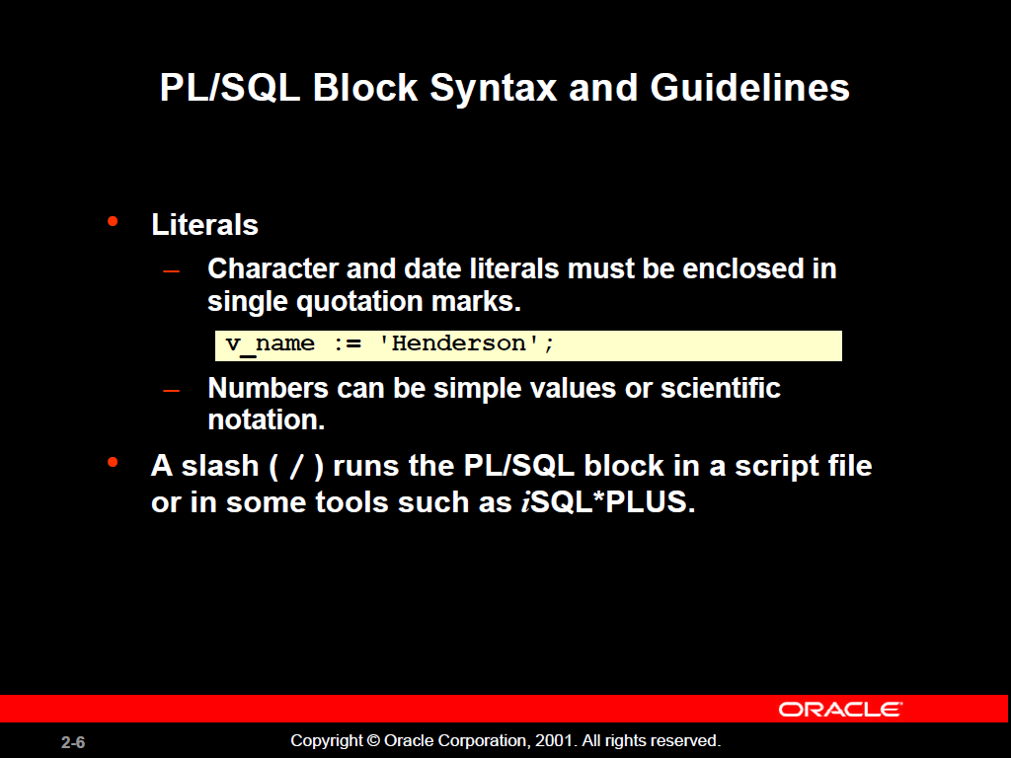

Slide 39
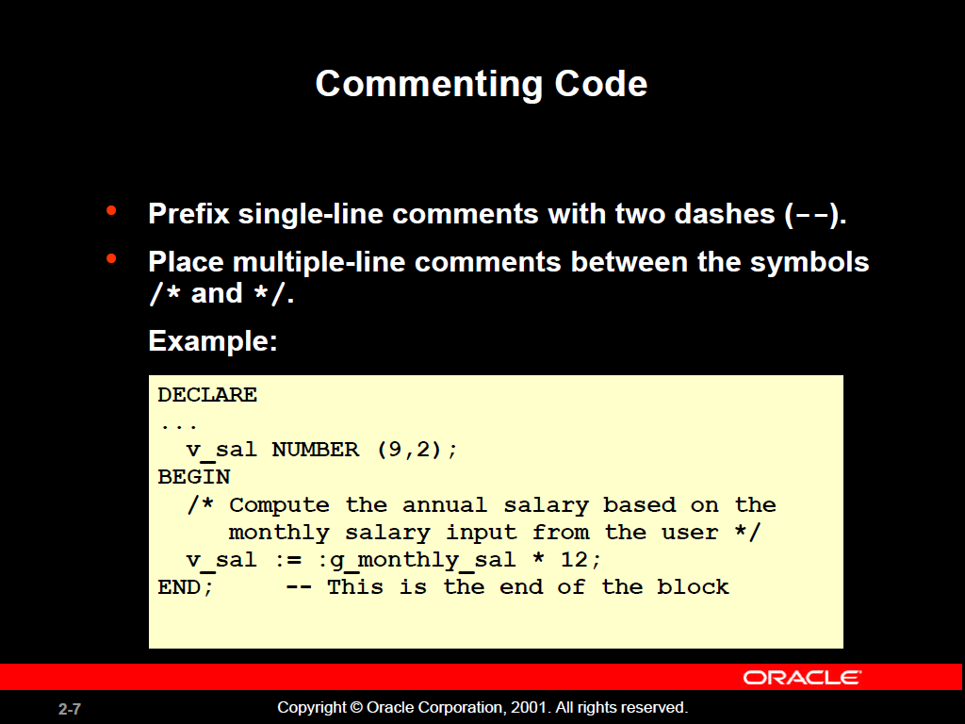

Slide 40
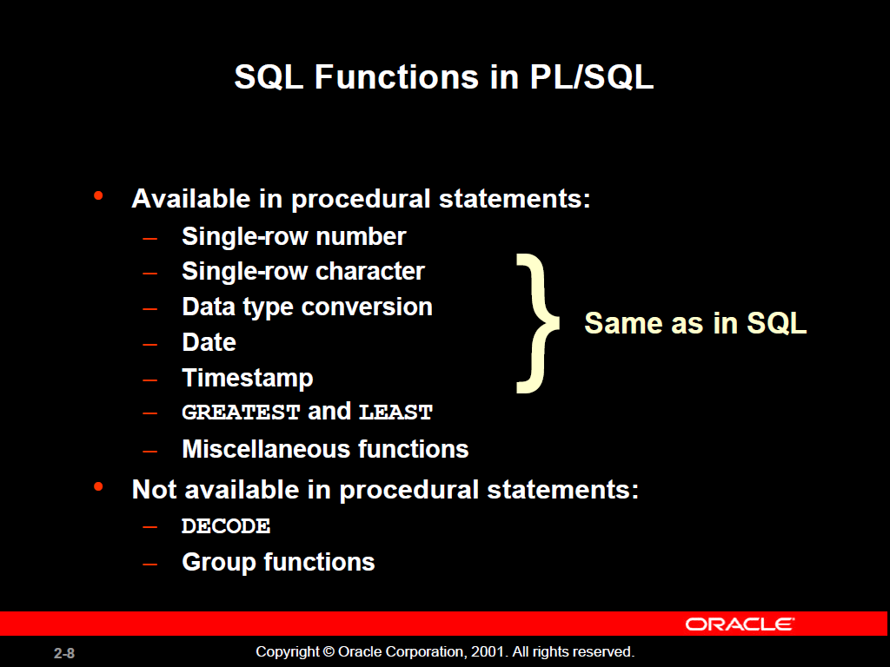

Slide 41
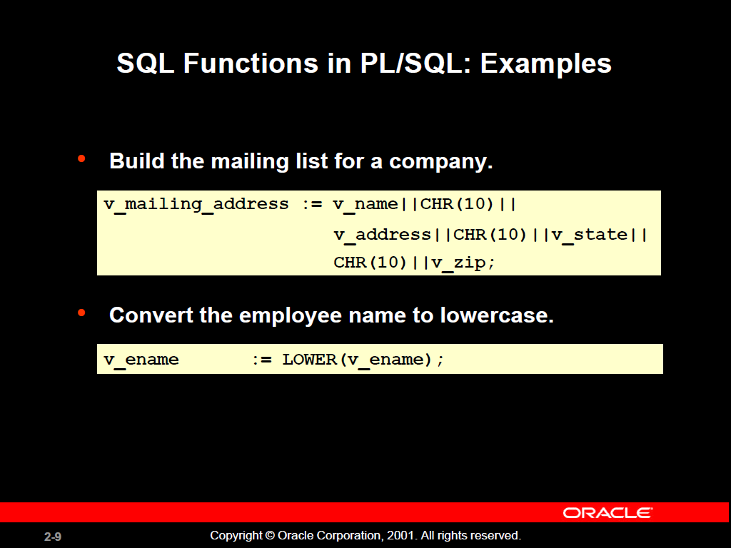

Slide 42
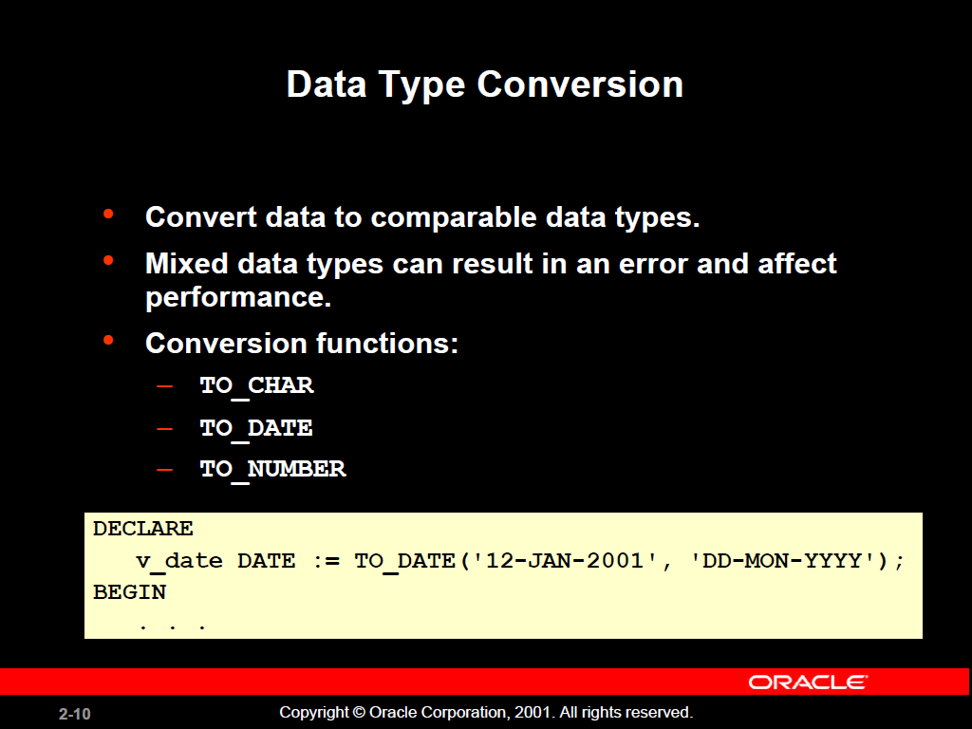

Slide 43
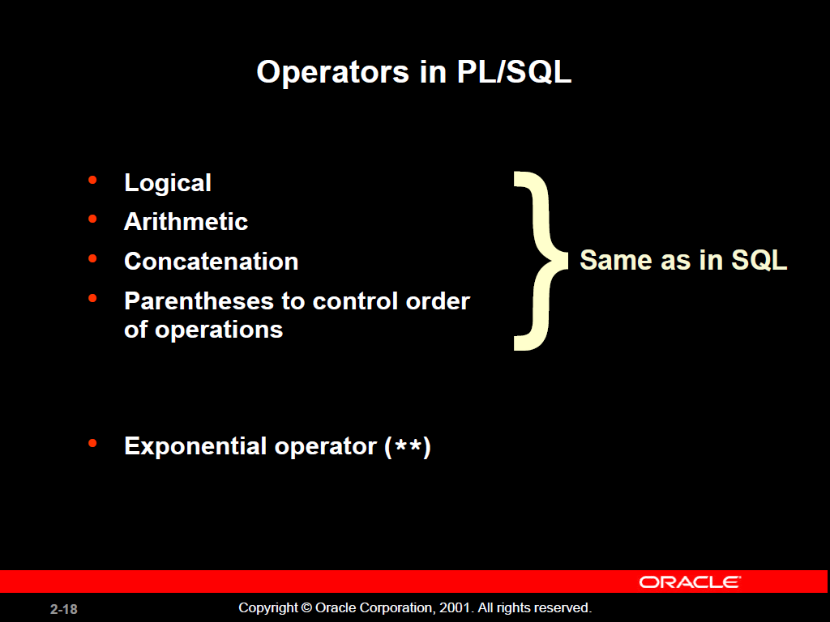

Slide 44
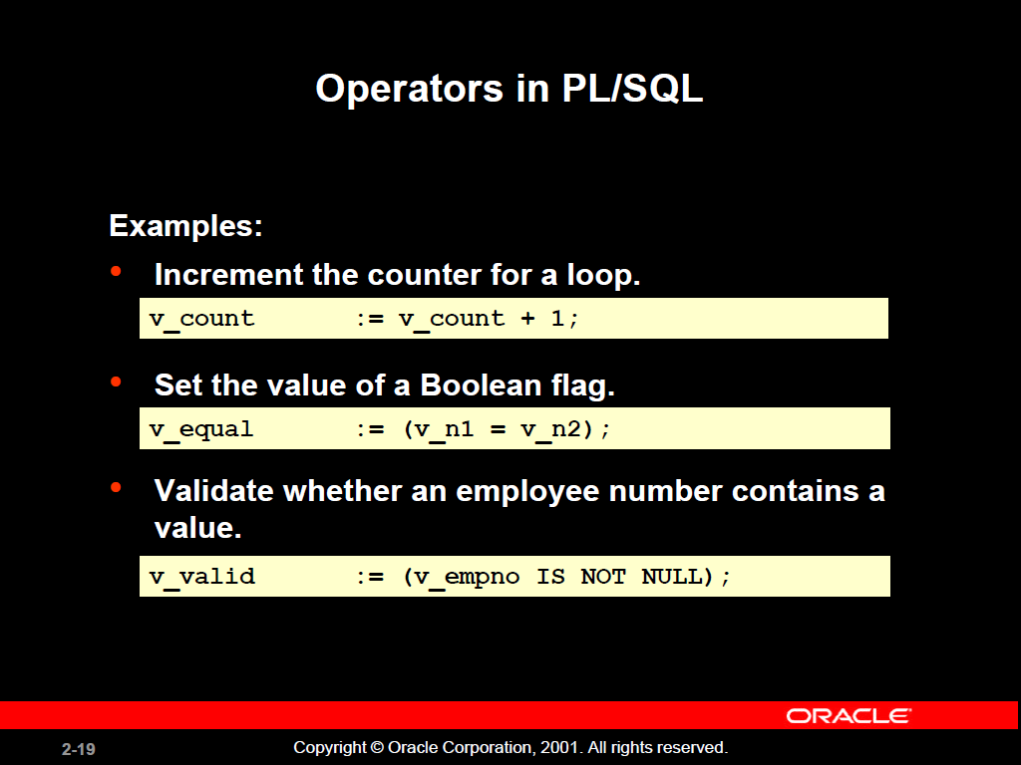

Slide 45
SQL Statements in PL/SQL
Extract a row of data from the database by using
the SELECT command.
Make changes to rows in the database by using
DML commands.
Control a transaction with the COMMIT, ROLLBACK,
or SAVEPOINT command.
Determine DML outcome with implicit cursor attributes.

Slide 46
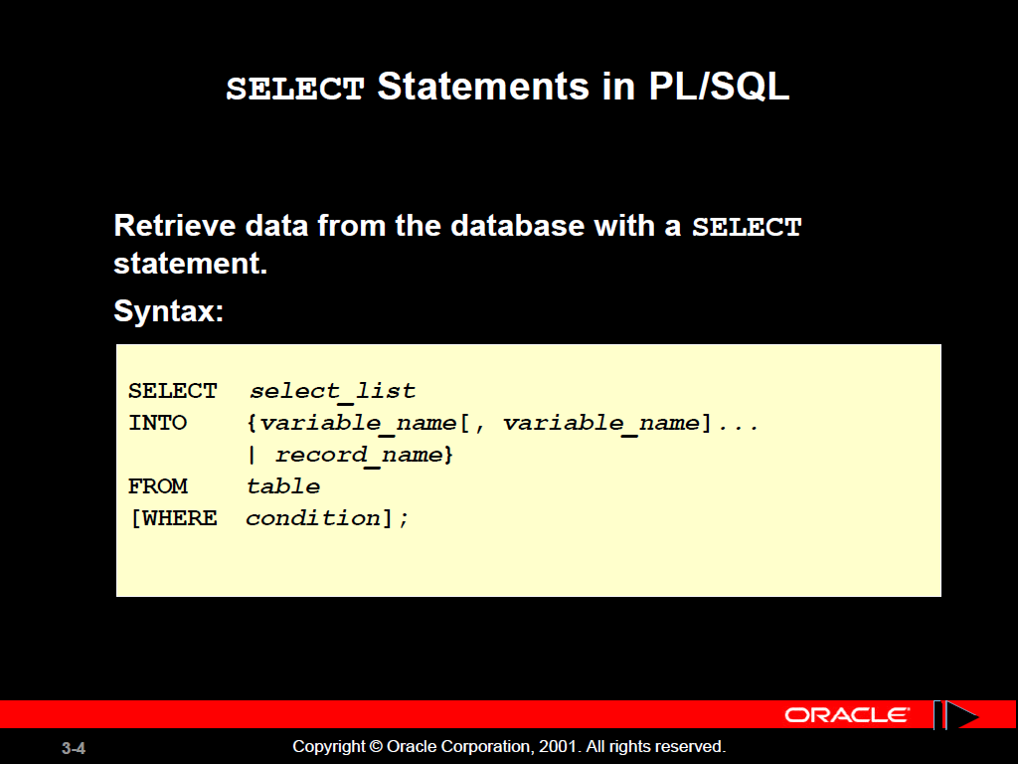

Slide 47
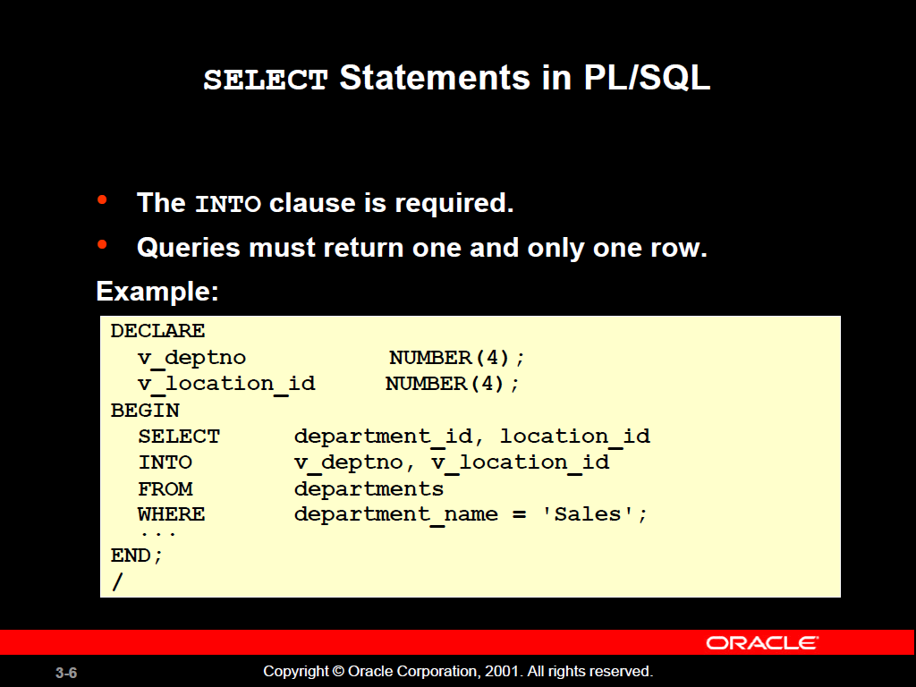

Slide 48
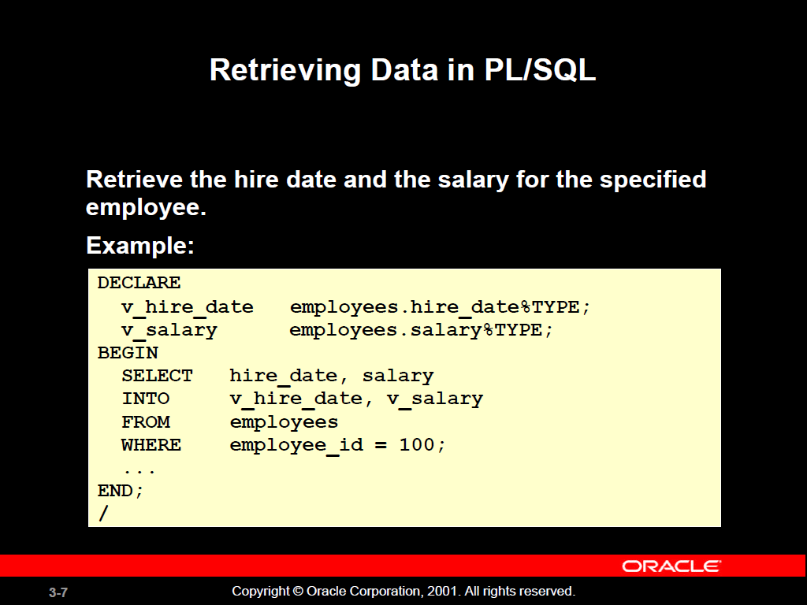

Slide 49
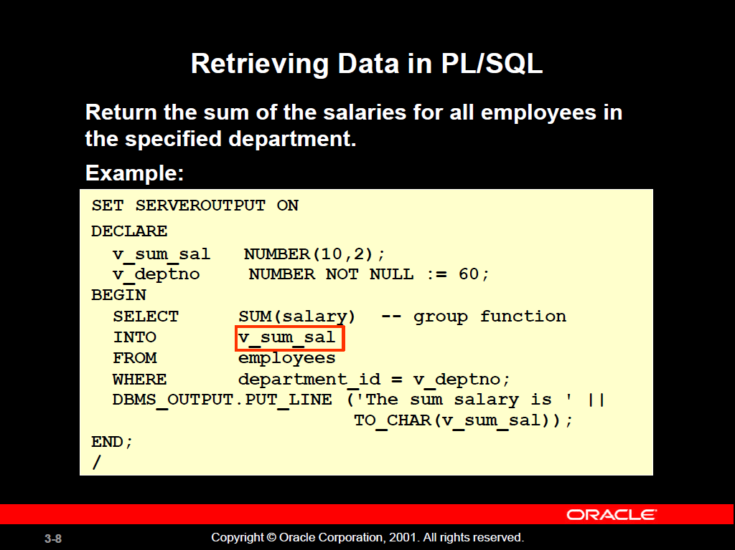

Slide 50
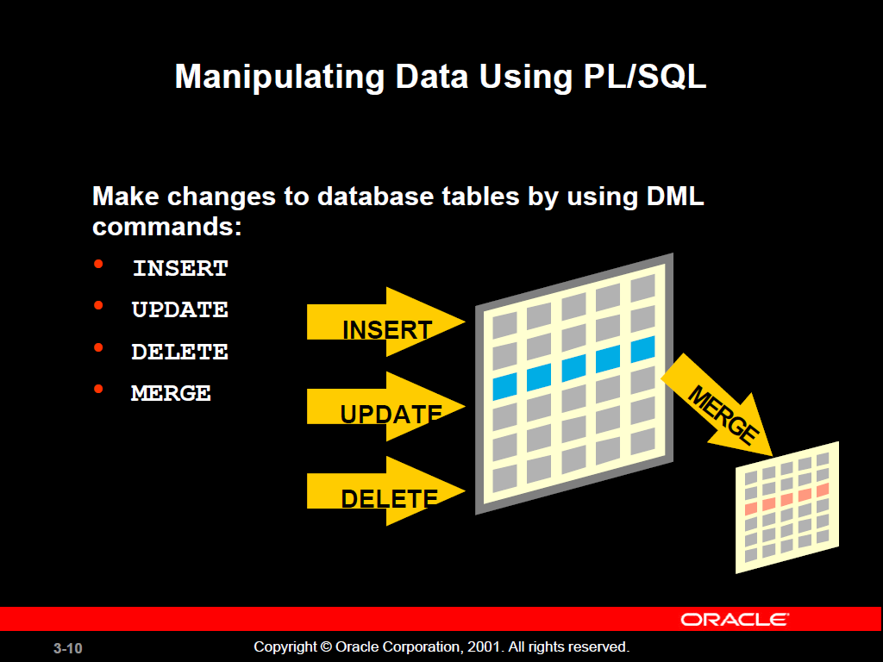

Slide 51
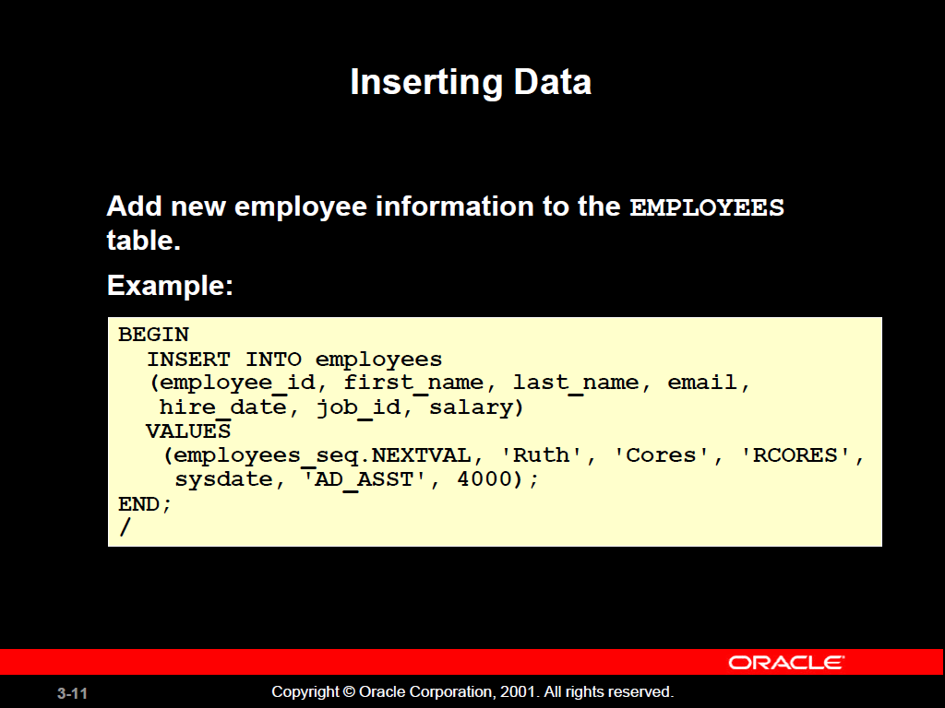

Slide 52
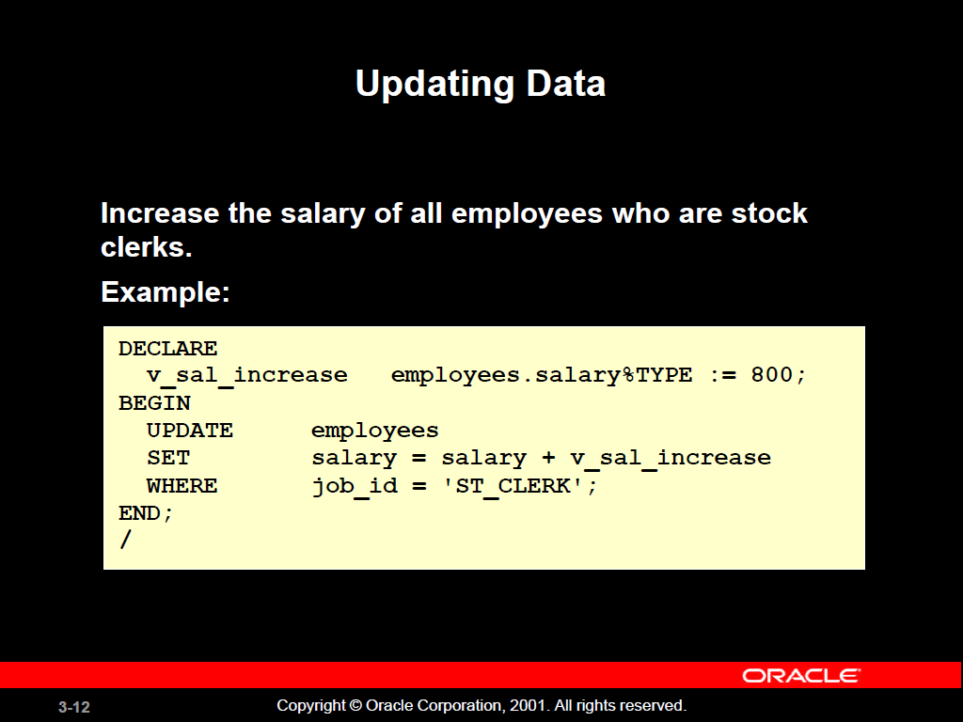

Slide 53
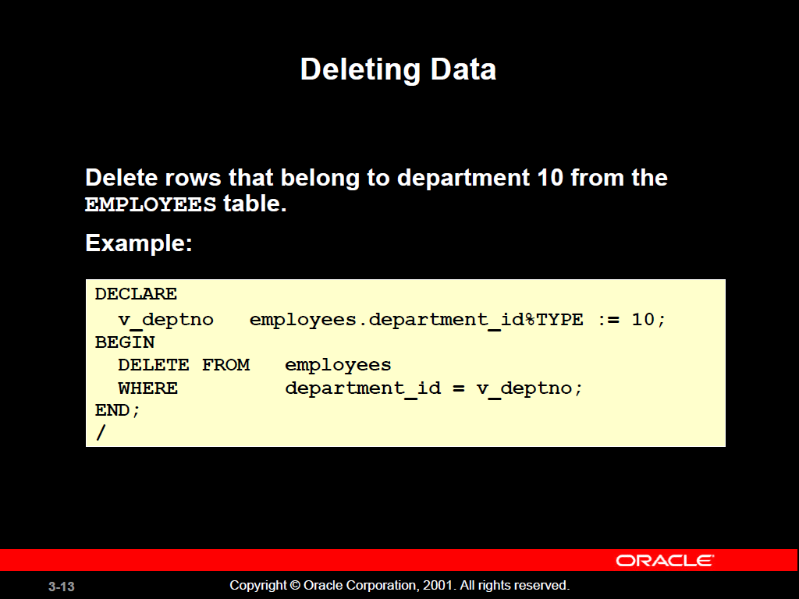

Slide 54
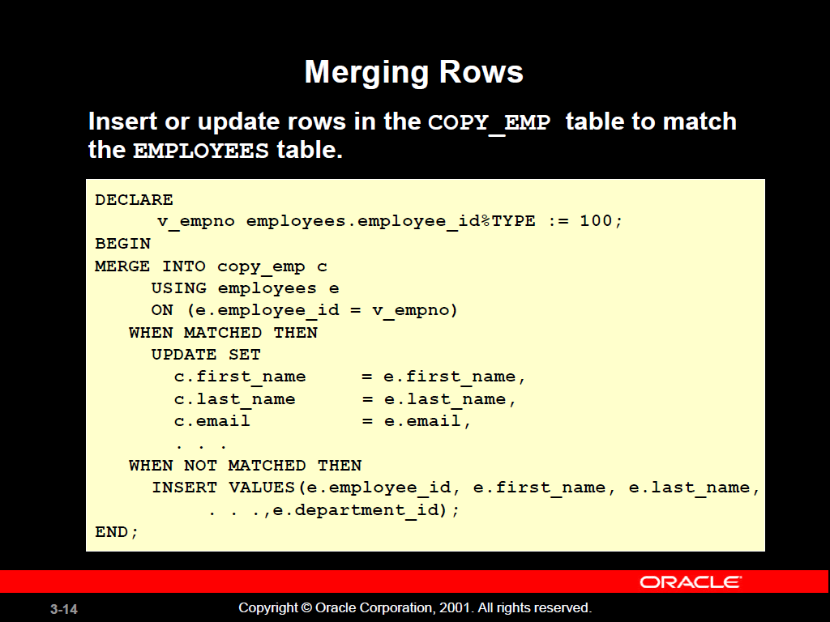

Slide 55
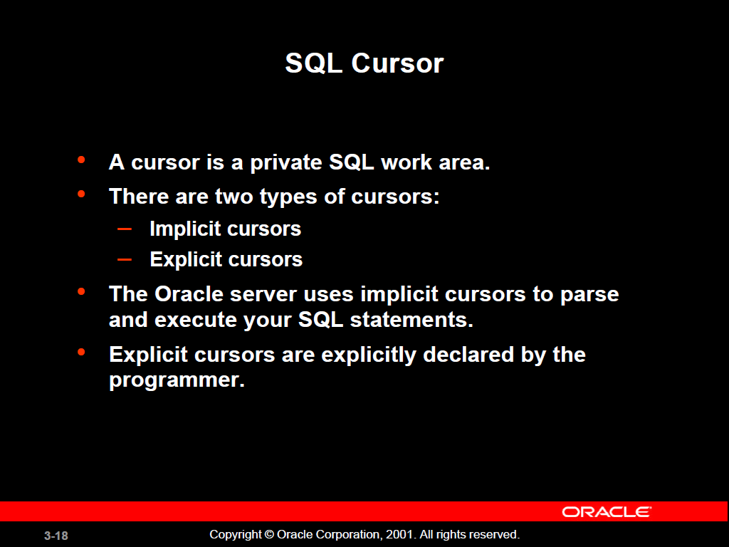

Slide 56
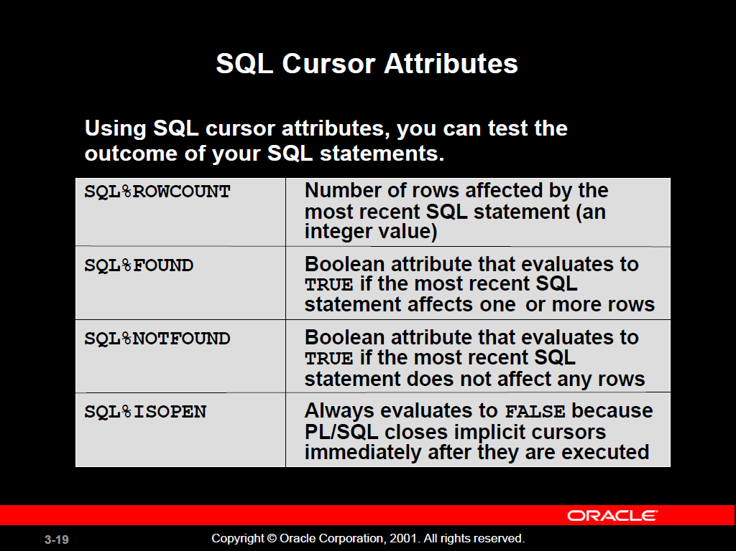

Slide 57
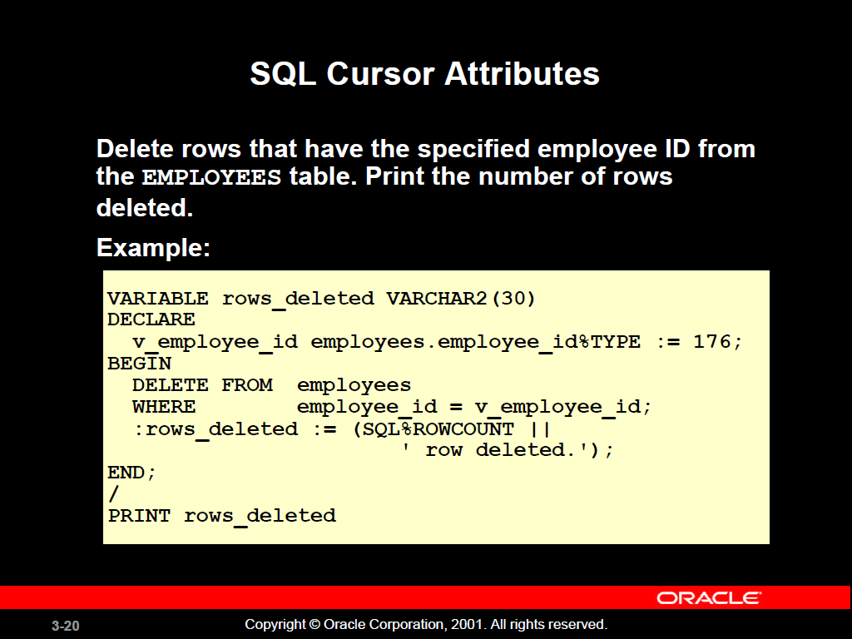

Slide 58
Transaction Control Statements
Initiate a transaction with the first DML command to follow a COMMIT or ROLLBACK.
Use COMMIT and ROLLBACK SQL statements to terminate a transaction explicitly.

