Slide 1
Customer Personality Analysis
Exploratory Data Analysis — Business Insights Summary
AI Lab 99 Internship Program 2026 | Module ML-M04 | Machine Learning Team

Slide 2
Agenda
Dataset Overview & Data Quality
Customer Demographics
Spending & Purchasing Behavior
Website Engagement & Recency
Marketing Campaign Performance
Correlation Analysis & Customer Segmentation
Key Business Insights & Recommendations

Slide 3
Dataset Overview
2237 customer records across 33 columns
0 missing values, 0 duplicate records — dataset is fully clean
Covers demographics, spending, purchase channels, campaigns, and web engagement

Slide 4
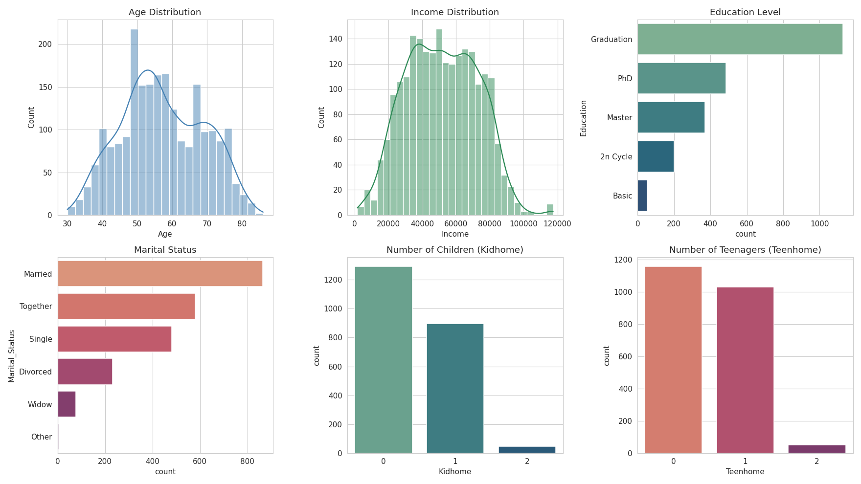
Customer Demographics
Avg age 57.1 yrs | Avg income $51,855 | Top education: Graduation | 71.5% have children

Slide 5
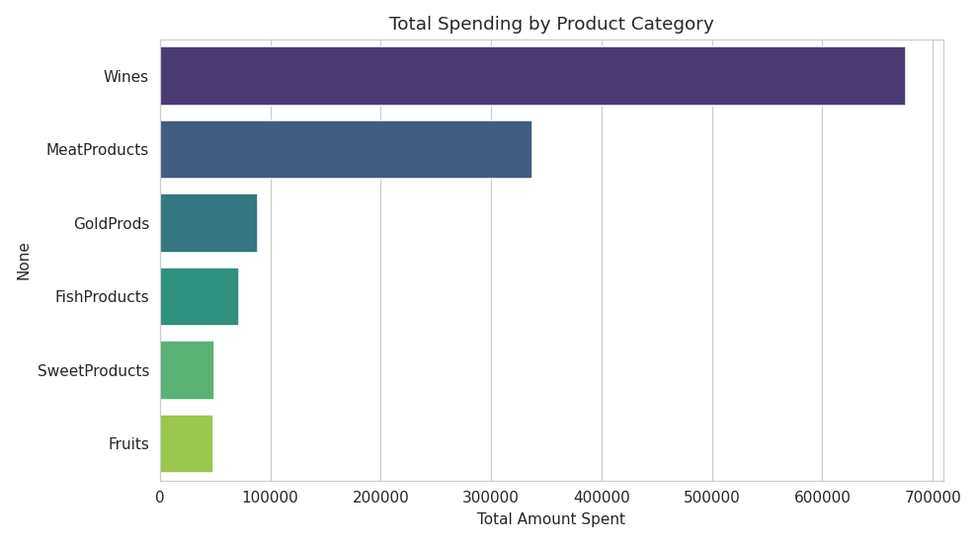
Spending Analysis
Total spending: $1,270,974 | Avg per customer: $568 | Top category: Wines

Slide 6
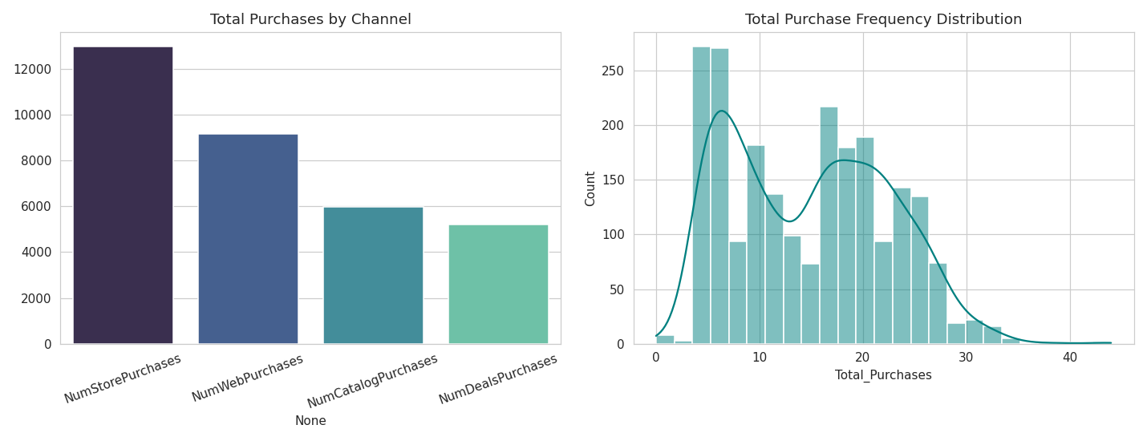
Purchasing Behavior
In-store purchases lead all channels, followed by web, catalog, and deal-based purchases.

Slide 7
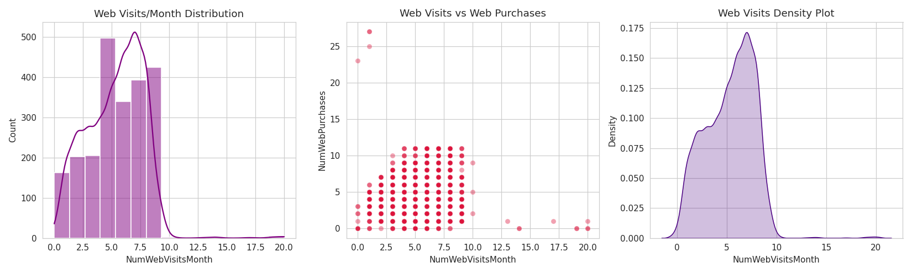
Website Engagement
Avg visits/month: 5.32 | Frequent visitors: 19.5% | Low engagement: 16.3%

Slide 8
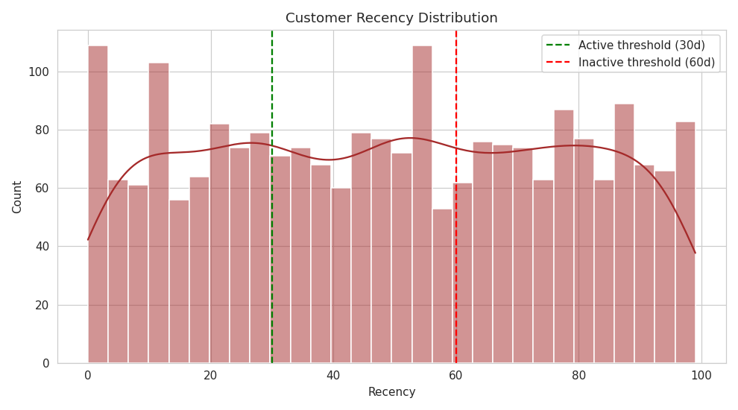
Customer Recency
Active (<=30 days): 32.3% | Inactive (>60 days): 38.5% — target for re-engagement

Slide 9
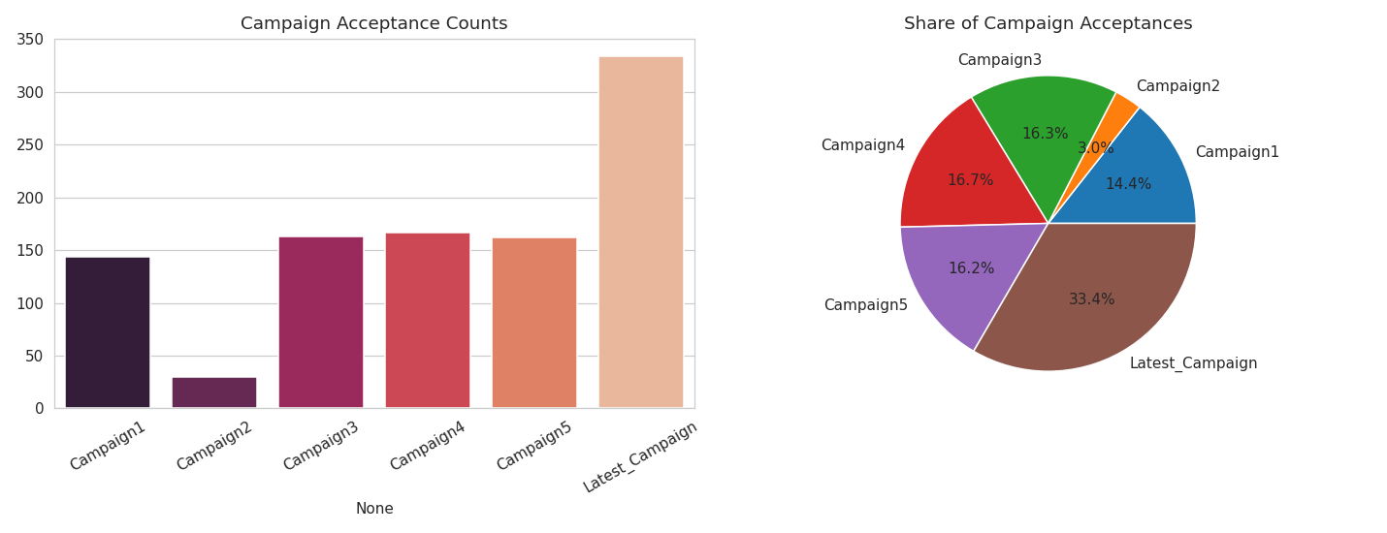
Marketing Campaign Performance
Best performing: Latest Campaign with the highest acceptance rate

Slide 10
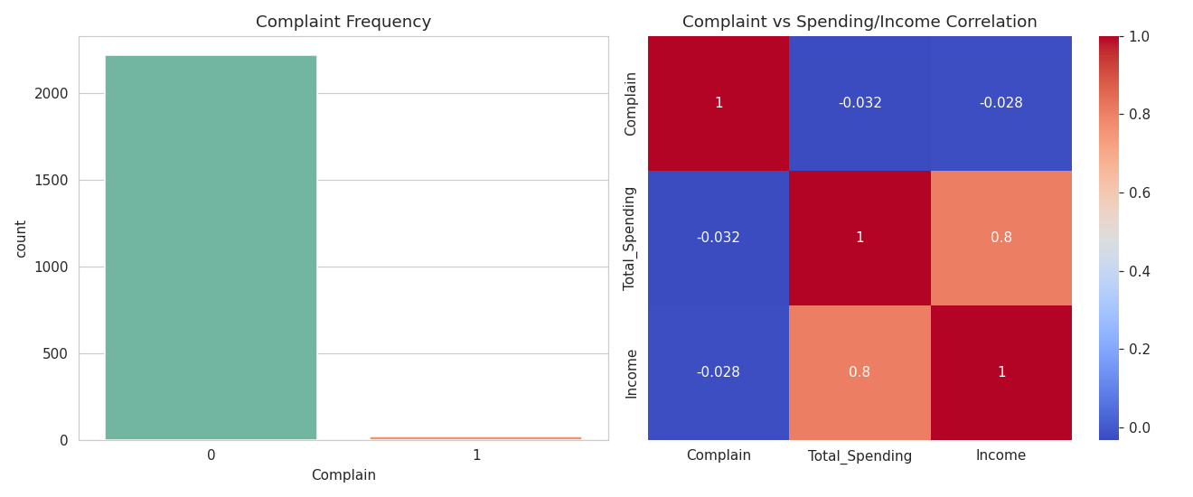
Customer Complaints
Only 0.89% of customers complained | Complainers show slightly lower spend & income

Slide 11
Correlation Analysis — Key Findings
Income vs Total Spending: +0.80 (strongest positive)
Total Spending vs Total Purchases: +0.77
Income vs Web Visits/Month: -0.65 (higher earners visit site less)
Kidhome vs Total Spending: -0.56 (children reduce spending)

Slide 12
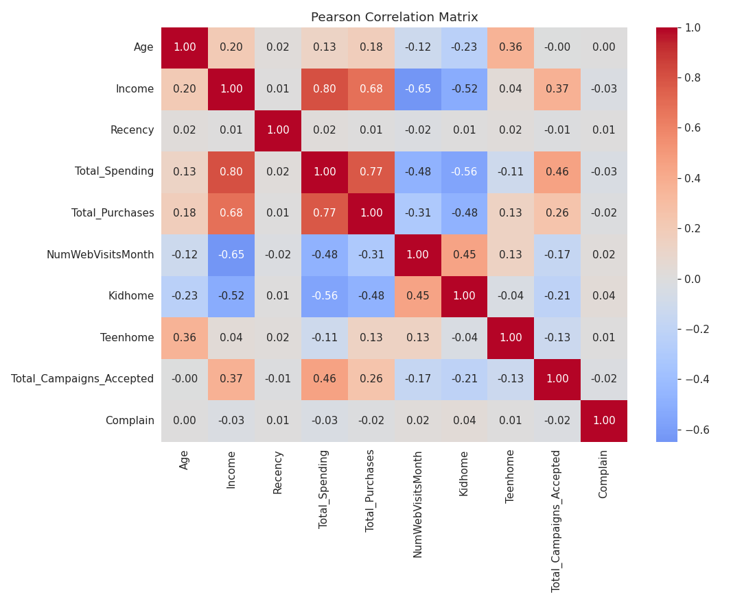
Correlation Heatmap
Pearson correlation across key numerical variables

Slide 13
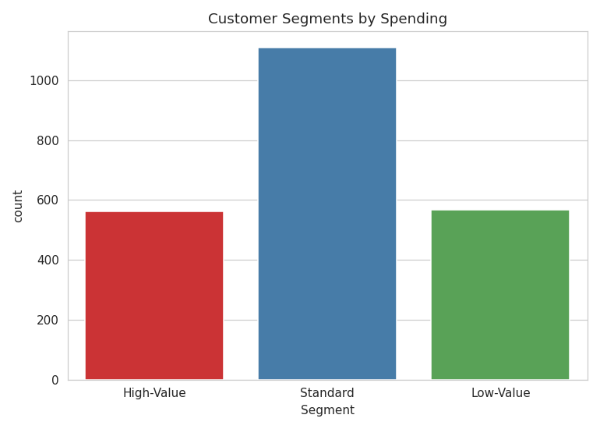
Customer Segmentation
High-Value: 561 | Standard: 1109 | Low-Value: 567

Slide 14
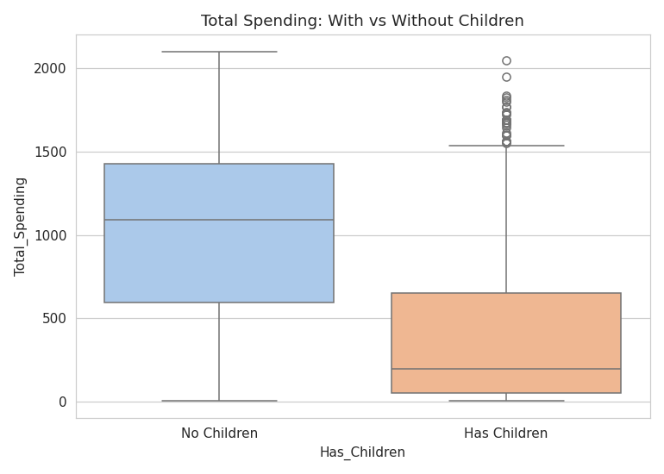
Children & Spending
No children: $1,003 avg spend vs With children: $395 avg spend

Slide 15
High-Value Customer Profile
Average age: 58.5 years
Average income: $74,349
Education: mostly Graduation
Preferred channel: Store purchases
Low complaint rate, moderate recency (~49.6 days)

Slide 16
Recommended Marketing Strategies
Re-engage customers inactive 60+ days with win-back campaigns
Prioritize in-store & catalog promotions for high-value, older, higher-income segments
Cross-sell Wine & Meat products — the top revenue drivers
Create family-oriented offers to lift spending among customers with children
Replicate the design of the top-performing (Latest) campaign in future planning

Slide 17
Thank You
Questions & Discussion

