Slide 1
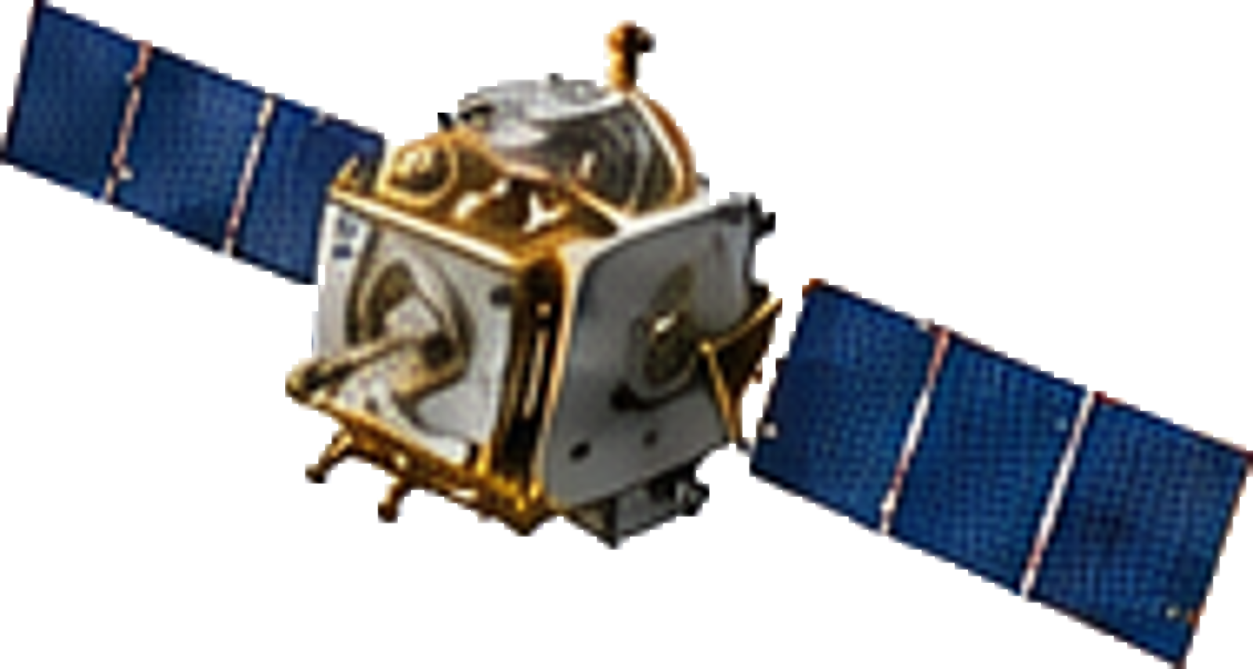

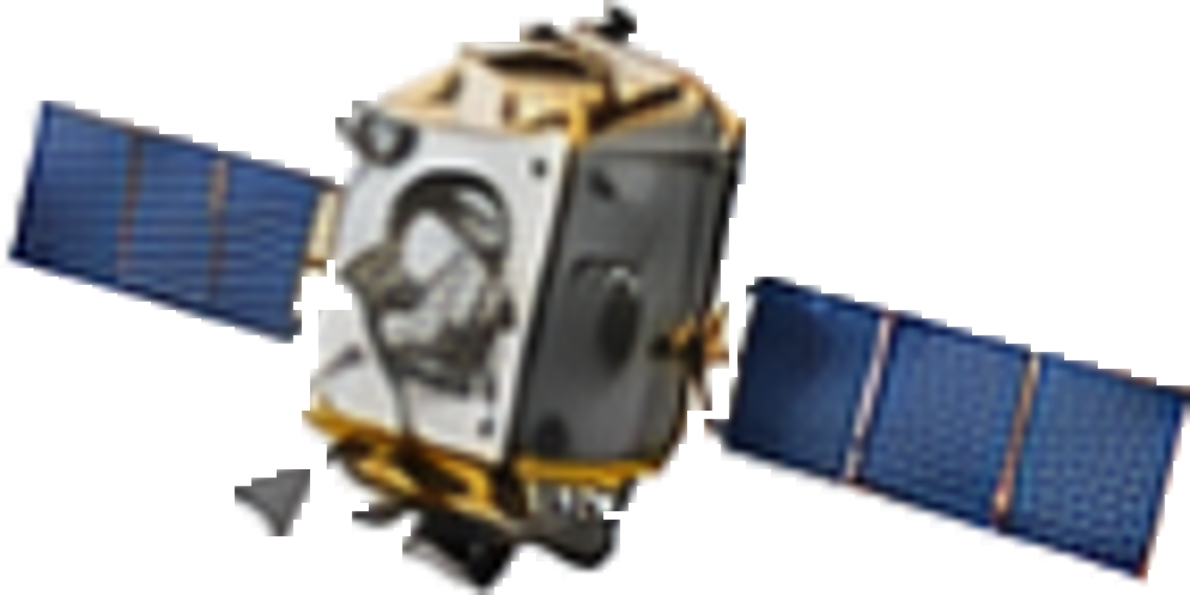

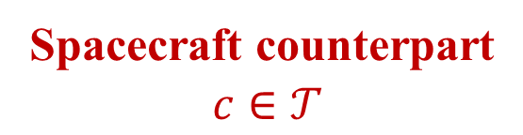

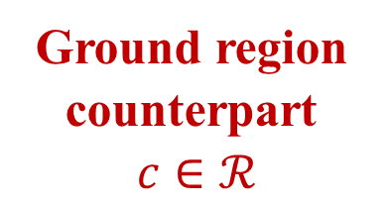


Non-cooperative Actor $a$
Spacecraft counterpart
$c∈𝒯$
Possible
intentions?
z_{I}
Ground region counterpart
$c∈ℛ$
$$O$$
$$yI$$
J2000 Frame
$$xI$$
Notes:
Local editable reconstruction of 01_task_scene_j2000_realistic_v3.png. Only Earth and the two spacecraft are raster PNG assets. All trajectories, coordinate axes, markers, arrows, text, module borders and output cells are native editable shapes. The illustration is schematic and not to scale. No Earth-rotation arrow is present.

