Slide 1

Hardware-Aware Real-Time Low-Light Image Enhancement for Lane Detection
Under the guidance of:
Prof. Pankaj Kumar
Praneel Vipul Vania (202201131)
Aditya Sable (202201049)

Slide 2
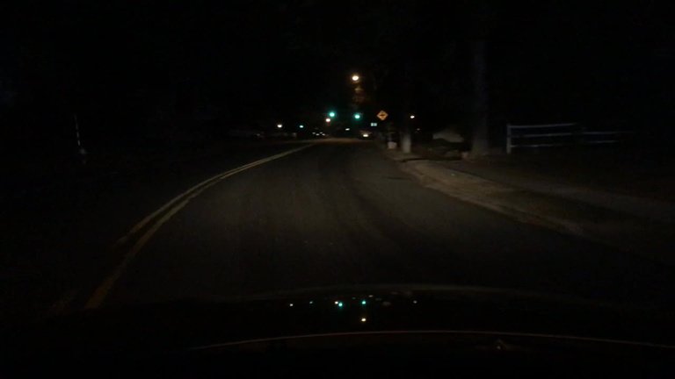
Lane detection relies on clear visibility of road markings
Low-light conditions reduce contrast and weaken edge information
This leads to unstable or incorrect lane detection results
Existing enhancement methods improve visibility but are often too slow for real-time use
There is a need for an efficient real-time enhancement pipeline
Problem Statement & Motivation
Can we improve visibility while still maintaining real-time performance?

Slide 3
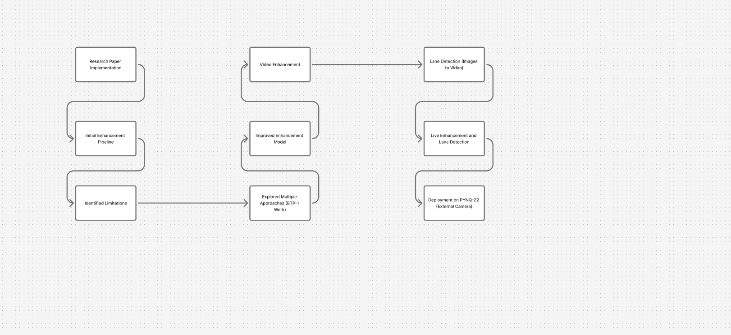
Project Evolution Overview
Research Paper on low-light image enhancement
Integrated with Lane Detection
Identified Limitations
Implementation
Proposed Improvements

Slide 4
Method
Limitations
Image converted from RGB to HSV color space
Illumination estimated using Gaussian filtering on V channel
Adaptive brightness enhancement applied
Two enhanced outputs (V1 and V2) generated
Wavelet fusion (max rule) used to combine results
Gaussian filtering causes edge blurring
Over-enhancement in already bright regions
Noise amplification in dark areas

Slide 5
Proposed Improvements
Replaced Gaussian filter with guided filter for better edge preservation
Introduced darkness-based adaptive scaling to avoid over-enhancement
Applied variance-based wavelet fusion for smoother and stable results
Improved overall enhancement quality while maintaining structural details

Slide 6
Explored Approaches
HSV-Based Enhancement
HSV → Gaussian Illumination → Adaptive Scaling → Output
Multi-Scale Illumination
HSV → Multi-Scale Gaussian → Adaptive Enhancement → Output
Gamma + CLAHE Pipeline
HSV → Gamma Correction → CLAHE → Denoising → Output
Retinex-Based Enhancement
HSV → Illumination Estimation → Retinex → CLAHE → Output
Fusion-Based Method (Paper)
HSV → Dual Outputs → Wavelet Fusion (Max Rule) → Output
Final Selected Pipeline
HSV → Guided Filter → Adaptive Scaling → Dual Outputs →
Wavelet → Variance Fusion → Output
All of the above approaches were tested on a dataset of 50 images

Slide 7
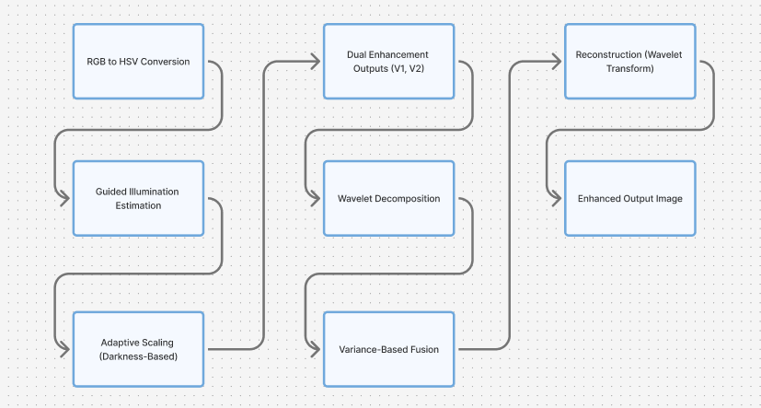
Final Enhancement Pipeline

Slide 8
Enhancement Results Statistics
Qualitative and Quantitative Improvements
Evaluation Metrics Used
Significant improvement in low-light image visibility
Better preservation of structural details and edges
Enhanced contrast and clarity of road features
Balanced brightness enhancement without over-saturation
PSNR – measures overall image quality improvement
SSIM – measures similarity preservation
AMBE – measures brightness consistency

Slide 9
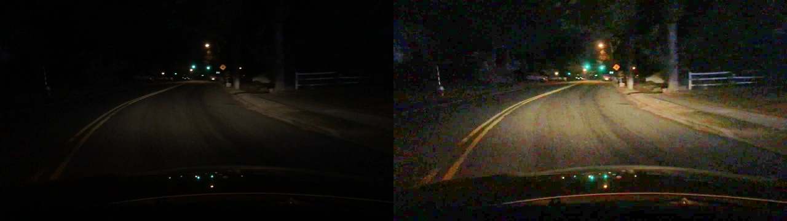
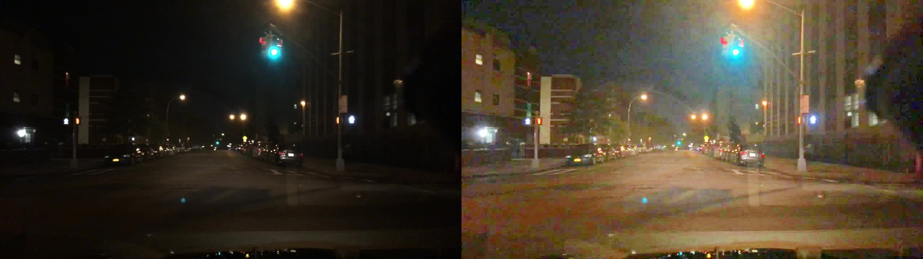
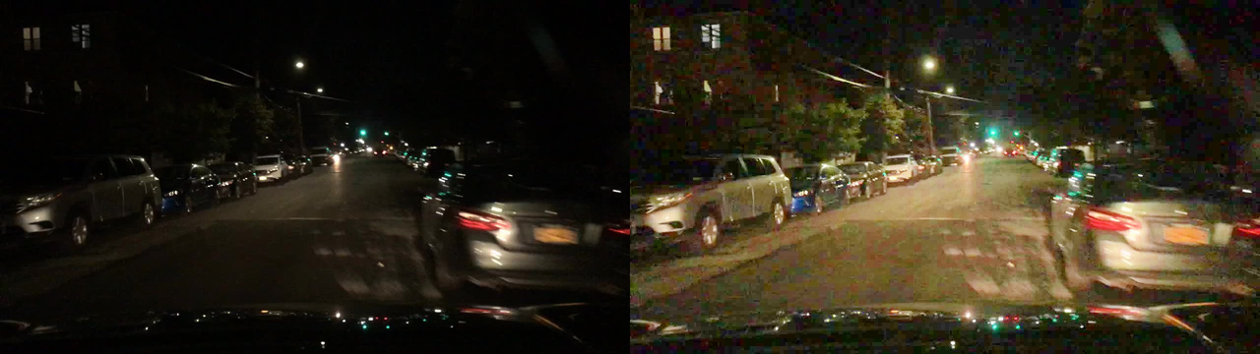
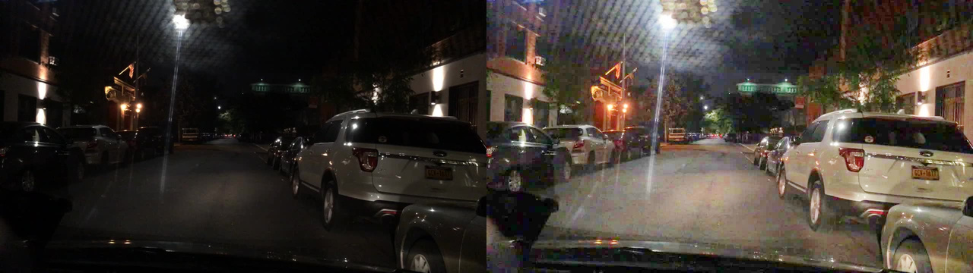
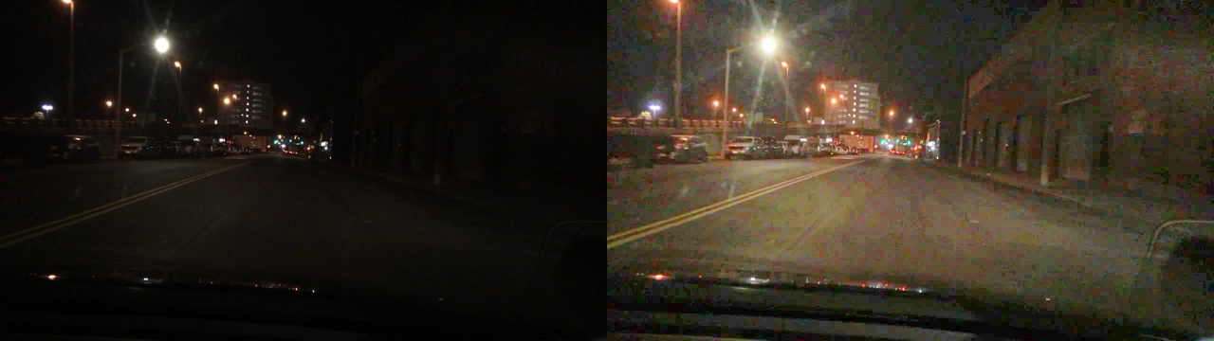
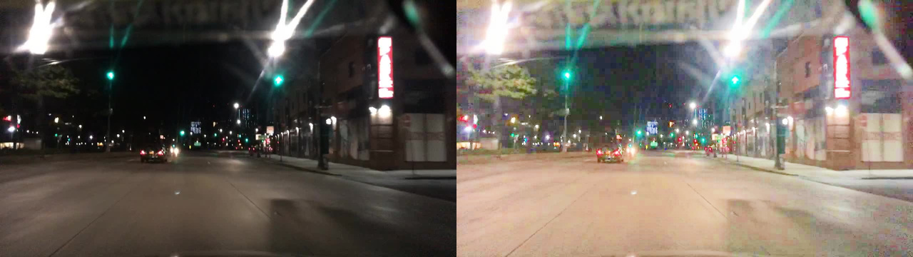
ENHANCEMENT RESULTS
[Before → After]
[Before → After]

Slide 10
Transition to Real-Time Processing
From Offline Enhancement → Real-Time System
Initial work focused on developing a high-quality enhancement pipeline
Designed primarily for offline image processing
During extension to lane detection and live video, computational limitations were observed
Required redesign of the pipeline for real-time performance

Slide 11
Real-Time Enhancement Pipeline
Input
Smoothing (Bilateral Filter)
Sharpening
Enhanced Frame
HSV Conversion
Enhanced Frame Output
Gaussian Illumination Estimation
Adaptive Enhancement

Slide 12
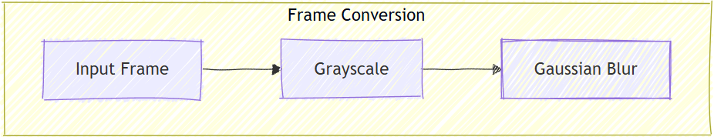
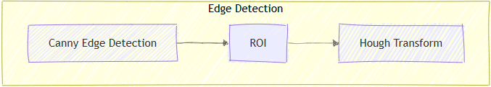


Lane Detection Pipeline

Slide 13
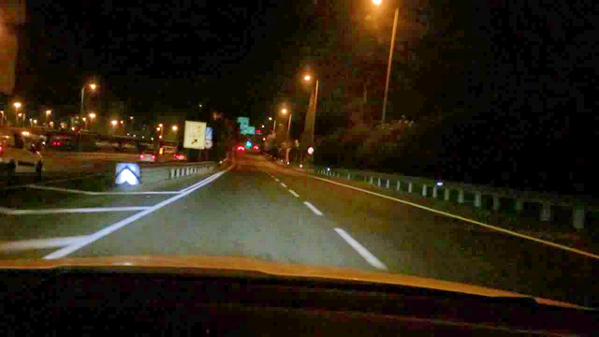
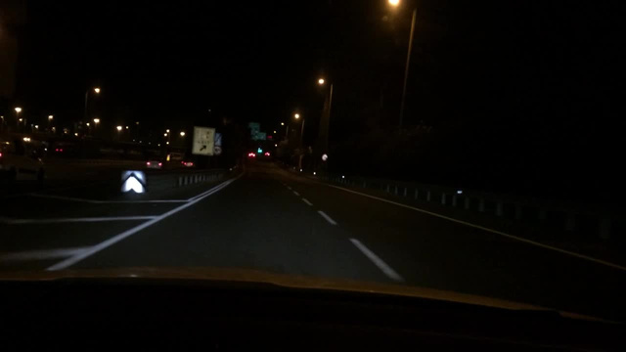
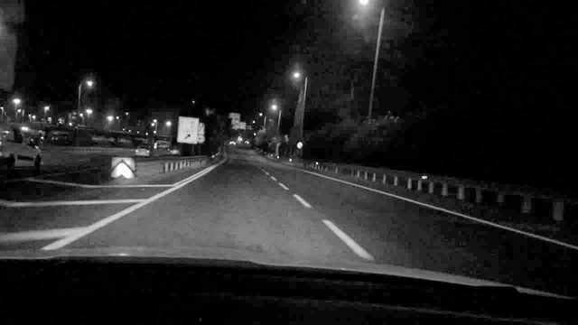
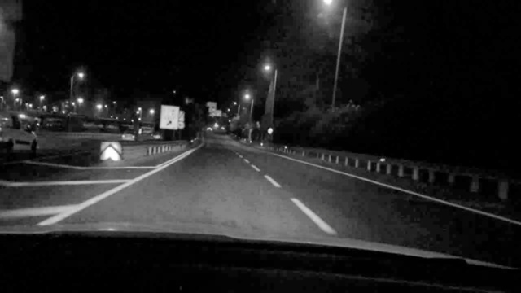
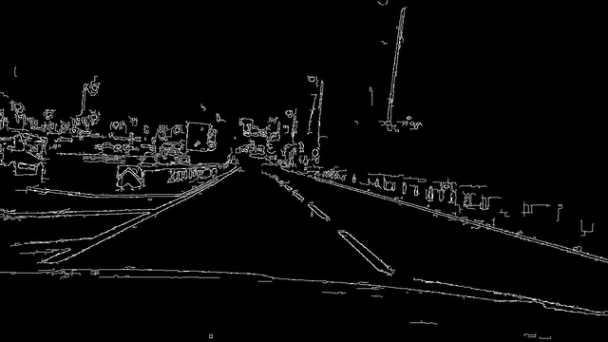
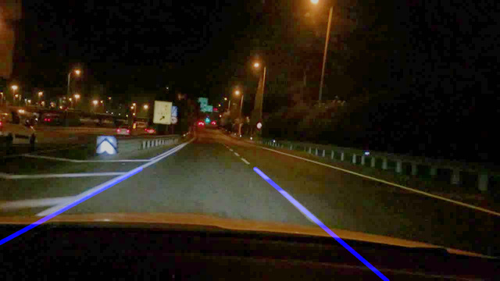

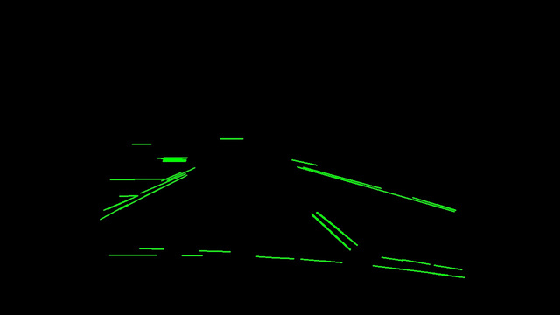
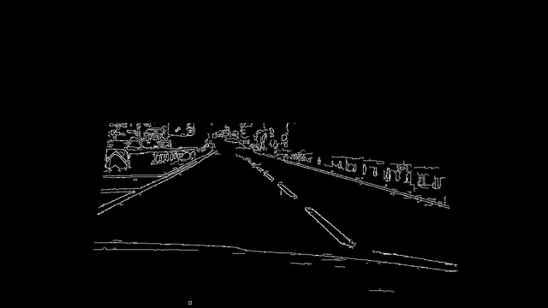
Lane Detection Pipeline Result
Enhanced Input
Grayscale Conversion
Gaussian Blur
Canny Edge Detection
Region of Interest
Final Output
Lane Lines
Hough Transform

Slide 14
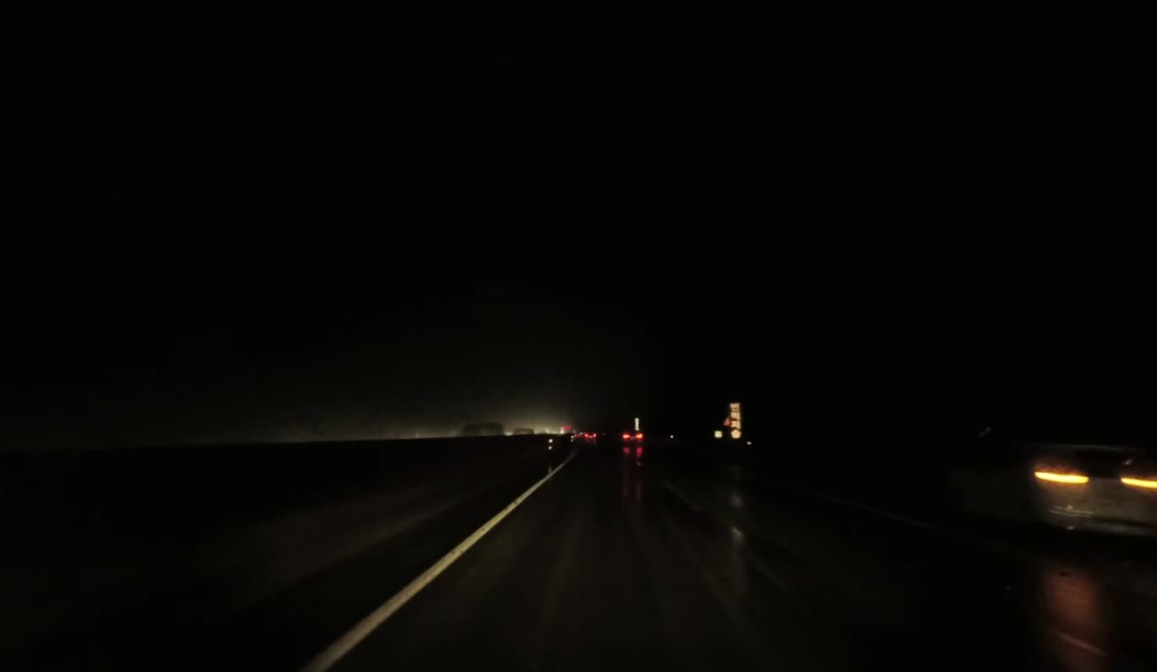
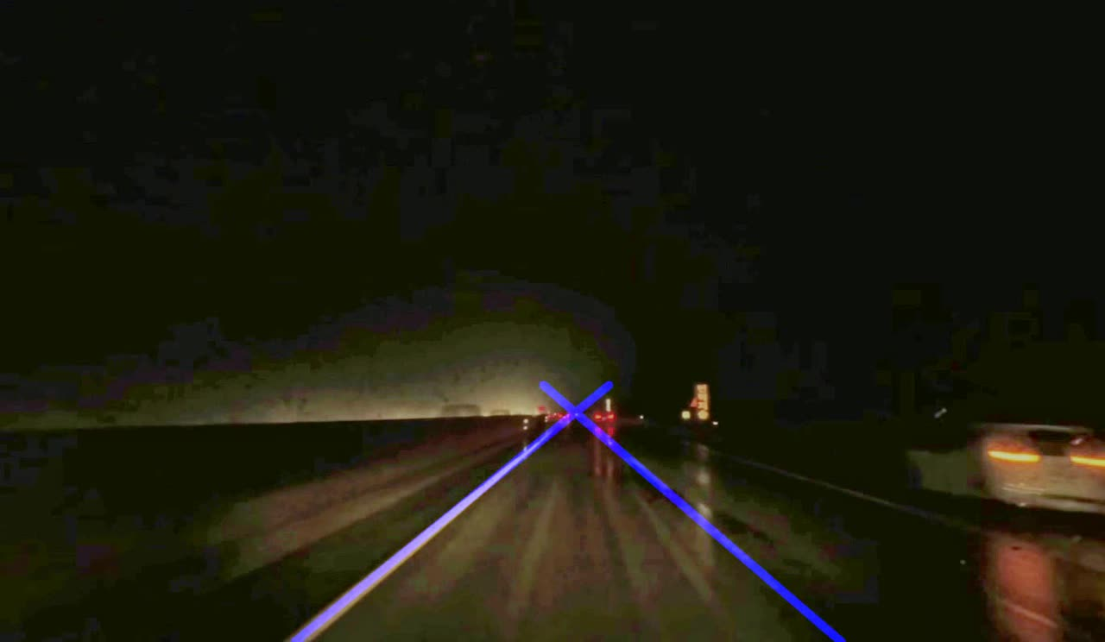
Video Demonstration
Real-Time Lane Detection in Action

Slide 15
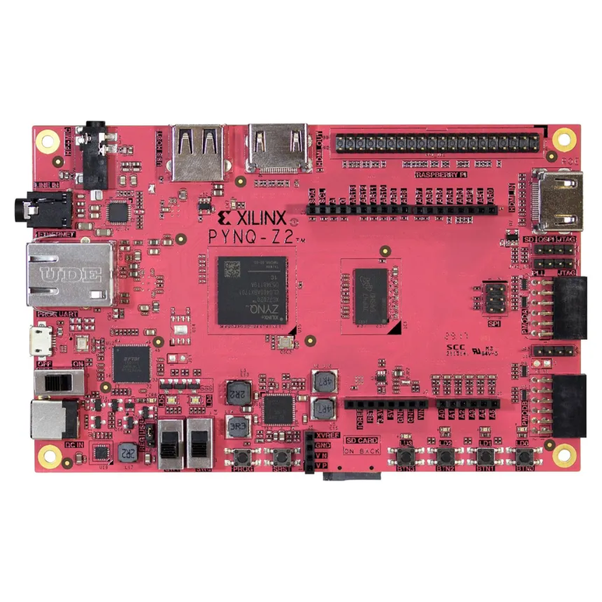
Hardware Implementation (PYNQ-Z2)
Deployed the pipeline on PYNQ-Z2 development board
Used external camera for real-time input
Processing performed on embedded ARM processor
Achieved ~9–10 FPS for live enhancement and lane detection
Demonstrated feasibility of real-time low-light processing

Slide 16
01
Developed an improved low-light image enhancement pipeline
02
Explored and compared multiple enhancement techniques
Key Contributions
Designed an adaptive and stable enhancement approach
03
04
Integrated enhancement with lane detection system
05
Built a real-time processing pipeline
06
Successfully deployed the system on PYNQ-Z2 hardware

Slide 17
Balancing high-quality enhancement with real-time performance was a major challenge, as improving visual quality often increased computational cost
01
Preventing over-enhancement in extremely low-light scenerios required careful consideration of parameters and filtering methods
02
Challenges & Learnings
some computationally intensive algorithms required simplification of pipeline to run efficiently on hardware with limited resources.
03
Ensuring stable and consistent lane detection across different lighting within the ROI was a difficult task and required for us to change ROI multiple times.
04
Understanding and optimizing trade-offs between accuracy, speed, and hardware constraints was critical for achieving real-time performance
05

Slide 18
Implement FPGA-based acceleration to improve processing speed and achieve higher frame rates beyond current performance
Explore deep learning-based approaches for more robust and accurate lane detection under complex real-world conditions
Enhance performance under extreme lighting scenarios such as heavy glare, fog, and very low visibility environments
Optimize the pipeline further for better resource utilization and improved efficiency on embedded hardware platforms
Integrate the system into a complete ADAS(Advanced Driver Assistance Systems) framework for real-world deployment and testing
Future Work

Slide 19
Developed an effective low-light image enhancement pipeline for improved visibility
Enhanced lane detection performance under challenging low-light conditions
Designed a simplified pipeline for real-time processing
Successfully implemented and tested the system on PYNQ-Z2 hardware
Demonstrated practical applicability for real-world driving scenarios
Conclusion

Slide 20
Thank You
Questions Welcome

