Slide 1
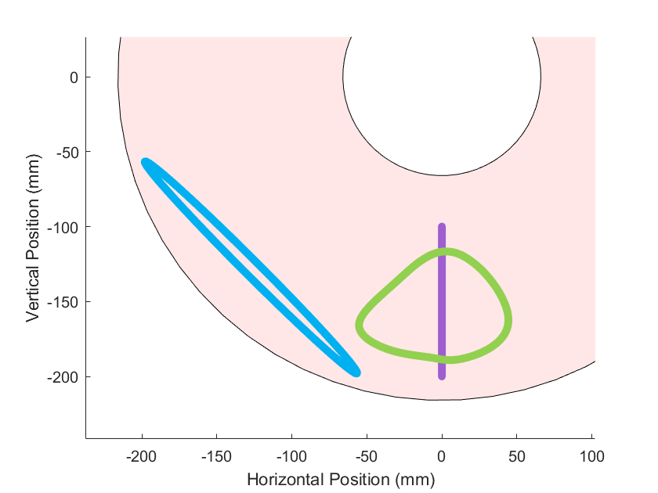
Robot Body
Joint at origin
Direction of travel
c) Swimming
Trajectory
b) Jump trajectory
Large amplitude generates forward thrust
a) Walking trajectory
Centered under hip for stability

Slide 2
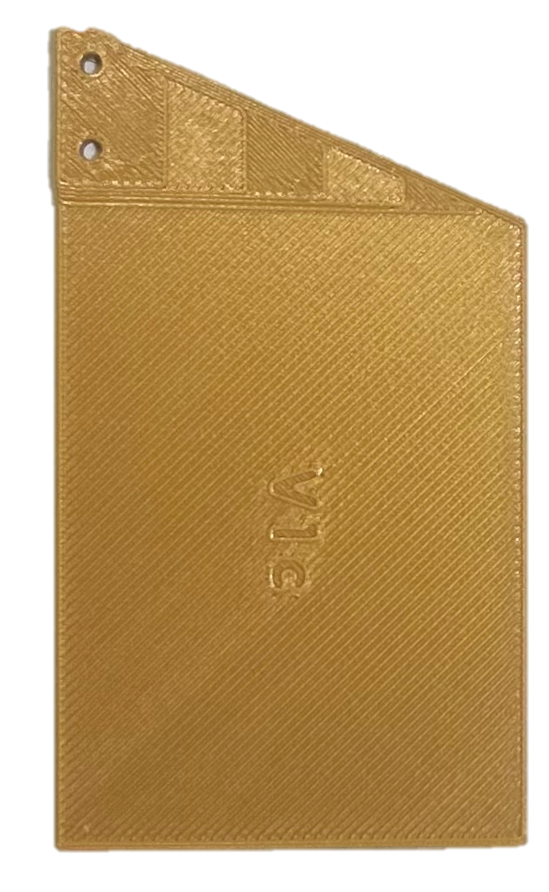
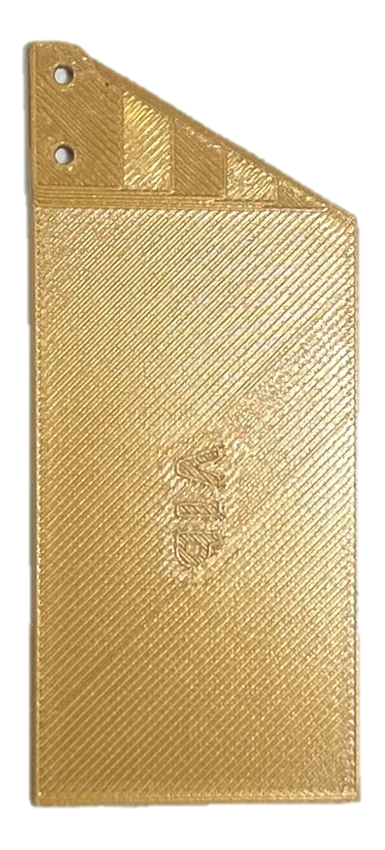
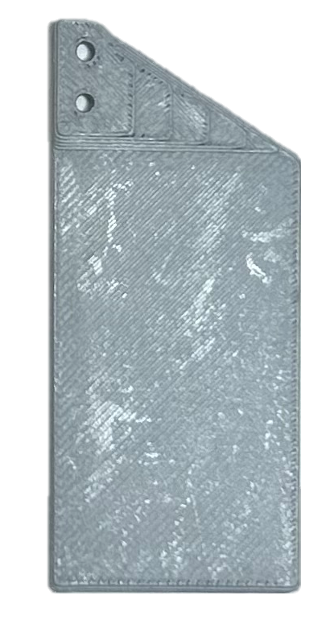
Fin B
Fin C
Fin A
6.8 cm
8.9 cm
8.9 cm
3.9 cm
4.9 cm
6.5 cm

