Slide 1
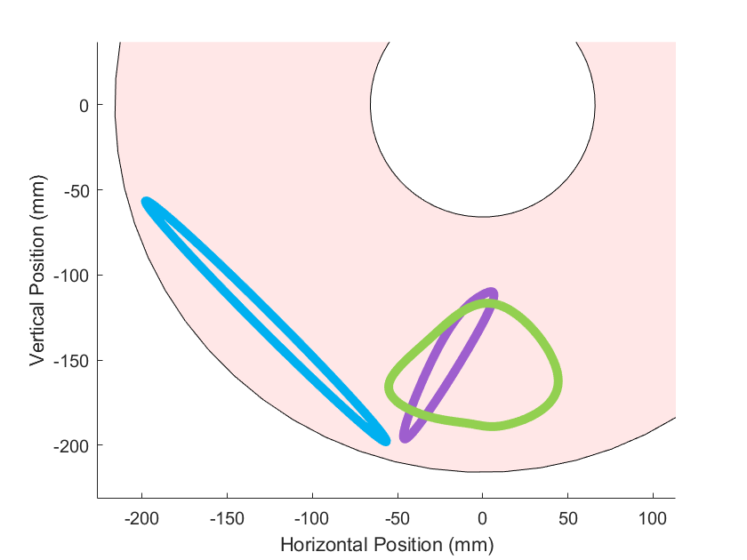
Robot Body
Joint at origin
Direction of travel
c) Swimming
Trajectory
b) Jump trajectory
Angled slightly for forward motion
Large amplitude generates forward thrust
a) Walking trajectory
Centered under hip for stability

Slide 2
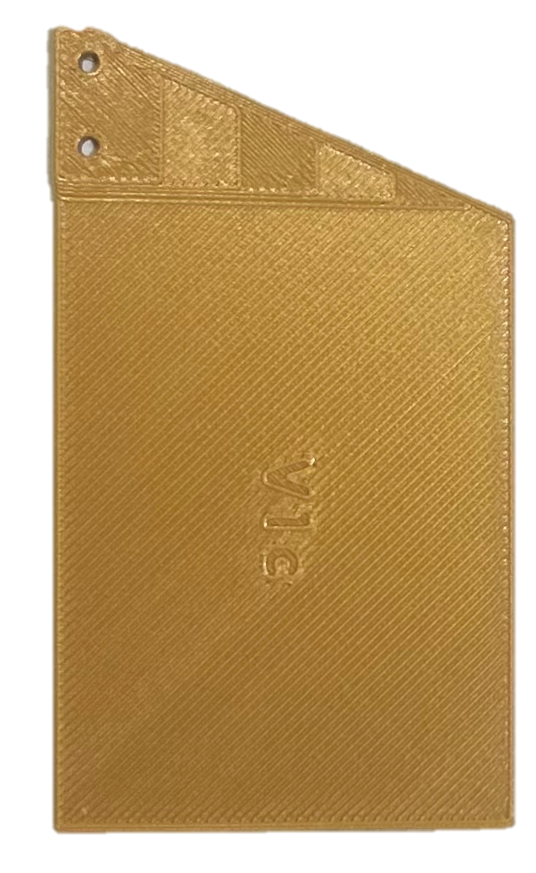
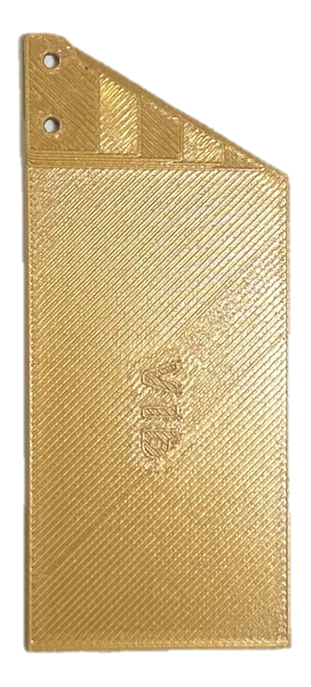

Fin B
Fin C
Fin A
6.8 cm
8.9 cm
8.9 cm
3.9 cm
4.9 cm
6.5 cm

