Slide 1
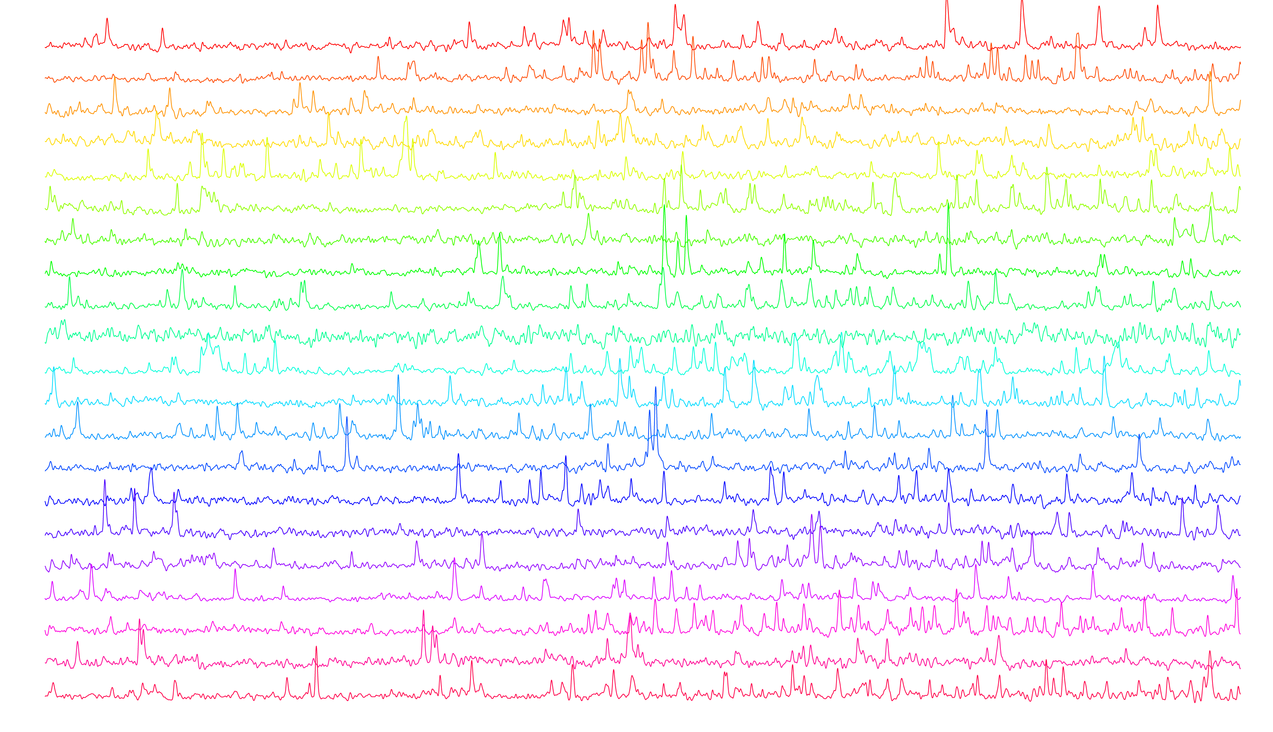

Tutorial on Suite2p
rossilab.iit.it - federico.rossi@iit.it
Federico Rossi
Heather Strelevitz
Notes:
Hello everyone, and thanks to the committee for selecting our abstract for a talk.
Today I am going to tell you about one line of work in the lab that investigates the role of apical dendrites in visual processing.
Good morning everyone, it is a pleasure to be here to present the research line in my lab, called Functional Architecture of Neural Circuits.

Slide 2

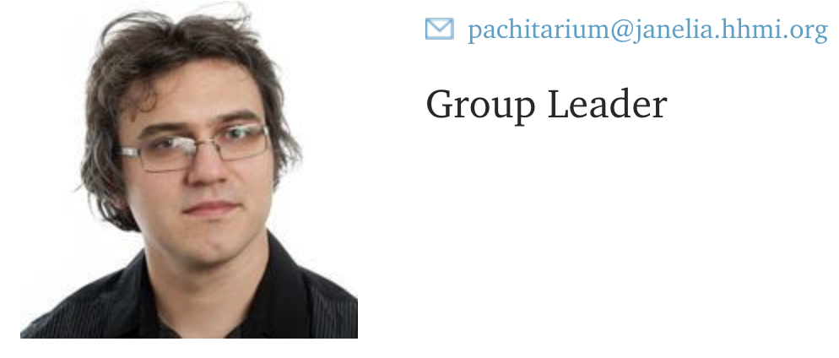
Suite2p is developed and curated by Marius and Carsen

Slide 3
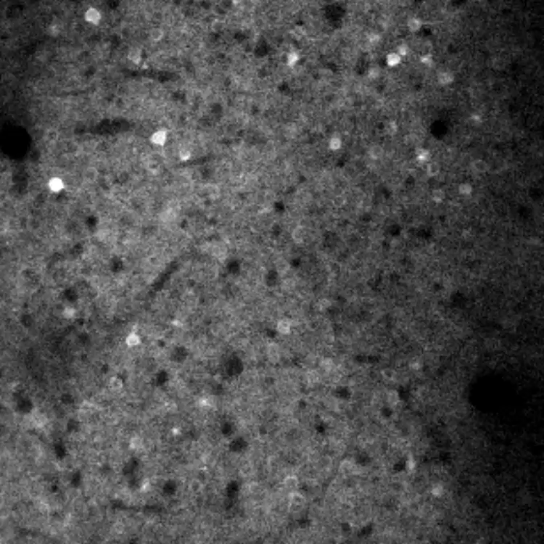
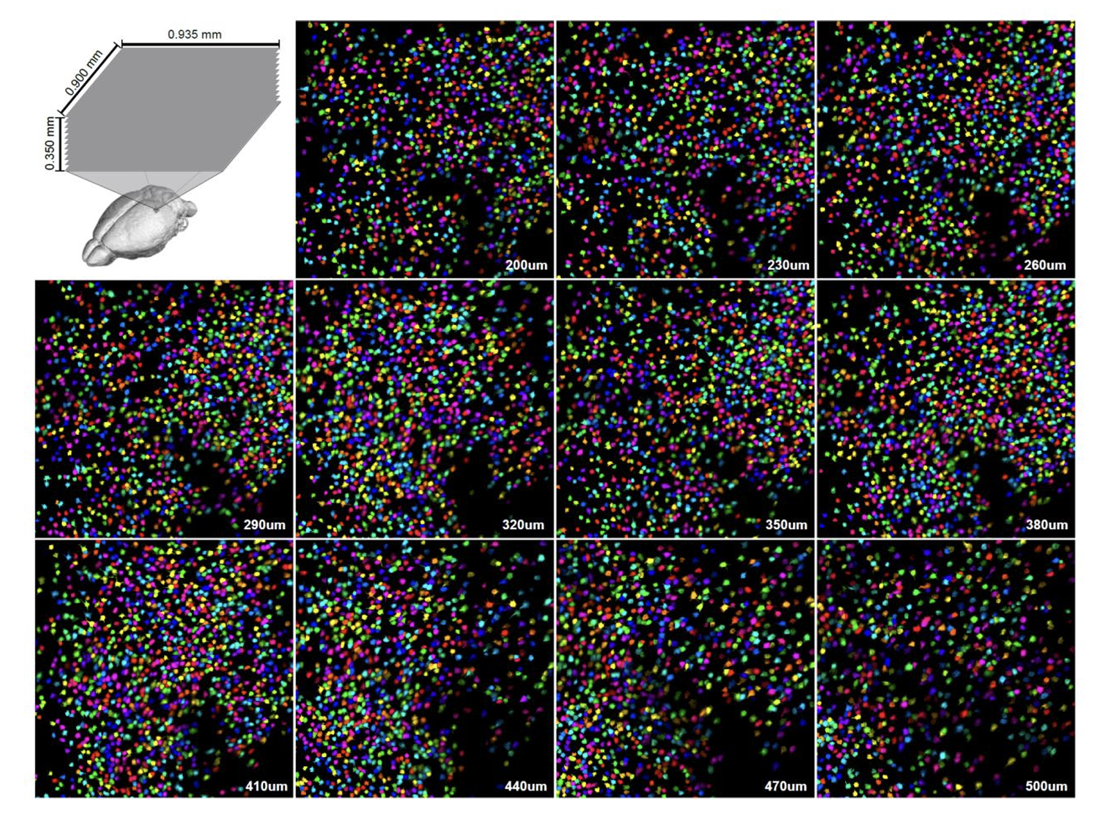
The goal
Pachitariu et al, 2017, bioRxiv

Slide 4
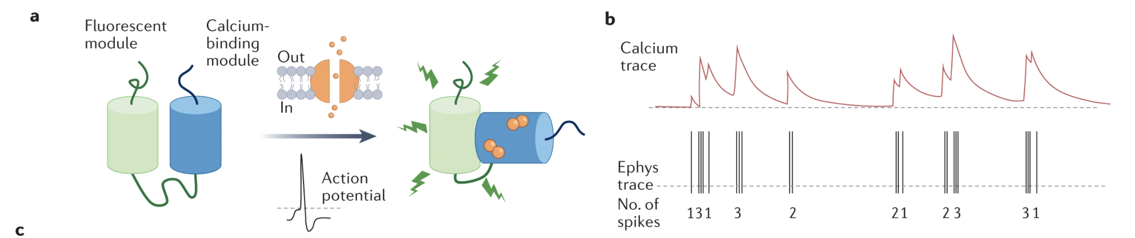
Recap: calcium sensors
Calcium imaging is an indirect measure of spiking. Spike trains are convolved with temporal dynamics of calcium entry
Signals are typically slower than underlying phenomenon – convolved with temporal dynamics of the sensor
Grienberger et al, Nat Rew mp, 2022

Slide 5
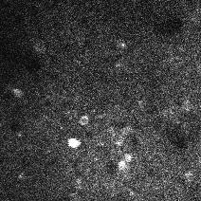
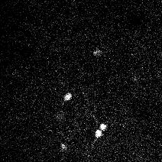
Example data – 2 channels 2P recording

Slide 6
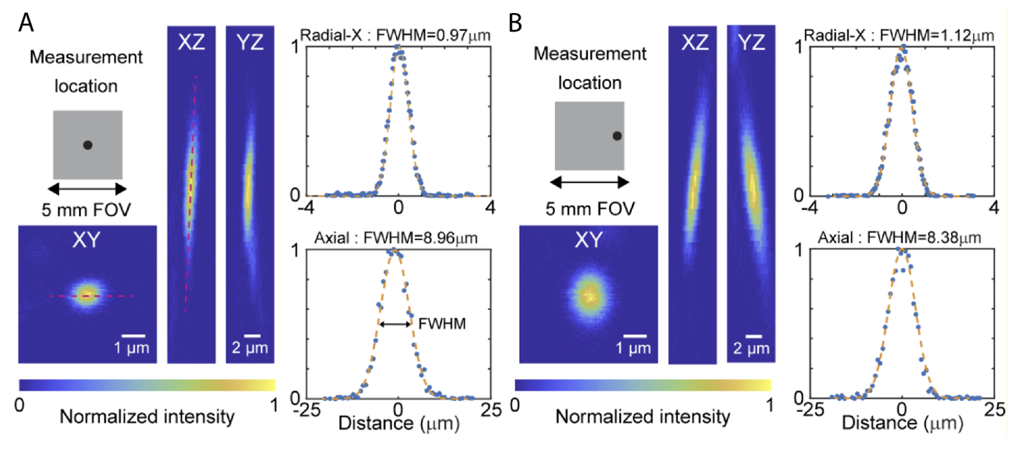
PSF and resolution of imaging – where does fluorescence come from?
Lees et al, bioRxiv 2024

Slide 7
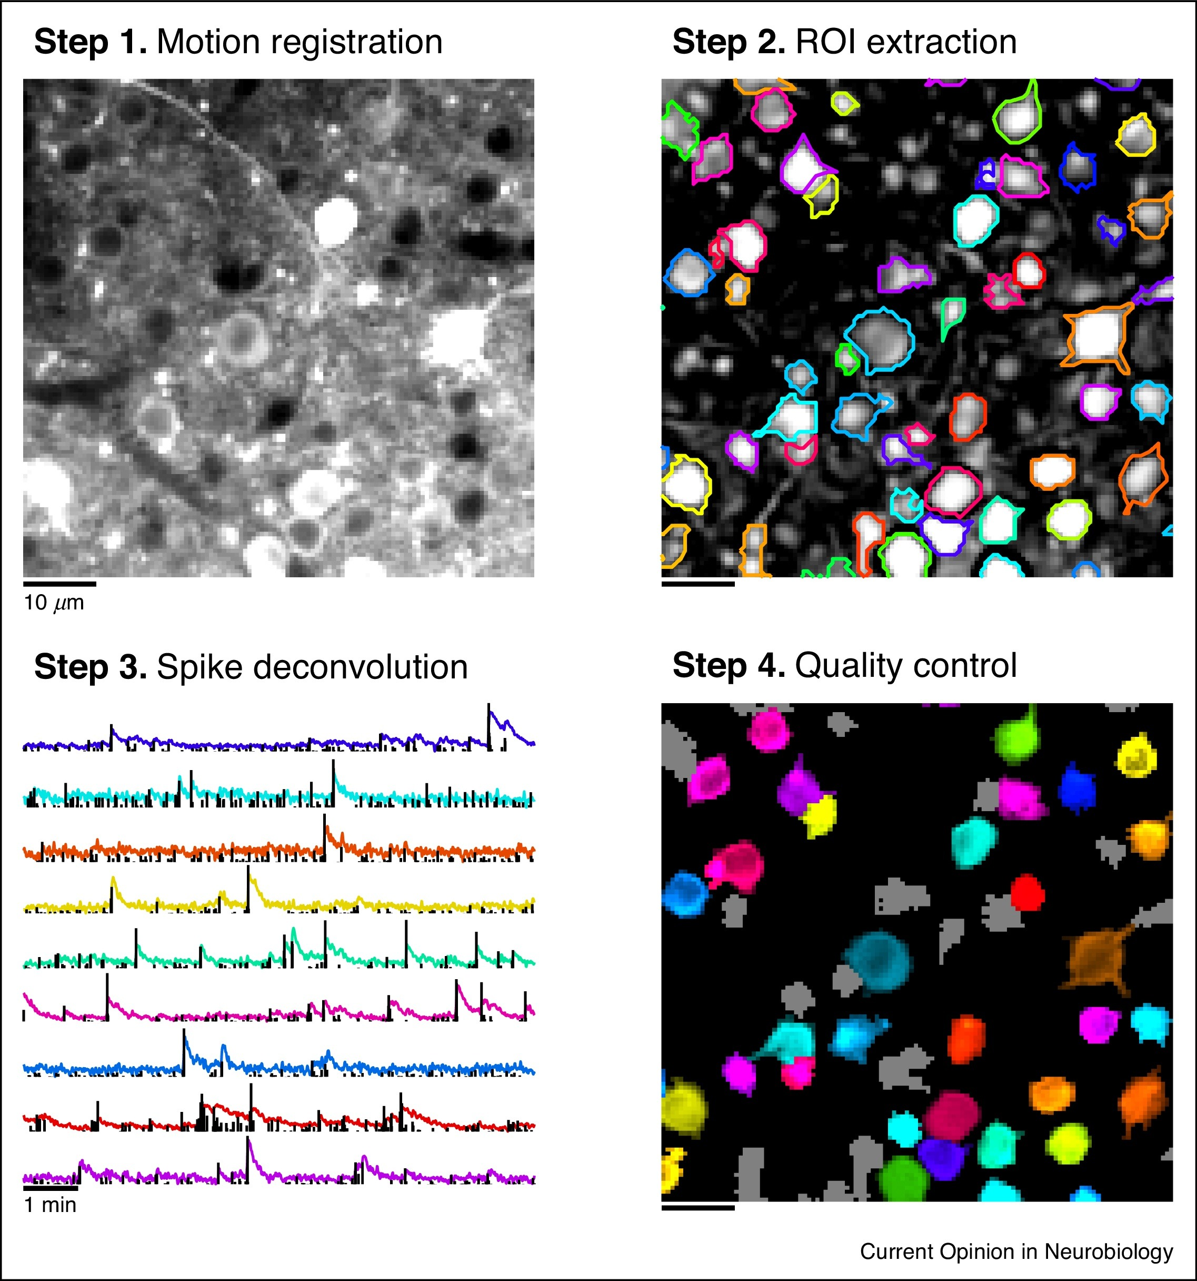
The pipeline
Stringer & Pachitariu, Curr Opinion Neurobiol 2019

Slide 8
Motion correction - XY
Compute reference/target frame
Compute rigid shifts to align images
If rigid shifts don’t fix it, compute non-rigid shifts
Benchmark results
Stringer, https://www.youtube.com/watch?v=HpL5XNtC5wU

Slide 9
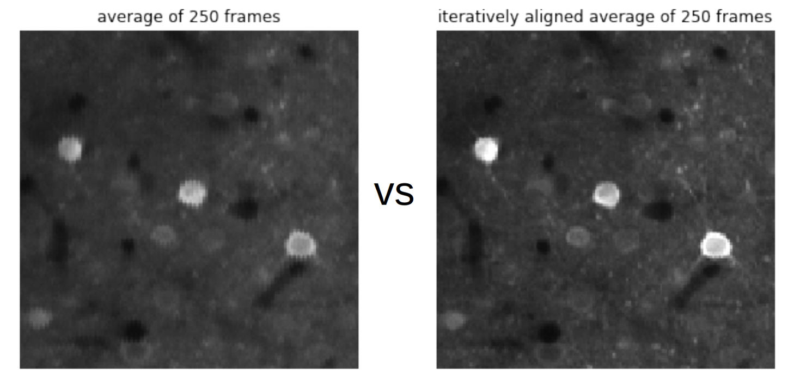
Target frame
Select nimg_init random frames
Compute correlation
Pick seed frame with most correlated neighbors
Average 20 most correlated frames with seed
Suite2P readthedocs

Slide 10
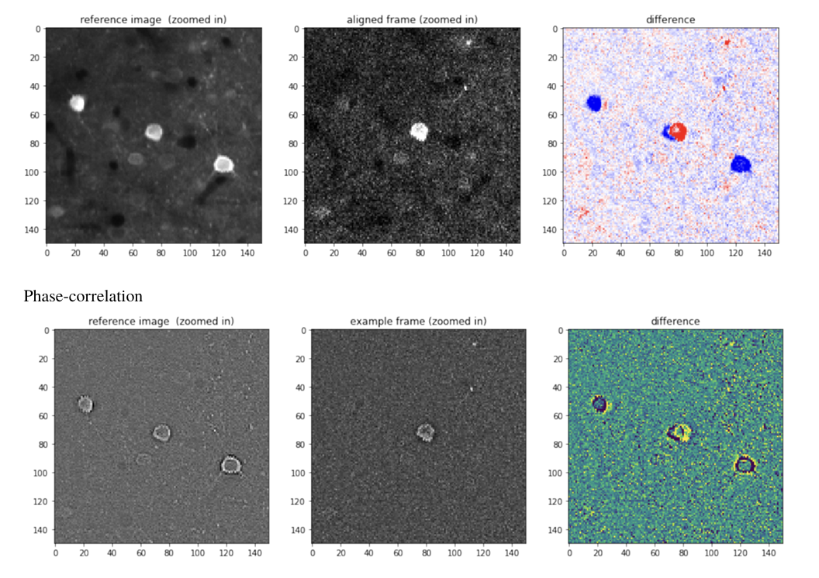
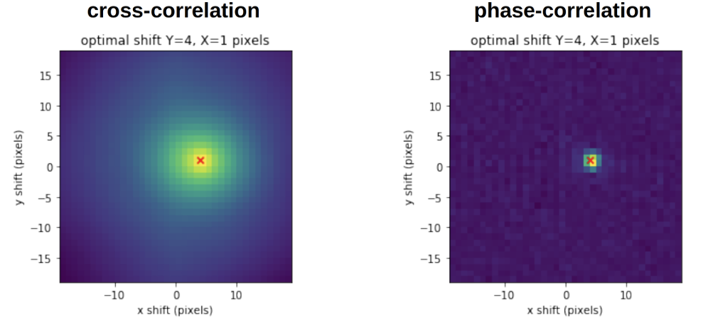
Rigid shifts – phase correlation
Suite2P readthedocs

Slide 11
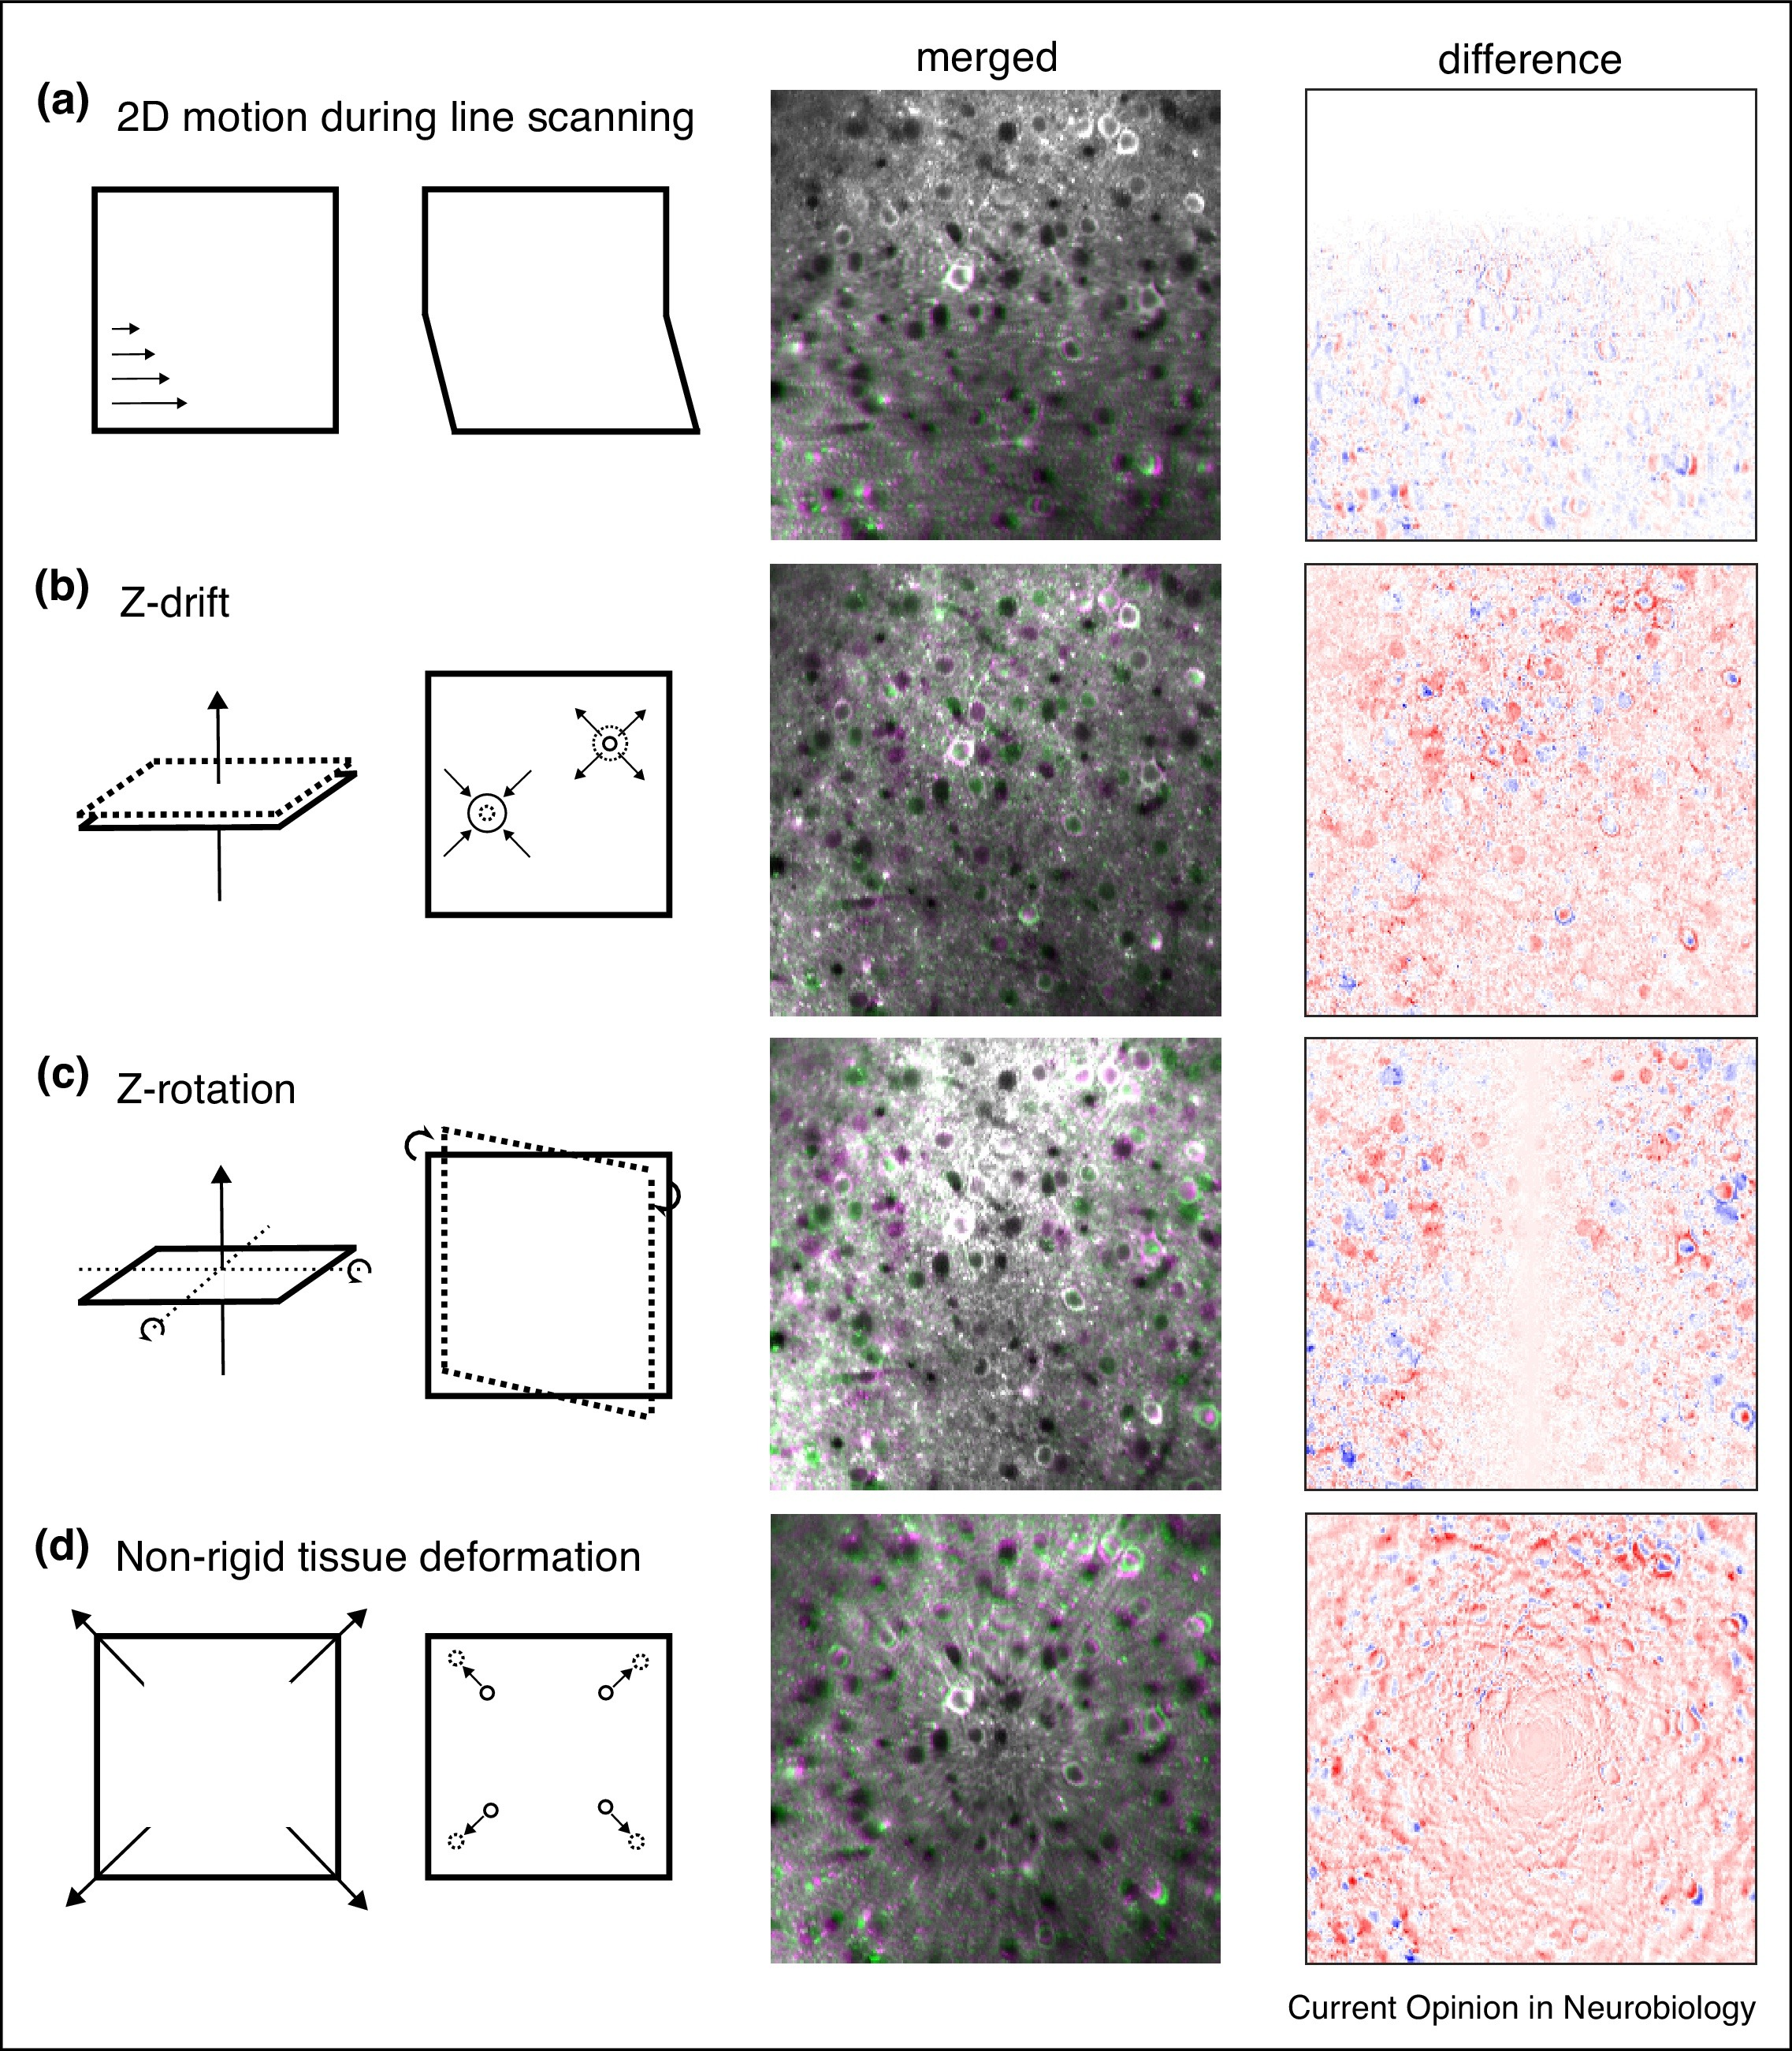
Non rigid motion aberration

Slide 12
Non rigid registration
Divide the FOV in sectors and compute rigid shifts ‘independently’
Interpolate the shifts and reconstruct the image
Mind your scanning pattern!

Slide 13
Non rigid motion aberration
Stringer & Pachitariu, Curr Opinion Neurobiol 2019

Slide 14
Non rigid motion aberration
Stringer & Pachitariu, Curr Opinion Neurobiol 2019

Slide 15
Non rigid motion aberrations
Stringer & Pachitariu, Curr Opinion Neurobiol 2019

Slide 16
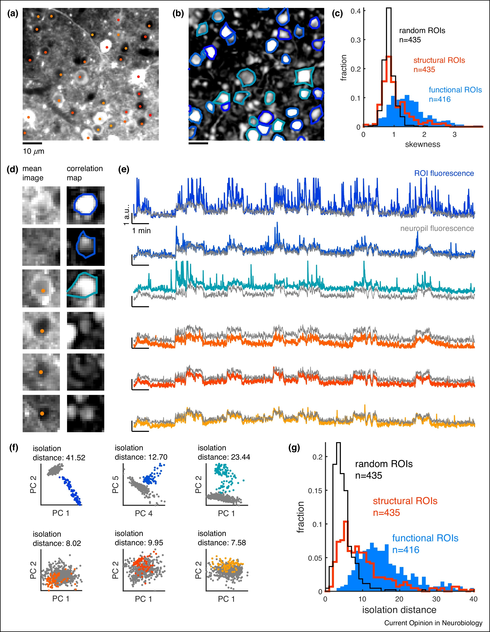
ROI segmentation: functional vs anatomical
Stringer & Pachitariu, Curr Opinion Neurobiol 2019

Slide 17
Functional segmentation returns better ‘ROIs’
Stringer & Pachitariu, Curr Opinion Neurobiol 2019

Slide 18
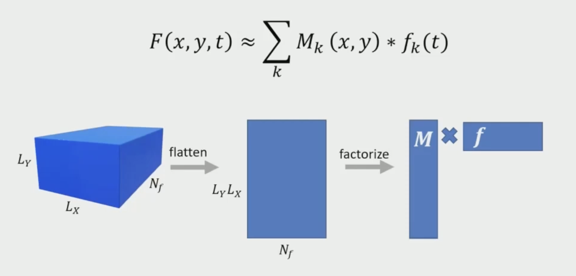
Functional segmentation – an intuition of how it works
Pachitariu, https://www.youtube.com/watch?v=n3CPMxW4QLo

Slide 19
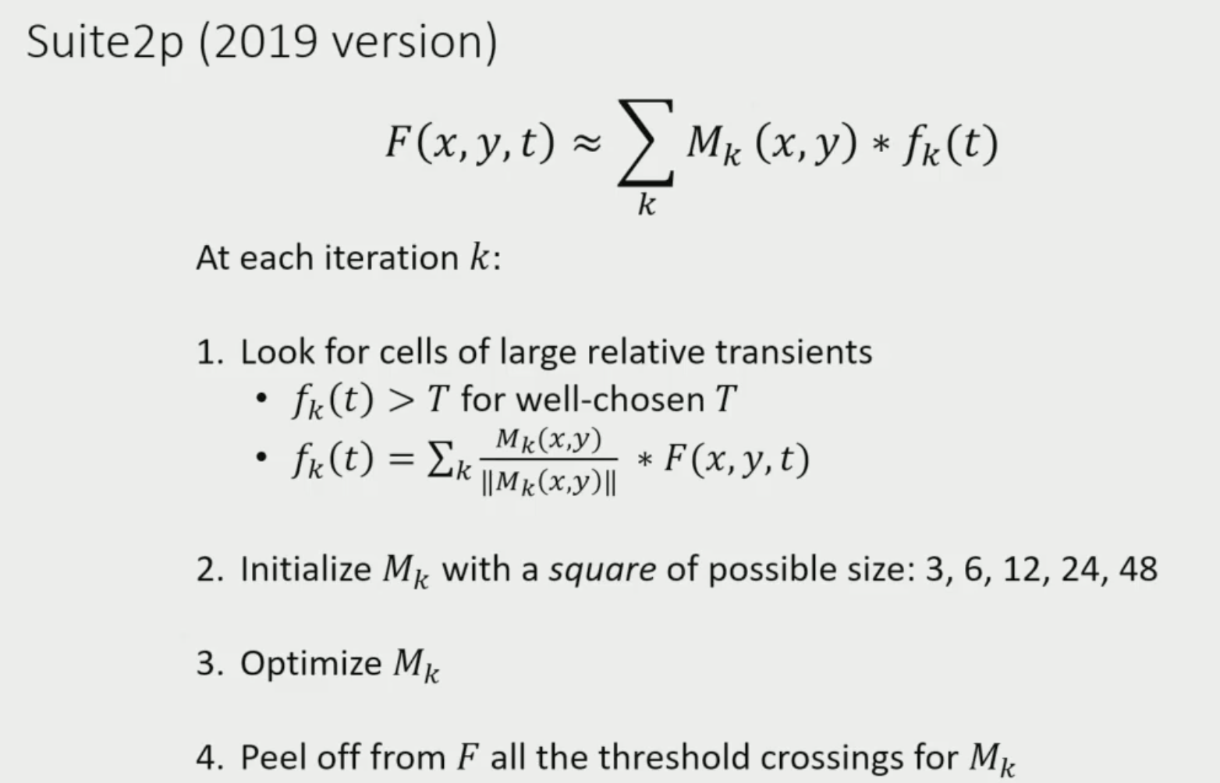
Iterative movie segmentation
Pachitariu, https://www.youtube.com/watch?v=n3CPMxW4QLo

Slide 20
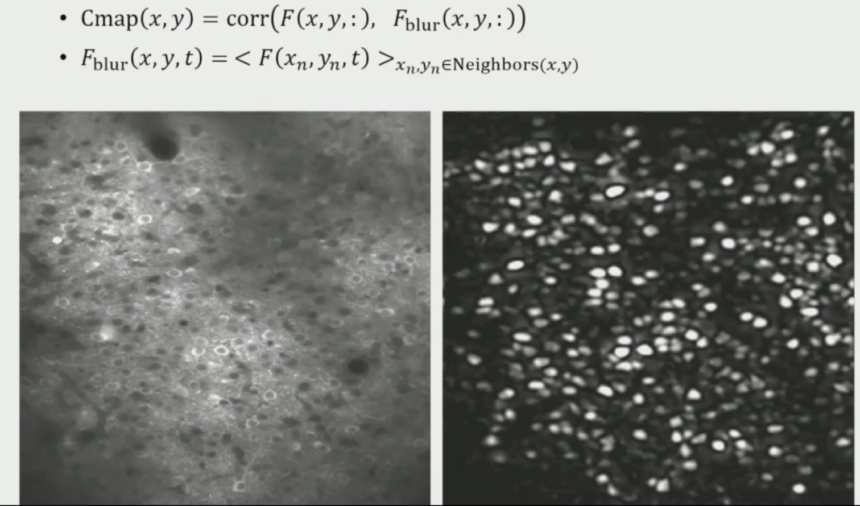
ROIs are seeded based on a ‘correlation’ map…
Pachitariu, https://www.youtube.com/watch?v=n3CPMxW4QLo

Slide 21
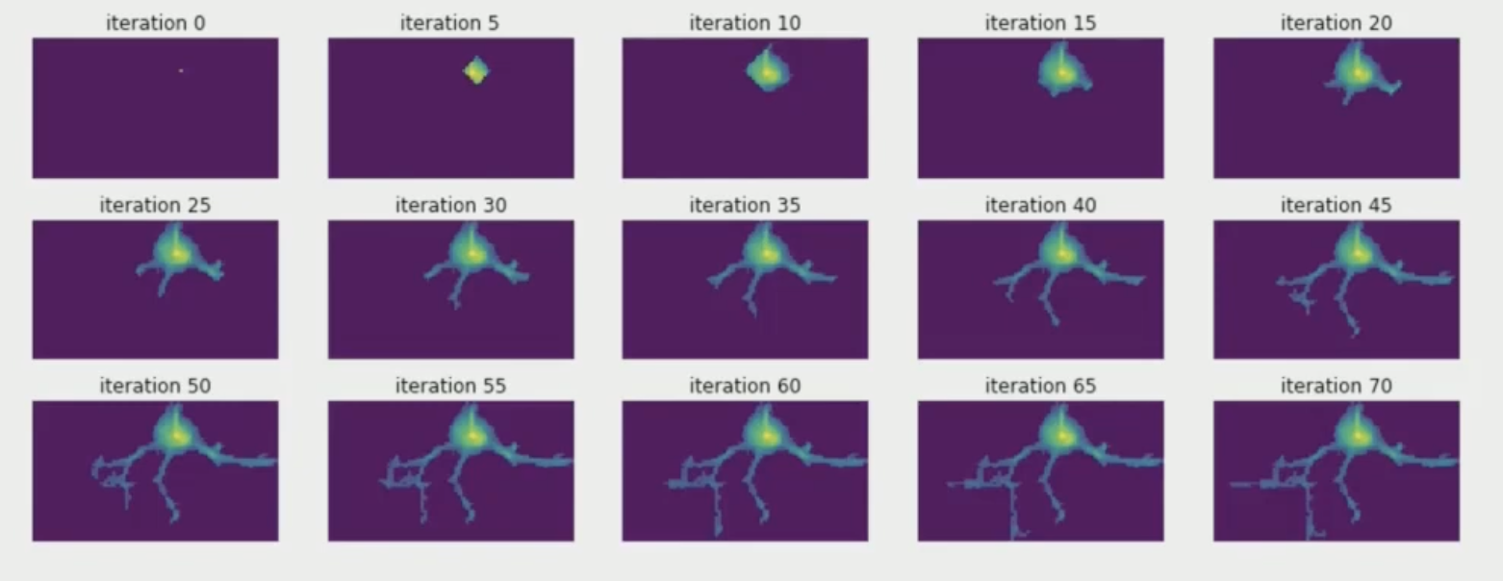
…then grown iteratively to minimize movie reconstruction loss function
Pachitariu, https://www.youtube.com/watch?v=n3CPMxW4QLo

Slide 22
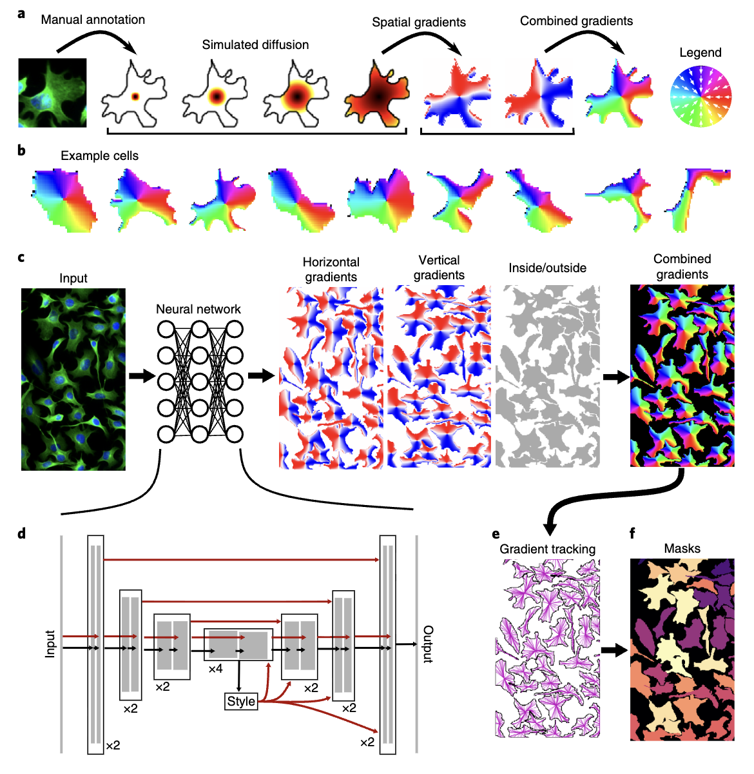
Anatomical segmentation – Cellpose
Stringer et al, 20221, Nature Methods

Slide 23
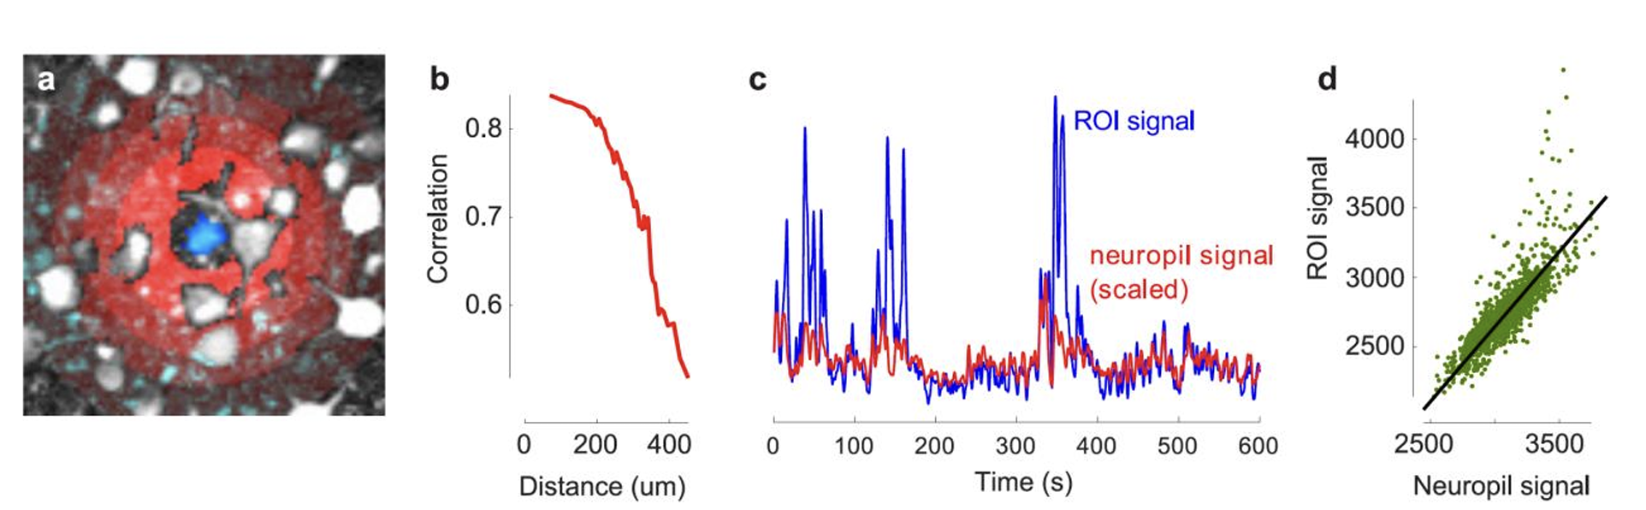
Signal extraction and neuropil contamination
Pachitariu et al, 2019

Slide 24
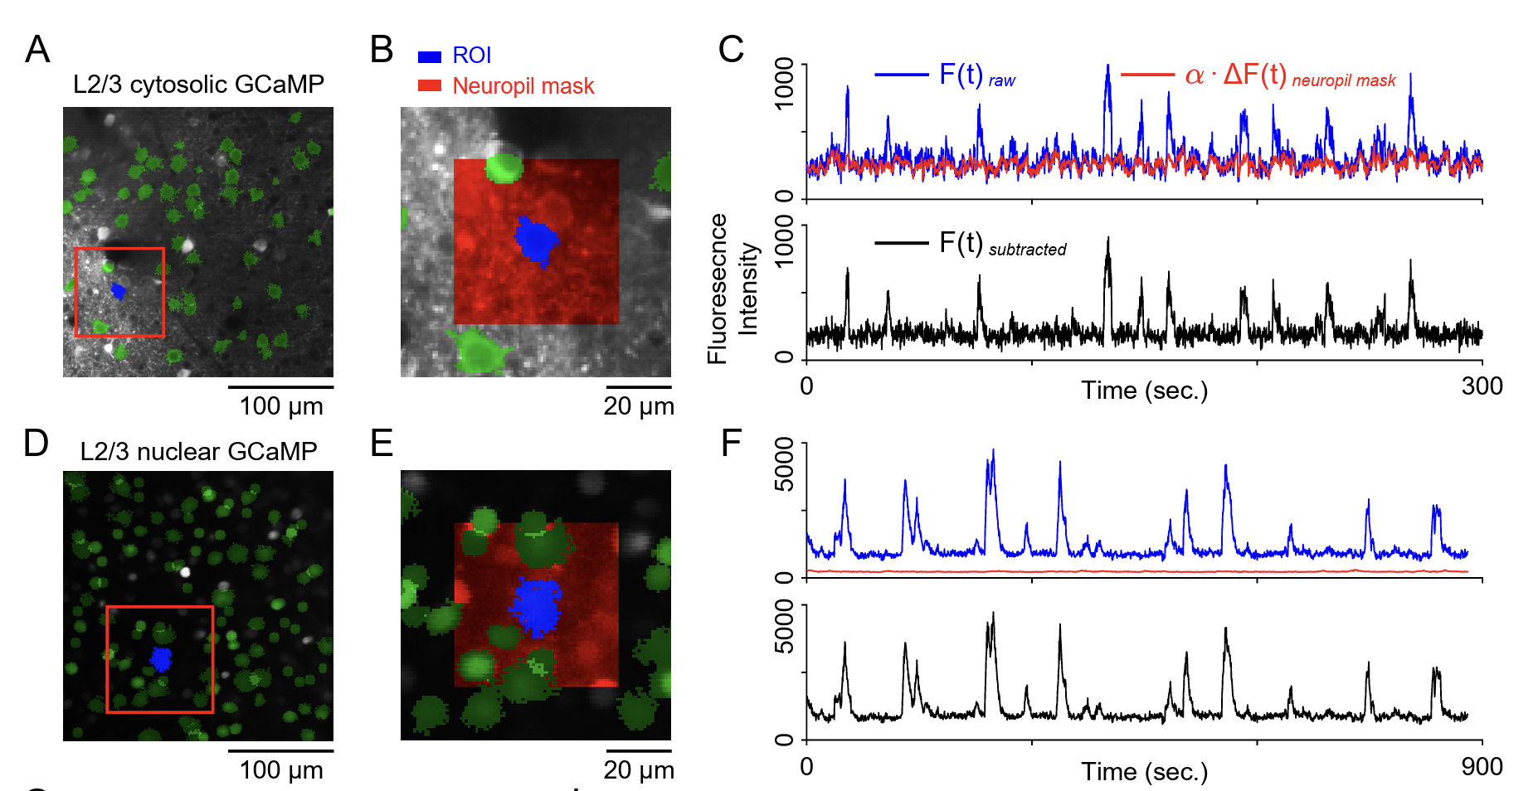
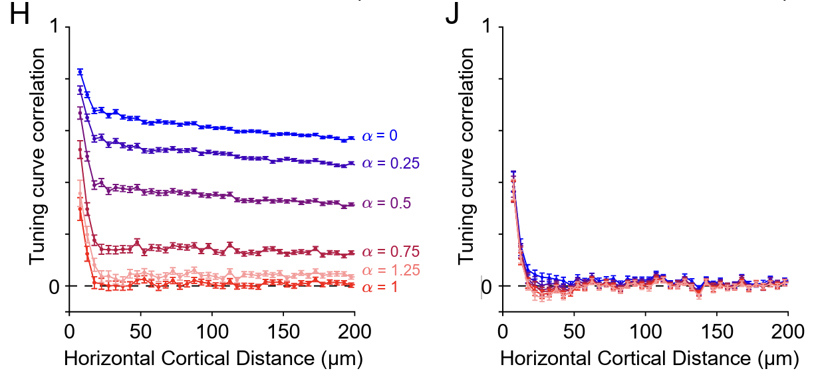
Ground truth for neuropil correction factor
Should be set to 1 for cortical dense recordings!!
Yu et al, bioRxiv, 2025

Slide 25
Deconvolution: an intuition
Estimate ‘quantal’ response (e.g. tau parameter)
Estimate spike train
Repeat to minimize loss function
WARNING: the deconvolve signals, are not really rates, or spike trains. They are estimates of events of calcium entry in the cell.

Slide 26
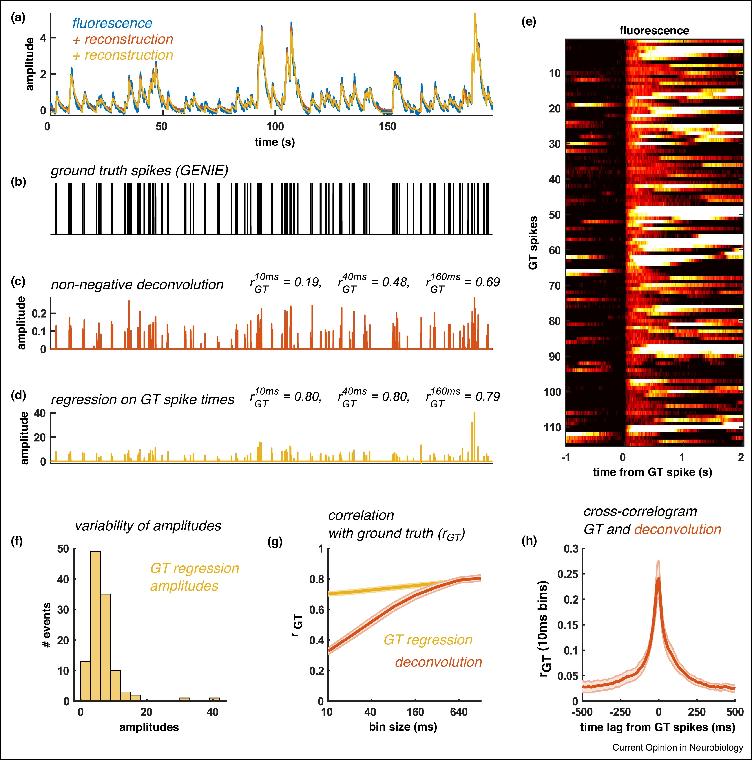
Should you work with fluorescence, or deconvolved activity?

Slide 27
Time to give it a go!
Stringer & Pachitariu, Curr Opinion Neurobiol 2019

