Slide 1


計算機組織
授課: 許佳興老師
jiashing@tea.ntue.edu.tw
篤行樓四樓，分機55425
助教: 郭修銘
iPV實驗室
s0930627301@gmail.com

Slide 2

Line 群組: 113-2計算機組織

Slide 3
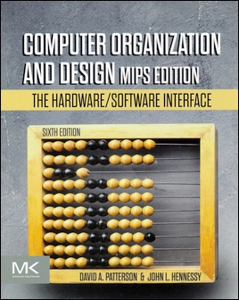
教科書(英文版)
Computer Organization and Design (MIPS Edition)
David A. Patterson and John L. Hennessy, “Computer Organization and Design - The Hardware/Software Interface,” 6/e (MIPS Asia Edition), Morgan-Kaufmann (東華書局代理), 2021, ISBN：9780128201091.
https://www.tunghua.com.tw/portal_c1_cnt_page.php?owner_num=c1_81363&button_num=c1&folder_id=&cnt_id=672653&search_word=&up_page=
MIPS Edition
(注意:不是ARM Edition)

Slide 4
教科書(英文版)—訂購資訊
台灣東華書局股份有限公司
地址：台北市重慶南路一段147號5樓
TEL：(02) 2311-4027（代表號）FAX：(02) 2311-6615
Email：service@tunghua.com.tw
新月圖書股份有限公司
地址：台北市重慶南路一段147號5樓
TEL：(02) 2331-7856（代表號）FAX：(02) 2331-7321
Email：service@tunghua.com.tw

Slide 5
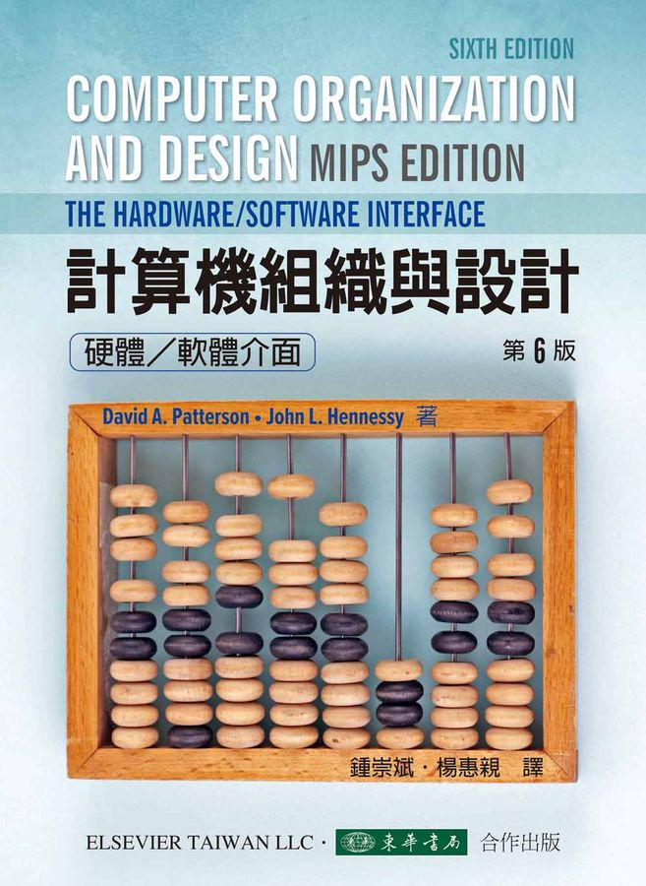
參科書(中文版)
出版商: 東華
出版日期: 2023-08-01
語言:
繁體中文
頁數: 840
ISBN: 6267130681
ISBN-13:
9786267130681
相關分類:
Computer-architecture
此書翻譯自:
Computer Organization and Design MIPS Edition: The Hardware/Software Interface, 6/e (Paperback)

Slide 6
授課對象
資科系大二同學

Slide 7
授課範圍
上課講議陸續可從本校Moodle教學平台下載 (非公開資料，只限修課同學)
https://md.ntue.edu.tw/
1. Computer Abstractions and Technology
(計算機抽象化與科技)
2. Instructions: Language of the Computer
(指令：計算機的語言)
3. Arithmetic for Computers
(計算機的算術)
4. The Processor
(處理器)
5. Large and Fast: Exploiting Memory Hierarchy
(記憶體階層)

Slide 8
評分準則
Week 8 (April 10th): midterm exam
(chapter 1 ~ chapter 3.2)
Week 16 (June. 5th): final exam
(chapter 3.3 ~ chapter 5)
Week 17 (June. 12th): check score
成績 = midterm exam x 0.4 +
final exam x 0.4 + 20

Slide 9
大學教育?

Slide 10
計算機組織?

Slide 11
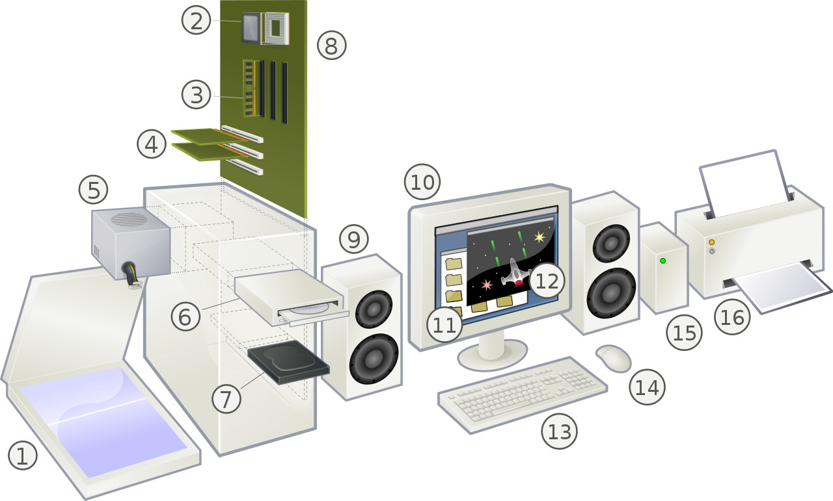

Slide 12
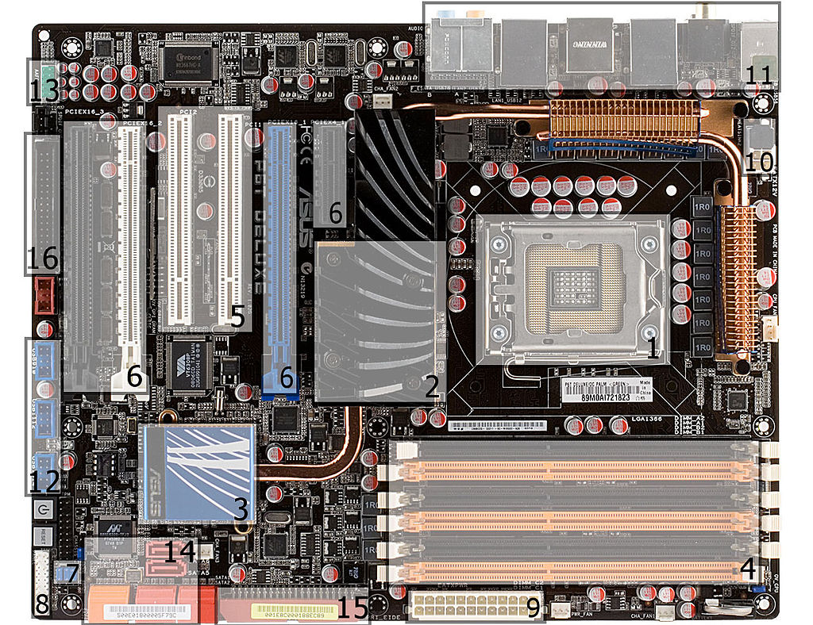

Slide 13
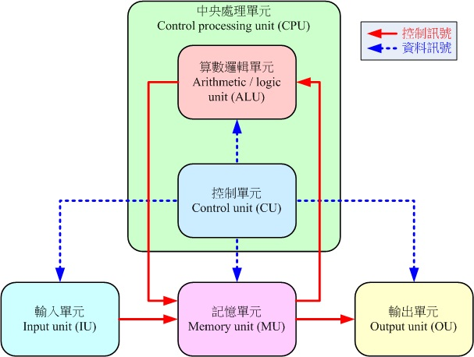
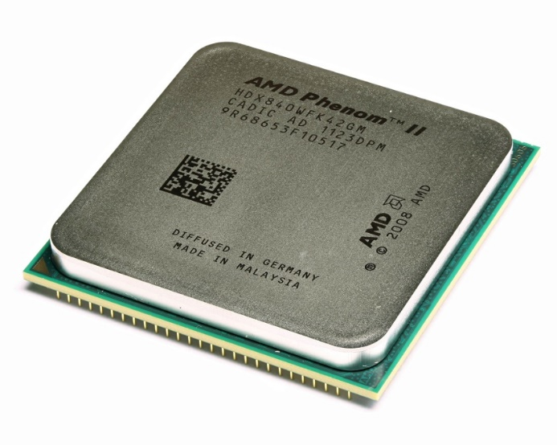
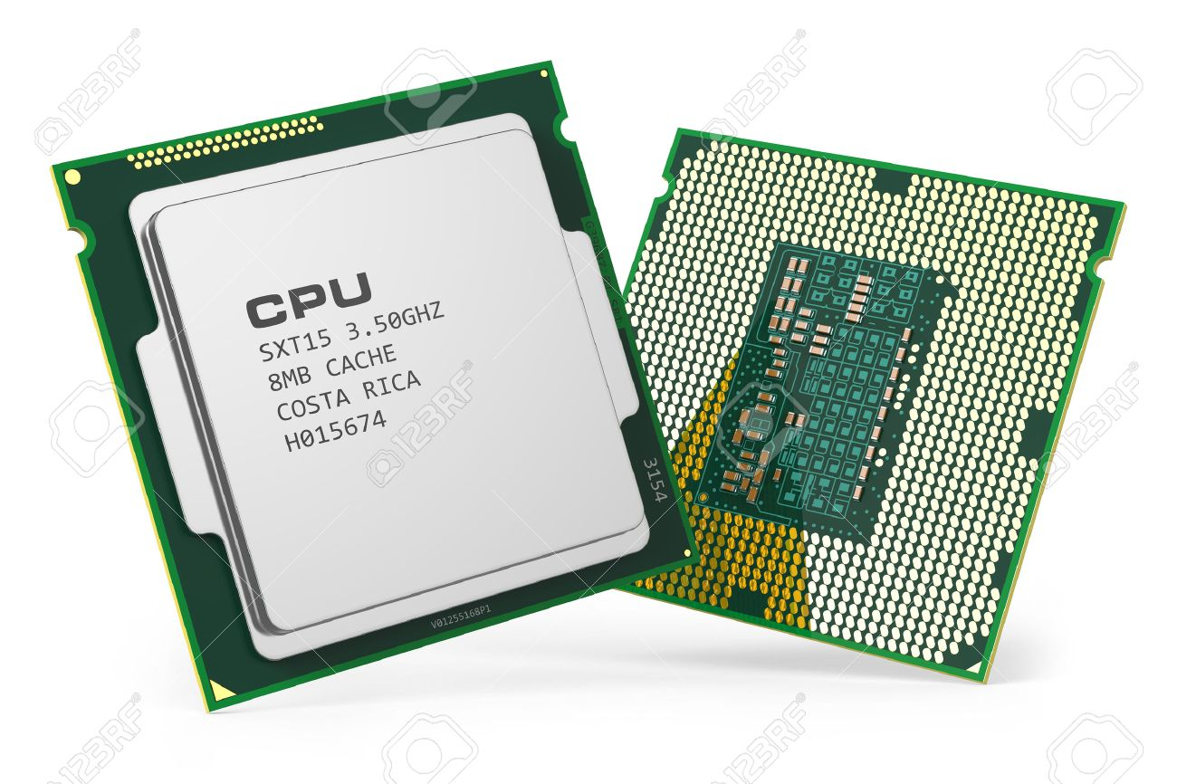
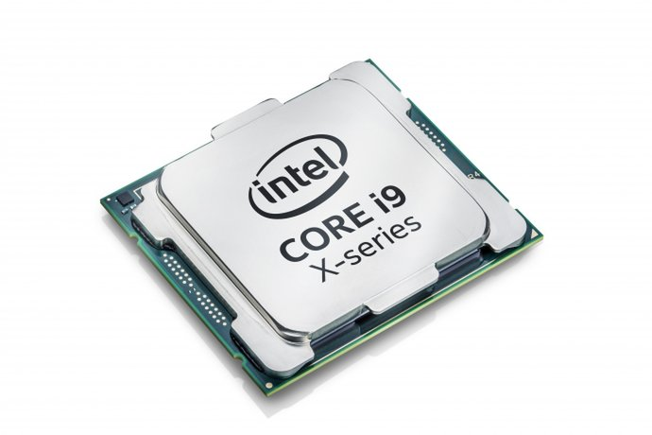

Slide 14
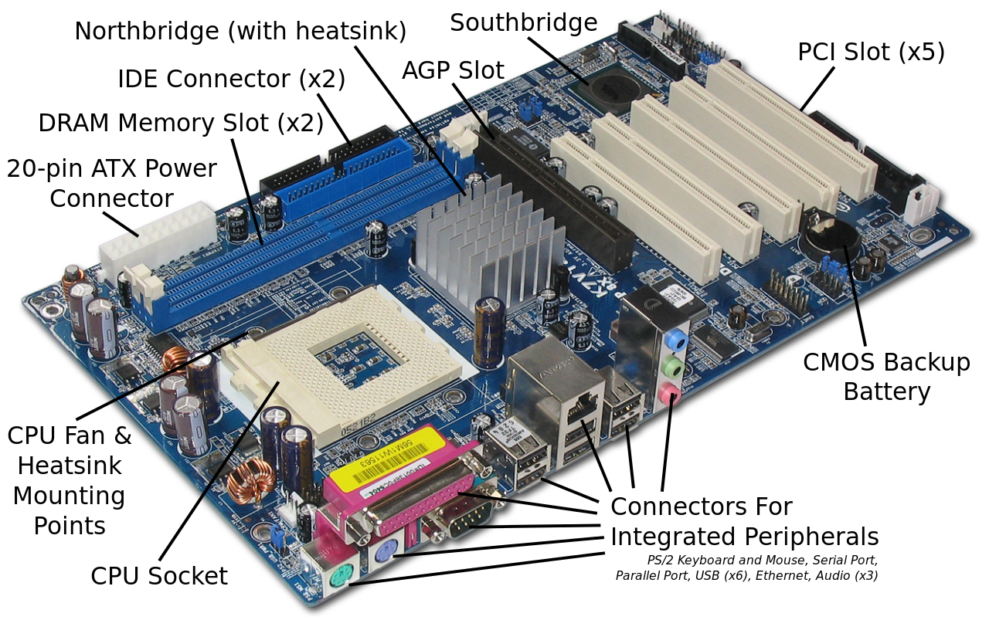

Slide 15
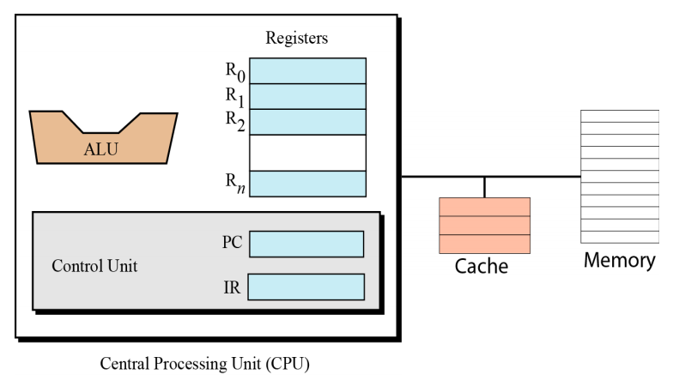

Slide 16
Processing the instructions
Our simple computer, like most computers, uses machine cycles. A cycle is made of three phases: fetch, decode, and execute. During the fetch phase, the instruction whose address is determined by the PC is obtained from the memory and loaded into the IR. The PC is then incremented to point to the next instruction. During the decode phase, the instruction in IR is decoded and the required operands are fetched from the register or from memory. During the execute phase, the instruction is executed and the results are placed in the appropriate memory location or the register. Once the third phase is completed, the control unit starts the cycle again, but now the PC is pointing to the next instruction. The process continues until the CPU reaches a HALT instruction.

Slide 17
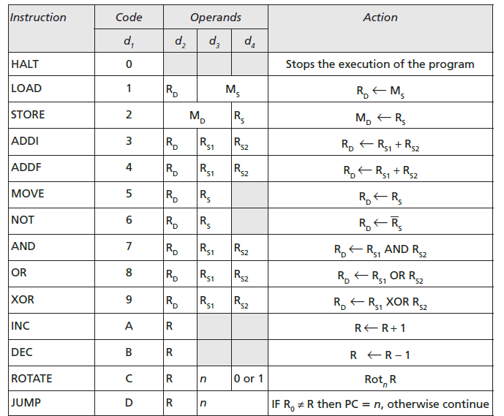
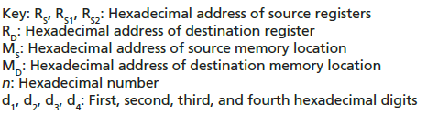

Slide 18
An example
Let us show how our simple computer can add two integers A and B and create the result as C. We assume that integers are in two’s complement format. Mathematically, we show this operation as:
We assume that the first two integers are stored in memory locations (40)₁₆ and (41)₁₆ and the result should be stored in
memory location (42)₁₆. To do the simple addition needs five instructions, as shown next:

Slide 19
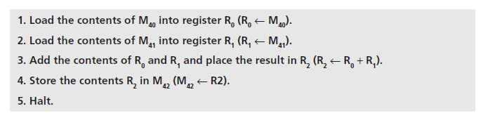
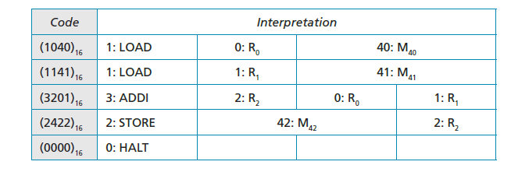
In the language of our simple computer, these five instructions are encoded as:

Slide 20
Storing program and data
We can store the five-line program in memory starting from location (00)₁₆ to (04)₁₆. We already know that the data needs to be stored in memory locations (40)16, (41)16, and (42)16.
Cycles
Our computer uses one cycle per instruction. If we have a small program with five instructions, we need five cycles. We also know that each cycle is normally made up of three steps: fetch, decode, execute. Assume for the moment that we need to add 161 + 254 = 415. The numbers are shown in memory in hexadecimal is, (00A1)₁₆, (00FE)₁₆, and (019F)₁₆.

Slide 21
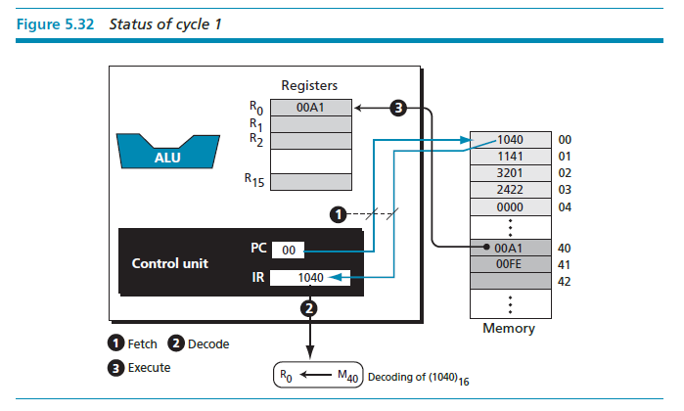

Slide 22
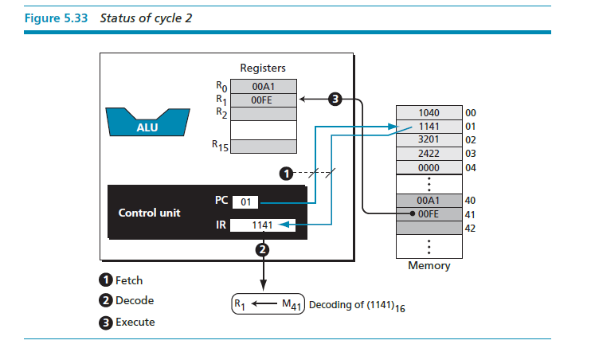

Slide 23
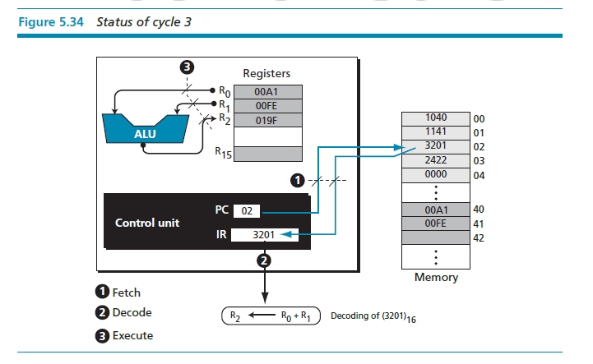

Slide 24
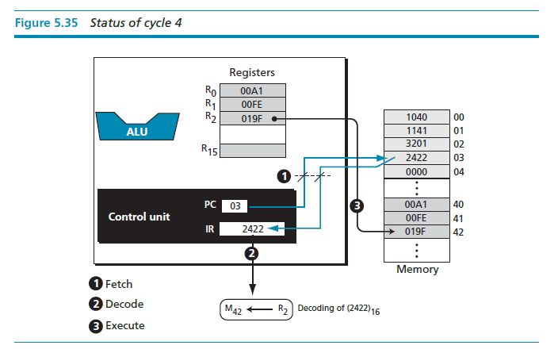

Slide 25
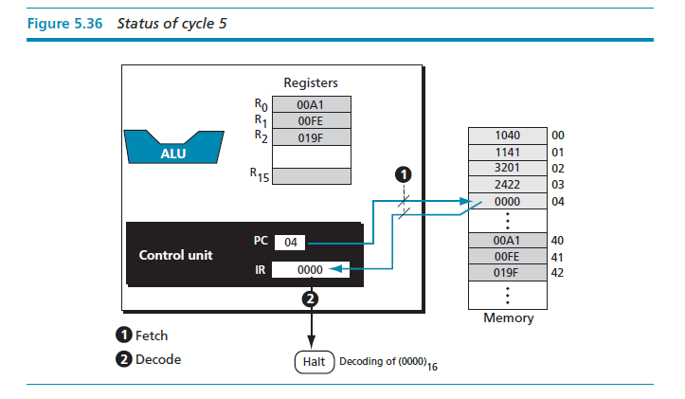

Slide 26

謝謝聆聽
Q
A

