Slide 1
Track 1 data challenge: Synthetic Health Activity Data
Greentea

Slide 2
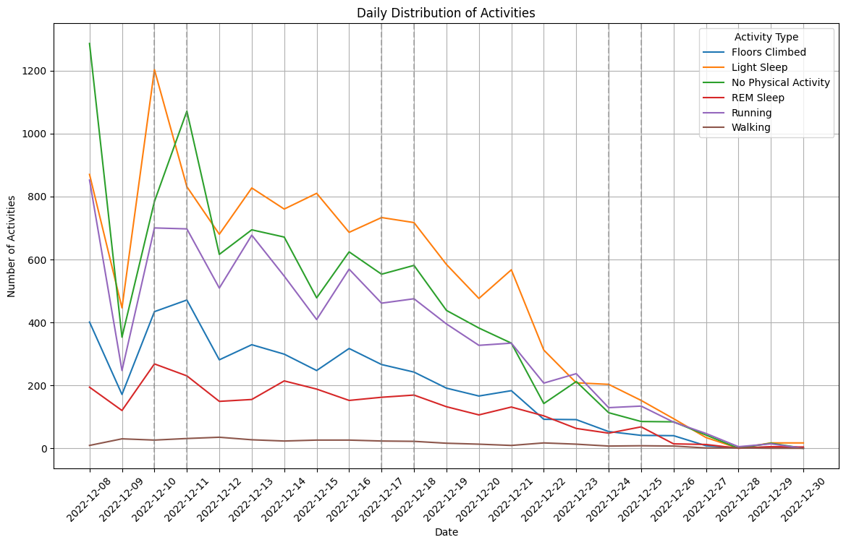
Statistical Analysis for original activity data
Key observations include: (1) heart rate is recorded for all activities, (2) calories burned and exercise duration are recorded for running and walking, (3) sleep duration metrics are recorded for light sleep and REM sleep, and (4) floors climbed are tracked only for the floors climbed activity.

Slide 3
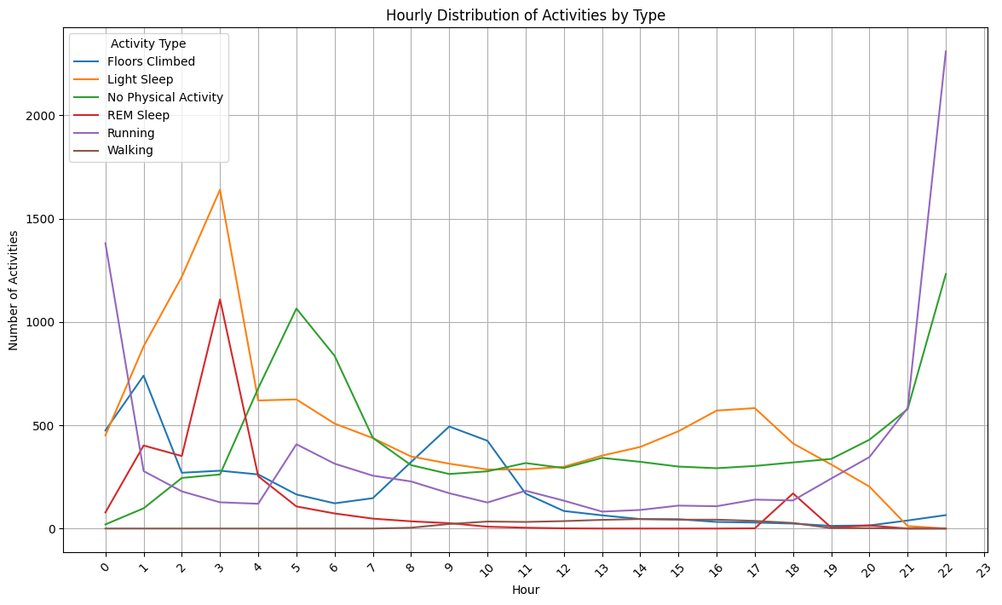
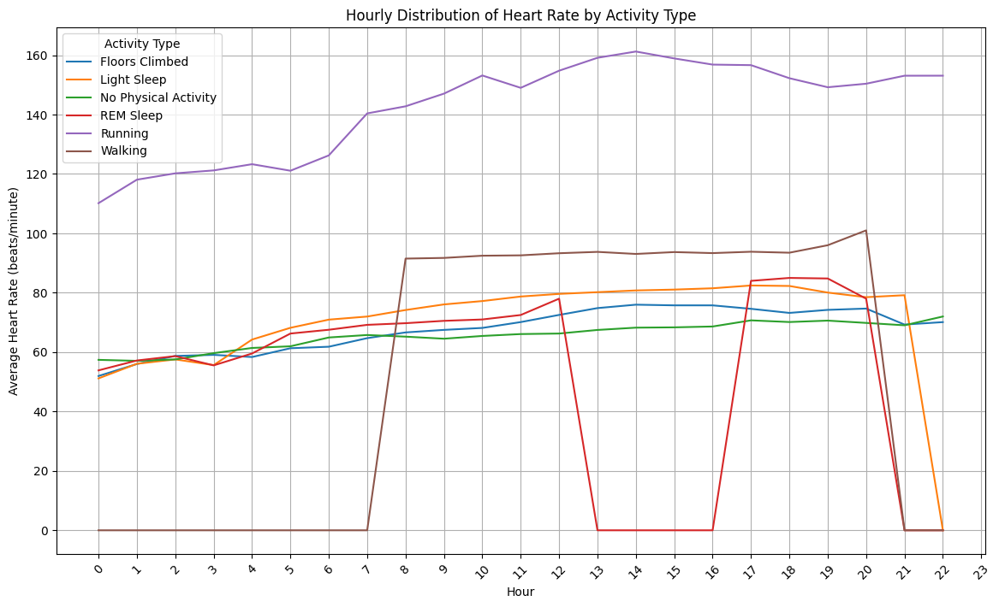
Hourly distribution of activities and heart rate for original data

Slide 4
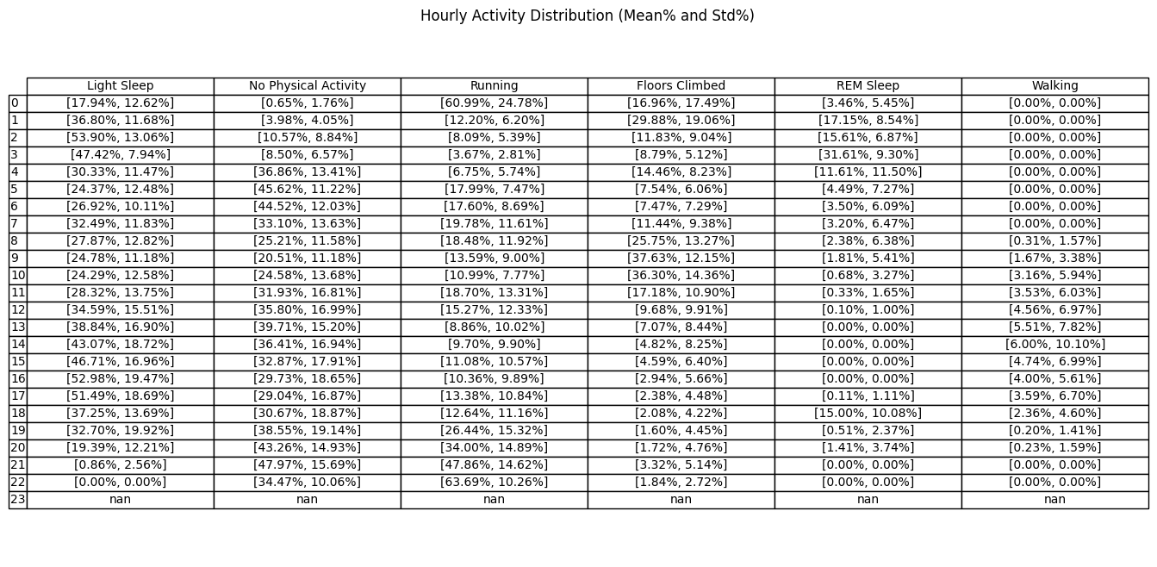
Hourly activity distribution

Slide 5
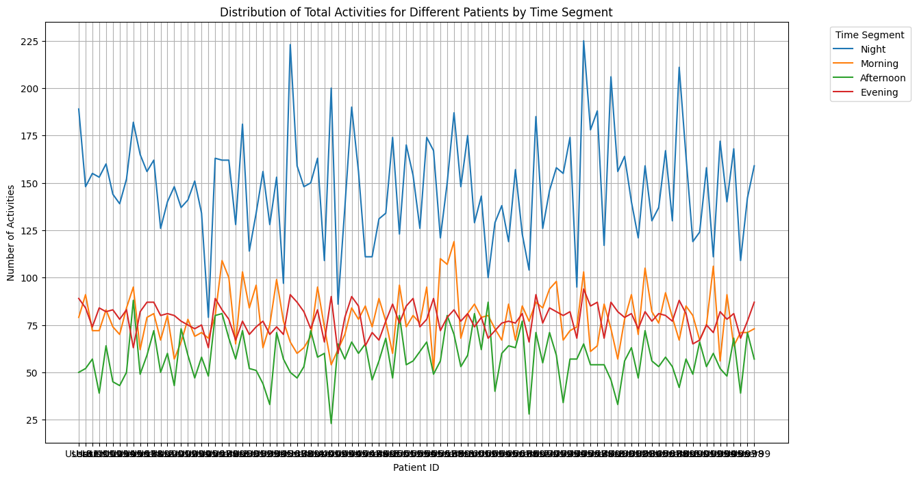
Aggregate activities in different time period

Slide 6
Synthetic Data Generation
Datetime Generation:
The start datetime was set as 2022-12-08 00:00, encoded as 1, and the end datetime as 2022-12-30 23:59, encoded as 33120, covering a total duration of 23 days (23 days × 24 hours × 60 minutes). A distribution of activities and timestamps was learned across all patients to capture typical activity patterns, and this learned distribution was then used to generate datetime points for 100 new synthetic patients. These generated datetime integers were later converted into timestamps.
Based on Table 1, we generated different activity types for each synthetic patient, ensuring that hourly distributions adhered to the constraints observed in the original data.
Activity Data Generation:
Using the CTGAN model, activity data was generated for each activity type, capturing realistic values for essential metrics:
For light sleep and REM sleep: generated heart rate, sleep duration, and sleep type duration.
For running and walking: generated heart rate, calories burned, and exercise duration.
For floors climbed: generated heart rate and floors climbed.
For no physical activity: generated heart rate.
Data Compilation:
The generated timestamps and activity types from Step 1 were combined with the detailed activity data (heart rate, calories, sleep duration, and floors climbed) from Step 2 to create the final synthetic dataset, representing a new population of 100 patients with realistic activity patterns.

Slide 7
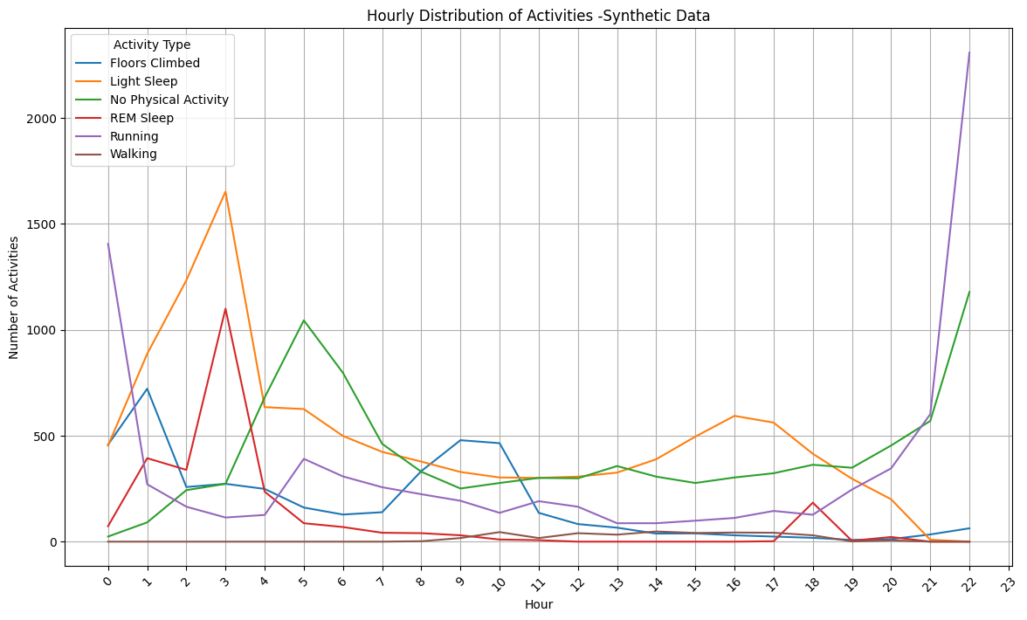
Hourly distribution of activities for synthetic data

Slide 8
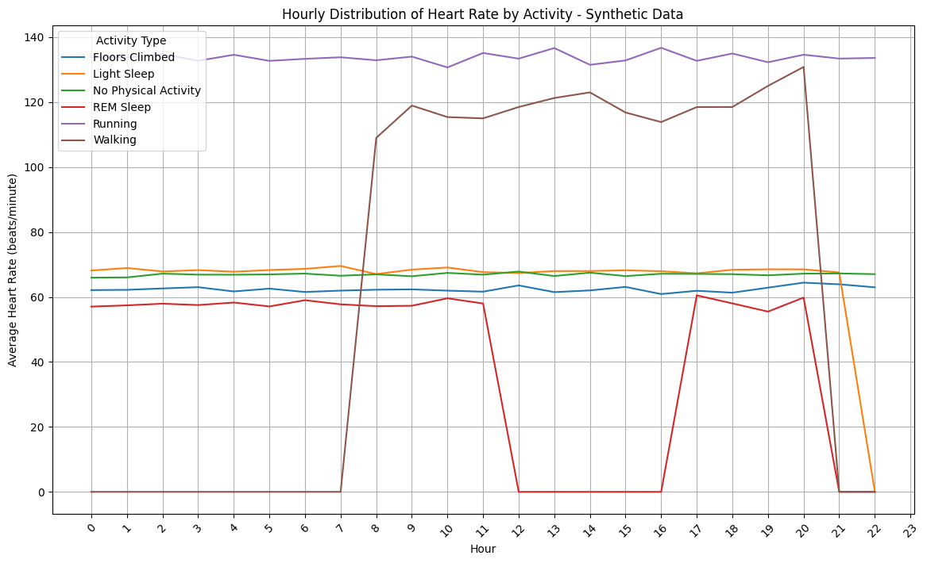
Hourly distribution of heart rate for synthetic data

Slide 9
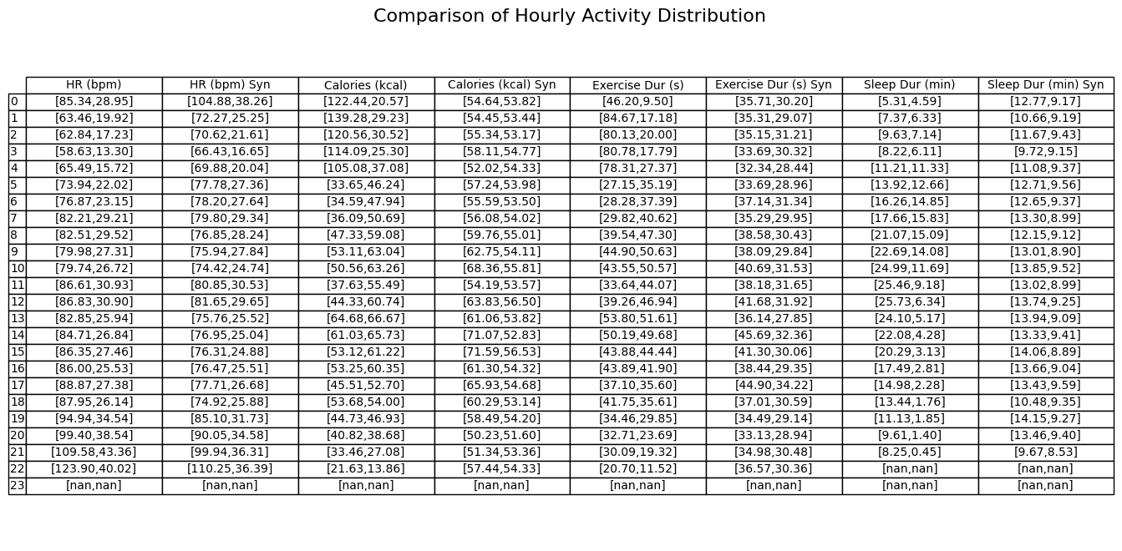
Comparing of hourly activity detail heart rate, calories, exercise duration and sleep duration

Slide 10
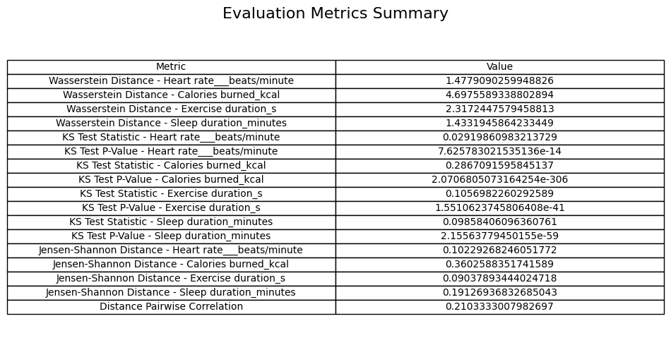
Evaluation Metrics
Reference: https://github.com/FANMISUA/BHI_Track1

